Slide 1
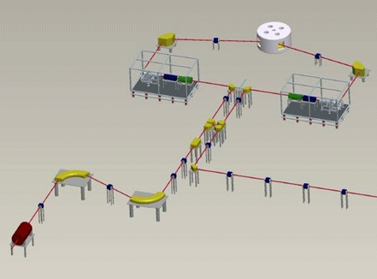

The SPES Target
Ion Source complex
Alberto Andrighetto
LNL-INFN
2° SPES workshop, 26 May 2014

Slide 2

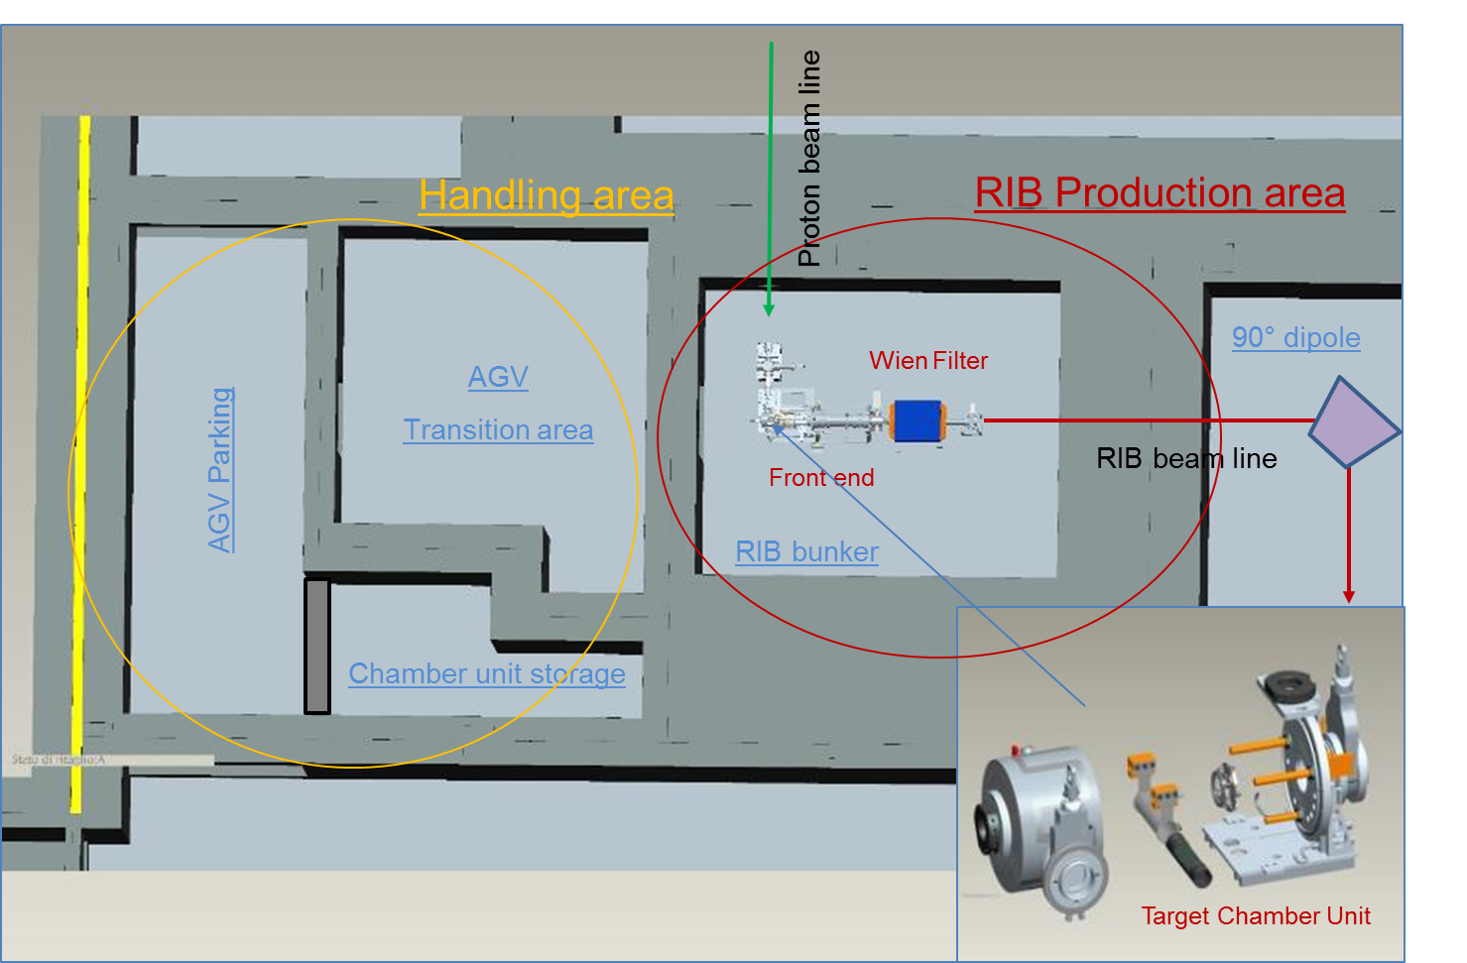
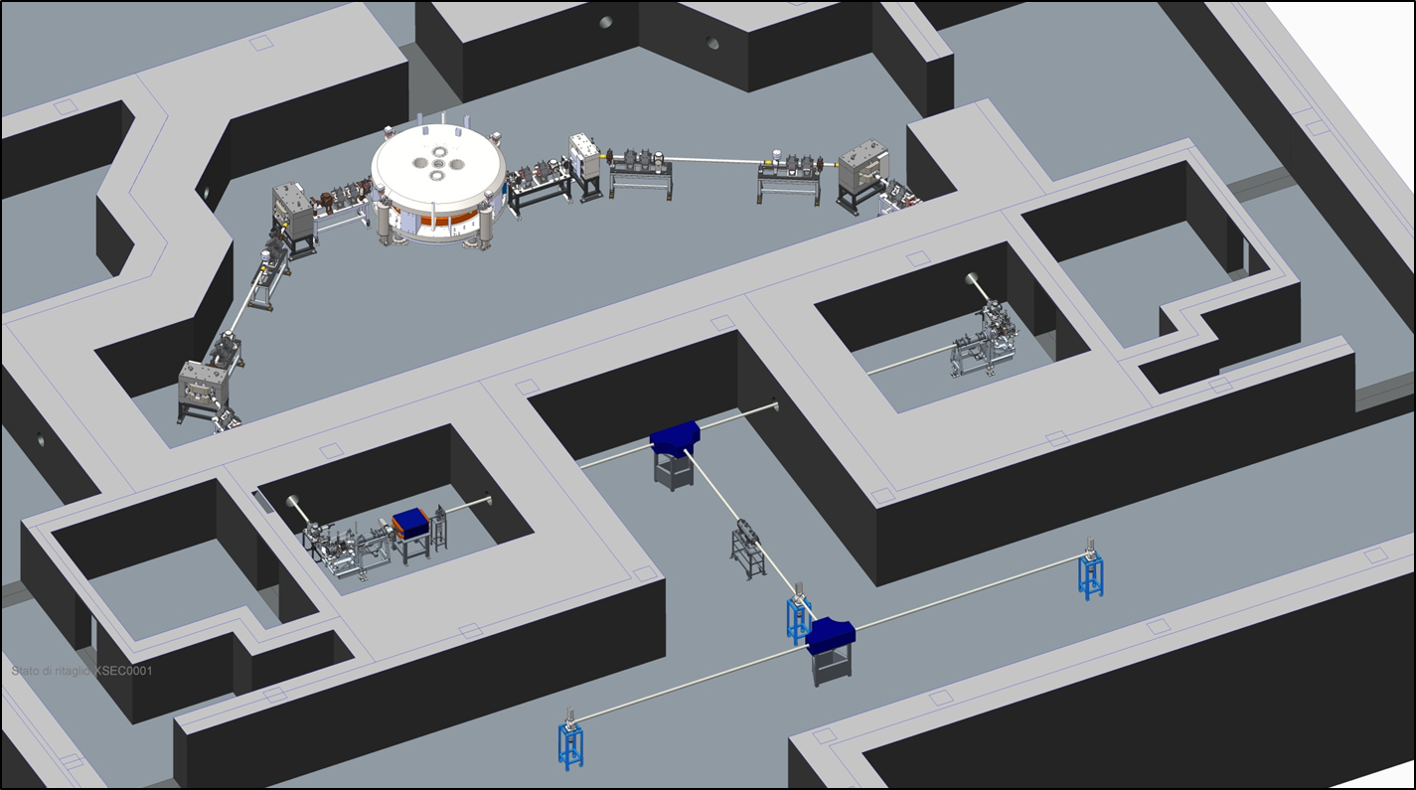

Slide 3
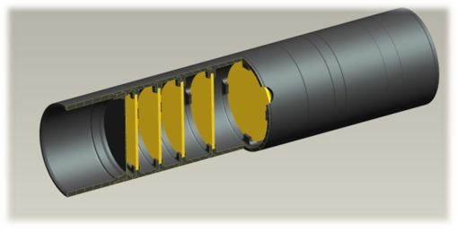
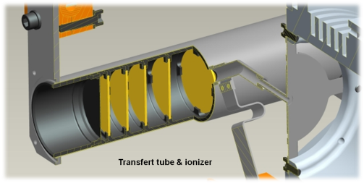

The TIS device
7 UCx coaxial disks:
thickness: 1.3 mm
diameter: 40 mm
SPES Target :
Optimized for 8 kW power dissipation
(E= 40 MeV, I= 200 μA)
Graphite box:
external diameter: 49 mm
average length: 200 mm
3 graphite dump disks
Tantalum tube:
external diameter: 50 mm
thickness: 0.35 mm
length: 200 mm
SPES Heater, Ionizer & Chamber
Ionizer & transfer tube:
thickness: 1 mm
height: 34 mm
Inner diameter: 3 mm
Aluminum target unit

Slide 4
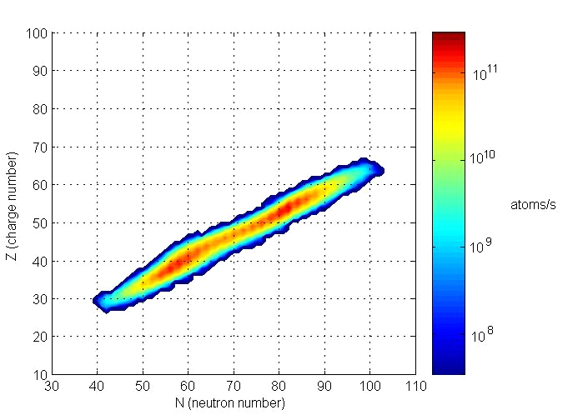
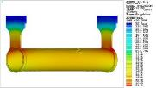
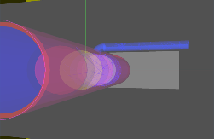

The target calculations
SPES
in
-
target yields (10
fissions
per
second)
13
a) Thermo Mechanical
b) Neutronics & Isotopes Yield
c) Isotopes Effusion

Slide 5
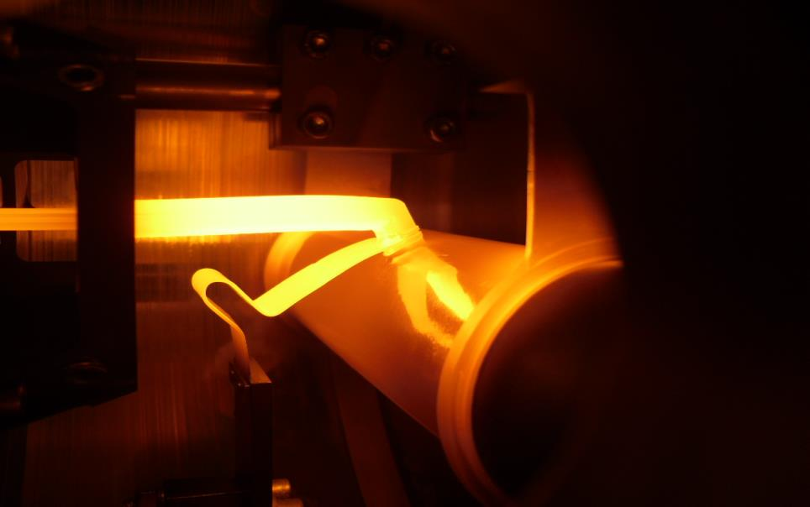
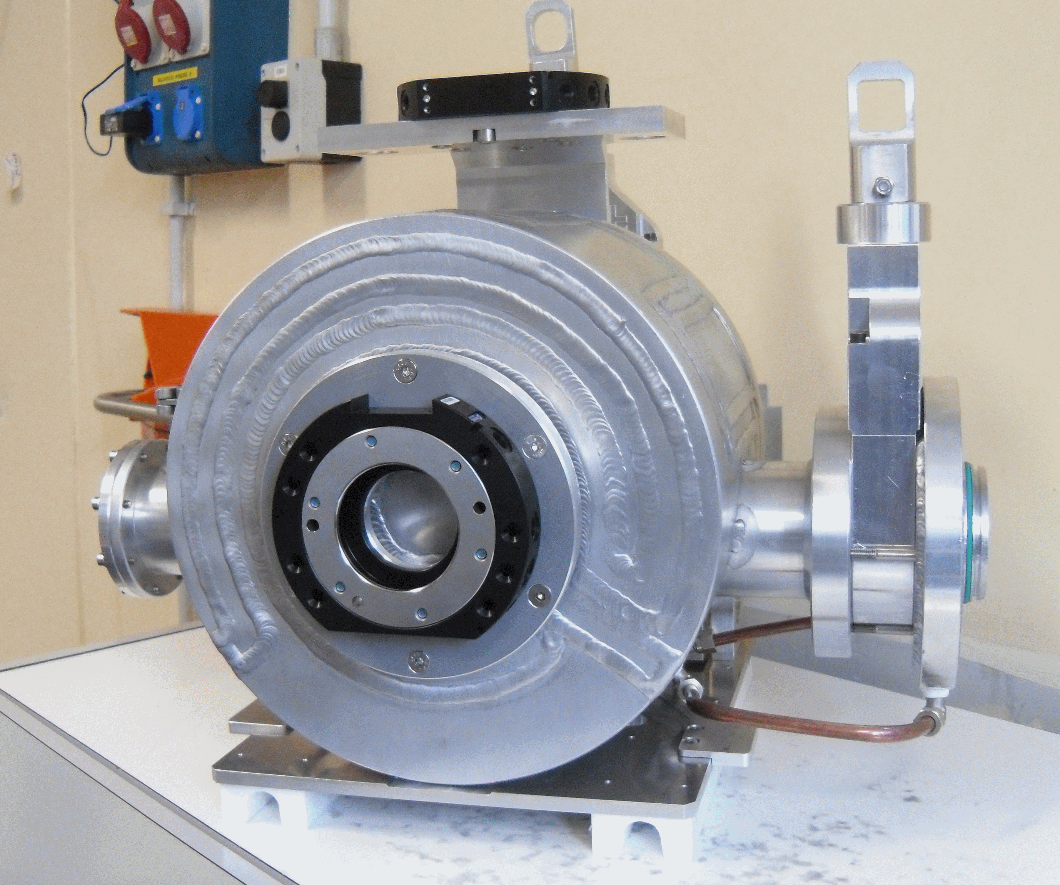
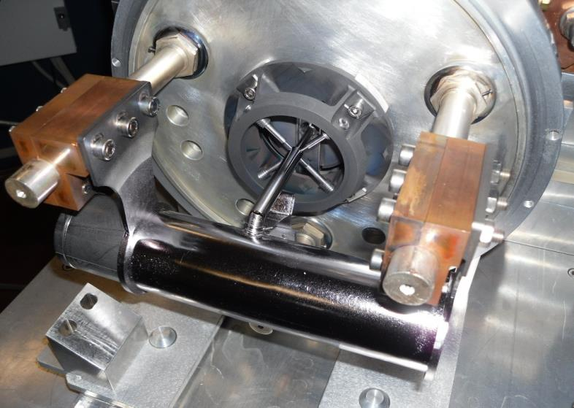
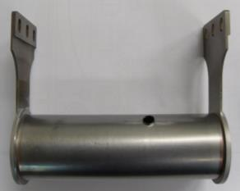
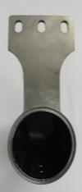
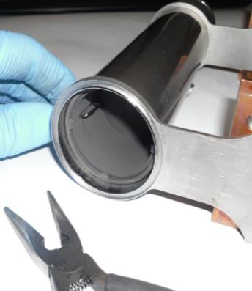
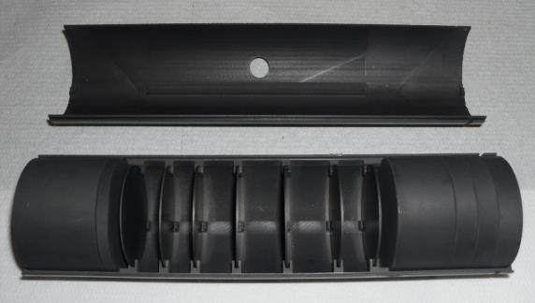
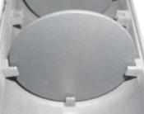
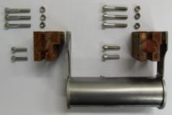
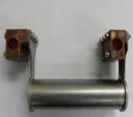
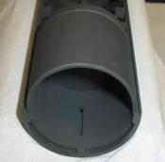
The target & ion source complex
I_{Target}= 700A -> 1200A max
I_{Line}= 200A -> 600A max

Slide 6
The SPES off-line Front end
(working since 2010 - evolution of ISOLDE FE6)

Slide 7

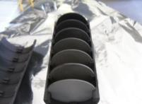
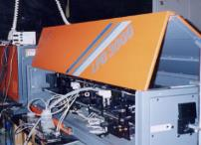
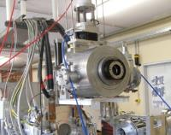
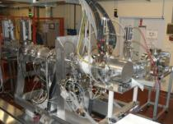
The SPES-RIB prod. Working Groups
WG-1: Target and Ion Sources
-> M. Manzolaro
WG-2: Target Materials
-> S. Corradetti
WG-3: Laser
-> D. Scarpa
WG-4: Handling
-> M. Calderolla
WG-5: Front End
-> A. Monetti

Slide 8
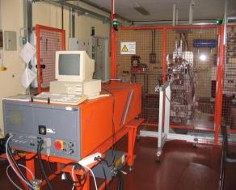
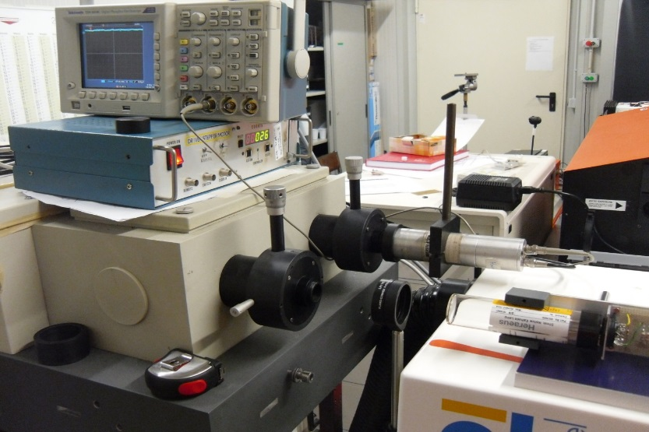
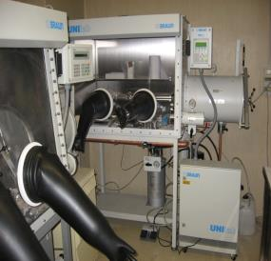
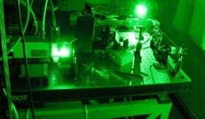
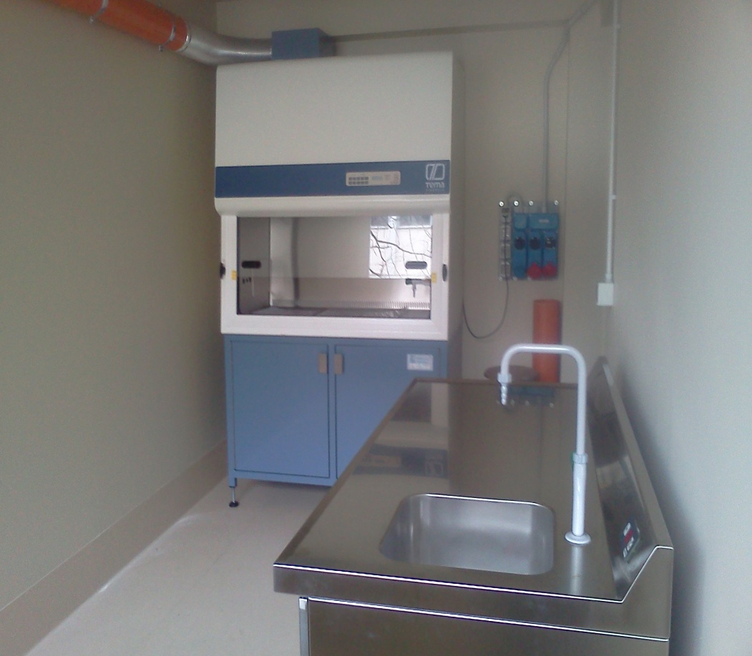
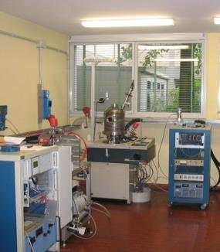
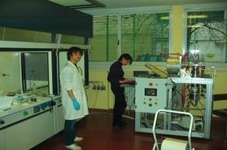
The SPES-RIB prod. Laboratories
Test Bench LNL Lab
New LNL laser Lab
UCx Chemistry PADOVA Lab
Pavia laser Lab
New ‘class A’ LNL Lab
HT LNL Lab
Carbide Chemistry LNL Lab

Slide 9

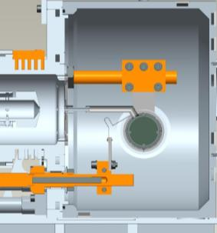
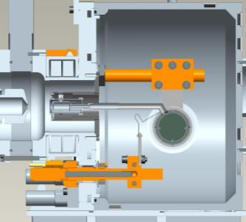
surface ionization mechanism
 | 1 |  |  |  |  |  |  |  |  |  |  |  |  |  |  |  |  | 18
1 | 1 H | 2 |  |  |  |  |  |  |  |  |  |  | 13 | 14 | 15 | 16 | 17 | 2 He
2 | 3 Li | 4 Be |  |  |  |  |  |  |  |  |  |  | 5 B | 6 C | 7 N | 8 O | 9 F | 10 Ne
3 | 11 Na | 12 Mg | 3 | 4 | 5 | 6 | 7 | 8 | 9 | 10 | 11 | 12 | 13 Al | 14 Si | 15 P | 16 S | 17 Cl | 18 Ar
4 | 19 K | 20 Ca | 21 Sc | 22 Ti | 23 V | 24 Cr | 25 Mn | 26 Fe | 27 Co | 28 Ni | 29 Cu | 30 Zn | 31 Ga | 32 Ge | 33 As | 34 Se | 35 Br | 36 Kr
5 | 37 Rb | 38 Sr | 39 Y | 40 Zr | 41 Nb | 42 Mo | 43 Tc | 44 Ru | 45 Rh | 46 Pd | 47 Ag | 48 Cd | 49 In | 50 Sn | 51 Sb | 52 Te | 53 I | 54 Xe
6 | 55 Cs | 56 Ba | 57 La | 72 Hf | 73 Ta | 74 W | 75 Re | 76 Os | 77 Ir | 78 Pt | 79 Au | 80 Hg | 81 Tl | 82 Pb | 83 Bi | 84 Po | 85 At | 86 Rn
7 | 87 Fr | 88 Ra | 89 Ac | 104 Unq | 105 Unp | 106 Unh | 107 Uns | 108 Uno | 109 Une | 110 Unn
laser ionization mechanism
electron impact ionization mechanism
not extracted
target + Re hot-cavity ion source
target + Ta hot-cavity ion source
target + FEBIAD ion source
Main fission (p-> ²³⁸U) fragments
WG-01

Slide 10
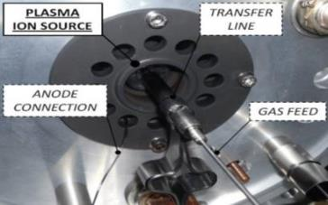
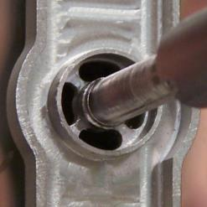
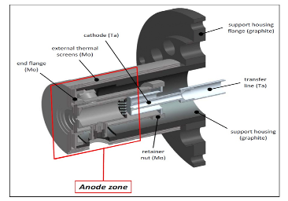
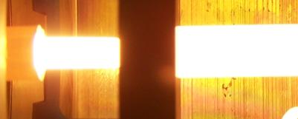
Ion Source Developments
> The Ion Source adopted for the SPES facility
The SIS Ion source
Efficiency measurements at different temperatures (1600°C, 1800°C, 2000°C, 2200°C) for Cs, Rb, Sr, Ba
The PIS Ion source
Ionization efficiency measured for Ar; Kr and Xe beams has been produced
screen support
screen
WG-01

Slide 11
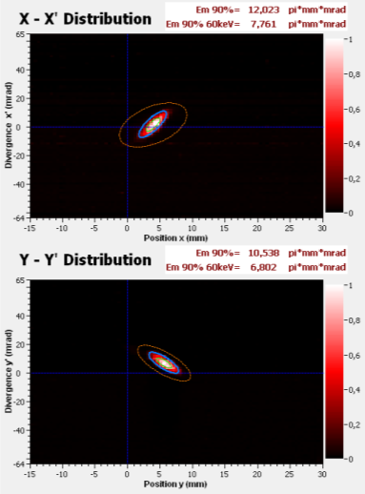
Ion Source Developments
> Emittance measurements for SIS and PIS (@ 25kV extraction voltage)
SIS (Cs beam)
ε_{RMS} ≈ 5 π mm mrad (ε_{90%} ≈ 20 π mm mrad)
PIS (Ar beam)
ε_{RMS} ≈ 10 π mm mrad (ε_{90%} ≈ 40 π mm mrad)
WG-01

Slide 12
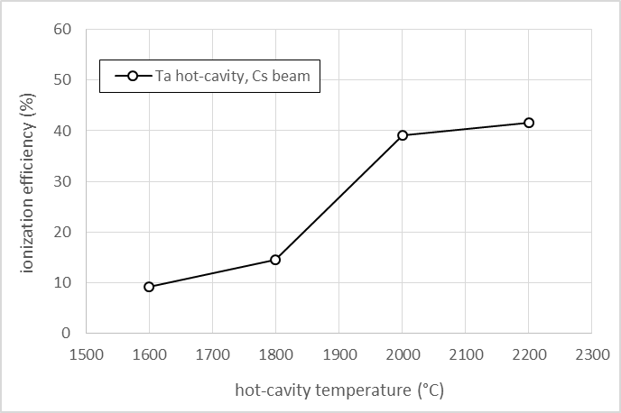
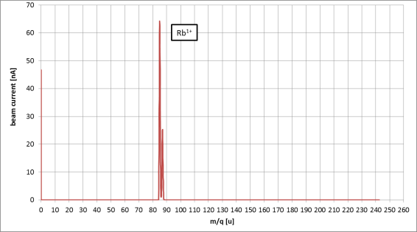
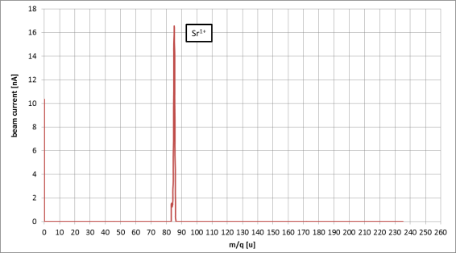
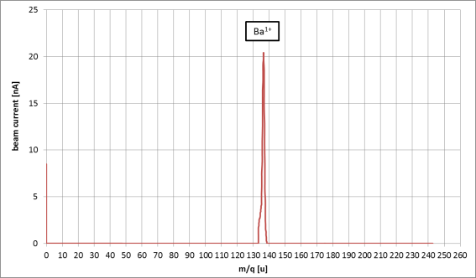
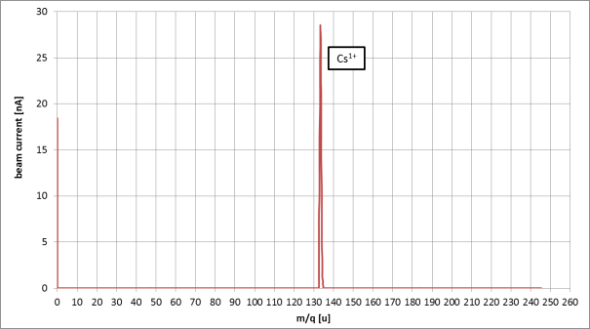
Ion Source Developments (SIS)
> Efficiency measurements for SIS
Ta - SIS efficiency data (off-line measurements)
T = 2200 °C
WG-01

Slide 13
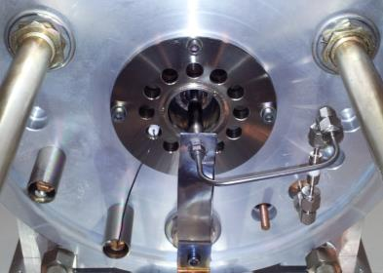
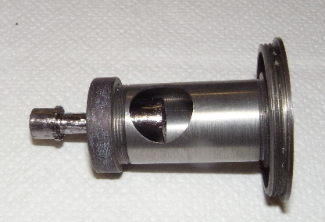
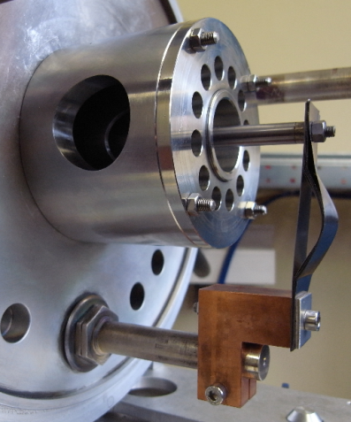
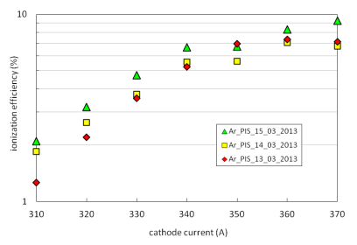
Ion Source Developments (PIS)
> Efficiency measurements for PIS
Cathode Improvement
Ionization efficiency measurements for Ar (25 kV)
- Anode voltage = 150 V
- Anode magnetic field ≈ 300 G
- Total beam current ≈ 3 µA
WG-01

Slide 14
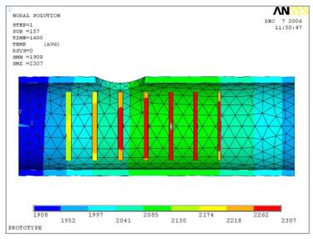
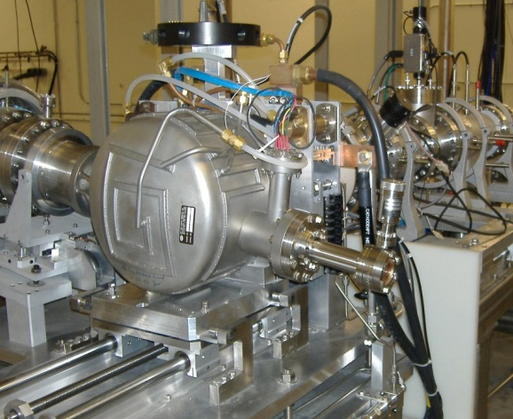
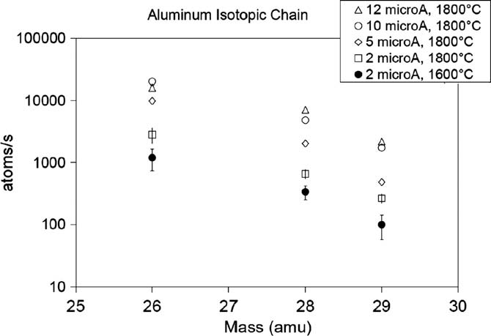
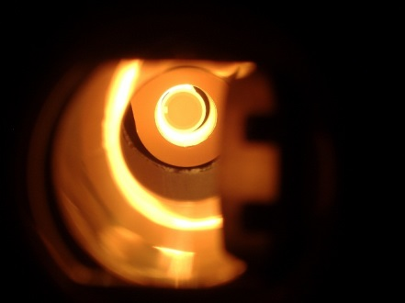


Experimental test 1/3
1) scaled (d = 13 mm) SiC SPES tested @ ORNL (2007), – 40 MeV, 12 mA p beam, for thermal & release study
2) scaled (d = 13 mm) UC_{X} SPES tested @ ORNL (2010-2011) – 40 MeV, 50 nA p beam, for relase study
 | 2010 Standard UC_{X} | 2011 Low density UC_{X}
Density (g/cm³) | 4.25 | 2.59
Diameter (mm) | 12.50 | 13.07
Thickness (g/cm²) | 0.41 | 0.41
Calculated porosity (%) | 58 | 75
WG-02

Slide 15



Experimental test 2/3
Actilab ENSAR JRA collaboration
3) scaled (d = 14 mm) UC_{X}-CNT discs tested @ CERN (2009) and IPNO (2013) for release efficiency studies
 | UC_{X}-CNT (synthesis at CERN, 2009)
Density (g/cm³) | 1.30
Diameter (mm) | 14.10
Thickness (mm) | 1.30
Calculated porosity (%) | 88
Test @ CERN (2009)
Test @ IPNO (2013)
WG-02

Slide 16







Experimental test 2/3
4) Full scale (40 mm.) SiC @ Ithemba, p=66 MeV, 60 microA for thermal dissipation studies
On-line testing of the SPES target architecture @ iThemba (May 2014)
iThemba LABS: funded to build an RIB target/ion-source like SPES
WG-02

Slide 17






FC
Wien Filter
Quadrupoles Deflectors
IS
Laser
Ions
WG-03

Slide 18


LNL Laser Laboratory
In 2013 a new SPES laser laboratory was build
A tunable dye laser system ready for atomic spectroscopy study
WG-03

Slide 19




SPES Horizontal Handling system
WG-04

Slide 20






Horizontal device (AGV based)
Devices under construction at the LNL mechanical workshop
WG-04

Slide 21


On-line FE design
RAD-HARD version
Critical material List
Teflon with glass fibres -> alumina
Polyethylene -> peek
Viton O-rings -> EPDM
Plastic cable insulator -> air (close the target)
Normal motors -> RAD HARD motors
before
after
WG-05

Slide 22

Radiation damage test
Use of the LENA reactor for material testing (collaboration under discussion..)
Reactor for research TRIGA Mark II (250 kW) – LENA since 1965
WG-05

Slide 23





The SPES : collaboration network
ITHEMBA
RISP-KOREA
ORNL- HRIBF
Since 2004: 52 thesis performed in the frame of target SPES activities
European Project:
ENSAR (2010-2014):
JRA Actilab (target material)
ENSAR2 (next call):
JRA Resist (laser technology)
JRA Beamlab (TIS technology)
CERN- ISOLDE
INFN- Pavia
SPES
TIS
INFN- Milano
GANIL-SPIRAL 2
INFN- Bologna
INFN- LNS
ORSAY-ALTO
INFN- Padova
UNISI
UNIPV
UNIPD
UNITN
SPES TIS papers
(About 39 contributions since 2004)
DSF
DSC
DIM
DIM
DSC
DEI
CONTROLS
LASER
ION SOURCES
MATERIALS
HANDLING
Notes:
26/05/2014
23

Slide 24

The SPES-TIS group
Thanks for your attention!

