Slide 1
A proposal for the KM3NeT Computing Model
Pasquale Migliozzi
INFN - Napoli

Slide 2
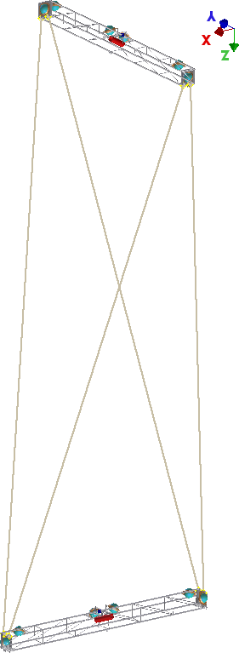
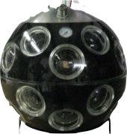
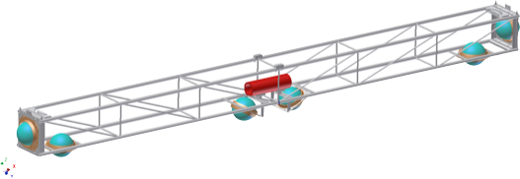
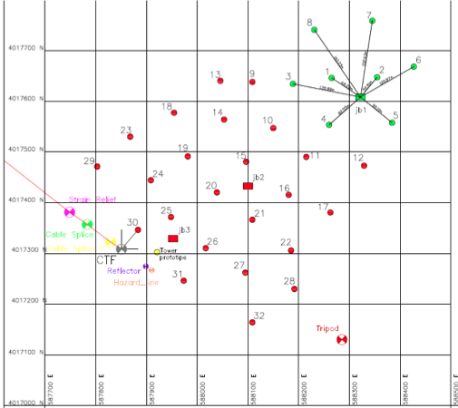
24 KM3NeT Strings
18 MultiPMT OMs with 31 3” PMTs
8 KM3NeT-Ita Towers
14 Floors with 6 OMs-10”PMT each
8 m
36 m
20 m
Foot print @ Capo Passero Site
since the beginning of 2015
2

Slide 3
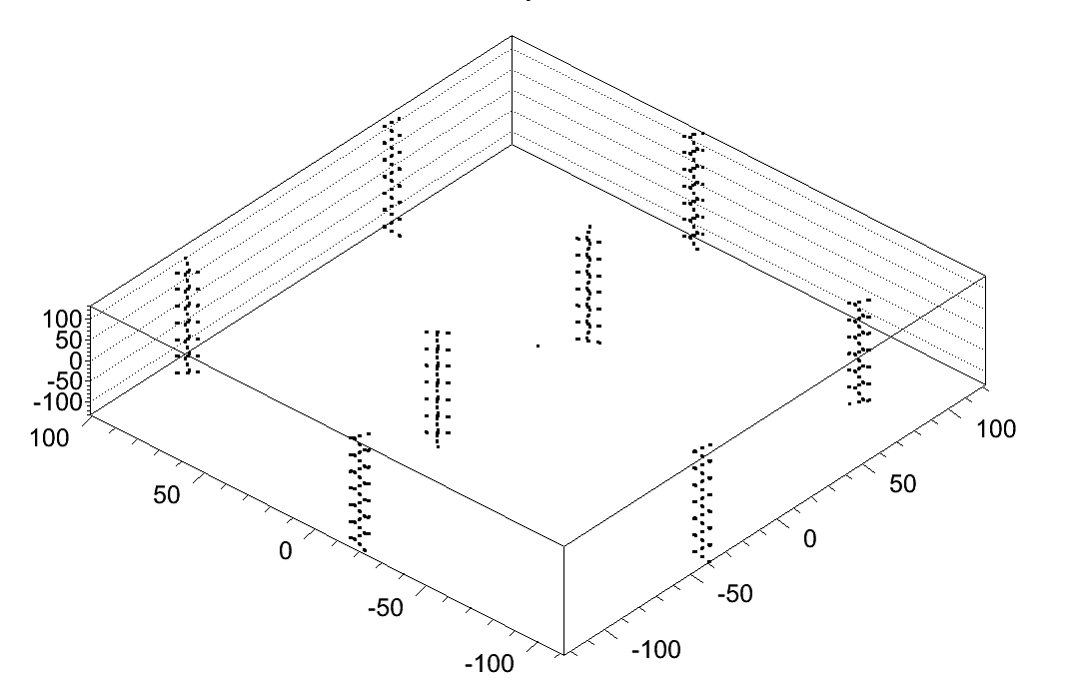
Optical TriDAS framework: trigger on a full detector snapshot (the 200 ms Time Slice)
ΔT
200 ms
event ΔT
~ O(1 µs)
µ
HM0
TCPUi with TSi
HM1
HM2
HM3
TCPUi+1 with TSi+1
HM4
HM: receive subsequent data from a fraction of the detector
TCPU: collect data from the full detector for a slice of time (i.e. the Time Slice)
TSi+1
TSi
time

Slide 4
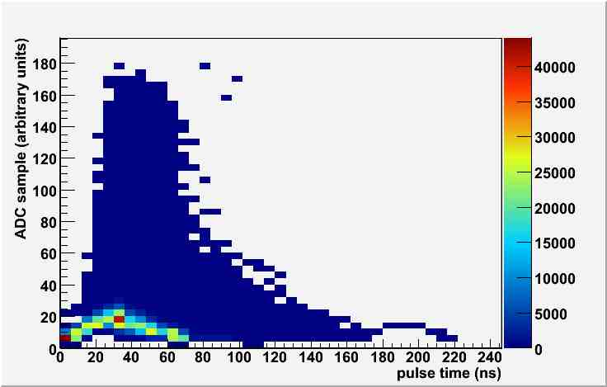
Optical DAQ: All data to shore
KM3NeT-Ita
KM3NeT-Eu
Hit PMT Info
Hit Abs Time
Hit Charge
Hit PMT Info
Hit Abs Time
Hit Charge
Hit Wave Form(samples)
6 Bytes
46 Bytes

Slide 5
Filtered data
Input parameters (conservative)
KM3NeT-Ita
KM3NeT-Eu
Throughputs
INCOMING
POST TRIGGER

Slide 6
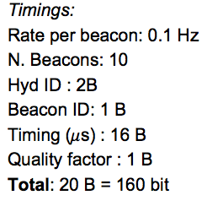
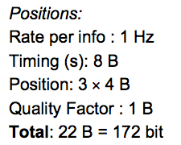
Acoustic DAQ: for the positioning
KM3NeT-Eu
KM3NeT-Ita
1 piezo sensor / DOM
1 Hydrophone / string base
total = 18 Piezo + 1 Hydrophone / String
2 Hydrophone / floor
1 Hydrophone / tower base
total = 29 hydrophones / Tower
constant Sampling rate : 12 Mbps/sensor

Slide 7
Computing Model: Requirements per Building Block
processing stage | size per year (TB) | time per year (HS06.h) | periodicity (per year) | comment
Raw Data
Raw Filtered Data | 300 | - | 1
Monitoring and Minimum Bias Data | 300 | - | 1 | assume same size as raw data
Experimental Data Processing
Calibration (incl. Raw Data) | 1500 | 13 M | 2 | from ANTARES: 2.5x raw data size
Reconstructed Data | 2100 | 89 M | 2 | from ANTARES: 3.5x raw data size
DST | 1800 | 22 M | 2 | from ANTARES: 3x raw data size, 25% of time
Simulation Data Processing
Air showers | 50 | 7 M | 0.5 | 10 month livetime
atm. Muons | 25 | 638 k | 0.5 | 10 month livetime
neutrinos | 20 | 220 k | 10 | per analysis
total: | 4595 | 132 M
875TB for FR!
based on ANTARES experience: we have to rethink what to store!
for Phase 1:
scaling ~ 1/3

Slide 9
Computing Model Workshop – Bologna Feb. 5th/6th
Workshop of the Computing and Software WG joined by experts of computing centers
Aim: prepare a computing model for KM3NeT
Decision: prepare a proposal based on the preliminary KM3-ITA model
Mainly GRID based, but include direct/batch access where available
Use all available resources:
CC-Lyon, CNAF, HELASGRID, HOU CC, ReCaS
The choice of GRID is not totally for free, there is a lot of work to be done…

Slide 10
General Scheme
Tier-like structure, GRID + direct (batch) access
Tier-0: FR, IT at/near detector site: DAQ, short-time data storage, data transfer to permanent storage at Tier-1s
Tier-1: currently: CC-Lyon, CNAF, HOU CC, ReCaS, HellasGRID:
permanent data storage (disk, tapes) at CC-Lyon and CNAF
data processing (CC-Lyon, ReCaS)
data reprocessing (CC-Lyon, CNAF, ReCaS)
simulation (CC-Lyon, HOU, ReCaS)
Data transfer between the computing centers based on GRID (where applicable)

Slide 11
KM3NeT-ITA Computing Model – Data

Slide 12
KM3NeT-ITA Computing Model – Simulations

Slide 13
KM3NeT-ITA: User Access

Slide 14
Ingredients to calculate the computing requirements
Data: 250Hz and 1100Hz trigger rate (IT, FR site) – based on muon rates (>100GeV), 100% trigger efficiency and purity
Data processing: scale ANTARES numbers
all we have but we need to be resource efficient (don’t store data that can easily be re-calculated)
MC: use numbers by the simulations WG
CPUs are not a problem, disk/tape space might be

Slide 15
To do list
Harmonize (symmetric) layout and data flow (in principle: no differences FR/IT)
Add direct/batch access to CC-Lyon and HOU computing clusters
Add “Tier-2s” (i.e. local computing clusters of institutes)
Add networking requirements
Further timeline:
first draft of document until beginning of March
get approval of the collaboration
present at the APPEC computing meeting (mid of April, Bologna)
derive application for INFN commission II (for 2015, IT part)

