Slide 1
RD at RM3
RM3 setup
Preliminary results
APD UV extended
Roma3 and I. Sarra

Slide 2
RM3 setup
two copper faraday cages for our PhotoPentode
Voltage divider received and tested
Big (unfortunately) dark faraday cage
Setup overview

Slide 3
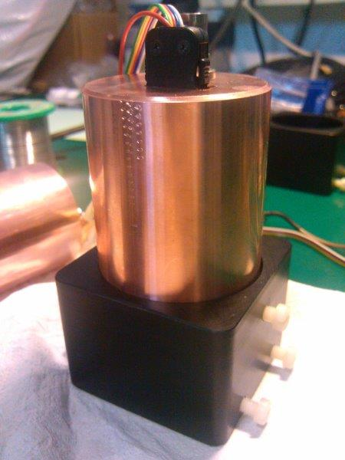
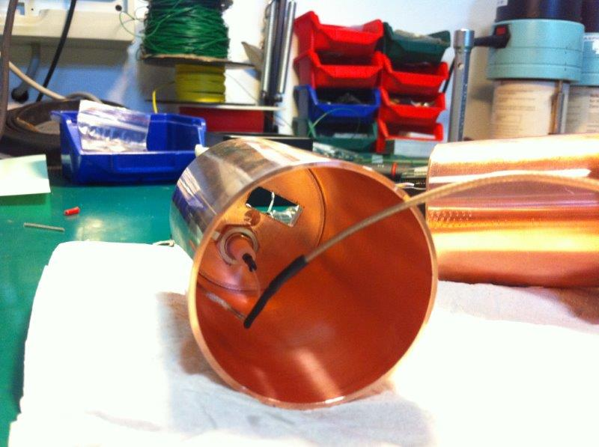
Photopentode cages
Photopentode Faraday cage
Faraday cage mounted on the mechanics which
Hosts the photopentode

Slide 4
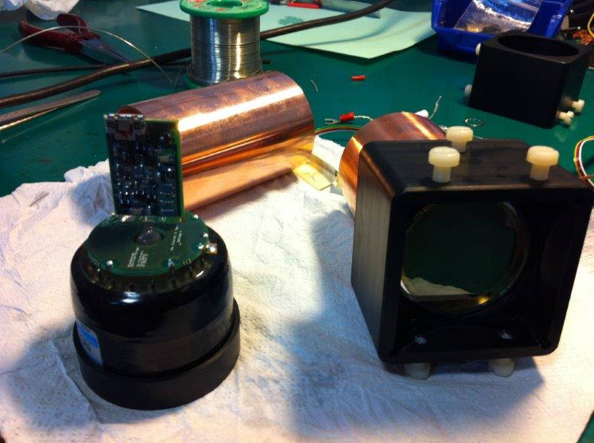
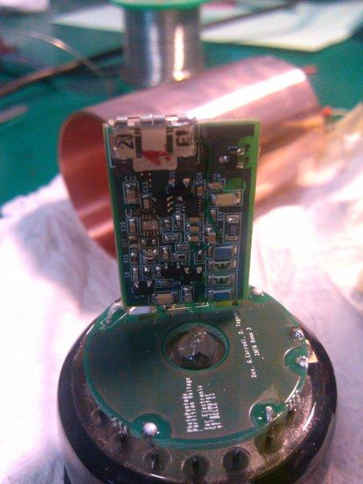
Voltage Divider and pre-amp
Voltage divider
pre-amp

Slide 5
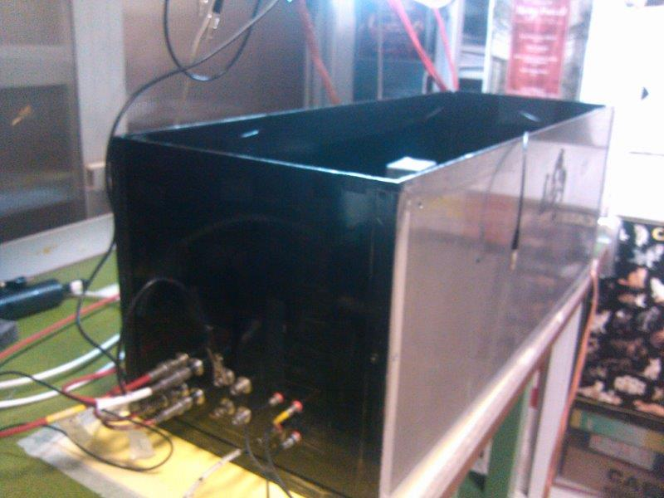
Dark box&setup
HV & signal cable
connections

Slide 6
Trigger Setup
VIEW
Electronics System
Finger UP
TOP VIEW
Pb
5cm
CsI Pure
Finger UP
Finger DOWN
Finger DOWN
SCOPE
Finger UP
Finger DOWN
Pb
CsI Pure
Trigger Finger UP & Finger DOWN
Threshold: -200mV

Slide 7
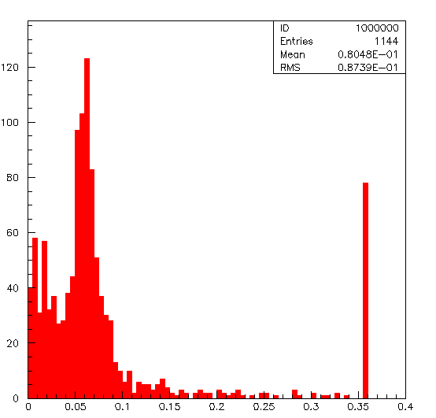
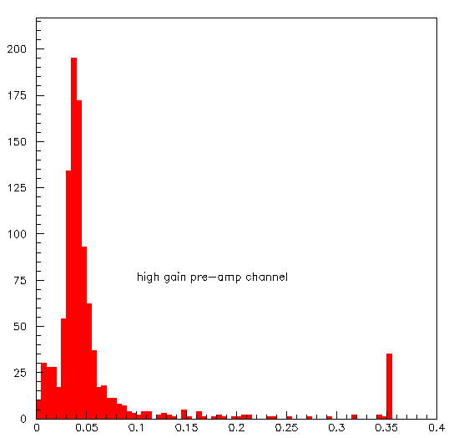
Comparison with/wo lead absorber
No Lead absorber
With lead absorber

Slide 8
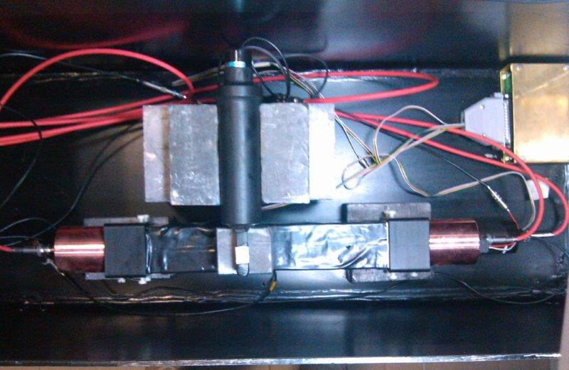
Setup topview

Slide 9
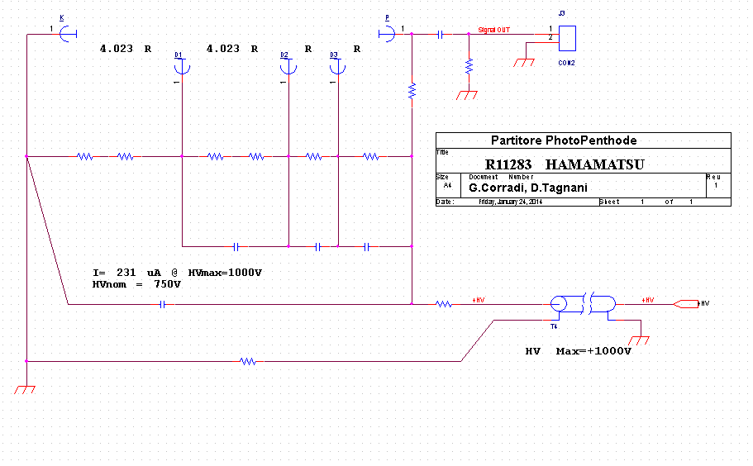
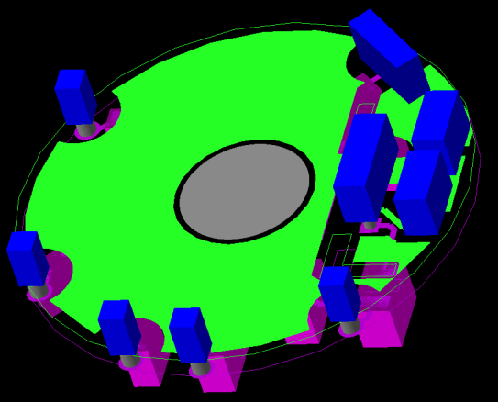
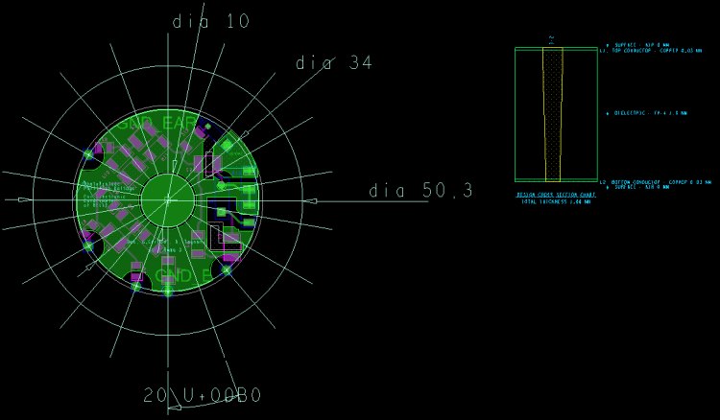
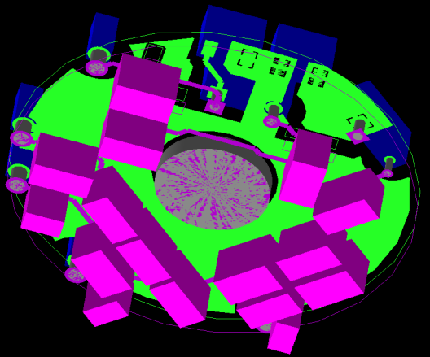
Voltage divider
LV PW
Pre Charge Amplifier
HV PW

Slide 10
Pre Charge Amplifier
Charge - Preamplifier
Gain = 1.4V/pC
Single power = 6V - GND
Power dissipation = 16mW 6V
Dynamic Range 2.2V su 50R
Tau = 150ns

Slide 11
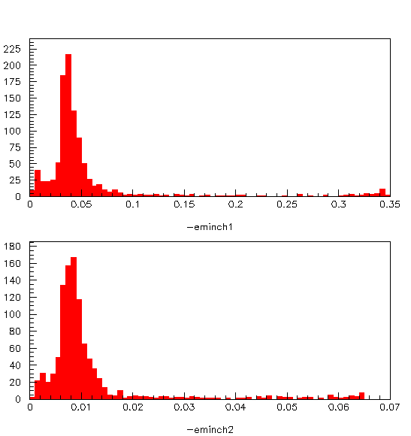
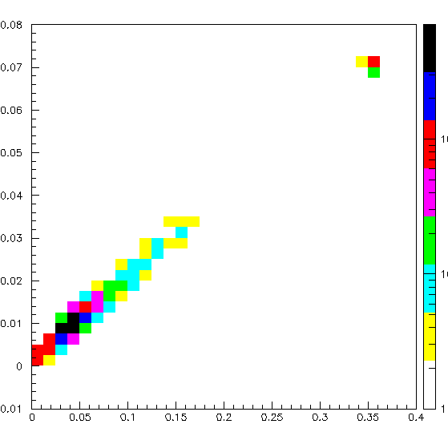
Cosmic energy deposition unshaped
What do these events look like?

Slide 12
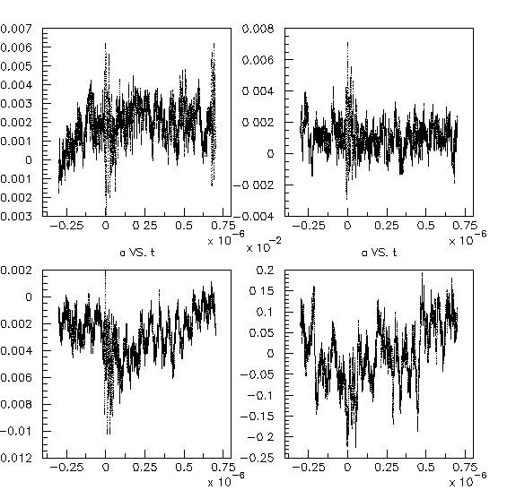
Background shapes
Is there any frequency
which drives the
noise shape ?

Slide 13
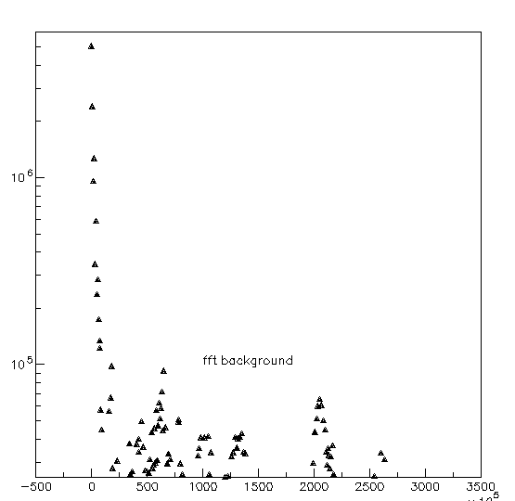
O yes!
FFT Background
10 ⁵
Though in log scale they have to be studied!

Slide 14
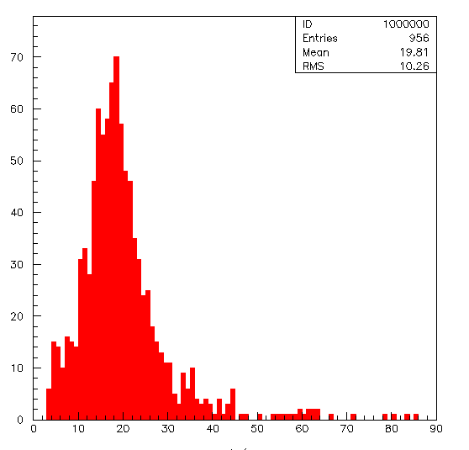
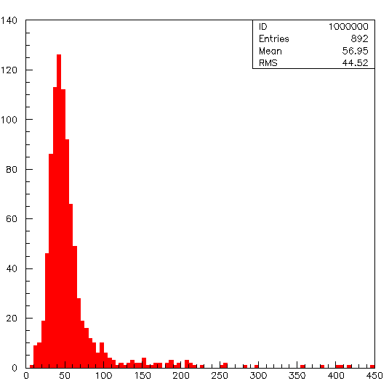
Signal to noise ratio before shaping
Low gain chain
High gain chain

Slide 15
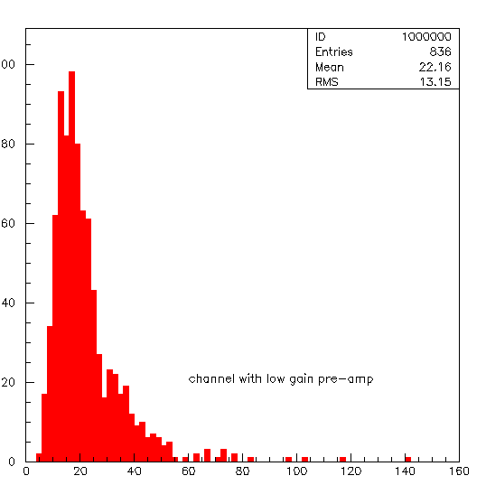
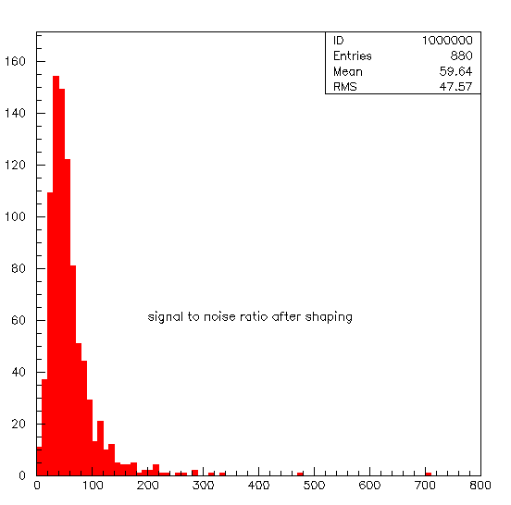
Signal to noise ratio after shaping
Mean = 60
Mean = 22
High gain chain
Low gain chain

Slide 16

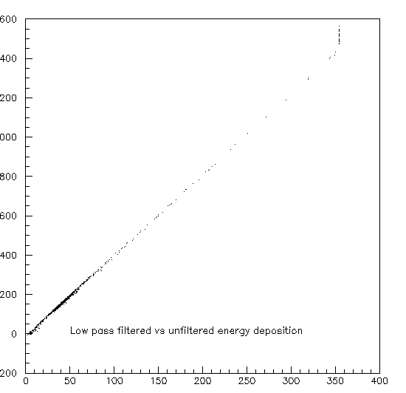
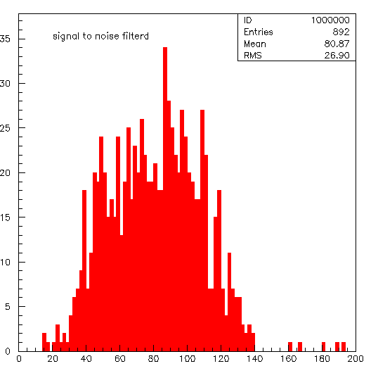
Low pass filter (CH1)
About 50
About 80
Filtered vs unfiltered data
In this case the signal to noise ratio for a improves
from 50 to 80.

Slide 17

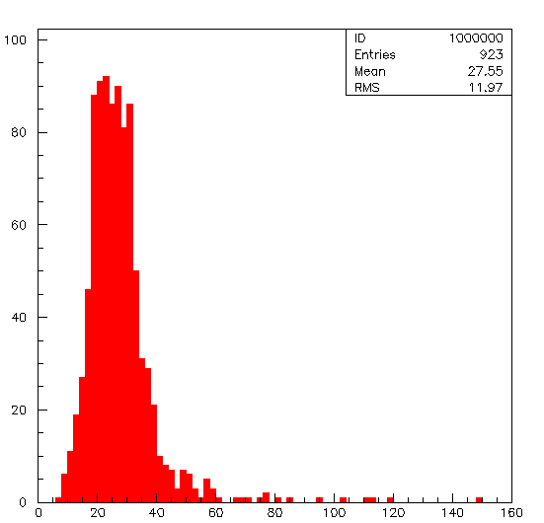
Fitered data on Ch2
S to n ratio:About 22
S to N ration about 27
In this case the signal to noise ratio improves from 22 to 27

Slide 18
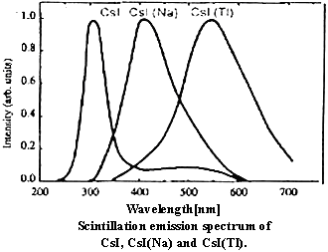
Scintillation emission CsI(Pure)
 |  | CsI
Density[g/cm³] |  | 4.51
Melting point[K] |  | 894
Thermal expansion coefficient[K⁻¹]\ |  | 49×10⁻⁶
Cleavage plane |  | None
Hardness(Mho) |  | 2
Hygroscopic |  | slightly
Wavelength of emission maximum[nm] |  | 315
Lower wavelength cutoff[nm] |  | 260
Refractive index at emission maximum |  | 1.95
Primary decay time[us] |  | 0.016
Afterglow(after 6ms)[%] |  | -
Light yield[photons/MeVγ] |  | 2×10⁴
Photoelectron yield[% of NaI(Tl)](γrays) |  | 4-6
Wavelenght of emission max CsI(PURE) = 315nm
Lower wavelenght cutoff CsI(PURE) = 260nm

Slide 19
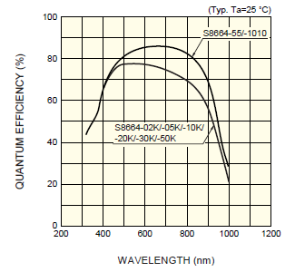
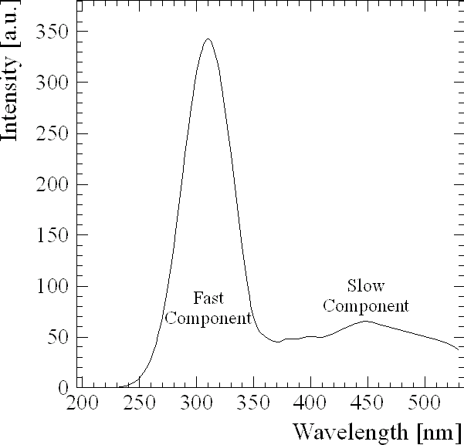
APD UV extended vs CsI(PURE)
Today we can get a APD UV extended, It’s working at 200 nm
This matches the CsI(pure) spectrum!!
Quantum efficiency: 80-90% in the working region.
  Standard APD: 40-50% in the working region.
APD Standard
315nm
APD UV extended
315nm

Slide 20
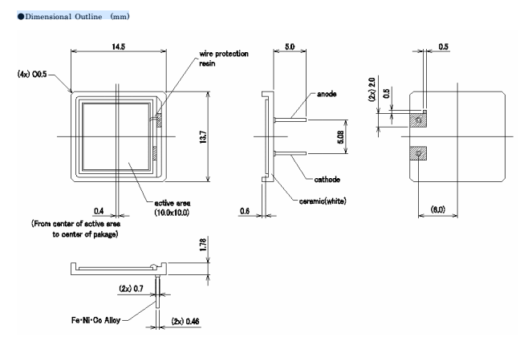
APD extended costs and sizes
  Quotation by Hamamatsu for the 10x10 mm2 APD
  Now we have:
    2 detectors with the window UV extended.
    1 detector without protective window.
S11759-1010
1-4pcs 1.080Euro
4000pcs 263Euro

Slide 21
Future developments
Test UV APD with UV windows.
    Performance gain.
    Quantum efficiently.
    Test cosmic -> APD UV vs APD standard vs PP
    Test beam -> APD UV vs APD standard vs PP

