Slide 1


Nuove Tecniche di Accelerazione basate su plasmi prodotti da laser
Danilo Giulietti
Dipartimento di Fisica dell’Università e INFN, Pisa.

Slide 2
Abstract
Lo sviluppo dei laser ad impulsi ultra-corti (fs) basati sulla tecnologia CPA consente di realizzare sistemi "table-top" di grande potenza di picco (PW).
Una volta che tali impulsi vengono focalizzati sulla materia si producono pressioni di centinaia di miliardi di Atmosfere e nei plasmi così generati enormi forze, capaci di contrastare localmente la neutralità del plasma eccitando onde elettroniche di grande ampiezza, cui sono associati campi elettrici longitudinali di centinaia di GeV/m.
La propagazione nel plasma di questi impulsi laser è caratterizzata da meccanismi fisici completamente nuovi. In particolare si creano condizioni favorevoli per l'accelerazione di elettroni e ioni ad altissimo gradiente di campo, ma anche per la realizzazione di sorgenti secondarie di radiazione energetica di elevata brillanza.

Slide 3
Summary
Evoluzione dei sistemi LASER di grande potenza
Interazione laser-materia ad intensità relativistiche
Onde di plasma elettroniche e campi elettrici acceleranti
Accelerazione laser-plasma di elettroni
NTA-PLASMONX: accelerazione laser-plasma e Thomson Scattering
Primi risultati sperimentali a LNF
Sorgenti secondarie
Conclusioni e prospettive

Slide 4
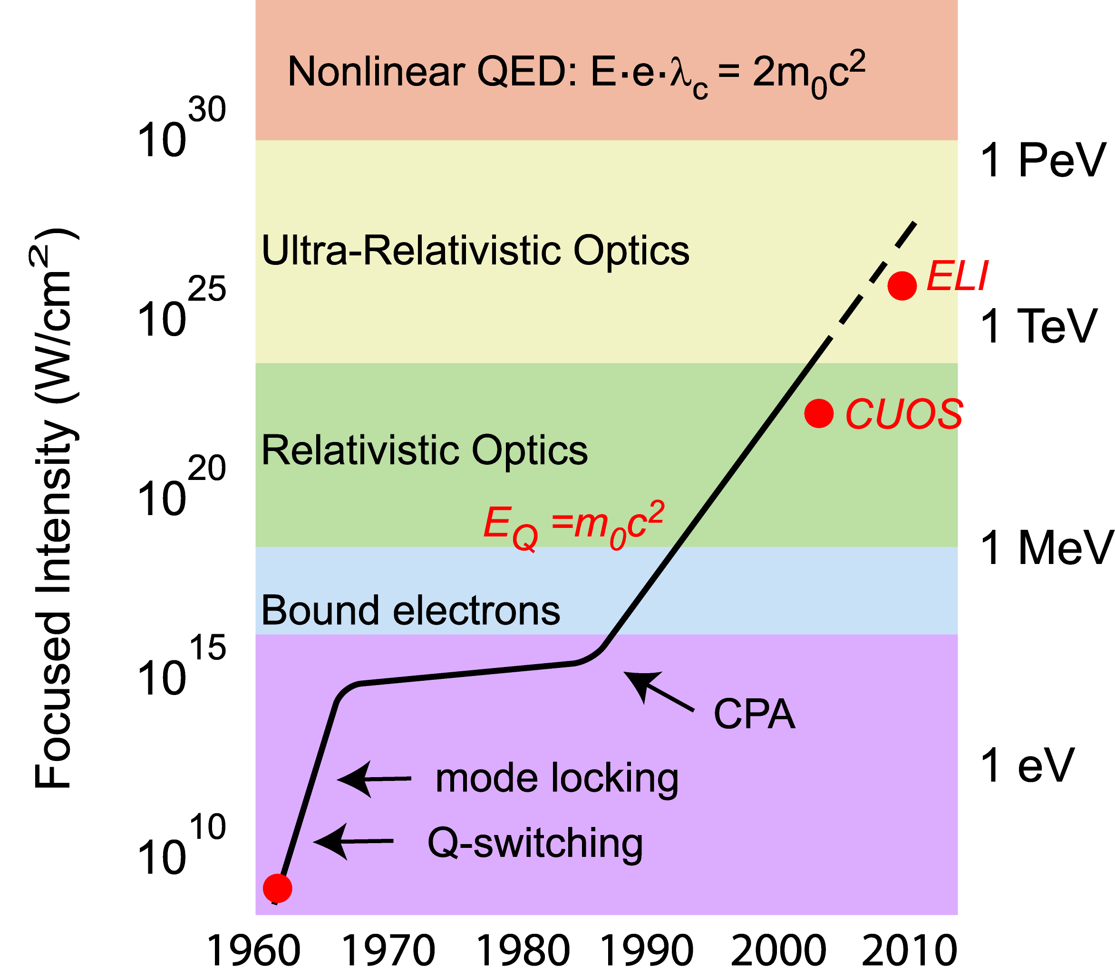
QCD ~10³⁵W/cm²
E_{Q}=m_{p}c²
LASER INTENSITY vs YEAR
PLASMONX
NL Optics
Courtesy G. Mourou

Slide 5
Laser-Matter Interaction

Slide 6
Super-intense laser pulse in a plasma (1)

Slide 7
Super-intense laser pulse in a plasma (2)

Slide 8
ELECTRON PLASMA WAVE (1)

Slide 9
ELECTRON PLASMA WAVE (2)
DAWSON LIMIT

Slide 10
ELECTRON PLASMA WAVE EXCITATION BY PONDEROMOTIVE FORCES (1)
non relativistic intensities
relativistic intensities
the excited E.P.W. phase velocity equals the e.m. wave group velocity

Slide 11
ELECTRON PLASMA WAVE EXCITATION BY PONDEROMOTIVE FORCES (2)

Slide 12
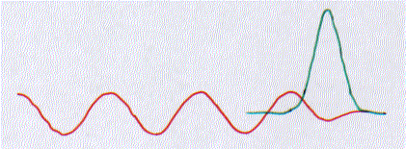
E.P.W. EXCITATION BY LASER WAKE FIELD
second push
first push
v_{g} _{LASER}
E.P.W.

Slide 13
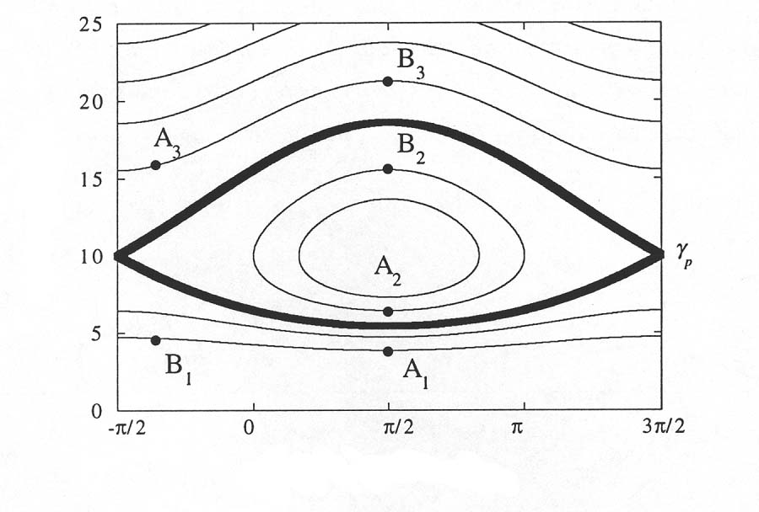
ELECTRON ACCELERATION IN E.P.W.
1D MODEL
γ
φ

Slide 14

BOAT / LASER PULSE
WAVE WAKE / PLASMA WAVE

Slide 15
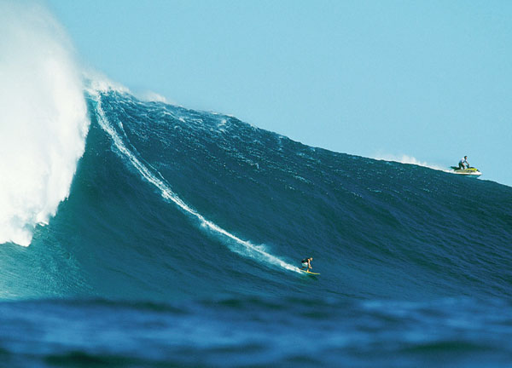
WATER SCOOTER / LINAC
SURFER / ELECTRON

Slide 16
L’Accelerazione Laser-Plasma è un’avventura scientifica nata “per caso”; indissolubilmente legata all’impetuoso sviluppo dei sistemi laser di grande potenza ad impulsi ultra corti ed al loro utilizzo nel campo degli studi sulla Fusione Termonucleare Controllata (Inertial Confinement Fusion)

Slide 17

2005

Slide 18
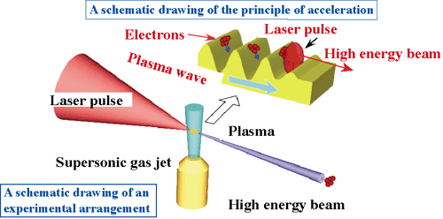
The ponderomotive force related to the laser pulse produces the Wake Field and the Coulomb force related to the Electron Plasma Wave accelerates the electrons

Slide 19
LWFA acceleration of externally injected electrons in a gas-jet plasma

Slide 20
Ultra-bright femtosecond γ-ray source
6J pulse
He jet
γ-rays
e⁻ beam
Gas-jet system

Slide 21
Tuneable X-ray radiation source based on Thomson Scattering

Slide 22
APPARATI SPERIMENTALI
@
LNF

Slide 23
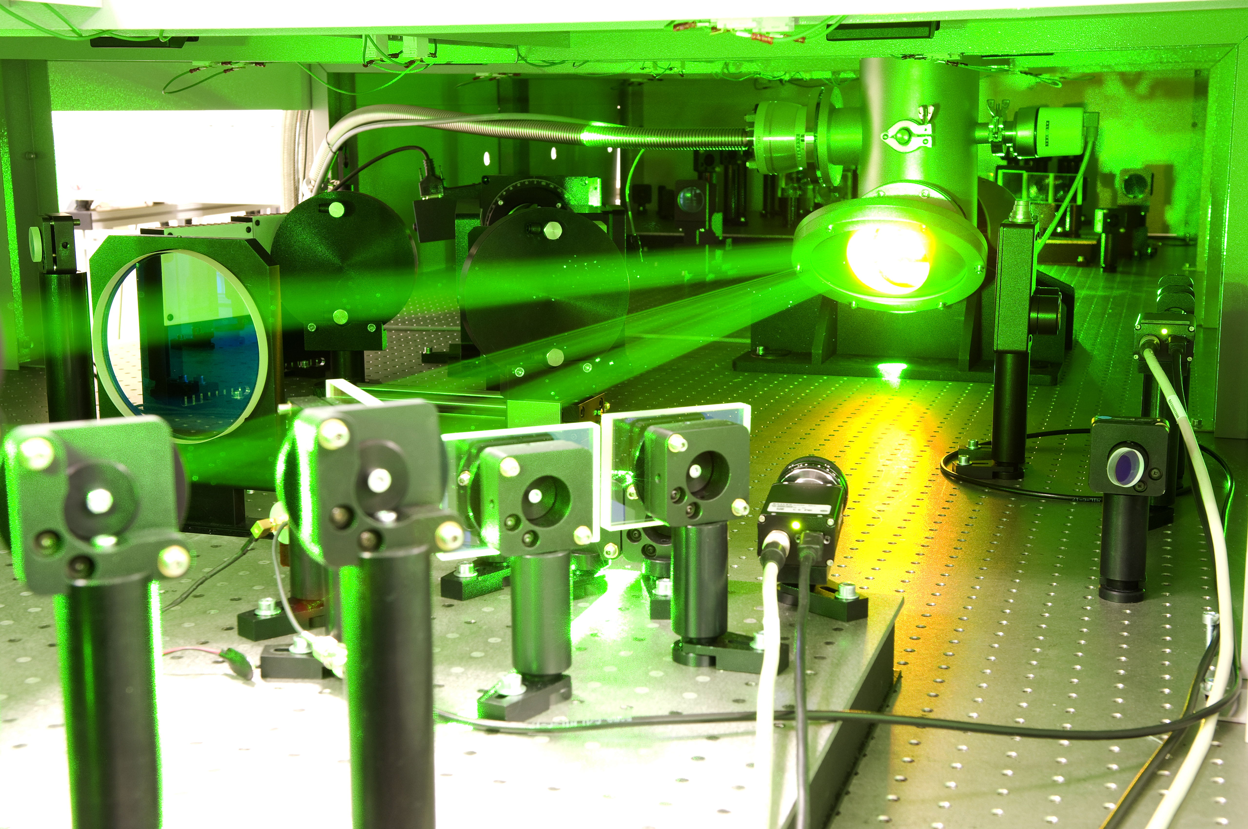
IL LASER DI
LASER PARAMETERS
Pulse duration 20 fs
Pulse energy 6J
Rep. Rate 10Hz
Peak power up to 300 TW
ASE contrast ≈10⁻¹⁰
Pre-pulse contrast < 10⁻⁸

Slide 24
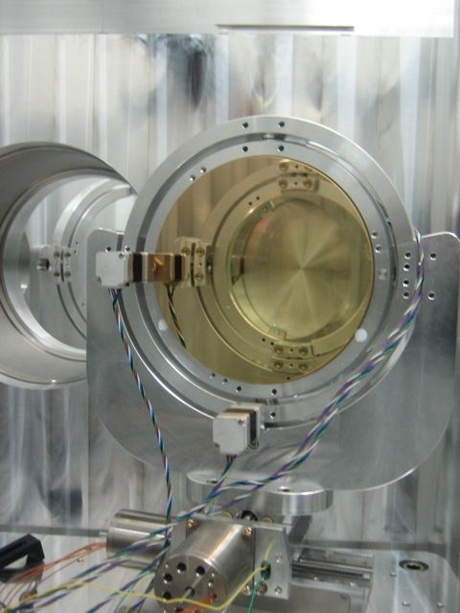
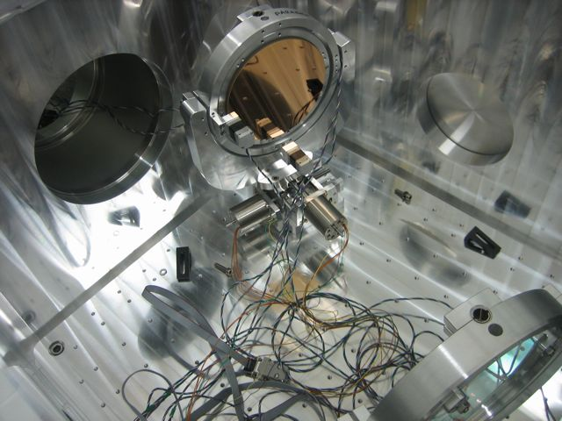
FOCUSING LASER
1 m focal length, 7”, 15° Off Axis Parabola (SORL)
Notes:
24

Slide 25
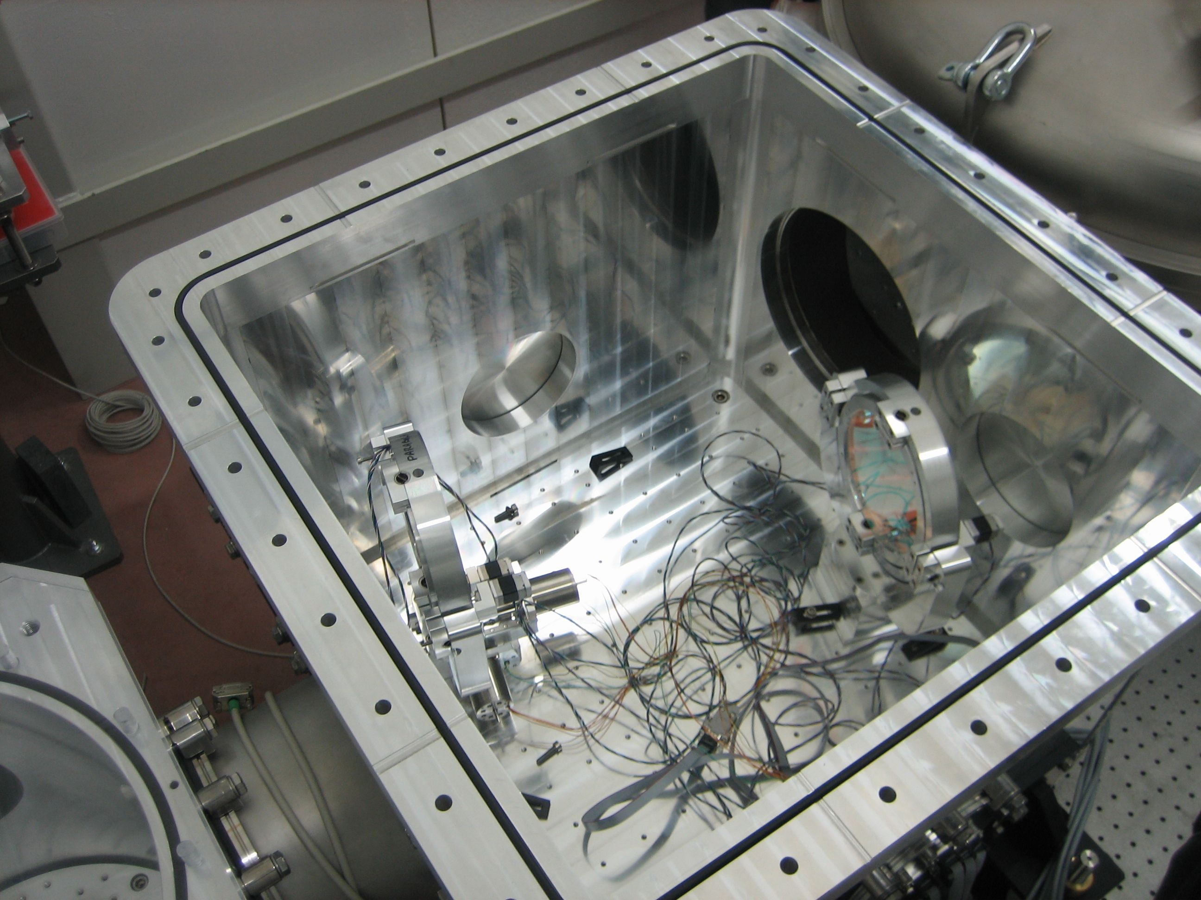
MAIN BEAM OPTICS IN PLACE
45 AND 15° TURNING MIRROR MOUNTED
Notes:
25

Slide 26
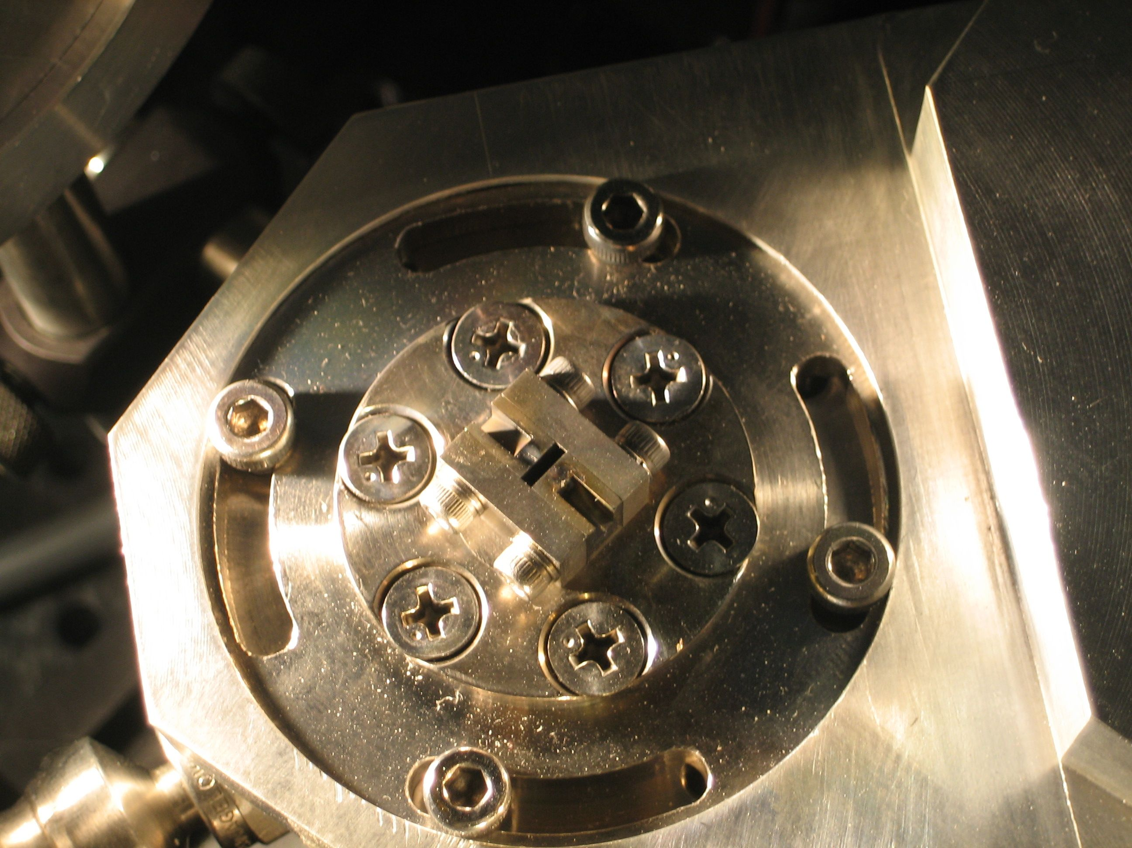
Gas-Jet nozzle
Laser
Notes:
26

Slide 27
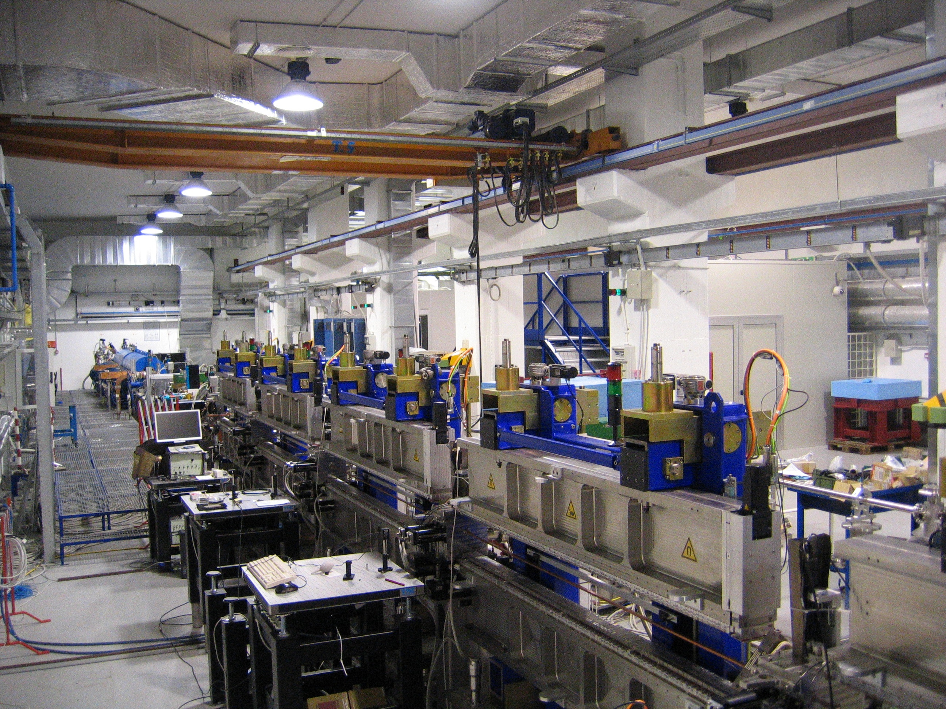
Sorgente Pulsata ed Amlpificata di Radiazione Coerente (SPARC)
Collaborazione INFN-ENEA
SPARC: the 200MeV LINAC and the UNDULATORS

Slide 28
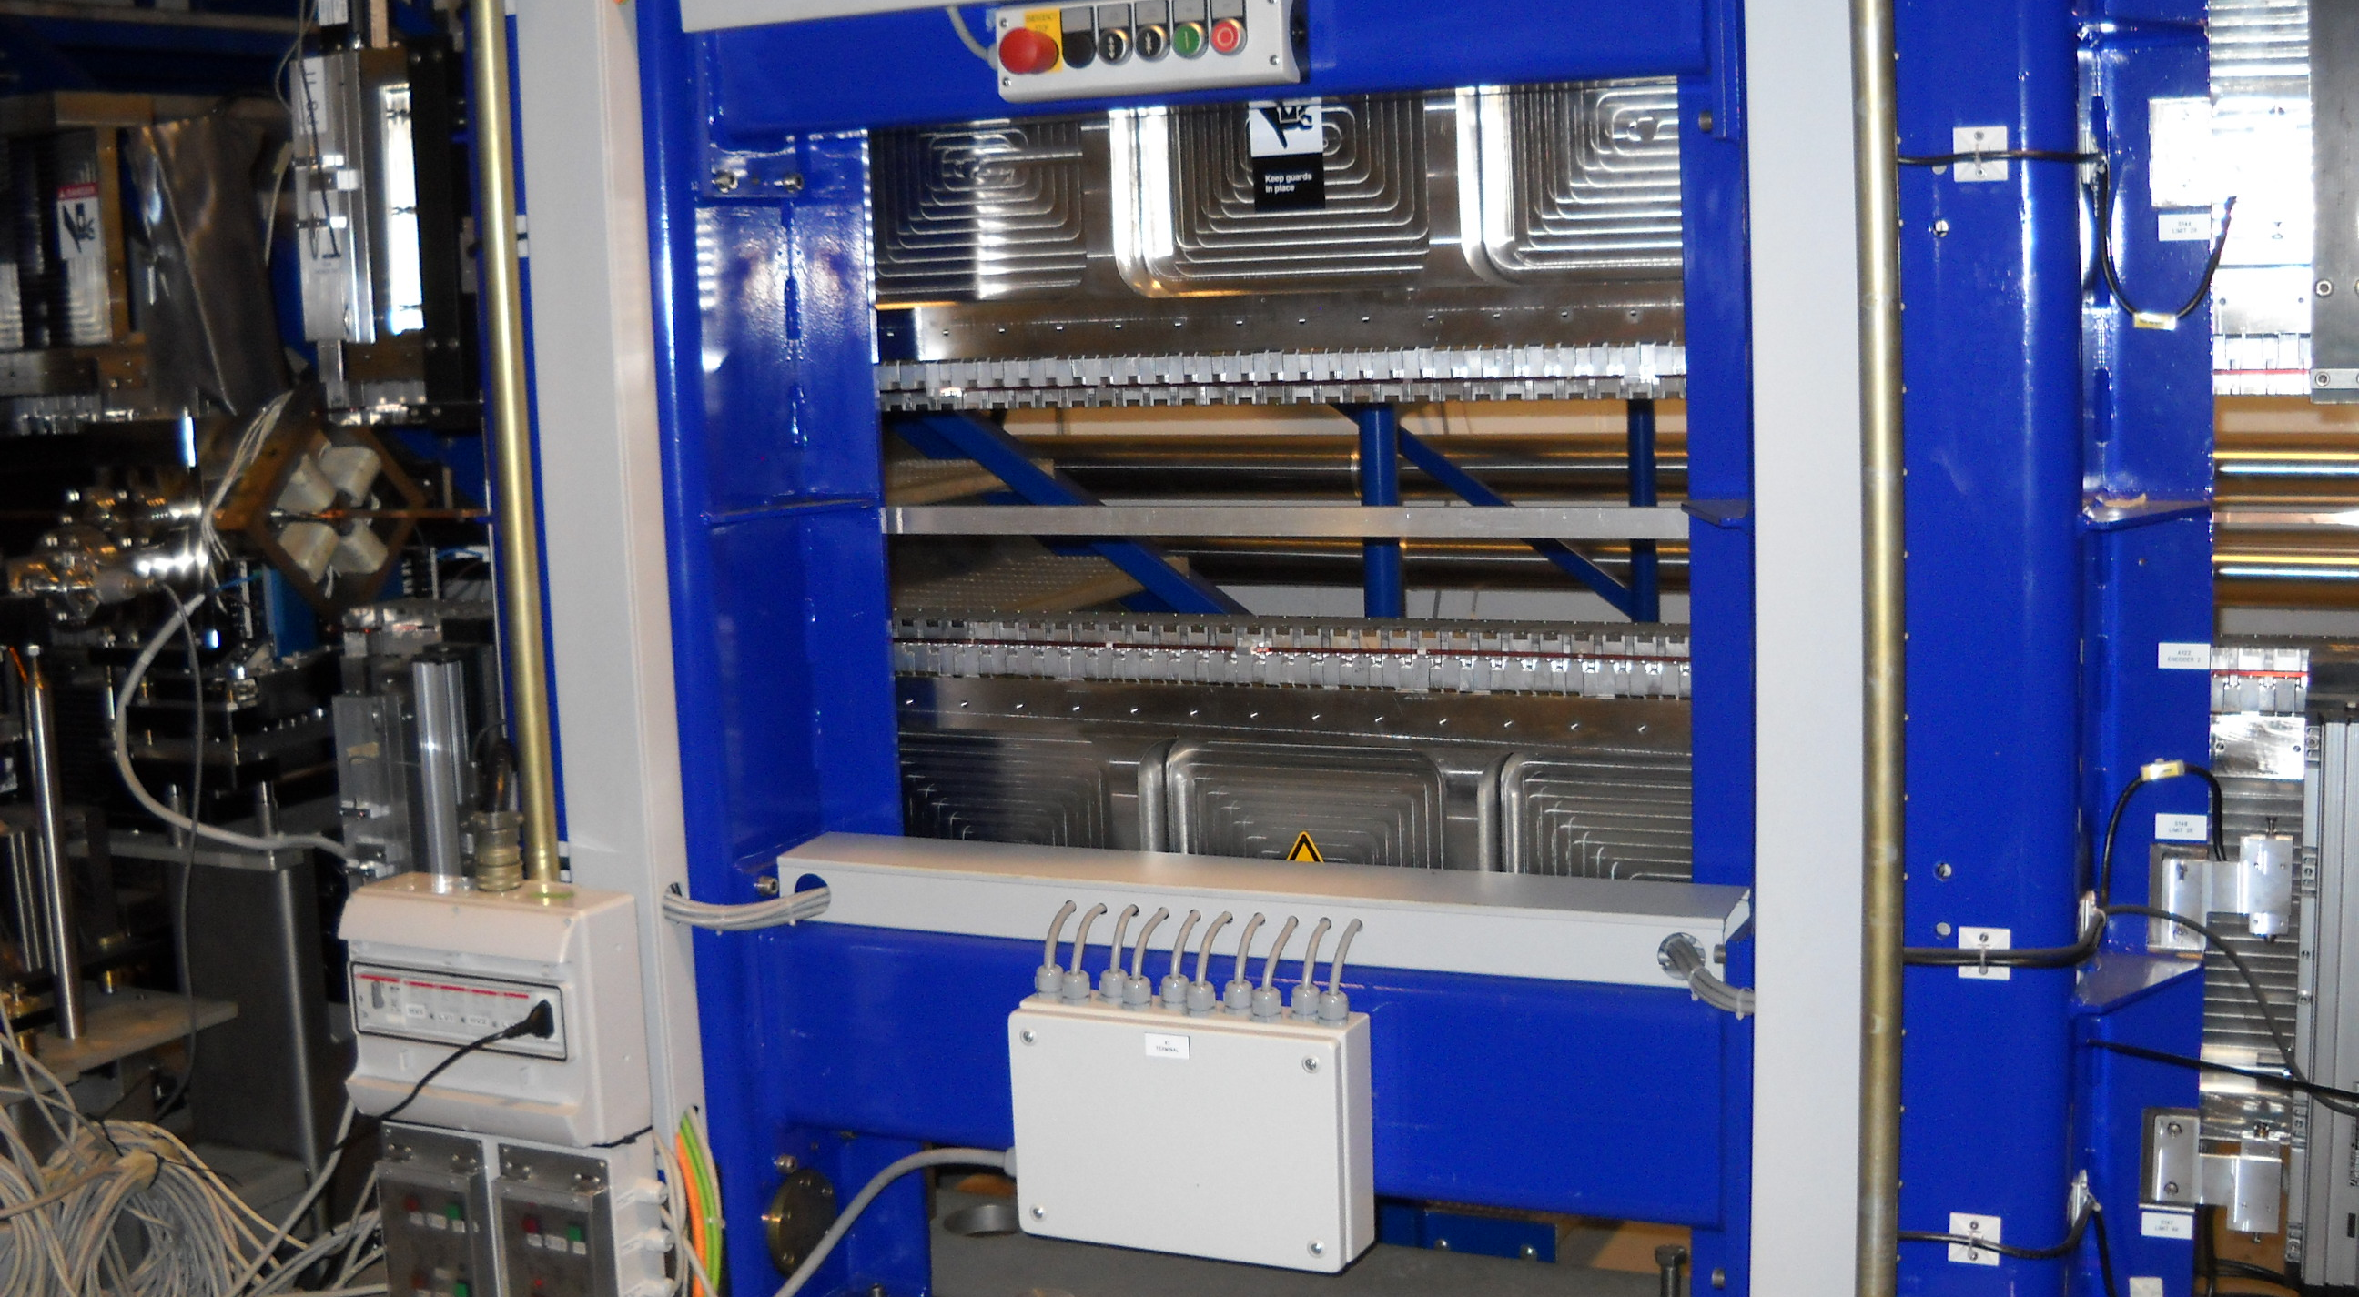
ENEA UNDULATOR

Slide 29
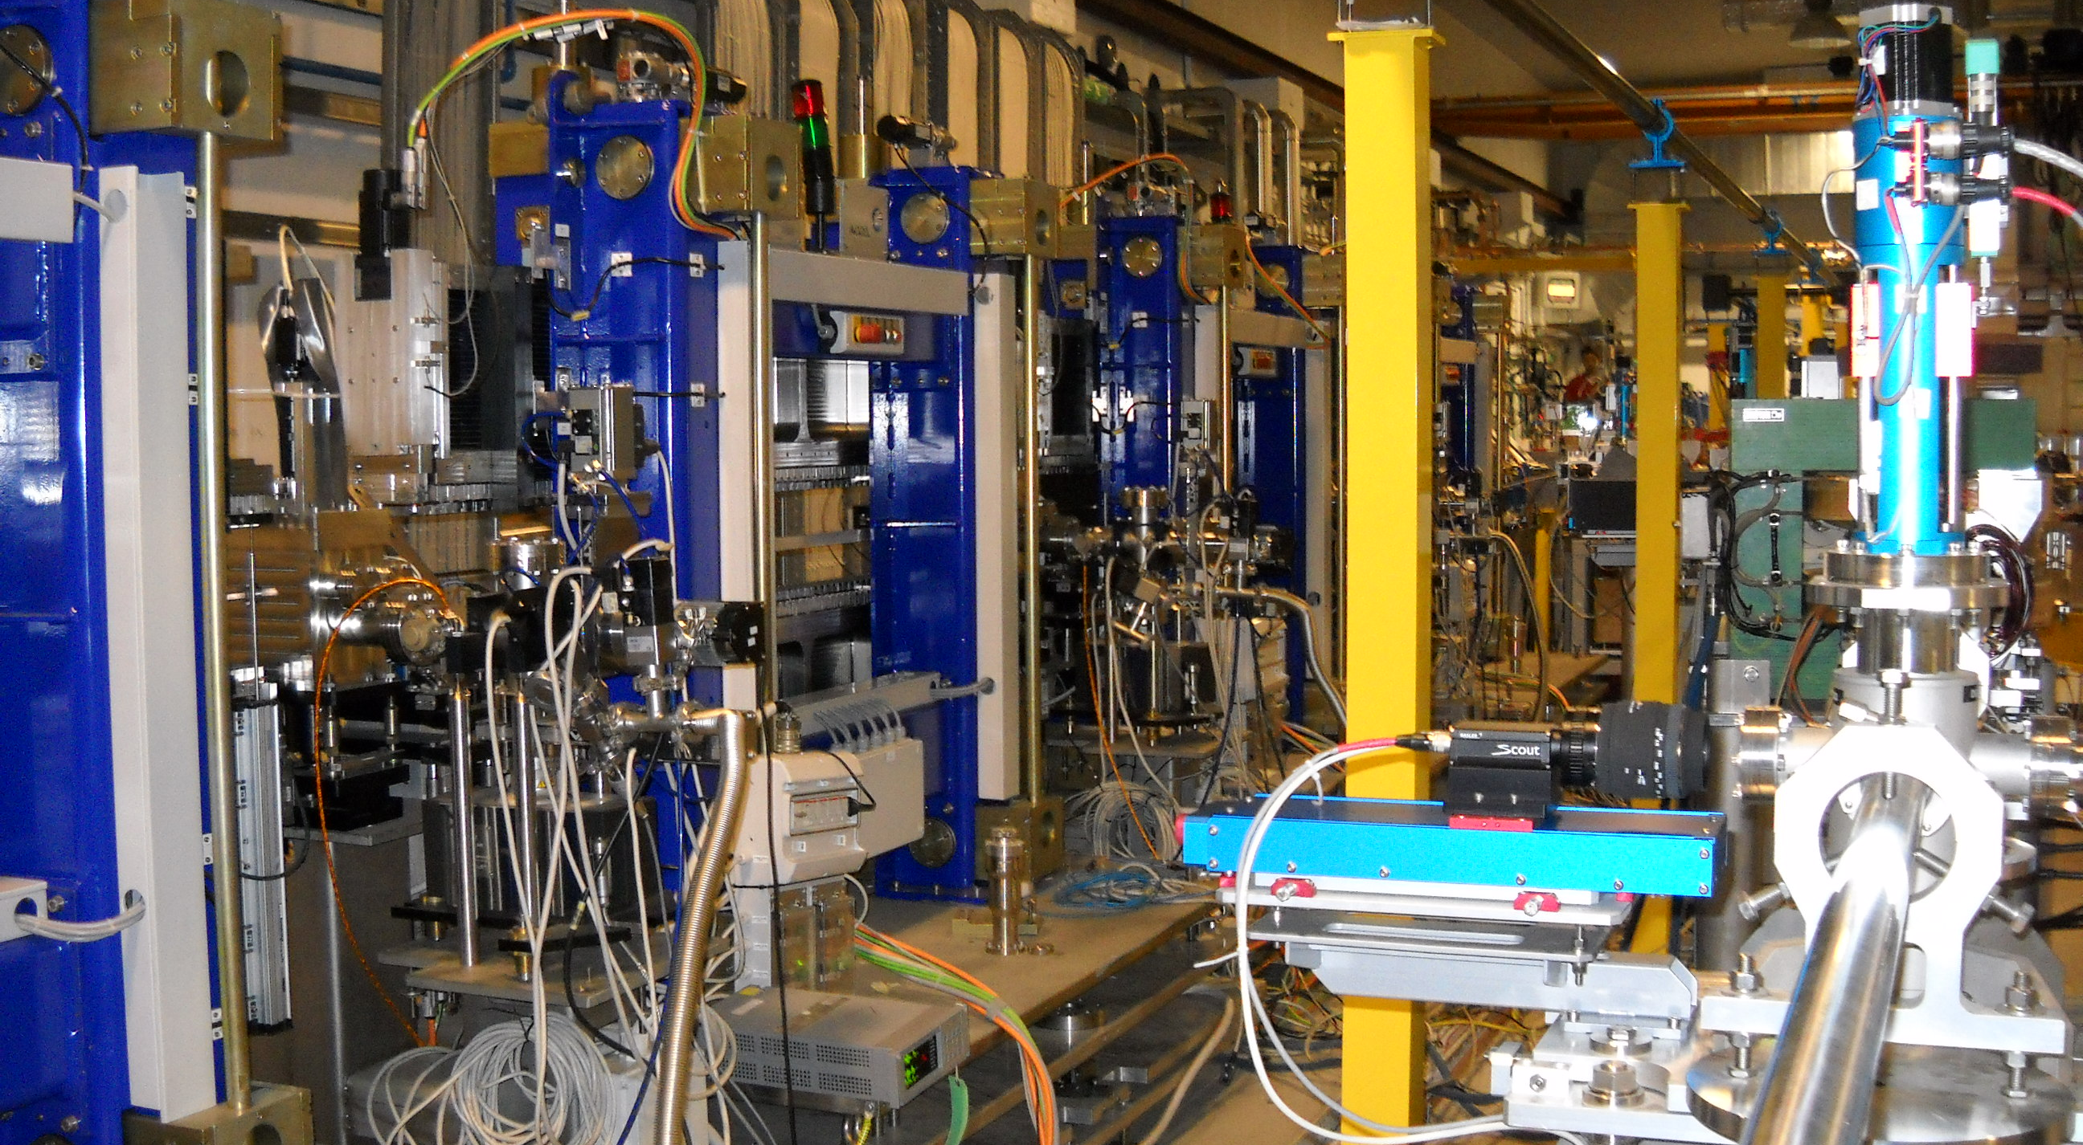
ENEA UNDULATORS

Slide 30
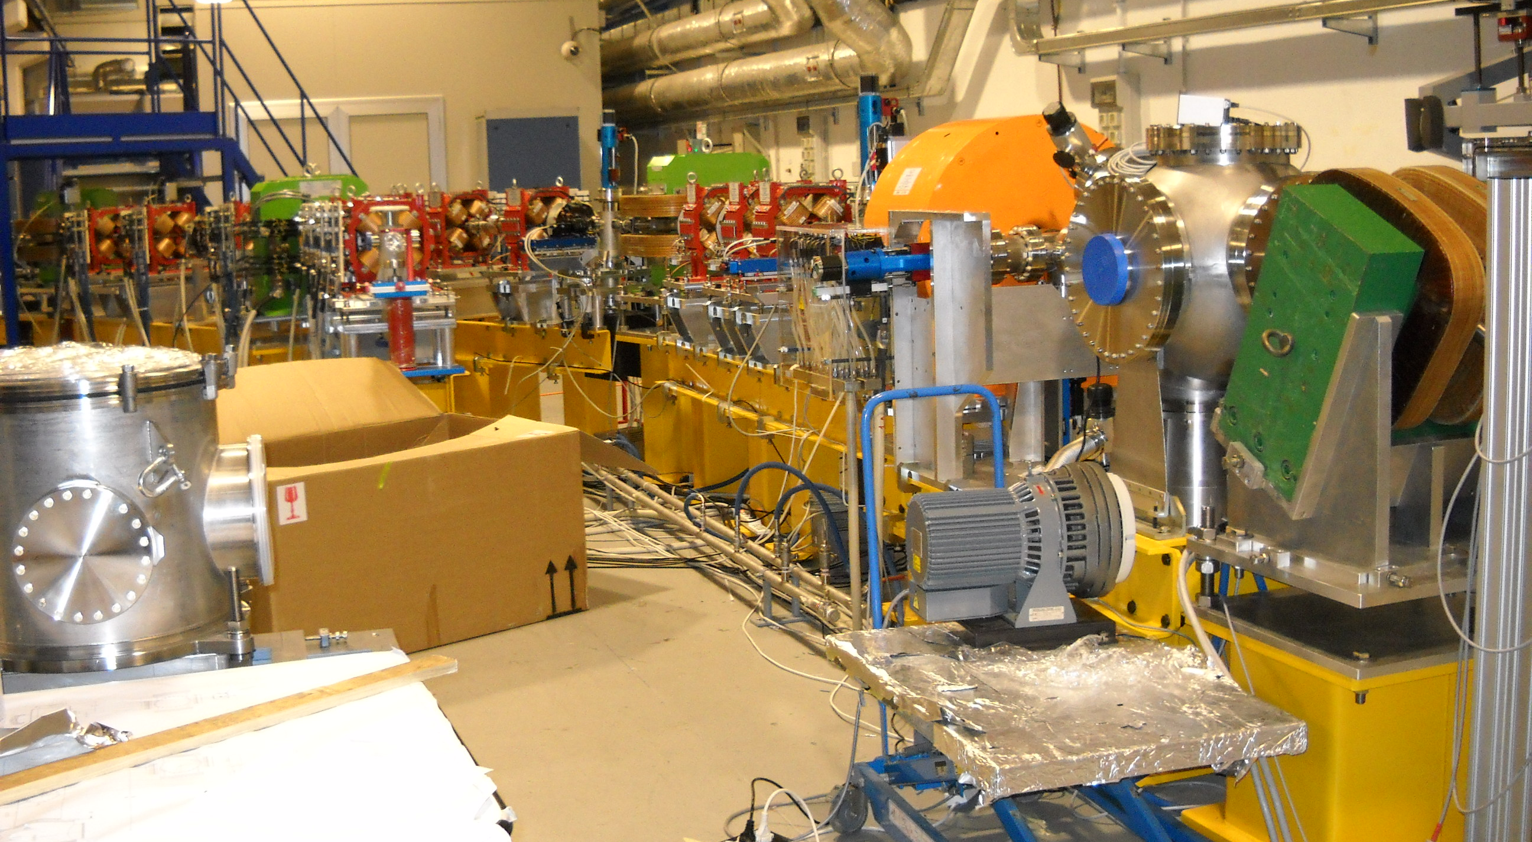
Thomson Scattering beam line

Slide 31
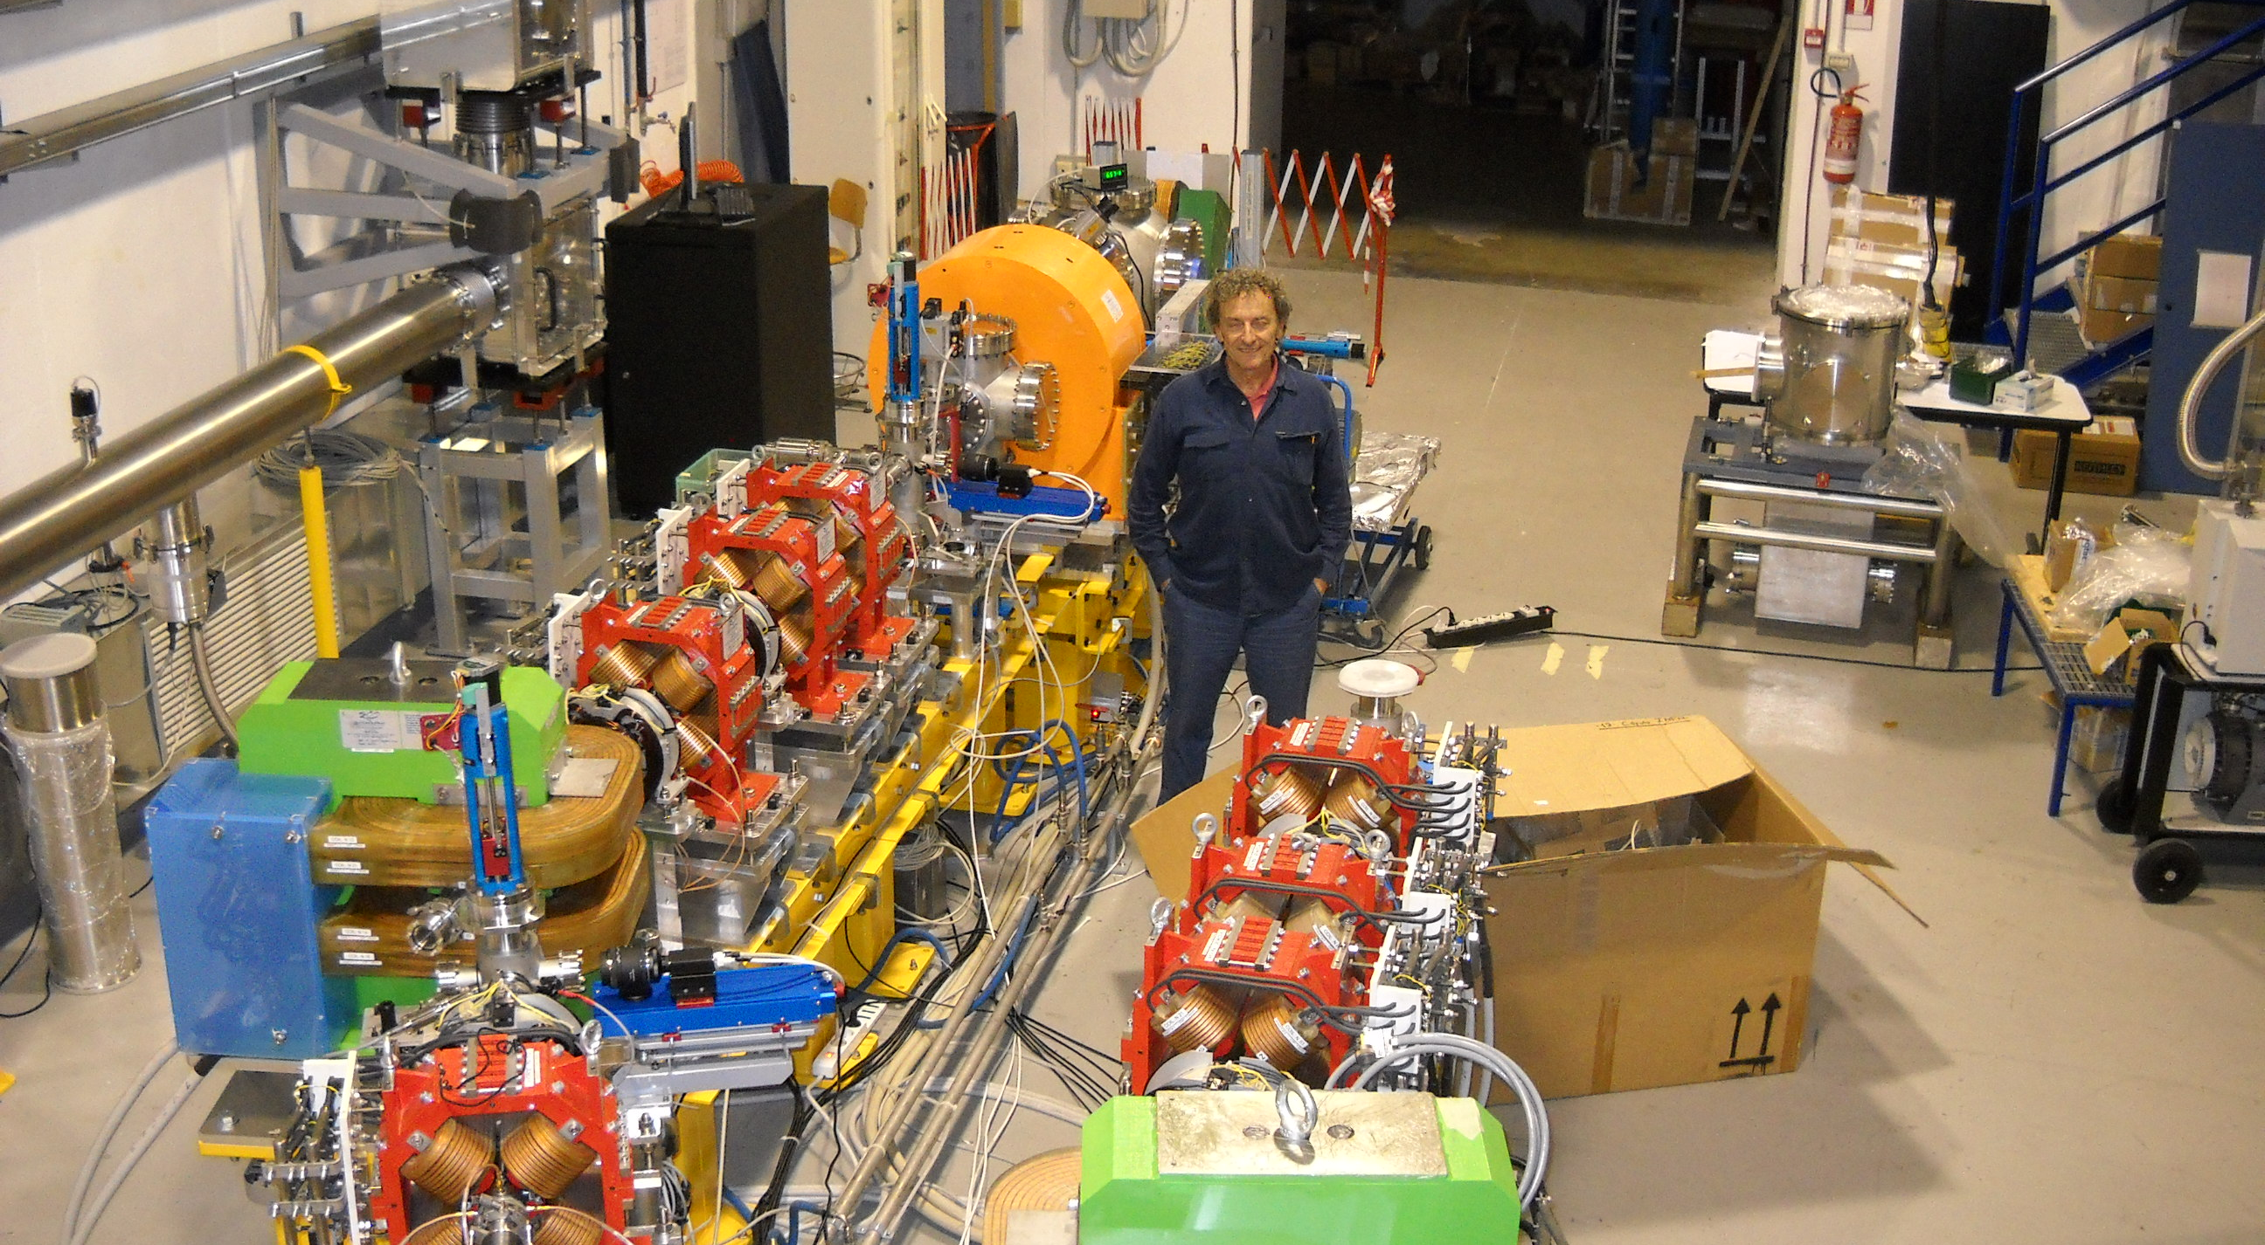
TS and External Injection beam lines

Slide 32
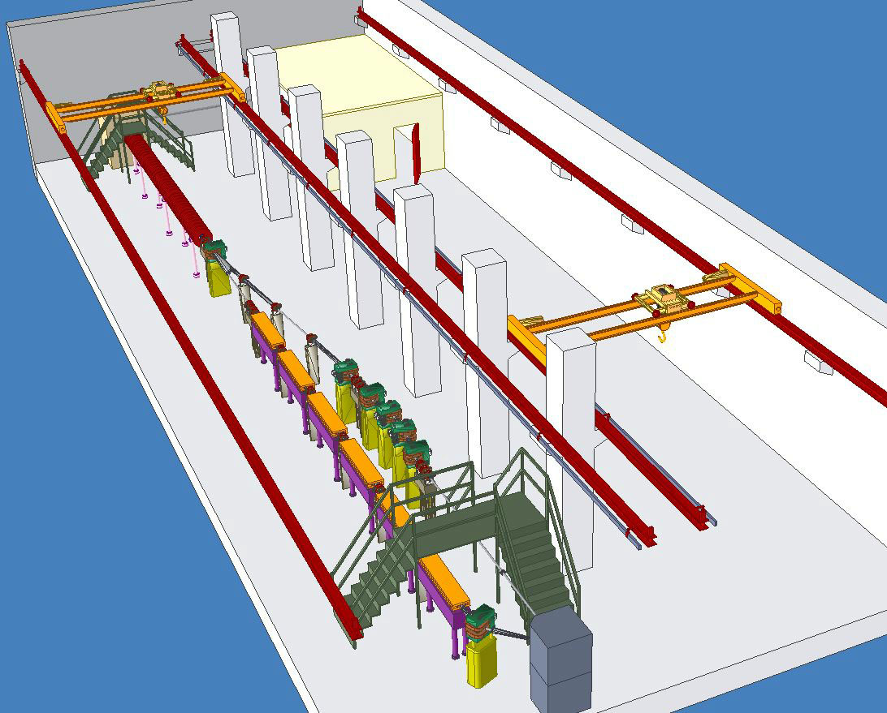

synchronisation
uncompressed pulse
vacuum compressor
acceleration
chamber
detectors
area
control
& data
FLAME
LINAC
UNDULATOR

Slide 33
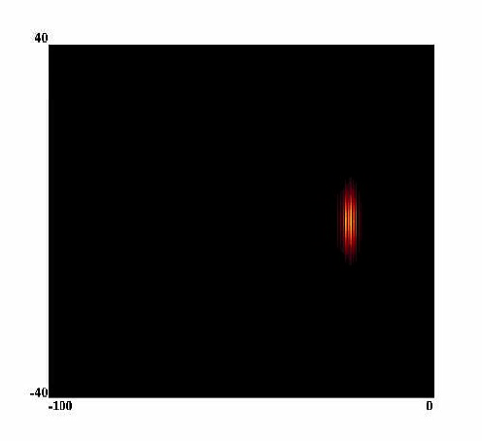
LASER PLASMA ACCELERATION
N_{e}=10¹⁹cm⁻³
L=1mm
T=20fs
W=9µm
I=1.5 10²⁰W/cm²
U_{el}≈400MeV
Bubble regime
PIC simulation by Carlo Benedetti, INFN-BO

Slide 34
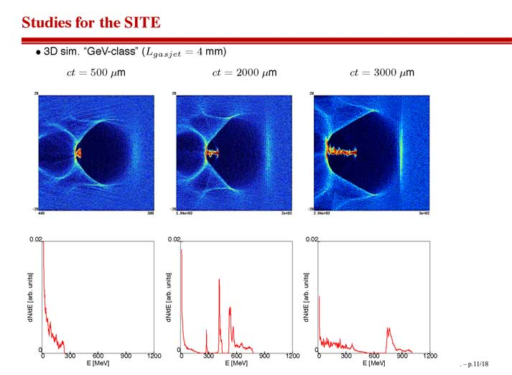
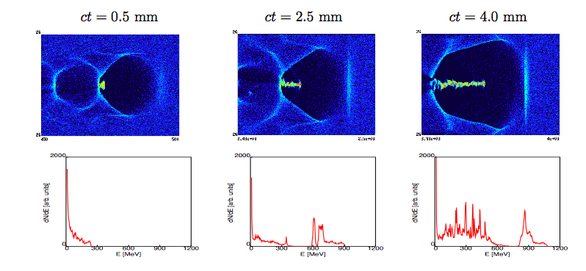
SIMULAZIONI ALADYN
(di C. BENEDETTI ET AL.,)
Bubble regime

Slide 35
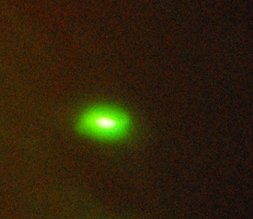
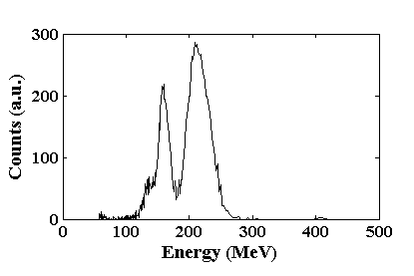
PLASMONX first results
20 mrad
→Laser Energy before compression ≈550mJ
→Laser pulse duration ≈25fs (FWHM)
→ W < 20TW
→Off-axis Parabola 1m focal lenght
→Back Pressure ≈17bar of N₂
lanex screen

Slide 36
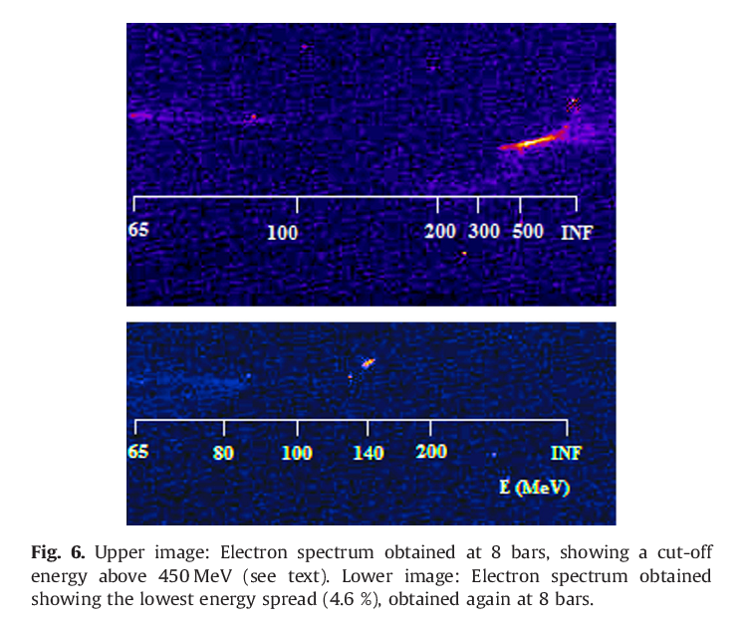
SPECTRUM OF ACCELERATED ELECTRONS
10mm He gas-jet
n_{e}= 1-4x10¹⁹ cm⁻³
λ_{L}=0.815 µm
I₀=2x10¹⁹Wcm⁻²

Slide 37
THOMSON BACK-SCATTERING
e⁻ (30MeV); λ₀=1µm, E₀=1.24 eV λ_{T}=0.069 x10⁻⁸nm, E_{T}=18 KeV
e⁻ (200 MeV); λ₀=1µm, E₀=1.24 eV λ_{T}=1.56 x10⁻³ nm, E_{T}=800 KeV

Slide 38
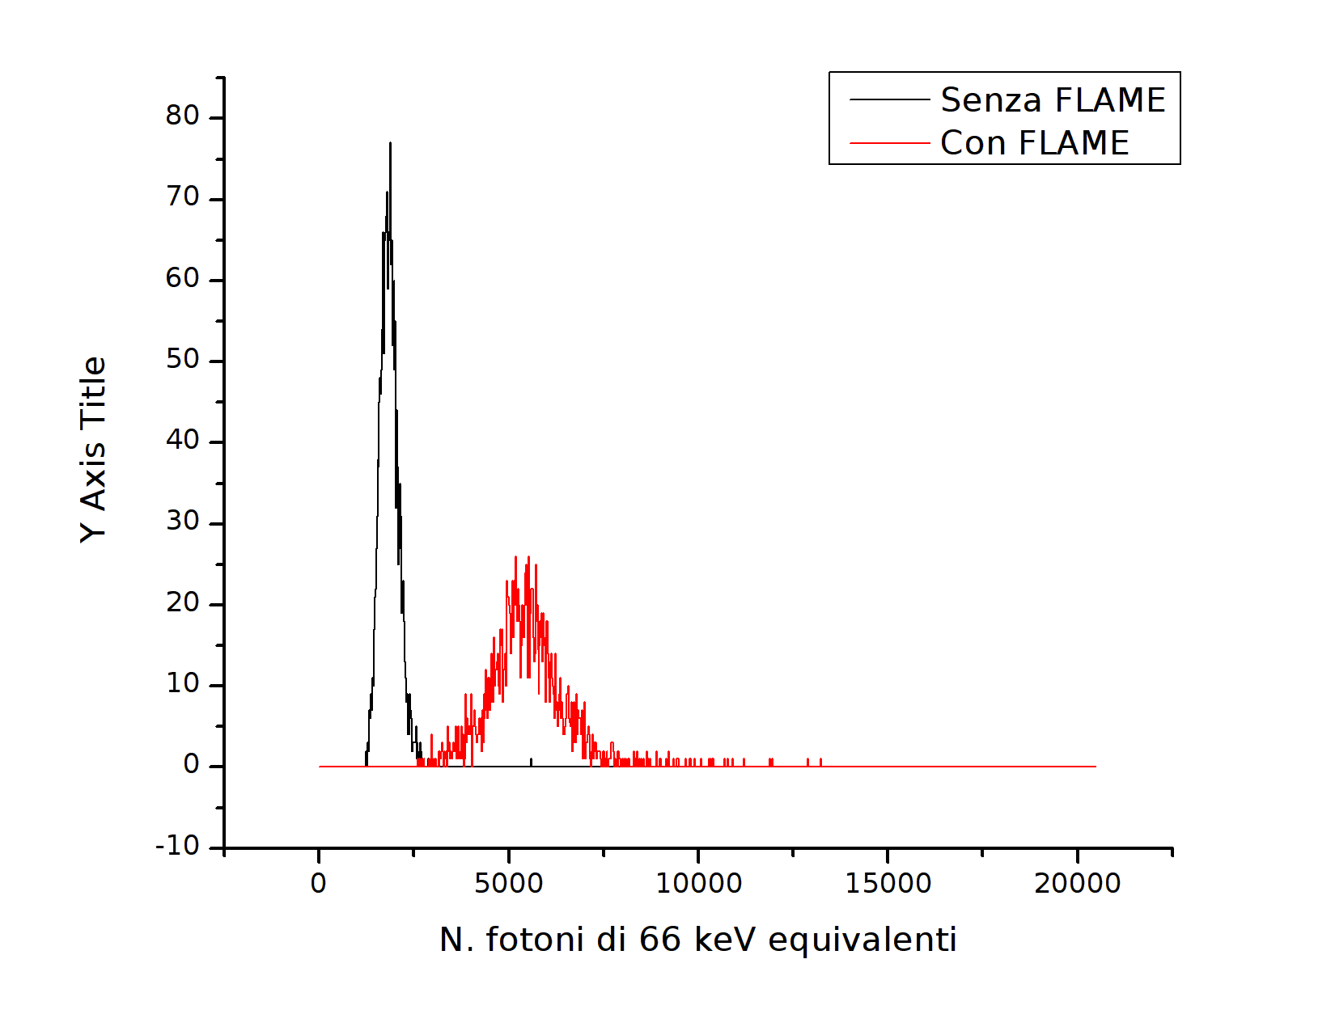
Primi fotoni dal Thomson Scattering 04.03.2014
LINAC @ 50MeV
Fotoni Thomson 60KeV
Rivelati con PM+ Scint NaI

Slide 39
Secondary Sources
Ion LPA
γ-rays via Bremsttrahlung
Betatron radiation
e+

Slide 40
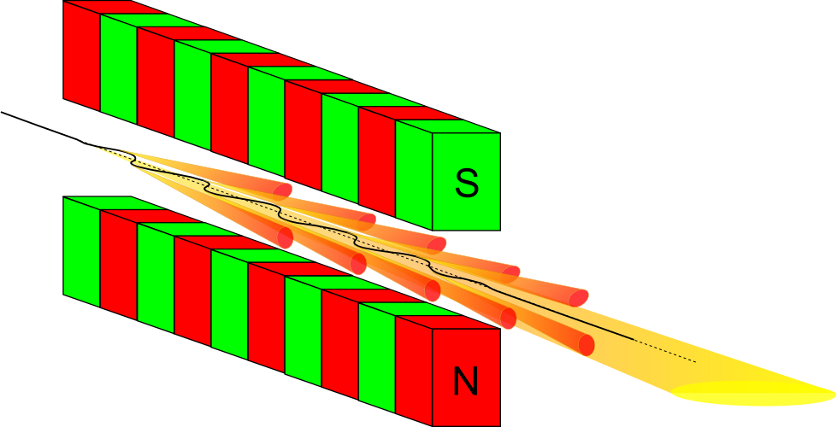
UNDULATOR

Slide 41
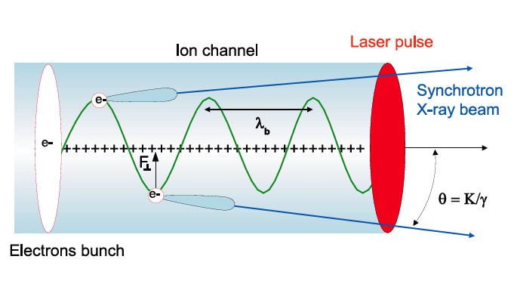
Laser based synchrotron radiation
Courtesy Antoine Rousse

Slide 42
Oscillatory motion of the relativistic electron in the ion channel

Slide 43
Emitted radiation

Slide 44
Da PLASMONX a SPARC-LAB
MAMBO
Q-FEL
FAST
BEATS
LILIA →
G-RESIST
THOMSON
EXIN
………
PLASMONX →
PLASMONX →
→ SPARC-LAB
ELI
HiPER

Slide 45

ELI
Extreme Light Infrastructure
ELI would be the first infrastructure dedicated to the fundamental study of laser-matter interaction in a new and unsurpassed regime of laser intensity: the ultra-relativistic regime (I_{L}>10²³ W/cm²). At its centre would be an exawatt-class laser ~1000 times more powerful than either the Laser Mégajoule in France or the National Ignition Facility (NIF) in the US. In contrast to these projects, ELI would attain its extreme power from the shortness of its pulses (femtosecond and attosecond).
The infrastructure would serve to investigate a new generation of compact accelerators delivering energetic particle and radiation beams of femtosecond (10⁻¹⁵s) to attosecond (10⁻¹⁸s) duration. Relativistic compression offers the potential of intensities exceeding I_{L}>10²⁵ W/cm², which would challenge the vacuum critical field as well as provide a new avenue to ultrafast attosecond to zeptosecond (10⁻²¹s) studies of laser-matter interaction.
ELI would afford wide benefits to society ranging from improvement of oncology treatment, medical imaging, fast electronics and our understanding of aging nuclear reactor materials to development of new methods of nuclear waste processing.

Slide 46
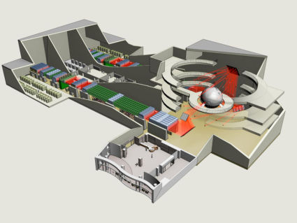
HiPER
HiPER is a proposed European High Power laser Energy Research facility dedicated to demonstrating the feasibility of laser driven fusion as a future energy source. HiPER is being designed to enable a broad array of new science including extreme material studies, astrophysics in the laboratory, miniaturised particle accelerators and a wide range of fundamental physics research.

Slide 47
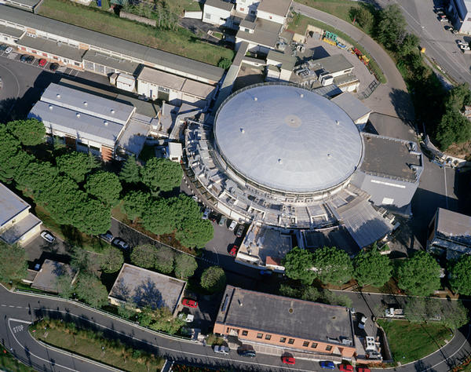
Laboratori Nazionali di Frascati
Laboratori Nazionali di Frascati

Slide 48
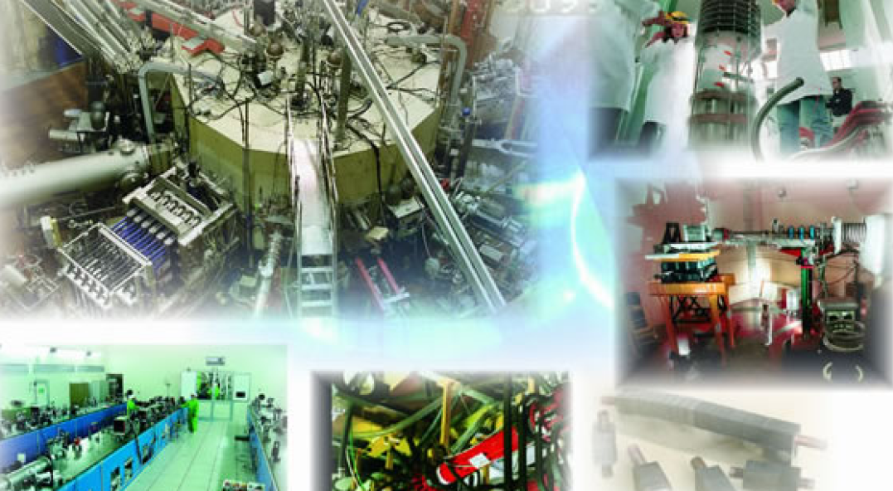

Centro Ricerche ENEA di Frascati

Slide 49
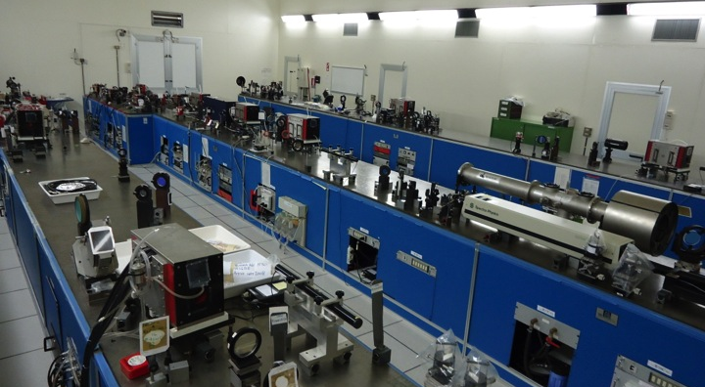
ABC: the Nd LASER, 2 x 100j in 2ns
@ Centro Ricerche ENEA di Frascati

Slide 50
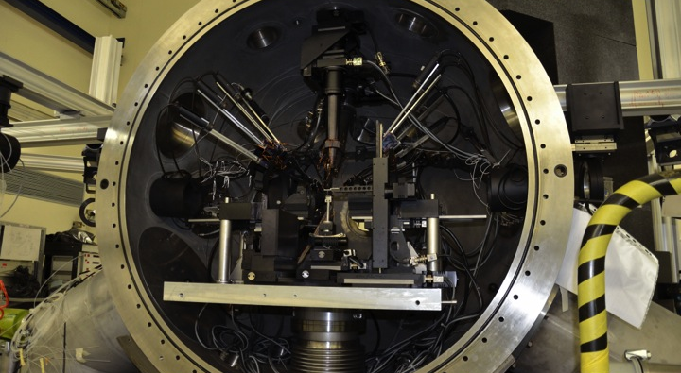
ABC: the interaction chamber

Slide 51
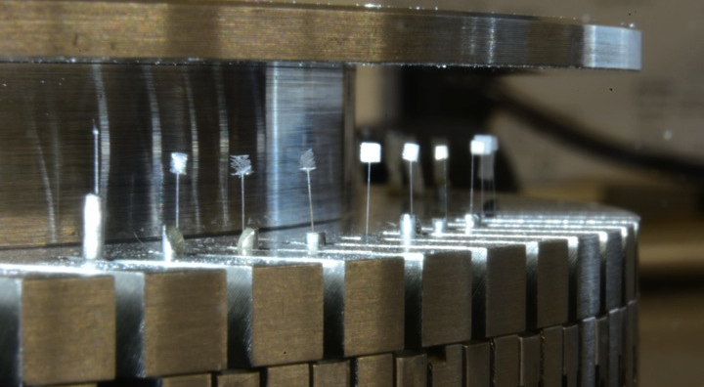
Targets for ICF stidies

Slide 52

CONCLUSIONS
At LNF the SPARC-LAB facility based on the synchronization of an ultra-intense and ultra-short pulse Ti:Sa laser system with a 150MeV LINAC is opening unique opportunities for:
New Acceleration Techniques
High brightness sources of electrons, protons, ions, neutrons, positrons, X & γ-rays, …
Applications in HEP, medicine, ICF, material science, astrophysics, femtochemistry, attosecond science, …

Slide 53
30-300-1000 MeV electrons

Slide 54
UNDULATOR EMISSION

Slide 55
WIGGLER
B↑ K↑ transverse oscillations ↑ λ_{L}↑
The emission in the harmonics ↑
Continuum spectrum: central wavelength λ_{C}↓

