Slide 1
LHC: PRESENT STATUS
AND FUTURE PROJECTS
Bologna, 3th February 2014
Departement of physics
E. Todesco
Magnet, Superconductors and Cryostats Group
Technology Department
CERN, Geneva, Switzerland
Thanks to F. Bordry, L. Bottura, R. Garoby, L. Rossi

Slide 2
CONTENTS
The present: LHC in the 10’s
  Luminosity equations
  Consolidation to 7 TeV
  Physics phenomena limitating LHC and injectors
  What was planned and what has been reached
The 20’s: HL-LHC
  How to improve luminosity
  Magnets
  Crab cavities
  Injectors
Plans for the 30’s
  Aiming at 30-100 TeV centre of mass

Slide 3
LHC IN the 10’s:
LUMINOSITY equation
Equation for the luminosity
Accelerator features
  Energy of the machine 7 TeV
  Length of the machine 27 km
Beam intensity features
  N_{b} Number of particles per bunch 1.15×10¹¹
  n_{b} Number of bunches ~2808
  Beam geometry features
  ε_{n} Size of the beam from injectors: 3.75 mm mrad
  β* Squeeze of the beam in IP (LHC optics): 55 cm
  F: geometry reduction factor: 0.84
Nominal luminosity: 10³⁴ cm⁻² s⁻¹
(considered very challenging in the 90’s,
pushed up to compete with SSC)

Slide 4
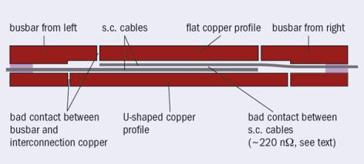


LHC IN the 10’s:
TOWARDS 7 TEV
Luminosity proportional to energy
  So running at 4 TeV instead of 7 TeV we lose nearly a factor two
Reason for lower energy: weakness in the interconnections
  This caused the 2008 incident – operation limited at 4 TeV in 1st run
  Shunt being added to cure the problem 2013-2014 [J. P. Tock, F. Bordry, et al., EUCAS conference, to be published on IEEE Trans. Appl. Supercond.]
Cross-section of the intreconnection and radiography showing missing continuity
[F. Bordry, J. P. Tock and LS1 team]

Slide 5
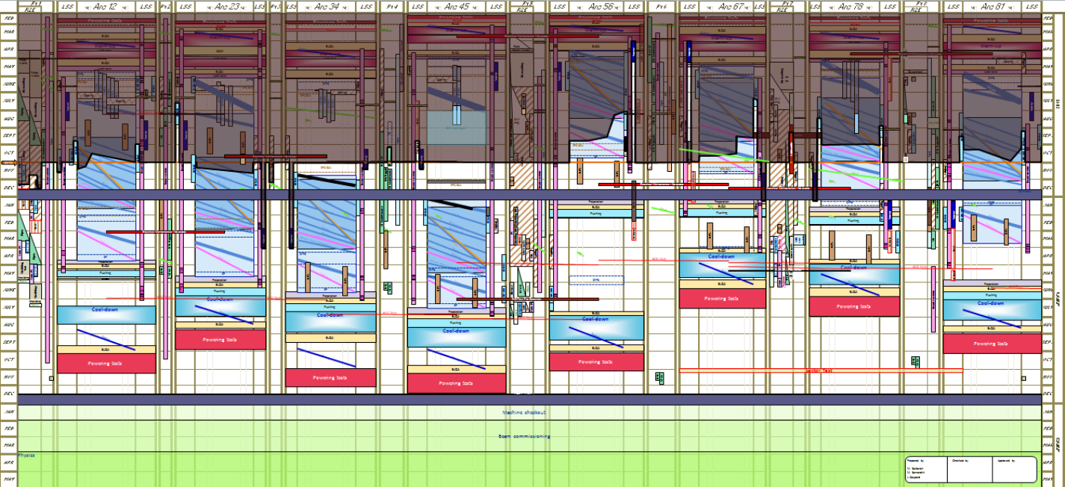
LHC IN the 10’s:
TOWARDS 7 TEV
Consolidation project is on schedule www.cern.ch/ls1dashboard
  Some delays have been recovered – others are not critical
  First powering in June (indications on operational energy in the 6 to 7 TeV range, most probably 6.5 TeV)
Plan of the works foreseen for Long Shutdown 1
[K. Foraz and LS1 team]

Slide 6
LHC IN the 10’s:
TOWARDS 7 TEV
What will be the final energy of the LHC?
  This is a feature of the training magnets (main dipoles)
  LHC dipoles are designed for 7 TeV (8.3 T, which is 86% of the 9.7 T maximum performance)
All dipoles rapidly reached this value individually
  But detraining observed in 2008 (only 1/8 of the dipoles tested)
  6.5 TeV looks reasonable, 7 TeV challenging
Training of sector 5-6 (154 dipoles) during 2008
[HC team]
Quenches per magnet to reach 6.5 and 7 TeV
during the LHC dipole production

Slide 7
LHC IN the 10’s:
LUMINOSITY equation
Equation for the luminosity
Now we will outline some of the luminosity limits
  Beam beam (limit on N_{b}/ε_{n})
  Electron cloud (limit on n_{b})
  Squeeze (limit on β* ε_{n})
  Injectors (limit on N_{b}, n_{b}, ε_{n})

Slide 8
LHC IN THE 10’S:
LUMINOSITY limits IN THE LHC
The beam-beam limit (Coulomb)
  N_{b} Number of particles per bunch ε_{n} transverse size of beam
  One cannot put too many particles in a “small space” (brightness)
    Otherwise the Coulomb interaction seen by a single particle when collides against the other bunch creates instabilities (tune-shift)
  This is an empirical limit, also related to nonlinearities in the lattice
    Very low nonlinearities → larger limits
    LHC behaves better than expected – boost to 50 ns

Slide 9

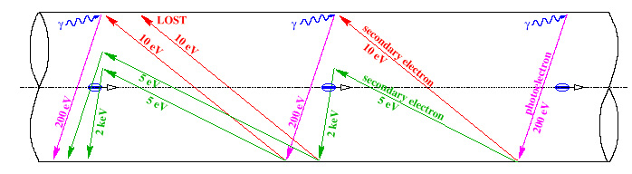
LHC IN THE 10’S:
LUMINOSITY limits IN THE LHC
The electron cloud
  This is related to the extraction of electrons in the vacuum chamber from the beam
  A critical parameter is the spacing of the bunches: smaller spacing larger electron cloud – threshold effect
    So this effect pushes for 50 ns w.r.t. 25 ns
  Spacing (length) ↔ spacing (time) ↔ number of bunches n_{b}
  7.5 m ↔ 25 ns ↔ 3560 free bunches (2808 used)
Mechanism of electron cloud formation [F. Ruggiero]

Slide 10
LHC IN THE 10’S:
LUMINOSITY limits IN THE LHC
The electron cloud
  Electron cloud has been observed close to what expected from models, in 2010 when n_{b}>500 (from 150 ns to 75 ns bunch spacing)
  Was cured by scrubbing of surface with intense beam as from baseline – operation at 50 ns stable without electron cloud with limited scrubbing (a few days in 2011)
(i) no visible tune shift limit, (ii) electron cloud as expected (iii) injector performance giving large N_{b} for 50 ns pushed operation to stay at 50 ns spacing in 2011-12
  The drawback: pile up ☹

Slide 11
LHC IN THE 10’S:
LUMINOSITY limits IN THE LHC
Optics: squeezing the beam
  Size of the beam in a magnetic lattice
  Luminosity is inverse prop to ε and β*
In the free path (no accelerator magnets) around the experiment, the β* has a
nasty dependence
with s distance to IP
The limit to the squeeze is the magnet aperture
  Key word for magnets in HL LHC: not stronger but larger

Slide 12
LHC IN THE 10’S:
LUMINOSITY limits IN THE LHC
Optics: squeezing the beam
  Size of the beam in a magnetic lattice
LHC was designed to reach β* = 50 cm with 70 mm aperture IR quads
  This aperture had no margin - when beam screen was added, one had to lower the target β* = 55 cm (and recover L=10³⁴ by slightly increasing bunch intensity from 10¹¹ to 1.15 × 10¹¹)
Today, less energy → larger beam → higher β*
  But lower emittance
  So at the end we are already at 60 cm

Slide 13
LHC IN THE 10’S:
LUMINOSITY limits IN THE INJEctORS
The injector chain limits
  Emittance ε_{n} vs intensity N_{b}
  This relation also depends on the bunch spacing n_{b}
  Surprise: very low emittance with high intensities at 50 ns
Pushing up these limits is the aim of the injector upgrade
nominal
2012
PSB space charge limit with Linac2
PSB space charge limit with Linac2
Limits imposed by the injectors to the LHC beam [R. Garoby, IPAC 2012]

Slide 14
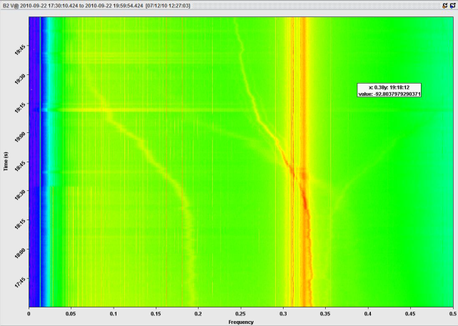

UNKNOWNS & SURPRISES
The hump (2011)
  A spurious frequency in the beam
  endangering stability
  Disappeared later
UFO (Unidentified Falling Objects)
  Particles in the beam vacuum creating showers of secondaries
  and stopping operation
  Not a problem at 4 TeV
  Will they be a problem at 7 TeV?
Octupoles and instabilities
  Stability of beam at collision
  Do we have enough force at 7 TeV?
The hump crossing LHC main betatron frequency
[G. Arduini et al, Evian workshop 2010]
M. Feldman in the famous scene of Frankenstein Junior
(what hump ?) [M. Brooks, 1974]

Slide 15
CONTENTS
The present
The 20’s: HL-LHC
  Reasons and targets
  Magnets
  Injectors and crab cavities (see appendix)
Plans for the 30’s
  Aiming at 30-100 TeV centre of mass

Slide 16
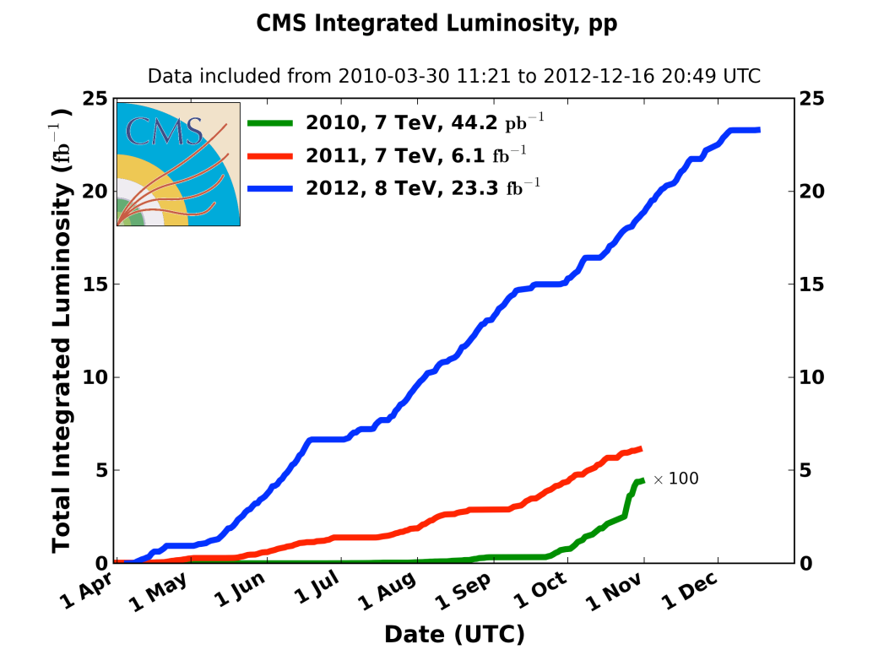
HL-LHC
THREE REASONS FOR THE UPGRADE
  2011: 6 fb⁻¹
  2012: 23 fb⁻¹
    peak lumi of 7×10³³ cm⁻² s⁻¹
  Ultimate: 60 fb⁻¹ per year?
    peak lumi of 2.4×10³⁴ cm⁻² s⁻¹
Assuming 40 fb⁻¹ after LS1 and 60 fb⁻¹ per year after LS2, we got to 30+40*3+60*3= 330 fb⁻¹ for the LHC
  Magnets (triplet, correctors, around ATLAS and CMS are designed to resist to 300-500 fb⁻¹) [L. Bottura, RLIUP meeting, https://indico.cern.ch/conferenceTimeTable.py?confId=260492#20131029]
  Experiments as well have components to be replaced for radiation damage
  Moreover as statistics is ∝ √N, little interest to run for many years with constant luminosity

Slide 17
HL-LHC tHE PATH TOWARDS 3000 FB⁻¹
CERN Project, EU funds for the design study, DR in 2014 www.cern.ch/hilumi [L. Rossi]
  The target:after reaching 300 fb⁻¹ in the 10’s, we need 3000 fb⁻¹ in the 20’s
We need to gain a factor four-five (250-300 fb⁻¹ per year, from the beginning of HL-LHC)
  Peak lumi 10³⁵ cm⁻² s⁻¹ is not acceptable for the experiments (pile up)
A levelling is proposed at 5×10³⁴ cm⁻² s⁻¹
  To have this the LHC must be able to reach a peak lumi 2×10³⁵cm⁻² s⁻¹
20 larger than nominal:
  Factor 5 from the beam
  Factor 4 from optics (reducing β*)

Slide 18
HL-LHC luminosity levelling
The luminosity levelling aims at compensating the faster decay in luminosity induced by higher peak lumi
  That’s why we need
  a factor 20 but we use
  only a factor 5
  How to do leveling
    With crossing angle ?
    With separation ?
    With β* ?
Main result: similar integrated lumi but lower pile up
  That’s the desiderata of experiments
Luminosity levelling principle (with a factor 10 shown)

Slide 19
HL-LHC:
LOWER BETA*
How to get a factor four from the optics ?
To reduce β* to 15 cm (factor four from 55 cm nominal) one needs larger aperture quadrupoles
  β in the quads is ∝ 1/β∗
  Scaling with square root: a factor two in aperture,
  i.e. 150 mm aperture quadrupoles
    First upgrades aimed β*=25 cm [F. Ruggiero, et al, LHC PR 626 (2002)]
  Other optics constraints: chromaticity
    Cured by ATS (Achromatic Telescopic Squeeze) optics – first successful tries in MD [S. Fartoukh, sLHC PR 53 (2011)]

Slide 20
HL-LHC: MAGNET TECHNOLOGY
FOR LOWER BETA*
Superconductivity takes place in some materials below thresholds values for magnetic field, current density and temperature
  Thresholds called critical surface
  Phenomena known since 100 years, applications since more than 50 years
    Related to quantum mechanics
  In a SC electromagnet, the coil must
  tolerate field and current density
  to produce that field
  This sets a limit of ~8 T for Nb-Ti
    LHC is built on this limit
  Nb₃Sn has a wider critical surface,
  with possibility of increasing to 12-15 T

Slide 21
HL-LHC: MAGNET TECHNOLOGY
FOR LOWER BETA*
In a superconducting quadrupole gradient*aperture is limited by maximum operational field (field on the coil)
    Present Nb-Ti triplet: 70/2 (mm) * 200 (T/m) +10% ~ 8 T
    With Nb₃Sn one can get 50% more: 140/2 (mm) * 150 T/m + 10% ~ 12 T
  Larger aperture can be obtained with lower gradients but
    Nb₃Sn gives ~50% more gradient for the same aperture, ~25% more luminosity
HL-LHC
Aperture versus gradient relation [L. Rossi, E. Todesco, Phys. Rev. STAB 9 (2006) 102401]

Slide 22
HL-LHC:
LARGER APERTURES FOR LOWER BETA*
First baseline around CMS and ATLAS for the upgrade
LHC today
HL-LHC

Slide 23
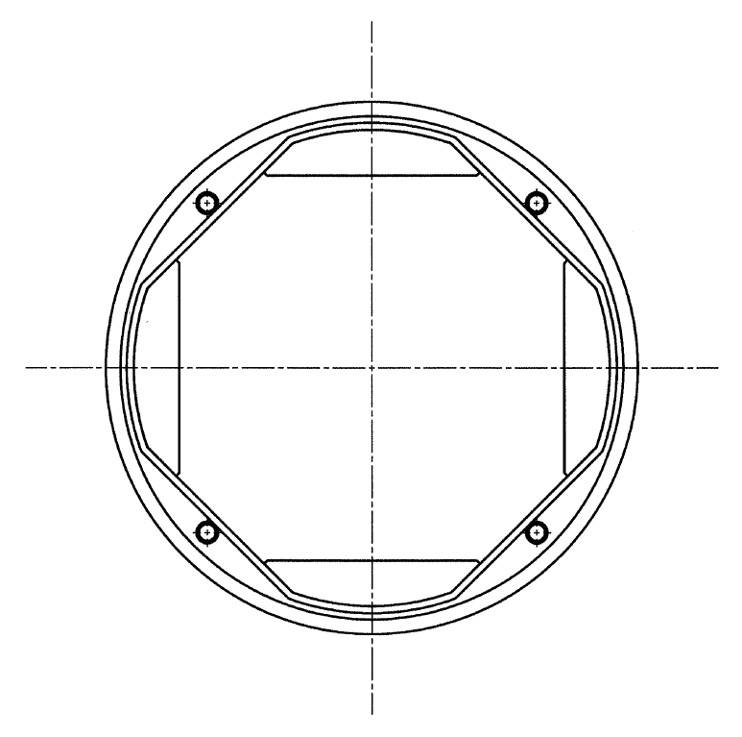
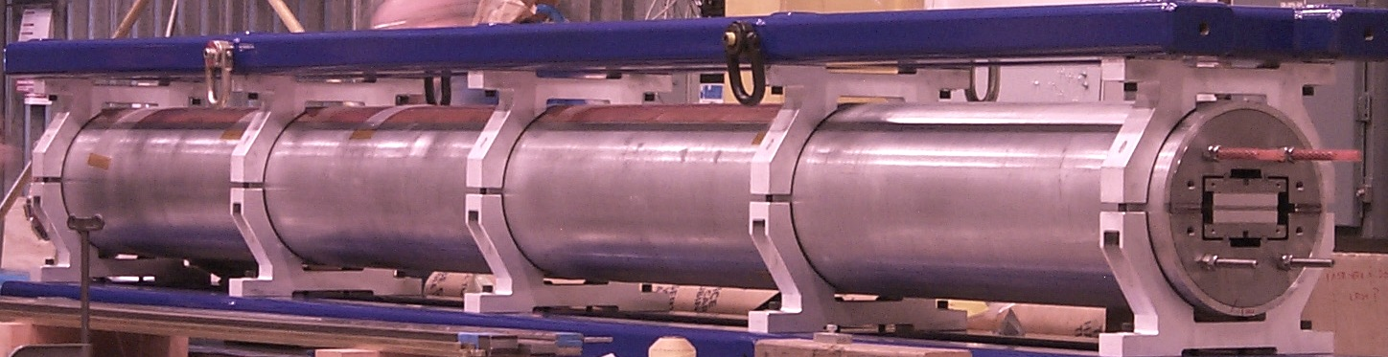
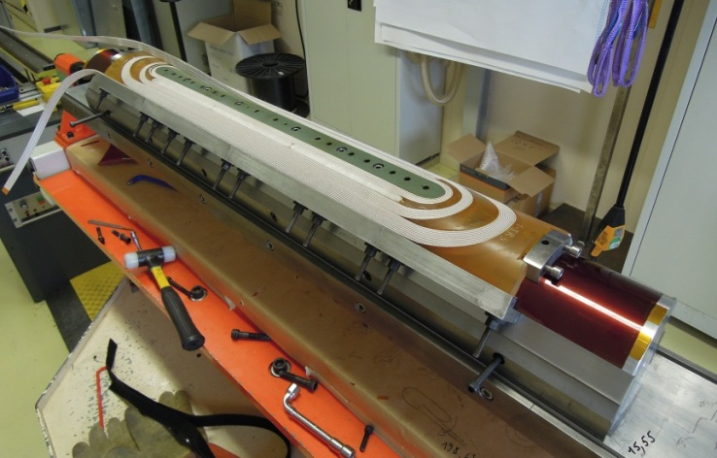
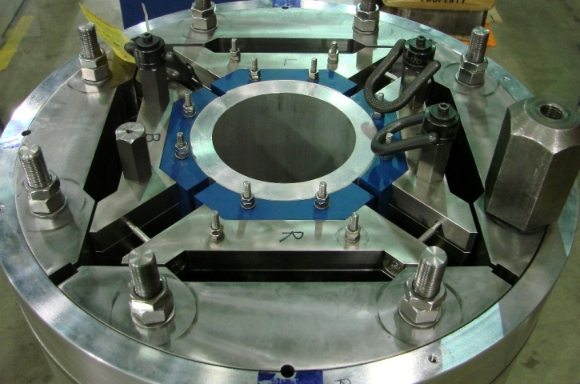
HL-LHC: larger apertures FOR LOWER BETA*
Some hardware (1-m long models) already built
  90 mm, 120 mm aperture Nb₃Sn quads (US LARP collaboration)
  150 mm aperture Nb₃Sn quadrupole being built (CERN and LARP)
Design relies on ~1 cm thick tungsten shielding
  So that radiation in HL-LHC will be as in LHC
LR (first long Nb₃Sn racetrack, LARP) [G. Ambrosio, et al.]
QXF dummy winding at CERN
[P. Ferracin, et al.]
HQ (Nb₃Sn LARP 120 mm magnet) [G. Sabbi, S. Caspi, et al.]

Slide 24
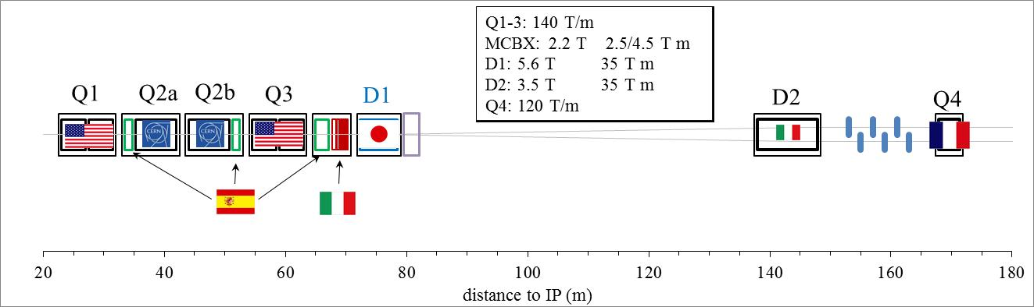
HL-LHC
As LHC, HL-LHC is an international collaboration
  Many magnets assigned to labs for design and model, but not all of them (some correctors and MS quads missing, TBD within 2014)
First baseline from Q1 to Q4, and tentative contributions

Slide 25
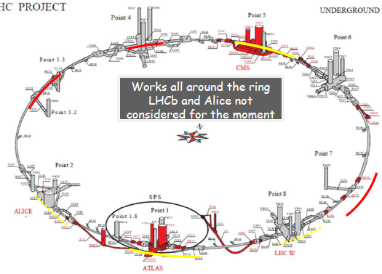
HL-LHC: not only magnets and crabs
HL LHC is not only new magnets in ~1 km of the the main ring, but also
  Cryogenics upgrade
  Collimation upgrade
  “Cold” powering
  Crab cavities
  Injectors

Slide 26
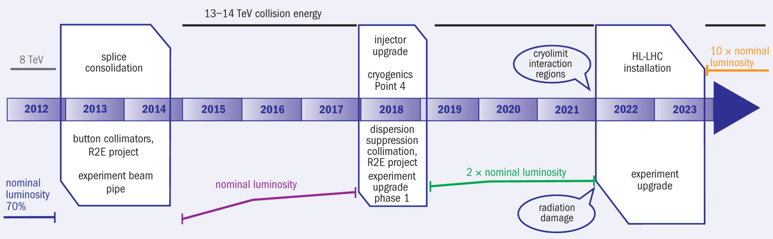
A TENTATIVE SCHEDULE
FOR NEXT 10 (20) YEARS
  Please note: we are a research lab, we must have a plan but we can change it
A plan for the LHC in the next 10 years [L. Rossi, IPAC 2011]

Slide 27
CONTENTS
The present: LHC in the 10’s
  Luminosity equations
  Limitations: LHC/injectors
  What was planned and what has been reached
The roaring 20’s: HL-LHC
  How to improve luminosity
  Magnets
  Crab cavities
  Injectors
Plans for the 30’s
  Aiming at 30-100 TeV centre of mass

Slide 28
THE HIGH ENERGY FRONTIER
First ideas
  Installing a 16.5+16.5 TeV proton
  accelerator in the LEP tunnel
  Main ingredient: 20 T operational field dipoles
    Proposal in 2005 for an LHC tripler, with 24 T magnets [P. McIntyre, A. Sattarov, “On the feasibility of a tripler upgrade for the LHC”, PAC (2005) 634].
CERN study: Working Group in 2010 www.cern.ch/he-lhc
  R. Assmann, R. Bailey, O. Bruning, O. Dominguez Sanchez, G. De Rijk, M. Jimenez, S. Myers, L. Rossi, L. Tavian, E. Todesco, F. Zimmermann, « First thoughts on a Higher Energy LHC » CERN ATS-2010-177
  E. Todesco, F. Zimmermann, Eds. « The High Energy LHC » CERN 2011-003 (Malta conference proceedings)
Motivations [J. Wells, CERN 2011-3]
  The energy frontier is always extremely interesting and for many processes cannot be traded with more luminosity at lower energy
“The results of the LHC will change everything, one way or another. There will be a new “theory of the day” at each major discovery, and the arguments will sharpen in some ways and become more divergent in other ways. Yet, the need to explore the high energy frontier will remain.”

Slide 29
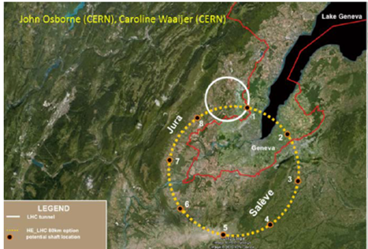
THE HIGH ENERGY FRONTIER
More ideas
  Having a new tunnel of 80-100 km with 16-20 T magnets to reach 50+50 TeV with proton collisions
Study group Future Circular Collider (FCC) established in late 2013 [M. Benedikt, F. Zimmermann]
A new tunnel in the CERN area [F. Bordry, HILUMI kick-off,
https://indico.cern.ch/conferenceDisplay.py?confId=257368 ]

Slide 30
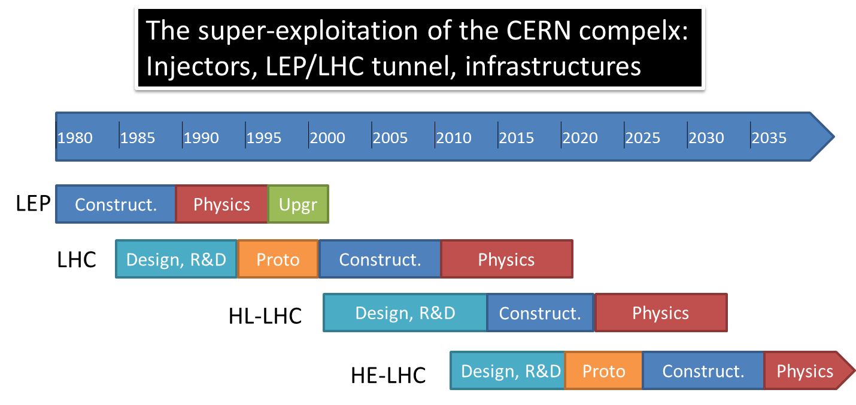
A TENTATIVE SCHEDULE FOR NEXT 30 YEARS
Using the LEP/LHC tunnel [L. Rossi, IPAC 2011]

Slide 31
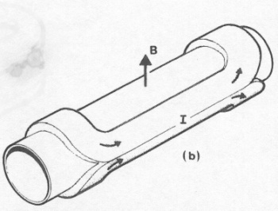
THE HIGH ENERGY FRONTIER: MAGNETS
One of the main challenge are the magnets
  First choice: current density – keep the same as the LHC
  B [T] ~ 0.0007 × coil width [mm] × current density [A/mm²]
  LHC: 8 [T]~ 0.0007 × 30 × 380
  Accelerators used current density of the order of 350−400 A/mm²
  This provides ~2.5 T for 10 mm thickness
    80 mm needed for reaching 20 T
    60 mm needed for reaching 16 T
    Coil size is still manageable
Operational field versus coil width in accelerator magnets

Slide 32
THE HIGH ENERGY FRONTIER: MAGNETS
What material can tolerate 400 A/mm² and at what field ?
  For Nb-Ti: LHC performances - up to 8 T
  For Nb₃Sn: 1500 A/mm² at 15 T, 4.2 K – up to 12 T
    With lower current density 190 A/mm²/m we can get to 15 T
  If we want to reach 20 T, last 5 T made by HTS - we ask for having ~380 A/mm²
    Today in Bi-2212 we have not so far from there
Engineering current density versus field for Nb-Ti and Nb₃Sn (lines) and operational current (markers)

Slide 33
THE LHC TUNNEL IN THE 30’s:
WHAT IS CLOSE AND WHAT IS FAR
HTS opens the way to higher and higher fields
  Used to build solenoids, proved to work in the 20-30 T range
Current density versus field for several superconductors [from P. J. Lee NHMFL database]

Slide 34
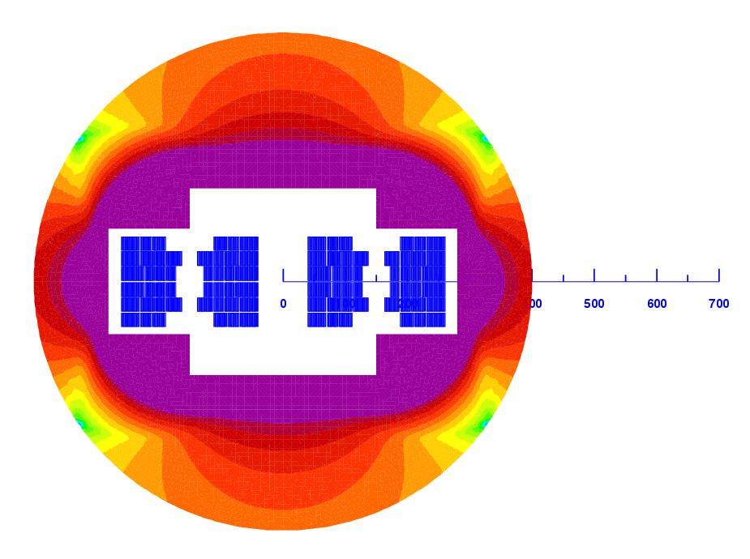
THE LHC TUNNEL IN THE 30’s:
DIPOLE PARAMETERS
Design is driven by the cost – grade as much as possible
  Initial study made for 20 T, cases 15-16 T under study
  One critical parameter: how much margin?
    Using 80% rule, we should design for 25 T – 5 T margin – is it too much?
    LHC at 6.5 TeV (80% rule ) would have 2 T margin
  Coil grading (one quarter of coil shown) and sketch of double aperture (coils in blue)
  [E. Todesco, L. Bottura, G. de Rijk, L. Rossi, IEEE Trans Appl Supercond (2014) in press]

Slide 35
CONCLUSIONS
The Fathers of the LHC designed a wise machine with the potential of reaching ultimate performance
  At full performance one can expect 60 fb⁻¹ per year (four times 2012), and 300 fb⁻¹ at the horizon of the 20’s
    These 300 fb⁻¹ are the lower estimate for the life of the inner triplet magnets
The aperture of the triplet is a bottleneck to performance
  So in any case better to replace with larger aperture. This will come in ~2022
Coupled with crab cavities, larger triplet can give a factor four boost to luminosity
  Together with the injector upgrade, one can get another factor five from beam intensity
HL LHC can provide 3000 fb⁻¹ at the horizon of the 30’s

Slide 36
CONCLUSIONS
HL-LHC can provide 3000 fb⁻¹ at the horizon of the 30’s
  Enabling technologies: large aperture magnets and crab cavities
  The could be the first application of Nb₃Sn to accelerators, pushing the operational field from 8 to 12 T
CERN infrastructure and (especially) LEP tunnel is a precious asset of our lab
  20 T magnets would enable a 33 TeV hadron collider
    No bottlenecks have been identified from the point of view of beam dynamics
A 80-100 km tunnel would allow reaching 50+50 TeV
  With 100 km ne would need 16 T magnet, which is not so far from our capabilities

Slide 37
BACK UP SLIDES

Slide 38
HL-LHC:
INTENSITY
How to get the factor five from the beam ?
  Increase current … and reduce emittance
  Preferred option is 25 ns
Please note: parameters for beam intensity are evolving, this is a possible option

Slide 39
HL-LHC:
INTENSITY
How to get the factor five from the beam ?
  25 ns option
Nominal
PSB space charge limit with Linac2
Emittance vs intensity at 25 ns [R. Garoby, IPAC 2012]

Slide 40
HL-LHC:
INJECTOR UPGRADE
Injector upgrade steps:
  Higher brighteness:
    Increase PSB energy from 1.4 to 2 GeV, replacing power supply and changing transfer equipment (space charge in PS)
    Increase injection energy in the PSB from 50 to 160 MeV, Linac4 (160 MeV H-) to replace Linac2 (50 MeV H+)
    Upgrade the PSB , PS and SPS to make them capable to accelerate and manipulate a higher brightness beam
  Reliability
Timeline: 2018 (LS2)
    Linac4 alone does not give additional performance
Injector upgrade project LIU [R. Garoby]
Upgrade of injector chain
[R. Garoby, IPAC 2012]

Slide 41
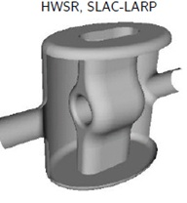
HL-LHC:
CRAB CAVITIES
When going to very low β*, (below 25 cm) the geometric factor considerably reduces the gain
  Crab cavity allows to set this factor to one by turning the bunches in the longitudinal space [R. Calaga, Chamonix 2012]
  Hardware being built, successful test in some electron machines [WP4, E. Jensen, collaboration with many institutes]
  First compact crab cavities with good performance have been built
θ_{c}
Crab crossing
One possible option for the design of crab cavity

Slide 42
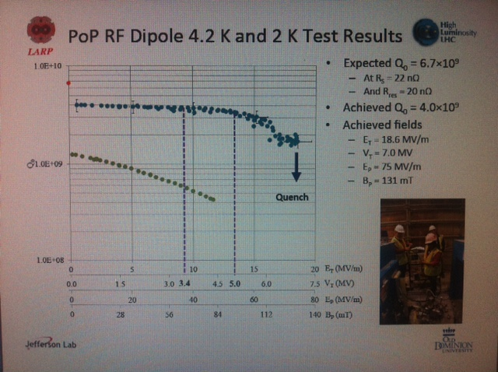
HL-LHC:
CRAB CAVITIES
Significant result on crab cavities !!!! [A. Ratti]
  MV/m reached, smaller quadlity factor but not critical (larger comsumption

