Slide 1



Λ_{c} analysis in pp collisions at $\sqrt{s}$ = 7 TeV with ALICE
Elisa Meninno
INFN and University of Salerno, Italy
IFAE-Incontri di Fisica delle Alte Energie
Laboratori Nazionali del Gran Sasso –Gran Sasso Science Institute
9-11 April 2014

Slide 2
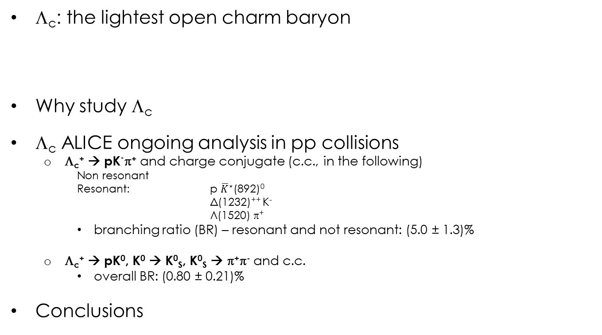
Outline
Λ_{c}: the lightest open charm baryon
Why study Λ_{c}
Λ_{c} ALICE ongoing analysis in pp collisions
  Λ_{c}⁺ → pK⁻π⁺ and charge conjugate (c.c., in the following)
    Non resonant
    Resonant: p ${\overline{K}}^{∗}$(892)⁰
  Δ(1232)⁺⁺ K⁻
  Λ(1520) π⁺
    branching ratio (BR) – resonant and not resonant: (5.0 ± 1.3)%
  Λ_{c}⁺ → pK⁰, K⁰ → K⁰_{S}, K⁰_{S} → π⁺π⁻ and c.c.
    overall BR: (0.80 ± 0.21)%
Conclusions
Quark content | m (MeV/c²) | τ (s) | cτ (μm)
udc | 2286.46±0.14 | (2.00±0.06)×10⁻¹³ | 59.9 (only!)

Slide 3
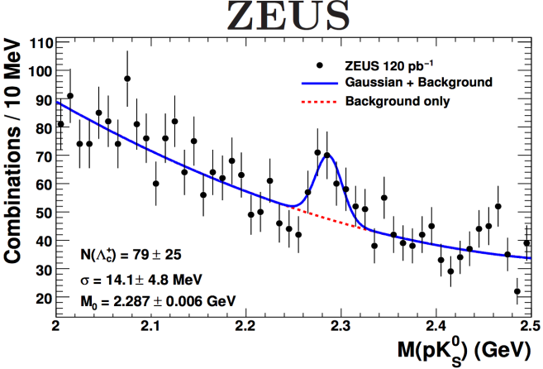
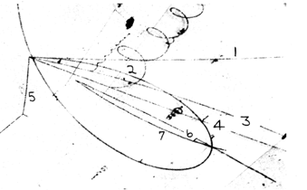
Why study Λ_{c} with ALICE
Measurements in the past:
ZEUS:measurement in e-p collisions
ISR: measurement
in p-p collisions @62GeV
BNL (1975): first observation
in bubble chamber
JHEP11 (2010) 009
N. P. Samios, Brookhaven National Laboratory Upton, New York (1973)
m_{inv}(pKπ) [GeV/c²]
G.Bari et al, IL NUOVO CIMENTO, vol.104 A, n. 4 (1991)
Measurements @ LHC energies:
in pp collisions:
test for perturbative Quantum ChromoDynamics (QCD) predictions (LHCb measurement at forward rapidity via Λ_{c}→pKπ reconstruction)
baseline for Pb-Pb measurements (see next slide)
CERN-PH-EP-2013-009
LHCb-PAPER-2012-041

Slide 4
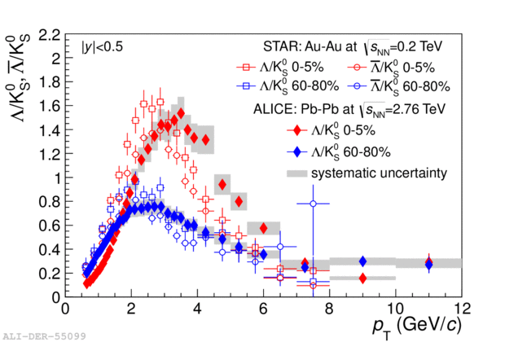
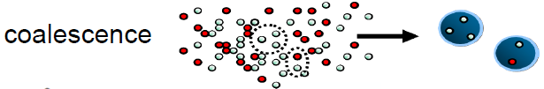
Why study Λ_{c} with ALICE
Measurements @ LHC energies:
in Pb-Pb collisions
  -Charm is a very sensitive probe of the high-density color deconfined state created in the collision, i.e. the Quark Gluon Plasma (QGP).
  -Λ_{c} in particular can give insight into the hadronization mechanism
Baryon/Meson in the strange sector suggests “coalescence”
What about the charm sector?
ALICE upgrade programme will allow the Baryon/Meson ratio measurement for charm sector.
Expected performance
Phys. Rev. Lett. 111, 222301 (2013)
Notes:
The observed enhancement for the baryon over meson ratio in the strange sector at RHIC and LHC suggests hadron production via «coalescence».

Slide 5
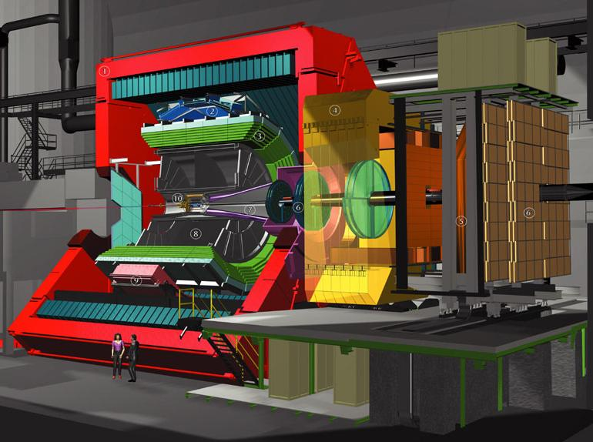
ALICE detectors essential for this analysis
Time-Of-Flight (TOF)
e, π, K and p identification
Inner Tracking System (ITS)
Vertexing (resolution~100μm in p-p)
Tracking
Time Projection Chamber (TPC)
Tracking
e, π, K and p identification (dE/dx)

Slide 6
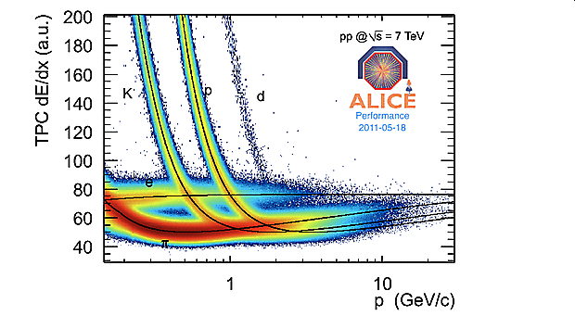
ALICE detectors essential for this analysis
K p π
π⁺ π⁻
p
K⁰_{S}
Λ_{c}⁺ → p K⁰_{S} and c.c.
Λ_{c}⁺ → p K⁻ π⁺ and c.c.

Slide 7
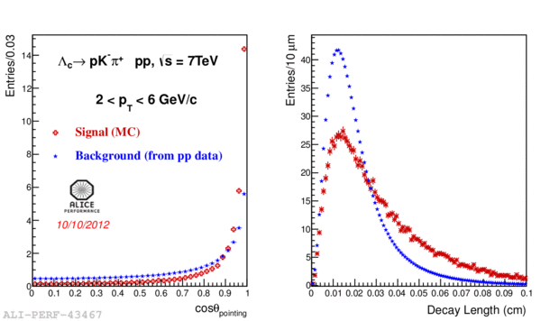
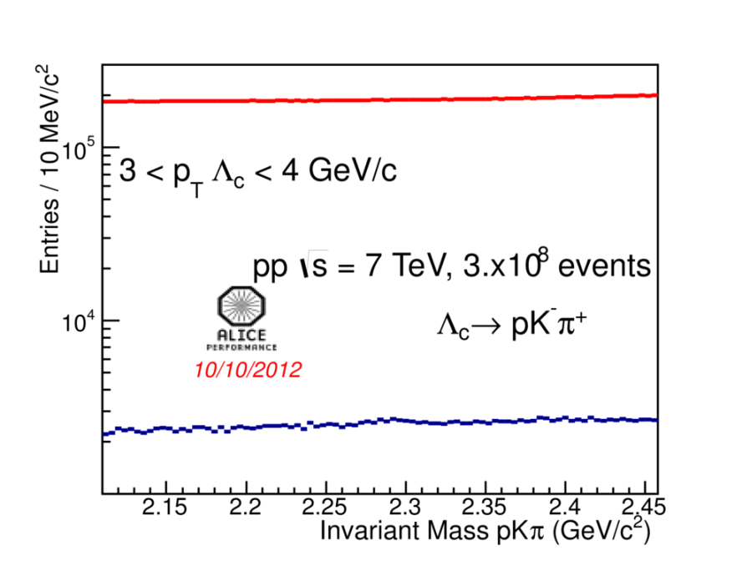
Λ_{c}⁺→pK⁻π⁺ analysis
Select triplets of reconstructed tracks according to topological selections
Not good signal-to-background separation
Loose topological cuts
Particle identification (to identify p, K, π) essential for this analysis
detectors: TOF and TPC;
approach: bayesian ;
criterion: maximum probability.
Background is suppressed by a factor 100 using PID (in blue)
Notes:
Select single tracks, pairs of track and triplets (Λ_{χ}⁺ χανδιδατεσ)

Slide 8
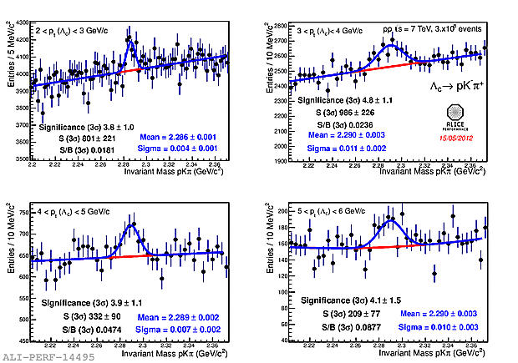
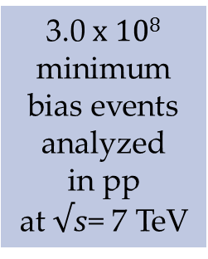
    Λ_{c}⁺→pK⁻π⁺: signal extraction
3.0 x 10⁸ minimum bias events analyzed
in pp
at $√s$= 7 TeV
Clear ${ Λ}_{c}^{+}$signal in 4 $p_{T}$ bins in [2,6[ GeV/c.
Notes:
The fit function used to reproduce the invariant mass distributions is the sum of a Gaussian for the ${ Λ}_{c}^{+}$peak and an exponential function for the background.

Slide 9
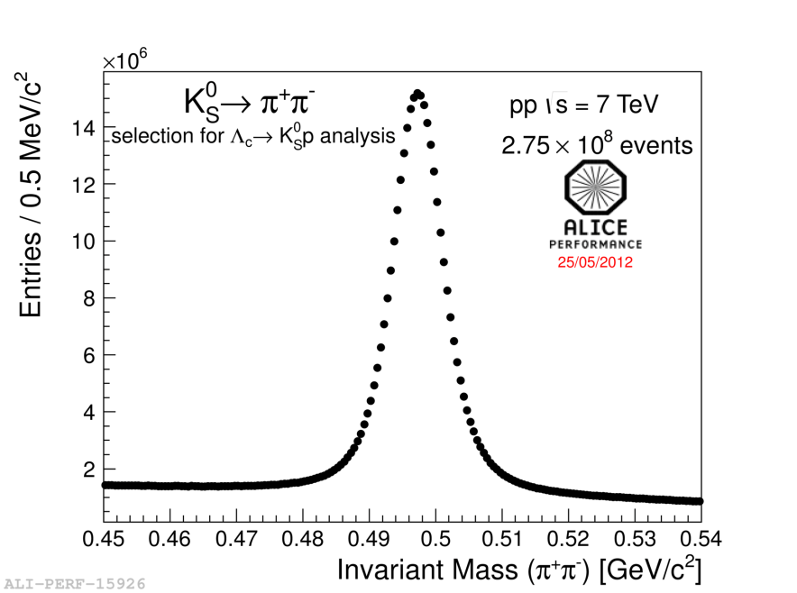
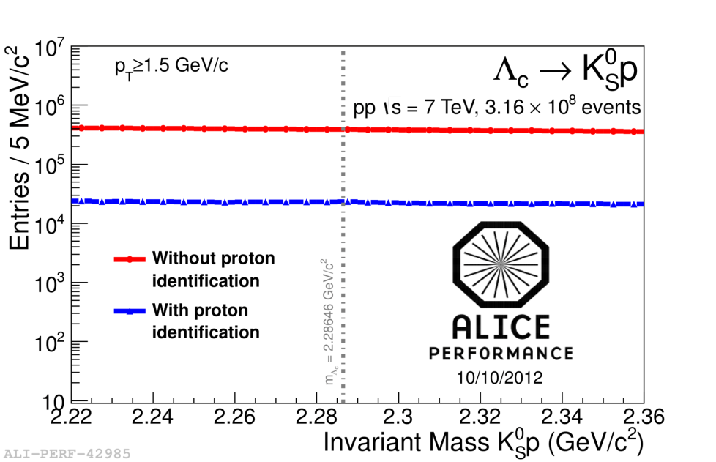
Λ_{c}⁺→pK⁰_{S} analysis
Select doublets of reconstructed tracks
according to topological cuts
(secondary vertex displacement for
strange decay)
Positive track
Negative track
Secondary V0 vertex
DCA
d0(positive track)
Clear K⁰_{S} signal in m_{inv}(π⁺,π⁻) plot
θ Pointing angle
Limited combinatorial background, despite the low B. R.
Primary vertex
d0(negative track)
Particle identification essential for this analysis too
detectors: TOF and TPC;
approach: number of sigma cut.
Background is suppressed by a factor 20 using PID (in blue)
Notes:
7.5MeV/c² ~2sigma, at least at low p_{T}(V0)

Slide 10
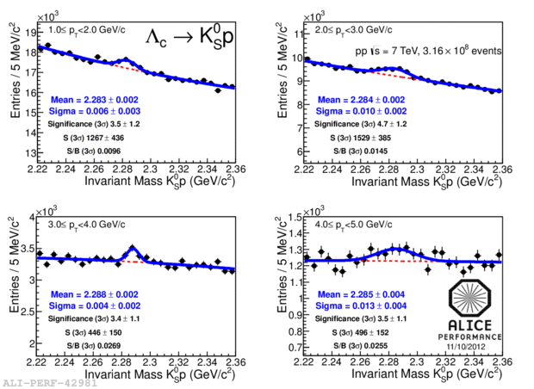


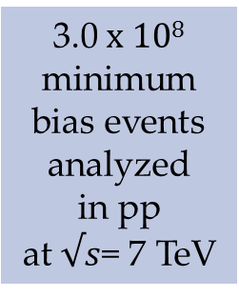
${ Λ}_{c}^{+}$→ K⁰_{S} p: signal extraction
3.0 x 10⁸ minimum bias events analyzed
in pp
at $√s$= 7 TeV
...and other p_{T} bins coming soon!
Clear ${ Λ}_{c}^{+}$signal in 4 $p_{T}$ bins in [1,5[ GeV/c
Significance > 3 in a larger p_{T} range ([1,12[ GeV/c
10

Slide 11
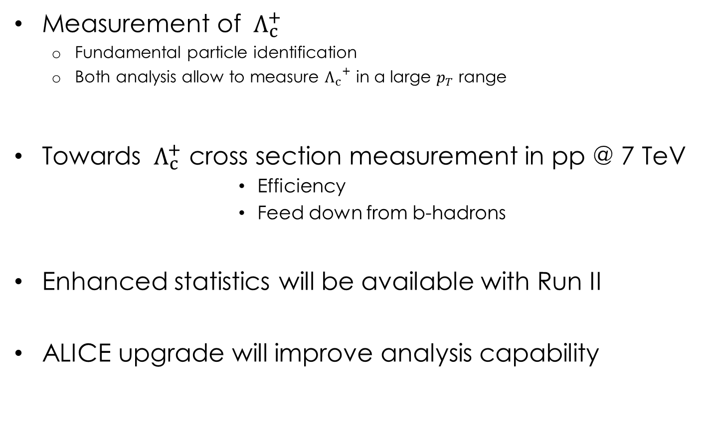
Conclusion and plan
Measurement of ${ Λ}_{c}^{+}$
  Fundamental particle identification
  Both analysis allow to measure ${Λ_{c}}^{+}$ in a large $p_{T}$ range
Towards ${ Λ}_{c}^{+}$ cross section measurement in pp @ 7 TeV
            Efficiency
            Feed down from b-hadrons
Enhanced statistics will be available with Run II
ALICE upgrade will improve analysis capability
ONGOING

Slide 12
Back up

Slide 13
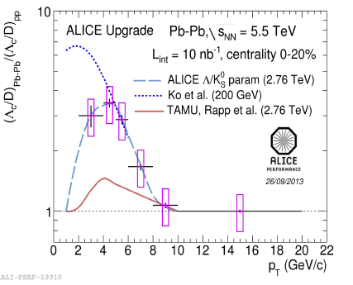
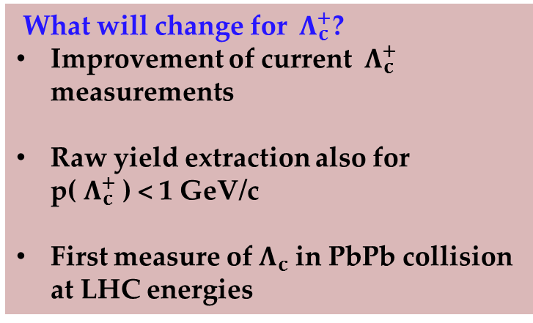
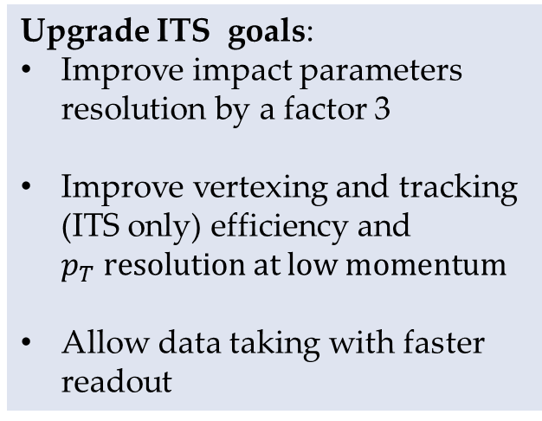
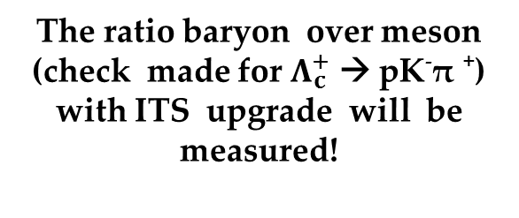
Looking to the future..
Upgrade ITS goals:
Improve impact parameters resolution by a factor 3
Improve vertexing and tracking (ITS only) efficiency and $p_{T} resolution at low momentum$
Allow data taking with faster readout
What will change for ${ Λ}_{c}^{+}$?
Improvement of current ${ Λ}_{c}^{+}$ measurements
Raw yield extraction also for p(${ Λ}_{c}^{+}$ ) < 1 GeV/c
First measure of $Λ_{c}$ in PbPb collision at LHC energies
The ratio baryon over meson (check made for $Λ_{c}^{+}$ → pK⁻π ⁺) with ITS upgrade will be measured!

Slide 14
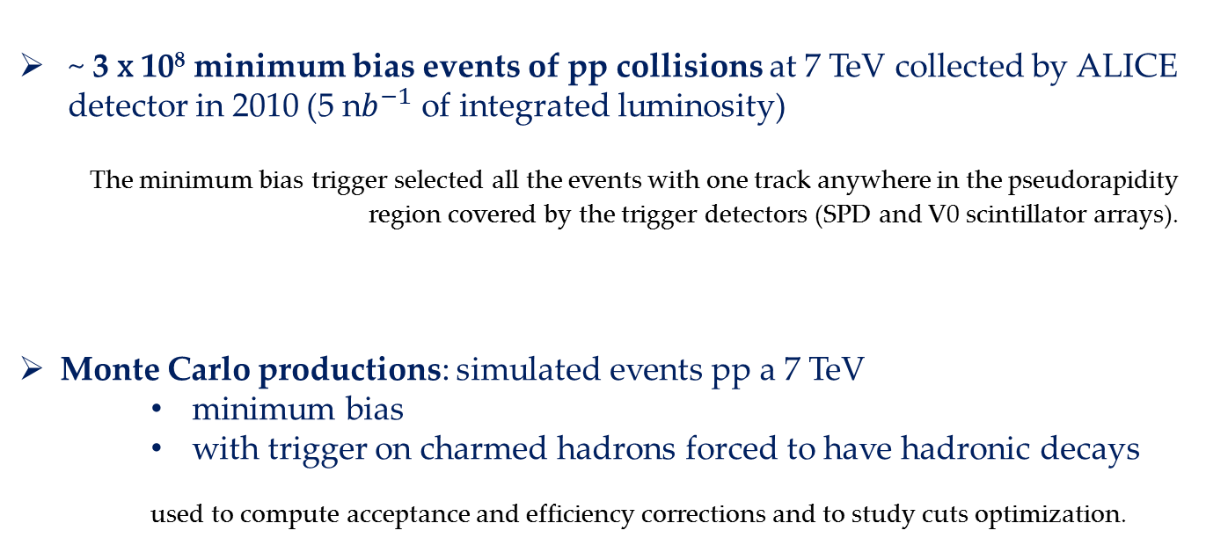
Data sample used for both analysis:
~ 3 x 10⁸ minimum bias events of pp collisions at 7 TeV collected by ALICE detector in 2010 (5 n$b^{−1}$ of integrated luminosity)
The minimum bias trigger selected all the events with one track anywhere in the pseudorapidity region covered by the trigger detectors (SPD and V0 scintillator arrays).
Monte Carlo productions: simulated events pp a 7 TeV
    minimum bias
    with trigger on charmed hadrons forced to have hadronic decays
    used to compute acceptance and efficiency corrections and to study cuts optimization.

Slide 15
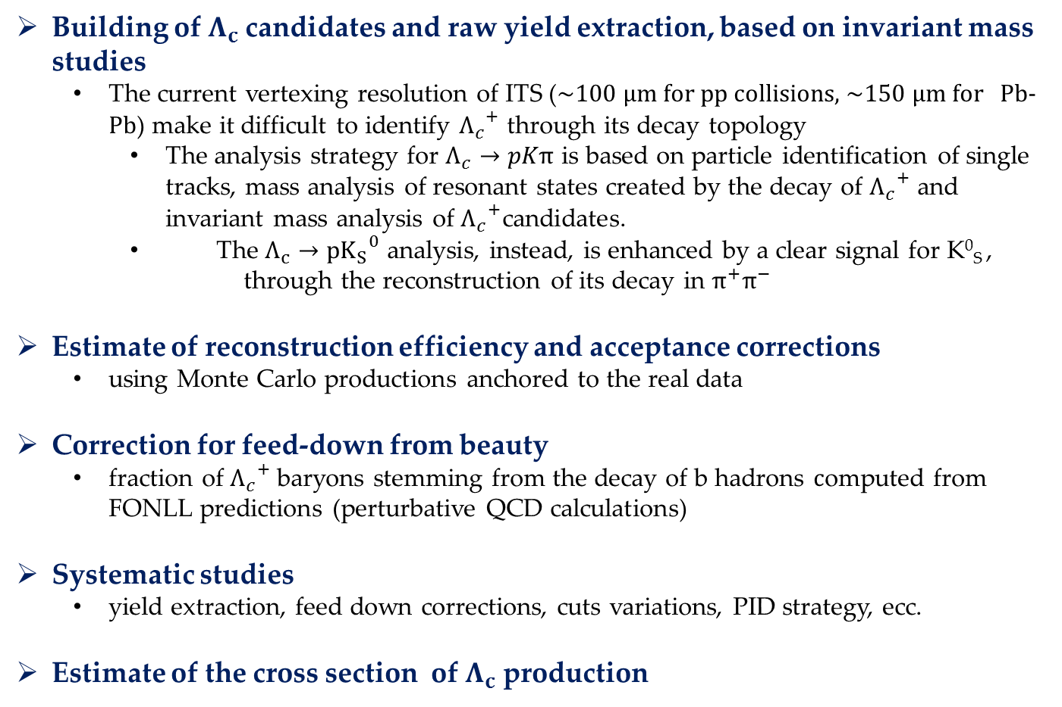
Analysis step by step
Building of $Λ_{c}$candidates and raw yield extraction, based on invariant mass studies
  The current vertexing resolution of ITS (~100 μm for pp collisions, ~150 μm for Pb-Pb) make it difficult to identify ${Λ_{c}}^{+}$ through its decay topology
    The analysis strategy for $Λ_{c}→pKπ$ is based on particle identification of single tracks, mass analysis of resonant states created by the decay of ${Λ_{c}}^{+}$ and invariant mass analysis of ${Λ_{c}}^{+}$candidates.
    The $Λ_{c}→p{K_{S}}^{0}$ analysis, instead, is enhanced by a clear signal for $\text{K}\text{0}\text{S}$, through the reconstruction of its decay in $π^{+}π^{−}$
Estimate of reconstruction efficiency and acceptance corrections
  using Monte Carlo productions anchored to the real data
Correction for feed-down from beauty
  fraction of ${Λ_{c}}^{+}$baryons stemming from the decay of b hadrons $c$omputed from FONLL predictions (perturbative QCD calculations)
Systematic studies
  yield extraction, feed down corrections, cuts variations, PID strategy, ecc.
Estimate of the cross section of $Λ_{c}$ production

Slide 16
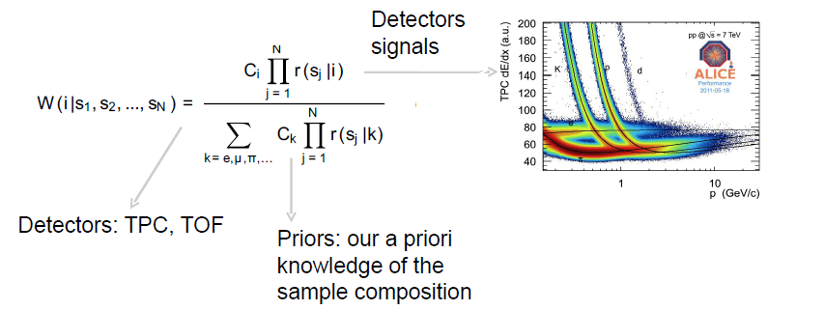
Λ_{c}⁺→pK⁻π⁺ : Bayesian PID
p, K, π are identified with the Bayesian PID approach
The probability for a track to be of the specie i is:
TPC and TOF separate well hadrons in complementary p range

Slide 17
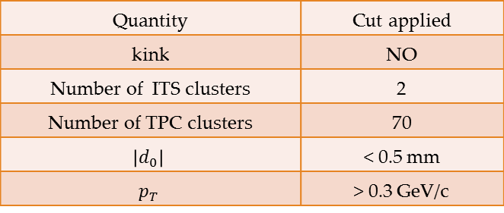
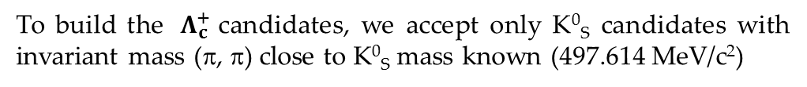
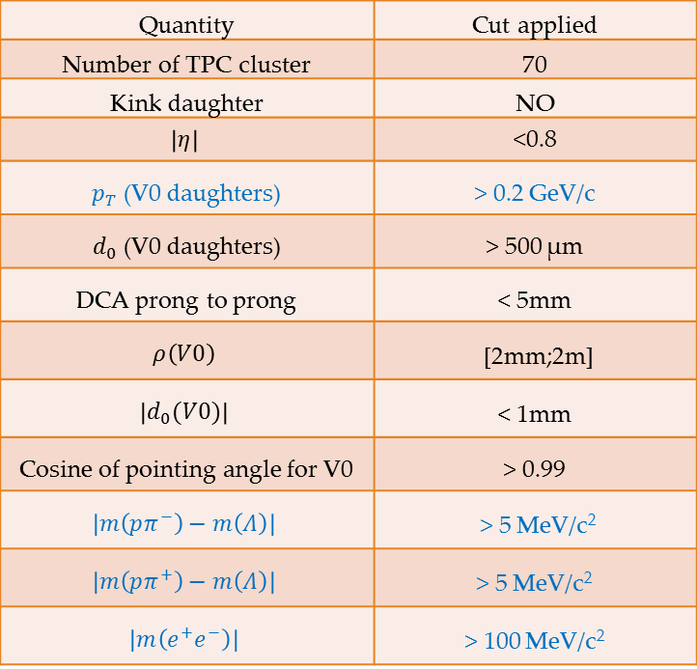
Reconstruction of ${ Λ}_{c}^{+}$→ K⁰_{S} p and c. c.
Building of K⁰_{S} candidates:
Positive track
Quantity | Cut applied
Number of TPC cluster | 70
Kink daughter | NO
$$\left|η\right|$$ | <0.8
$p_{T}$ (V0 daughters) | > 0.2 GeV/c
$d_{0}$ (V0 daughters) | > 500 μm
DCA prong to prong | < 5mm
$$ρ\left(V0\right)$$ | [2mm;2m]
$$\left|d_{0}(V0)\right|$$ | < 1mm
Cosine of pointing angle for V0 | > 0.99
$$\left|m\left(pπ^{−}\right)−m\left(Λ\right)\right|$$ | > 5 MeV/c²
$$\left|m\left(pπ^{+}\right)−m\left(Λ\right)\right|$$ | > 5 MeV/c²
$$\left|m\left(e^{+}e^{−}\right)\right|$$ | > 100 MeV/c²
Negative track
Secondary vertex for V0
DCA
d0(positive track)
θ Pointing angle
Primary vertex
d0(negative track)
Selection of bachelor candidates:
Quantity | Cut applied
kink | NO
Number of ITS clusters | 2
Number of TPC clusters | 70
$$\left|d_{0}\right|$$ | < 0.5 mm
$$p_{T}$$ | > 0.3 GeV/c
To build the ${ Λ}_{c}^{+}$candidates, we accept only K⁰_{S} candidates with invariant mass (π, π) close to K⁰_{S} mass known (497.614 MeV/c²)
Notes:
7.5MeV/c² ~2sigma, at least at low p_{T}(V0)

Slide 18
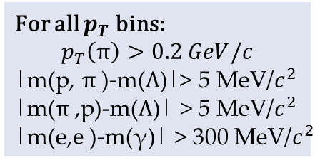
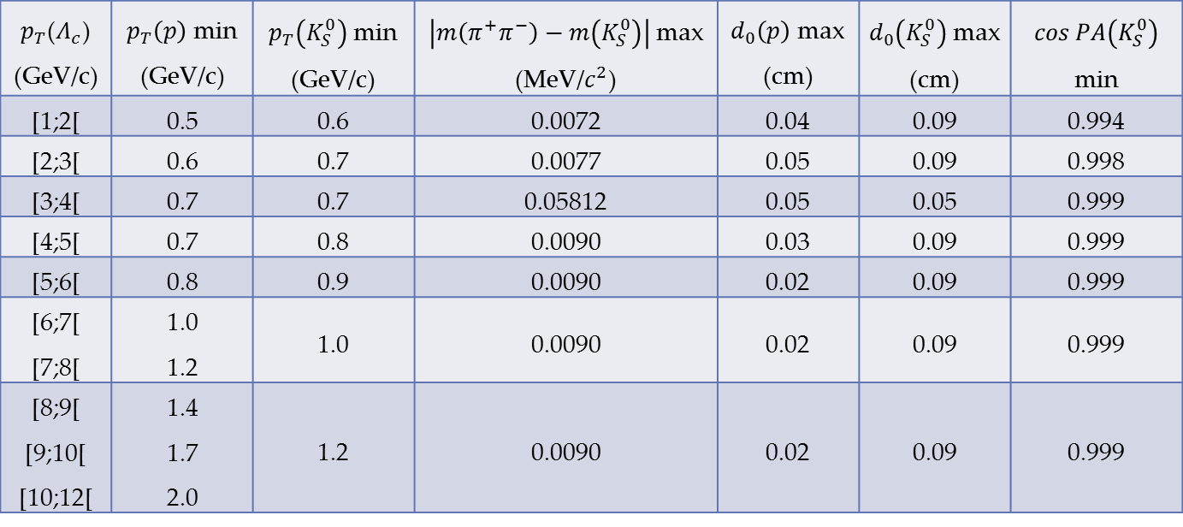
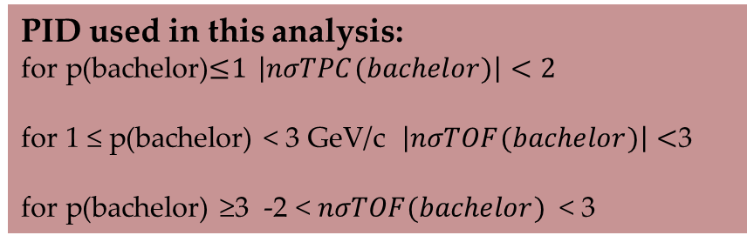
Optimized cuts for Λc→K⁰_{S}p
$p_{T}$($Λ_{c}$) (GeV/c) | $p_{T}\left(p\right)$min (GeV/c) | $p_{T}\left(K_{S}^{0}\right)$min (GeV/c) | $\left|m\left(π^{+}π^{−}\right)−m\left(K_{S}^{0}\right)\right|$max (MeV/$c^{2}$) | $d_{0}\left(p\right)$max (cm) | $d_{0}\left(K_{S}^{0}\right)$max (cm) | $$\cos{PA\left(K_{S}^{0}\right)}$$ min
[1;2[ | 0.5 | 0.6 | 0.0072 | 0.04 | 0.09 | 0.994
[2;3[ | 0.6 | 0.7 | 0.0077 | 0.05 | 0.09 | 0.998
[3;4[ | 0.7 | 0.7 | 0.05812 | 0.05 | 0.05 | 0.999
[4;5[ | 0.7 | 0.8 | 0.0090 | 0.03 | 0.09 | 0.999
[5;6[ | 0.8 | 0.9 | 0.0090 | 0.02 | 0.09 | 0.999
[6;7[ [7;8[ | 1.0 1.2 | 1.0 | 0.0090 | 0.02 | 0.09 | 0.999
[8;9[ [9;10[ [10;12[ | 1.4 1.7 2.0 | 1.2 | 0.0090 | 0.02 | 0.09 | 0.999
For all $p_{T}$ bins:
$$p_{T}\left(π\right)>0.2 GeV/c$$
|m(p, $π$)-m(Λ)|> 5 MeV/$c^{2}$
|m($π$,p)-m(Λ)| > 5 MeV/$c^{2}$
|m(e,$e$)-m(γ)| > 300 MeV/$c^{2}$
PID used in this analysis:
for p(bachelor)≤1 $\left|nσTPC(bachelor)\right|<2$
for 1 ≤ p(bachelor) < 3 GeV/c $\left|nσTOF(bachelor)\right|<$3
for p(bachelor) ≥3 -2 < $nσTOF(bachelor)$ < 3

Slide 19

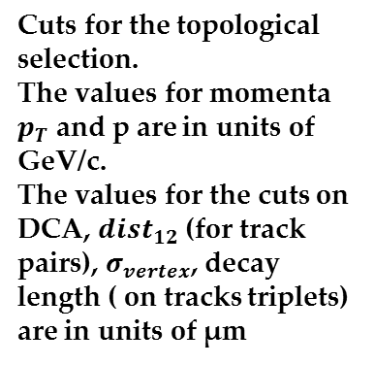
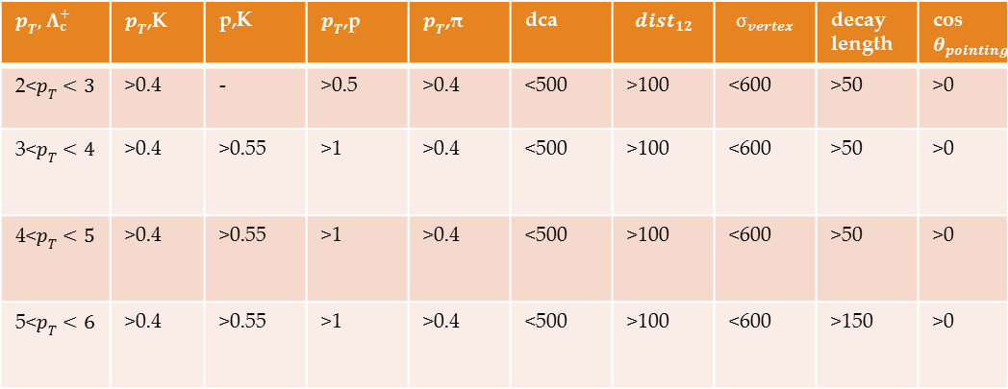
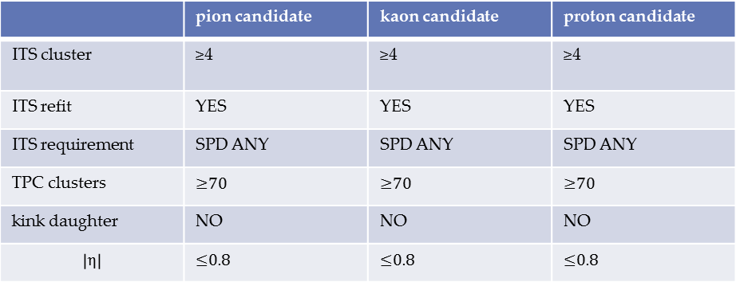
Set of cuts used for ${ Λ}_{c}^{+}→\text{pK}\text{−}π\text{+}$
 | pion candidate | kaon candidate | proton candidate
ITS cluster | ≥4 | ≥4 | ≥4
ITS refit | YES | YES | YES
ITS requirement | SPD ANY | SPD ANY | SPD ANY
TPC clusters | ≥70 | ≥70 | ≥70
kink daughter | NO | NO | NO
$$\left|η\right|$$ | ≤0.8 | ≤0.8 | ≤0.8
Selection cuts for single tracks
$p_{T},$ $Λ_{c}^{+}$ | $p_{T}$,K | p,K | $p_{T}$,p | $p_{T}$,π | dca | $${dist}_{12}$$ | $$σ_{vertex}$$ | decay length | cos$θ_{pointing}$
2<$p_{T}<3$ | >0.4 | - | >0.5 | >0.4 | <500 | >100 | <600 | >50 | >0
3<$p_{T}<4$ | >0.4 | >0.55 | >1 | >0.4 | <500 | >100 | <600 | >50 | >0
4<$p_{T}<5$ | >0.4 | >0.55 | >1 | >0.4 | <500 | >100 | <600 | >50 | >0
5<$p_{T}<6$ | >0.4 | >0.55 | >1 | >0.4 | <500 | >100 | <600 | >150 | >0
Cuts for the topological selection.
The values for momenta $p_{T}$ and p are in units of GeV/c.
The values for the cuts on DCA, ${dist}_{12}$ (for track pairs), $σ_{vertex}$, decay length ( on tracks triplets) are in units of μm

Slide 20
Heavy Quark:
powerful probes for the Quark Gluon Plasma
charm and beauty are produced during the early stages of heavy-ion-collisions (p-p, p-A, A-a), in processes of hard scattering between partons (quark and gluons)
As soon as produced in A-A collisions, charm and beauty propagate through the extremly hot and dense medium created and interact with its constituents.
So, they allow to follow the whole evolution of QCD medium.

Slide 21
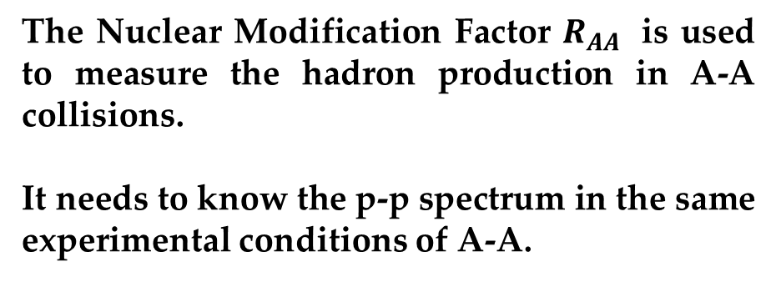
The measurement of heavy-flavour hadrons production in p-p collisions provides a better understanding of QCD processes and is a fundamental reference for Pb-Pb studies
The Nuclear Modification Factor $R_{AA}$ is used to measure the hadron production in A-A collisions.
It needs to know the p-p spectrum in the same experimental conditions of A-A.

