Slide 1
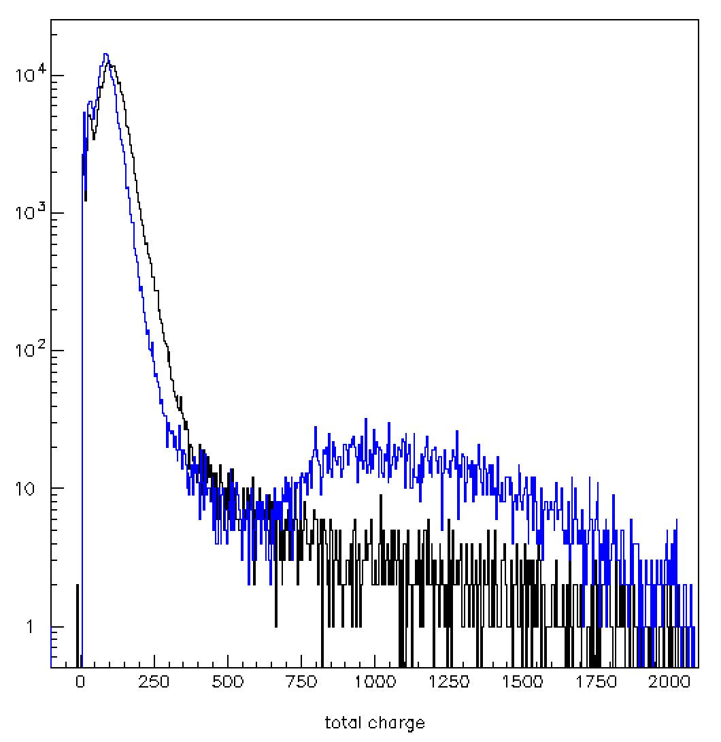
Trying to understand the differences between data and MC
Analysis-elog note n. 5 (A. Capone, P. Fermani)
All events
Total charge distribution (ADC channels) for the same OM in May and in July
Run 0499
Run 1090

Slide 2
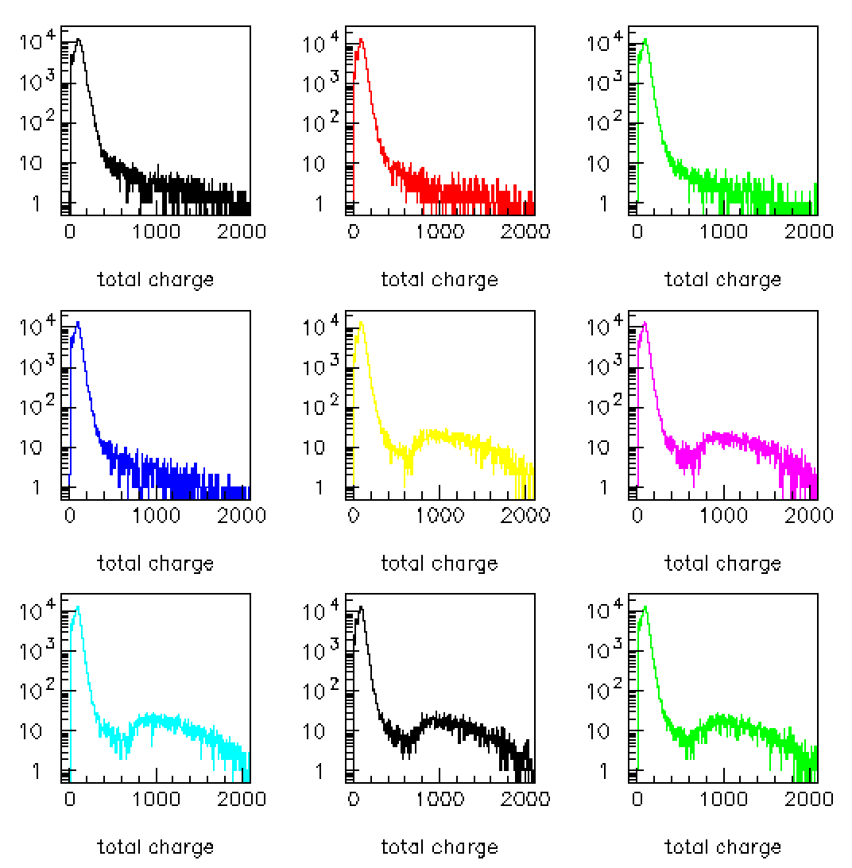
On 22 June there is a change !
Run 499
08/05/2013
Run 760
Run 840
Run 845
Run 847
22/06/2013
Run 1011
Run 1050
Run 1090
Run 1409
30/09/2013
Total charge distribution (ADC channels) for OM=1 from May to September

Slide 3
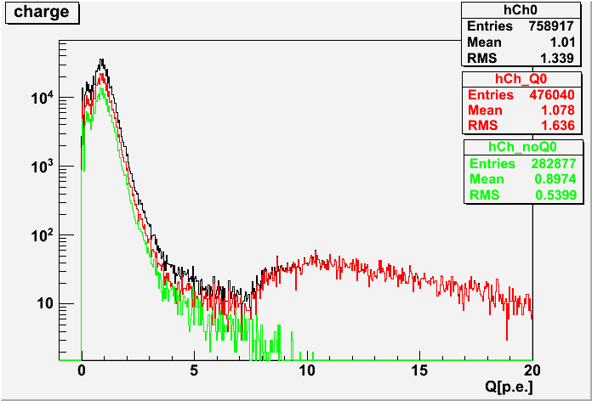
Since 22/06 Q trigger at L1 is set if has Q>500
Before run 846 the L1Q trigger condition was Q>1000

Slide 4
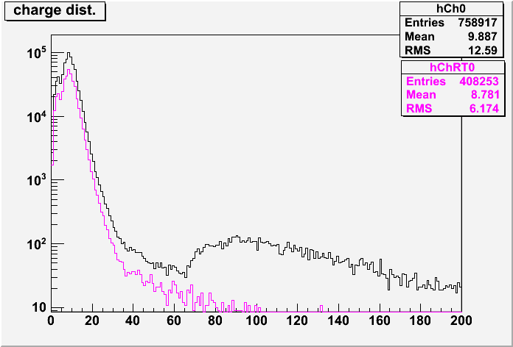
Total Charge distribution for events collected with Random trigger (magenta) and for all events (black)
G. De Bonis
Analyss-elog n. 6

Slide 5
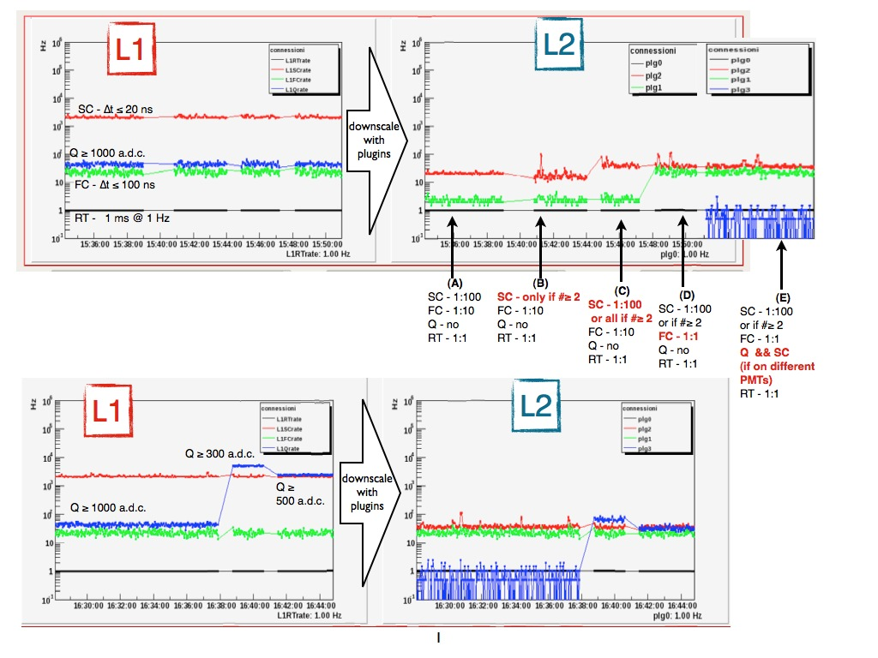
Info from the NEMO-elog
The Q>500 change has increased the L2Q trigger (plg2 SC+Q) that, after the change, has the same rate as the L2 SC+SC, so in the total charge distribution, for "all events" we find the two kind of events with the same rate.
T. Chiarusi
NEMO-elog 666

Slide 6
One effect of the H.V. change
Analysis-elog note n. 7 (G. De Bonis)
Since run 847, not only the trigger change but also the OM HV have been changed: in general decreased. Before this change sometime we saw very long events ("fragmented").
saturation
Very long events
Run 499
Run 1390
After the HV change no more "saturation" and no more "very long events"

