Slide 1

“GPU for trigger applications in HEP”
Pisa, 28.1.2014
Gianluca Lamanna (INFN)
On behalf of GAP collaboration

Slide 2
Outline
GPU: brief introduction
GAP: GPU Application Project – Real Time
  GPU in low level triggers
  GPU in HLT and Medical Imaging
Examples of GPU in High Energy Physics

Slide 3
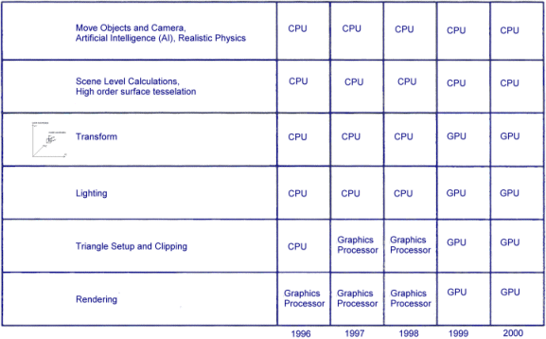

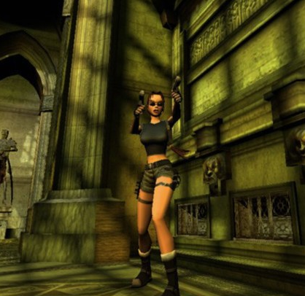
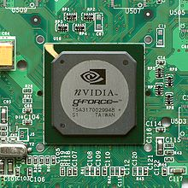
GPU
The technical definition of a GPU is "a single-chip processor with integrated transform, lighting, triangle setup/clipping, and rendering engines that is capable of processing a minimum of 10 million polygons per second.“
First GPU: 31 august 1999 by NVIDIA (GeForce 256)
Revolution in Computer Graphics and Video Games!
1999
2002

Slide 4
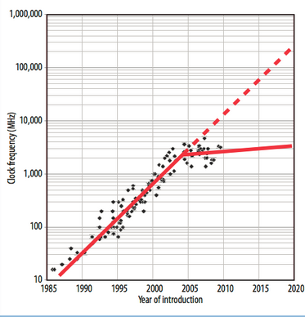
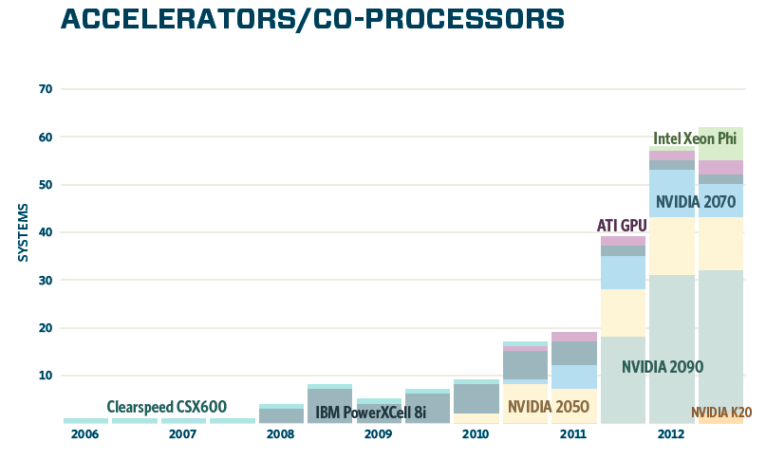
GPGPU
The possibility to use the GPU for generic computing (GPGPU) has been introduced by NVIDIA in 2007 (CUDA)
In 2008 OpenCL: consortium of different firms to introduce a multi-platform language for manycores computing.
At the same time the Moore’s law starts to show saturation: parallel computing is the solution!
Nowadays several supercomputers are based on GPU.

Slide 5
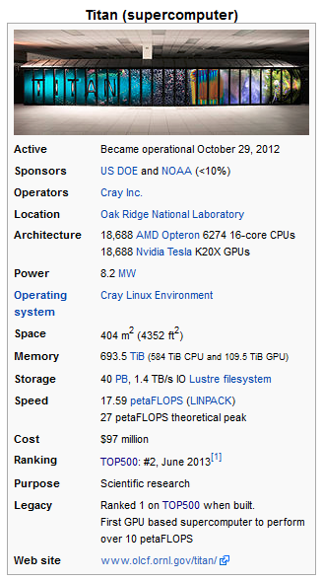
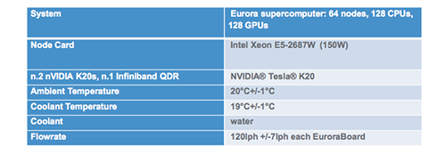
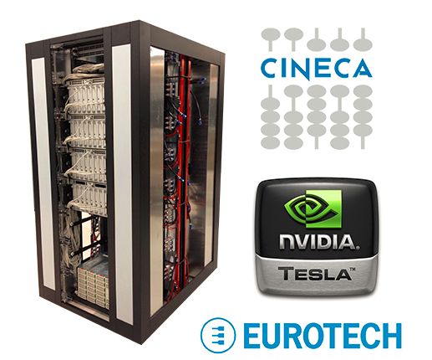
Supercomputers

Slide 6
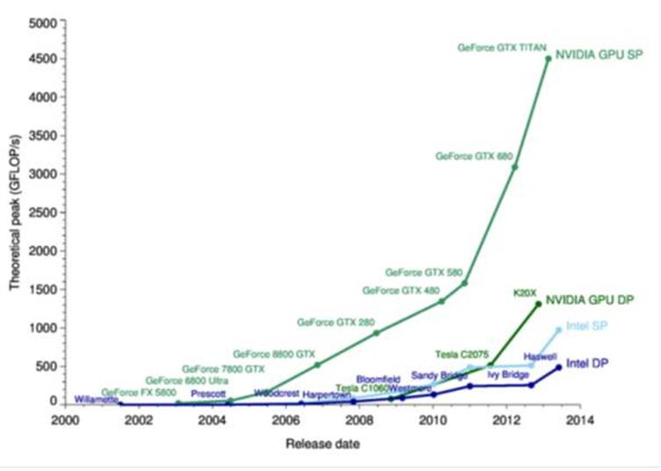
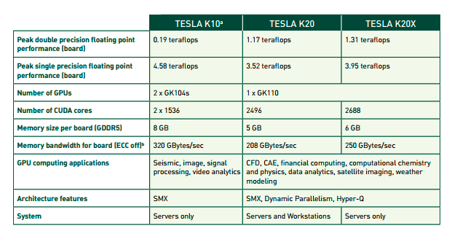
The GPUs are very powerful
The GPU is a way to cheat the Moore’s law
  The PC no longer get faster, just wider.
  Very high computing power for «vectorizable» problems
Impressive derivative
  almost a factor of 2 in each generation
  Continous development
Easy to have a desktop PC with teraflops of computing power, with thousand of cores.
APE1000
APE100

Slide 7
GPU vs CPU
A GPU is tailored for highly parallel operation while a CPU executes programs serially
For this reason, GPUs have many parallel execution units and higher transistor counts, while CPUs have few execution units and higher clock speeds
A GPU is for the most part deterministic in its operation
GPUs have much deeper pipelines (several thousand stages vs 10-20 for CPUs)
GPUs have significantly faster and more advanced memory interfaces as they need to shift around a lot more data than CPUs

Slide 8
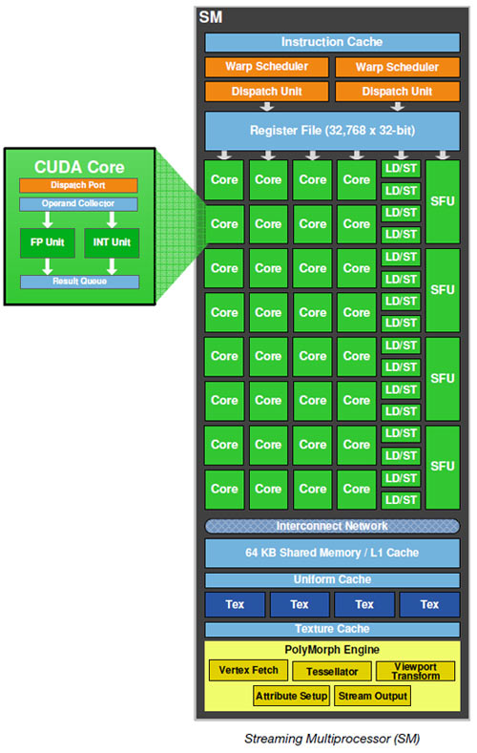
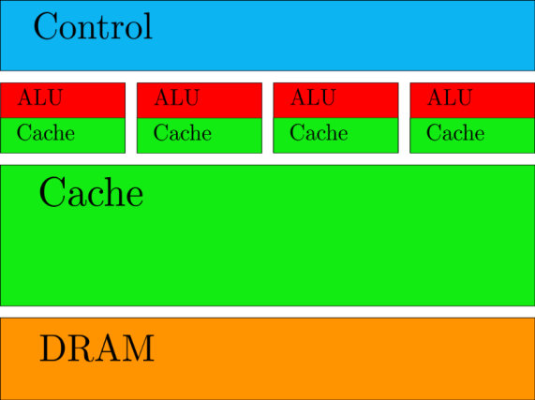
Different architecture
SMX executes kernels (aka functions) using hundreds of threads concurrently.
SIMT (Single-Instruction, Multiple-Thread)
Instructions pipelined
Thread-level parallelism
Instructions issued in order
No Branch prediction but Branch predication
Large caches
ILP
Brach prediction
Few powerful ALU
Short pipeline
CPU

Slide 9
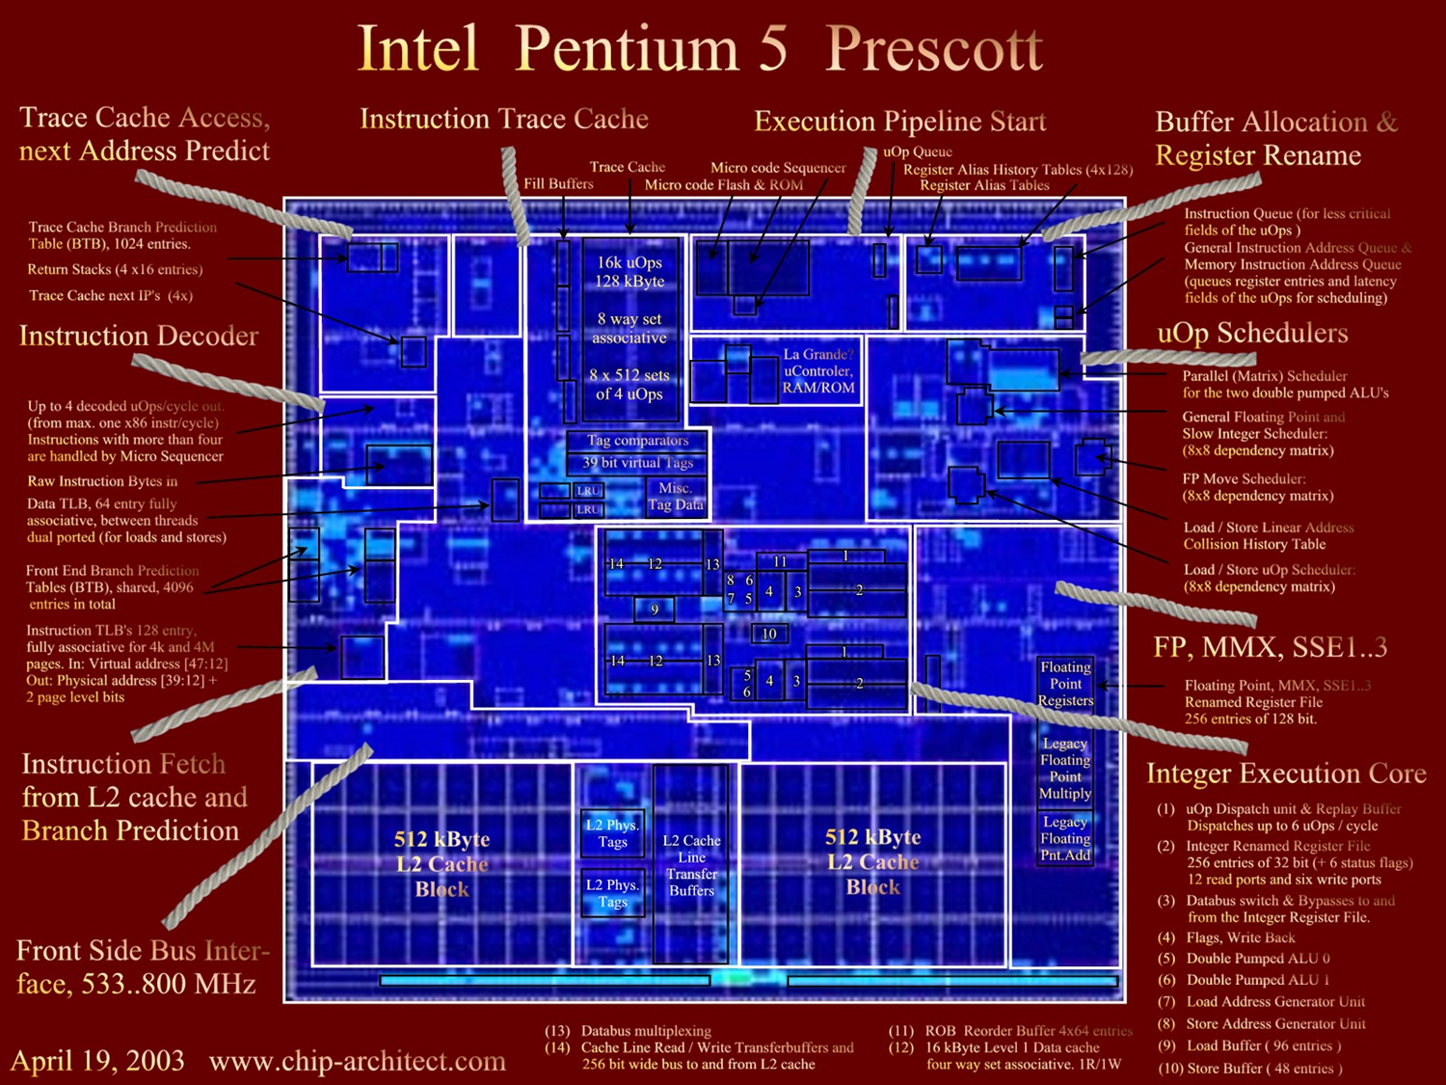
Pentium 5

Slide 10
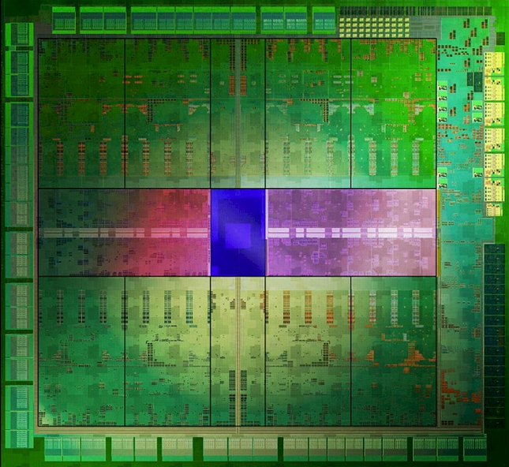
GK104 - Kepler

Slide 11
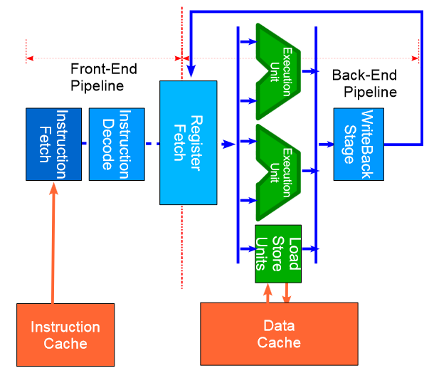
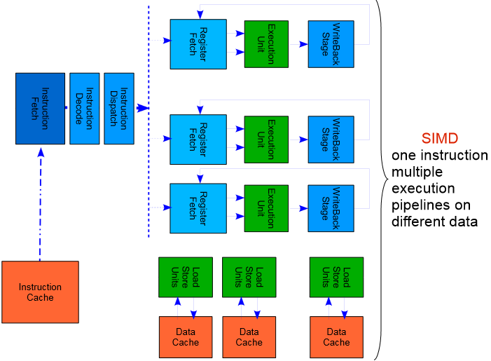
Different pipeline
The data and instruction handling in multicores CPU and GPU are totally different.
Most of the resources in the GPU are in the ALUs.

Slide 12
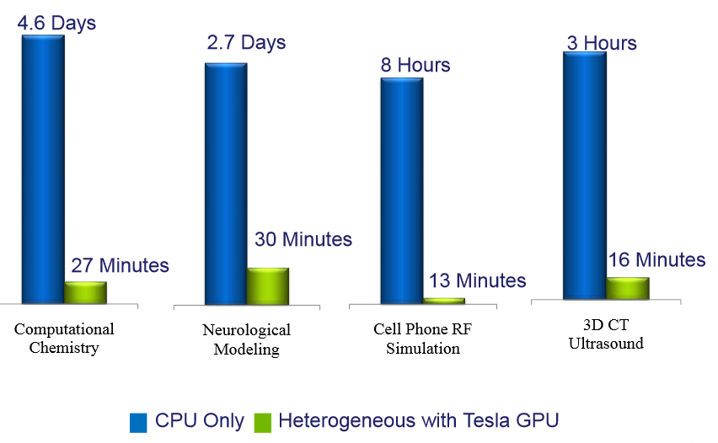
Example of performances

Slide 13
GAP
GAP (GPU Application Project) for Realtime in HEP and medical imaging is a 3 years project funded by the Italian Ministry of research started in the beginning of April 2013.
Several position will be opened to work on GAP. Contact us for further information (http://web2.infn.it/gap ... Under construction).

Slide 14
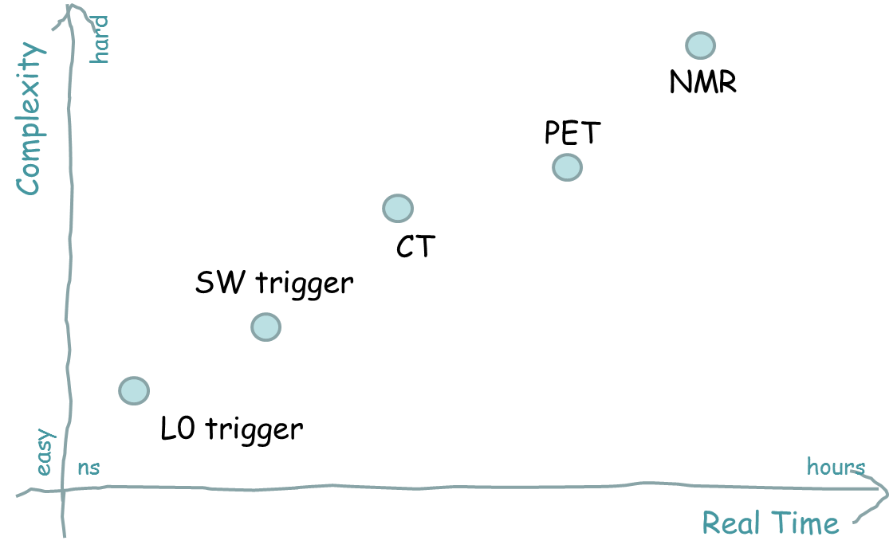
GAP and real-time

Slide 15
Two problems to use GPU at L0
Computing power: Is the GPU fast enough to take trigger decision at tens of MHz events rate?
Latency: Is the GPU latency per event small enough to cope with the tiny latency of a low level trigger system? Is the latency stable enough for usage in synchronous trigger systems?

Slide 16
GPU processing
VRAM
Example: packet with 1404 B (20 events in NA62 RICH application)
T=0
NIC
GPU
PCI express
chipset
CPU
RAM
0
us

Slide 17
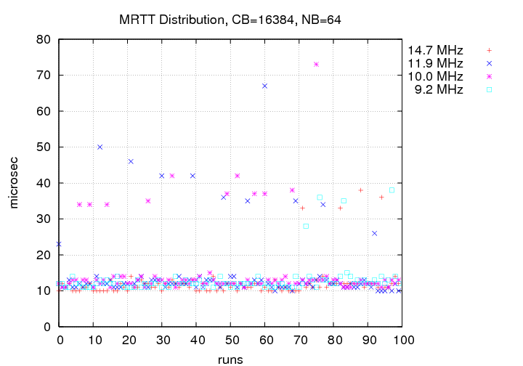
GPU processing
VRAM
NIC
GPU
PCI express
chipset
CPU
RAM
0
10
us

Slide 18
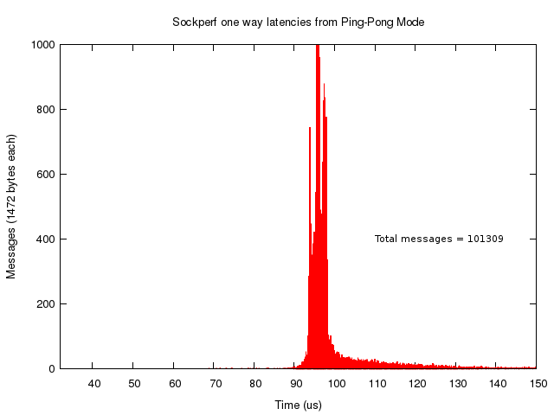
GPU processing
VRAM
NIC
GPU
PCI express
chipset
CPU
RAM
0
10
99
us

Slide 19
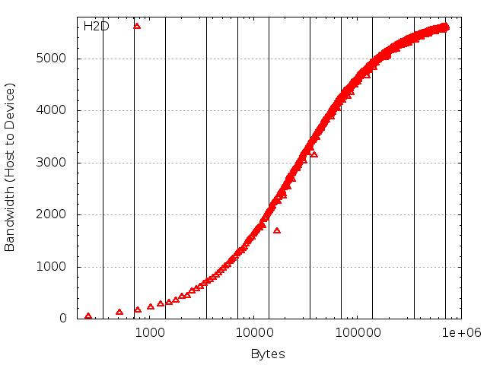
GPU processing
VRAM
NIC
GPU
PCI express
chipset
CPU
RAM
104
0
10
99
us

Slide 20
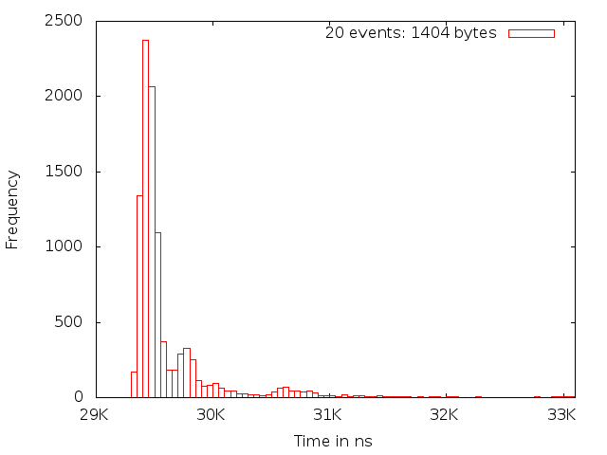
GPU processing
VRAM
NIC
GPU
PCI express
chipset
CPU
RAM
104
0
10
99
134
us

Slide 21
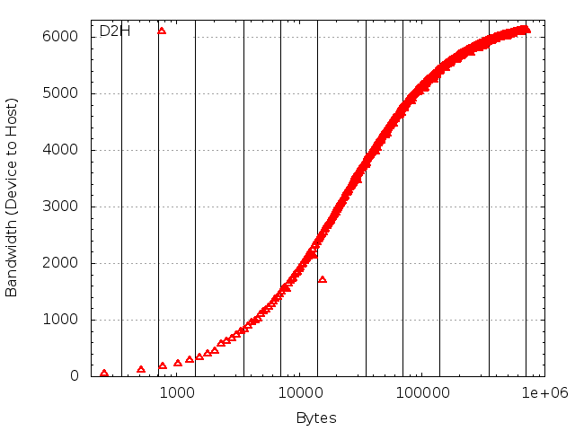
GPU processing
VRAM
NIC
GPU
PCI express
chipset
CPU
RAM
104
139
0
10
99
134
us

Slide 22
GPU processing
The latency due to the data transfer from data source to the system is more important than the latency due to the computing on the GPU
It scales almost linearly (apart from the overheads) with the data size while the latency due to the computing can be hidden exploiting the huge resources.
Communication latency fluctuations quite big (~50%).
VRAM
NIC
GPU
PCI express
chipset
CPU
RAM
104
139
0
10
99
134
us

Slide 23
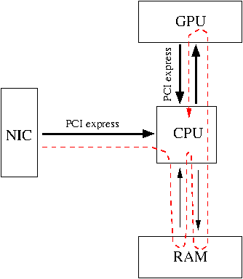
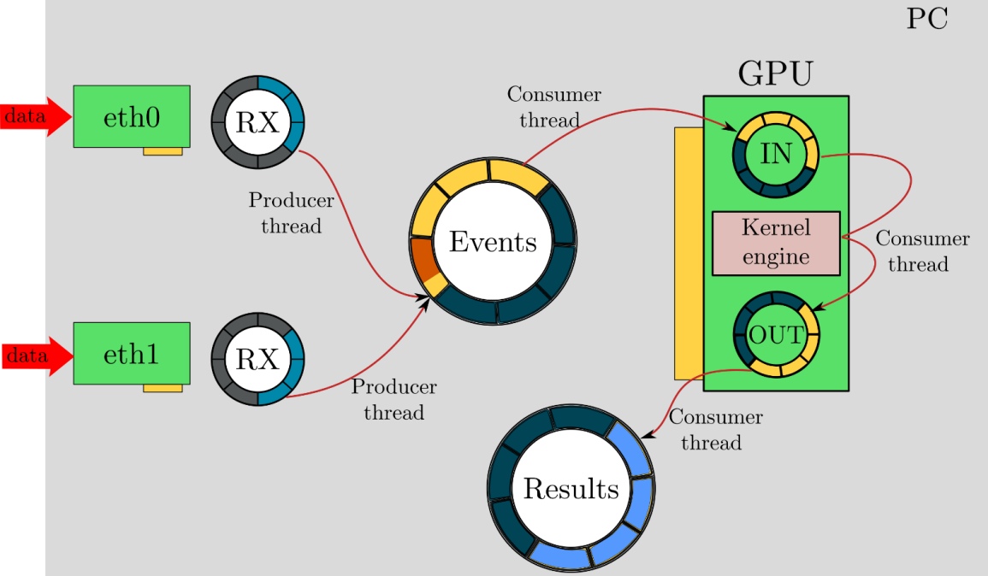
First solution: PFRING
PFRING

Slide 24
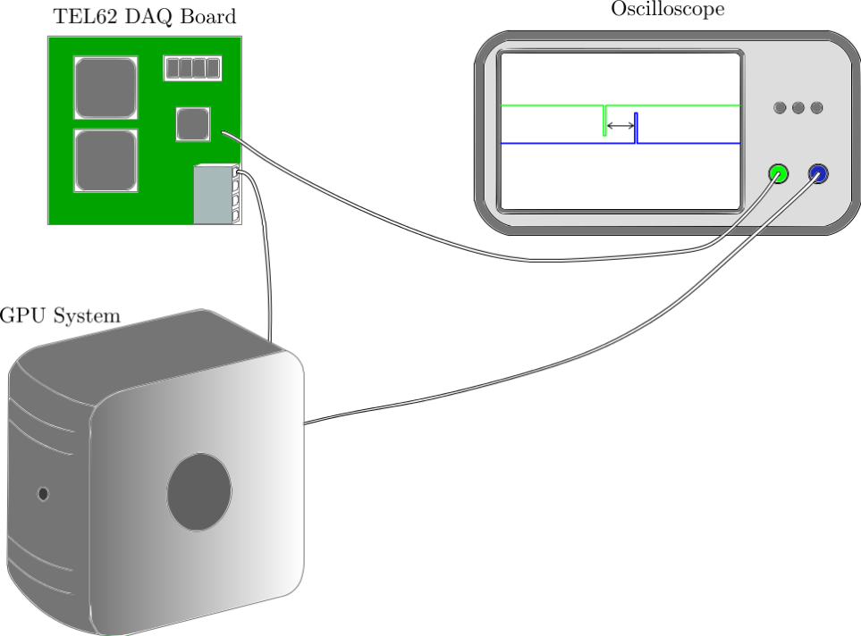
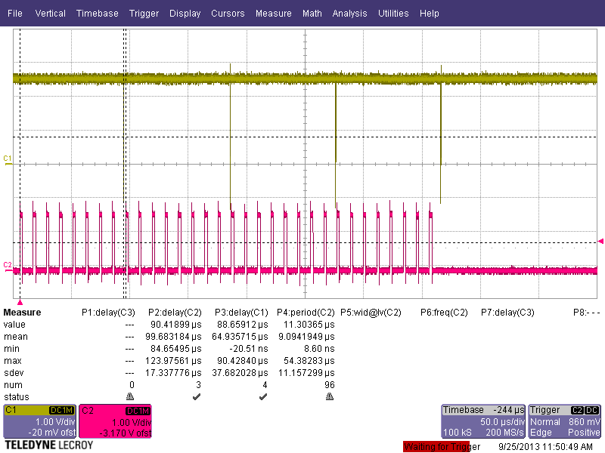
Latency measurement
It is not easy to measure (with high precision) the latency between two systems running with uncorrelated clocks
Use an oscilloscope to have a common time reference

Slide 25
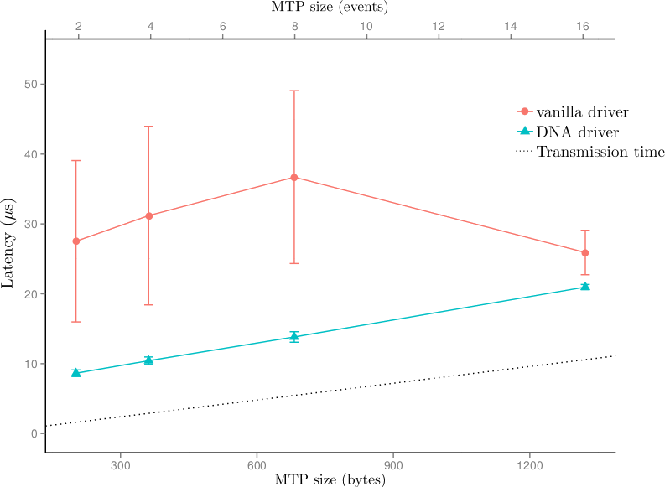
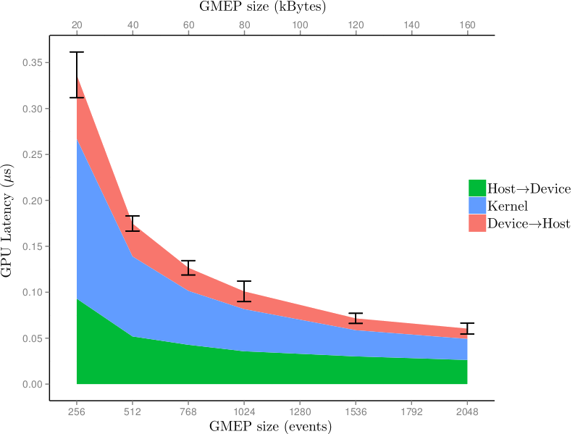
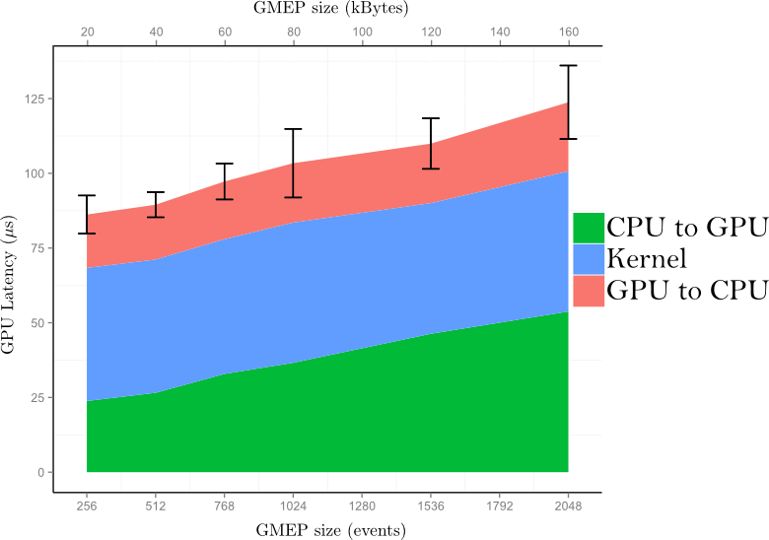
Results: PFRING
Big improvement thanks to the DNA driver
Concurrent data copy – kernel execution

Slide 26
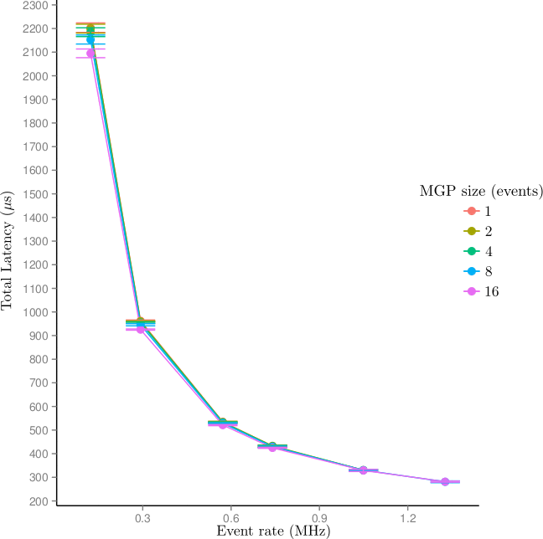
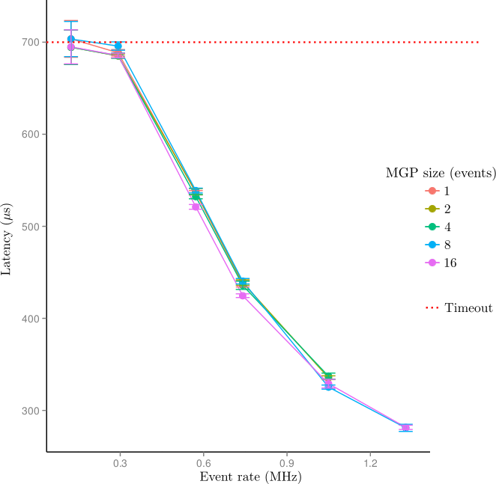
Results: PFRING

Slide 27
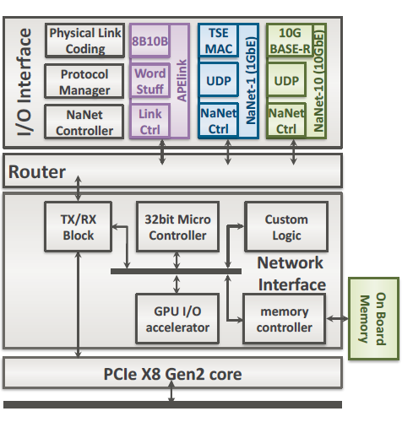
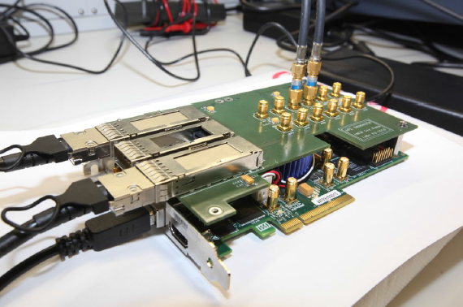
Second solution: NANET
Nanet

Slide 28
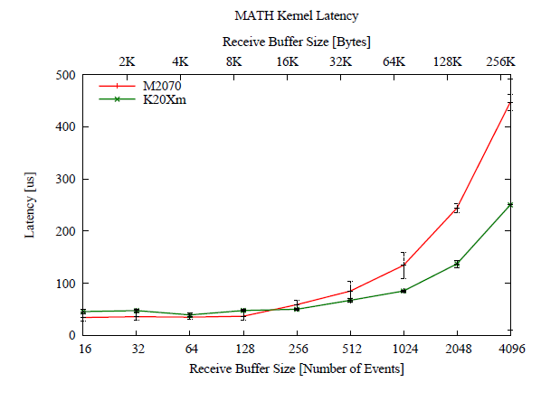
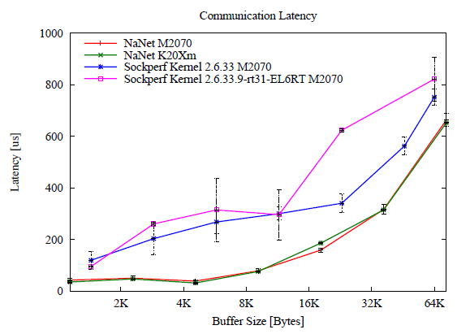
Results: NANET

Slide 29
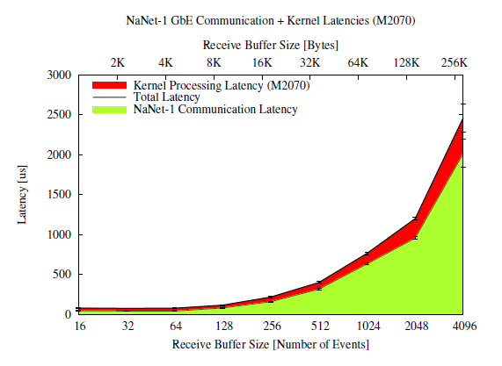
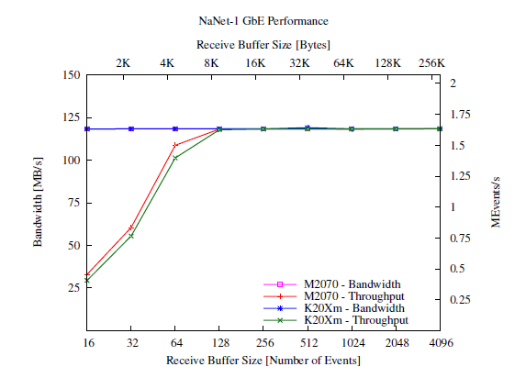
Results: NANET

Slide 30
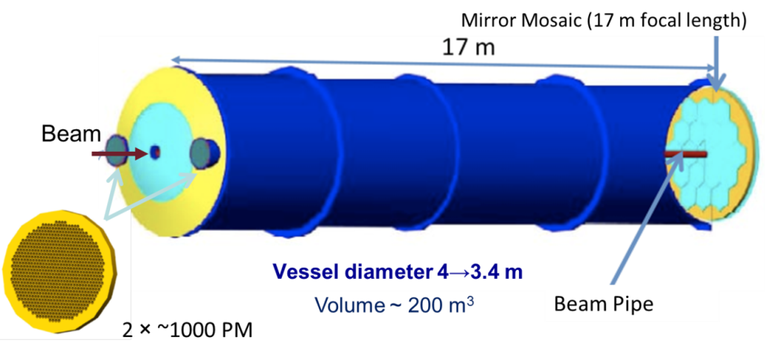
Physics case: NA62
Kaon decays in flight
  High intensity unseparated hadron beam (6% kaons).
  Event by event K momentum measurement.
Huge background from kaon decays
  ~10⁸ background wrt signal
  Good kinematics reconstruction.
  Efficient veto and PID system for not kinematically constrained background.
  Trigger/DAQ:
  Three levels
  L0 max latency: 1ms
  10 MHz events on main detectors
RICH:
  17 m long, 3 m in diameter, filled with Ne at 1 atm
  Distinguish between pions and muon from 15 to 35 GeV.
  2 spots of 1000 PMs each
  Time resolution: 70 ps
  MisID: 5x10⁻³
  10 MHz events: about 20 hits per particle

Slide 31
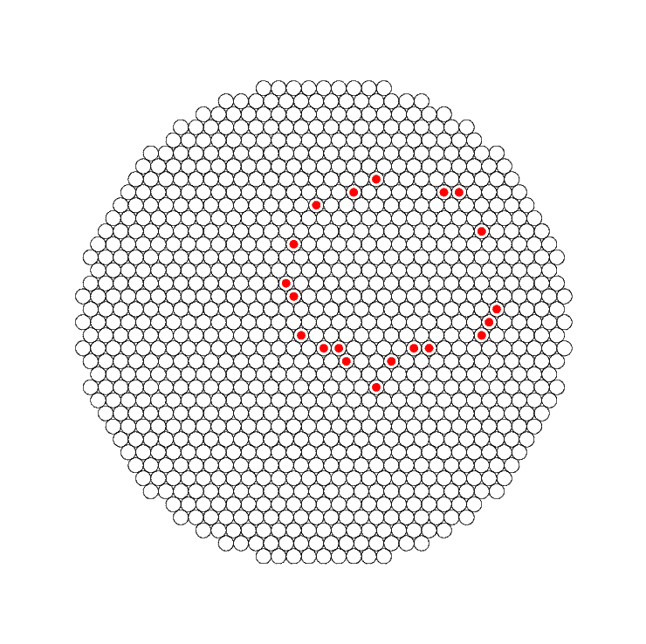
What we need?
In HEP there are several approaches to the ring fitting problem:
  Incompleted rings (non symmetric hits distribution)
  Accurate results
  Fast reconstruction
  Multi-rings
  Fit with additional info…
?

Slide 32
A look at the market: single ring
Geometric fits:
  Gauss-Newton, Levenberg-Marquardt, Spath, Landau, Chernov-Lesort, …
Algebraic fits:
  Kasa, Chernov-Ososkov, Pratt, Taubin, Crawford, …
Statistical fits:
  MLE, GRAF, …
Conformal fits:
  Riemann-Sphere, Inversion-based, Iterative-RTKD, Karimaki,…

Slide 33
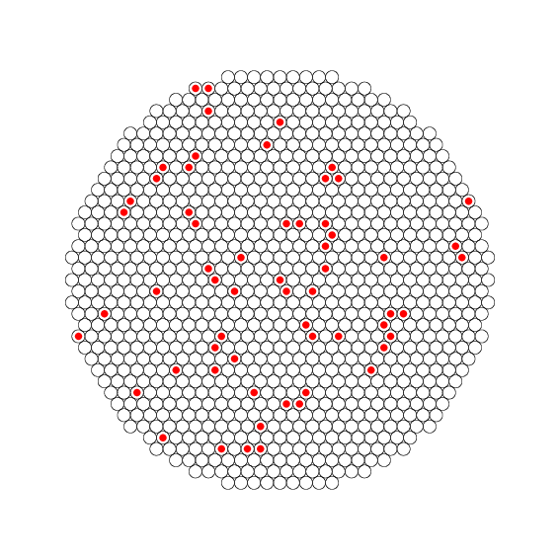
A look at the market: double rings
Multi rings:
  With seeds: Likelihood, Constrained Hough, …
  Trackless: fiTQun, APFit, possibilistic clustering, Metropolis-Hastings, Hough transform, …
?
?
?

Slide 34
Requirements for an online multi-rings algorithm
Trackless
  no information from the tracker
  Difficult to merge information from many detectors at L0
Multi rings
  Multi body decay in the RICH acceptance
Fast
  Not iterative procedure
  Events rate at levels of tens of MHz
Low latency
  Online (synchronous) trigger
Accurate
  Offline resolution required

Slide 35
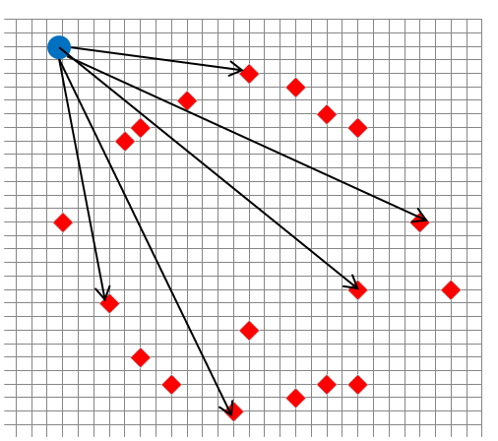
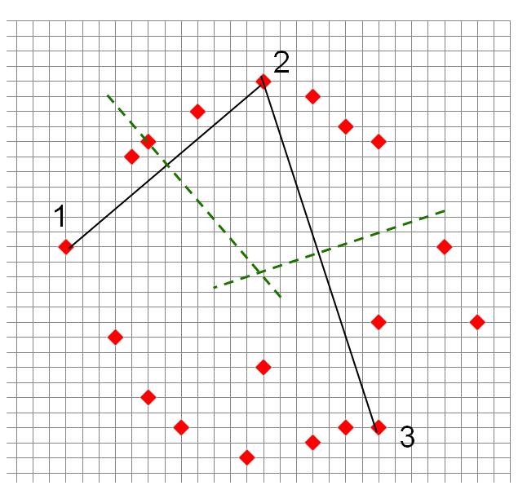
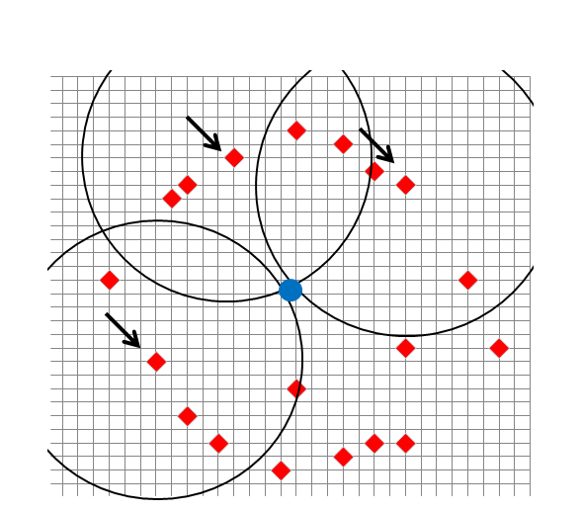
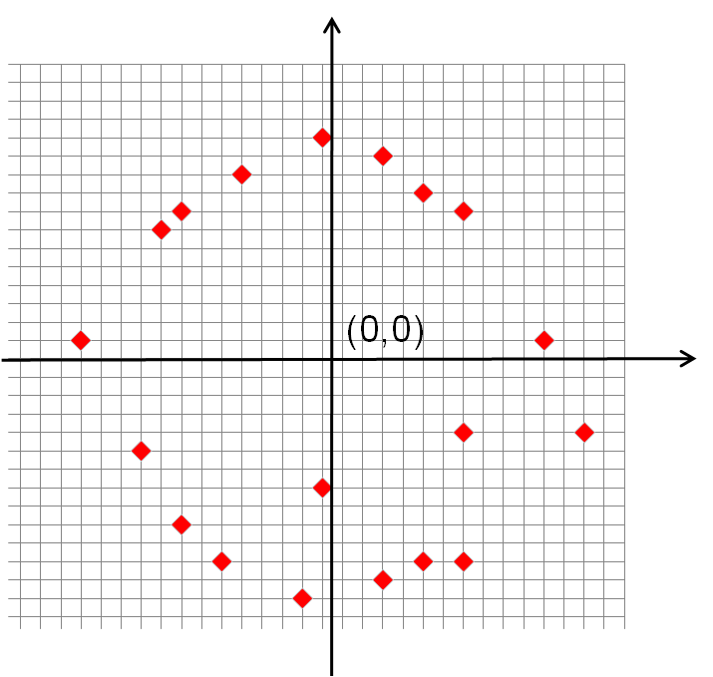
Single ring
domh
tripl
hough
math

Slide 36
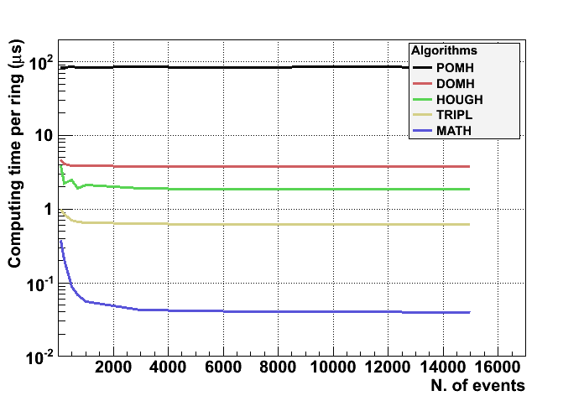
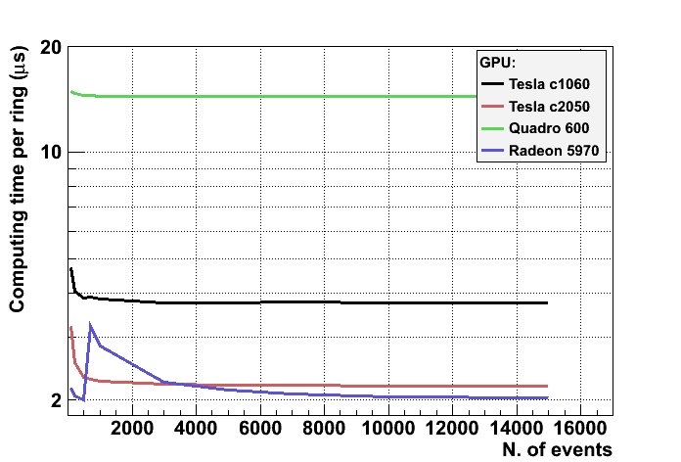
Processing time
Using Monte Carlo data, the algorithms are compared on Tesla C1060
For packets of >1000 events, the MATH algorithm processing time is around 50 ns per event
The performance on DOMH (the most resource-dependent algorithm) is compared on several Video Cards
The gain due to different generation of video cards can be clearly recognized.
“Fast online triggering in high-energy physics experiments using GPUs” Nucl.Instrum.Meth.A662:49-54,2012

Slide 37
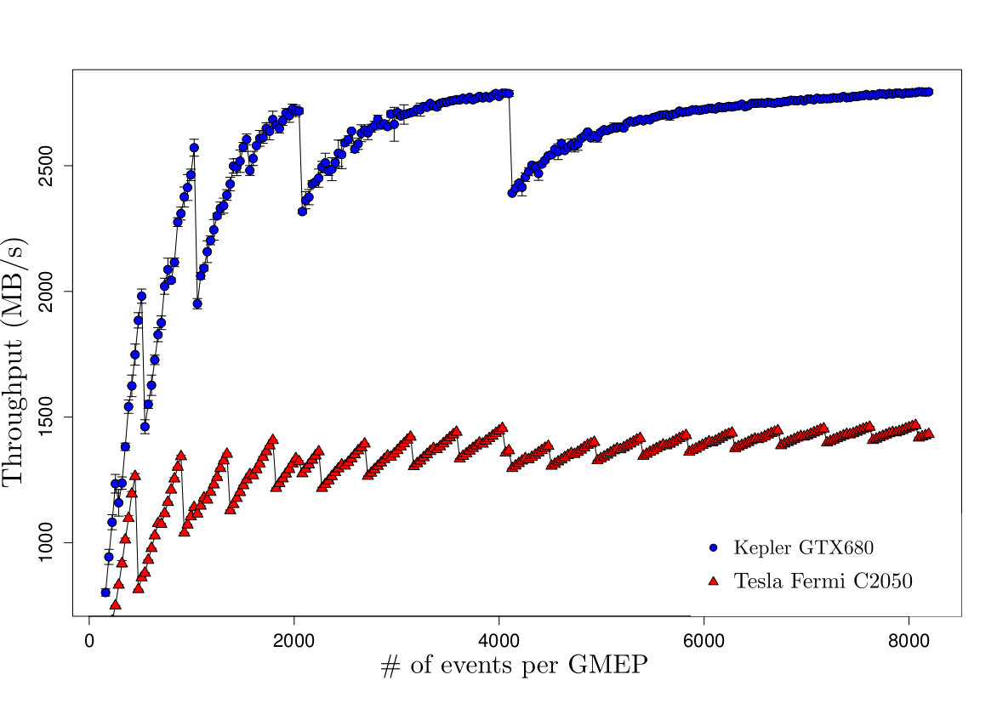
Single Ring Fit - Throughput
constant time to process a varying number of events, activating more processors as the packet size increases
discrete oscillations due to the discrete nature of the GPU
saturation plateau (1.4 GB/s and 2.7 GB/s )

Slide 38
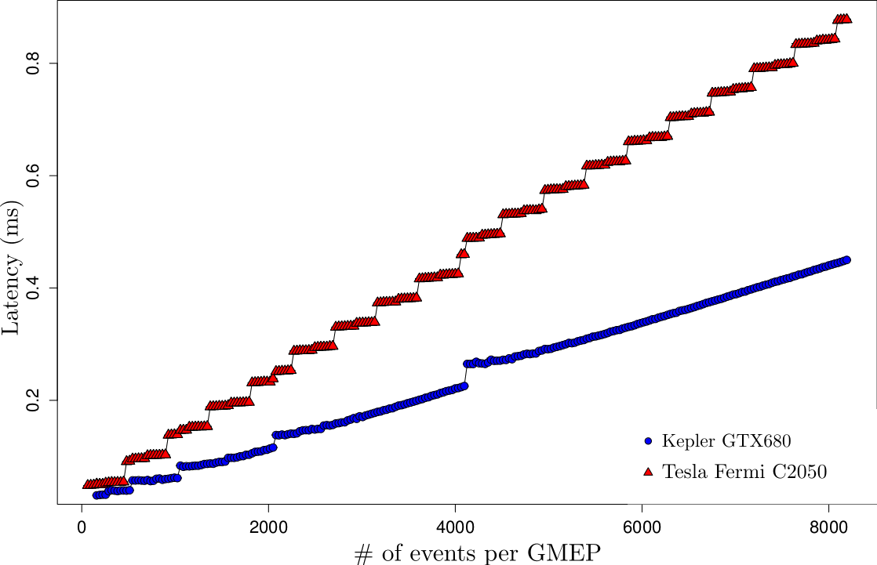
Single Ring Fit - Latency
A lower number of events inside a GMEP (packet) is better to achieve a low latency
A larger number of events guarantees a better performance and a lower overhead
The choice of the packet size depends on the technical requirements

Slide 39
A look at the market: double rings
Multi rings:
  With seeds: Likelihood, Constrained Hough, …
  Trackless: fiTQun, APFit, possibilistic clustering, Metropolis-Hastings, Hough transform, …
?
?
?

Slide 40
Requirements for an online multi-rings algorithm
Trackless
  no information from the tracker
  Difficult to merge information from many detectors at L0
Multi rings
  Multi body decay in the RICH acceptance
Fast
  Not iterative procedure
  Events rate at levels of tens of MHz
Low latency
  Online (synchronous) trigger
Accurate
  Offline resolution required

Slide 41
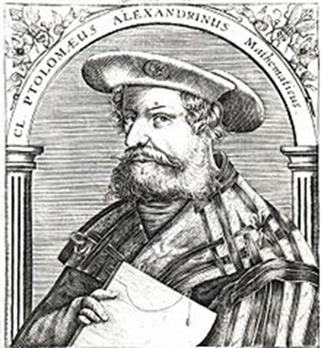

Almagest
New algorithm (Almagest) based on Ptolemy’s theorem: “A quadrilater is cyclic (the vertex lie on a circle) if and only if is valid the relation: AD*BC+AB*DC=AC*BD “
Design a procedure for parallel implementation

Slide 42


Almagest
i) Select a triplet (3 starting points)
ii) Loop on the remaining points: if the next point does not satisfy the Ptolemy’s condition then reject it
A
D
D
B
D
vi) Repeat by excluding the already used points
iii) If the point satisfy the Ptolemy’s condition then consider it for the fit
C
v) Perform a single ring fit
iv) …again…

Slide 43


A more “complicated” example

Slide 44

Almagest on GPU
Very high parallelism:
  Huge number of computing cores (>2000)
  Huge memory bandwidth
Two level of parallelism:
  Several triplets run in parallel
  Several events at the same time
. . .

Slide 45


Implementation: 4 geometrical selected triplets
Tests on Tesla K20
Total computing time order of few us per event (on single GPU).
Efficiency quite good (by using 8 triplets):
  Room for improvement (points reusing, cuts optimization, …)
Further tests on going to study noise immunity, bias, efficiency as a function of the number of hits, …
8 triplets
preliminary
4 triplets
256 events
preliminary

Slide 46
NA62 GPU trigger system
Readout event: 1.5 kb (1.5 Gb/s)
GPU reduced event: 300 b (3 Gb/s)
2024 TDC channels, 4 TEL62
8x1Gb/s links for data readout 4x1Gb/s Standard trigger primitives
4x1Gb/s GPU trigger
TEL62
GPU NVIDIA TITAN:
  2688 cores
  4.5 Teraflops
  6GB VRAM
  PCI ex.gen3
  Bandwidth: 288 GB/s
GPU
Events rate: 10 MHz
L0 trigger rate: 1 MHz
Max Latency: 1 ms
Total buffering (per board): 8 GB
Max output bandwidth (per board): 4 Gb/s

Slide 47


GAP-ATLAS
Several groups interested in using GPUs in HLT and EB (Wuppertal, Frankfurt, Bonn, Edimburg, Oxford,…)
Client-server layer to allow heterogeneous computing solution
Encouraging preliminary tests

Slide 48

GAP-ATLAS

Slide 49


GAP-ATLAS
Porting of Track reconstruction (same serial algorithm)
Using standard CPUs the processing time is proportional to the pileup
The GPU give a processing time almost independent
Start the porting of the muon trigger algorithm

Slide 50

GAP-LHCb
The present trigger/daq scheme can’t fit in the luminosity upgrade (need to increase Pt cuts to maintain the 1 MHz L0 output)
Discussion to have full 40 MHz readout
In any case: GPU in first or second HLT stage (several many-cores architecture under study)

Slide 51

GAP-NMR

Slide 52


GAP-NMR
From preliminary estimation:
  Assuming 512x512 pixels
  Factor 20-100 including optimization part
With this gain in image reconstruction time, both Kurtosis and stretched exponential techniques would be used in diagnostic.

Slide 53




GAP-CT
Porting of FDK algorithm on GPU
Big improvement with respect to already parallel version
Big benefit from next generation (already on the market) GPU (K40)

Slide 54
GAP-PET
Preliminary studies to identify suitable algorithms:
  MLEM (Maximum Likelihood expectation maximization)
  Common points with CT development (retro-projectors)
  Indication of relevant improvement using GPUs, essential for new scanners with higher resolution (more LOR)

Slide 55




Alice: HLT TPC online Tracking
2 kHz input at HLT, 5x10⁷ B/event, 25 GB/s, 20000 tracks/event
Cellular automaton + Kalman filter
GTX 580

Slide 56



Mu3e
Possibly a “trigger-less” approach
High rate: 2x10⁹ tracks/s
>100 GB/s data rate
Data taking will start >2016

Slide 57



CBM & STAR
10⁷ Au+Au collisions /s
~1000 tracks/event
trigger-less
Since the continuos structure of the beam ~10000 tracks/frame
Cellular automaton+KF
Grid=100000 cores

Slide 58


PANDA
10⁷ events/s
Full reconstruction for online selection: assuming 1-10 ms → 10000 – 100000 CPU cores
Tracking, EMC, PID,…
First exercice: online tracking
Comparison between the same code on FPGA and on GPU: the GPUs are 30% faster for this application (a factor 200 with respect to CPU)
1 TB/s
1 GB/s

Slide 59


Other applications
LQCD simulation on GPU
  Di Giacomo, D’Elia, Bonati et al.
Geant4 on GPU
  Tool for medical simulation
  Particle transportation
  Physical processes
Madgraph on GPU
  Event generator for LHC
  Big improvement using GPU
And many many others
  …Virgo, Fermi, KM3, …

Slide 60

“GPU in HEP” conference in PISA!
LOC (temp):
Marco Sozzi
Massimo D’Elia
Claudio Bonati
Silvia Arezzini
Alberto Ciampa
Lucia Lilli
Gianluca Lamanna

Slide 61
Conclusions
The use of GPU for scientific computing is becoming commonplace
  The future will be necessarily parallel!!!
Several possible uses in HEP: data analysis, Monte Carlo, …
…and outside HEP:
  Medical imaging reconstruction
  … http://www.nvidia.com/object/gpu-applications.html (272 applications)
The GPU in the trigger could give several advantages, but the processing performances should be carefully studied:
  Latency
  Throughput
  I/O
Several experiments are thinking about to use GPU in the trigger in future (both in Lower and Higher levels):
  Upgrade: ATLAS, LHCb, ALICE (already used GPU in run1), …
  NA62, PANDA, CBM, STAR, …

Slide 62
Spares

Slide 63
Computing vs LUT
LUT
Sin, cos, log, …
Higgs Analysis
2x2=4
processors
Complexity
Where is this limit?
It depends …
In any case the GPUs aim to shrink this space

Slide 64
Where is your application?
ASIC
performace
FPGA
GPU
why would I do something in such a complicated way if I can just make it simple?
CPU
Versatility
It depends on the application→ i.e. memory speed vs processor speed
GPUs are a good “compromise” …fill the GAP
General purpose or dedicated hardware???

Slide 65


Slide 66


Slide 67


Slide 68


Slide 69


Utilità per la fisica in NA62

Slide 70
Why GPU?
Specialized for math-intensive, highly parallel computation.
Very high computing power for «vectorizable» problems.
In the GPU more transistors are devoted to ALU with respect to the standard CPU.
Two main vendors: effort to simplify GPU programing.
Development drived by video editing and video games industry.

Slide 71

GPU: parallel structure
Thousand of cores organized in multiprocessor structure.
Multiple memory structure.
2 levels of parallelism:
  For the algorithm
  For the events
Fast connection with the PC (PCI express gen.3)
Concurrent data copy and execution of the “kernel”

Slide 72


Implementation: Single Ring
Crowford method (“math”):
  Translate in the center of mass
  Least square minimization → linear
Taubin method:
  More efficient: minimize the bias introduced by the Kasa related methods (minimization of simple algebraic distance)
  Resolution slightly better (on identified rings)
The difference of computing time on the GPU is at level of 10 ns per event
N. Chernov

Slide 73


Implementation: N (=hits) triplets
Number of triplets equal to the number of hits.
Relatively high efficiency.
Computing time depends on number of rings (different number of GPU cores per events)
Results on TESLA C1060 (240 cores, less than 1 Tflops)
Room for optimization

Slide 74

Implementation: 4 geometrical selected triplets
Only 4 triplets per event are used: left, right, up and down.
Further cuts to avoid too close hits.

Slide 75


Implementation: 4 geometrical selected triplets
Stability with small noise (studies are ongoing)
Inefficiency due to the order in choosing the rings.
Dependence on the cuts to define the triplets.

Slide 76



Flange geometry
18 mm

Slide 77






The NA62 TDAQ system
L0: Hardware synchronous level. 10 MHz to 1 MHz. Max latency 1 ms.
L1: Software level. “Single detector”. 1 MHz to 100 kHz
L2: Software level. “Complete information level”. 100 kHz to few kHz.
10 MHz
RICH
MUV
CEDAR
STRAWS
LKR
LAV
1 MHz
10 MHz
L0TP
L0
1 MHz
100 kHz
GigaEth SWITCH
L1/L2
PC
L1/L2
PC
L1/L2
PC
L1/L2
PC
L1/L2
PC
L1/L2
PC
L1/L2
PC
L1/2
L0 trigger
O(KHz)
L1 trigger
CDR
Trigger primitives
EB
Data

Slide 78


GPU: where?
Reduced rate
RO buffer
HLT
«classical trigger»
L0
RO
full rate
HLT
«triggerless»

Slide 79

GPU roadmap
Thanks to video game industry, the GPU technology will be supported for a long long time.

Slide 80


Processing time stability
The stability of the execution time is an important parameter in a synchronous system
The GPU (Tesla C1060, MATH algorithm) shows a “quasi deterministic” behavior with very small tails.
The GPU temperature, during long runs, rises in different way on the different chips, but the computing performances aren’t affected.

Slide 81


Data transfer time
The data transfer time significantly influence the total latency
It depends on the number of events to transfer
The transfer time is quite stable (double peak structure in GPU→CPU transfer)
Using page locked memory the processing and data transfer can be parallelized (double data transfer engine on Tesla C2050)

Slide 82

TESLA C1060
On TESLA C1060 the results both in computing time and total latency are very encouraging
About 300 us for 1000 events
Throughput about 300 MB/s
“Fast online triggering in high-energy physics experiments using GPUs” Nucl.Instrum.Meth.A662:49-54,2012

