Slide 1
Optimization of Energy resolution
Ideas and results for improvement of calorimeter energy resolution

Slide 2
Ideas
Crystal’s response
Improvement of the general energy resolution
Study of light collection efficiency and response uniformity using different types of covering materials.
Cherenkov Light
Improvement of hadronic resolution
Study of possibility of Cherenkov light detection for estimation of electromagnetic component in hadronic showers

Slide 3
Crystal’s response
CsI(Tl) cubes of 25 mm and 36 mm side
Aluminum, Teflon and aluminum+Teflon covering of different thickness
Photodiode VTH 2090 9,2x9,2 mm2
Single-channel high resolution spectrometer by Amptek
Am 214 source, α-particles 5,5 MeV

Slide 4
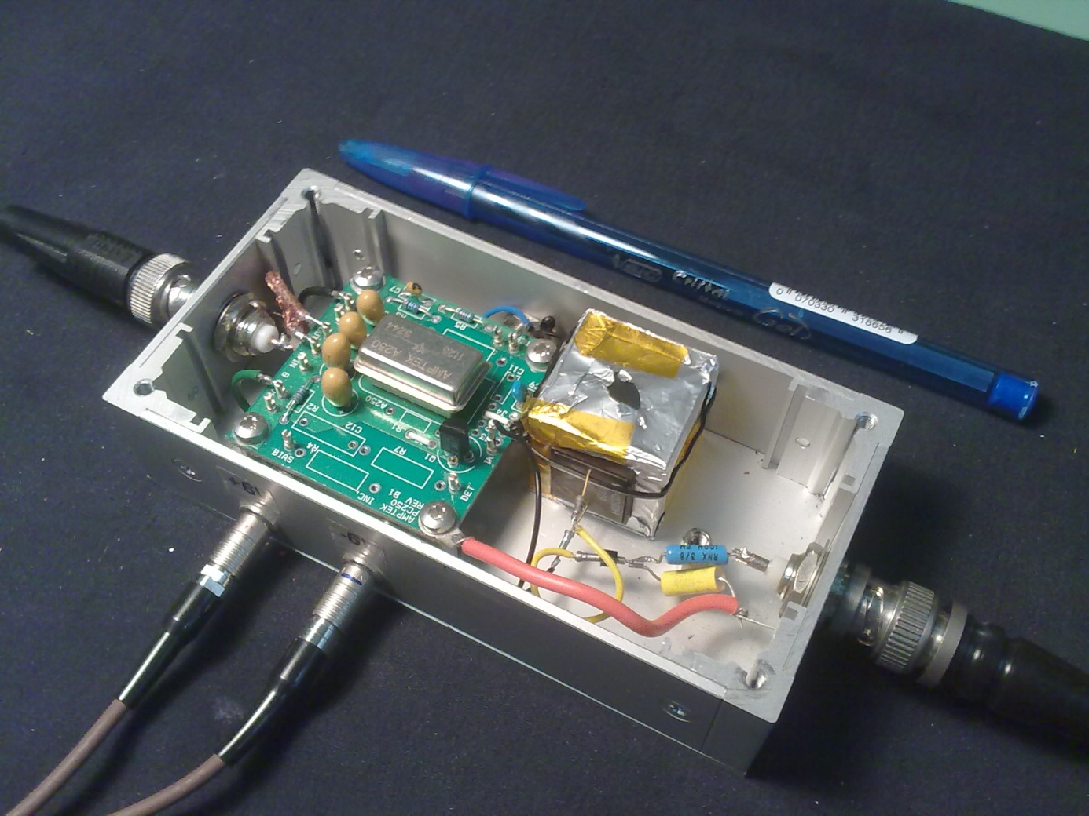
Crystal’s response

Slide 5
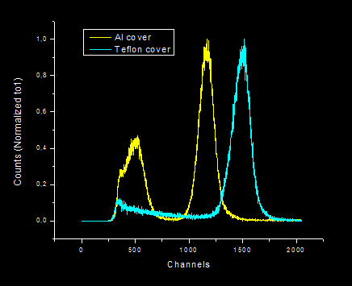
Crystal’s response. Al - Teflon
Aluminum/Teflon comparison
Cube 25 mm side
Two layers of Al foil
Three layers Teflon tape 100 um
Peak α 5,5 MeV
Al – 1165 channel
Teflon – 1500 channel

Slide 6
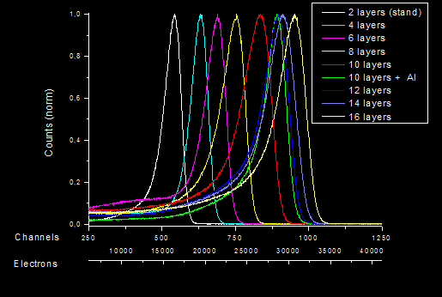
Crystal’s response. Teflon
Teflon, different numbers of layers
Cube 36 mm side
Teflon tape 100 um
Number of layers varies from 2 (prototype config) to 16
Peak α 5,5 MeV

Slide 7
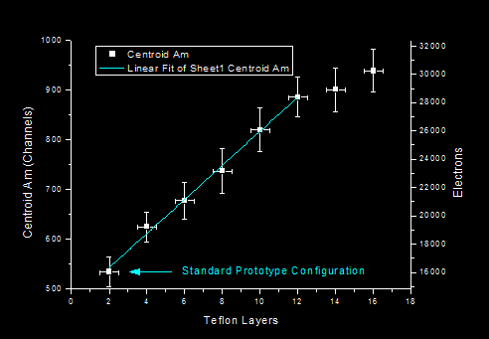
Crystal’s response. Teflon
Teflon, different numbers of layers
Cube 36 mm side
Teflon tape 100 um
Number of layers varies from 2 (prototype config) to 16
Peak α 5,5 MeV

Slide 8
Crystal’s response. Conclusion
For our configuration of the scintillators the diffusion type of wrapping has been found better than reflective.
We have large possibility of light collection improvement in comparison with configuration used for the tests
Really applicable number of layers of 100 um Teflon tape does dot provide optimal light collection efficiency
Further studies are needed to find optimal solution for covering materials
The studies on uniformity of the response should be performed

Slide 9
Cherenkov Light Main idea
Cherenkov light
Ultraviolet - violet spectrum
Fast (tens ns)
Directional (depends on interaction particle direction)
Scintillation light
Visible spectrum (peak 530 nm)
Slow (1,3 us decay time)
Absolutely isotropic

Slide 10
Cherenkov Light Main idea

Slide 11
Cherenkov Light. Tests
Laboratory tests with Sr β source
Did not give significant results because of technical problems
Beam Test Facility (BTS) of the DAFNE accelerator at LNF
e- up to 700 MeV (we used 496 MeV)
Mostly single particles
Different scintillators, photosensors and filters

Slide 12
Cherenkov Light. Tests
Scintillators:
PWO bar 30x30x200 mm, mylar cover
BSO bar 21x21x180 mm, mylar cover (courtesy DREAM group Pavia)
CsI(Tl) cubes 36 mm side with black and white wrapping
Plexiglas cube 30 mm side, white wrapping

Slide 13
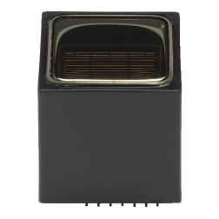
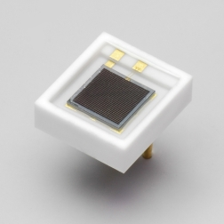
Cherenkov Light. Tests
Sensors:
Phototubes Hamamatsu R8900 series (DREAM group Pavia)
Bialkali photocathode.
Effective area : 23.5 x 23.5 mm.
Spectral response : 300 to 650 nm
Peak: 350 nm
SiPM Hamamatsu S10362 series
Active area: 3x3mm
900 pixels 100x100 um
Spectral response: 320 to 900 nm
Peak: 440 nm

Slide 14
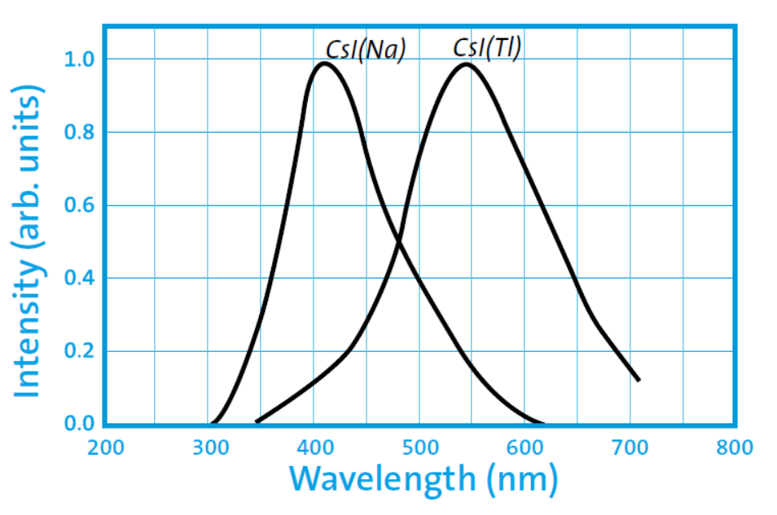
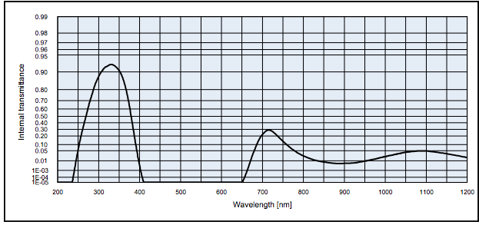
Cherenkov Light. Tests
UV filters:
UG11

Slide 15
Cherenkov Light. Tests
LeCroy oscilloscope
4 channels
6GHz
40 GS/s
PreAmp chain from TS
Fast preamplifiers for SiPM
Goniometer

Slide 16
Cherenkov Light. Tests
0
-30
+30

Slide 17
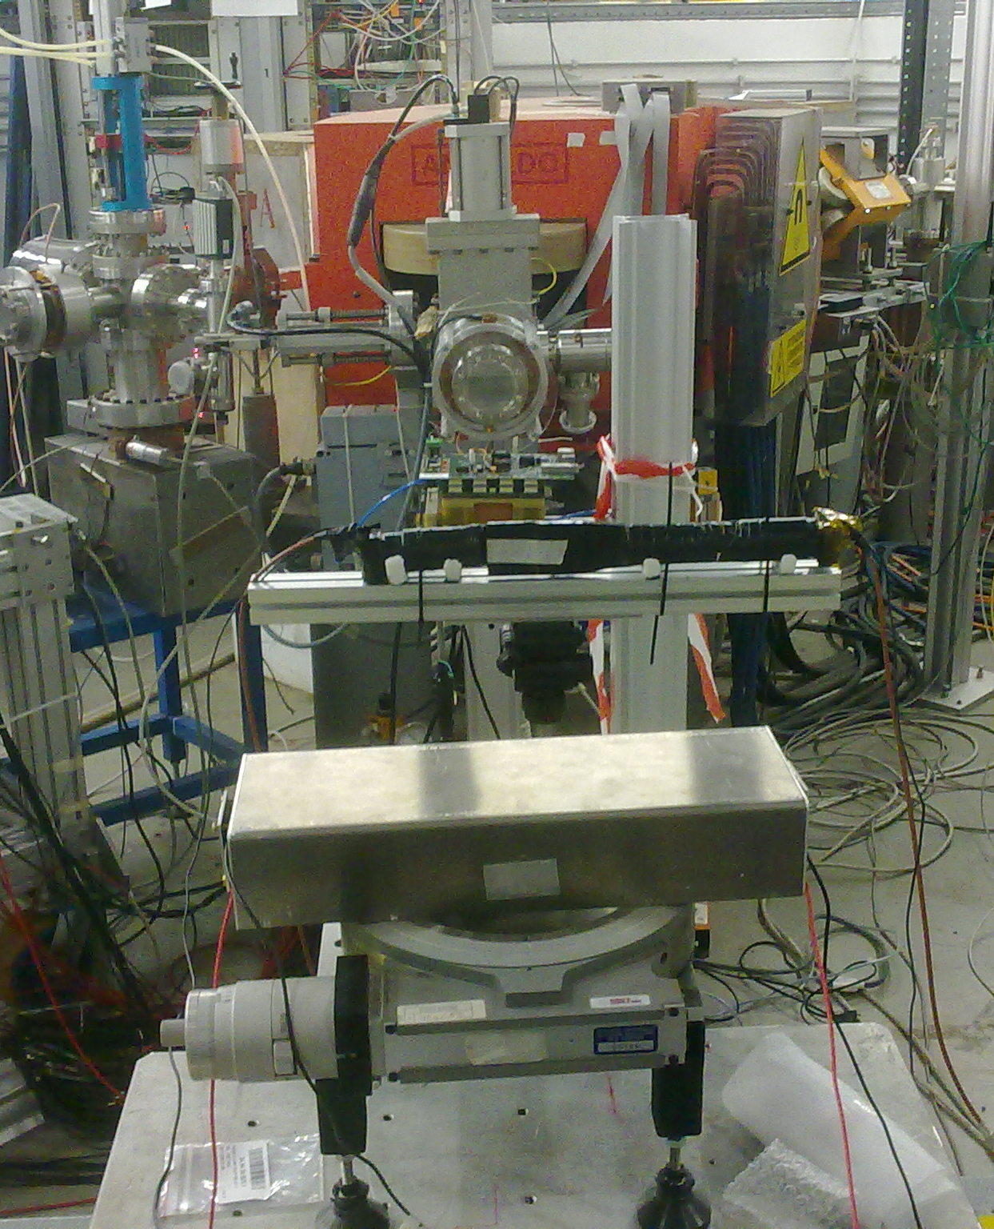
Cherenkov Light. Tests

Slide 18
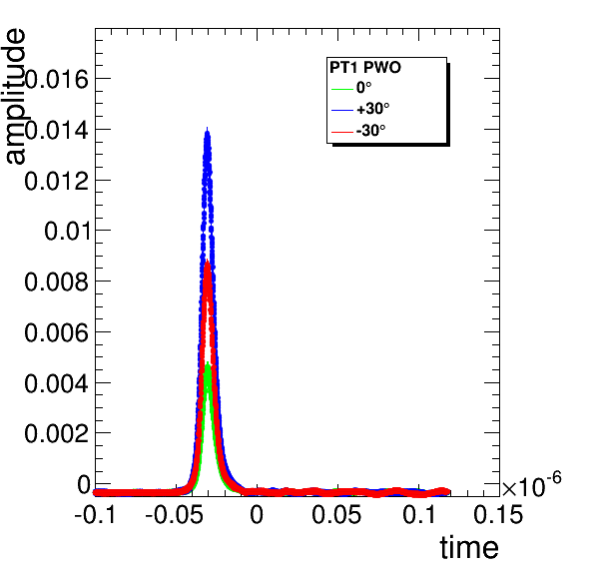
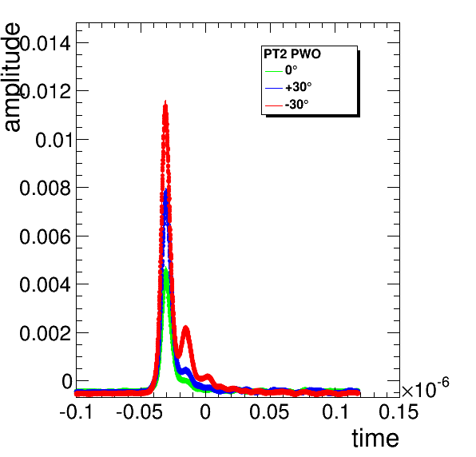
Cherenkov Light. Results
PWO with PT and filters (DREAM like configuration)

Slide 19
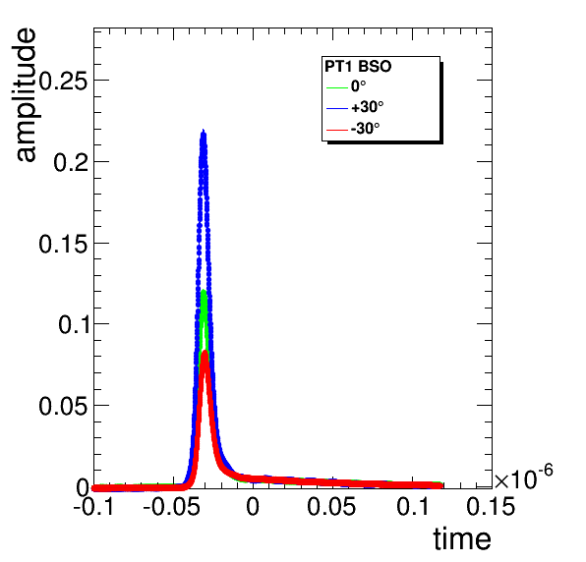
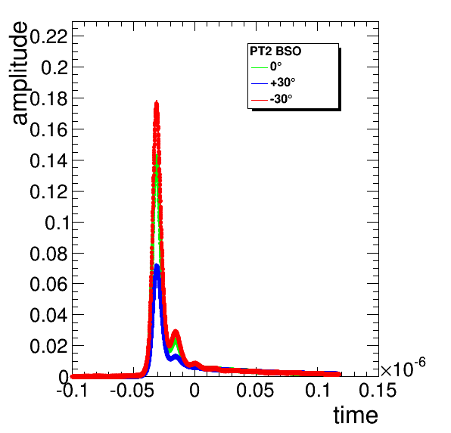
Cherenkov Light. Results
BSO with PT and filters (DREAM-like configuration)

Slide 20
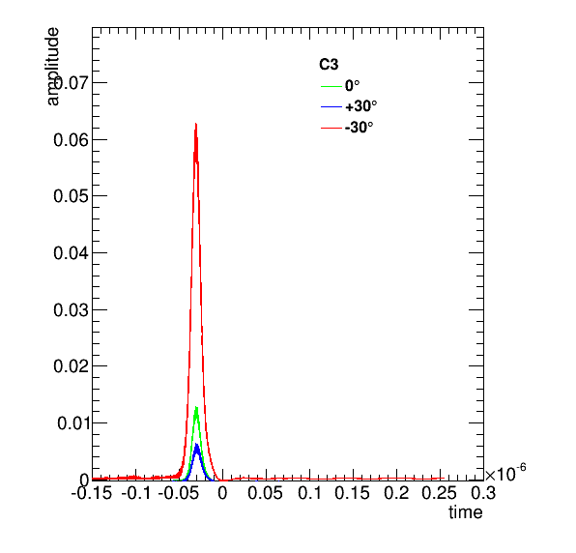
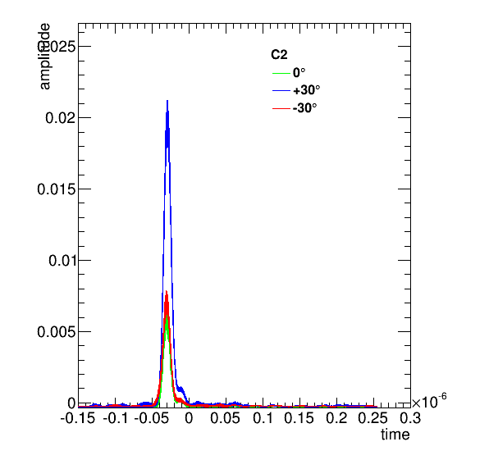
Cherenkov Light. Results
Plexiglas cube wrapped in black, 2 phototubes, one with UV filters (Check for no scintillation, Cherenkov only)
Filter
No filter

Slide 21
Cherenkov Light. Results
Plexiglas cube wrapped in teflon, 2 phototubes, one with UV filters (Check for no scintillation, Cherenkov only)
Filter
No filter

Slide 22
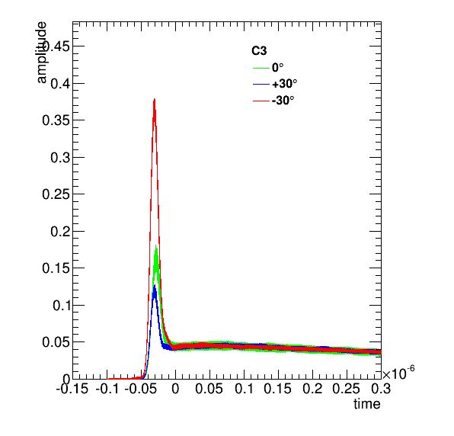
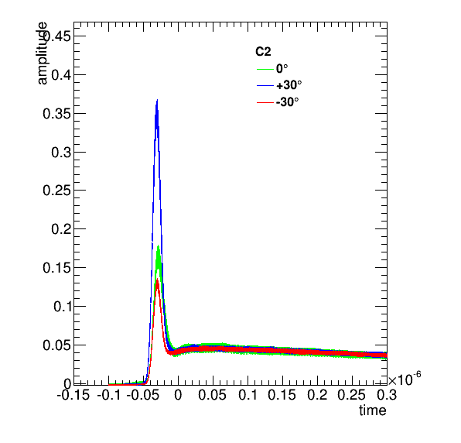
Cherenkov Light. Results
CsI cube wrapped in black, 2 phototubes, both with UV filters

Slide 23
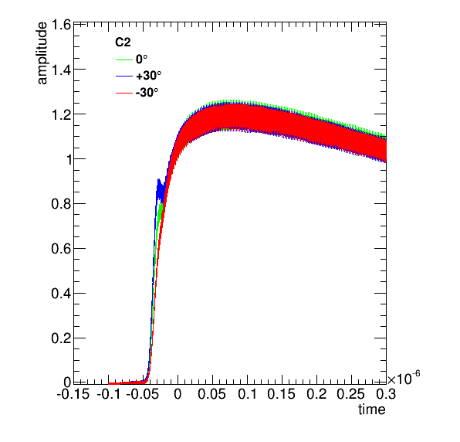
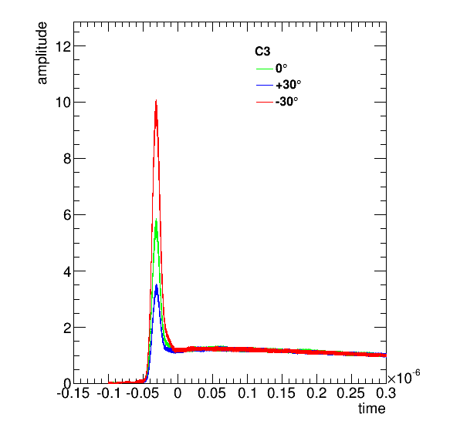
Cherenkov Light. Results
CsI cube wrapped in black, 2 phototubes, one with UV filter
No filter
Filter

Slide 24
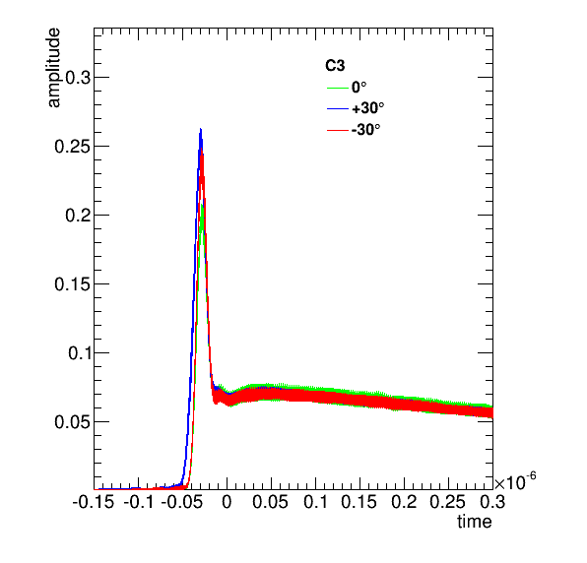
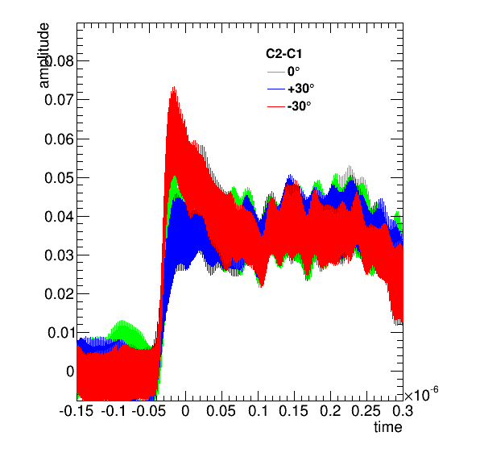
Cherenkov Light. Results
CsI cube wrapped in black, phototube and SiPM, both with UV filters
PT
SiPM

Slide 25
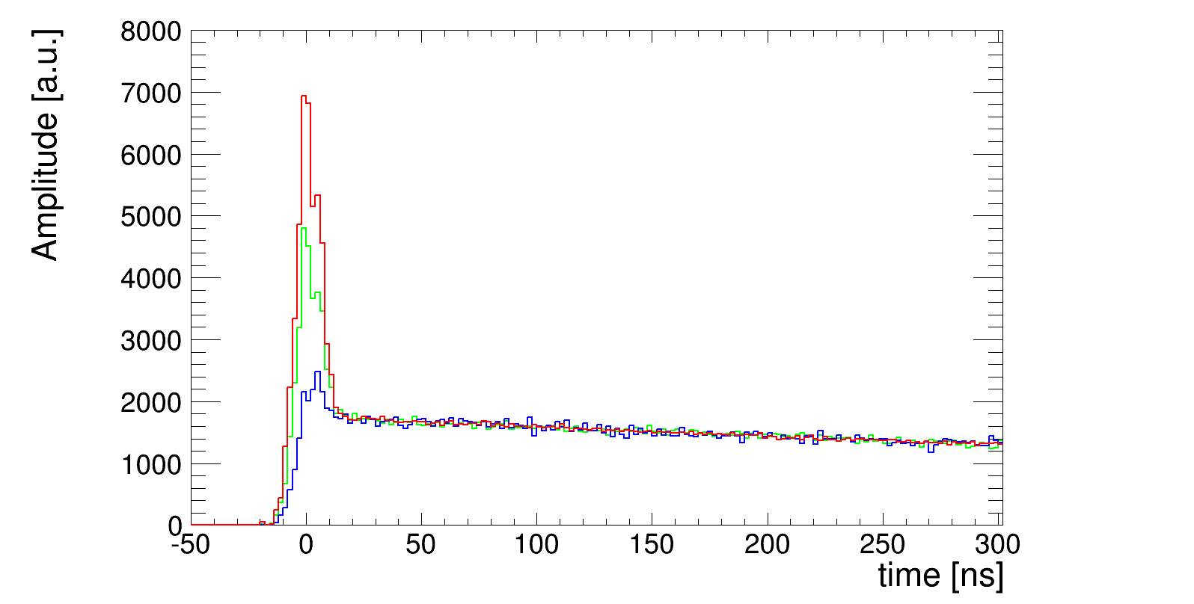
Cherenkov Light. Simulations
We simulated the response of the CsI cube, black wrapped, with filter in front of a phototube and checked the simulated timing profile for the 3 different incidence angles presented before. We also simulated a timing jitter of 5 ns, to account for the accelerator gate. Although the amount of scintillation may need to be tuned, the change in the height of the Cherenkov peak is reasonably comparable with what we see in data.

Slide 26
Cherenkov Light. Conclusions
Performed test shows possibility of Cherenkov light detection in CsI(Tl) crystals
Further studies are needed to find the appropriate technics for Cherenkov light detection in the space experiment conditions.

