Slide 1
CONDENSATION OF LARGE FLUCTUATIONS
IN A THERMODYNAMICAL SYSTEM
Federico Corberi - Univ. Salerno
in collaboration with
Marco Zannetti - Univ. Salerno
Giuseppe Gonnella - Univ. Bari
Antonio Piscitelli - Nanyang Univ.
F. Corberi, G. Gonnella, A. Piscitelli, M. Zannetti:J. Phys. A: Math. Theor. 46 (2013) 042001
M. Zannetti, F. Corberi, G. Gonnella: submitted to PRE. (arXiv: 144.3975)
M. Zannetti, F. Corberi, G. Gonnella, A.Piscitelli: submitted to Comm. Theor Phys.
F. Corberi, G. Gonnella, A.Piscitelli: submitted to J.Non-cryst. Sol.

Slide 2
Fluctuations of a variable
(in a classical system)
M
P(M)
M
Non
Equilibrium
Equilibrium

Slide 3
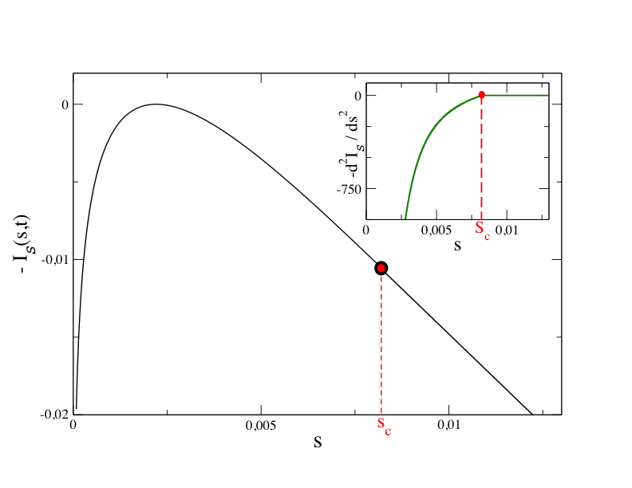
Singularity in energy fluctuations
Condensation
Of Fluctuations
arXiv: 1404.3975

Slide 4
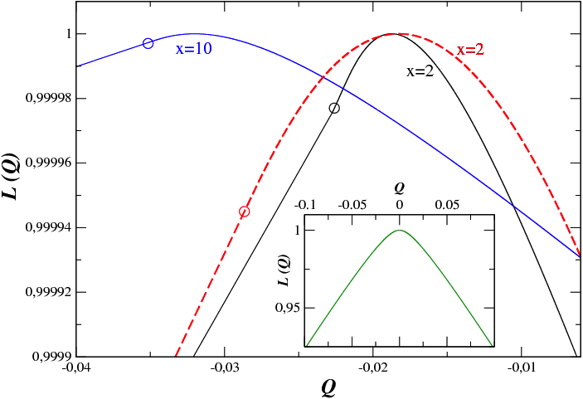
Singularity in heat fluctuations
Condensation
Of Fluctuations
J. Phys. A: Math. Theor. 46, 042001 (2013)

Slide 5
How this comes about?

Slide 6
Probability of a fluctuation
Microvariables with probability
J control parameters (Temperature, time)
Macrovariable (like energy)
In Equilibrium
Prob. of having
Partition function Z(M,J)

Slide 7
Dual (constrained) system
Dual
Prior
Constraint
Responsible of
Singularity

Slide 8
Constraints may induce singularities
Boson Gas (BEC)
Examples:
(Equilibrium)
Spherical Model (Magnetism)
Ferro
Para
T_{c}
T
(M=S)
Para
Ferro
S_{c}
S

Slide 9
Fluctuations in the
Prior
P(M,J)
Singular P(M,J)
In Equilibrium
Average properties
in the Dual
Z(M,J)
Phase Transition
(Condensation)

Slide 10
The Gaussian Model

Slide 11
Temperature quench
M

Slide 12
Fluctuation of the variance (S)
Fluctuating
variable
Constraint

Slide 13
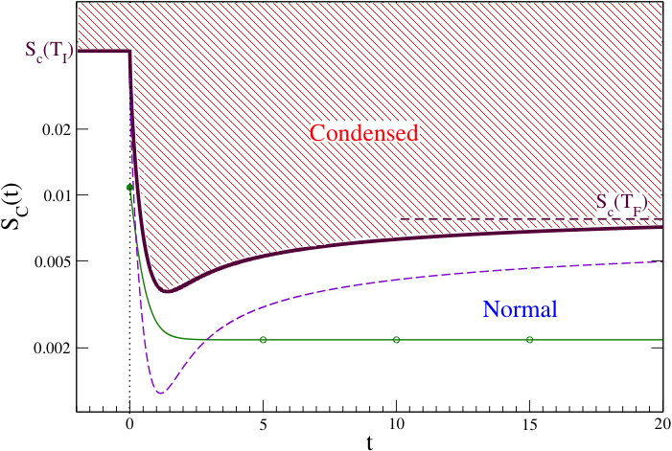
Phase diagram (S)
S_{c}(t)-<S(t)>
<S(t)>

Slide 14
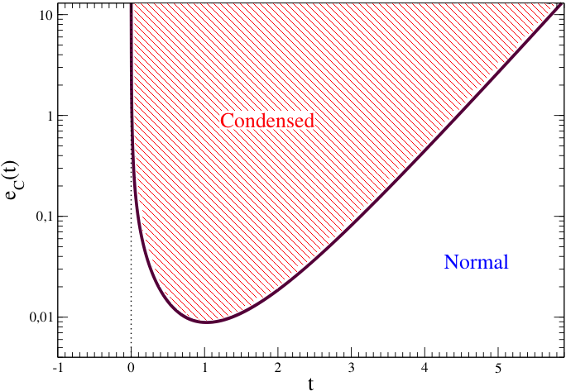
Phase diagram (E)

Slide 15
Large Volume Limit
Rate function
I(m,J)
m=M/V
Saddle Point Equation

Slide 16
Condensation
Saddle Point Equation
F(z,J)
As in BEC!
m
m_{c}
m
Z*
Z
Z_{c}
Z
Z*

Slide 17
Conclusions
Fluctuations of extensive variables may be highly non
trivial even in trivial non interacting systems, out of
Equilibrium or even in Equilibrium.
Condensation of fluctuations is related to the duality
Fluctuations in a prior ensemble
↔
Average properties in dual ensemble

Slide 18
Question
May I detect BEC in the fluctuation
of photon number?
Thank you for
the attention!
(and possibly for the answer)

