Slide 1

NA62: verso la presa dati
F. Ambrosino, T. Capussela, D. Di Filippo, P. Massarotti, M. Mirra, M.Napolitano, G. Saracino

Slide 2
Outline
Recent results:
  NA62 : Ke2 , Kμ2 and lepton universality
  NA48/2-NA62 : K → π γ γ
Prospects:
  NA62 and K → π ν ν
  Other rare and forbidden decays studies
  Napoli in NA62

Slide 3
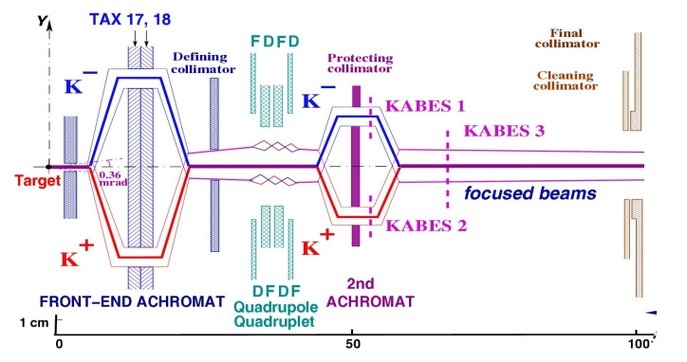
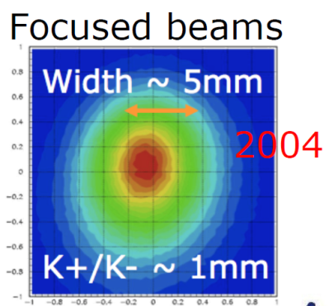
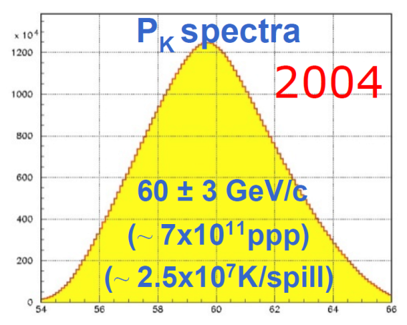
The beam(s)
m
Primary beam: 400 GeV protons from CERN SPS
Charge symmetrization of experimental conditions
Flux ratio K⁺ /K⁻ ≈ 1.8 (2003-2004) → 2 (2007-2008)
P_{K} = 60±3 GeV/c (NA48/2, 2003-2004)
→ 75±2 GeV/c (NA62 R_{K} phase, 2007-2008)

Slide 4
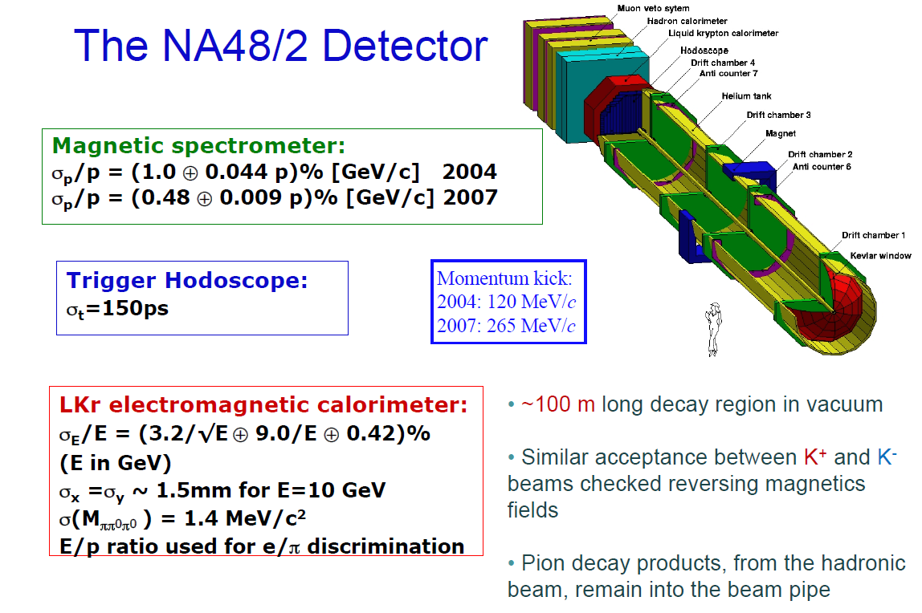
The detector (2004-2007)
≈ 100 m decay region in vacuum
Similar acceptance between K⁺ and K⁻ beams ensured reversing magnetic fields
Pion decay products from hadronic beam remain into the beam pipe

Slide 5
Outline
Recent results:
  NA62 : Ke2 , Kμ2 and lepton universality
  NA48/2-NA62 : K → π γ γ
Prospects:
  NA62 and K → π ν ν
  Other rare and forbidden decays studies
  Napoli in NA62

Slide 6
Ke2 and Kμ2: motivations
The ratio R_{K} accurately predicted within the SM:
Helicity suppression
Radiative (IB) correction
[V. Cirigliano and I Rosell, JHEP 0710:005 (2007)]
Cancellation of hadronic uncertainties (no f_{K} )
ΔR_{K}/R_{K}|_{SM} ~ 0.04%
A precise measurement probes μ−e univesality and provides a stringent test of the SM

Slide 7
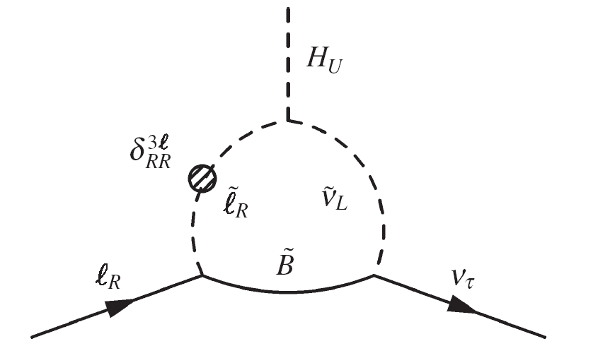
R_{K} beyond Standard Model
MSSM with R-parity allows new contributions to the decays:
effective pseudoscalar LFV amplitude
SM
Effective coupling (HRS mechanism):
u_{L}
d_{R}
[Masiero, Paradisi, Petronzio, Phys. Rev. D74 (2006) 011701]
[Hall, Rattazzi, Sarid, Phys. Rev. D50 (1994) 7048]

Slide 8
NA62 measurement Strategy
K_{e2} and K_{μ2} candidates collected simultaneously:
  -> Many systematic effects reduced,
  -> Measurement independent of the Kaon flux.
Particle identification with E/p (LKr and spectrometer)
MC simulations used to limited extent:
  -> Acceptance correction (only for geometry),
  -> Simulation of “catastrophic” bremsstrahlung by muons.
Analysis in 10 track momentum bins.
Trigger
Efficiency (>99.9%)
Signal
events
Particle
ID efficiency
1
N(K_{e2}) - N_{B}(K_{e2})
f_{m} · A(K_{μ2}) · ε(K_{μ2})
1
R_{K} =
D
N(K_{μ2}) - N_{B}(K_{μ2})
f_{e} · A(K_{e2}) · ε(K_{e2})
f_{LKR}
K_{μ2}
downscaling
Background
Events
(Main source of systematics)
Geometrical
acceptance
Global LKr
readout eff (0.998)
Notes:
8

Slide 9
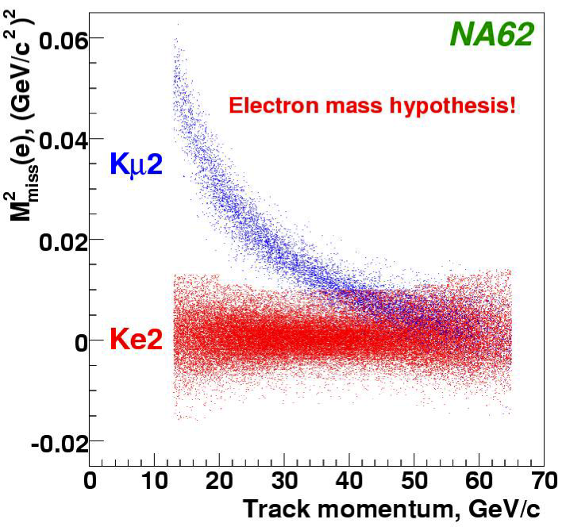
Signals selection
Common reconstruction:
    -> 1 Reconstructed Track,
    -> Geometrical acceptance cuts,
    -> Photon veto using LKr
    -> Track momentum 13 GeV/c < p < 65 GeV/c
    -> Good decay vertex reconstruction
Kinematical separation :
    -> Missing mass M² = (p_{K} - p_{l})²
    -> P_{K} : Average monitored with K_{3π} decays
Particle Identification => Muon suppression ~10⁻⁶ :
    -> E/p = (LKr energy deposit/track momentum)
      0.90<E/p<1.10 for electrons with P≤25GeV,
      0.95<E/p<1.10 for electrons with P>25 GeV,
      E/p<0.85 for muons.
Notes:
ma la separazione cinematica non e’ a 35???
Sulle slides di Eugenio c’e` 25
Forse e’ ecclente a 25 un po meno fino a 35
9

Slide 10
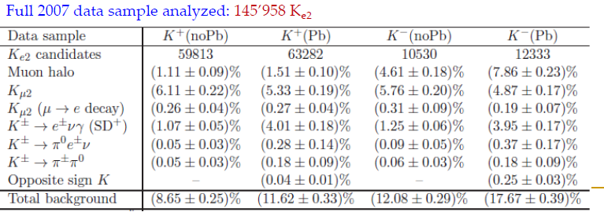
Ke2 : μ background
Subsample of data (55%) taken with a 9.2-X₀ Pb in front of LKr in order to measure on data the μ mis-ID
Four samples analyzed independently: K⁺(Pb) ; K⁺ (NoPb); K⁻(Pb) ; K⁻ (NoPb)

Slide 11
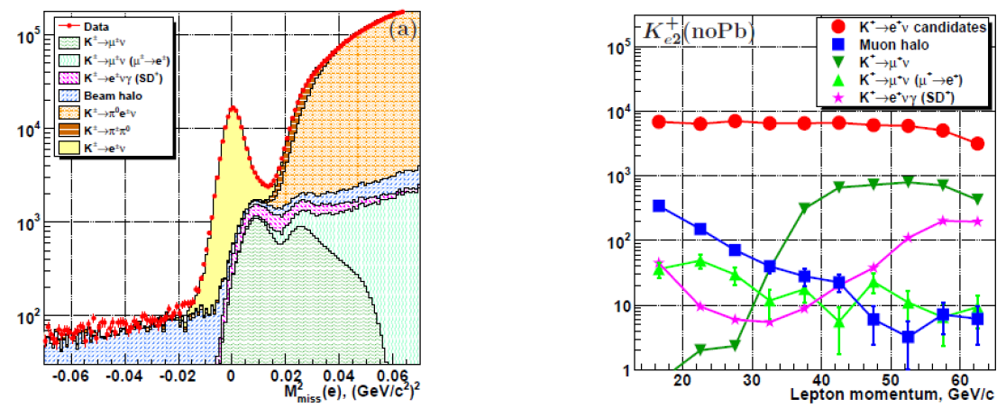
Ke2 : μ background
Subsample of data (55%) taken with a 9.2-X₀ Pb in front of LKr in order to measure on data the μ mis-ID
Four samples analyzed independently: K⁺(Pb) ; K⁺ (NoPb); K⁻(Pb) ; K⁻ (NoPb)

Slide 12
R_{K} final result
0.4% accuracy reached! But theoretical error still 1 order of magnitude smaller …
R_{K} = 2.488(7)_{stat}(7)_{syst}10⁻⁵ [PLB 719 (2013) 326]
Source | δR_{K} (10⁻⁵)
Statistics | 0.007
Kμ2 bkg | 0.004
Ke2γ SD+ bkg | 0.002
Ke3, ππ⁰ bkg | 0.003
Muon halo bkg | 0.002
Material budget | 0.002
Acceptance corr | 0.002
DCH alignment | 0.001
Electron ID | 0.001
1 TRK trigger eff | 0.001
LKr readout eff | 0.001
Total | 0.010
Fit over 40 independent measurements, 10 lepton momentum bins × 4 configurations:
χ² / Nd.o.f. = 47/39 (P = 18%)

Slide 13
Outline
Recent results:
  NA62 : Ke2 , Kμ2 and lepton universality
  NA48/2-NA62 : K → π γ γ
Prospects:
  NA62 and K → π ν ν
  Other rare and forbidden decays studies
  Napoli in NA62

Slide 14
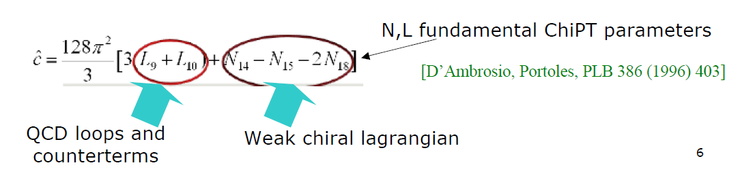
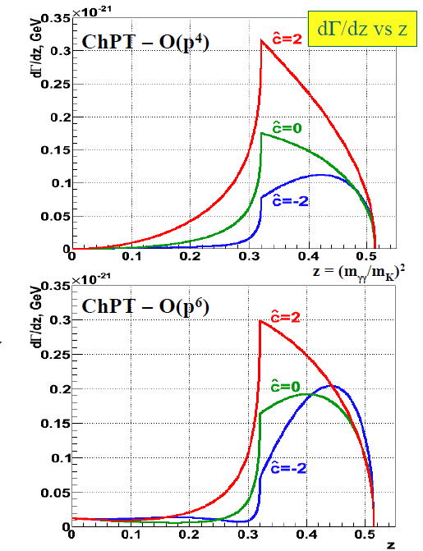

K⁺ → π⁺γγ and ChPT
In ChPT rate and spectrum in z=m²γγ / m²_{K} depend on a single, unknown, O(1) parameter $\hat{c}$:
«Cusp» like behavior @ (2m_{ππ} )² threshold
Predictions at O(p⁴) and O(p⁶) differ:
may be tested experimentally !

Slide 15
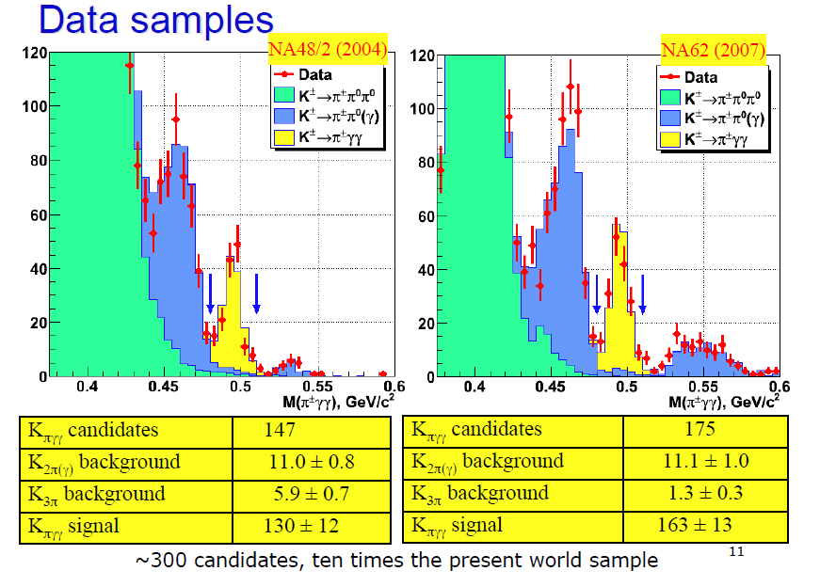
K⁺ → π⁺γγ at NA48 & NA62
Data collected w minimum bias trigger condition

Slide 16
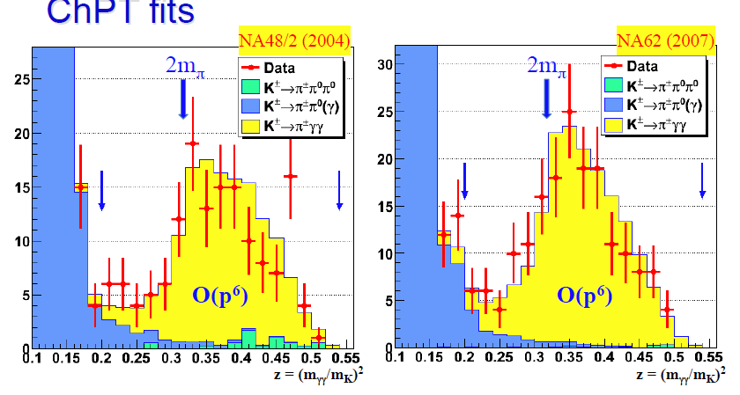
K⁺ → π⁺γγ ChPT fits
Fits limited to region z>0.2 due to residual BKG

Slide 17
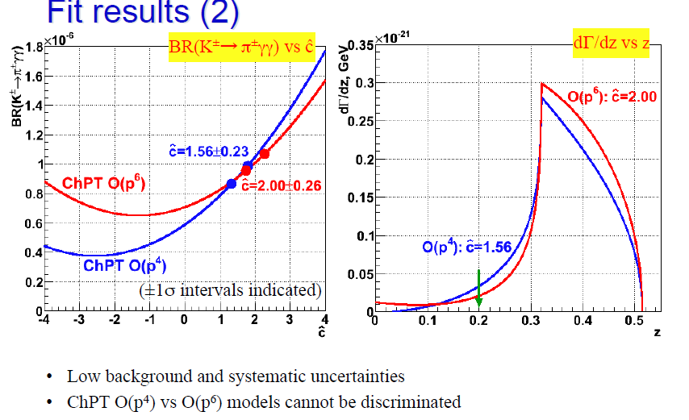
K⁺ → π⁺γγ ChPT fits
Fits limited to region z>0.2 due to residual BKG

Slide 18
Outline
Recent results:
  NA62 : Ke2 , Kμ2 and lepton universality
  NA48/2-NA62 : K → π γ γ
Prospects:
  NA62 and K → π ν ν
  Other rare and forbidden decays studies
  Napoli in NA62

Slide 19
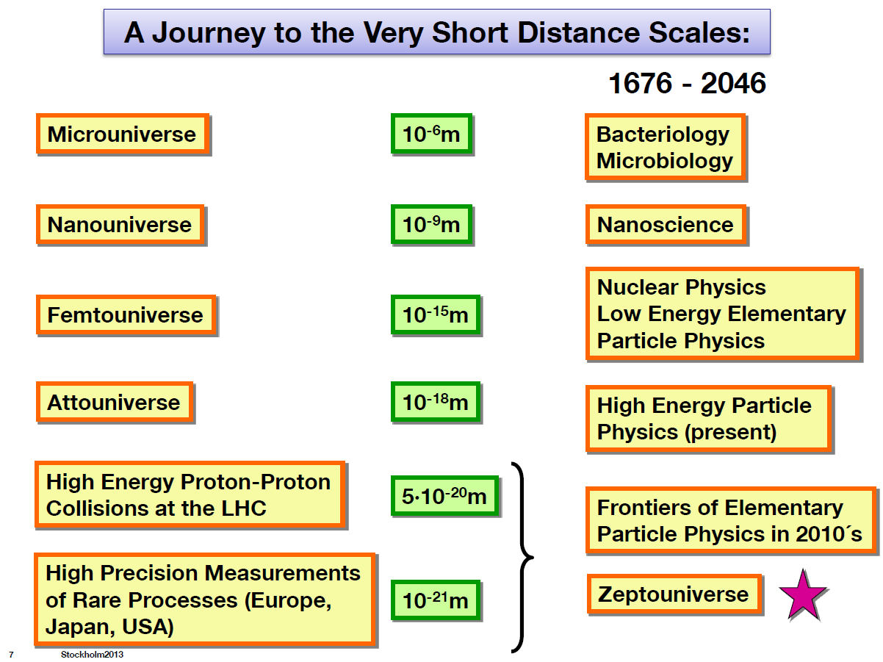
Rare kaon decays: motivation
A. Buras@EPS 2013
The 100 TeV scale will only be accessible with rare decay studies up to > 2035

Slide 20
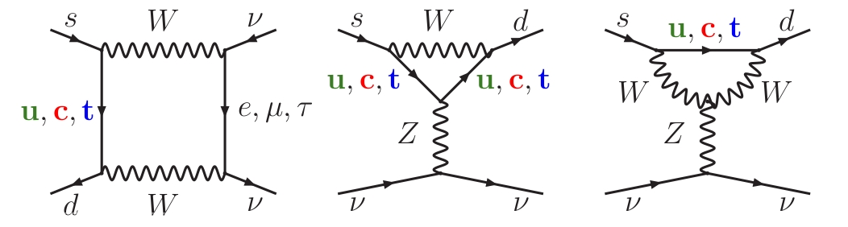


K⁺→π⁺νν in SM
FCNC process forbidden at tree level
Only one loop contributions: Boxes and Penguins
SM prediction (10⁻¹¹ units) [Brod, Gorbahn and Stamou 2011 and refs therein]
Loops favour top contribution
Hadronic matrix elements from BR(Ke3) via isospin rotation
Charm contributes to theory error: 4% for K⁺
Error on input parameters (V_{cb}, ρ, η, ...) dominant wrt other theory errors
BR sensitive to NP. Best probe for non MFV NP

Slide 21
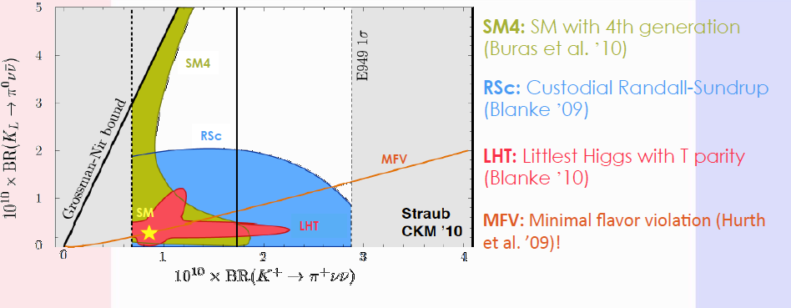
K→ πνν beyond SM

Slide 22
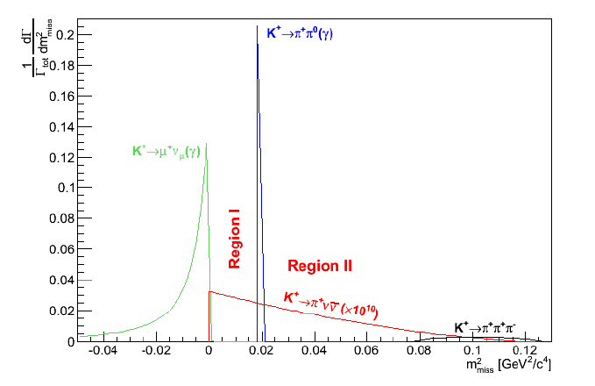

NA62 : the strategy
High K momentum (in flight technique)
Low π momentum to allow enough «missing» energy to be detected by hermetic veto detectors (LAV,IRC,SAC,LKr)
Particle identification (RICH, MUV)
Kinematical rejection w lightweight spectrometers (GTK, STRAW)
Beam particle identification and inelastic event suppression (KTAG, CHANTI)
Fast timing
K⁺
π⁺
Signature:
Incoming high momentum K⁺
Outgoing low momentum π⁺
GOAL: BR measurement @ 10% relative uncertainty

Slide 23
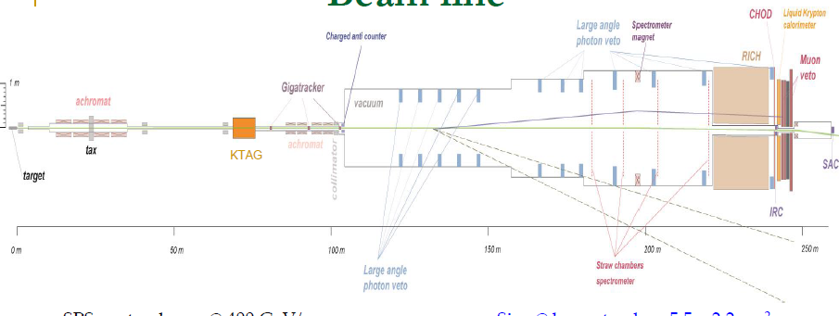
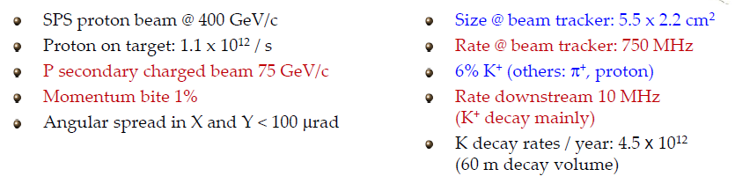
NA62 : beam and detector
CHANTI

Slide 24
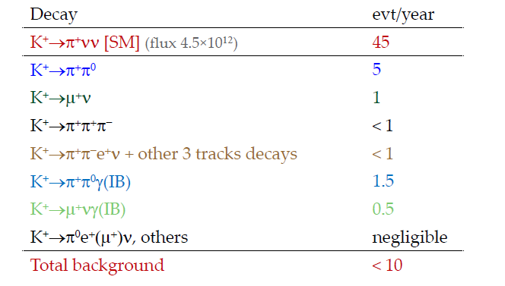
NA62 expected sensitivity
Simple cut and count estimation with no optimization
Background to be evaluated on data to reach the 10% accuracy

Slide 25
Outline
Recent results:
  NA62 : Ke2 , Kμ2 and lepton universality
  NA48/2-NA62 : K → π γ γ
Prospects:
  NA62 and K → π ν ν
  Other rare and forbidden decays studies
  Napoli in NA62

Slide 26
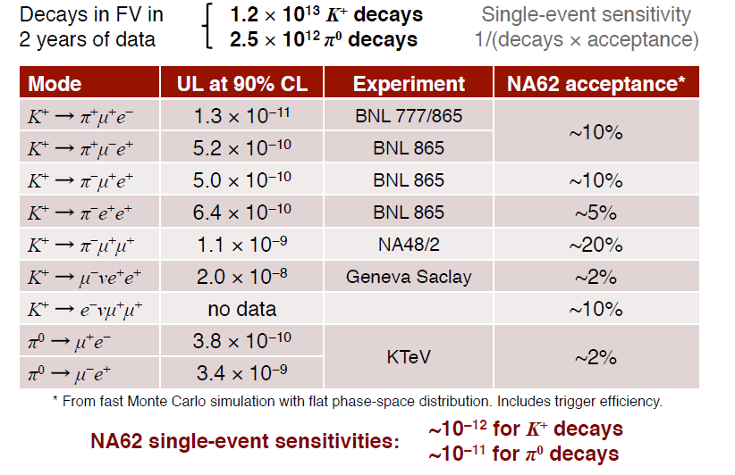
LFV/LNV modes
High fluxes and PID/veto capabilities of NA62 well suited to look for Lepton Flavor/ Lepton Number Violation modes in both kaon and pion decays:

Slide 27
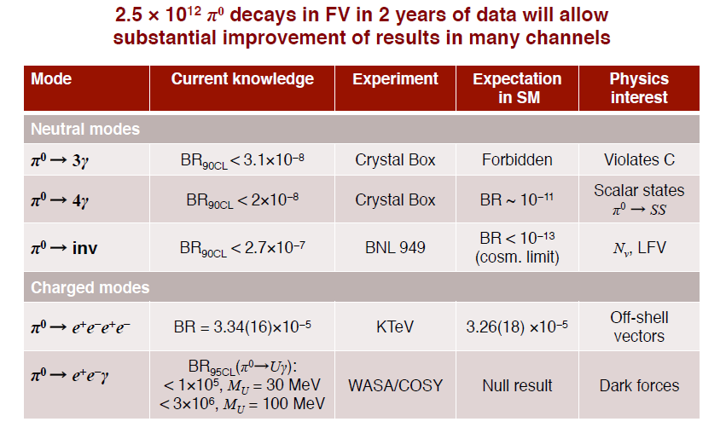
Other rare/forbidden modes

Slide 28
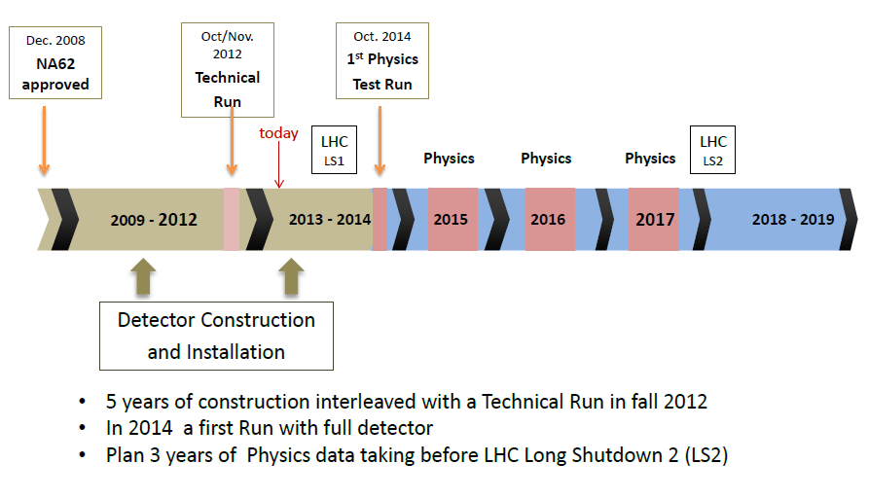
NA62 timeline

Slide 29
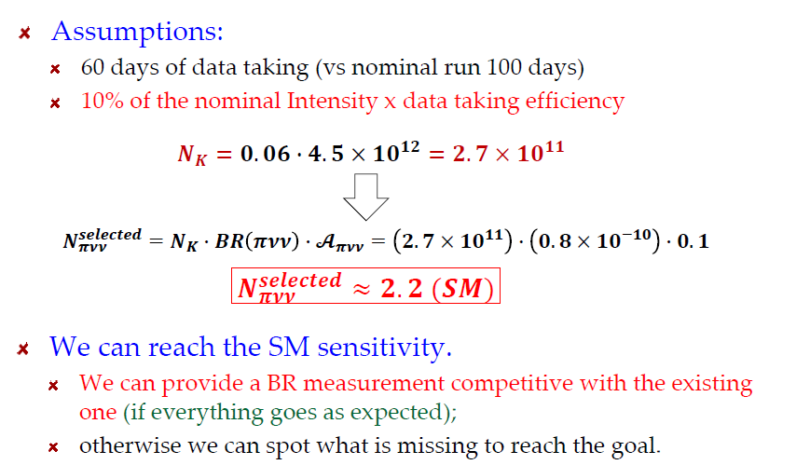
NA62 challenge for 2014

Slide 30
Outline
Recent results:
  NA62 : Ke2 , Kμ2 and lepton universality
  NA48/2-NA62 : K → π γ γ
Prospects:
  NA62 and K → π ν ν
  Other rare and forbidden decays studies
  Napoli in NA62

Slide 31
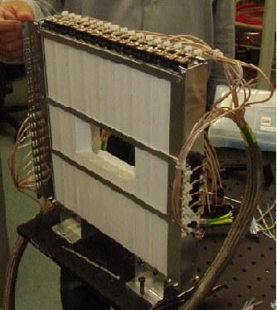
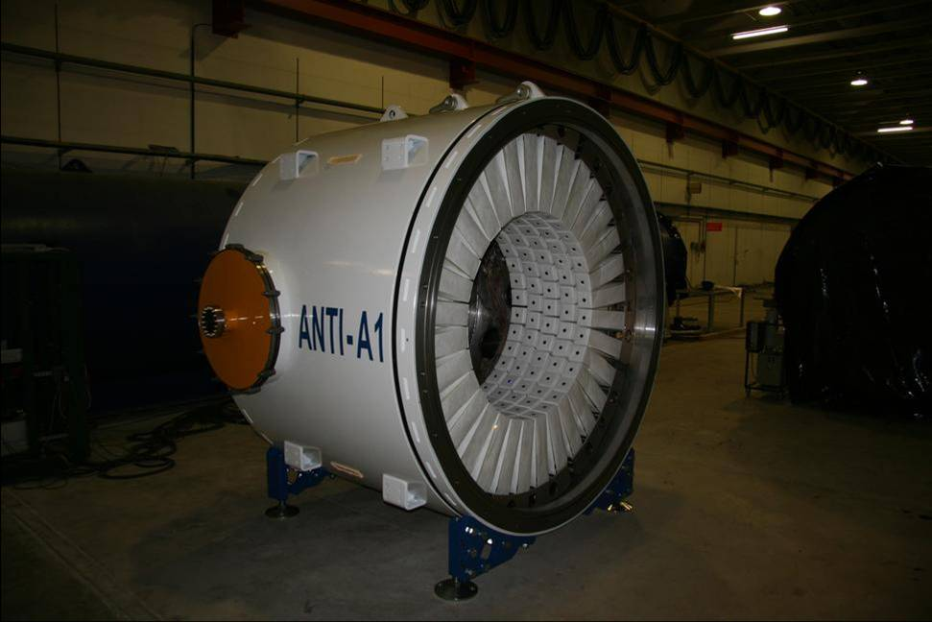
Napoli in NA62 since proposal
Two main hardware responsibilities:
  Large Angle Vetoes (w LNF-PI-Rm1)
  CHANTI (NA only)

Slide 32
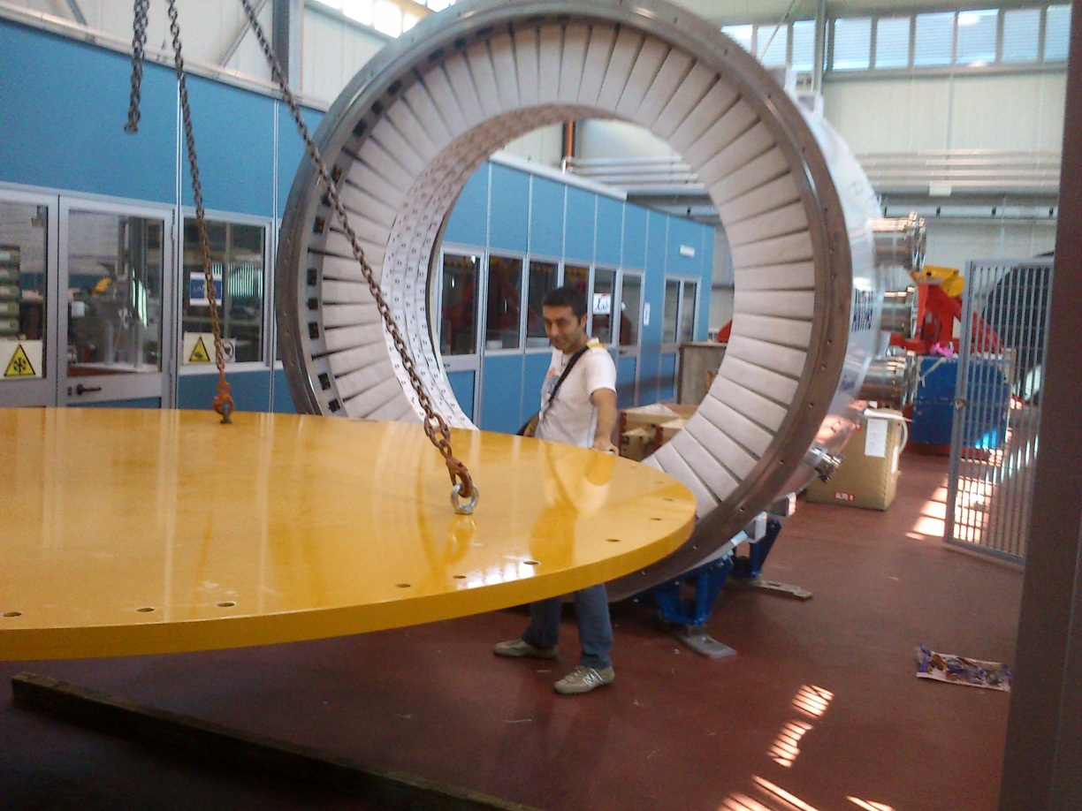
2013 → 2014: LAV
A9 and A10 completed at LNF and transported at CERN (A11 already done in 2012)
A9 installed on beam line (November 2013)
In 2014 need to complete the last station A12, the largest of all (and the only one which is not in vacuum) and assemlble the last part of the line
Expect to deliver to CERN Summer 2014

Slide 33
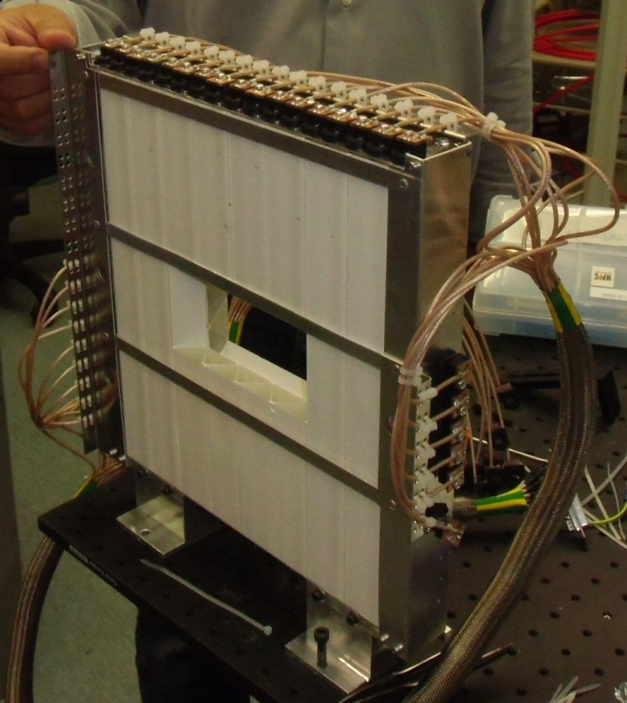
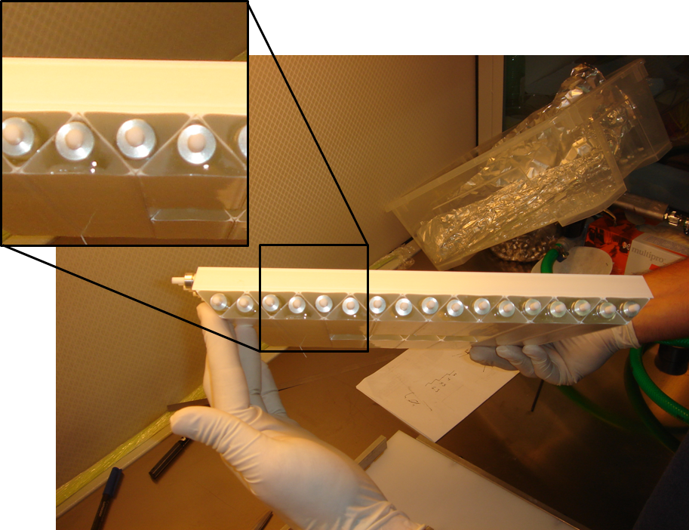
CHANTI postcard
π
K
Tracker (GTK)
Six «guard rings» to veto inelastic interactions of K on GTK3
Staggered scintilaltor bars w triangular section read via fast WLS fibers and SiPM forming 6 xy sensitive planes
Rate on full detector O(2 MHz), veto efficiency ∼99% limited by acceptance

Slide 34
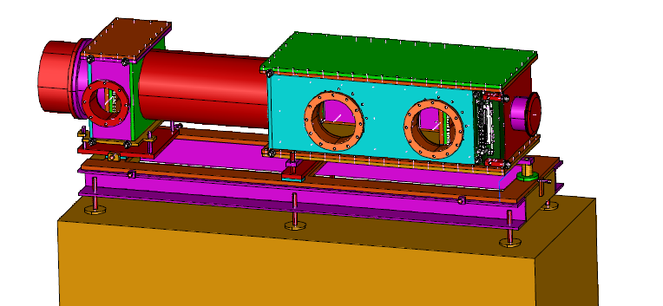
2013 → 2014: CHANTI
Mechanical design almost completed. Still needed tools for assembly, alignment etc.
Will be delivered to CERN mid June 2014
>90% of bars produced. >80% of them tested in climatic chamber

Slide 35
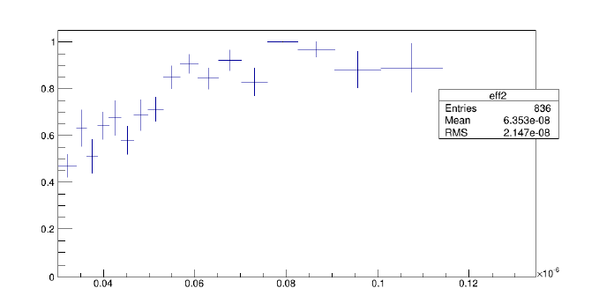
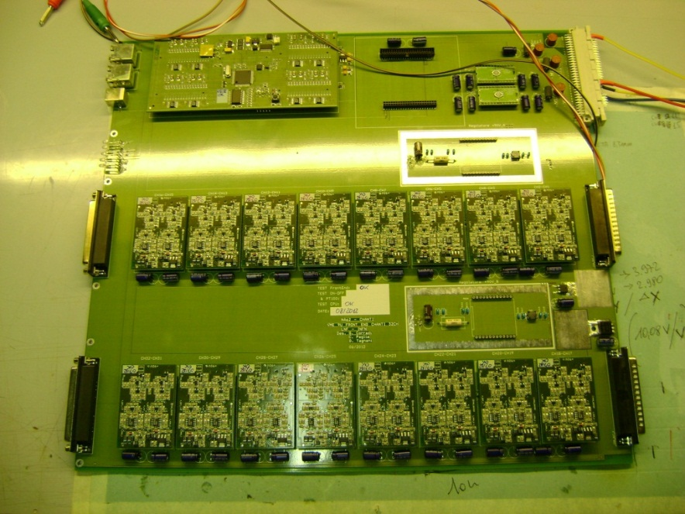
2013 → 2014: CHANTI
Custom front-end electronics production will start soon (gara closed yesterday!). Expect delivery by end of March
Tests at BTF (B. Sc. thesis M. Corvino) → dead time < 2% for hottest channels
DCS still to be addressed

Slide 36
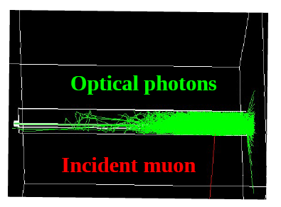
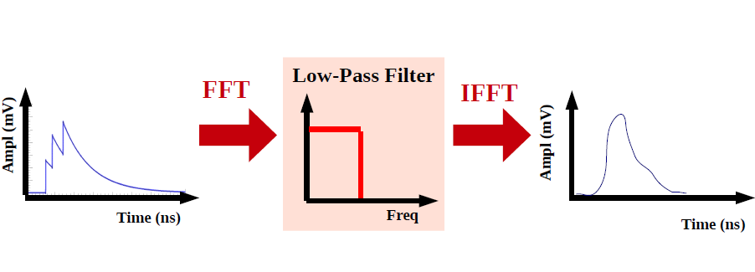
Simulation
Very detailed simulation of the CHANTI in order to obtain a realistic digitization of the signal
Includes all optical processes inside a bar and the simulation of the analog signal in order to obtain the time over threshold for a given energy deposit.
ToT

Slide 37
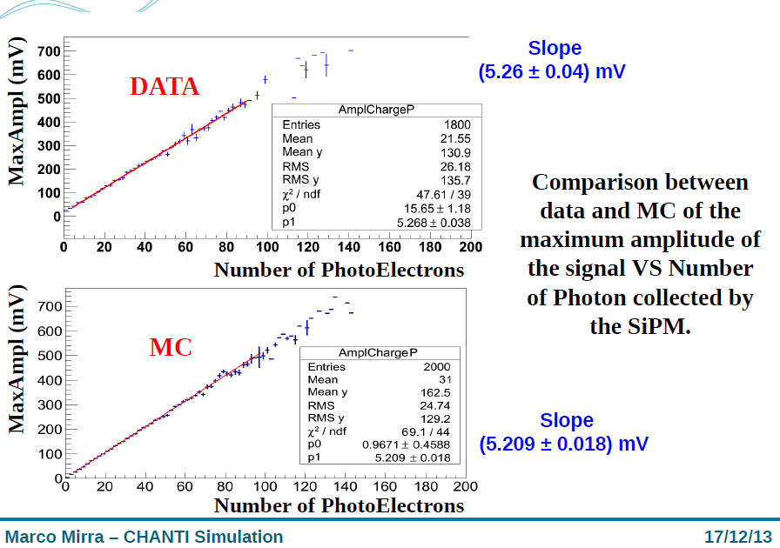
Simulation (2)

Slide 38
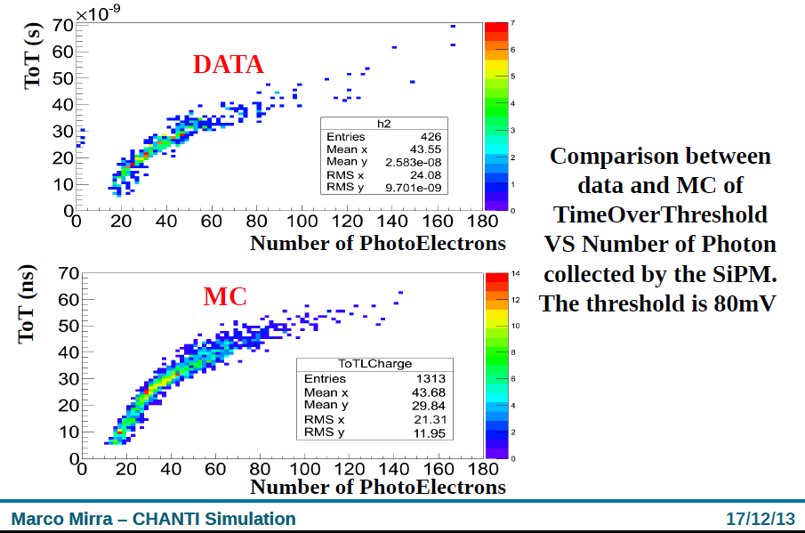
Simulation (3)

Slide 39
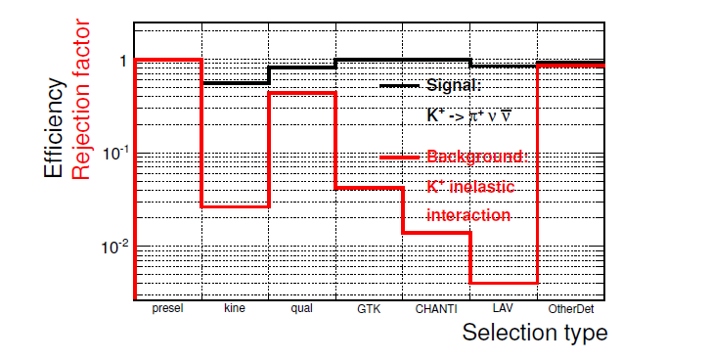
Analysis
Main responsibility: evaluation of the beam anelastic background for the K→πνν analysis
Main ingredients to suppress this (huge) background:
CHANTI + LAV (!!!) →Ph.D. thesis D. Di Filippo
Also interest in LFV-LNV modes (P. Massarotti)

Slide 40
Conclusions
More than 60 years after their discovery kaons provide a unique playground for testing our ideas on fundamental physics
NA62 collaboration is analyzing data taken in past years and producing very precise results for both leptonic, non-leptonic and semileptonic kaon decays.
But the best is yet to come, with the new generation NA62 apparatus starting its data taking in fall 2014: it will collect an unprecedented statistics and exploit its powerful detector features to push further our knowledge of rare (and forbidden) kaon decays.
We are very close to completion of our hardware tasks. Everything is very advanced (but nothing is complete yet…)
2014 will be the most important year since we started the NA62 challenge.

Slide 41
SPARES
Notes:
Inserire le caratteristiche del fascio
41

Slide 42
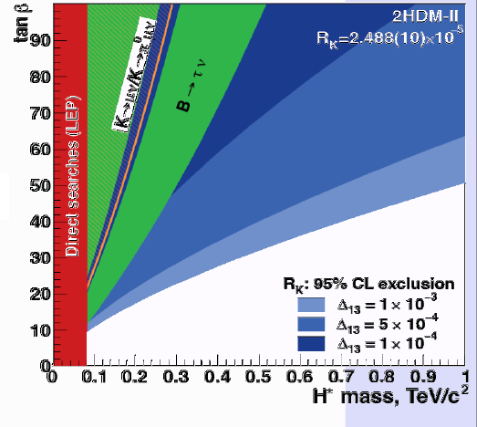
Bounds on NP from R_{K}

Slide 43
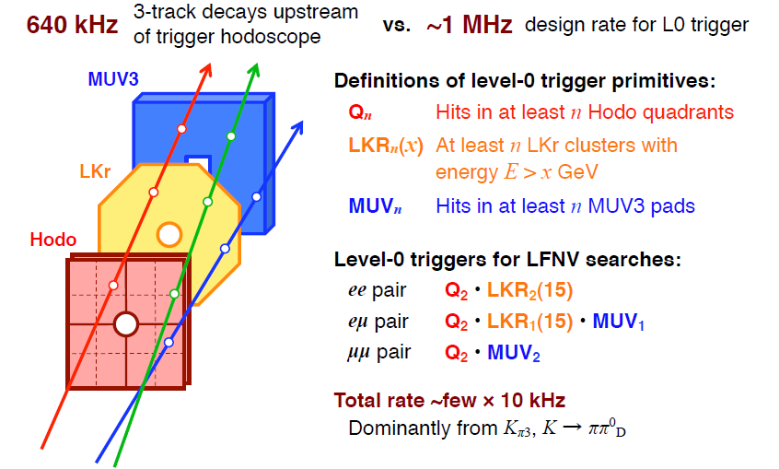
Trigger for LFV modes in NA62

Slide 44
Motivazioni per il CHANTI
Il flusso previsto di K sul GTK nei due anni di presa dati di NA62 è pari a 7.8*10¹³
Circa 7*10⁻⁴ di essi subirà interazione anelastica su GTK3
I tagli «standard» dell’analisi (incluso il volume fiduciale) sono in grado di sopprimere il fondo anelastico di un fattore 4*10⁻⁵
Aggiungendo una richiesta di veto sui LAV e assumendo che l’inefficienza dei LAV per questo tipo di eventi (3*10⁻³ ) fattorizzi si rimane con
O(7000) eventi di fondo pari a circa 70 volte il segnale SM
Altri tre-quattro ordini di grandezza di reiezione da ottenere: necessità di sfruttare la risposta del GTK (reiezione circa 4*10⁻²) e un veto specifico per eventi anelastici (anche per validare le simulazioni e selezionare campioni di controllo !).

Slide 45
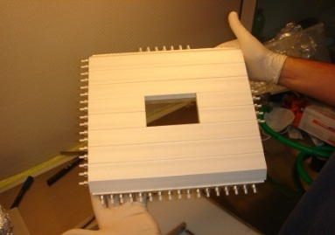
Chanti FEE scheme
Ri uso delle LAV-FEE ToT boards in uno schema a due livelli
CHANTI boards (LNF, G. Corradi):
  Set Vbias (mV),
  Amplificazione veloce
  Lettura corrente singolo canale (nA)
  Lettura sonde di temperatura (pt100)
CHANTI boards (9X)
TOT boards (9X)
Vacuum vessel
16 CH
32 CH
16 CH
Flange

Slide 46
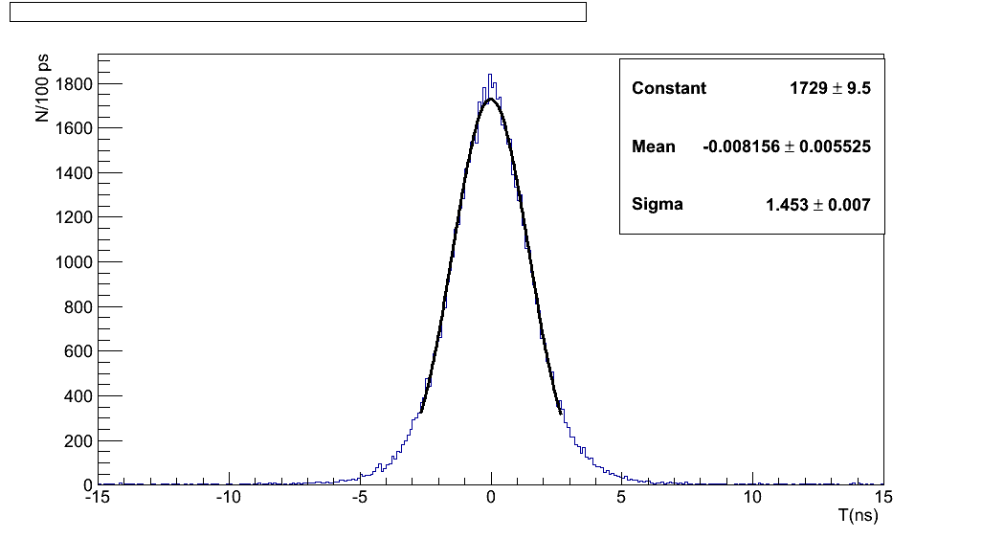
CHANTI-01 nel technical run
La prima stazione del CHANTI è stata utilizzata nel TR, posizionata in modo da misurare l’alone del fascio
Tutti i 46 canali letti con successo (max 32 simultaneamente) con la catena FE-ToT-TDC (Tel62)
Time difference among two bars (corrected for time slewing & position).
Res= σ/√2 = 1ns
Risultati molto buoni per la risoluzione temporale (1 ns/ch)
Prese dati in diverse condizioni di guadagno/diverse soglie ToT per tuning simulazione→ simulazione dettagliata del segnale
Operata con successo in vuoto

