Slide 1
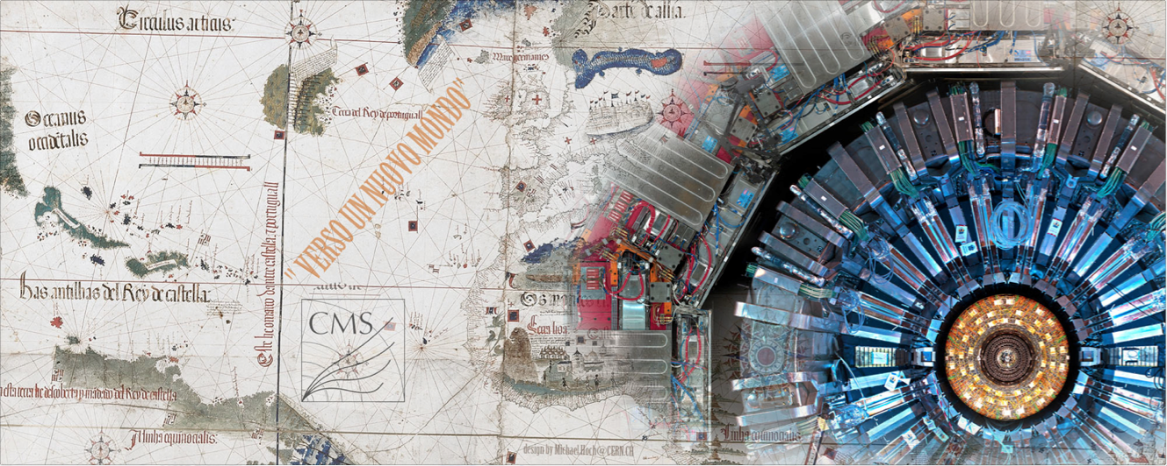
CMS upgrade
Pierluigi Paolucci

Slide 2
Outline
Phase I (2012-2014) 30 fb⁻¹
RE4 RPC detector installation
HCAL upgrade
Phase II pre (2016)
Pixel installation
GEM detector at high eta
RPC consolidation
Phase II (2018-2019) or (2019-2020) 300 fb⁻¹
Phase III (2023-2025) HL-LHC 3000 fb⁻¹
Phase IV (?)

Slide 3
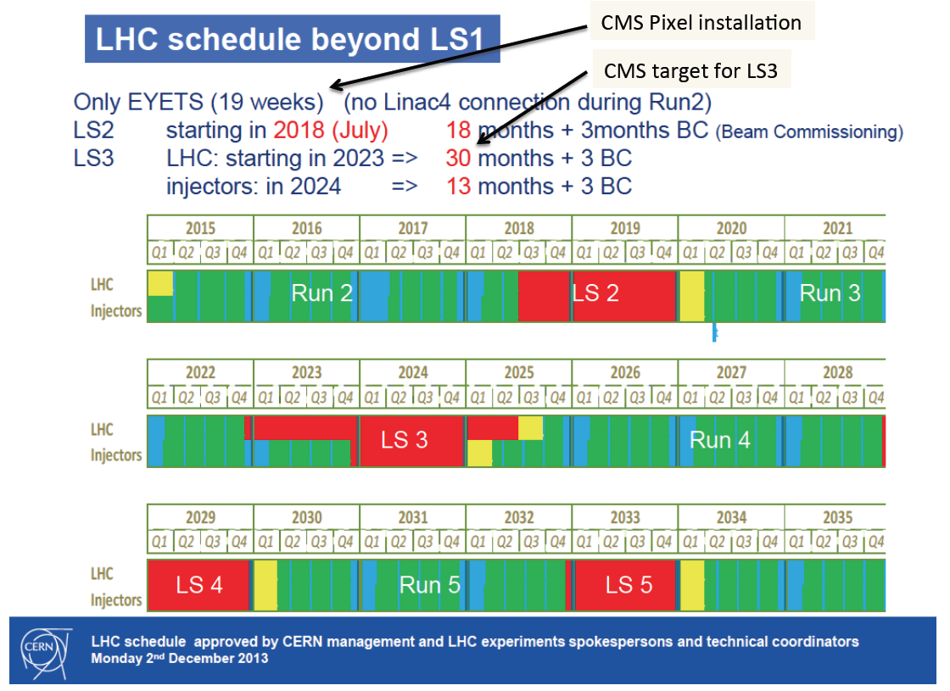
LHC schedule

Slide 4
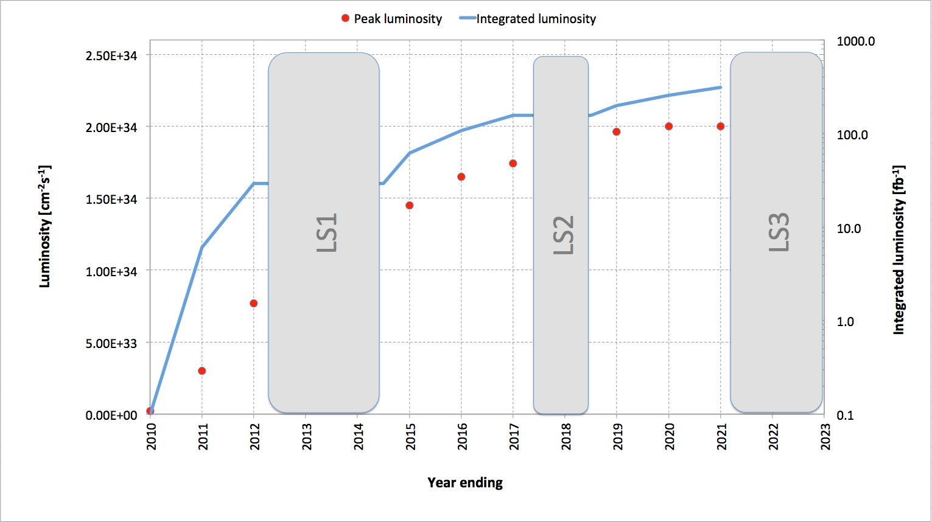
LHC luminosity schedule

Slide 5
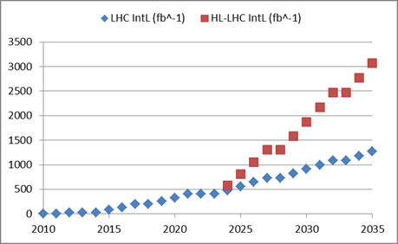
LHC luminosity schedule
By implementing HL-LHC
Almost a factor 3
By continuous performance improvement and consolidation
Goal of HL-LHC project:
250 – 300 fb⁻¹ per year
3000 fb⁻¹ in about 10 years

Slide 6
LHC luminosity schedule
“CERN should undertake design studies for accelerator projects in a global context, with emphasis on proton-proton and electron- positron high-energy frontier machines.”
today
Project
Kick-off meeting: 11th Nov. 2013 (Daresbury)
FCC Study : p-p towards 100 TeV
Kick-off meeting: mid-February 2014

Slide 7
Ingredients for the future scenario
The present system was designed up to:
L = 10³⁴, pile-up = 40 and Time = 20 years
First chamber built in the 2007
Electronic designed in the 2006
Chamber tested at GIF up to 0.1 C/cm² (1000 fb⁻¹)
Component tested up to a neutron fluence of 10¹² neutrons/cm², corresponding to 3000 fb⁻¹
New goals are:
L = 5 10³⁴, pile-up = 60-140 and Time = 30-35 years

Slide 8
Ingredients for the future scenario
Three bitter enemies:
Time, high luminosity & pile-up →
Detector Longevity
Trigger rate (physic case)
Electronic speed/transmission protocol
Computing (Filter farm.....)
Natural improvements thanks to the technology constantly developing.

Slide 9
Ingredients for the future scenario
A lot of physic in the high/very high eta region
Pile-up 140, background and secondary vertexes
Trigger at 1 MHz
Tracker trigger & muon tagger
New muon technology & present system ?
New R&D and test needed to get 3000 fb⁻¹ and 30 years.
But what about glue, bakelite, wires, spacers..... ?
We don’t have experience about an experiment of more than 30 years.

Slide 10
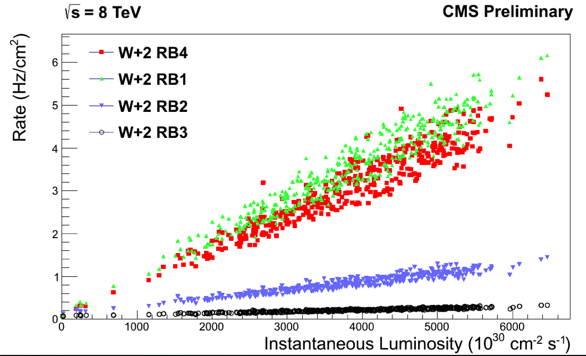
Detector Longevity - background
Real time background monitor extrapolation
chamber | Rate (Hz/cm²) @ 10³⁵ cm⁻² s⁻¹ | Integrated charge C/cm² @ 3000 fb⁻¹
W-2 RB3 | 2 | 0.0036
W+2 RB1 | 40 - 50 | <=0.07
W+2 RB4 | 30 - 40 | <=0.07
W-2 RB4 S4 | 80-90 | 0.13
RE1_ring3 | 5-10 | 0.01-0.02
RE-2_ring2 | 100-150 | <=0.21
RE-2_ring2_C | 150-200 | <=0.36
In the worst case
Q = 0.36 C/cm² @ L_{int} = 3000 fb⁻¹ close to
Barrel chamber tested at GIF (0.1 C/cm²)
But Atlas and LHCb tested up to ~0.4 C/cm²
Test of 40x40 cm² CMS chamber by korean group > 0.4 C/cm²
At moment, END OF RUN 2012-13, integrated charge is < 3 mC/cm²

Slide 11
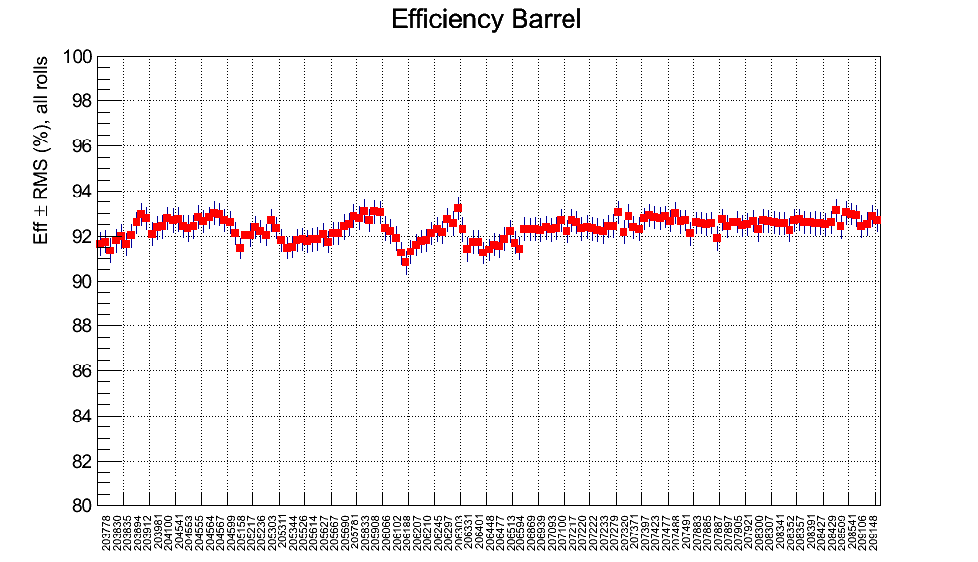
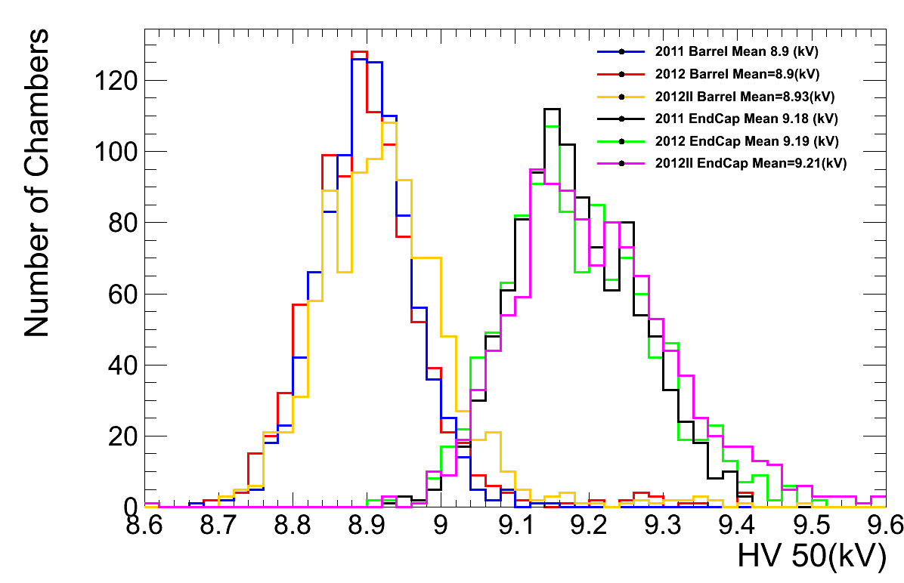
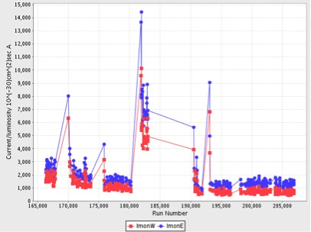
Detector performance
2200 gaps, 250K electronic channels, 1200 DAQ boards, 1K sensors, 1K power system channels, 100 Km cables, 25K connectors.....

Slide 12
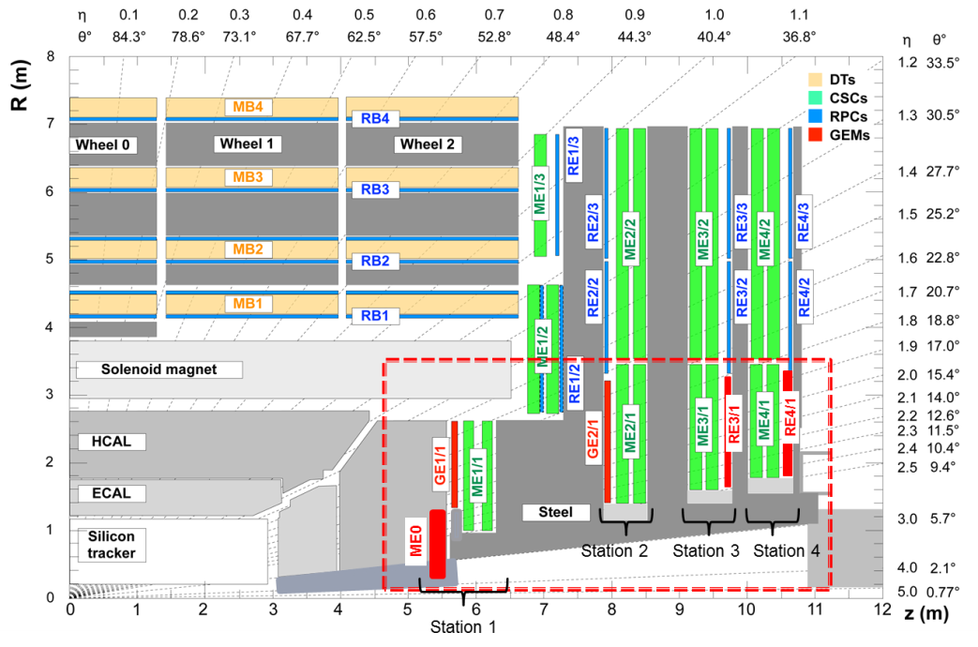
Muon upgrade I & II

Slide 13
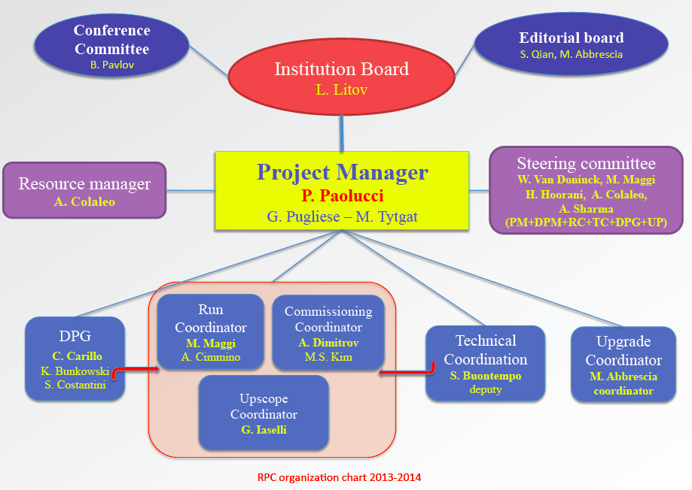
Progetto RPC (2013-2014)

Slide 14
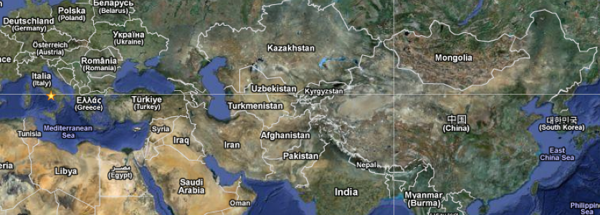
CHINA | 2
KOREA | 16
INDIA | 4
BELGIUM | 10
COLOMBIA | 2
N. Puebla | 3
PAKISTAN | 6
EGYPT | 3
CERN | 4
ITALY | 28
BULGARIA | 12
Georgia | 2
TOTAL | 90
Nueva
Puebla
Barrel | Italy | Bulgaria | China | Colombia
Endcap | Korea | Pakistan | China | Belgium | CERN
Upgrade | Italy | Pakistan | India | Colombia | CERN
 | Korea | China | Belgium | Finland | Egypt
 | N. Puebla |  | Georgia
Uniandes
Belgium
Georgia
CERN
Bulgaria
Italy
14/7/11
RPC project overview - CMS retreat Jan 2013
14
Dott. Pigi Paolucci - I.N.F.N. of Napoli (ITALY) - Symposium on Collider Physics at Seoul (Korea)
14

Slide 15
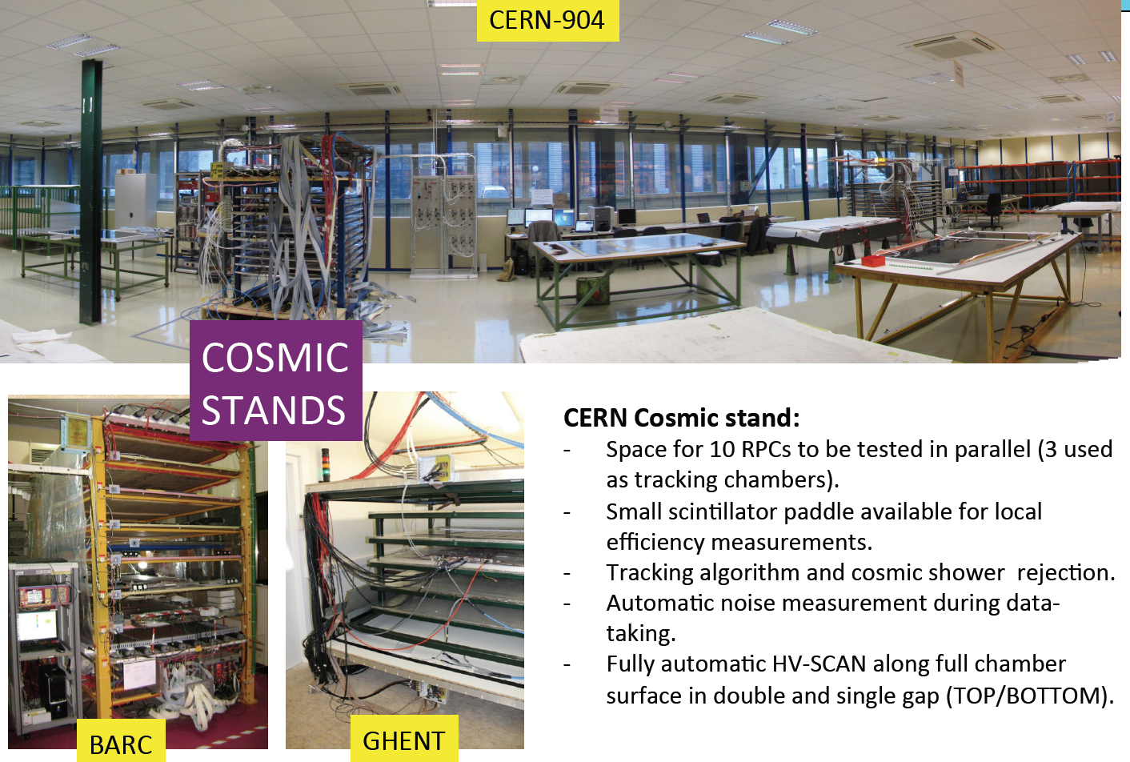
RE4 production sites

Slide 16
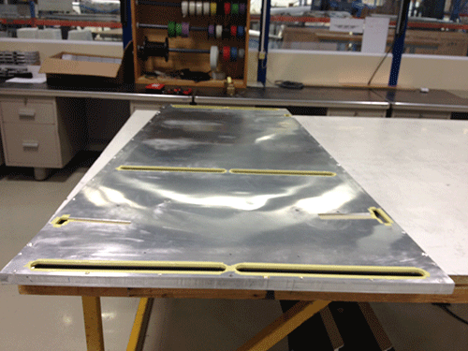
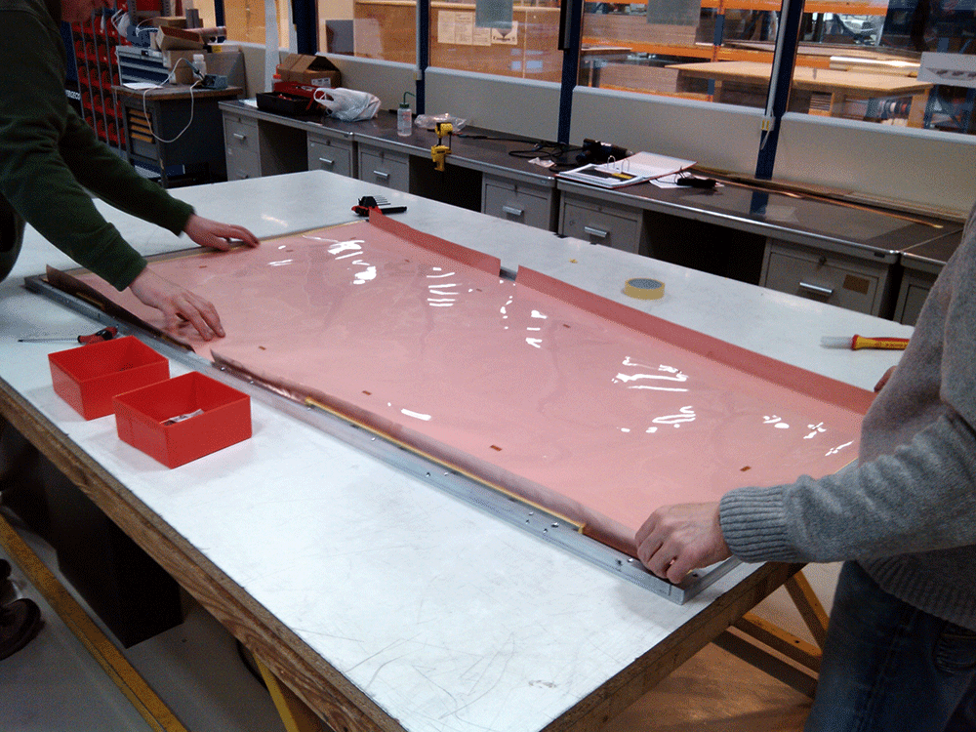
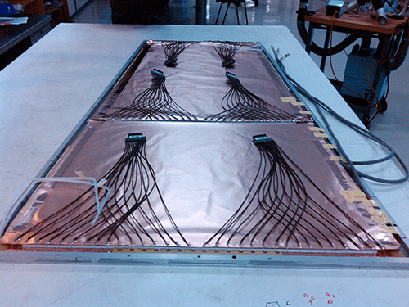
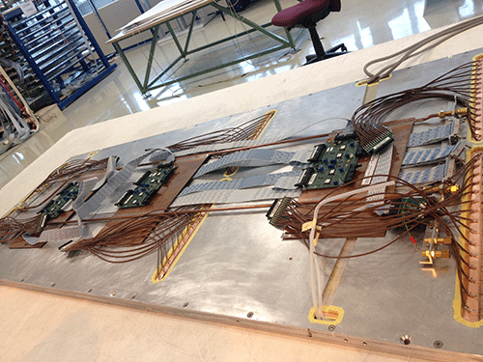
Chamber construction

Slide 17
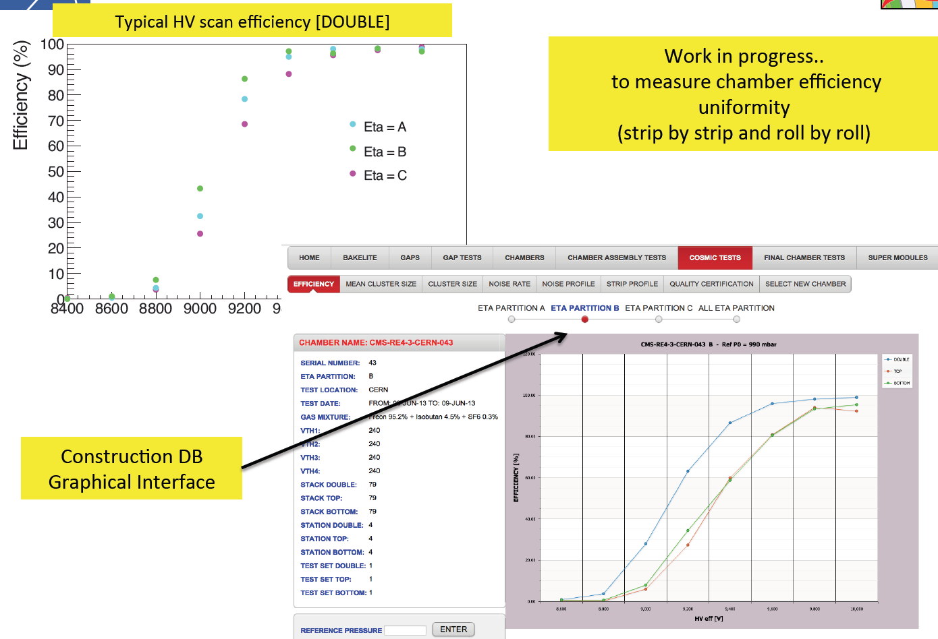
72 RE4 chambers built in the 2013

Slide 18
RE4 installation (phase I) Today

Slide 19
RE4 installation (phase I) Today

Slide 20
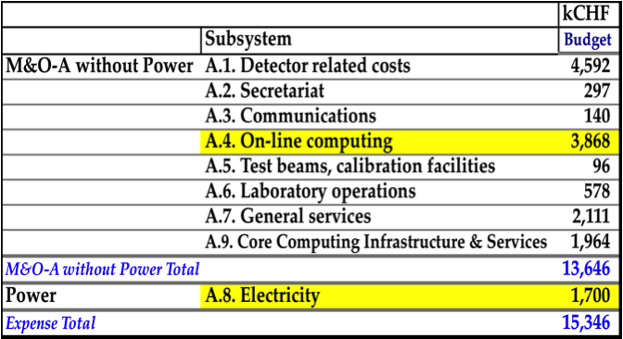
But, how much does it cost ?
running

Slide 21
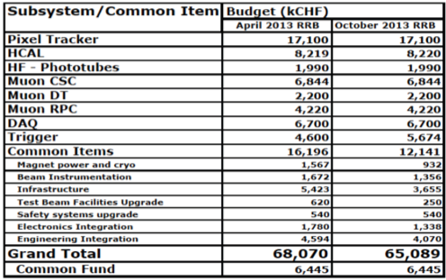
But, how much does it cost ?
Upgrade I

Slide 22
Phase II CMS proposal

Slide 23
Muon upgrade proposal
Phase I: complete the endcap region
Phase II – pre: internal layer of 1 disk of the forward region (up to eta = 2.1)
Phase II: internal layer of the 2°, 3° and 4° disk.
Consolidation of the present system.
REQUIREMENTS
Background rate up to 1 MHz/cm2
Pile-up and secondary vertex
Trigger rate reduction
Background identification with time resolution

Slide 24
Napoli nell’upgrade
Il gruppo è composto da 14 persone. Attualmente 4 persone sono già coinvolte nell’upgrade.
Napoli è coinvolta nel disegno delle camere a GEM
Napoli è responsabile per la progettazione dei nuovi rivelatori ad RPC per il consolidamento insieme a Bari, Pavia e Ghent
R&D per Elettronica e sistema di potenza sono già stati approvati dall’INFN
Purtroppo mancano giovani con la cultura “giusta”, riflessione tardiva in tutta la collaborazione. Alcune cose andrebbero cambiate e migliorate per consentire all’Italia di essere competitiva (Phd, post-doc….)

Slide 25
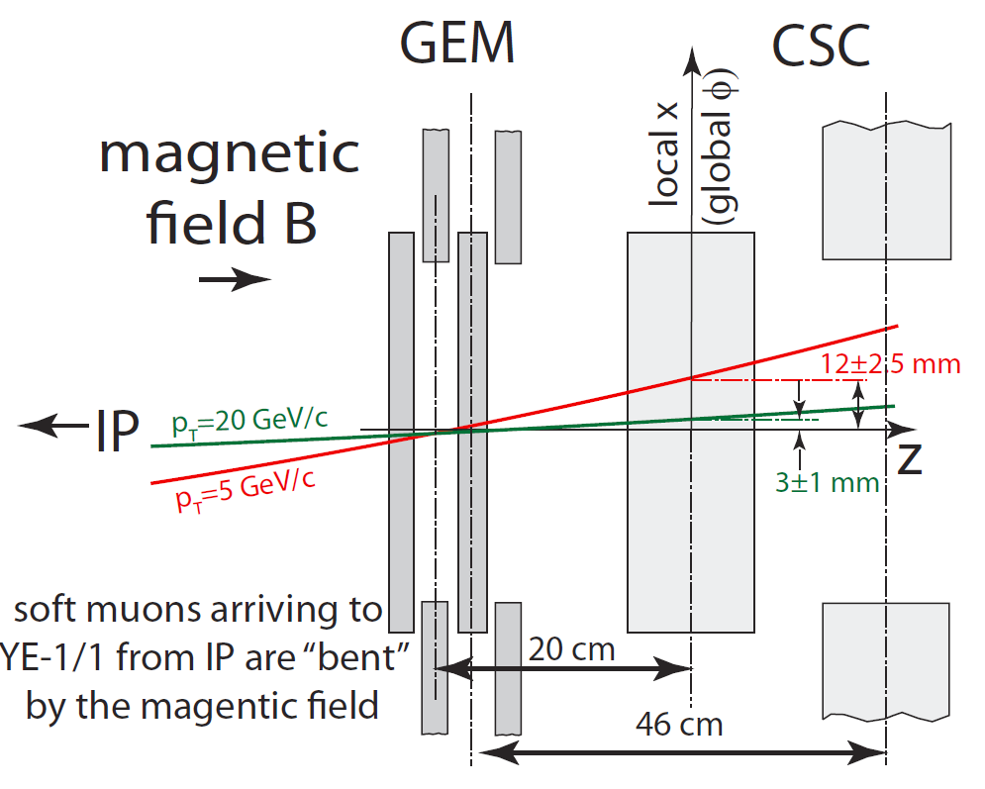
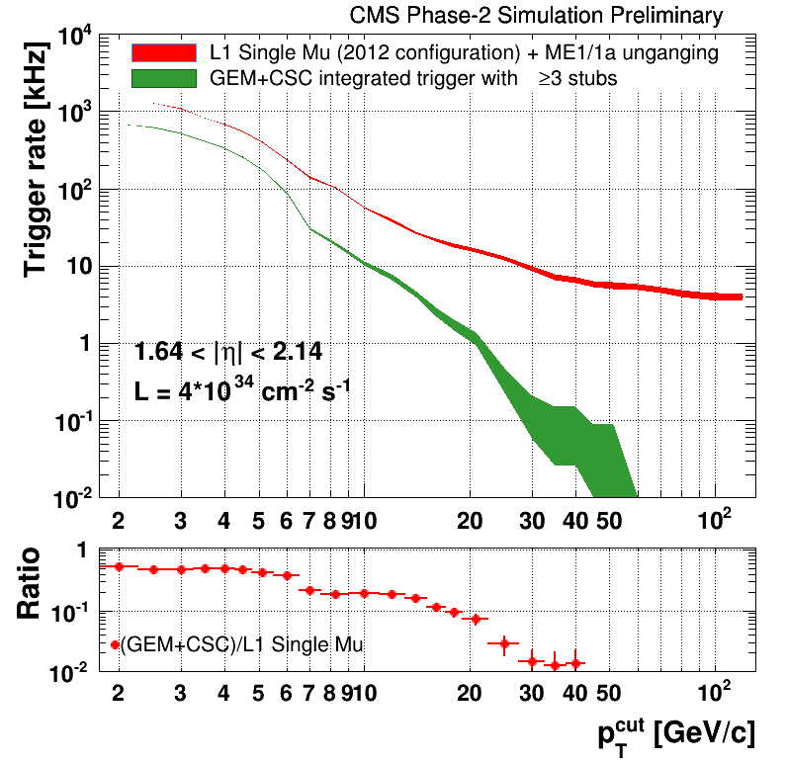
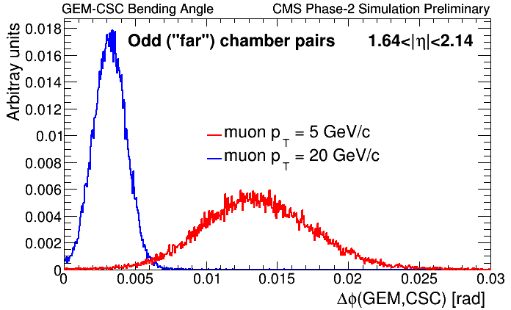
GEM proposal - basic idea
The leading motivation is to improve muon triggering in this region
Rate reduction from bending angle and increased efficiency from added redundancy

Slide 26
GEM proposal

Slide 27
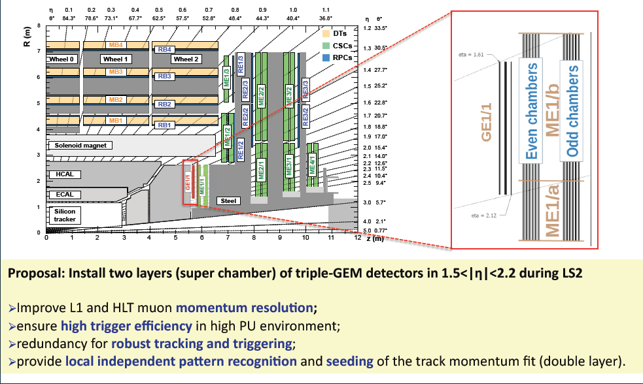
GEM proposal

Slide 28
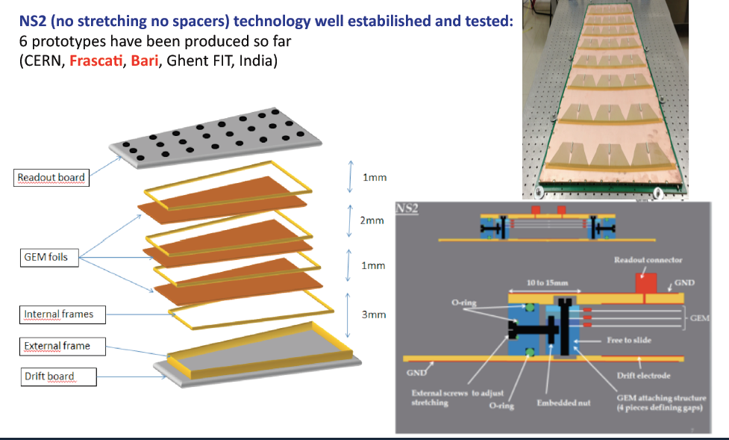
GEM proposal

Slide 29
GEM proposal

Slide 30
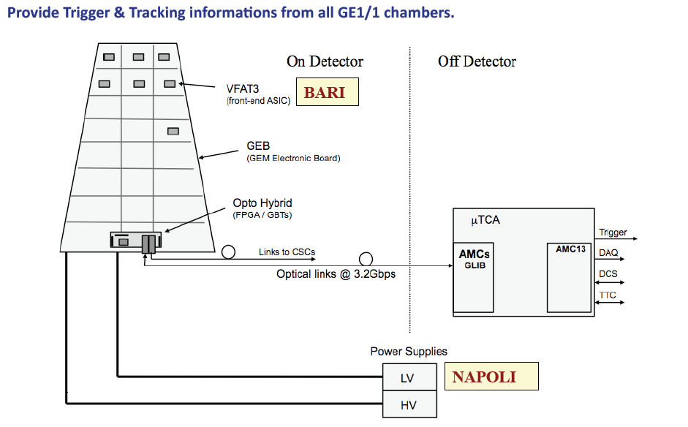
GEM proposal

Slide 31
iRPC
New “bakelite” and “glass” RPC are under test right now at GIF
Old and new electronics
New gas freon-less
New gas components
A first new detector will be installed in the 2016 in the barrel region.

Slide 32
Conclusioni
La fase I del progetto muoni sta procedendo benissimo. In schedule e nel budget.
L’upgrade di fase II è in fase di elaborazione e di scrittura. Il TP dovrebbe essere pronto per la fine dell’anno. Molte simulazioni sono ancora in corso.
Per HL-LHC il percorso è secondo me lungo e va capito bene che funzione deve avere il sistema dei muoni quando il tracker trigger sarà in funzione.
Enorme la mole di lavoro necessaria per la parte tecnologica.

