Slide 1
ATLAS & Upgrades
Introduzione
Fase I: New Small Wheel
Fase II: panoramica

Slide 2
Alviggi Mariagrazia
Aloisio Alberto
Canale Vincenzo
Carlino Gianpaolo
Cevenini Francesco
Chiefari Giovanni
Conventi Francesco
de Asmundis Riccardo
Della Pietra Massimo
Di Donato Camilla
Doria Alessandra
Giordano Raffaele
Iengo Paolo
Izzo Vincenzo
Merola Leonardo
Perrella Sabrina
Russo Guido
Rossi Elvira
Sekhniaidze Givi
Sanchez Arturo
Zurzolo Giovanni
Il gruppo ATLAS 2013-14
Laureati/ndi nel 2013:
• Magistrali:
A. Sannino,
F. Cirotto,
N. Bruscino,
C. Savarese
L. Paolillo
N.Calace
• Triennali:
L.DiColandrea
C.Grieco
A.Evangelisti
P. Iovine
Tot 15.7 FTE ma…..
Givi, CERN associate fino a giugno 2014
Paolo Iengo, CERN staff 2014-2019

Slide 3
Attività ATLAS 2013-14
RPC e LVL1/TDAQ maintenance & ‘small’ upgrades
  Data Quality, Massimo (resp. DQ RPC), Camilla
  RPC : Givi (resp.), G.Chiefari, Lello Rocco
  LVL1/TDAQ: Vincenzo I. (LVL1 coord. group), Massimo, Sabrina, A.Aloisio
Computing
  Gianpaolo (Deputy coord. Naz. e scrutiny group), Alessandra(resp.op.Tier2), Arturo, Camilla, L.Merola, G.Russo
Upgrade: NSW Micromegas and trigger
  Micromegas: Paolo I. (Resp. naz. MM, in congedo al CERN dal 2014), Givi (CERN associate fino a giugno 2014), Riccardo, MG, Camilla, Massimo, Vincenzo C.
  Trigger: Vincenzo I., Raffaele G., Sabrina P.
Analisi
  Higgs: Francesco, Elvira, Arturo, Giovanni + laureati/ndi: F.Cirotto., N.Bruscino, C.Savarese, L.Paolillo
  Bs→μμ : Paolo, Vincenzo C., laureata A.Sannino
  W+jets: laureanda N. Calace (A.Tricoli (CERN), Paolo I.)

Slide 4
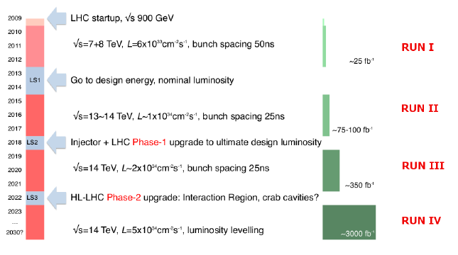
LHC Long Shutdowns & Runs
new
LS2
LS3
2025

Slide 5
PHASE I

Slide 6
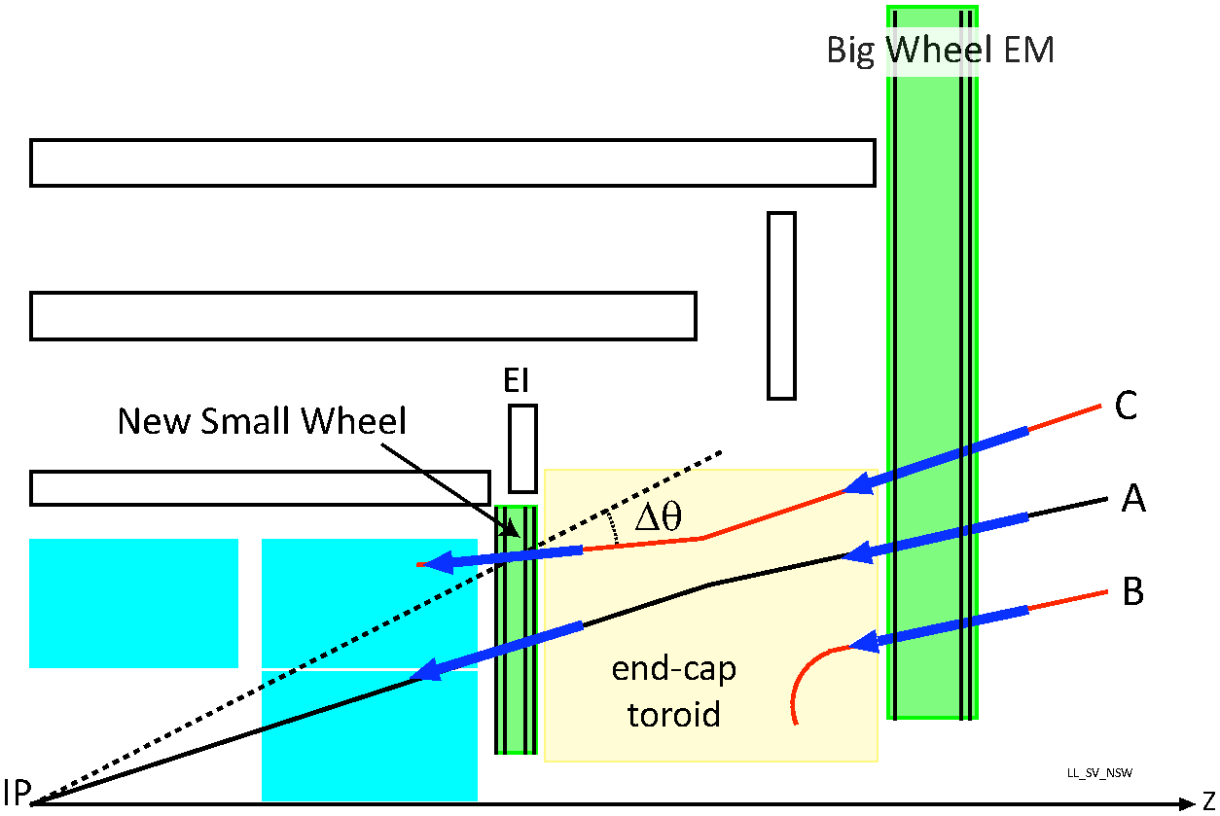
PHASE I Upgrade: New Small Wheel
The NSW Upgrade with the replacement of the existing Small Wheels has the goal to address
The high fake track rate with the current setup
Prohibitively high L1 Muon rates if current pt thresholds would be kept at luminosities as expected after LS2 and during HL-LHC ...
Δθ<7 mrad

Slide 7
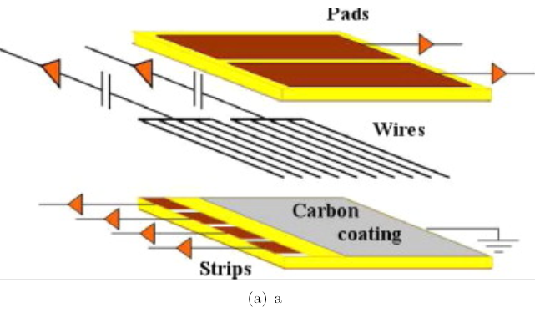
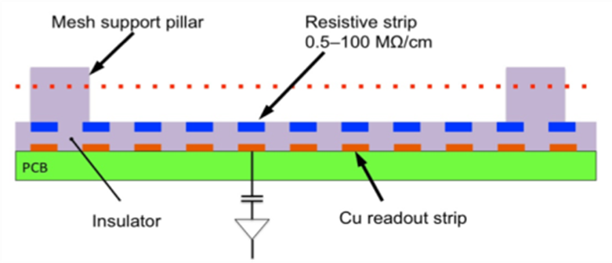
NSW Detectors
2 detector technologies, complementing each other:
Micro-Mesh Gaseous detectors (Micromegas) as primary precision tracker
Space resolution < 100 µm independent of track incidence angle
Good track separation due to small 0.5 mm readout granularity (strips)
Excellent high rate capability due to small gas amplification region and small space charge effects
sTGCs as primary trigger detector
Bunch ID with good timing resolution – additional suppression of fakes
Good space resolution providing track vectors with < 1 mrad angular resolution
Based on proven TGC technology, PAD electrodes instead of only strips as in current detector
High redundancy, 16 active detection plane in total, technologies complement each other, both with trigger and tracking capabilities !

Slide 8
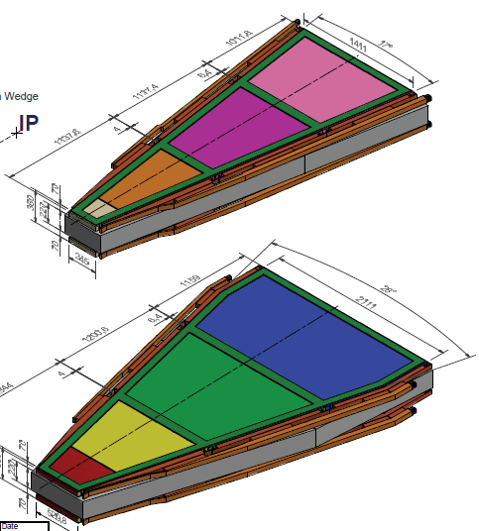
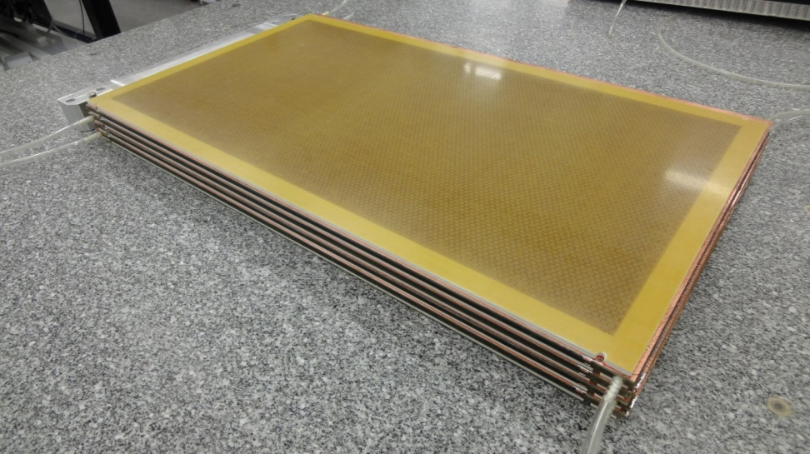
sTGC Chamber Construction
There will be 6 different type of sTGC modules (quadruplets), produced in 4 major and 1 auxiliary production sites: Israel, Canada, Chile, China (Shandong) + St. Petersburg.
Note: IL and CN produced TGC for the current muon spectrometer.
Israel: New 60x40cm module produced using quasi final tooling, results meet specs for flatness and uniformity: Flatness to within 50μm and uniformity of thickness around the edges with Ϭ=48μm with largest deviation ~100μm.
2nd module being built to complete qualification of procedure and involved company
Preparations for Module-1: 2 Quote asked from 2 companies for production of the cathode plane

Slide 9
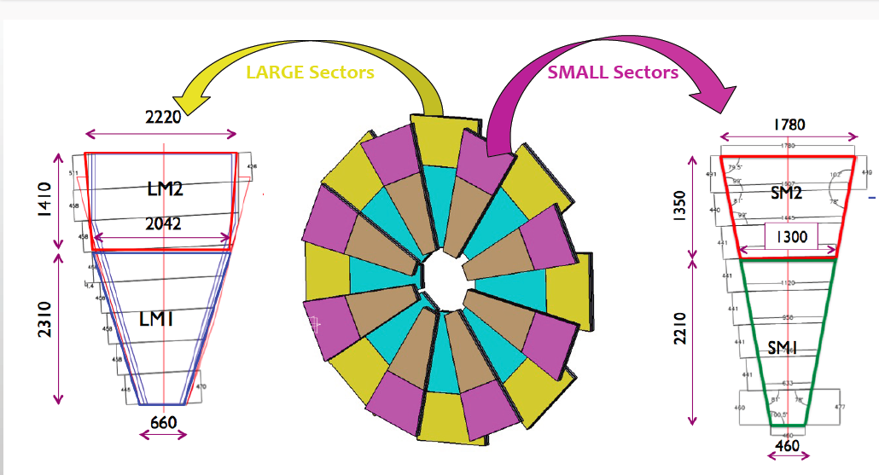
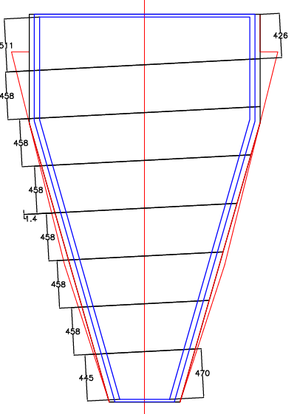
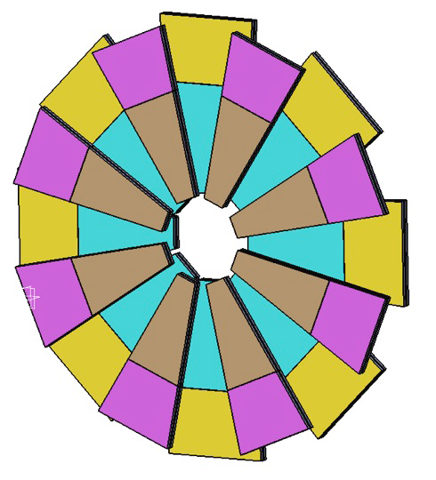
MM Chamber Construction
Tessaloniki,
Dubna
Germany
Saclay
Italy-INFN
Large sectors
Italy-INFN: Cosenza, Frascati, Lecce, Napoli, Pavia, Roma 1, Roma 3,

Slide 10
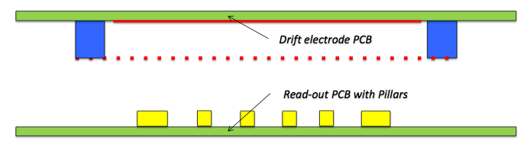
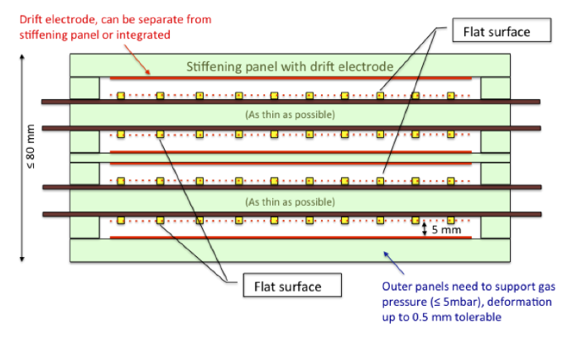
Micromegas production
Drift panel
PCB production → industries
Mesh stretching → industries (?)
Panel productions → Institutes
  INFN (Pavia, Rome1); Saclay; Germany, Tessaloniki, Dubna
Quadruplet assembly
and test → Institutes
  INFN (LNF); Saclay;
  Germany; Tessaloniki;
  Dubna
RO panel

Slide 11
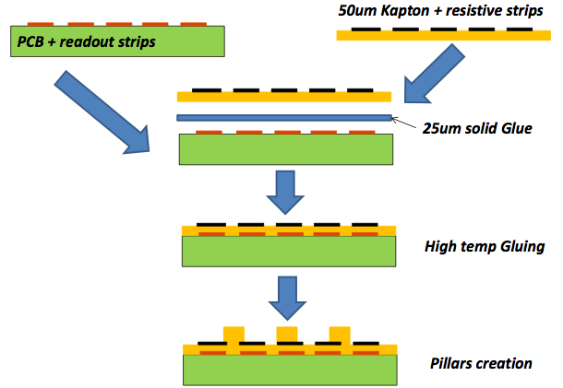
PCB production
Firms under evaluation
PCB + readout strips:
ELTOS, ELVIA, Triangle Lab
Kapton + resistive strips:
Screen printing:
ELTOS, ELVIA, Charbonnay
Spattering:
Raytech (Japan, A. Ochi)
Gluing:
Press: MDT
Autoclave: ELVIA
Pillar creation:
ELTOS, ELVIA, Triangle Lab
Working group on PCB production/procurement created to define the construction procedure and ‘validate’ the firms → final contract (with tender following CERN rules) to be signed in fall 2014

Slide 12
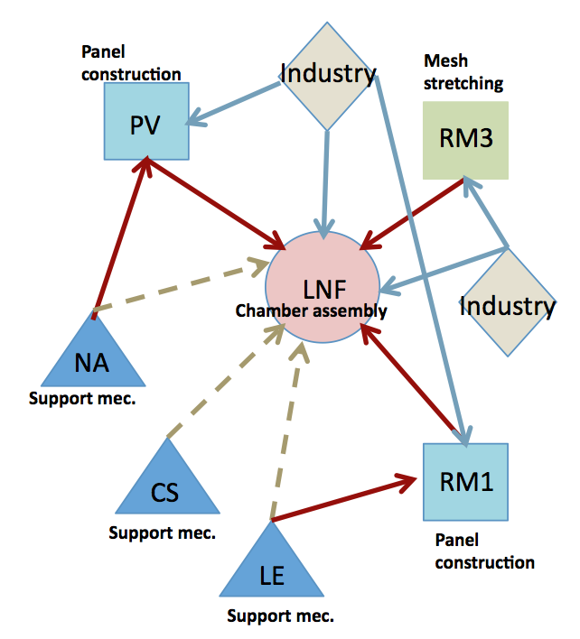
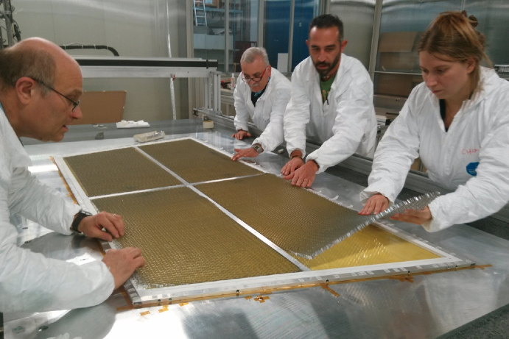
MM production
Possible production flow-chart:
supporto dell’officina meccanica
‘limitato’ → partecipazione in altre sedi…
Lello Rocco a Pavia per la costruzione dei pannelli

Slide 13
MM Prototypes
(Mechanical) Prototype construction ongoing in Italy, Germany, Saclay and CERN --- 1 full wedge + 4 modules of different size ---- defined before segmentation was decided.
  Demonstrate feasibility: Strip pos. in plane ≈ 50 μm, Parallelism ≤100 μm
  Test of different gluing procedures with the aim to define a common procedure
  Test of different material, eg type of glue
  Setup of basic infrastructures
  Gain experience
Assembly prototypes into 2 dummy sectors, with dummy counter weights as 2nd wedge, to study mechanical deformation and stress
  Crucial input to settle In-plane alignment needs
  Assess and define method to attach modules to sector structure – glueing, kinematic mounting, ....
Saclay
Pavia/Frascati
Rome1
LMU
Overall status: Modules will be completed by the end of the year, followed by measurement campaign: Define in January final construction method and write manual

Slide 14
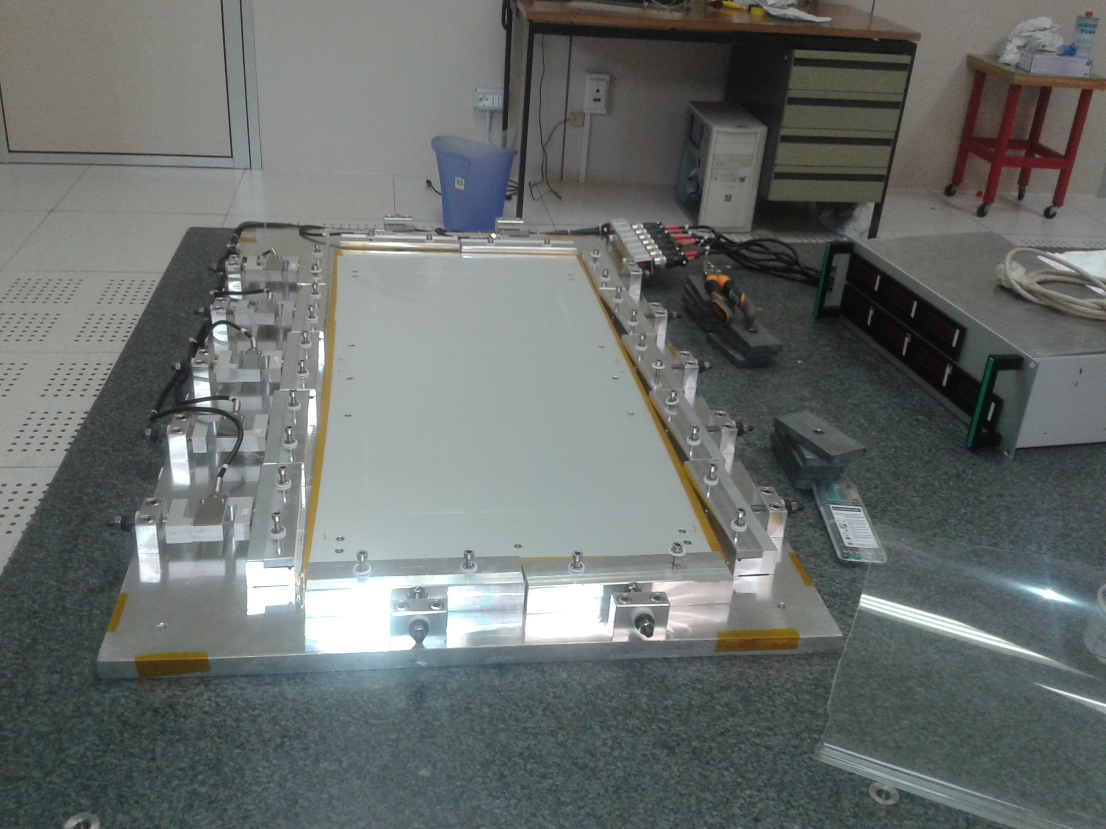
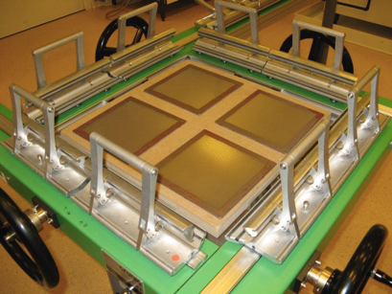
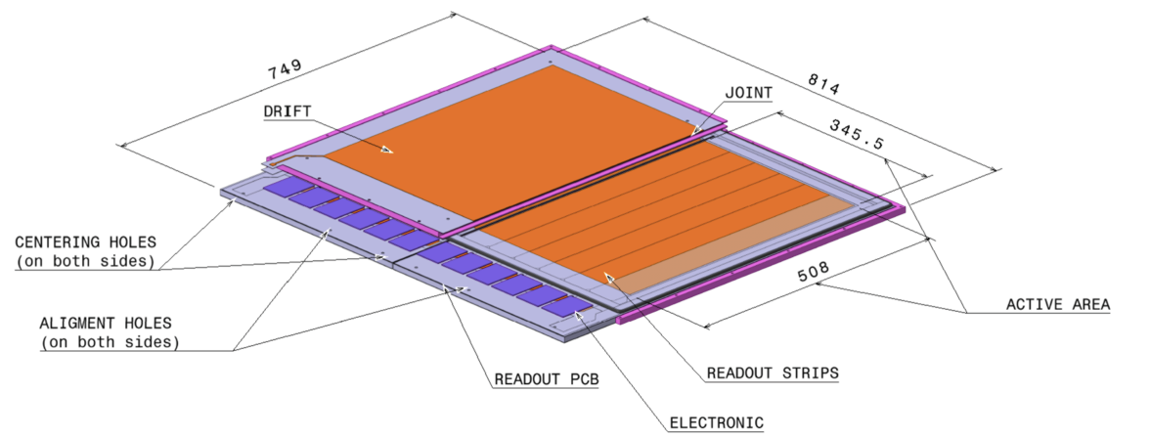
Functional Prototypes
Several of the mechanical prototypes will be extended into functional prototypes or separate functional prototypes built: HV stability studies, efficiency and resolution measurements, ...
Mesh stretching, INFN
Mesh stretching
Saclay
Frascati prototype

Slide 15
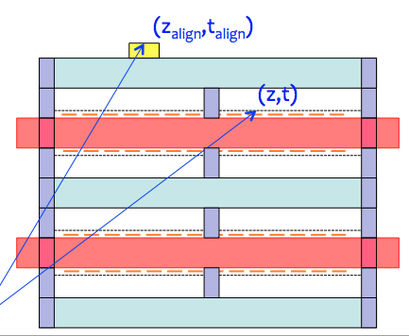
Detector construction: chamber assembly
1 MM multiplet is made out of:
  2 RO panels
  3 drift panels (1 internal, 2 external)
  4 mesh frames
Mechanical prototypes under construction in the production sites give useful indication on the assembly procedure (still to be defined)
Alignment sensor
Interconnection
Open points:
  gluing vs screwing
  Which kind (and how many) interconnection points?

Slide 16
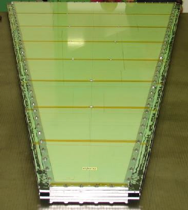
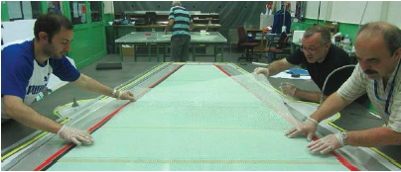
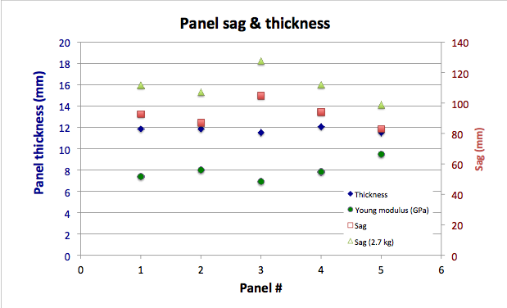
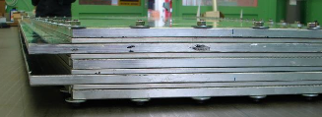
Detector assembly example: CERN
Mechanical prototype of a full small wedge
4 m² - 107 kg total weight
RO/drift interconnections
Alignment done with alignment holes
Mechanical behavior measured (sag, Young modules)

Slide 17
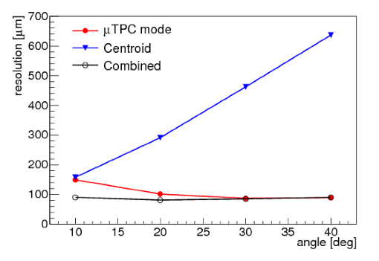
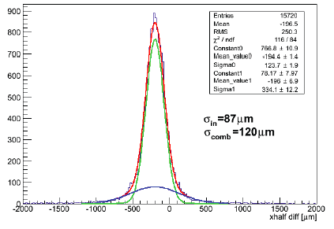
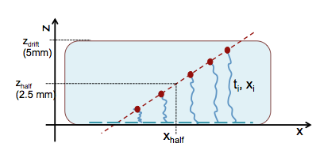
Detector performance
Intense test beam campaign to study detector performance with excellent results
Still room for improvements
Distributions of Δxhalf (from two MM) for particle impact angle of 30. The distribution is fitted with a double Gaussian (red line) accounting for a core distribution (green line) plus tails (blue line).
Notes:
From NSW TDR, pag 56-7:
For impact angles greater than 10 the TPC method [31] is used for a local track segment
reconstruction in the few-millimeter wide drift gap. It exploits the measurement of the hits time
and the highly segmented readout electrodes: the position of each strip gives an x coordinate,
while the z coordinate (perpendicular to the strip plane) can be reconstructed from the time
measurement of the hit after calibrating the z–t relation (z = t vdrift), see Fig. 5.10, left.
The hit time is measured for each strip by applying a fit to samples obtained from the shaped
output of the charge integrating pre-amplifier.
The time resolution obtained with this analysis
depends on the impact angle and is approximately 12 ns at 30. For each event, (xi; zi) coordinates
are assigned to each hit and fitted with a straight line, from which the best position
measurement,‘xhalf’ is obtained (as indicated in Fig. 5.10 left).
Tracklet angles are reconstructed with about 70 mrad resolution. The TPC spatial resolution
has been measured by the difference of xhalf in two chambers with the same orientation (xhalf ).
The time jitter is equal in the two chambers and cancels out in the difference. In Fig. 5.10 right the
distributions of xhalf for a beam impact angle of 30, are reported. The single plane resolution
is about 90 m, assuming that it is obtained by the width of the fitted distribution by
p
2.
The results for the MM spatial resolution study are summarized in Fig. 5.11. As expected, the
cluster centroid behaves better at small angles (small cluster size) while the TPC method reaches
best performance for larger angles. Moreover,it has been verified that the position determination
with the two methods is systematically anti-correlated; for that, a weighted average can improve
the resolution further. The result of a simple combination method using a weighted average of the
cluster centroid and the TPC position measurement is also reported in the figure, demonstrating
that spatial resolutions below 100 m is achievable for all impact angles up to 40 (the impact
angle range for muons in the NSW is approximately between 8 and 30).

Slide 18
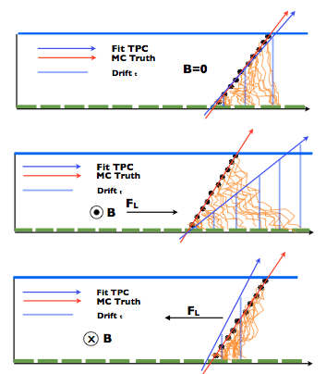
Detector performance
Ongoing studies
  Compensation of the bias due to Lorentz angle in the back-to-back configuration
  Reduction of the bias (long tail) in the uTPC mode at small angle
  Optimization of the working parameters (drift and amplification fields, gas mixture)
New test beams starting from summer 2014 (plus aging and irradiation test at GIF++)

Slide 19
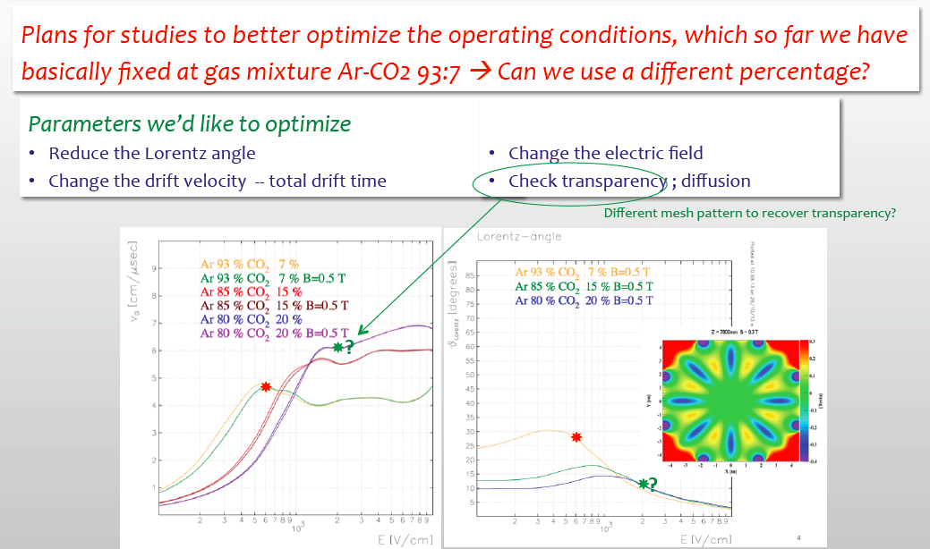
Detector performance simulation

Slide 20
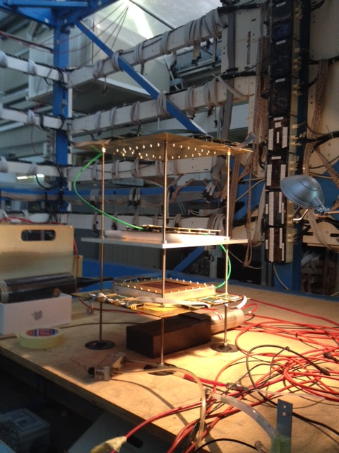
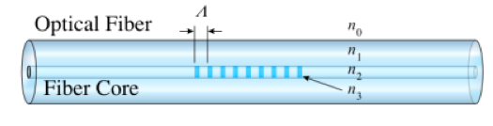
MicroMegas in lab@NA
Tracciamento con μM/drift chambers
Misure (vs. HV, T, P, gas)
  amplificazione
  trasparenza mesh
  risoluzione spaziale
  velocità di drift
  Misure di planarità @Parthenope
  Fiber Bragg Grating:
Fibra ottica in cui l’indice di rifrazione viene variato in maniera periodica, formando una ‘griglia’ nella quale si ha diffrazione di Bragg
Lo spettro riflesso è piccato ad una lunghezza d’onda funzione della periodicità Λ, la quale cambia a causa di deformazione/temperatura
Tesi (triennali) 2013-14:
    L.DiColandrea,C.Grieco, A. Evangelisti, P. Iovine

Slide 21
MM construction next step
Construction of working prototypes first half of 2014
    (LNF, Saclay, CERN/Mainz)
CERN prototype (MMSW) will be installed in ATLAS in July 2014
  dimensions: 1.2 x 0.5 m2, four layers (2 eta, 2 stereo), strip pitch 0.425 mm, 1024 strips/layer
  readout electronis: ATCA SRS as DAQ system, Front-end boards (SRS compatible) with 8 VMM2 chips/boards
  Collaborative effort
    CERN, Japan, Mainz, Lecce, Napoli,… for detector
    Bucharest, BNL, Arizona,… for electronics
Construction of MM mudules-0 in mid/fall 2014
Starting of detector production in 2015

Slide 22
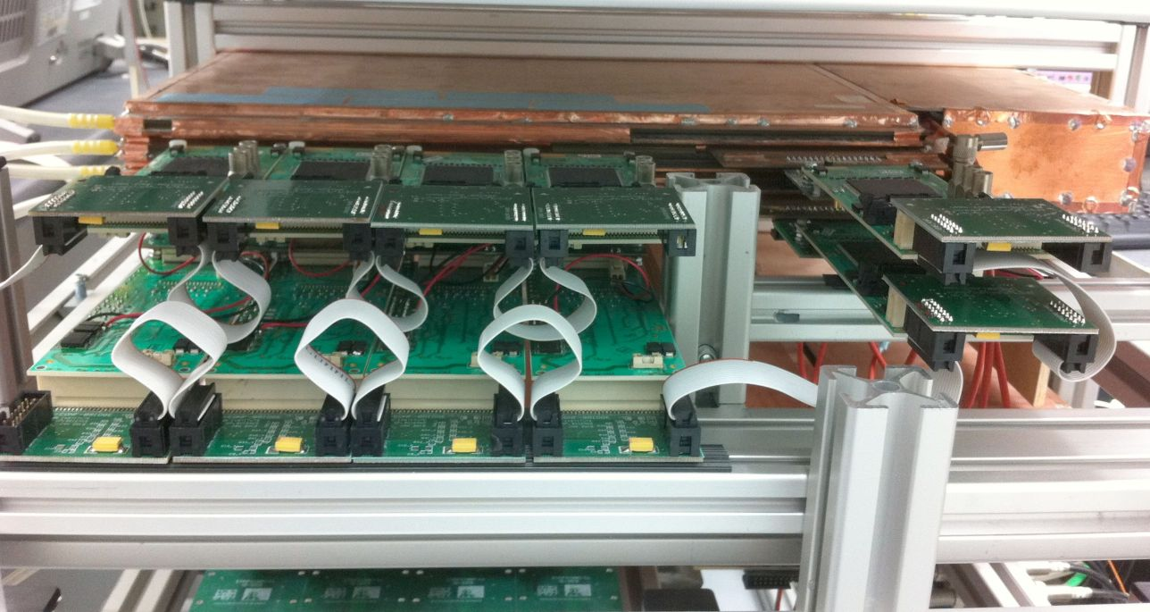
NSW Electronics
NSW project does not involve only detector construction, but substantial electronics development as well
New VMM frontend chip, common to sTGC and MM
Frontend boards
Micromega and sTGC trigger-on-detector electronics. Sector logic, and off-detector processors ...
Roma1 e Napoli coinvolte nel processore di trigger sTGC
sTGC quadruplet
VMM1
Pad readout
Strip readout

Slide 23
PHASE II

Slide 24
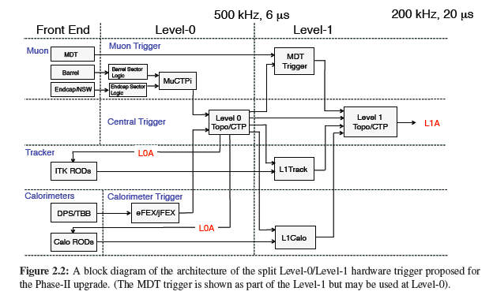
Upgrade Phase II: Trigger DAQ
nuova architettura di trigger
nuovo detector readout
importante ridisegno del software

Slide 25
Upgrade Phase II: L1 Muon Barrel
L1 Muon Barrel (Roma1,Roma2,Napoli,Bologna):
l’attuale sistema non può lavorare a 500kHz (max 100kHz readout rate, max latenza 6.4 μs -> compatibile)
→ completa riprogettazione
  sostituzione PAD box con Data Collector Transmitter (collect trigger data, syncronize with LHC clock and apply zero suppression→ 40 MHz in USA15, basato su ‘GBT system’ a 10Gb/s)
  algoritmi di trigger non più on-detector ma off-detector tramite link ottici a large bandwidths
  algoritmo di trigger su FPGA invece che su ASICs dedicati
  Sector Logic manderà I dati di trigger al MUCTPI via link ottici
  ROD per il readout dei dati RPC probabilmente unico almeno tra RPC e MDT
  passaggio da VME a ATCA (Advanced Computer Telecommunication Architecture board)

Slide 26
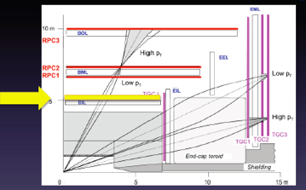
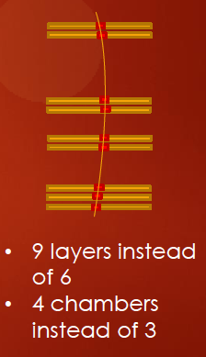
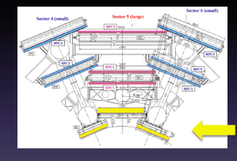
Upgrade Phase II: Muon, RPC
RPC (Bo, RM1, RM2):
vari piccoli upgrades
principale: 1 layer (3 gap) nello strato interno di MDT
circa 500 m²

Slide 27
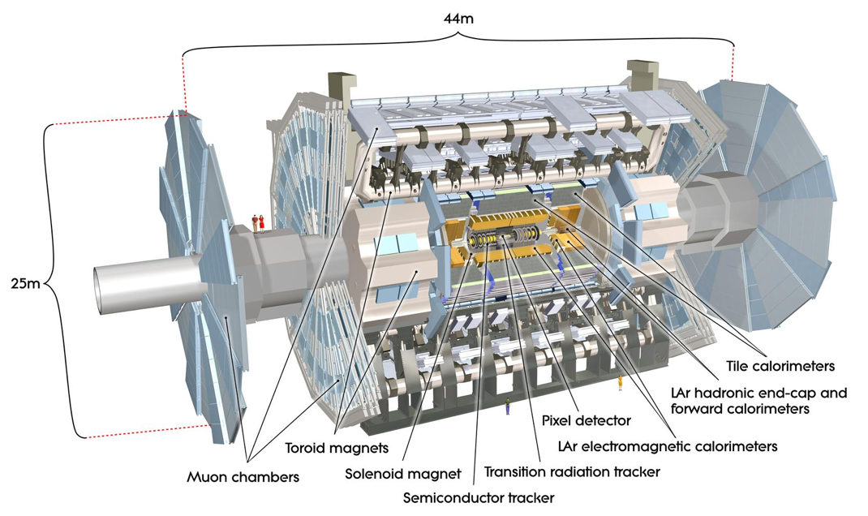
Upgrade Phase II: Muon, Big Wheel
Muon LVL1 trigger in the endcap is generated from three TGC layers in the Big Wheel
Possible solution to sharpen the high-p_{T} threshold in this region:
replace the TGC in the Big Wheel inner ring with the sTGC (same as in the NSW) with higher resolution
previous point + MicroMegas
use the MDT precision coord

Slide 28
Upgrade Phase II: Calorimeters
Lar:
sostituzione elettronica di front-end (sia per radiation damage che per compatibilità con la nuova architettura di trigger)
Interesse italiano (Milano):
  distribuzione di potenza
  nuovo front-end: ASIC che integra PreAmp e Shaper (LAPAS)
TileCal:
Sostituzione totale dell’elettronica di read out del Tile hadronic calorimeter (compatibilità con la nuova architettura del trigger L0/L1, aumento della radiation hardness richiesta, aumento granularità dell’informazione ai processori di trigger)
Sostituzione partitori dei PMT con partitori attivi con controllo dinamico del guadagno
Interesse italiano (Pisa)
  studio della risposta nel tempo dei PMT in funzione della corrente anodica generata
  qualificazione comparativa delle differenti soluzioni per la nuova scheda completa di FE (amplificazione, integrazione, digitizzazione,controllo e temporizzazione) come proposte dalle altre istituzione coinvolte (Chicago, Argonne, Valencia, Stoccolma)

Slide 29
Upgrade Phase II: Tracker
Tracker:
per resistere alle condizioni di radiazione e di occupancy molto più severe di HL-LHC sarà necessario sostituire completamente l’Inner Detector
  (attuale: 3 layer di pixel, 4 di microstrip, uno di transition radiation, ancora uno strato di pixel, IBL, inserito durante l’attuale shutdown)
Si propone un rivelatore basato solo su pixel e microstrip al silicio
Sostituzione di tutto il tracker durante LS3 con opzione sostituzione pixel durante LS2
Possibili scelte per i sensori a pixel:
  planari
  3D
  diamante
Interessi Italiani (Bo, Ge, Le, Mi, Rm2, Tn, Ud):
  sviluppo/test sensori 3D (Ge, Ud, Tn)
  sensori a diamante (Le, Bo, Rm2)
  architettura di read-out e trigger L1 (Bo, Ge, Mi, Ud)
Attività di R&D proposte in sinergia con CMS

Slide 30

…the end…

