Slide 1
The origin of Cosmic Rays:
New developments and old puzzles
Focus on recent experimental developments
IceCube’s neutrinos
AMS’s positrons
K. Blum*, B. Katz*, A. Spector, E. Waxman
Weizmann Institute
*currently at IAS, Princeton
Notes:
The origin of cosmic-rays at different energies, from a few GeV to 100 EeV, is still unknown. Recent neutrino and cosmic-ray measurements provide new clues to the solution of this old puzzle. I will discuss these new clues, with emphasis on the implications of IceCube’s detection of astrophysical high energy neutrinos, the main open questions, and the prospects for progress with future high energy neutrino measurements. The most important step forward would be an identification of the neutrino sources. Such will allow one to identify the UHECR accelerators, to resolve open questions related to the accelerator models, and to study neutrino properties (related e.g. to flavor oscillations and coupling to gravity) with an accuracy many orders of magnitude better than is currently possible. The most promising method for identifying the sources is by association of a neutrino with an electromagnetic signal accompanying a transient event responsible for its generation. The neutrino flux that is produced within the sources, and that may thus be directly associated with transient events, may be significantly lower than the total observed neutrino flux, which may be dominated by neutrino production at the environment in which the sources reside.

Slide 2
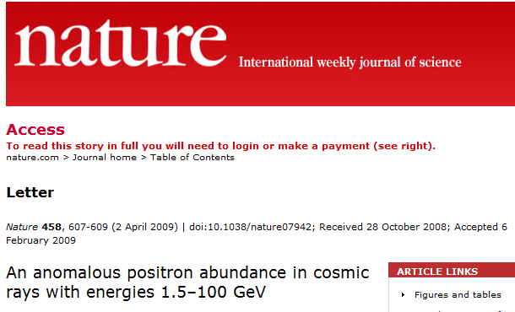
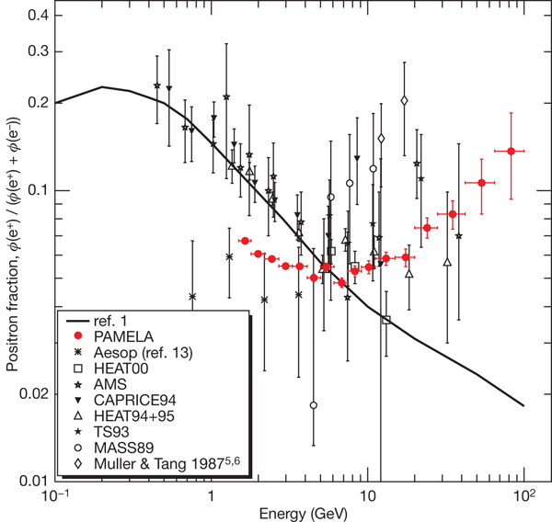
PAMELA 09
…Our results clearly show an increase in the positron abundance at high energy that cannot be understood by standard models describing the secondary production of cosmic-rays.

Slide 3
The positron “anomaly”
A common argument:
Unsubstantiated assumptions:
The “anomaly” implies that (some of) these assumptions, which are not based on theory or observations, are not valid.

Slide 4
What we really know
For all secondary nuclei (e.g. C → B, Be; …):

Slide 5
Why does it work?
We have no basic principles model for CR propagation.
In general
If: The CR composition (n_{j}/n_{p}) is independent of x,
The CR spectrum is independent of x
(or: E/Z the same for prim. & sec.),
Then:

Slide 6
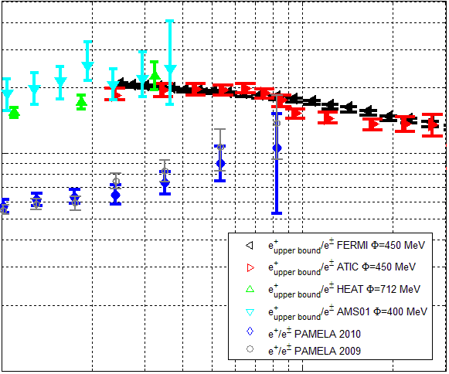
PAMELA 09-10
For all secondaries (e.g. anti-p)
Radiative e⁺ losses- depend on propagation in Galaxy (poorly understood)
* At ~20GeV: f_{rad}~0.3~f_{10Be}
→ e⁺ consistent with 2ndary origin
* Above 20GeV:
If PAMELA correct
→ energy independent f_{rad}(ε)
[Katz, Blum, Morag & EW 10]

Slide 7
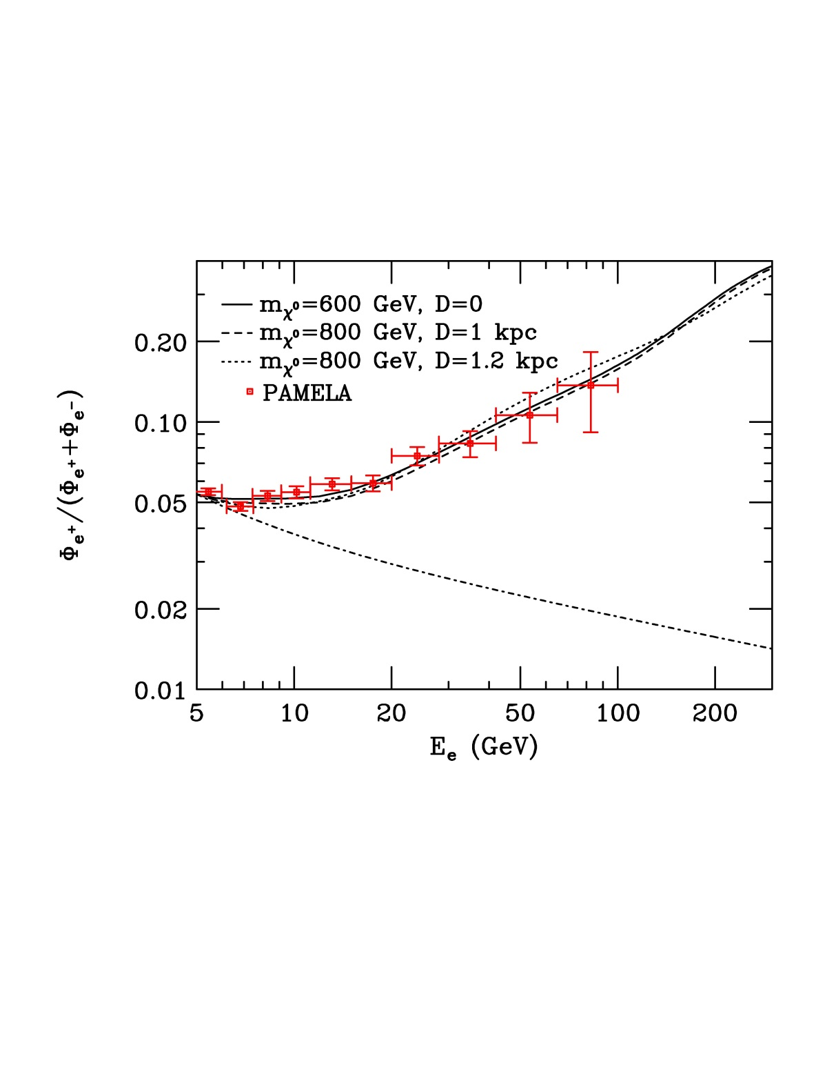
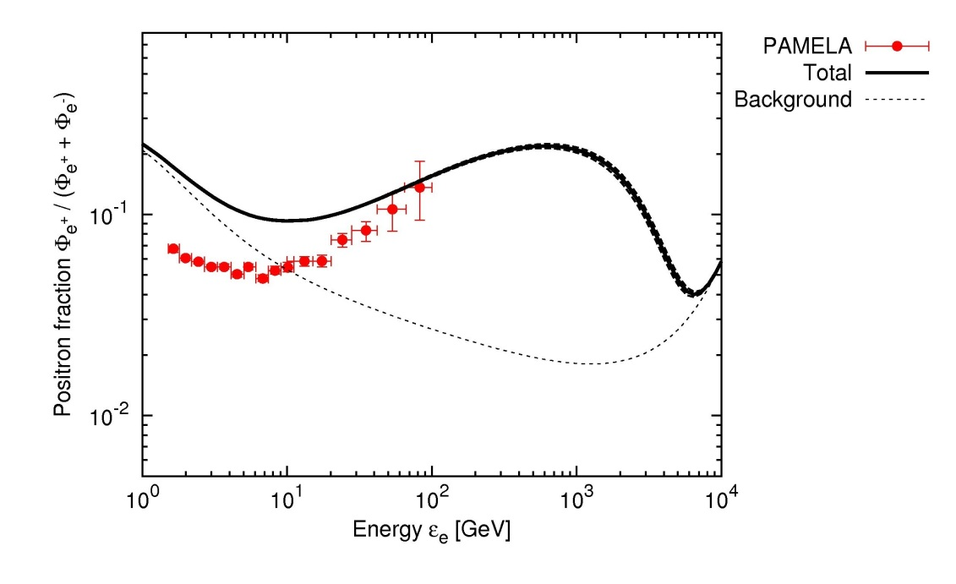
Primary e+ sources
DM annihilation [Hooper et al. 09]
Pulsars [Kashiyama et al. 11]

Slide 8
New primary sources
?
Secondary origin

Slide 9
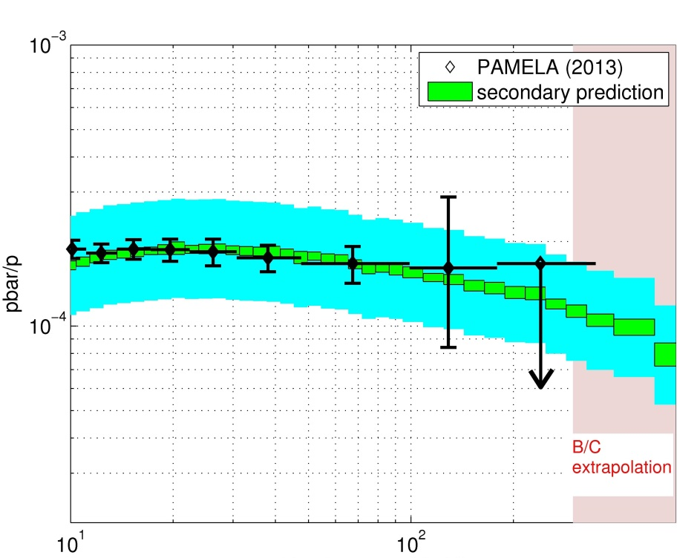
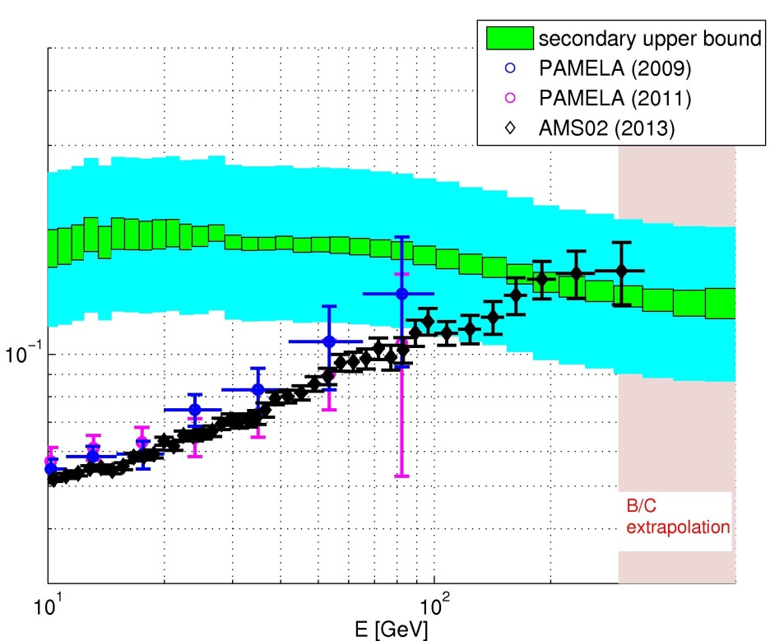
PAMELA & AMS 2013
Anti-p consistent with prediction.
e⁺ flux saturates at the secondary upper bound.
The ABSOLUTE e⁺ flux matches the secondary bound.
In all primary e+ models (DM, pulsars…) there is no intrinsic scale that would explain why the ABSOLUTE observed flux lies near the data-driven secondary bound.
[Blum Katz & EW 13]

Slide 10
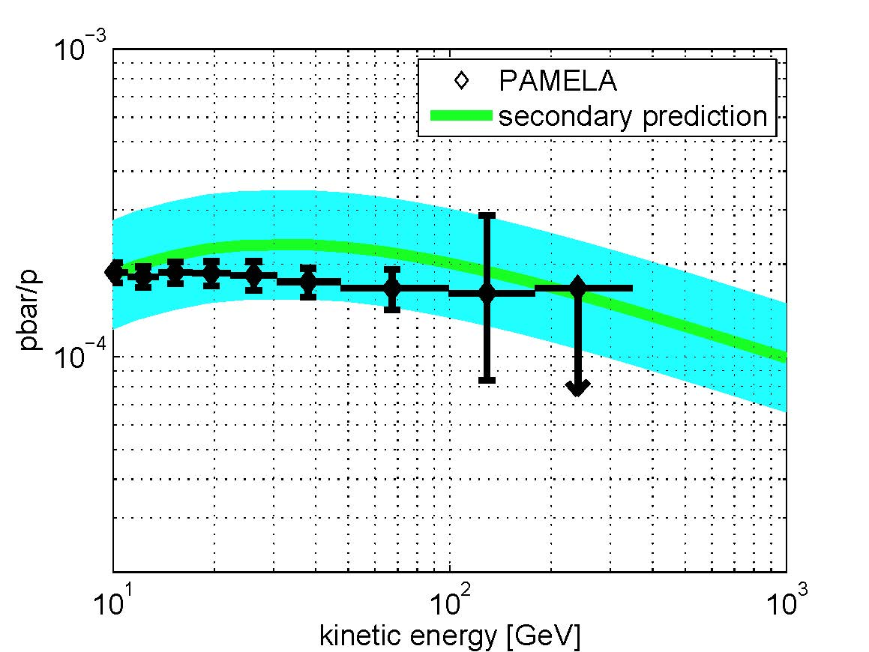
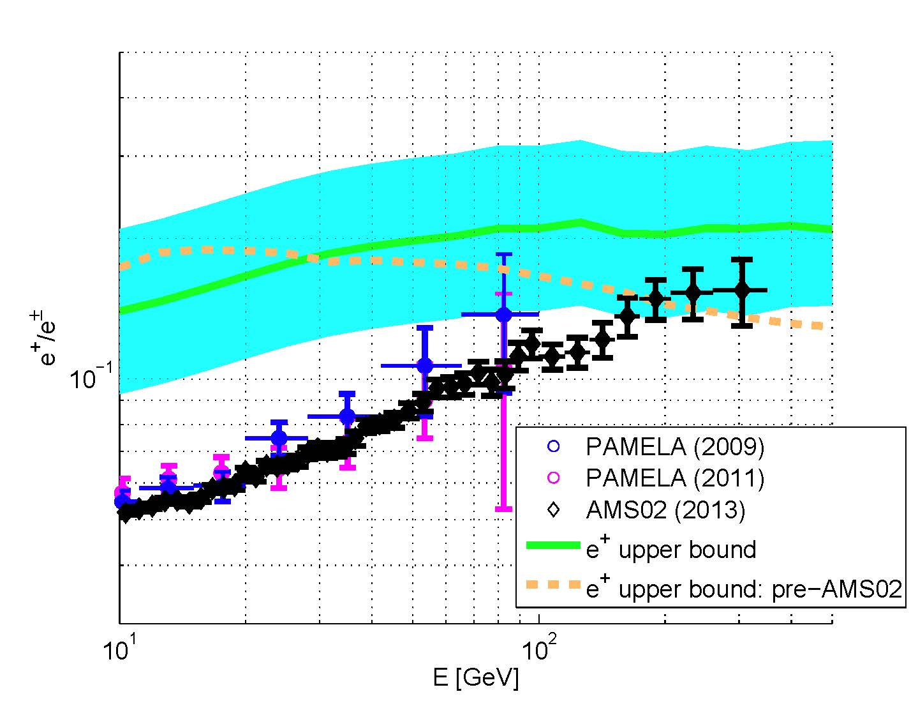
PAMELA & AMS 2013, AMS B/C & e⁺
Anti-p consistent with prediction.
e⁺ flux saturates at the secondary upper bound.
The ABSOLUTE e⁺ flux matches the secondary bound.
In all primary e+ models (DM, pulsars…) there is no intrinsic scale that would explain why the ABSOLUTE observed flux lies near the data-driven secondary bound.
e⁺ measurements constrain Galactic propagation models, in particular f_{rad}(e⁺).
[Blum Katz & EW 13]

Slide 11
Some cautionary notes
t_{sec} is not the residence time
If G(x,x’) is independent of x’ then
For particles with life time τ,
f_{sec} depends on model assumptions. It may, e.g.,
attain the values τ/t_{res} or V(t_{prop}<τ)/V_{G} under
different model assumptions.

Slide 12
Implications of f_{sec}(e⁺)~0.3- an example
Under some model assumptions
f_{sec}(e⁺)~ t_{cool}/t_{res}
which would imply
t_{res}(E/Z=10GeV)>30Myr, t_{res}(E/Z=200GeV)<1Myr
and using Σ_{sec}
<n_{ISM}>(E/Z=10GeV) < 0.2g/cc,
<n_{ISM}>(E/Z=200GeV)> 0.6g/cc,
which in turn implies that the CR halo scale height
decreases with E.

Slide 13
High energy ν’s: A new window
MeV ν detectors:
Solar & SN1987A ν’s
Stellar physics (Sun’s core, SNe core collapse)
ν physics
>0.1 TeV ν detectors:
Extend ν horizon to extra-Galactic scale
MeV ν detectors limited to local (Galactic) sources
[10kt @ 1MeV→1Gton @ TeV , σ_{TeV}/σ_{MeV}~10⁶ ]
Study “Cosmic accelerators” [pγ, pp → π’s → ν’s]
ν physics
Cosmic accelerators:
Open questions → Prime scientific motivation
Observed properties → Detector characteristics

Slide 14
log [dJ/dE]
E^{-2.7}
Galactic
Protons
UHE
X-Galactic
Source: Supernovae(?)
E⁻³
Heavy Nuclei
Source?
Light Nuclei?
Lighter
Source?
1
10⁶
10¹⁰
Cosmic-ray E [GeV]
[Blandford & Eichler, Phys. Rep. 87;
Axford, ApJS 94;
Nagano & Watson, Rev. Mod. Phys. 00;
Lemoine, J. Phys. 13]

Slide 15
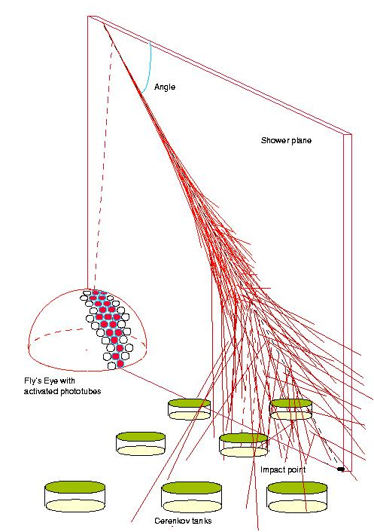
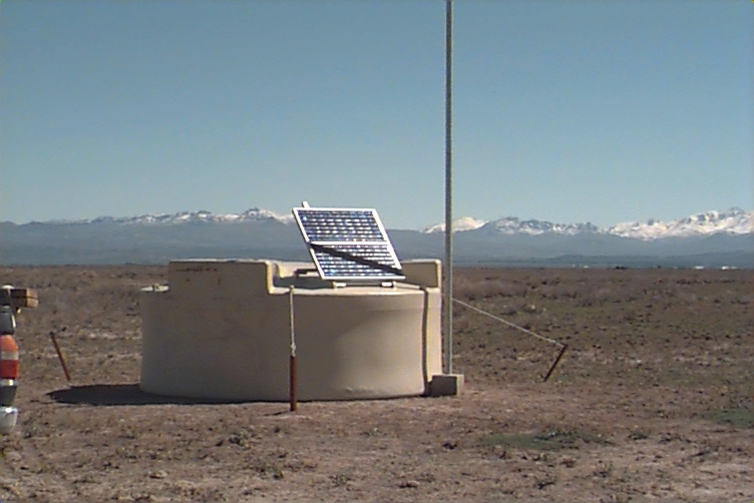
UHE, >10¹⁰GeV, CRs
J(>10¹¹GeV)~1 / 100 km² year 2π sr
Auger:
3000 km²
3,000 km²
Fluorescence
detector
Ground array

Slide 16
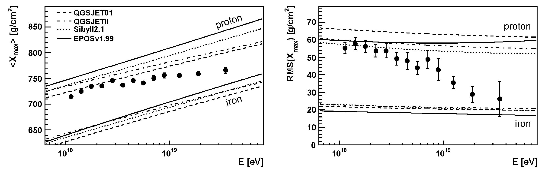
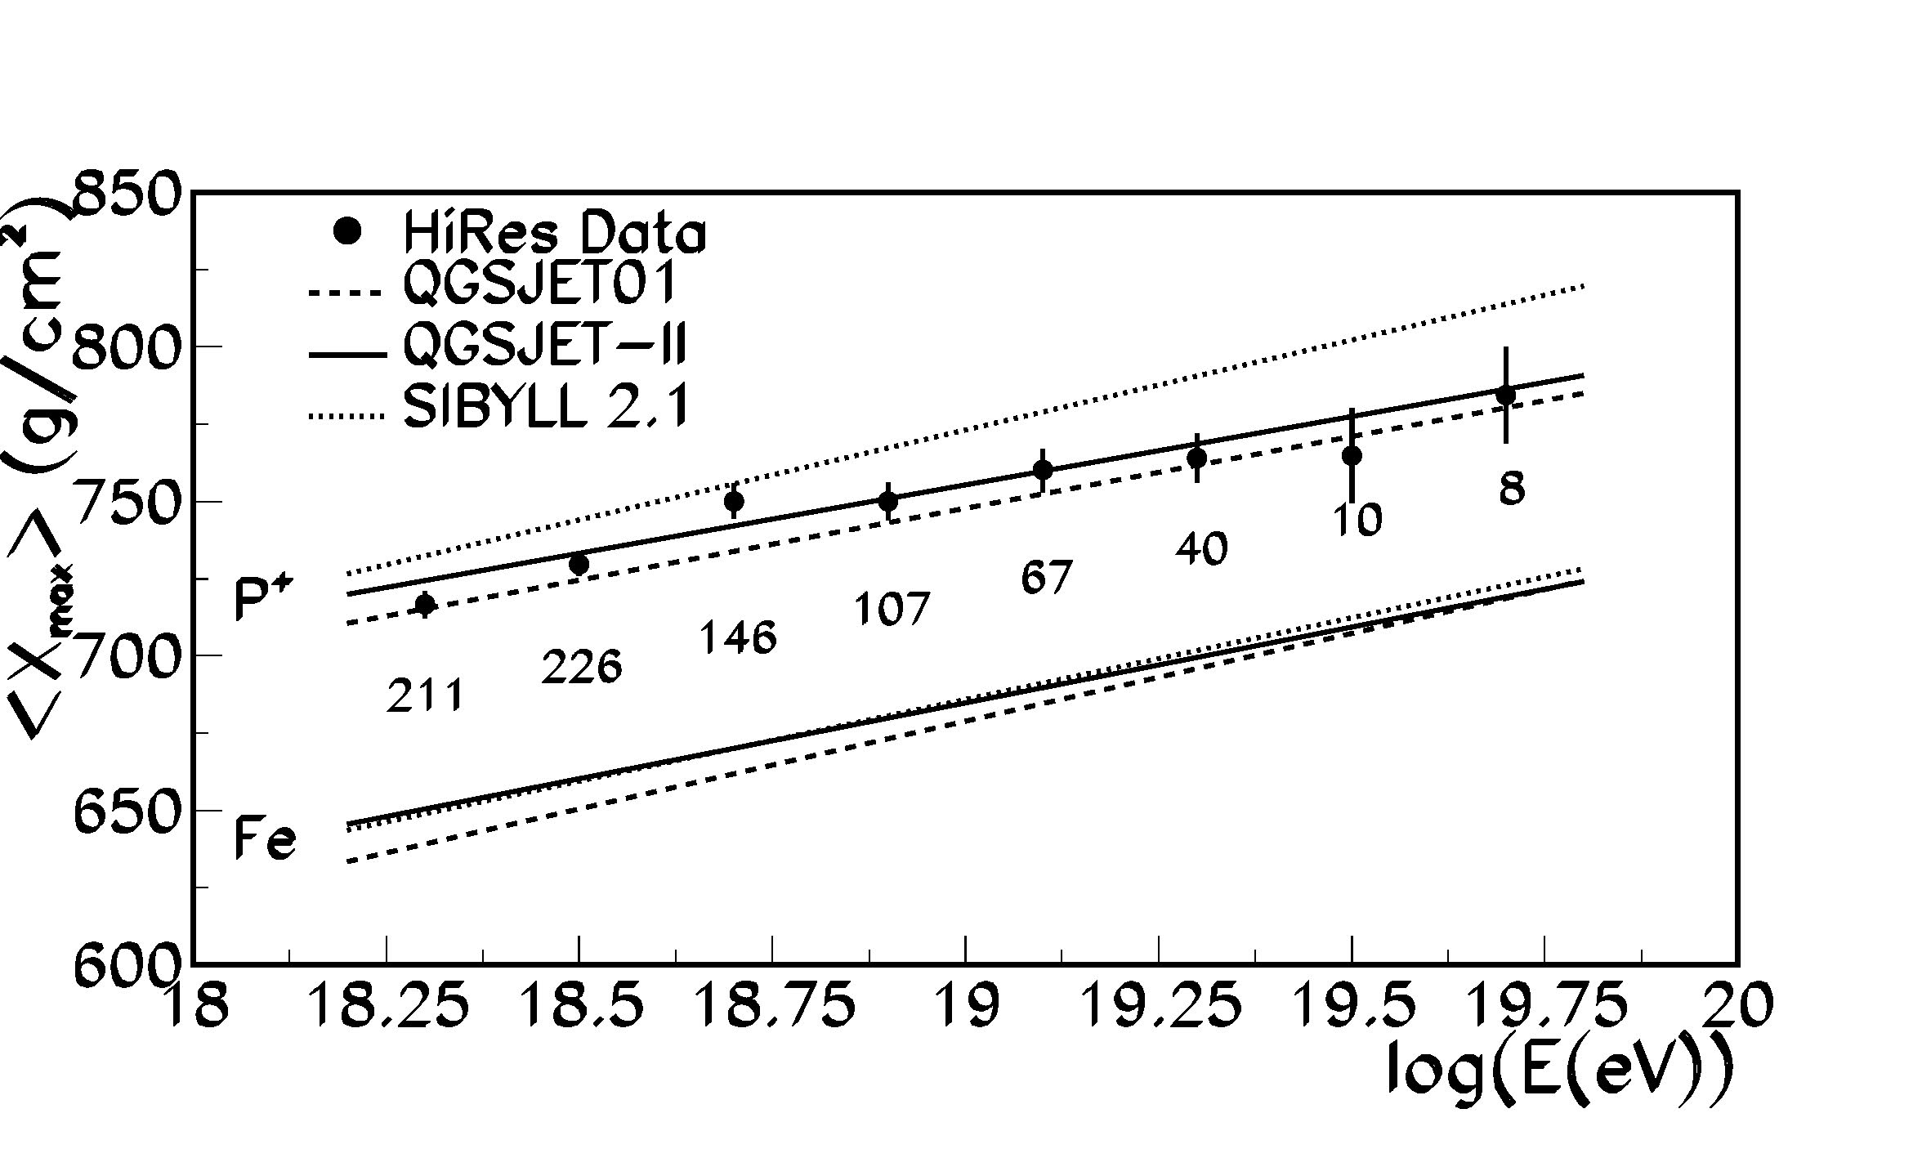
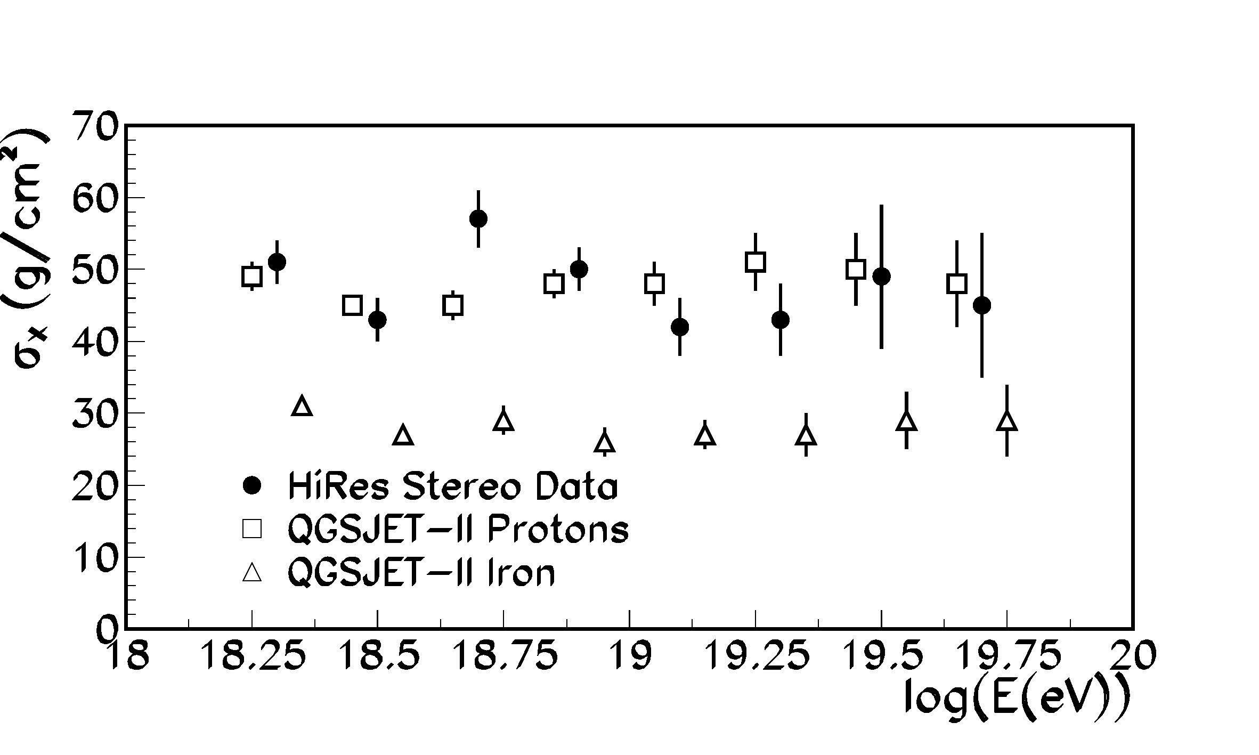
UHE: Composition
Auger 2010
[Wilk & Wlodarczyk 10]*
HiRes 2010 (& TA 2011)
HiRes 2005
[*Possible acceptable solution?, Auger collaboration 13]

Slide 17
Flux & Spectrum
ε²(dN/dε)_{Observed}=ε²(dQ/dε) t_{eff.} (t_{eff.} : p + γ_{CMB} → N + π)
Assume: p, dQ/dε~(1+z)^{m}ε^{-α}
ct_{eff} [Mpc]
log(ε²dQ/dε) [erg/Mpc² yr]
GZK (CMB)
suppression
[Katz & EW 09]
>10^{19.3}eV: consistent with
protons, ε²(dQ/dε) =0.5(+-0.2) x 10⁴⁴ erg/Mpc³ yr + GZK
ε²(dQ/dε) ~Const.: Consistent with shock acceleration
[EW 1995; Bahcall & EW 03]
[Reviews: Blandford & Eichler 87; EW 06
cf. Lemoine & Revenu 06]

Slide 18
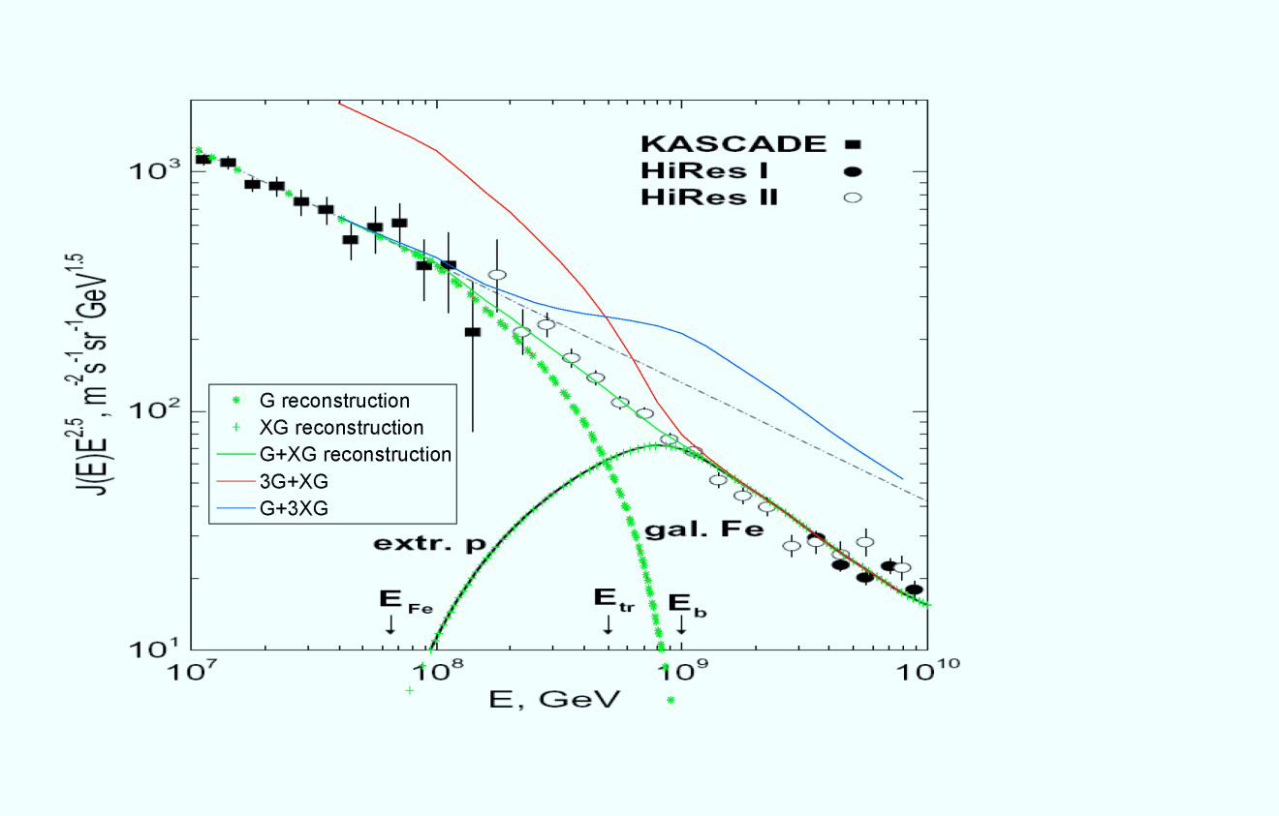
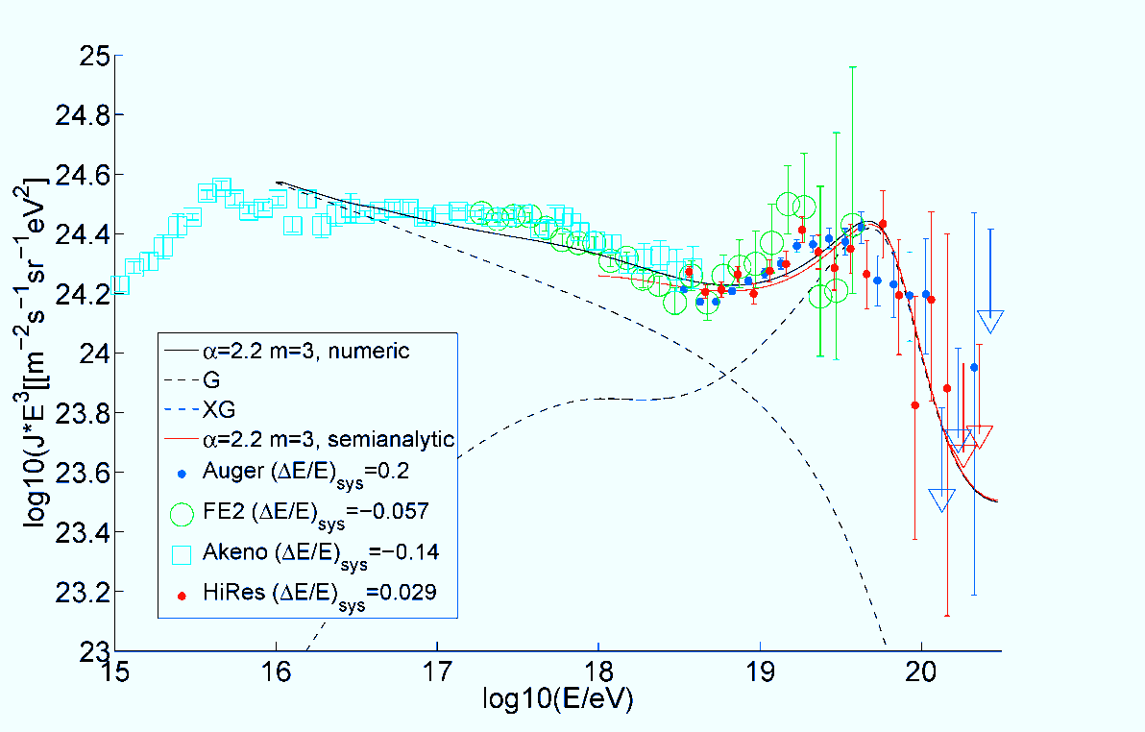
G-XG Transition at ~10¹⁸eV?
Inconsistent spectrum
@ 10¹⁸eV: Fine tuning
Fermi: XG γ (<1TeV) flux
→ small XG p contribution @ 10¹⁸eV
G cutoff @ 10¹⁹eV
[Katz & EW 09]
[Gelmini 11]

Slide 19
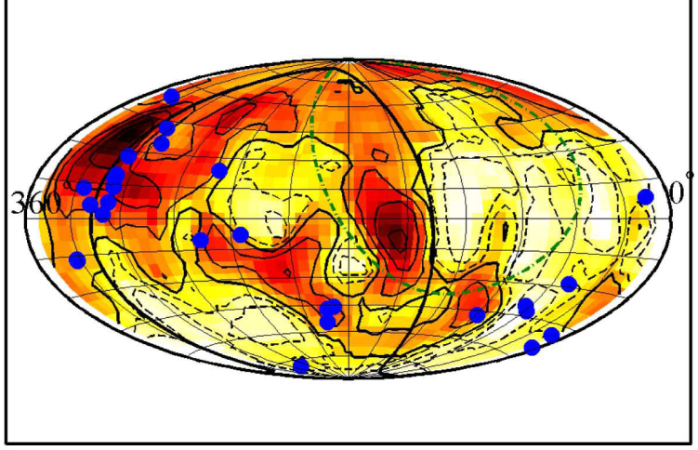
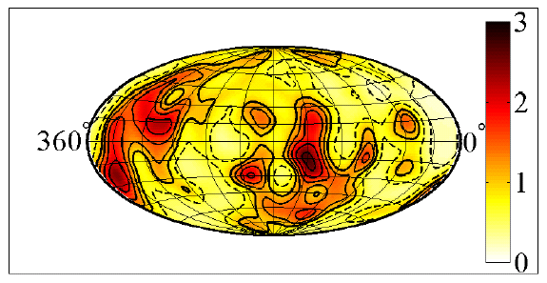
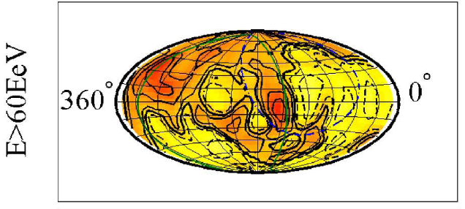
UHE: Anisotropy & Composition
Biased (ρ_{source}~ρ_{gal} for ρ_{gal}>ρ_{gal} )
CR intensity map (ρ_{source}~ρ_{gal})
Galaxy density integrated to 75Mpc
[Kashti & EW 08]
[EW, Fisher & Piran 97]
Anisotropy @ 98% CL; Consistent with LSS
Anisotropy of Z at 10^{19.7}eV implies
Stronger aniso. signal (due to p) at (10^{19.7}/Z) eV
[since: Acceleration of Z(>>1) to E ~ Acceleration of p to E/Z,
p(E/Z) propagation = Z(E) propagation,
n_{p} >= n_{Z} at the source.]
Not observed → No high Z at 10^{19.7}eV
[Kotera & Lemoine 08; Abraham et al. 08… Foteini et al. 11]
[Lemoine & EW 09]

Slide 20
The 10²⁰eV challenge
v
R
B
/Γ
v
Γ²
Γ²
2R
l =R/Γ
(δt_{RF}=R/Γc)
[EW 95, 04,
Norman et al. 95]

Slide 21
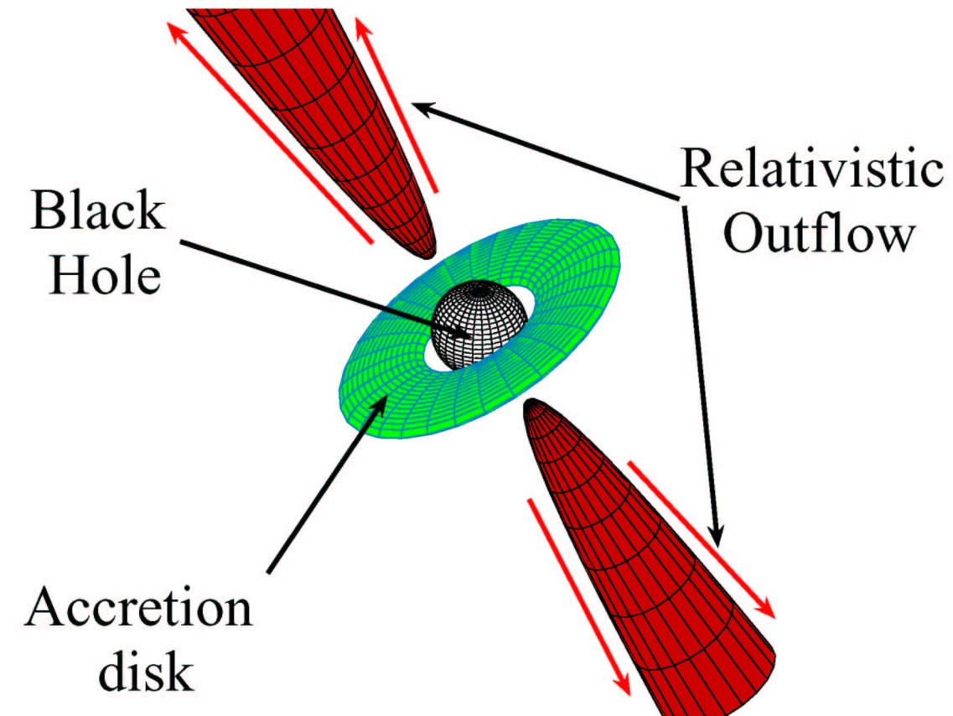
Source physics challenges
GRB: 10¹⁹L_{Sun}, M_{BH}~1M_{sun}, M~1M_{sun}/s, Γ~10^{2.5}
AGN: 10¹⁴ L_{Sun}, M_{BH}~10⁹M_{sun}, M~1M_{sun}/yr, Γ~10¹
MQ: 10⁵ L_{Sun}, M_{BH}~1M_{sun}, M~10⁻⁸M_{sun}/yr, Γ~10^{0.5}
Jet acceleration
[Reviws:
GRBs Kouveliotou 94; Piran 05
AGN Begelman, Blandford & Rees 84
MQ HE:
Aharonian et al 2005;
Khangulyan et al 2007]
Energy extraction
Particle acceleration
Jet content (kinetic/Poynting)
Radiation mechanisms

Slide 22
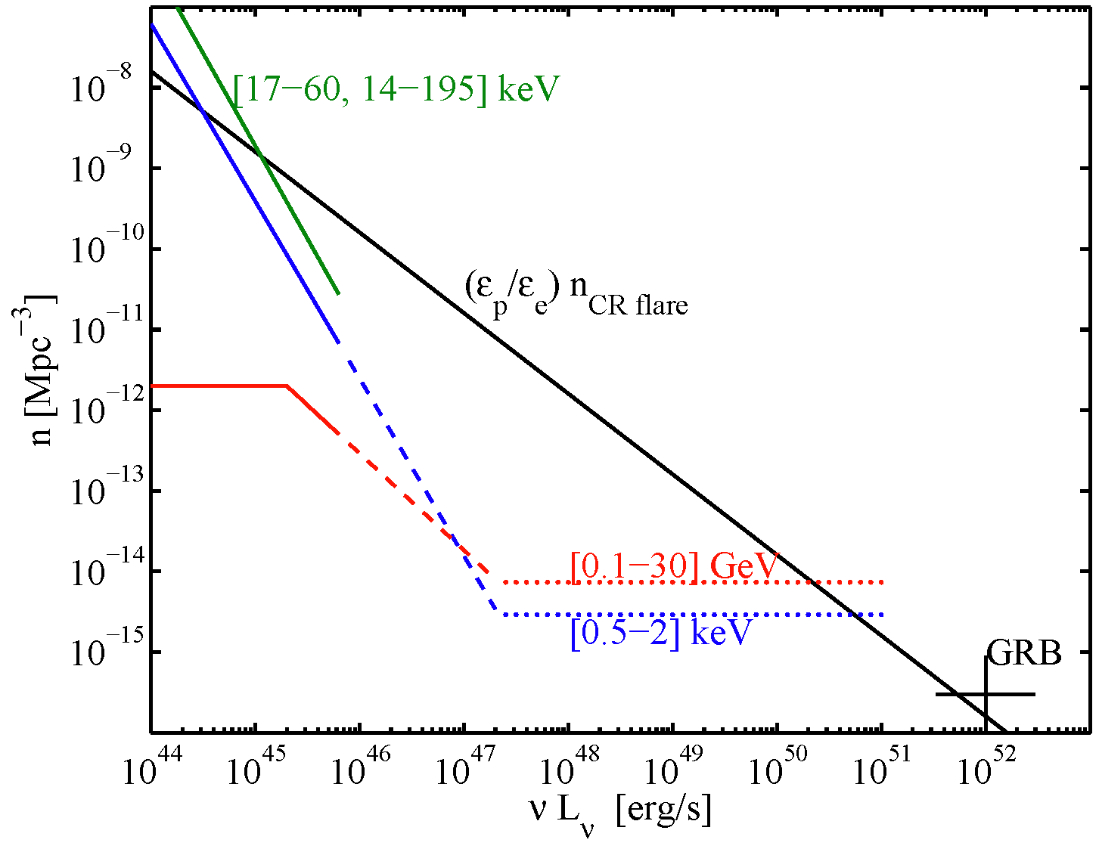
UHE: Bright transients
Electromagnetic acceleration in astrophysical sources requires
L>L_{B}>10⁴⁶ (Γ²/β) (ε/Z 10²⁰eV)² erg/s
→ No steady sources at d<d_{GZK} → Transient Sources
Number density of active flares (nxΔt)
→ >10⁵⁰ erg/s flares
or
Inefficient e-acceleration
(“dark flares”)
[Lovelace 76; EW 95, 04; Norman et al. 95]
[EW & Loeb 09]
Notes:
0.5-2 keV (ROSAT, Miyaji et al. 2000),
17-60 keV (INTEGRAL, Sazonov et al. 2007),
15-195 keV (Swift BAT, Tueller et al. 2008),
> 100 MeV (EGRET, Chiang & Mukherjee 1998).

Slide 23
UHECR experiments: prospects
Establish XG LSS origin,
Improve on spectrum.
Unlikely to identify sources:
Anisotropy does not discriminate between sources,
“Repeater” spectra may discriminate steady/transient.
Composition?
Energy dependent anisotropy clues.

Slide 24
HE ν: UHECR bound
p + γ → N + π
π⁰ → 2γ ; π⁺ → e⁺ + ν_{e} + ν_{μ} + ν_{μ}
→ Identify UHECR sources
Study BH accretion/acceleration physics
For all known sources, τ_{γp}<=1:
If X-G p’s:
→ Identify primaries, determine f(z)
[EW & Bahcall 99;
Bahcall & EW 01]
[Berezinsky & Zatsepin 69]

Slide 25
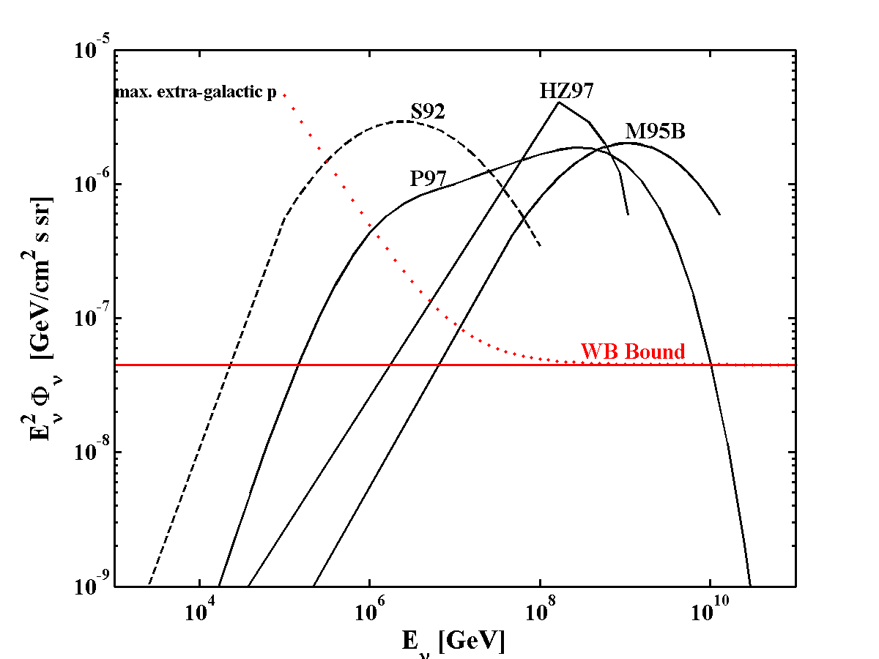
Bound implications: I. AGN ν models
“Hidden” (ν only)
sources
Violating UHECR
bound
BBR05

Slide 26
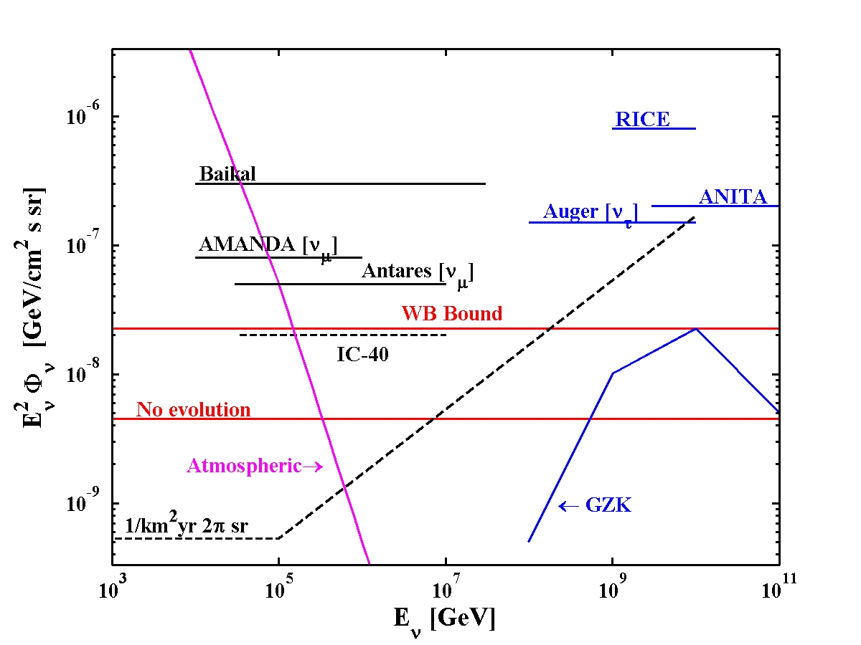
Bound implications: ν experiments
Fermi
2 flavors,

Slide 27
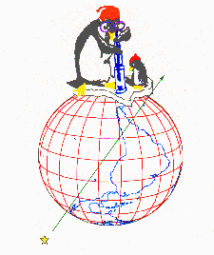
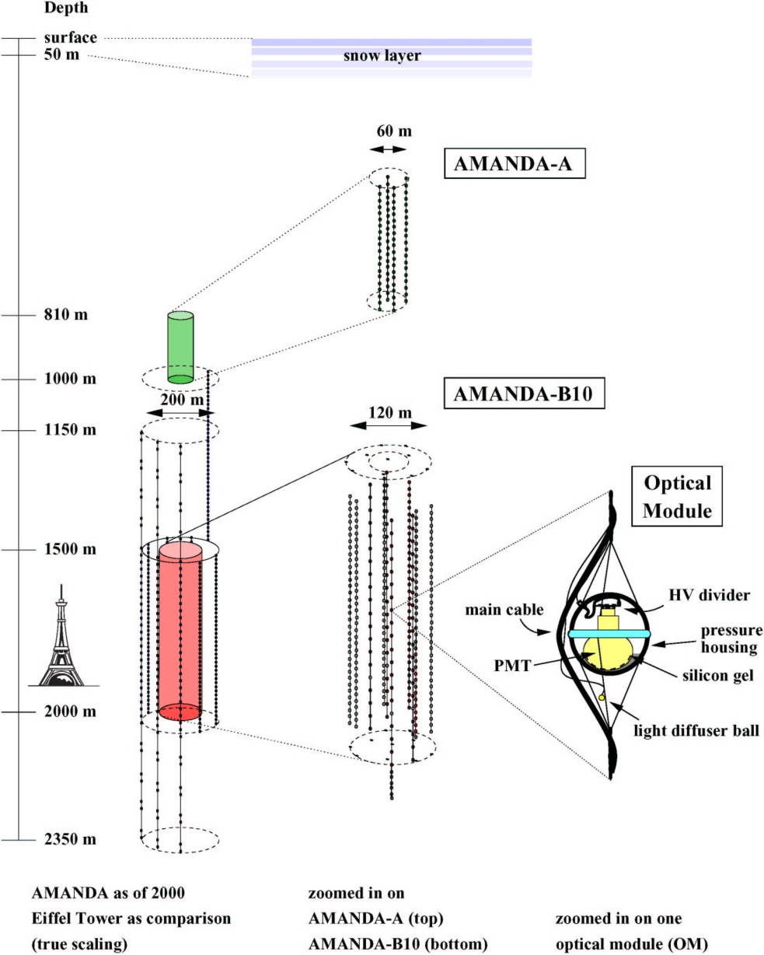
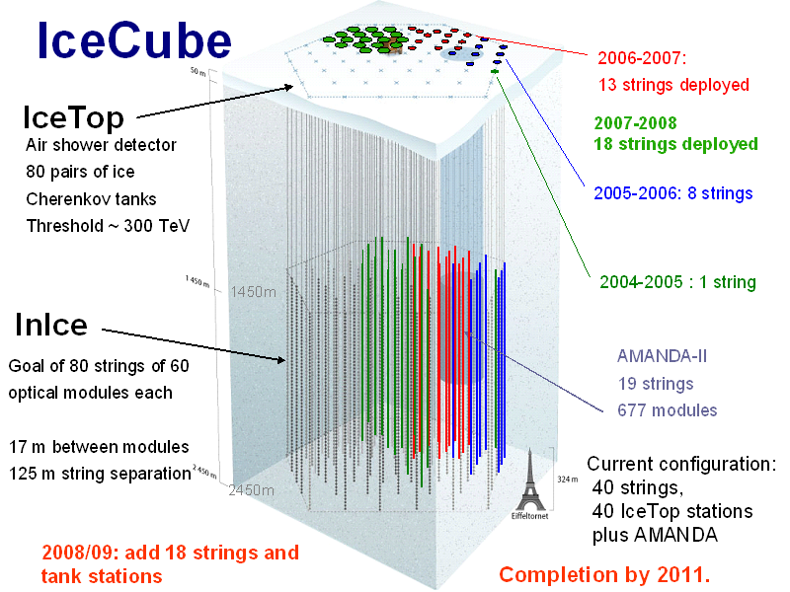
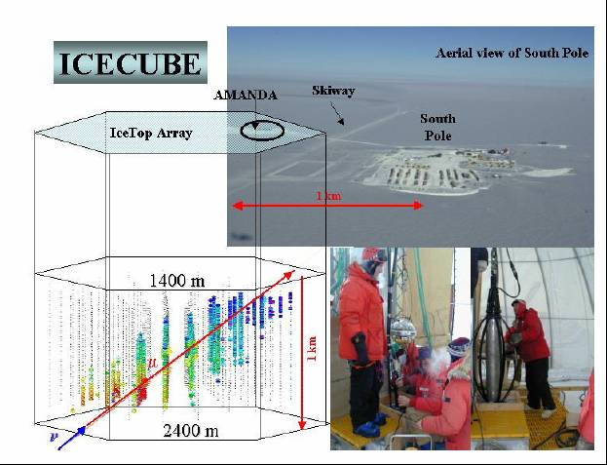
AMANDA
& IceCube
Completed

Slide 28
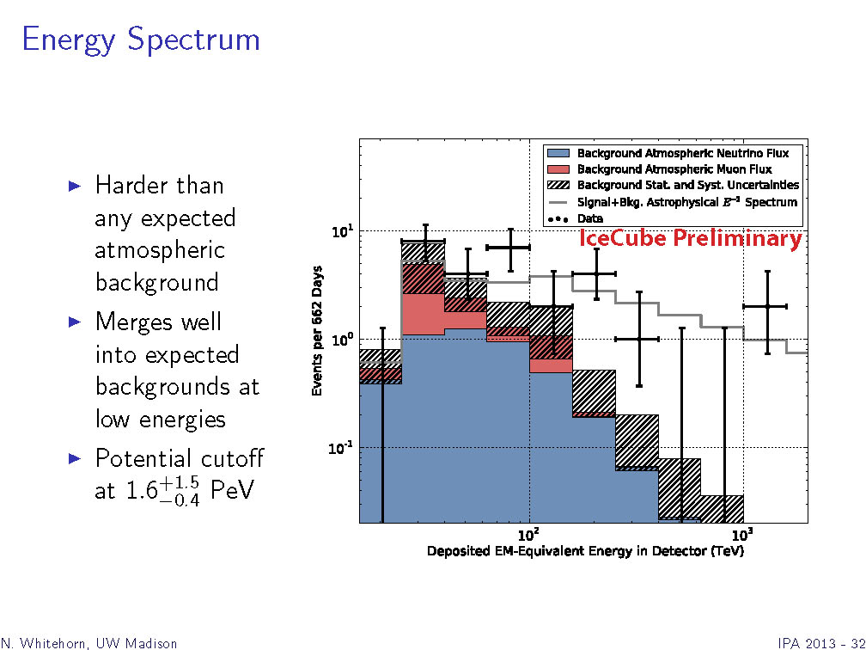
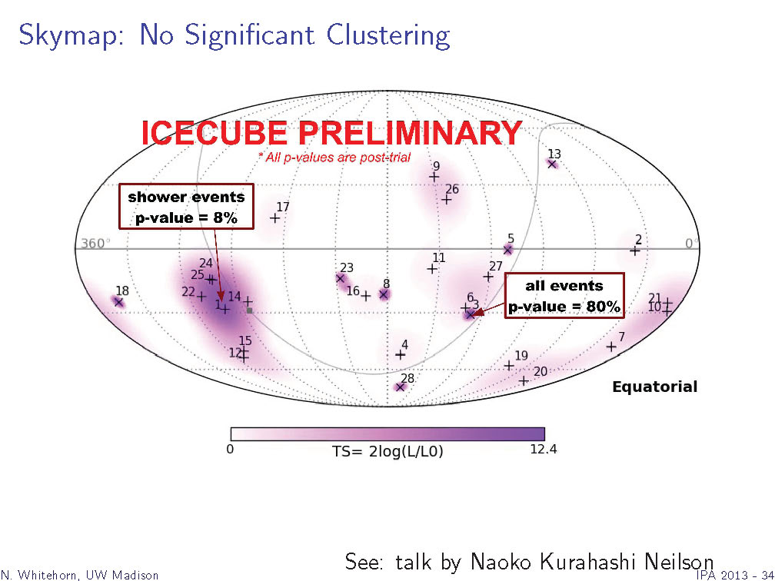
IceCube’s detection
28 events, compared to 12 expected, above 50TeV; ~4σ
(cutoff at 2PeV?)
1/E² spectrum, 4x10⁻⁸GeV/cm²s sr
Consistent with ν_{e}:ν_{μ}:ν_{τ}=1:1:1
Consistent with isotropy
New era in ν astronomy
[N. Whitehorn, IC collaboration, IPA 2013]

Slide 29
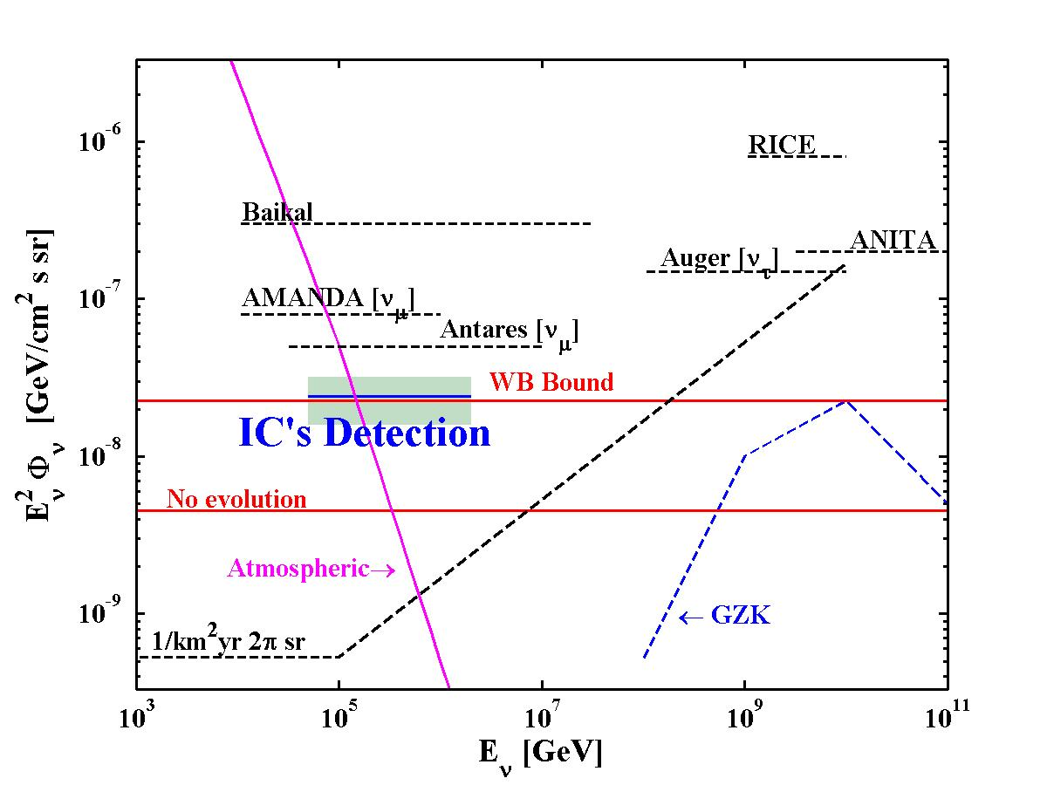
IceCube’s detection
2 flavors,

Slide 30
π production: p/A—p/γ
π decay → ν_{e}:ν_{μ}:ν_{τ} = 1:2:0 (propagation)→ ν_{e}:ν_{μ}:ν_{τ} = 1:1:1
p(A)-p: ε_{ν}/ε_{p}~1/(2x3x4)~0.04 (ε_{p}→ε_{A}/A);
- IR photo dissociation of A does not modify Γ;
- Comparable particle/anti-particle content.
p(A)-γ: ε_{ν}/ε_{p}~ (0.1—0.5)x(1/4)~0.05;
- Requires intense radiation at ε_{γ}>A keV;
- Comparable particle/anti-particle content,
ν_{e} excess if dominated by Δ resonance (dlog n_{γ}/dlog ε_{γ}<-1).
[Spector, EW & Loeb 14]

Slide 31
IceCube’s detection: Some implications
Unlikely Galactic: ε²Φ_{γ}~10⁻⁷(E_{0.1TeV})^{-0.7}GeV/cm²s sr [Fermi]
→ ε²Φ_{ν} ~10⁻⁹(E_{0.1PeV})^{-0.7}GeV/cm²s sr << Φ_{WB}
DM decay?
The coincidence of 50TeV<E<2PeV ν flux, spectrum (& flavor)
with the WB bound is unlikely a chance coincidence.
XG distribution of sources,
ε²(dQ/dε)_{PeV-EeV}~ ε²(dQ/dε) _{>10EeV}, τ_{γp(pp)}>~1
Or:
ε²(dQ/dε)_{PeV-EeV}>> ε²(dQ/dε) _{>10EeV}, τ_{γp(pp)}<<1
& Coincidence over a wide energy range.
ε²(dQ/dε) ~ ε⁰ implies: p, G-XG transition at ~10¹⁹eV.
Radiative losses may modify the flavor ratio at fixed ε,
Unlikely to be significant given the coincidence with WB.
[Kashti & EW 05]

Slide 32
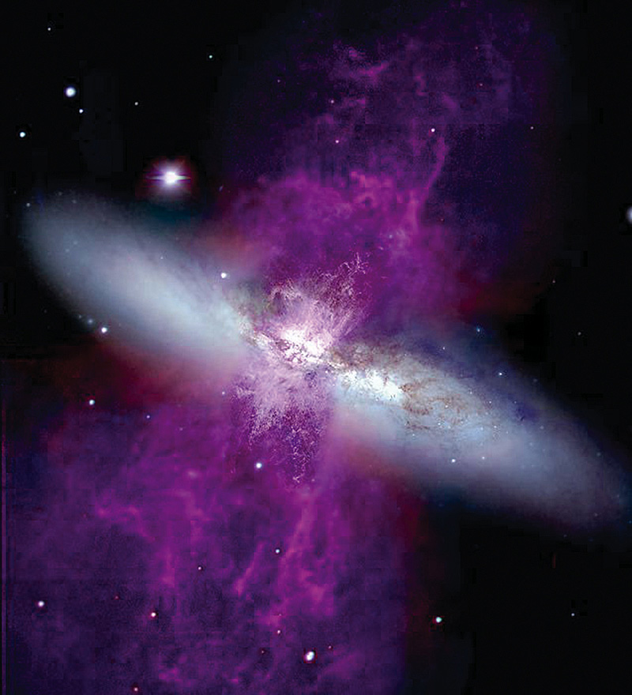
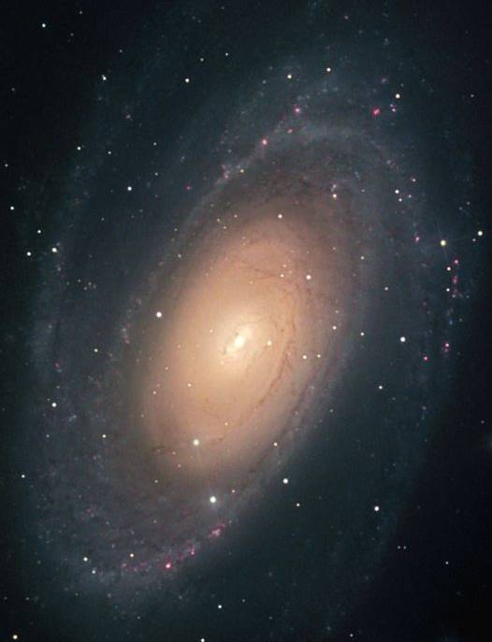
M82 M81
Mark Westmoquette (University College London),
Jay Gallagher (University of Wisconsin-Madison),
Linda Smith (University College London),
WIYN//NSF, NASA/ESA
Robert Gendler

Slide 33
Starburst galaxies
{Star formation rate, density, B} ~ 10³x Milky way.
Most stars formed in z>1 star bursts.
<1 PeV p’s lose all their energy to π production,
secondary e’s lose all (most) energy to synchrotron radiation.
10GeV p:
Estimating the CR and ν production.
  ε²(dQ/dε) _{10GeV}=12f⁻¹_{synch}(νL_{ν})_{1GHz};
  (νL_{ν})_{1GHz}=1.7x10⁻⁶L_{FIR} ; L_{FIR}~5x10⁵⁰(erg/M_{sun})
  ε²(dQ/dε) _{10GeV}=10⁴⁶ f⁻¹_{synch} (erg/M_{sun}).
  If CR production ~ SFR, using SFR(z=0)~0.015 M_{sun}/Mpc³yr:
  ε²(dQ/dε) _{10GeV}~2f⁻¹_{synch}x10⁴⁴ erg/Mpc³ yr,
  Φ_{ν,10GeV}~a few x Φ_{WB} .
  If ε²(dQ/dε)~ ε⁰ : ν flux extends to ~1PeV
[Quataert et al. 06]
Synchrotron radio
Φ_{ν,1GeV}
[Loeb & EW 06]

Slide 34
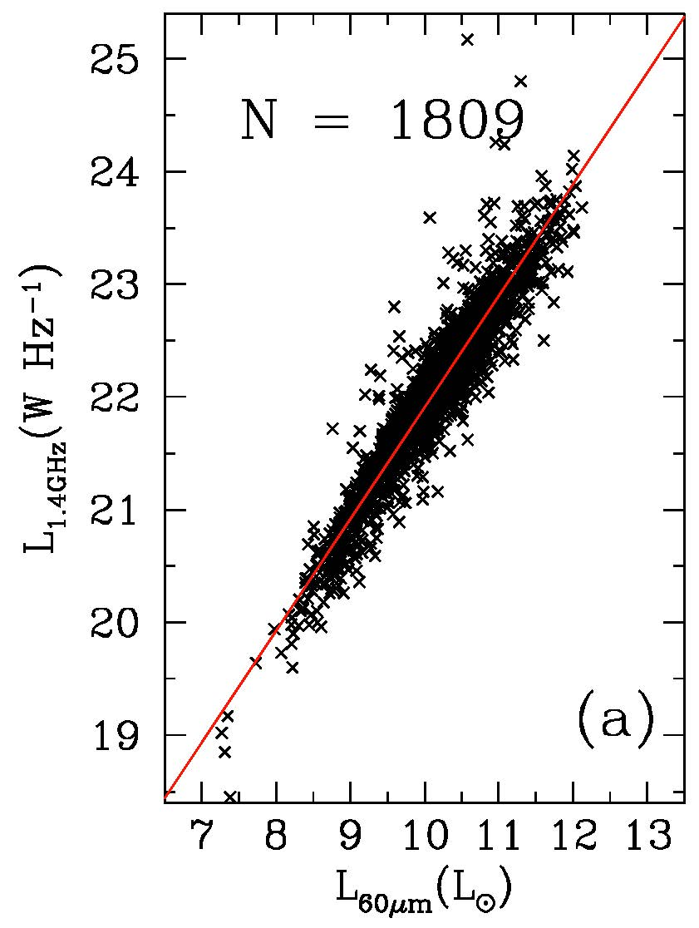
Radio – FIR correlation

Slide 35
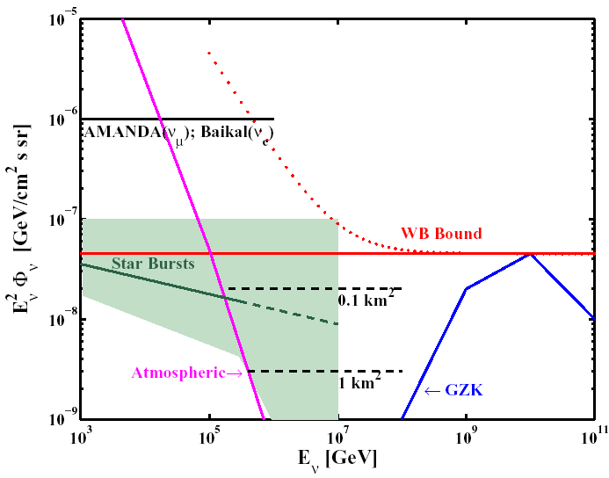
Starburst galaxies: ν emission
[Loeb & EW 06]

Slide 36
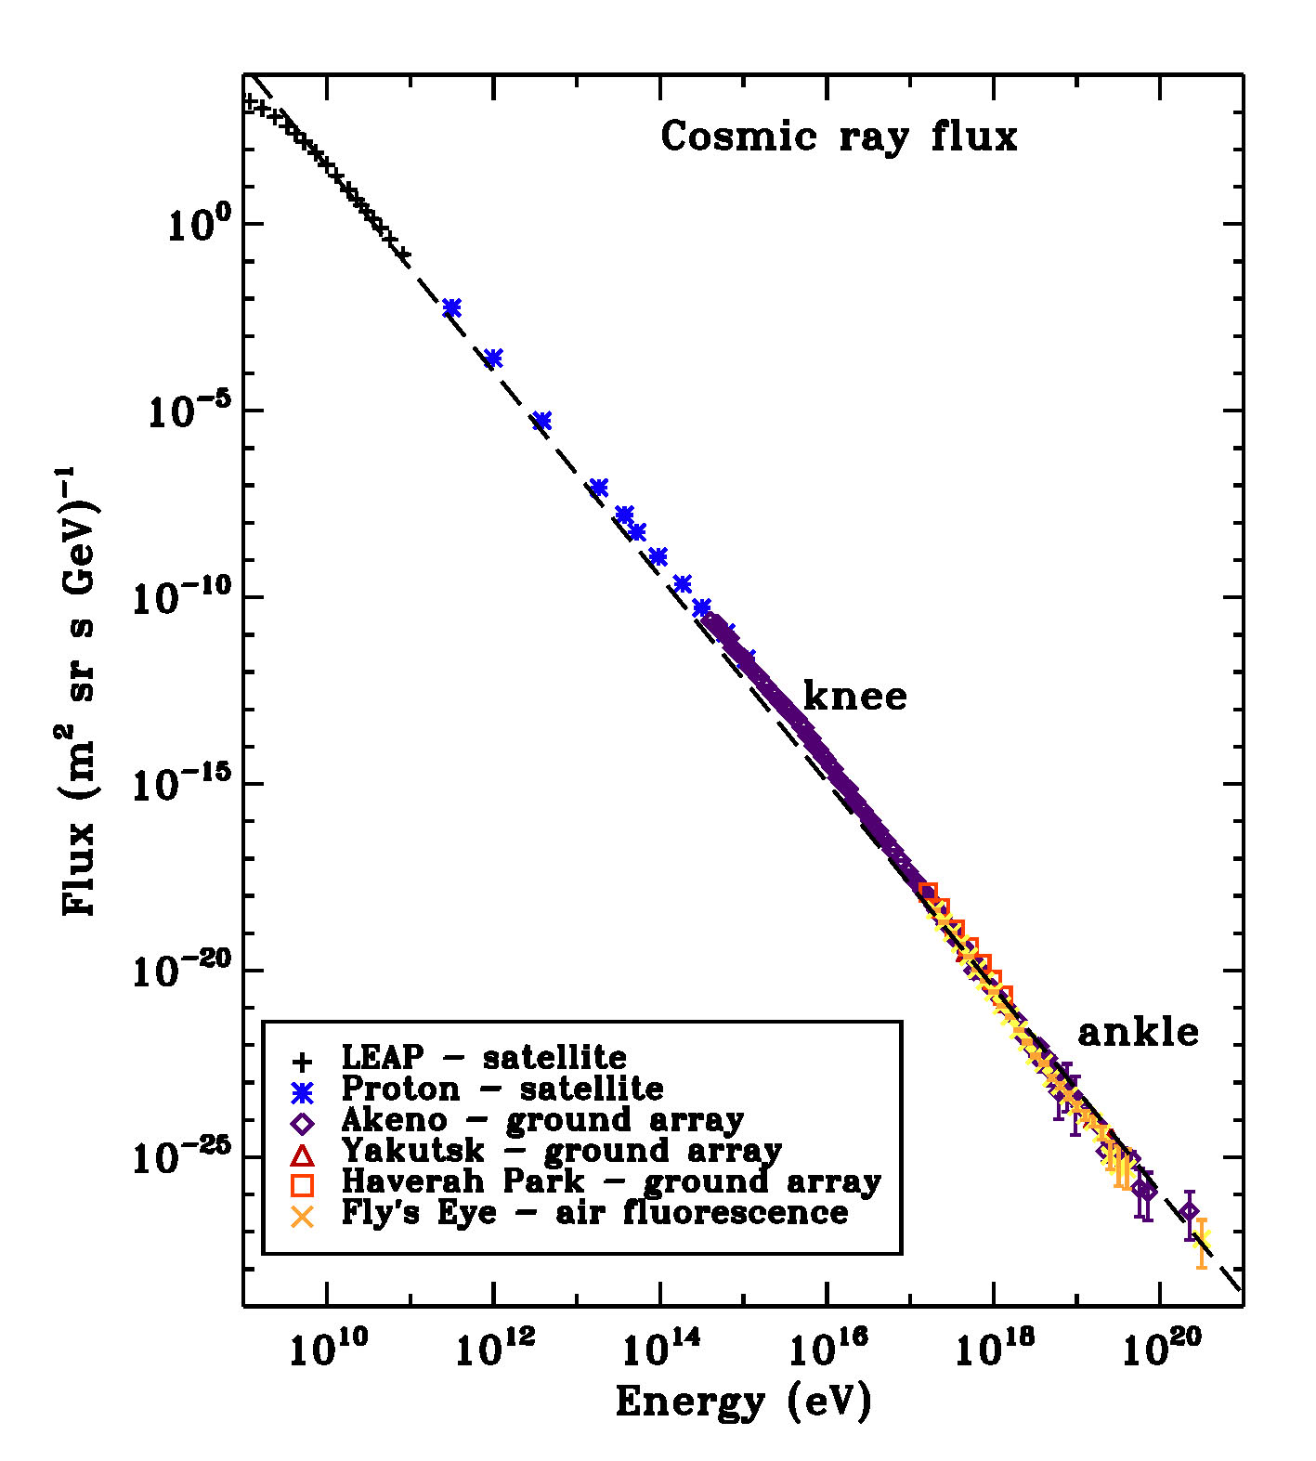
The cosmic ray spectrum
[From Helder et al., SSR 12]

Slide 37
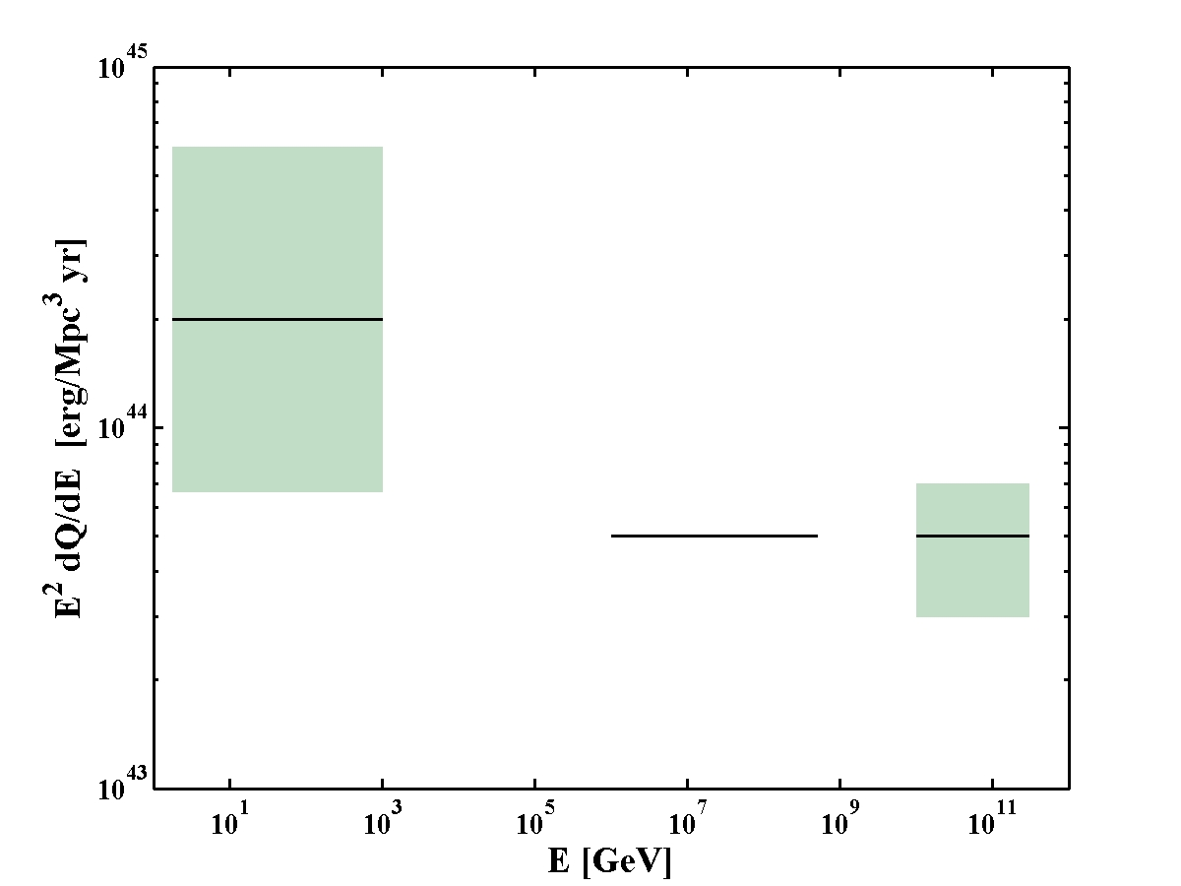
The cosmic ray generation spectrum
Galactic CRs,
Starbursts
(+ CRs~SFR)
XG ν’s
XG CRs
[Katz, EW, Thompson & Loeb 14]

Slide 38
Identifying the sources
The angular “resolution” of ν-telescopes, ~1deg or worse, will not allow one to identify cosmologically distributed sources.
Steady UHECR sources are unlikely detectable:
1 x 6x10¹⁹eV /3000 km² = 2x10⁴TeV/km²
x P_{νμ}(1TeV)~10⁻⁶ → 0.02 μ/km²
No repeaters → <10⁻³ μ/km²
[A_{detect}(10¹⁴eV ν)~10^{-7.5} A_{detect}(10¹⁹eV CR)].
→ Not detectable in ν’s unless L_{ν}>>100L_{CR}, which
Cannot be the case since Q_{CR}~Q_{ν}.
The only hope is to associate a ν with an EM transient.
Luckily, UHECR sources must be bright transients.
Required: Wide field EM monitoring.

Slide 39
What will we learn? astro-physics & ν-physics
Identify the CR sources;
p/A;
Study accelerator physics:
BH jets, particle acceleration, collisionless shocks…
Fundamental/ν physics
- π decay → ν_{e}:ν_{μ}:ν_{τ} = 1:2:0 (Osc.)→ ν_{e}:ν_{μ}:ν_{τ} = 1:1:1
◊ τ appearance
- GRBs: ν-γ timing (10s over Hubble distance)
→ LI to 1:10¹⁶; WEP to 1:10⁶
Optimistic (>100’s of ν’s with flavor identification):
Constrain flavor mixing, new phys.
[Learned & Pakvasa 95; EW & Bahcall 97]
[EW & Bahcall 97; Amelino-Camelia,et al.98;
Coleman &.Glashow 99; Jacob & Piran 07]
[Blum, Nir & EW 05; Winter 10; Pakvasa 10]

Slide 40
Transient sources: GRB ν’s
If: Baryonic jet
Background free:
[EW & Bahcall 97, 99; Rachen & Meszaros 98; Guetta et al. 01; Murase & Nagataki 06]
Notes:
Detector effective area: A_eff = A_0 * (E/100TeV)^w with w=1,0.5 for E<100TeV,E>100TeV
Source intensity: Phi=E^2 dN/dE= Phi_0* min[(E/E_0), 1] with E_0>100TeV
Gives an event rate of
Rate=4*pi*A_0*(Phi_0/E_0)*[4Sqrt(E_0/100TeV)-1]
For GRBs: Phi_0=4.5e-8*0.5(UHECR normalization)*0.2(f_pi)*0.5(osc to nu_tau)=2e-9
Taking A_0=100m^2 (corresponding to 1km^2 and Pnu-mu=1e-4 at 100TeV) gives
20/ Sqrt(E_0/300TeV) per yr (to ~10% for E_0/100TeV=1 to 100).

Slide 41
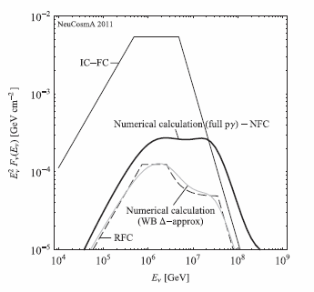
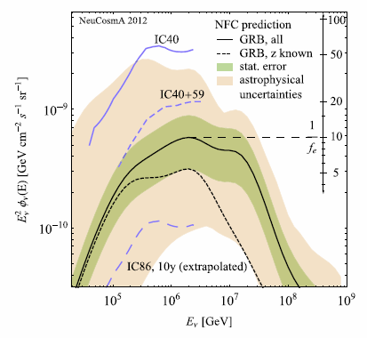
IceCube’s limits
IC40+59: No ν’s for ~200 GRBs (~2 expected).
IC is achieving relevant sensitivity !
IC analyses overestimate GRB flux predictions,
and ignore astrophysical uncertainties:
[Hummer, Baerwald, and Winter 12;
see also Li 12; He et al 12]

Slide 42
Are SNRs the low E CR sources?
UHE, Intermediate E: Not yet identified
Low E- SuperNova Remnants? [Baade & Swicky 34]
So far, no clear evidence.
Electromagnetic observations- ambiguous
(e.g. * TeV → e⁻ I.C. [Katz & EW 08; Butt et al. 08] .
* Fermi “π⁰ decay signature in IC443 & W44”? [Ackermann et al. 13]
Based on <1GeV spectral shape deviation from e⁻ Bremm.
- Uncertain due to galactic foreground
- Consistent with e⁻ if spectrum deviates from power-law
- π⁰ explanation requires p spectrum cutoff at ~100GeV).
[e.g. Butt 09; Helder et al., SSR 12]

Slide 43
Summary
The identity of the CR source(s) is still debated.
Many open Q’s RE candidate source(s) physics [accreting BHs].
ε²(dQ/dε) ~ 10⁴⁴erg/Mpc³yr at all energies, 10 to 10¹¹GeV.
Q~ SFR.
→ A single class of transients?
UHE: p; G-XG transition @ ~10¹⁹eV;
L>10⁴⁷⁽⁵⁰⁾erg/s, GRBs/bright AGN flares.
IceCube detects extra-terrestrial ν’s, φ~φ_{WB} at 50TeV—2PeV
- A new era in ν astronomy.
- Unlikely Galactic, unlikely DM.
- Consistent with the predicted emission of StarBursts for
ε²(dQ/dε) ~ 10⁴⁴erg/Mpc³yr, p, Q~ SFR.

Slide 44
A new era in HE ν’s
IceCube’s detection: A new era in ν astro.
Next: spectrum, flavor, >1PeV, GZK,
EM association- Bright transients are the prime targets.
Coordinated wide field EM transient monitoring crucial:
Identify sources, Enable physics output.
EM Association may resolve outstanding puzzles:
- Identify CR (UHE & G-CR) sources,
- Resolve open “cosmic-accelerator” physics Q’s
(related to BH-jet systems, particle acc., rad. mechanisms),
- Constrain ν physics, LI, WEP.

