Slide 1
Power system for GEM detector
Pierluigi Paolucci
I.N.F.N. of Napoli

Slide 2
Introduction
The GEM power system will provide high and low voltages to the 144 GEM chambers and to the front-end electronics boards.
The design of the power system is strongly related to the chamber design and to the grounding schema of the full system.
Custom solutions have been adopted by KLOE and LHCb.
Commercial solution are available.

Slide 3
CMS Requirements
General requirements:
working in high magnetic field (up to 2 Tesla);
working in an high radiation environment
(5*10¹⁰ p/cm² & 5*10¹¹ n/cm² & 12−15 kRad);
local system in control room + distributed remote systems on the detector (at least for the LV);
redundancy of the control electronic devices (μP per board)
input voltage from the CMS AC/DC 48V power supply;
Floating channels up to 5 V each other
looking forward common CMS solutions in order to simplify the hardware and software development/maintenance of the systems

Slide 4
GEM detector Requirements
The main requirements of the GEM power system are:
assure a very high stability of the detector
low noise induced on the chamber and front-end electronic (floating channels + filters)
Reduced number of cables to run out from the chamber
HV range 4-5 KV with 1 mA per chamber !!!
compatible with CMS DCS and DSS system
be modular and accessible and have a reasonable cost.

Slide 5
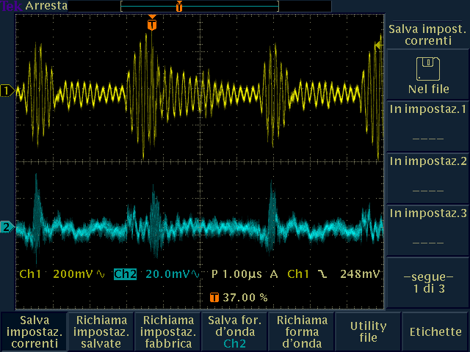
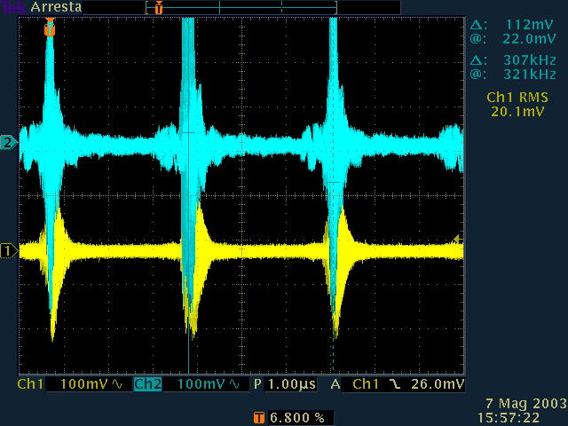
Ripple measurament on RPC system
The ripple peek to peek at load (f < 1 MHz) of the 2 HV channels is < 20 mV while for the 6 LV channels it is about 200 mv
Is such a noise reasonable for the GEM detector ?
RPC Manufacturing Review - Pierluigi Paolucci - I.N.F.N. Napoli
5

Slide 6
Ingredients needed to design the system
How prevent and cure chamber discharge ?
Every chamber is divided in a certain number of GEM sectors, resistive coupled each other and the way they are coupled is essential to correctly design the power system.
The resistive coupling (filtered is better) is intended to power all the sectors at the same voltage, to protect them in case of discharge and reduce the noise.
One more critical point in the power system design is the noise induced on the chamber that depends to the grounding schema of the system, to the cable routing and to the faraday cage of the chamber. Passive or active filters have to be introduced on both power supply and chamber in order to reduce the induced noise and to protect the chamber in case of discharge.

Slide 7
HV schema - proposal
HV
Distributor
+
filter
* Any resistor along the
HV line introduce a
Voltage drop.
PS
system
CAEN EASY PS and is under test in Napoli
A first passive filter* will be introduced on the HV board or on the distributor
A second and most important passive filter* will be mounted as close as possible to the chamber. This can be also used to protect the chamber from spikes.
Test at CERN or LNF will be done in the first part of the 2014.
Cables routing on the chamber is under study in Napoli.
GEM 1
HV
D
I
v
i d e
r
filter
GEM 2
filter
GEM n
filter

Slide 8
HV module under test

Slide 9
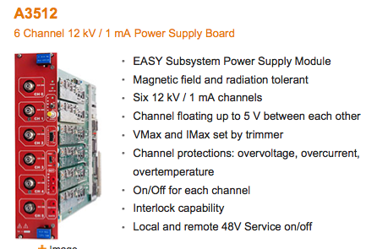
HV module under test

Slide 10
Missing items
Chamber CAD drawing is mandatory to study the cable routing.
Ground and electrical connection schema is necessary to design a Power System.
A dedicated test to study noise and grounding is important in my view. ASAP
More experts needed to design the chamber for what concern the electronics.
Cable dimension and path requirements neded

Slide 11
How estimate the cost
How many channels per chamber.
Maximum voltage and current.
Noise requirements and filters on board and on chamber.
Precise current measurements requires ADC (ATLAS) ?
2 Mainframes about 20 KCHF
1 HV board with 6 channels costs 7 KCHF
1 LV board with 6 channels costs 7 KCHF
LV on the balcony and HV in USC ?
From my experience this is mandatory
Long cable, patch panel, distributors – 100KCHF in RPC
Safety and monitoring
About 1.2 KCHF/channel

Slide 12
Conclusion
Chamber and super-module design are necessary to design the power system.
Filters and discharge control are mandatory.
Cost estimation between 400-600 KCHF
in a months I’ll provide a couple of schema with a better quotation

