Slide 1
GEM for CMS
Electronics Overview
Giuseppe De Robertis - INFN Bari
Gilles De Lentdecker - ULB

Slide 2
Overview
Introduction
Technologies
Design steps
Current status
Planning
Alternative design
Conclusions

Slide 3
Introduction
Tasks of the GEM Trigger and Data Acquisition system
  Inspect detector information at the full crossing frequency
  Select events within 3.2 μs with a max. accept rate (L1A) of 100 kHz
  Upon L1A, acquire the detector data and provide it to the HLT (EVB and CMS DAQ)
In addition:
  The system should supervise all detector components through the Detector Control System (DCS)
Should be designed having in mind various LHC operating scenarios
  Increase of the luminosity
  Possible extension of the latency up to 20 μs
  Increase of the max. L1A rate up to 1 MHz

Slide 4
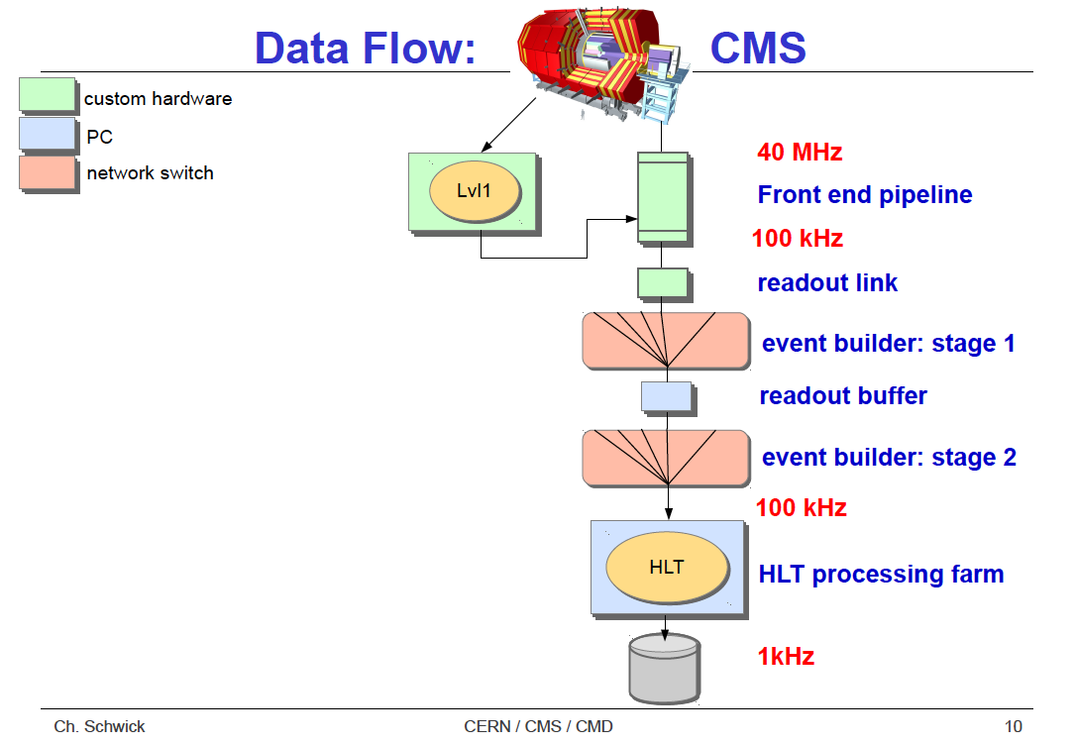
Reminder CMS DAQ
We are here
Central DAQ

Slide 5
System overview
VFAT3

Slide 6
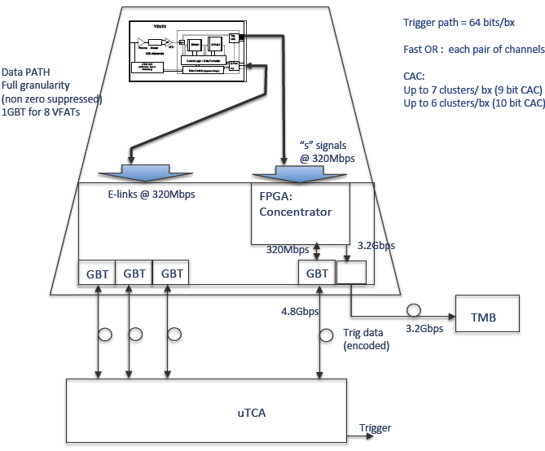
Current baseline
VFAT3 ASIC
Opto-hybrid
GBT ASIC
FPGA
(programmable logic)
TTC
Opto links
DCS
DAQ
Backend electronics

Slide 7
Trigger Data flow
Trigger data are sent @ 40 MHz
from every VFAT3 chip
Trigger data = Fast ‘OR’ of 2 or 4 strips
(sometimes referred to as a ‘pad’)
2560 or 1280 Mbps / VFAT3
Signals transmitted through copper
lines within the GEB PCB
Full granularity data
(tracking data) are
stored in VFAT3 SRAM
TTC
DCS
DAQ

Slide 8
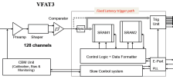
Trigger Data flow
Trigger data = Fast ‘OR’ of 2 or 4 strips
→ FPGA concentrator gets:
~ 62 or 31 Gbps, but mostly ‘zeros’
FPGA applies zero suppression and
send only hit ‘pad’ addresses to trigger
processors (CSC TMB & μTCA) through
optical links.
TTC
DCS
DAQ

Slide 9
Tracking Data flow
Tracking data are sent upon L1A (100 kHz) from every VFAT3 chip
Tracking data = 128 strips data
Order of magnitudes of data volume:
  12.8 Mbps / VFAT3
  307.2 Mbps/ GEM
Signals transmitted through copper lines within the GEB PCB (see later)
TTC
DCS
DAQ

Slide 10
Tracking Data flow
1 GBT can handle max. 10 FE ASICs
→1 GBT to read-out 1 column
up to 10 VFAT3 / column
Data sent through optical link to
uTCA
TTC
DCS
DAQ

Slide 11
Tracking Data flow
TTC
In μTCA, tracking data are formatted within a CMS data
fragment sent to central CMS DAQ
DCS
DAQ

Slide 12
Technology choices
Since the beginning, backbones of the GEM DAQ are:
  uTCA standard
  Generic CERN developments
    GBT, Versatile Link, GLIB

Slide 13
Versatile link & GBT
VFAT3

Slide 14
Versatile link & GBT
The versatile link is a bi-directional digital optical link operating at rates up to 4.8 Gbps (3.2 Gbps for data)
It features rad-hard components for the FE
It has serial data interfaces and is protocol agnostic
However targeted to operate with the Gigabit Transceiver (GBT) ser/deser. chip designed by CERN
VFAT3
GBT
GBT
Versatile Link
FPGA
Timing & Trigger
GBTX
PD
Timing & Trigger
GBTIA
FE
DAQ
DAQ
GBLD
LD
Slow Control
Slow Control
Custom ASICs
E-Link
On-Detector
Radiation Hard Electronics
Off-Detector
Commercial Off-The-Shelf (COTS)

Slide 15
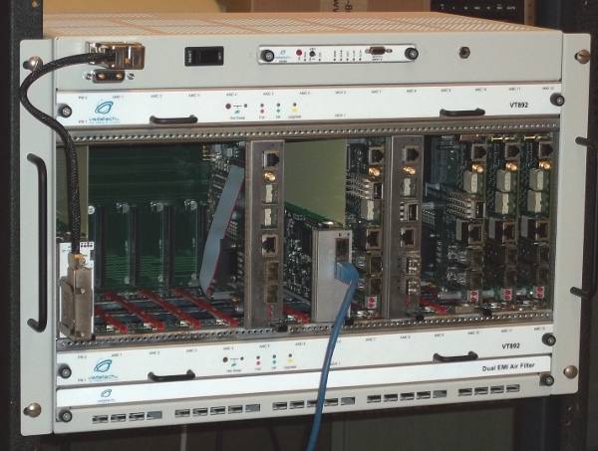
μTCA
Little brother of ATCA (Advanced Telecommunications Computing Architecture)
  the largest specification effort in the history of the PCI Industrial Computer Manufacturers Group (PICMG)
  Offers a flexible, high density, high performance backplane based on serial standards used today (GbE, PCIe, …), designed for highly redundant systems
  Large & common effort within CMS to replace VME by μTCA for upgrades
    CMS Calorimeter trigger already
    CMS Trigger & HCAL upgrade
  μTCA crate needs a small embedded
  computer to “boot up” and control it:
  the MCH (Main Carrier Hub)
    IPMI protocol used within the crate
    to manage it
  μTCA boards are called AMC
  (Advanced Mezzanine Card)

Slide 16
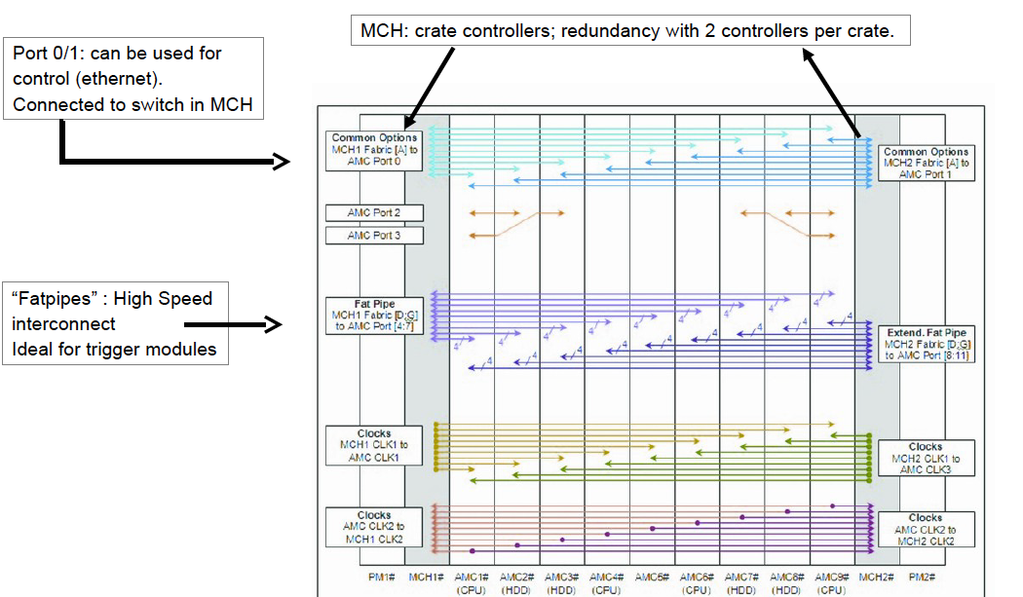
μTCA technology: the backplane

Slide 17
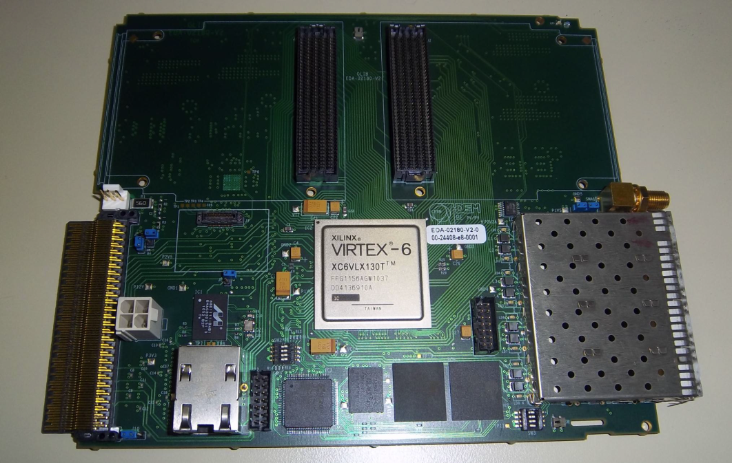
GEM DAQ AMCs
GLIB
AMC13
Mid-size double-width AMC
4 SFP+ transceiver modules
Virtex-6 FPGA
I/O capability can be further enhanced with 2 FPGA Mezzanines
Max 8 SFP+ transceiver modules
Distributes LHC clock / timing / controls to AMCs
It collects DAQ data from AMCs
It provides standard interface to CMS DAQ:
  CMS DAQ via optical fibers (currently 2 at ~ 5Gb/s)
  TTC via 1300nm fiber @ 160Mb/sec
  TTS via 1300nm fiber with protocol t.b.d.

Slide 18
Tracking data distribution to μTCA
10°
GE1/1 back
GE1/1 front
Separate trigger & tracking data path
1 GLIB + FMC = 8 Optical links
1 SC → 6 GBTs
10° → 1 GLIB
120° → 1 crate
3 crates / endcap
+1 for trigger data
CMS
AMC13
MCH
GLIB#11
GLIB#3
GLIB#2
GLIB#1
GLIB#0

Slide 19
Opto hybrid
TTC
DCS
DAQ

Slide 20
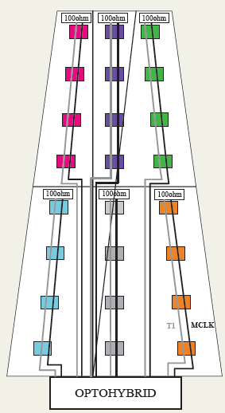
GEB board
The PCB board plugged to the GEM readout PCB
VFAT hybrids plugged on GEB
GEB is a multilayer PCB routing the signal lines from the VFAT hybrids towards the opto-hybrid

Slide 21
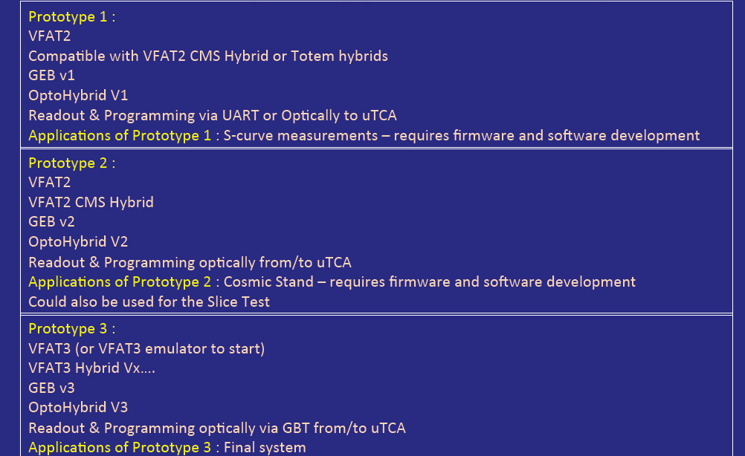
Full size prototype Hardware steps
can read-out 6 VAFT2
can read-out 24 VAFT2

Slide 22
Current Status

Slide 23
μTCA
1 full system in ULBrussels
  1 Vadatech VT892 crate + MCH + 3 GLIB + 1 AMC13
1 half system in Wayne State University
  1 small NAT crate + MCH + 1 GLIB
A starter kit at CERN (TIF)
  1 GLIB board
  However a full Vadatech VT892 + MCH has been ordered by ULB to be installed at TIF (should be available in November 2013)
Note : μTCA is not plug & play; learning takes several months

Slide 24
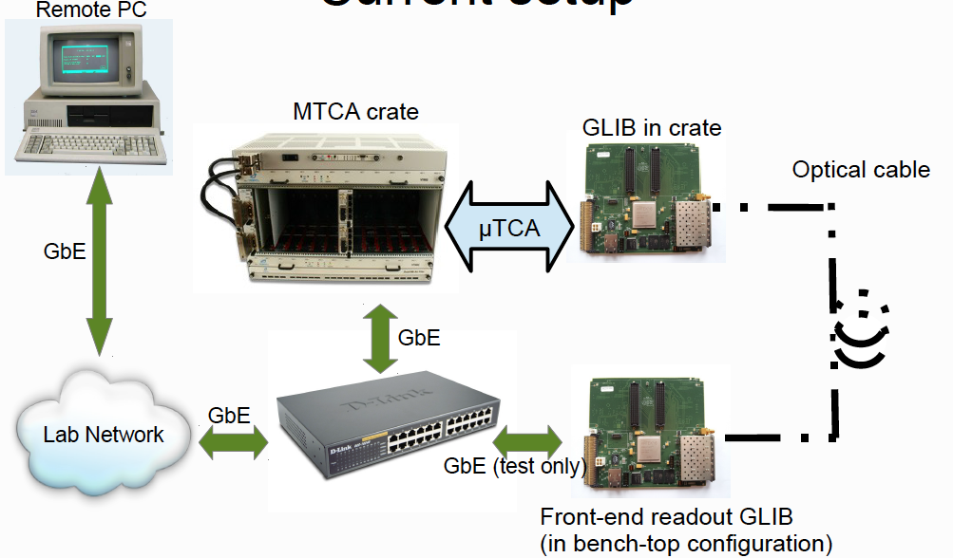
Current tests
GLIB HW ☑
Communication with DAQ PC ☑
IPBus
Read/write (also over fibers)
Firmware upgarde
Integration of GBT FW ☑
To be done:
VFAT2 readout & slow control (FW)
Optical communication with Opto-hybrid
Issues:
data packet losses using GBT protocol between 2 GLIBs
(under investigation)

Slide 25
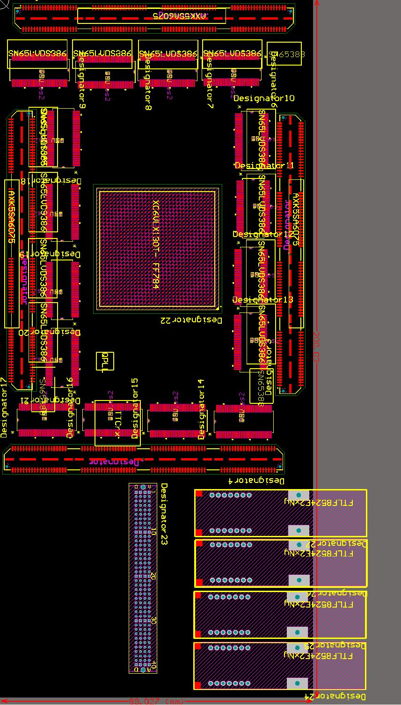
Opto-hybrid status
90 mm
Shown here: initial design proposed for VFAT2
For illustration purpose only
24 VFAT2 : each has 8 S-bits (FastOR) and DataOut (LVDS)
  ~500 signals in total
  4 samtec 160 pins connectors
Virtex 6 FPGA
  GTX transceivers 6.6 Gbps (GBT needs 4.8 Gbps)
  600 I/Os
  35x35 mm²
  part of the CSC system firmware can be reused and also possible to emulate GBT which is an asset for LS2 design
  Need SEU recovery procedure
Power
  15.9W in total
  Enough cooling power on the detector
space:
  From 90 x 200 x 11.5 mm³
200 mm

Slide 26
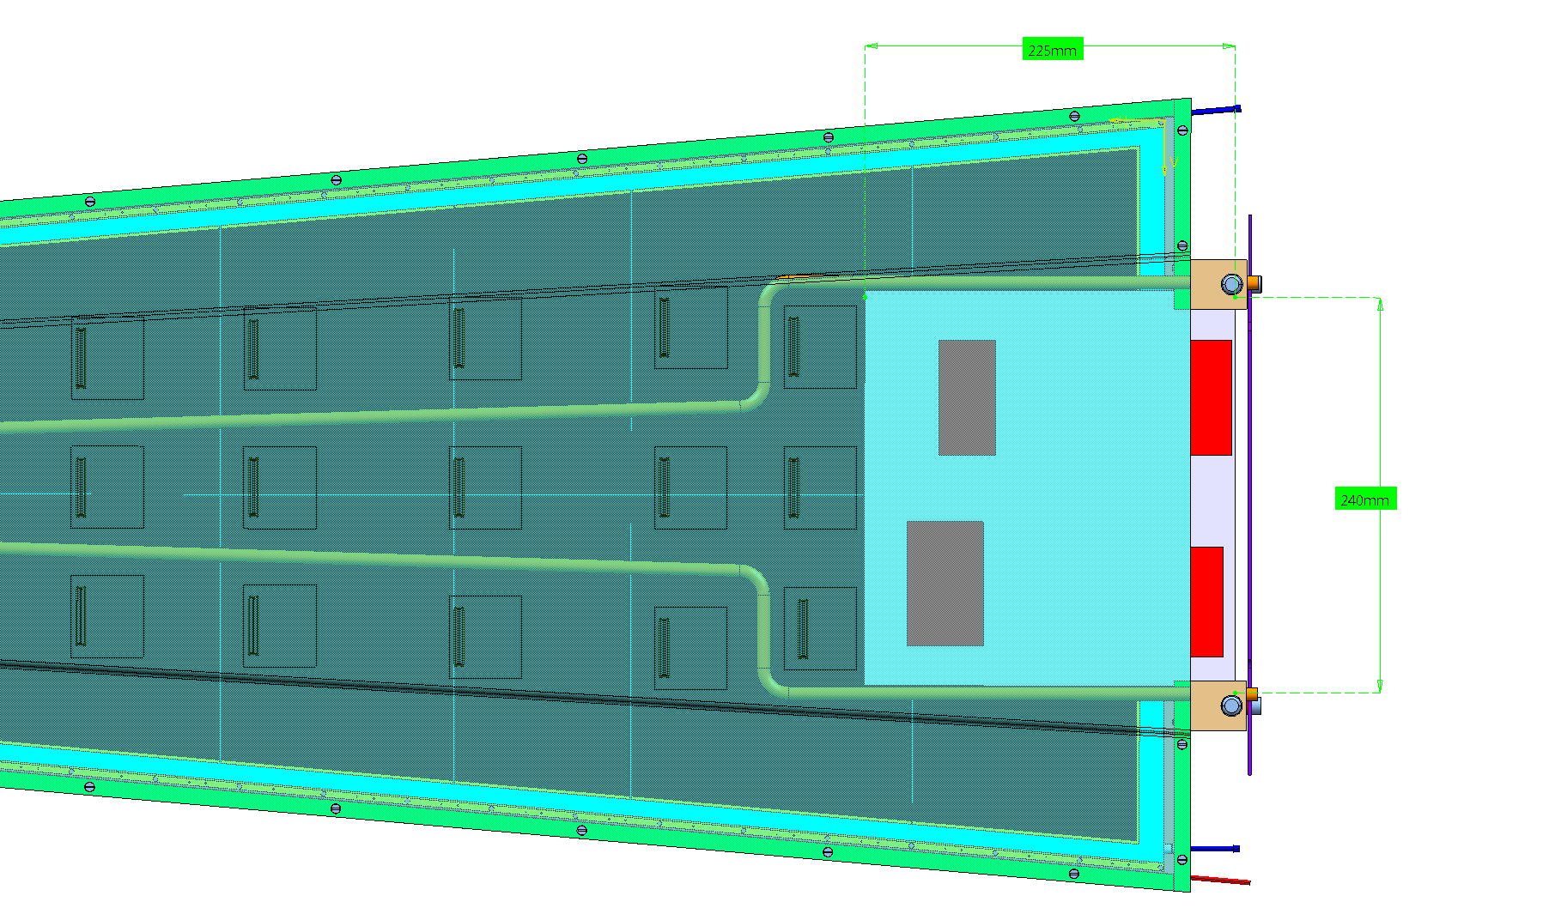
Design evolution
The use of powerful FPGA on detector is not encouraged
  More recent and more powerful FPGAs are less power consuming
  Investigating the possibility to replace Virtex-6 by Artix-7
    Number of I/O’s may be an issue, especially with new long detector design: limited to 500 I/0’s in Artix-7
  Note : there are 7 Virtex-6 FPGAs on each ME1/1 CSC

Slide 27
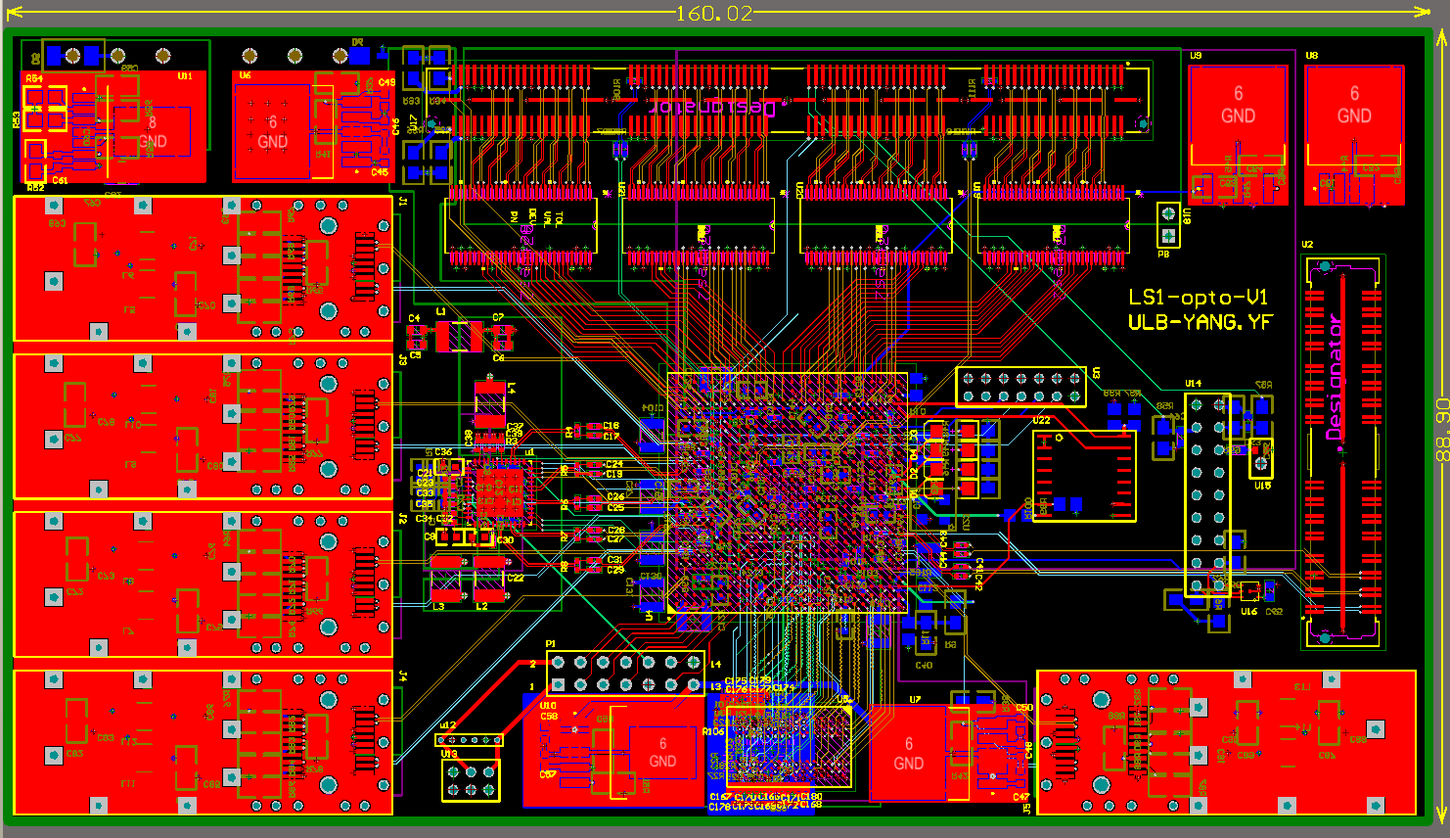
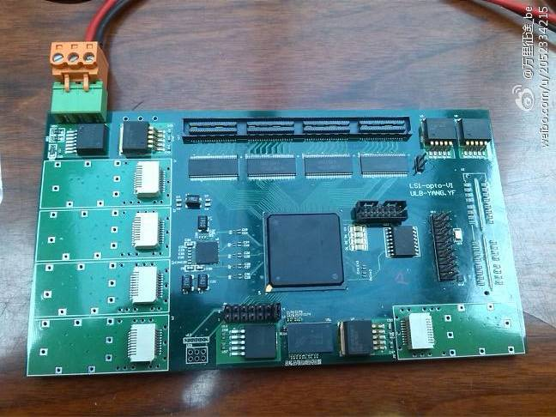
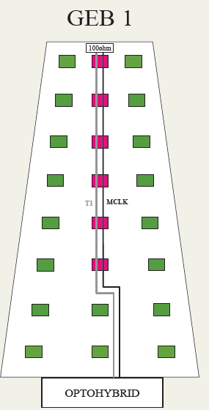
Opto-hybrid v1
Core component is a Spartan 6
Smaller and cooler than Virtex-6
Can readout 6 VFAT2
Fast transceivers slower but still can run at 3.2Gbps
External ADC is required
First board available and under test (w/o optical modules for the time being)
To test: signal integrity, power, …
platform to develop FW and SW.

Slide 28
GEB board steps
GEB 1 has 6 VFAT2 chips which are readout with Optohybrid 1 (red). Also signal integrity, timing and clock distribution can be tested for the over 1 meter long LVDS pairs.
In GEB 2 the VFAT2 chips are
separated to 6 sections.
Each section has its own address
and T1 and MCLK which are
terminated on the last hybrid of
each section.
v1
v2

Slide 29
CMS VFAT2 hybrids
GEB v1 can be tested with new and old CMS VFAT2 hybrids
GEB v1 already back from manufacturer
GEB v2 design starting
New CMS VFAT2 hybrid will be submitted for manufacturing before the end of November 2013 together with GEB v2.

Slide 30
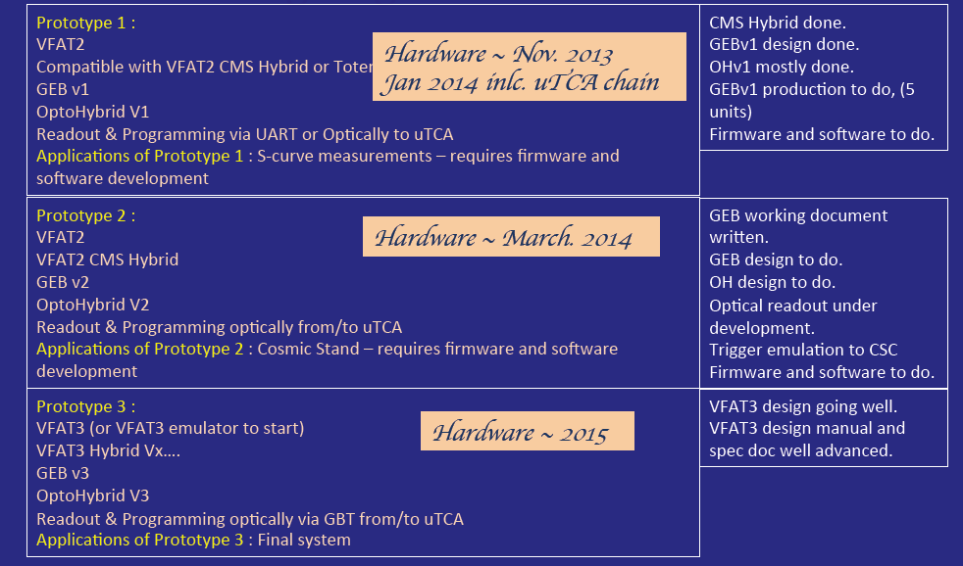
Schedule

Slide 31
Alternative to reduce the costs

Slide 32
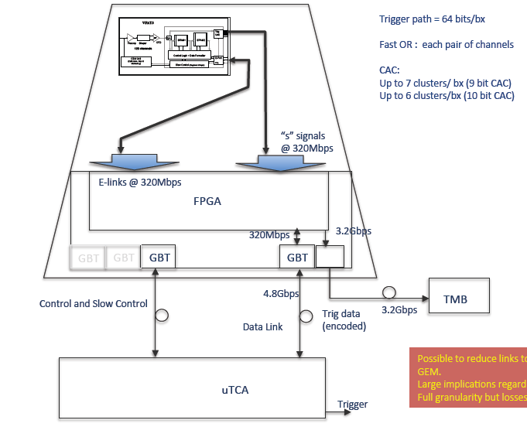
A possible alternative
All data, trigger and tracking should transit through FPGA
→ In this case more powerfull FPGA may be needed
Under Investigation

Slide 33
Alternative
Bandwidth for tracking data is reduced by a factor 3
All data (tracking & trigger) transit through FPGA
  1 GBT can handle at most 10 eLinks
We should most probably use PZS
  Need to study the probability of data losses vs. luminosity (simulation started)
New possible scheme also raises new questions:
  If data need to be transmitted through FPGA anyway, do we need to use the GBT chipset ?
  In that case we could move to other μTCA AMCs, like MP7, planned for upgraded Global Trigger and Global Muon Trigger

Slide 34
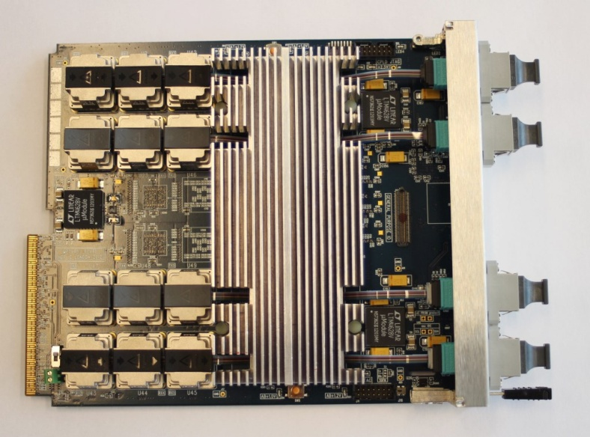
Alternative
Reducing the number of fibers from 3 to 1 for tracking data:
  1 endcap tracking data could be readout by 1 μTCA crate (instead of 3)
  From 96 to 24 GLIBs
If we use MP7 instead of GLIB:
  Up to 72 input optical links @ 10.3 Gbps
  In theory 1 board can read full system

Slide 35
Conclusions
Project well on track
The 3 areas (HW, FW, SW) now covered
Soon first pieces of HW will be released (GEB and Opto-hybrid v1)
  Will allow a lot of functionality testing
  Will help to speed-up FW and SW developments
Developing the baseline while still looking at alternatives to reduce the cost and increase the efficiency of the Trigger/DAQ system

