Slide 1
Readout R&D @ LNF
L. Benussi On Behalf of LNF crew

Slide 2
Main LNF activities on GE1/1
Studies on alternative gas mixtures
Studies on different GE1/1 gap size
Studies on GE1/1 material ageing (on going at
Studies on GEM foils tensioning (see Moire slides)
Studies on readout optimization and strips layout(?)

Slide 3
Alternative gas mixtures studies HOW-TO
Use a small 10X10 cm² GEM chamber (Allow fast gas exchange) ✓
DAQ fast high sample (2 GHz) digital oscilloscope. (Allow precise signal recording and detailed offline analysis) ✓
Good time resolution trigger (<1ns) ✓
FEE with high gain and analog readout (presently the GEM signal is amplified by means of a VME amplifier) ✗
Low noise (as much as possible…) readout. ✗

Slide 4
Work in Progress items
FEE with high gain and analog readout ✗
Low noise (as much as possible…) readout. ✗
In collaboration with Tonio we have designed a dedicated PDB readout board for a 10X10 cm² GEM chamber. This board integrates a board designed by Bari for the GASTONE analog chip, and an improved version of the default 10X10 cm² Rui’s readout board. The PDB board as X-Y readout. One view is done with strips. The other one is done with pads read trough vias (a la Kloe).
Improved shield and grounding will ensure low external noise pick-up.
The GASTONE chip analog version allow single strip readout and has an high gain, with an integration time of 90ns. It has also a relative low internal noise.
It is the only chip that presently allow single strip readout.

Slide 5
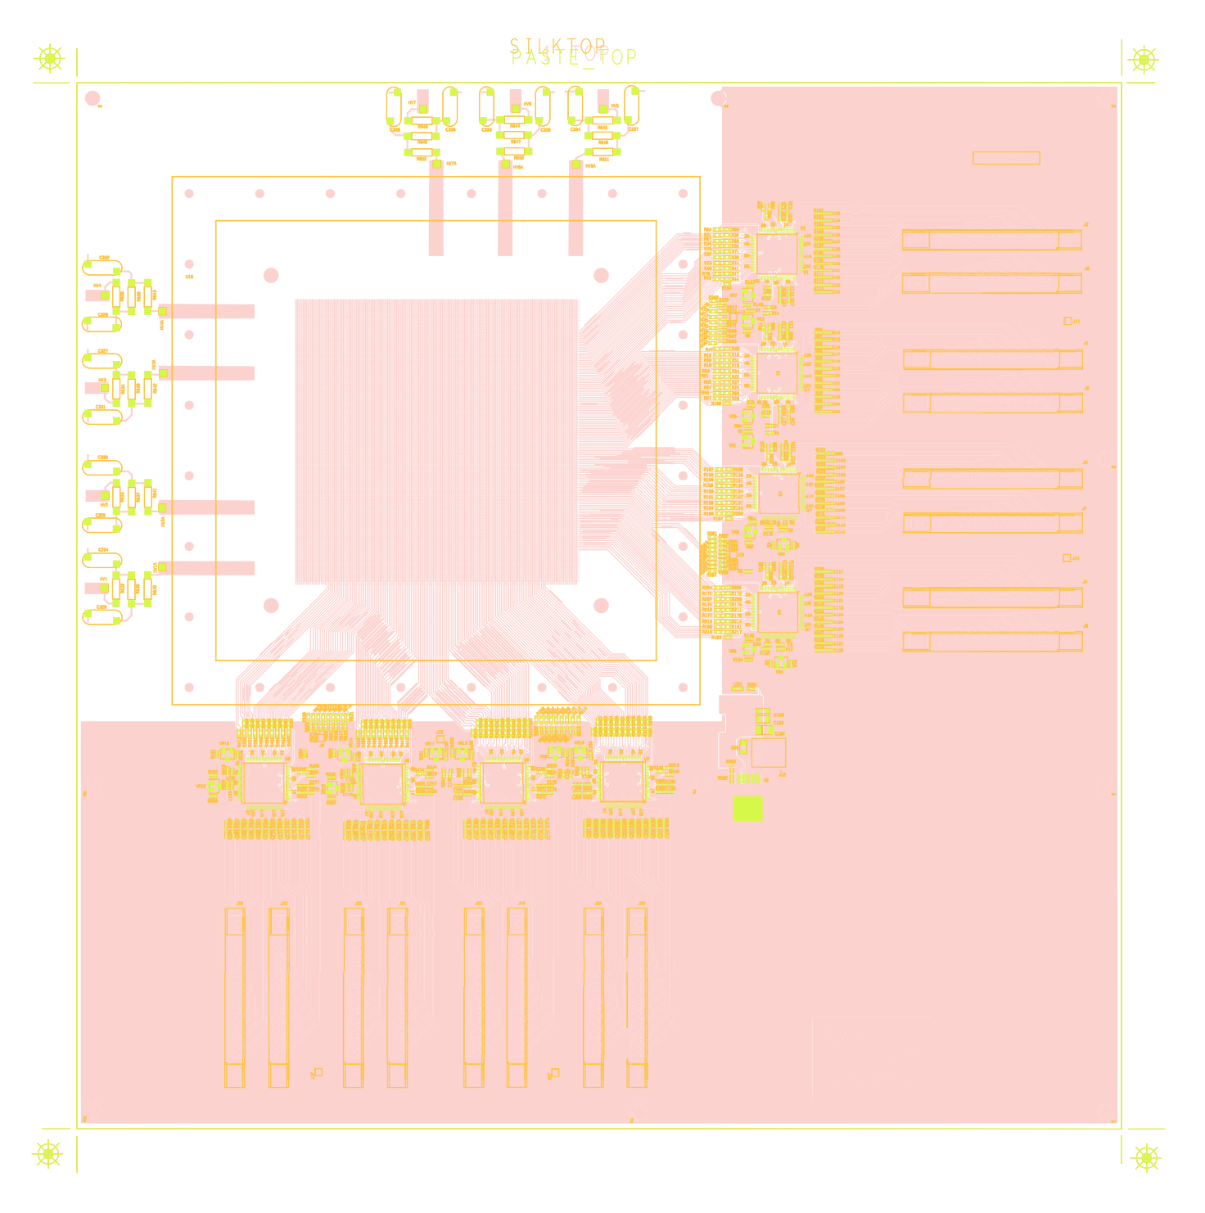
PBC layout
Improved strip readout
shielding and grounding
X-Y readout a la Kloe
GASTONE board

Slide 6
PCB layout
The PCB layout as been finalized and is now read to be sent to the firm for production We will ask to produce 3 – 5 boards. A survey of possible interested firms has been already done. The cost ranges around 2 k€

Slide 7
Issues
The availability of GASTONE chips is limited. We have 4 chip, Bari has 15 chips but they want to use them to instrument 3 eta partition of their GE1/1-IV prototype (12 chips). However 4 chips allow us to fully readout one single view (Y or X)
We have to discuss if it is reasonable to find money for a new GASTONE analog chip production.

Slide 8
Why?
We will improve the results obtained so far both from S/N ratio both in terms of DAQ rate and data quality.
Better grounding and shielding improve S/N.
Fully 10X10 readout improve statistics and speed up DAQ rate (at least a factor 3 from present situation).
Integrated PCB (X-Y and GASTONE boards) remove connectors and cables, sources of external noise pick-up.
High GASTONE gain increase our sensitivity on low amplitude signals.
High GASTONE gain allow better S/N ratio discrimination during offline analysis.
There are no other possible solution on the market!!

