Slide 1



Evidence for high energy neutrinos from extraterrestrial souces
Astrophysical neutrinos
and
the cosmic-ray connection

Slide 2
Outline
Motivation
  Neutrinos: a new probe of the high energy Universe
Neutrino properties and how to detect them
Construction of IceCube
Evidence for astrophysical neutrinos at high energy
Significance, implications, the cosmic-ray connection
Summary and outlook

Slide 3
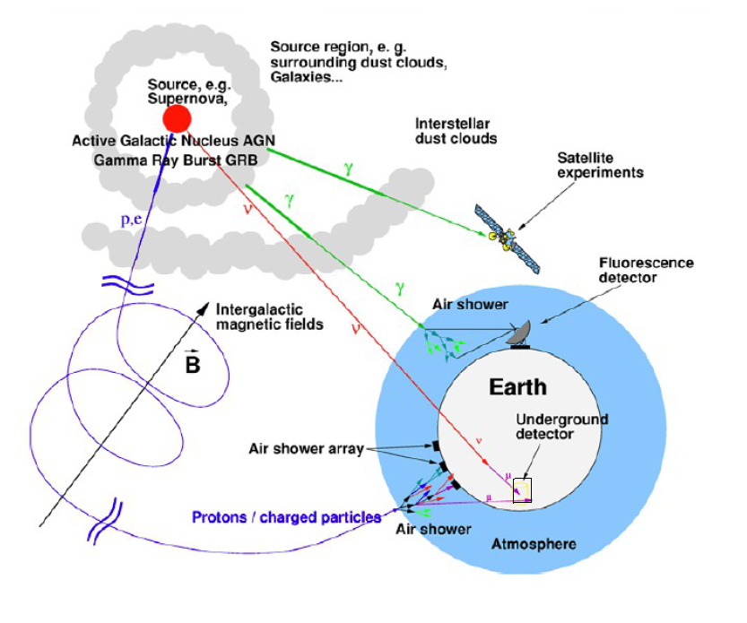
Multi-messenger astronomy:
Cosmic rays
Photons
Neutrinos
Only ν propagate freely through the cosmos

Slide 4
Cosmic ray – neutrino connection
Cosmic rays are accelerated
  in galactic sources such as supernova remnants
  In extragalactic sources such as active galaxies and gamma-ray bursts
Cosmic ray sources produce γ-rays in two ways
  From radiation by accelerated electrons
  From decay of π⁰ produced by interactions of accelerated cosmic-ray protons or nuclei with gas or photons
High energy ν are produced only in hadronic collisions:
  From decay of π/K produced when cosmic rays interact with gas in or near their sources
  Or from photo-pion production on CMB or EBL

Slide 5
Implications of astrophysical ν
Observations of γ−rays are often ambiguous
  Electrons radiate efficiently and usually explain the observations
  Signatures of hadronic origin of photons are difficult to identify and prove
Neutrinos have a unique implication
  Observation of high energy extraterrestrial ν requires a hadronic origin
  Neutrinos can emerge from deep inside a compact source without degradation by electromagnetic cascading

Slide 6
Cosmic Rays
Energy content of CR determines possible sources of neutrinos
Extra-galactic origin is likely
Location of transition from galactic to extra-galactic affects energy estimate
Galactic
Extra-Galactic
at 10¹⁰ GeV (10¹⁹ eV)

Slide 7
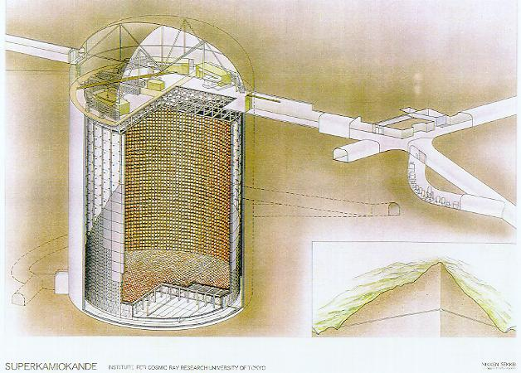
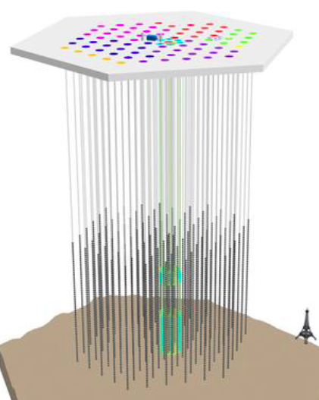
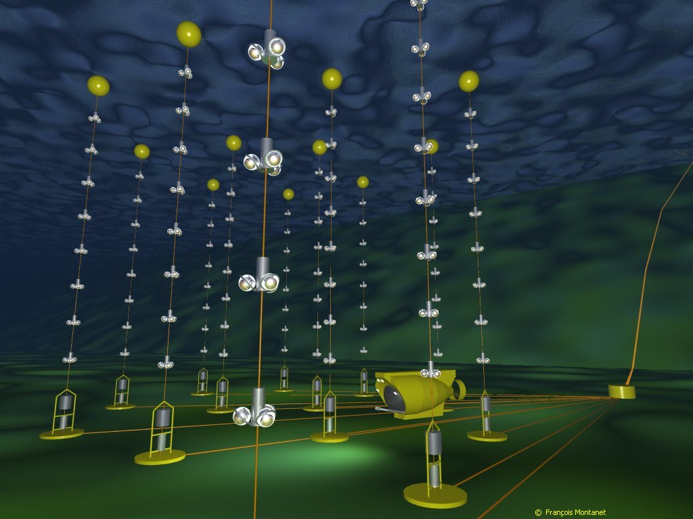
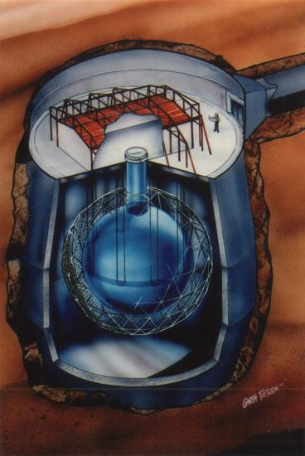
Detecting neutrinos in H₂0
Proposed by Greisen, Reines, Markov in 1960
Heritage:
DUMAND
IMB
Kamiokande
Baikal
AMANDA
Super-K
SNO
IceCube
ANTARES
Neutrino must interact
to be detected

Slide 8
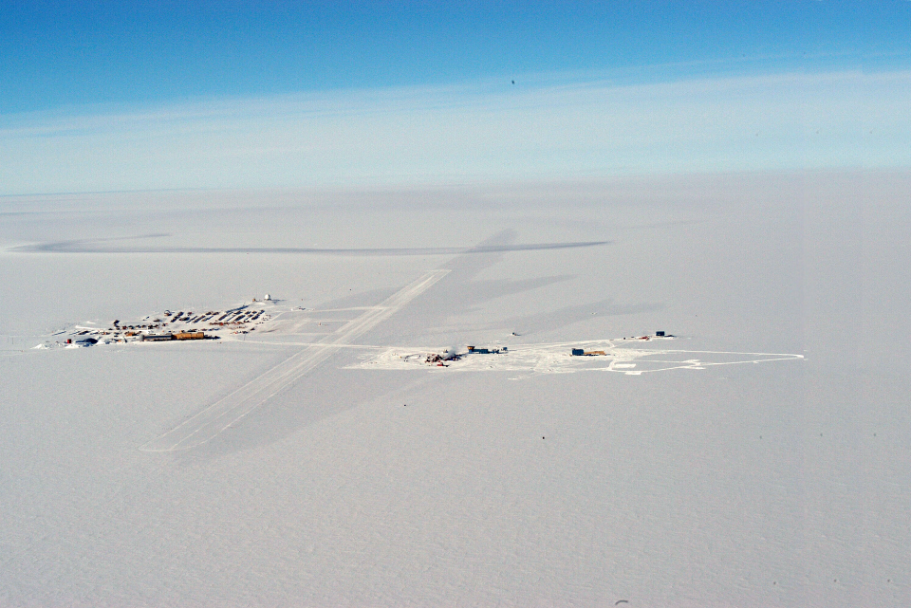
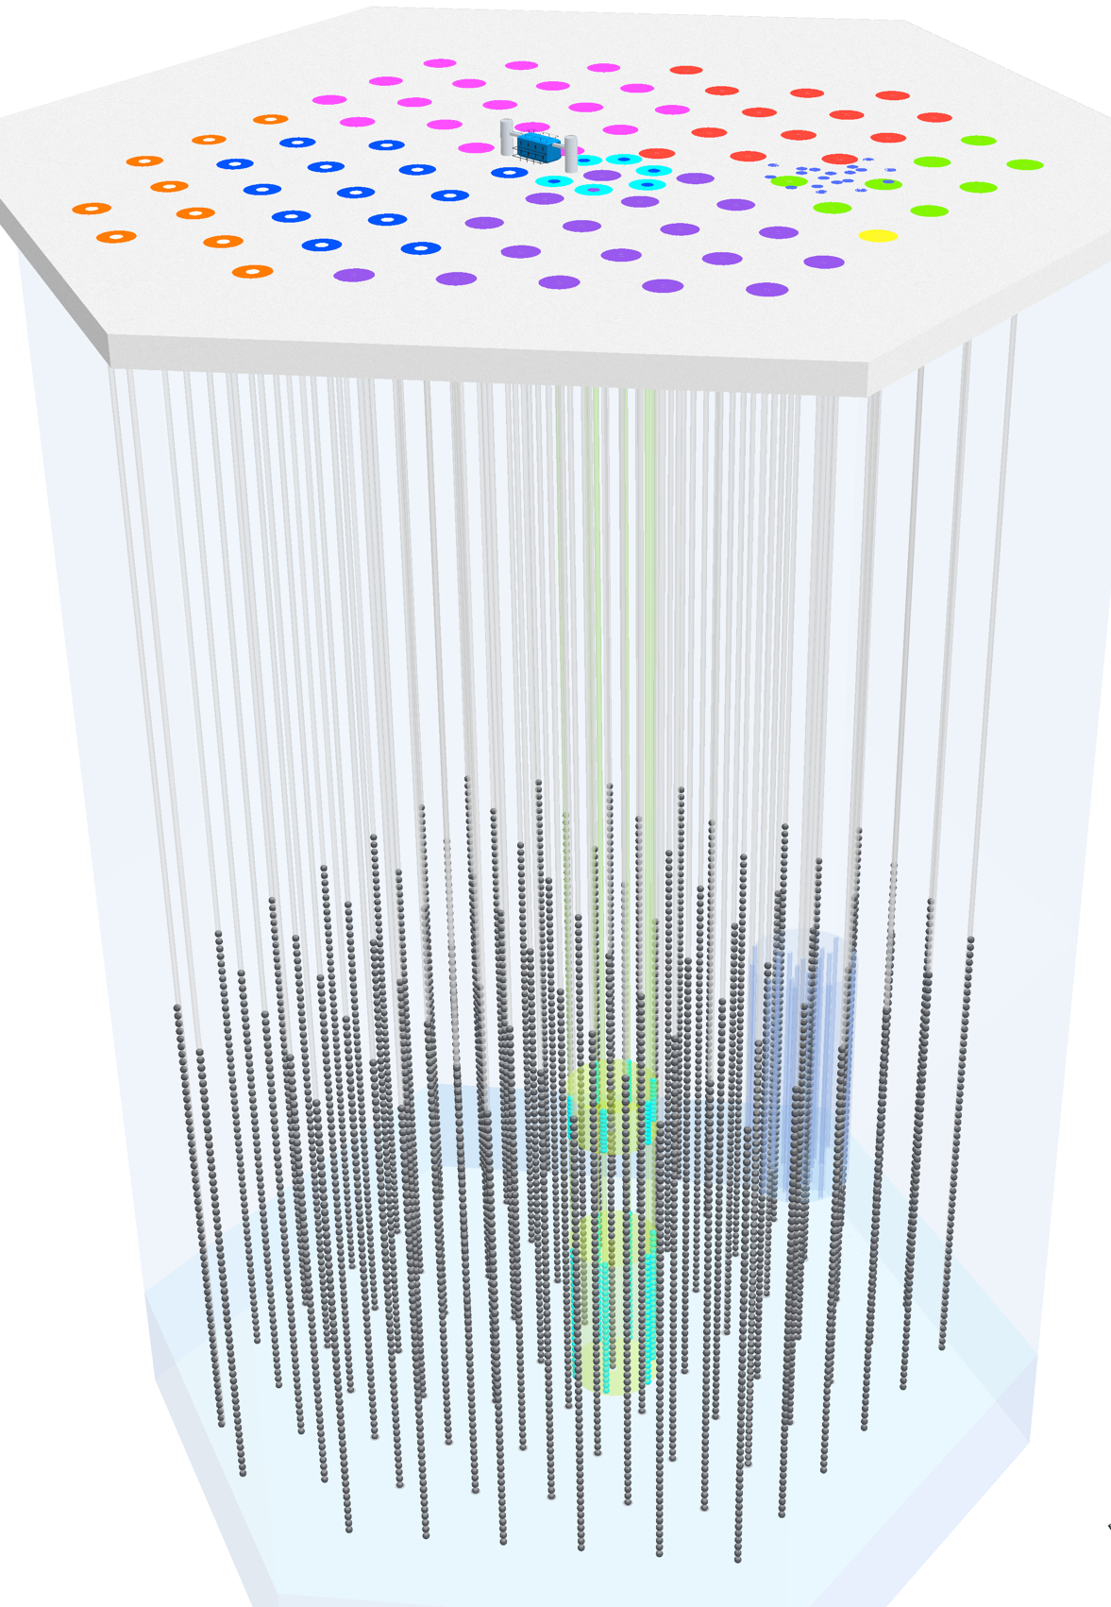
A 3-D cosmic-ray detector:
Two different kinds of events
Closely related scientifically:
Cosmic rays after propagation
Neutrinos from cosmic ray sources
ν_{e}:ν_{μ}:ν_{τ} = 1:2:0 → 1:1:1
Cosmic ray showers from above
South Pole
2835 m.a.s.l.
IceTop
Neutrinos from all directions
ν_{μ}-induced μ (from below)
all flavors starting inside detector
1450 m
IceCube
2450 m
Atmospheric muons

Slide 9
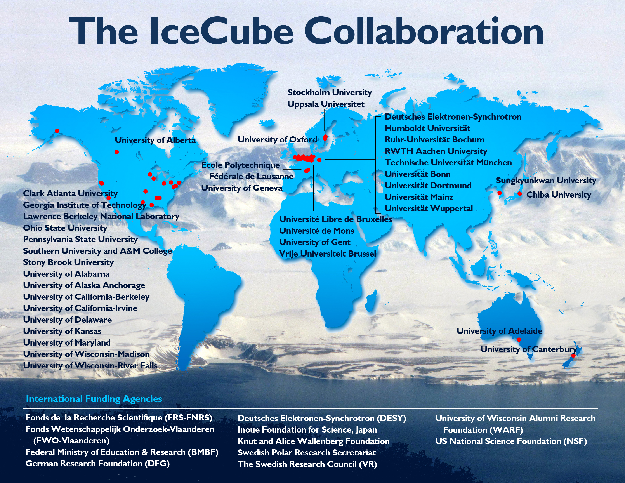

Slide 10
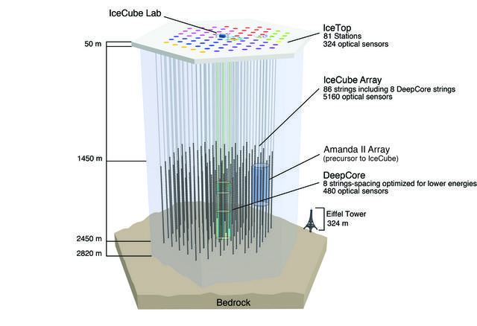
Deployment history
2002: proposal
2003-04 staging
2004-05 1 4
2005-06 9 16
2006-07 22 26
2007-08 40 40
2008-09 59 59
2009-10 79 73
2010-11 86 81
Deep strings
Surface stations

Slide 11
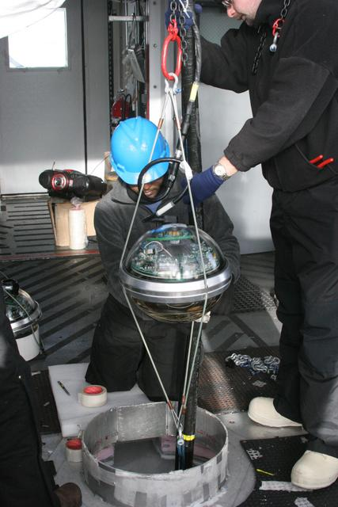
IceCube Digital Optical Module and deployment
LED Flasher board
HV board
Main board for digitizing & time stamping

Slide 12
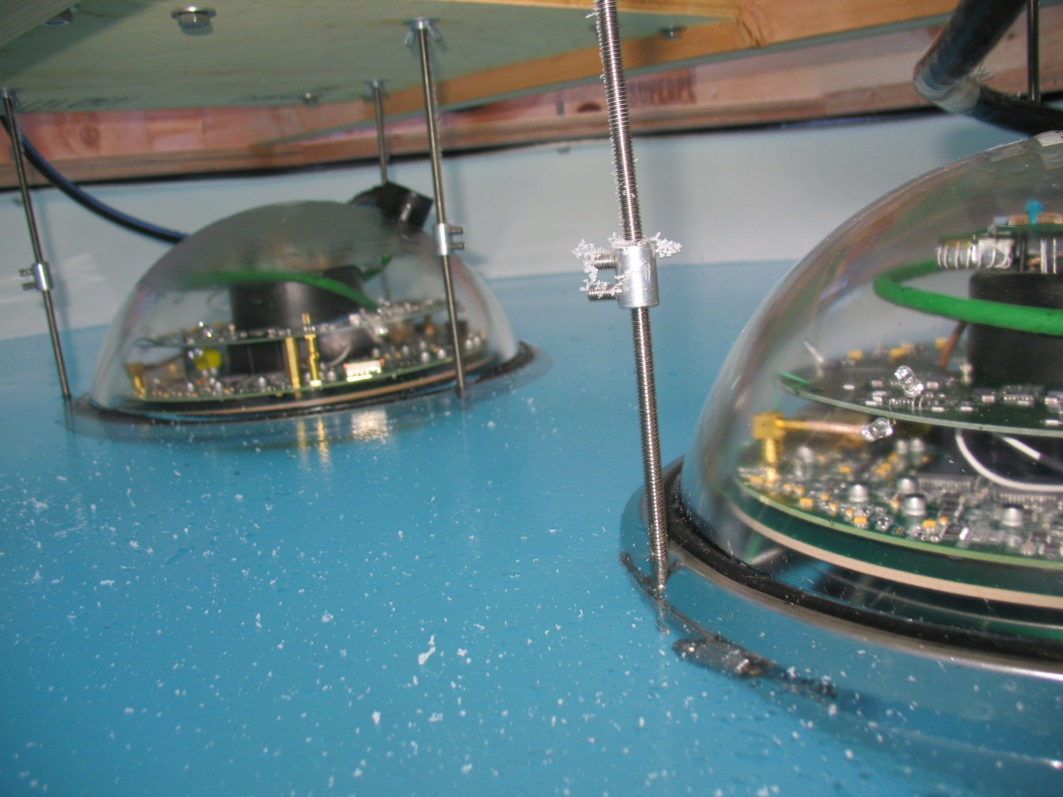
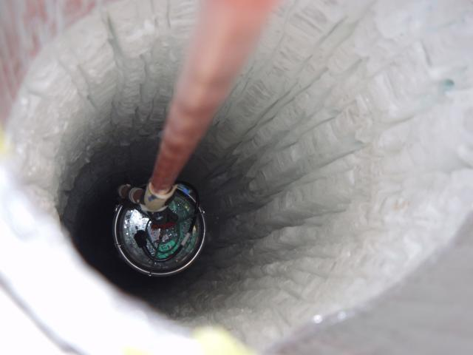
DOMs during construction

Slide 13
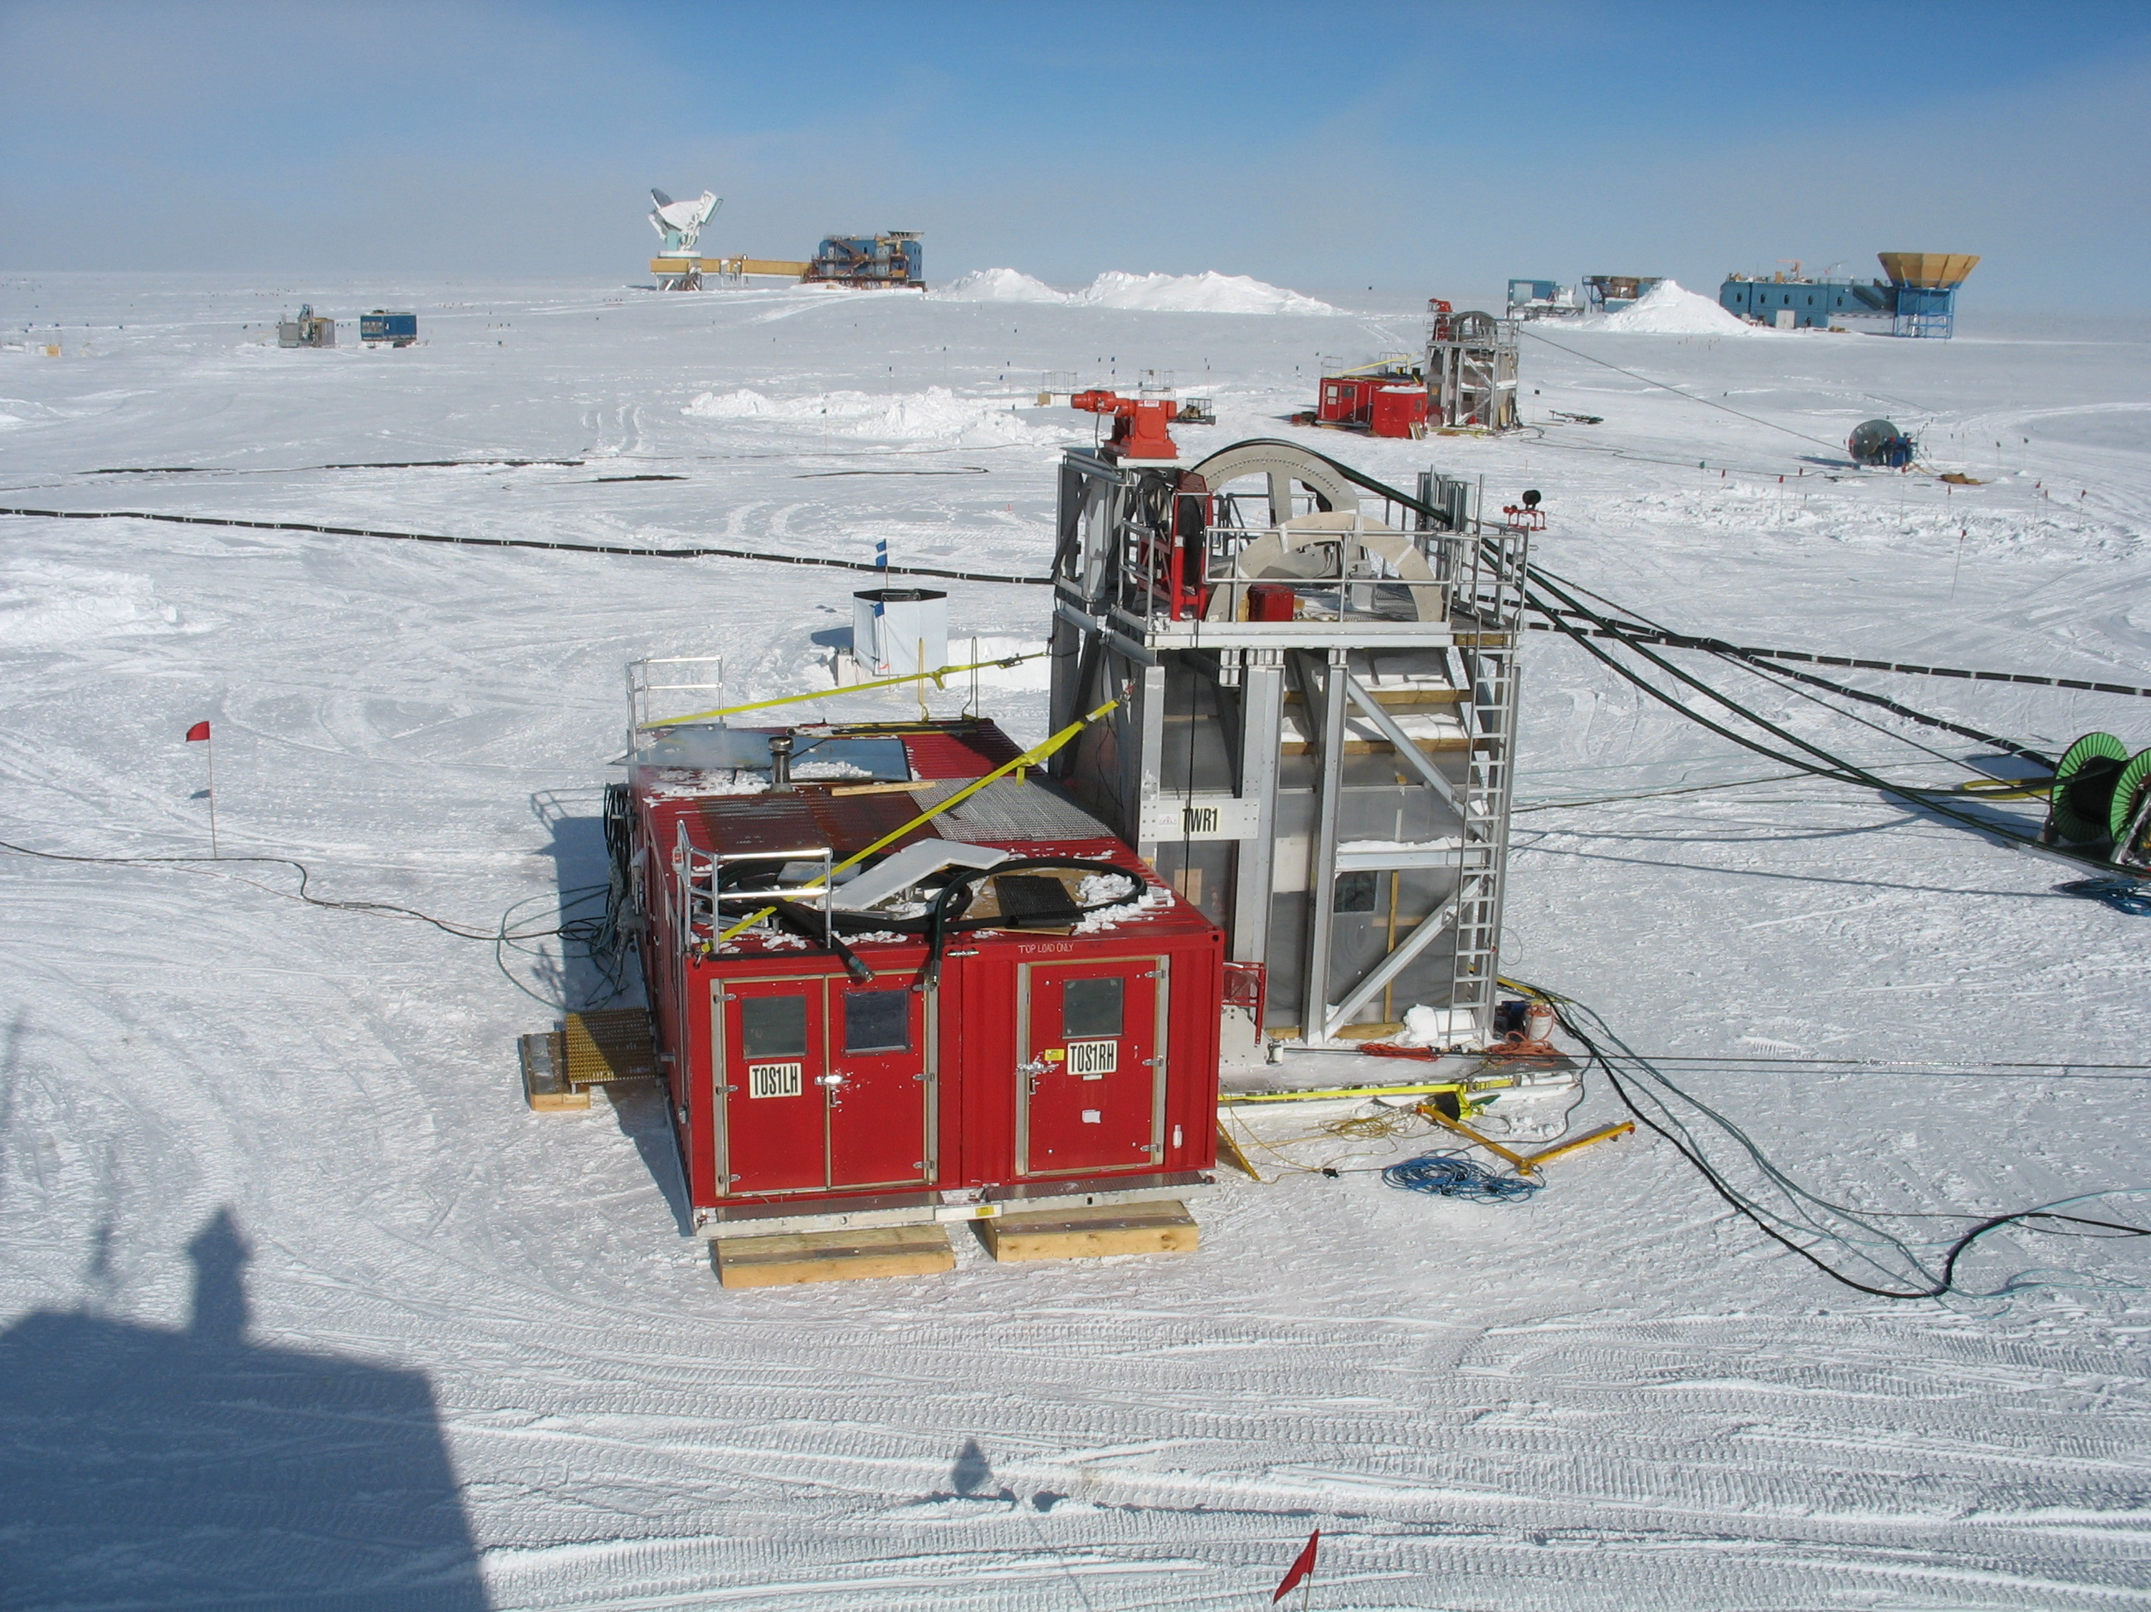

Slide 14
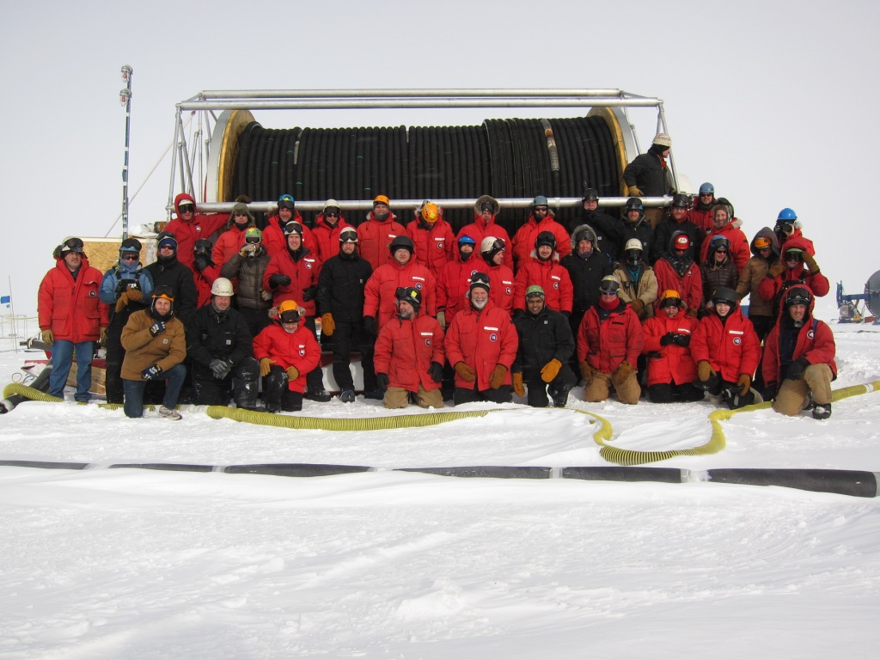
Drilling, deployment team
2010-2011

Slide 15
5 μs

Slide 16
Properties of ice vary with depth

Slide 17
Ice properties
IceCube, NIM A 711, 73, 2013

Slide 18
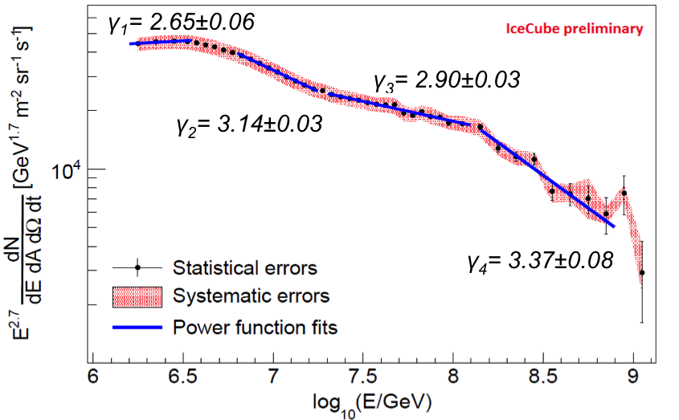
Primary spectrum from IceTop
Phys. Rev. D 88, 042004 (2013).
10⁶ – 10⁸ GeV sets normalization for PeV ν
  Directly for background atmospheric ν
  At sources for astrophysical ν
10⁷ – 10⁹ GeV: transition from galactic to extragalactic
  Model dependent

Slide 19
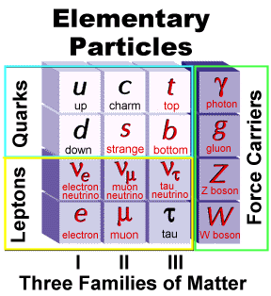
Neutrino interactions - 1
Charged current ν_{μ}:
Force carrier

Slide 20
Neutrino interactions - 2
Tracks
(because of μ)
Force carrier
Cascades

Slide 21
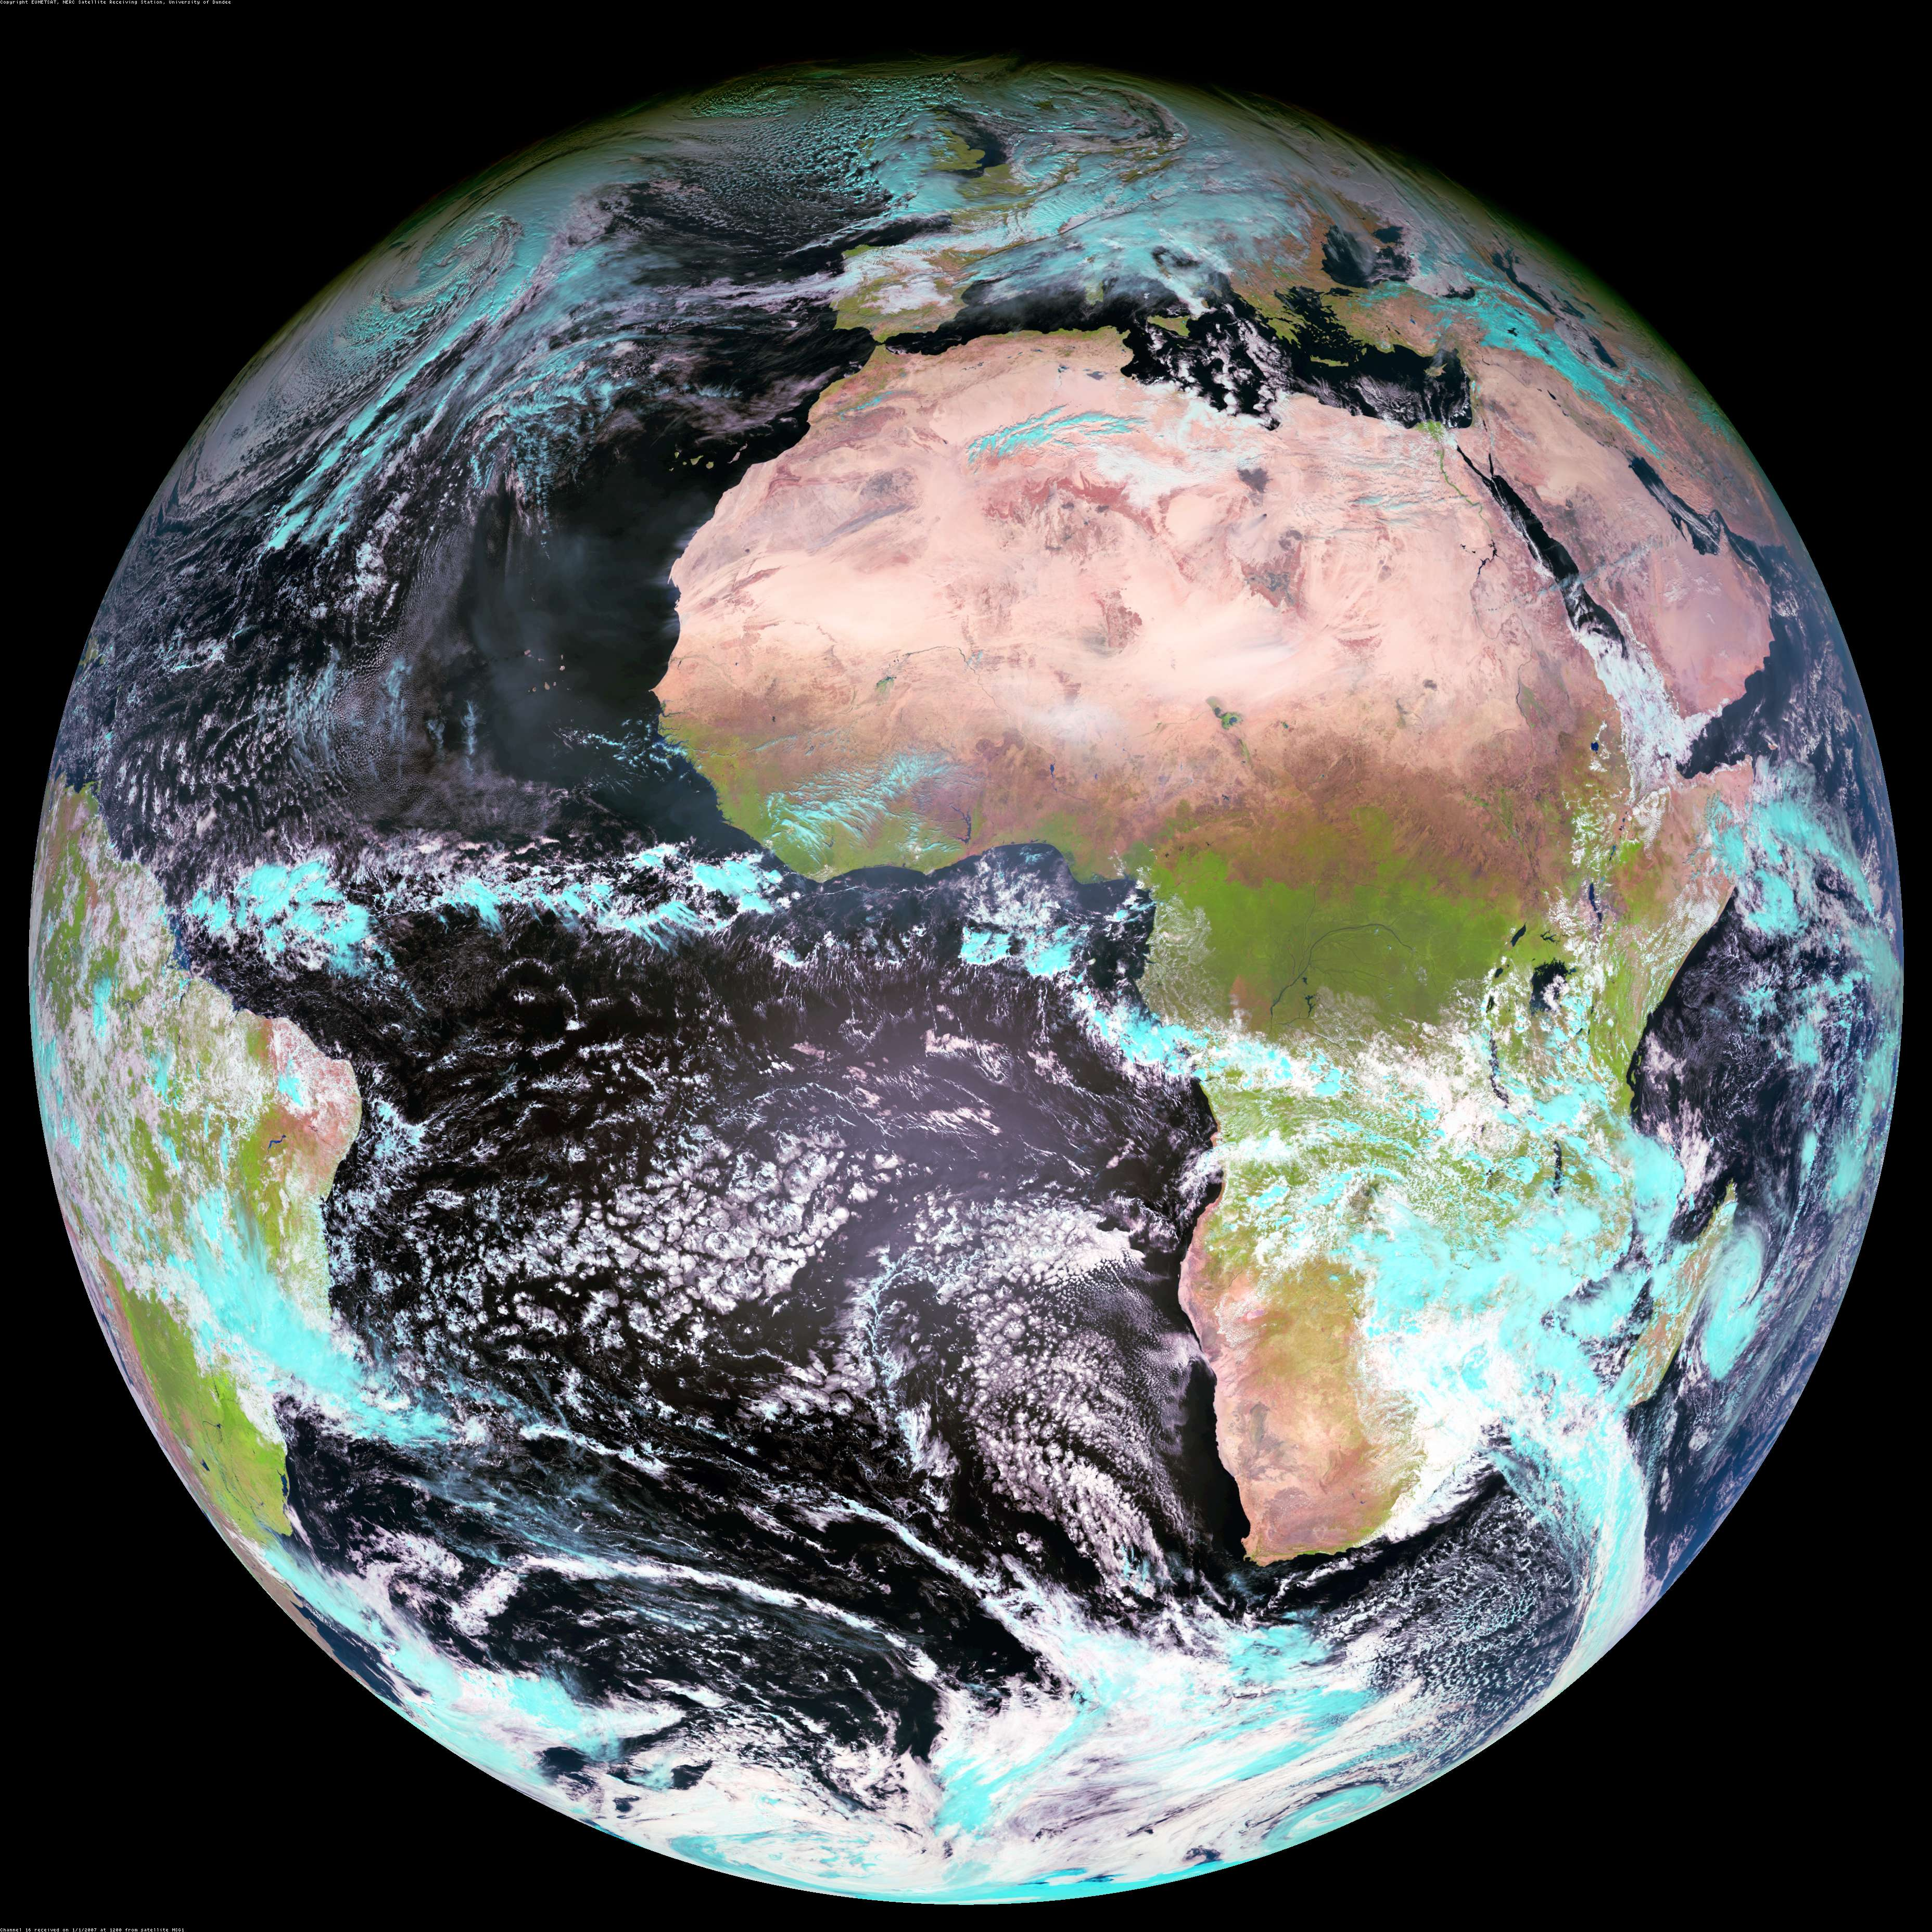
Upward ν in IceCube
S.P.
P. Lipari, 1308.2086
Fraction absorbed
Passing fraction

Slide 22
Upward neutrinos in IceCube
Must have low enough energy to get through the Earth (depends on direction)
Must produce a signal in the detector
  – induced muon from neutrino interaction in the rock or ice below the detector (highest rate)
  Neutrino of any flavor interacts inside detector
Product ≈ 10⁻⁵ is fraction of ν of this energy that interact in detector

Slide 23
Neutrino events
ν-induced μ entering from below
PeV = 10⁶ GeV = 10¹⁵ eV. These are the highest energy neutrinos ever detected!
Two PeV cascades starting inside the detector
PRL 111, 021103 (2013)
Large energy
→ atmospheric origin unlikely
20
14

Slide 24
Starting event
Event starts in fiducial volume
Light from vertex spreads spherically with v=c/1.31
Muon moves ahead with v = c
ID confirmation by timing
Jakob van Santen

Slide 25
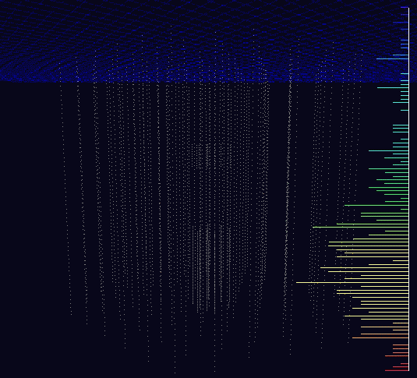


Slide 26
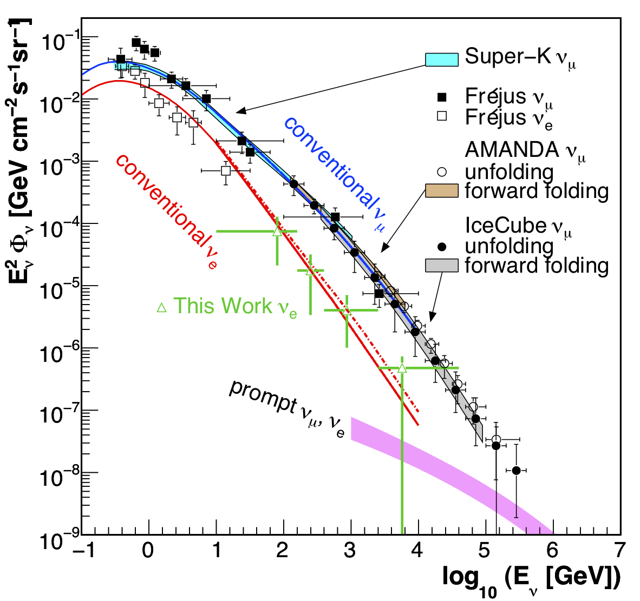
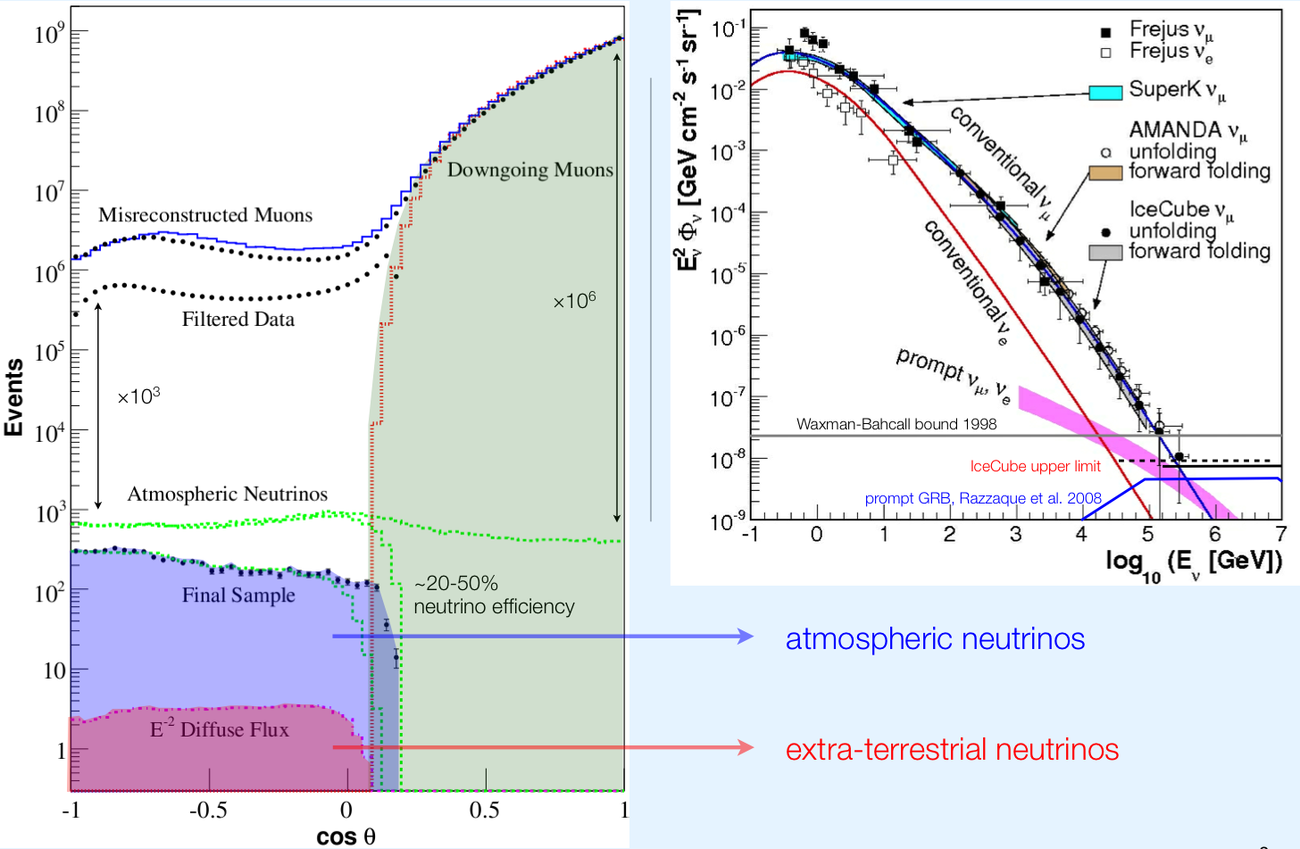
Most events are not astrophysical ν!
2.5 kHz
Astrophysical ν
~ 1 per million
~ 1 per billion

Slide 27
Search strategy for astrophysical ν
Look for a hard, high-energy component above the atmospheric background
  Upward ν_{μ} induced muons
    Highest rate
  Events starting in the detector
    Lower rate, but
    Atmospheric ν background is lower
Look for excess of events in the ν_{μ} skymap

Slide 28
Results from IC 59 (2009-2010)
Analysis of ν_{μ} induced μ from below
Cascade search with IC59 finds 8 events (expected background of 4).
Prompt ν?
ICRC paper 0662
Suggestion of hard (astrophysical?) component ~0.25 x 10⁻⁸ GeV cm⁻² sr⁻¹ s⁻¹
arXiv:1311.7048
Most energetic event….

Slide 29
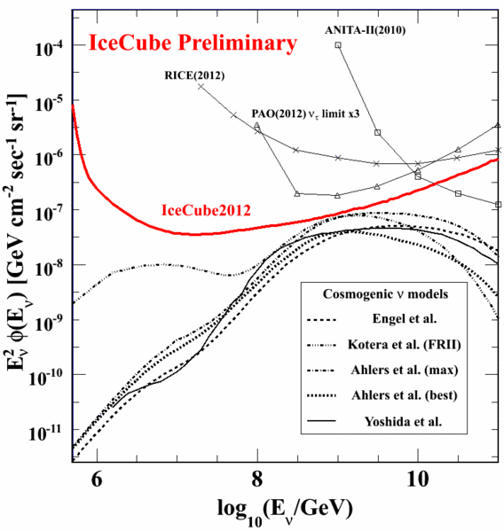
Search for cosmogenic ν (aka GZK ν)
Limits from IC-79 + IC-86, May 2010-May2012
This search discovered two PeV cascade events, each with just over 1 PeV deposited energy--lower than expected for cosmogenic neutrinos. The events were just at the threshold of the search.
Engel, Seckel, Stanev

Slide 30
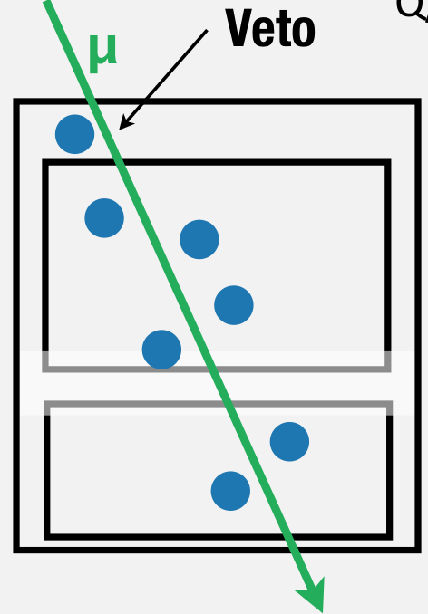
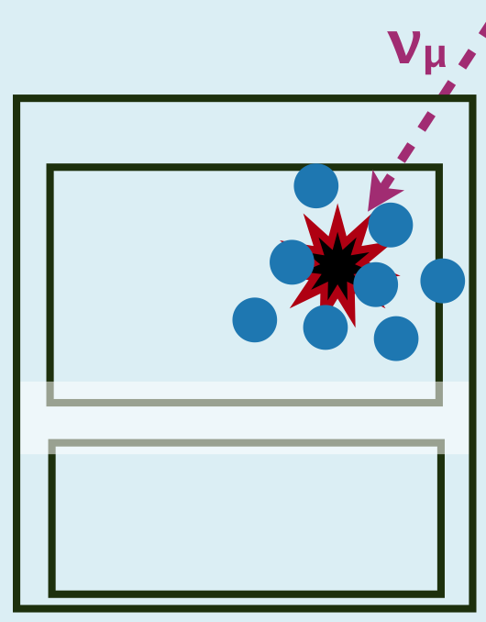
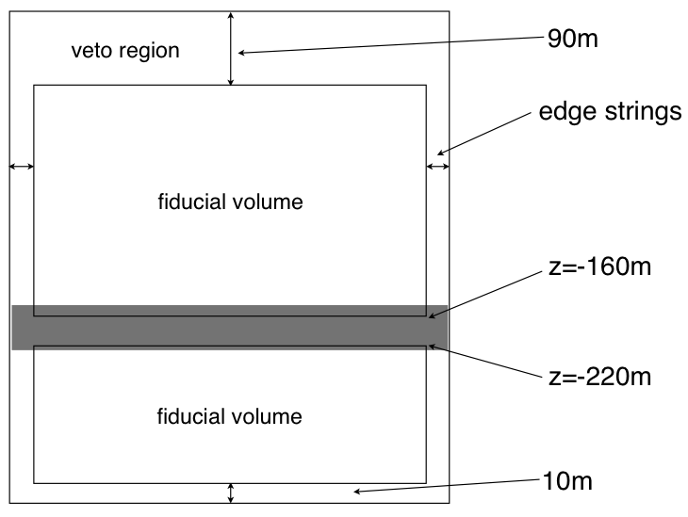
HESE: follow-up analysis of PeV events
HESE = High Energy Starting Events
Looks at same 662 days of data (June 2010 – May 2012), Science, 22 Nov 2013
Require event to start inside fiducial volume
6000 p.e. threshold deposited energy, lower than EHE search
Accept
Comparison of effective areas

Slide 31
Charge distribution of events compared to expected backgrounds
Agreement with expected muon punch-through below 6000 p.e.
6 ± 3.4 expected above 6000 p.e.
Blue region shows conventional atmospheric ν background with prompt estimate hatched
Non-prompt: 4.6 ± 1.2 expected
+ 1.5 prompt
Total expected background:
12.1 ± 3.4
Concentrated at low energy

Slide 32
Energy and direction of 28 events
Bins in sin(δ) contain equal solid angle

Slide 33
Results: 21 cascades, 7 tracks
Vertically up
26 new events
The PeV events previously reported
Horizontal
Vertically down
Note: phase space distorted by flat projection of declination

Slide 34
Sky map of 28 events
For ν_{μ} tracks (x’s on plot) angular resolution is ≤ 1º
For cascades (+’s on plot) resolution is 10º – 15º
Shower events p-value = 8%

Slide 35
Comments on backgrounds
Atmospheric muons passing the veto
  This background is determined experimentally by defining a smaller, inner veto region and checking the rate at which tagged muons leak through
Atmospheric neutrinos
  “Conventional” ν (from K and π decay)
  “Prompt” ν (from decay of charm)
  Muons produced in the same shower as ν provide a partial self-veto in Southern sky

Slide 36
4 likely atmospheric μ background tracks

Slide 37
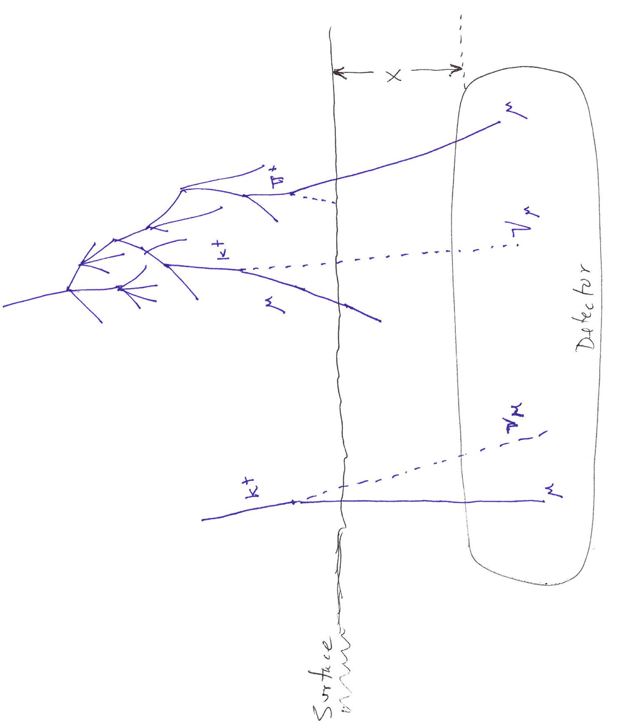
Atmospheric neutrino self veto
Two cases
2. Veto by an unrelated μ
--also applies to ν_{e}
Requires Monte Carlo or numerical integration
1. Stefan Schönert et al.
Phys. Rev. D79 (2009) 043009
Can be evaluated analytically

Slide 38
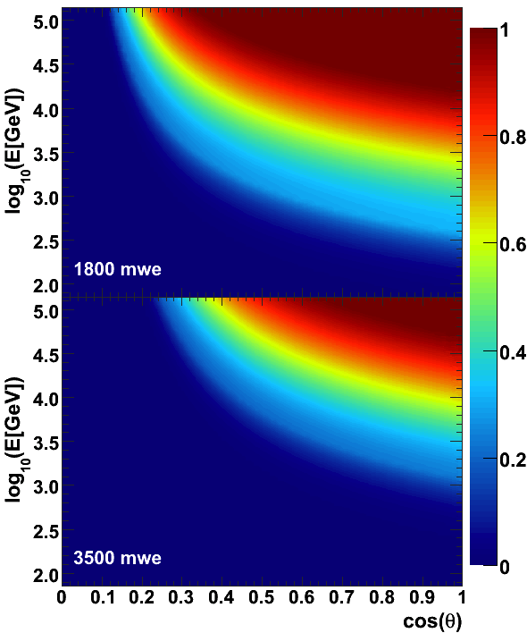
Angular/energy dependence
Analytic calculation:
  For E_{ν} > 100 TeV
  Passing rate < 10% for cosθ > 0.3
  70% of downward phase space
  Even better at higher E
Generic veto
  Not as strong
  Applies to ν_{e} and prompt ν
Schönert et al. PR D79 (2009) 043009

Slide 39
Passing rate depends on ν flavor
Veto = 1 – Passing
Veto is more effective for ν_{μ} than for ν_{e} and prompt ν

Slide 40
Results revisited
Earth shadow – neutrinos suppressed
ν_{e} veto
Green zone: only astrophysical neutrinos allowed

Slide 41
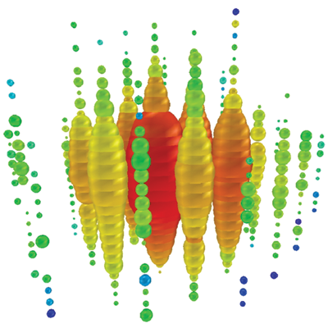
Papers explaining IceCube neutrinos
(partial list)
Extragalactic
Galactic
“PeV neutrinos from the propagation of ultra-high energy cosmic rays,” Roulet et al., arXiv:1209.4033
“On The Origin of IceCube's PeV Neutrinos,” Cholis, Hooper, arXiv:1211.1974
“Cosmic PeV Neutrinos and the Sources of Ultrahigh Energy Protons,” Kistler, Stanev, Yuksel , arXiv:1301.1703
“PeV neutrinos from intergalactic interactions of cosmic rays emitted by active galactic nuclei,” Kalashev, Kusenko, Essey, arXiv:1303.0300
“Neutrinos at IceCube from Heavy Decaying Dark Matter,” Feldstein et al., arXiv:1303.7320
“Ice Cube Observed PeV Neutrinos from AGN Cores,” Stecker, arXiv:1305.7404
“Demystifying the PeV Cascades in IceCube: Less (Energy) is More (Events) ,” Laha et al., arXiv:1306.2309
“On the Hadronuclear Origin of PeV Neutrinos Observed with IceCube,” Murase, Ahlers, Lacki, arXiv:1306.3417
“Photohadronic Origin of the TeV-PeV Neutrinos Observed in IceCube,” Winter, arXiv:1307.2793
“Galactic PeV Neutrinos,” Gupta, arXiv:1305.4123
“Sub-PeV Neutrinos from TeV Unidentified Sources in the Galaxy,” Fox, Kashiytama, Mészarós, arXiv:1305.6606
“Pinning down the cosmic ray source mechanism with new IceCube data,” Anchordoqui et al., arXiv:1306.5021
“The Galactic Pevatron,” Neronov, Semikoz, Tchernin, arXiv:1307.2158

Slide 42
Power for extragalactic cosmic rays (assuming transition at the ankle)
Energy in extra-galactic cosmic rays per ln(E):
Divide by Hubble time to estimate power required:
Power required > 10³⁷ erg/Mpc³/s
  Estimates depend on cosmology + extragalactic magnetic fields:
  3 x 10⁻³ galaxies/Mpc³ 5 x 10³⁹ erg/s/Galaxy
  3 x 10⁻⁶ clusters/Mpc³ 4 x 10⁴² erg/s/Galaxy Cluster
  10⁻⁷ AGN/Mpc³ 10⁴⁴ erg/s/AGN
  ~300 GRB/(Gpc³yr) 10⁵¹ erg/GRB
Notes:
Energy estimate for UHECR is subject to large undertainty:
--what part of observed spectrum to fit? Above the ankle or super GZK?
--if the latter, what to assume about evolution and diffusion in extragalactic B?
--how to extrapolate to low energy?
--demonstrate with graph and overlay
This is basically the “Bahcall and Waxman bound” but stated simply as using the cosmic rays as a guide to what might be expected for neutrinos.
The bound with evolution still allows a fairly big signal--up to 100/yr with energy high enough to be distinguished from atmospheric background.
Hidden sources are also possible (see below).

Slide 43
New limit on ν from GRB (IC40/IC59)
IceCube: Nature, 19 April 2012
Note shape due to photoproduction: Both low and high cutoffs in region of interest.
8 events expected if observed GRB account for all UHECR
None seen in correlation with GRBs of SWIFT & Fermi GBM
Different class of low luminosity GRB? (Cholis & Hooper, 1211.1974)

Slide 44
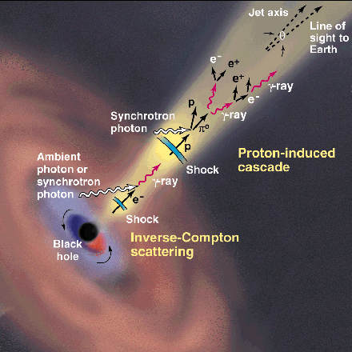
Generic model I
CR acceleration occurs in jets
  AGN or GRB
Intense radiation fields
  Models assume photo-production:
    p + γ → Δ⁺ → p + π⁰ → p + γ γ
    p + γ → Δ⁺ → n + π⁺ → n + μ + ν
Ideal case ( ~ “Waxman-Bahcall limit”)
  Strong magnetic fields retain protons in jets
  Neutrons escape, decay to protons & become UHECR
  Extra-galactic cosmic rays observed as protons
  Energy content in neutrinos ≈ energy in UHECR
This picture disfavored as limits go below W-B
http://www.ucd.ie/math-phy
/rieger/science.gif
Waxman, Bahcall, PRD 59,
023002 (1998). Also
TKG astro-ph/9707283v1

Slide 45
Generic model II
UHECR are accelerated in external shocks analogous to SNR
  See E.G. Berezhko, 0809.0734 & 0905.4785
  mixed composition (accelerate whatever is there)
  Low density of target material
  → lower level of TeV-PeV neutrino production
Diagram from Begelman & Cioffi, Ap.J. (1989) L21

Slide 46
Significance and interpretation
High energy particles are producing neutrinos somewhere in space at detectable levels
  Galactic or extragalactic?
  By photo-pion production or by p-gas collisions?
Consider the extragalactic possibility
  Neutrinos are not absorbed. Therefore
  All sources out to Hubble radius contribute
We may see a large number of events from the whole sky before a single point source emerges
  [see paper by Lipari, Phys. Rev. D78, 083011 (2008).]

Slide 47
Future outlook
Immediate future: more IceCube analyses, e.g.
  3rd year added to HESE analysis
  Diffuse atmospheric ν_{μ} with IC79 and full detector
  Nested veto regions to lower energy of HESE analysis
  Spectrum of atmospheric μ
  Need to understand flavor ratio, North/South ratio, charm contribution, energy-dependence of excess
Longer term: build bigger detectors
  KM3NeT in the Mediterranean
  GVD in Lake Baikal
  IceCube extension

Slide 48
> PeV event found in 3rd year burn sample

Slide 49
KM3NeT design options
From KM3NeT, TDR
From KM3NeT, 1303.6877

Slide 50
Galactic coordinates.
From KM3NeT paper 1208.1226
From Anchordoqui et al., 1312.6587

Slide 51
Ideas for the future at South Pole
Sunflower pattern minimizes entry channels
Average spacing:
~250 m

Slide 52
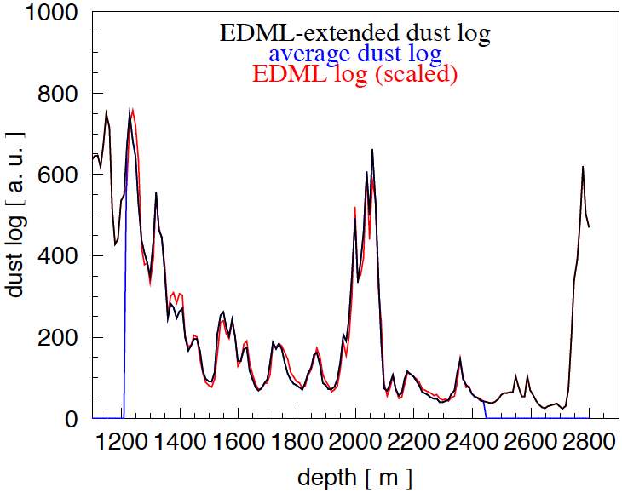
Region of ice to instrument DOMs for simulations
New (continued):
updated dust+EDML merged log and best tilt maps
improved dust log vs. EDML correlation (hyperbolic log-log)
correlation with SPICE model: 23% → 14%, thus better extrapolation
1280 m
1380m
(Simulate 1350m)
2650m
(Simulate 2700m)
OLD
NEW

Slide 53
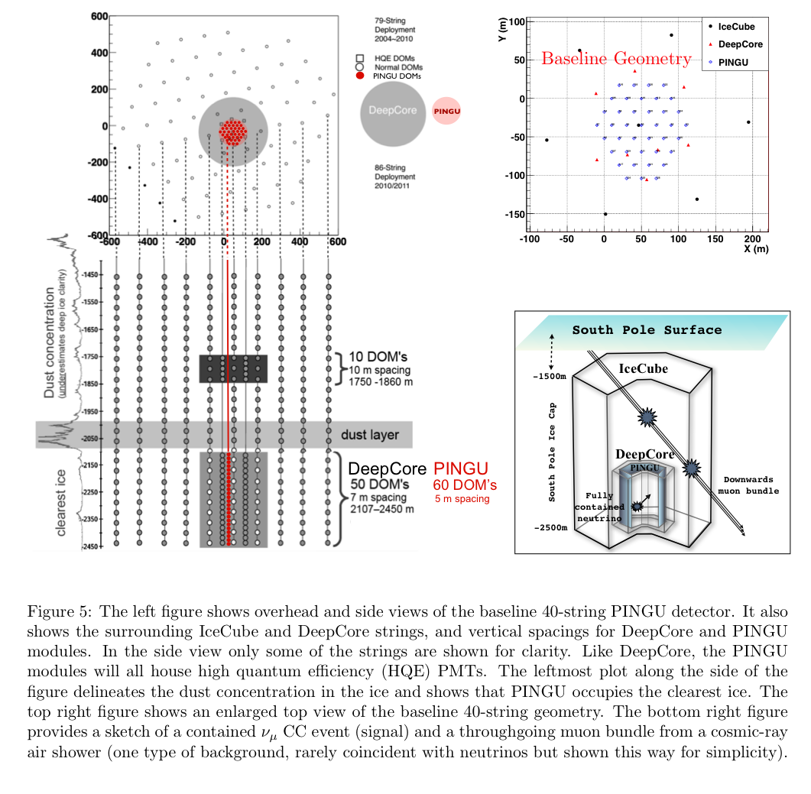
PINGU

Slide 54
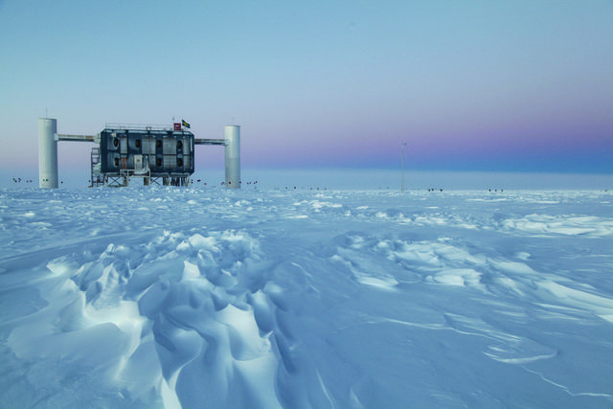
Thank you
Credit: Sven Lidstrom, IceCube/NSF

