Slide 1

Costo ~ 600 kE
ATLAS: Frascati, Milano, Pavia, Pisa
CMS: Firenze, Padova, Perugia, Pisa, Trieste
Applicazioni:
FTK Phase II, L1 Track Trigger, outside Hep

Slide 2
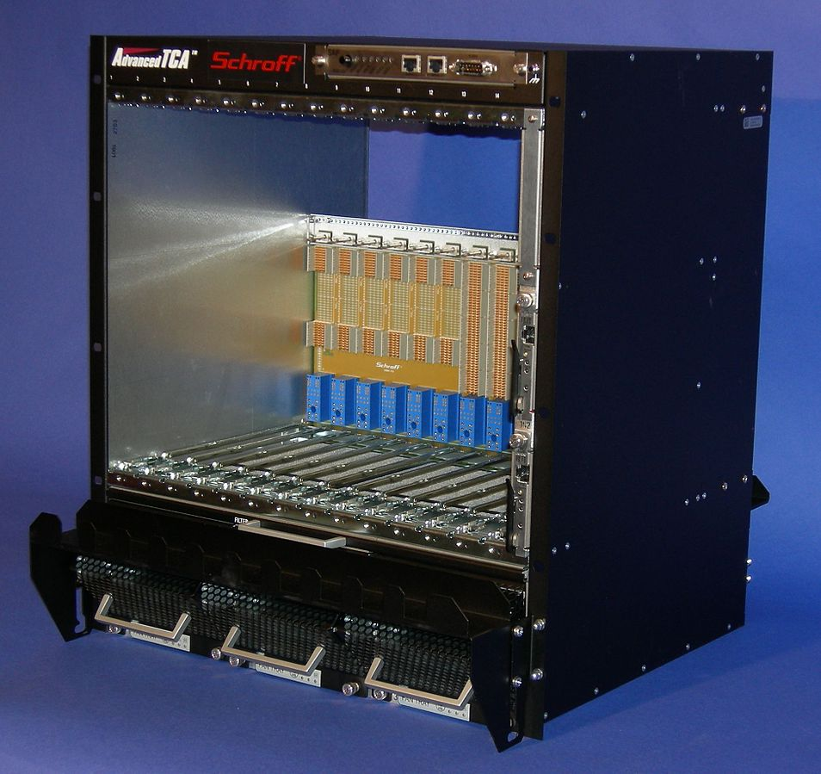
(1) New Amchip (40 nm), (2) Multipackaging, (3) ATCA power
FTK miniaturization: 3 areas of actions
Goal: build a Lamb that can fit in a PC or can be accessed by a PC.
What about this size ?
FTK
New Amchip 40 nm (200 MHz?, new functionalities for L1)

Slide 3
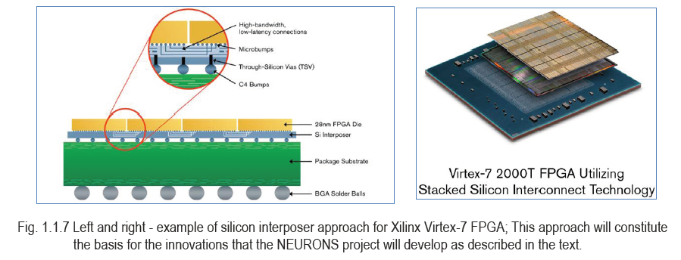
New Ideas for the future - FTK could become smaller and smaller
Multi-packaging FPGA & Amchip – mini FTK
Pattern matching
& track fitting (TF)
sqweezed in a
SIP (BGA 23x23)
TF highly parallelized
We have a very interesting quotation for FPGA bare dies to be packaged with AMchips
IMEC support for feasibility studies
FTK SIP (System In Package) becomes a real possibility – large impact on AM bank sizes

Slide 4
R&D activities and costs
Sviluppo schede e mezzanine ATCA, new Amchip & AM SIP
  2 CPU ATCA 12 keuro
  2 crates 20 keuro
  6 Pulsars II 30 keuro
  8 ATCA mezzanines 32 keuro
  128 Amchips 10 keuro
  2 miniasics submissions (40 nm) 44 keuro
  MPW (40 nm) 100 k$
  naked FPGAs 50 keuro
  Multipackaging = AMSIP 150 keuro
  Tests of AMSIP system 150 keuro
  New mezzanine with AMSIP 10 keuro
  TOT ~ 600 keuro
Demo for
L1-tracking
New
AMchip
AMSIP

Slide 5
GOALS
To produce a modern-powerful hardware for
Level 1 @ CMS & ATLAS
Level 2 @ ATLAS
Applications outside HEP

