Slide 1
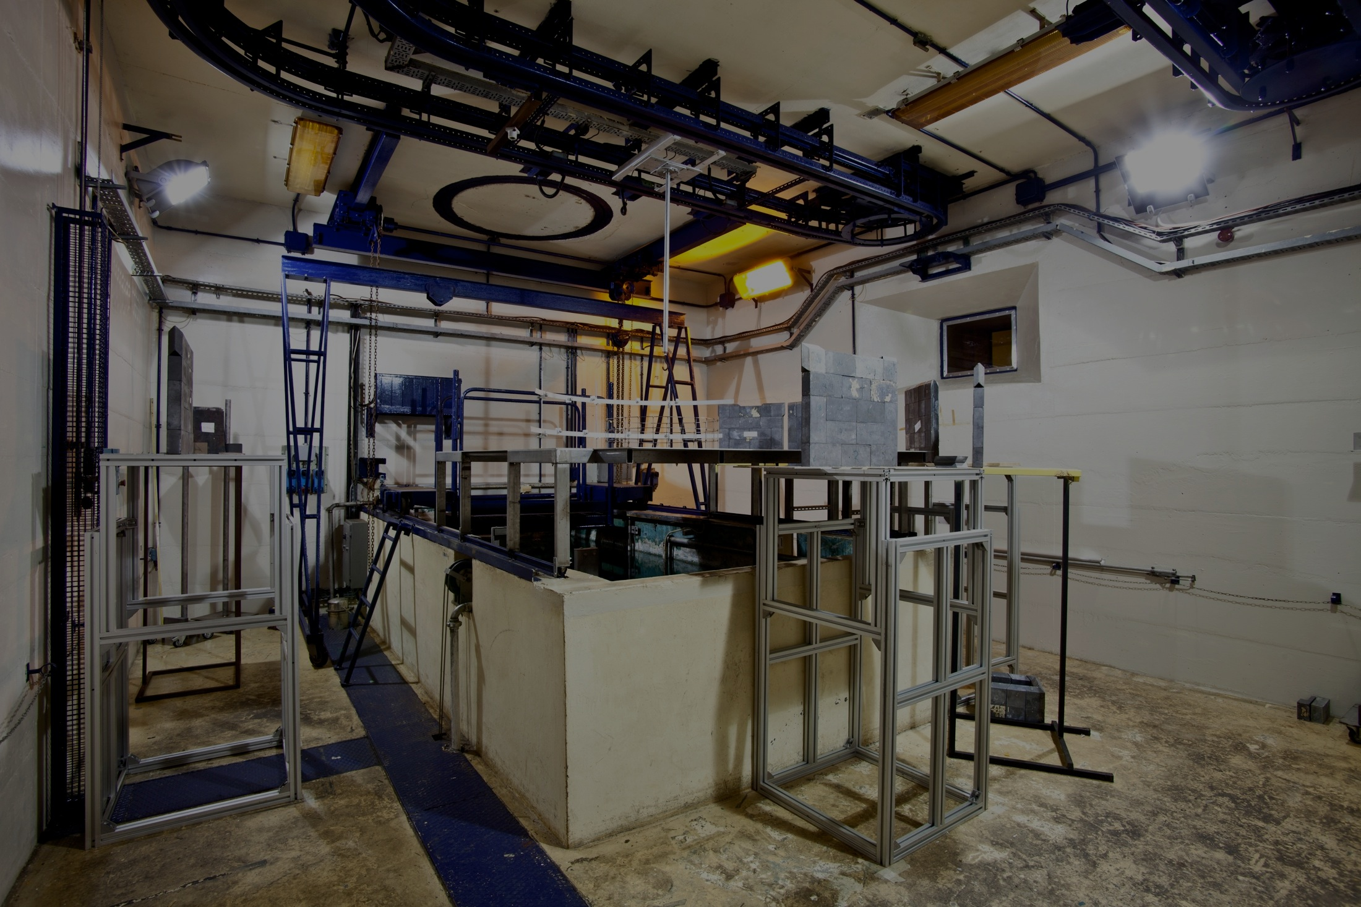
Belle II ECL activities at ENEA Casaccia:
CsI Crystals LY and optical measurements, optical couplings, wavelength shifters and APD irradiation
Stefania Baccaro, Alessia Cemmi, Salvatore Fiore
CALLIOPE

Slide 2
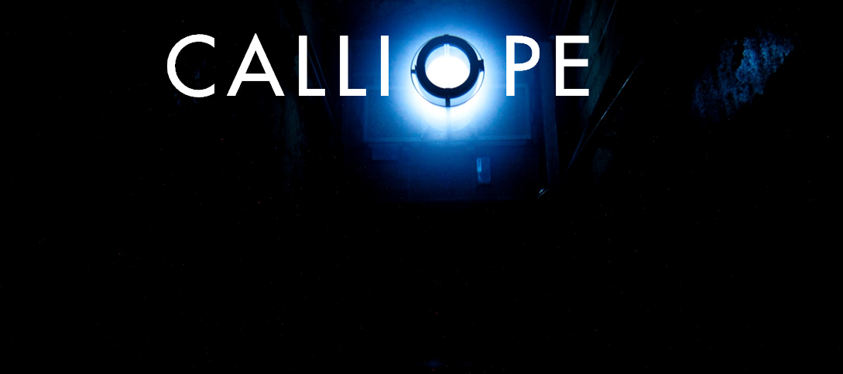
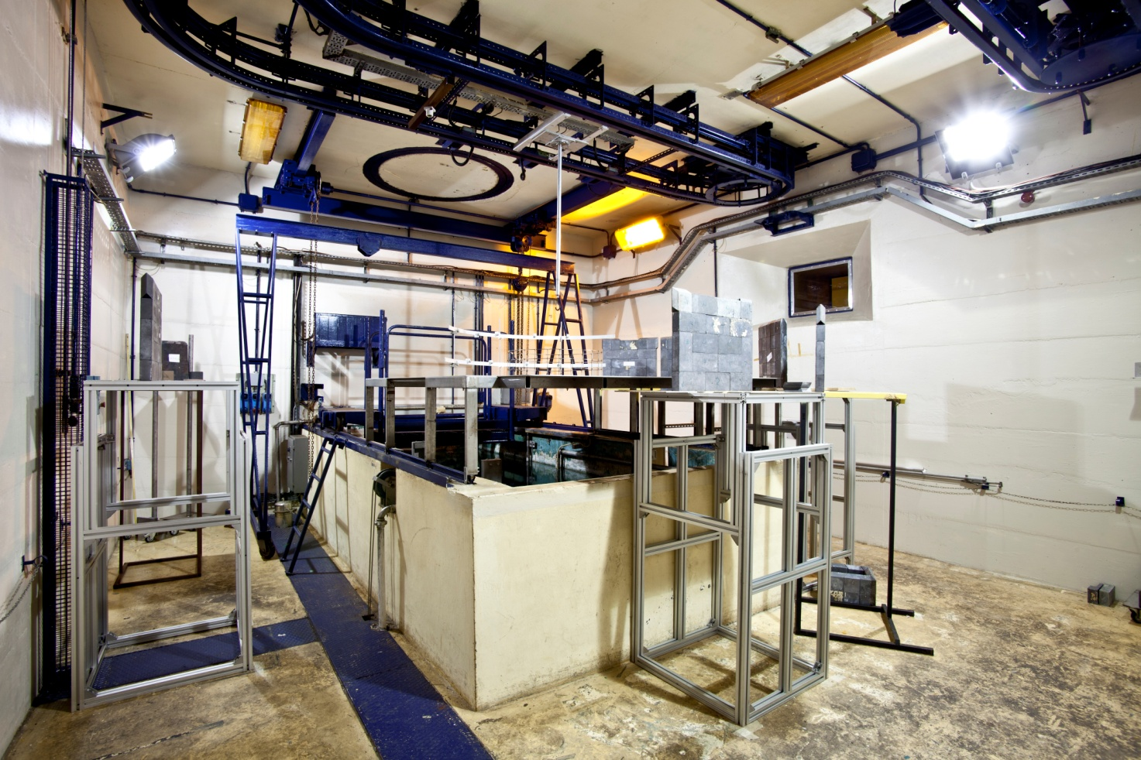
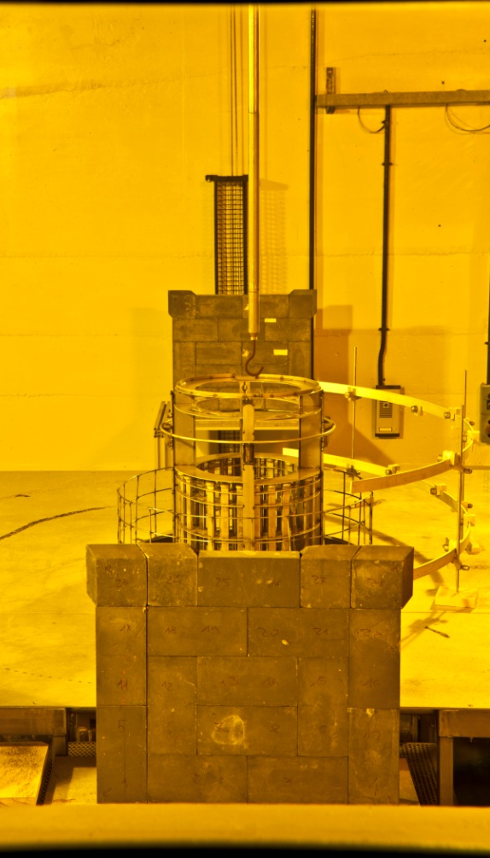
GAMMA IRRADIATION FACILITY
© valentinogriscioli.com
© valentinogriscioli.com
Calliope facility: ⁶⁰Co high intensity gamma irradiation facility up to 3x10¹⁵ Bq certified dose delivery, on-line measurement on irradiated electronics

Slide 3
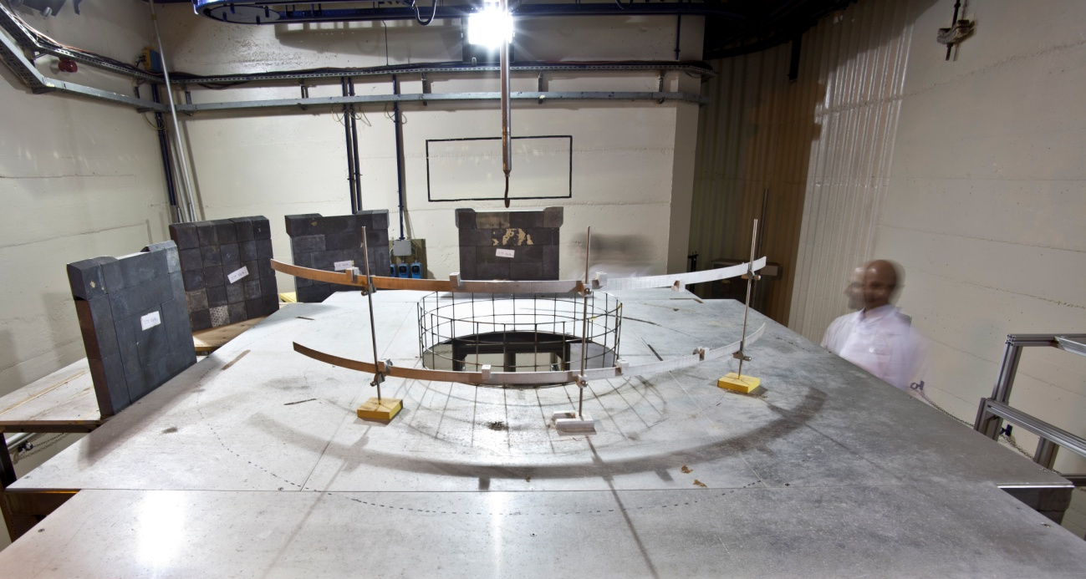
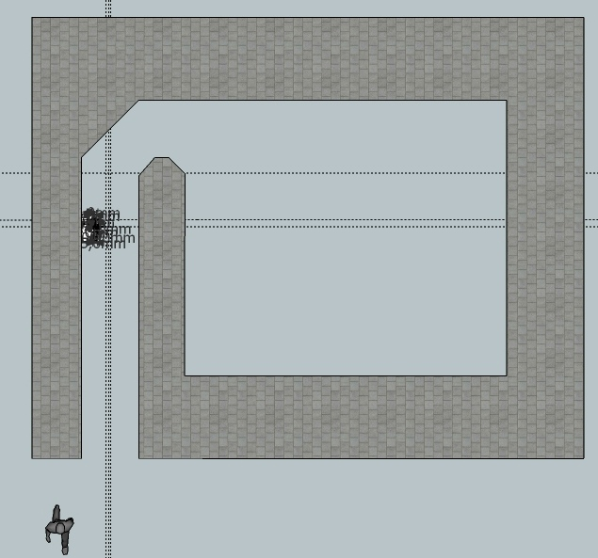
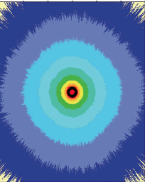













Volumes with dosimetry-certified low dose rates down to 0.1 Gy/h
Dose rate simulation
6 m
Up to 2 kGy/h dose rate
7 m
© valentinogriscioli.com
Top view of the irradiation cell
Irradiation test and collaboration with:

Slide 4
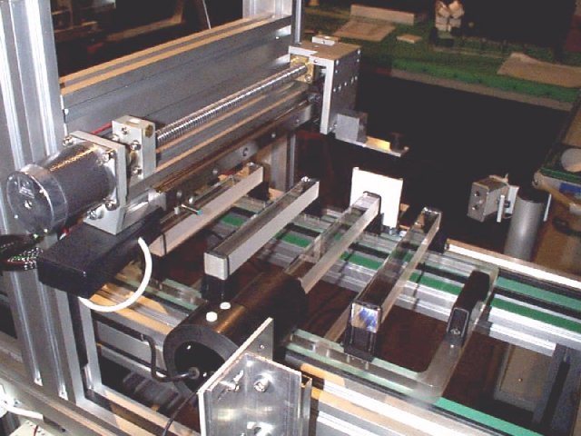
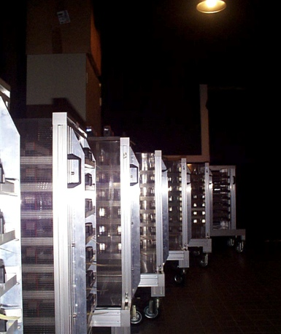
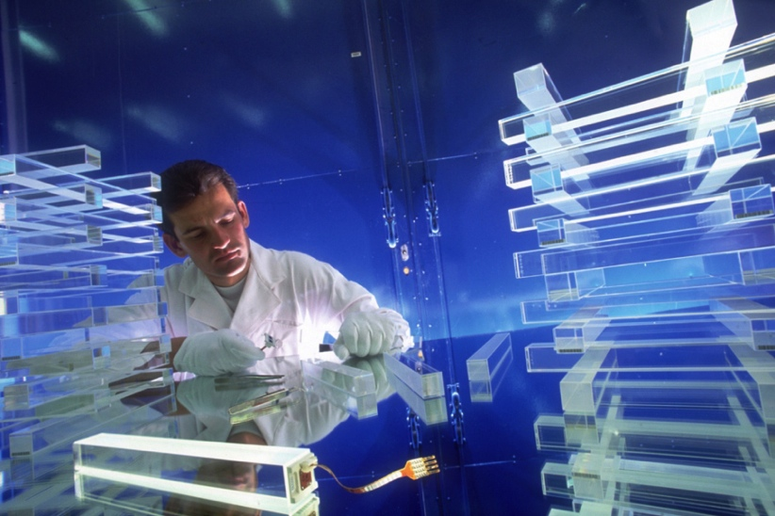
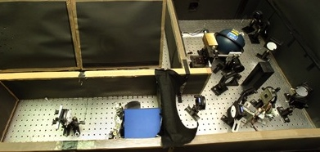
ENEA Casaccia Irradiation laboratories
Irradiation Technology Lab equipped with optical and EPR instrumentation to measure radiation effects: UV-VIS and FT-IR spectrometers, optical bench for large samples (scint. crystals long-trasv transmittance);
Large dark room with controlled temperature, ovens for thermal annealing, tools for cutting and polishing crystals also avaliable.
Instrumentation use for R&D of CMS PbWO₄ scintillating crystals, and APD detectors’ radiation hardness and efficiency studies. Casaccia laboratories hosted the Regional Center for CMS ECAL modules construction and test
Notes:
Immagini dalla strumantazione usata per R&D e costruzione ECAL CMS. In particolare in basso a dx il MiniAccor, che potrebbe essere utilizzato per I nuovi cristalli previo adattamento, per le misure di trasmittanza automatizzate

Slide 5
Issues and Solutions for tests @ ENEA
CsI Light Yield measurements:
Hygroscopicity, UV emission spectrum, crystal dimensions
Special containers, UV-sensitive detectors
CsI Optical measurements:
Hygroscopicity, crystal dimensions
Special containers
CsI Gamma irradiation:
Hygroscopicity, optical bleaching
Special containers
APD gamma irradiation:
HV bias, test in B-field
HV power supply, dipole permanent magnet

Slide 6
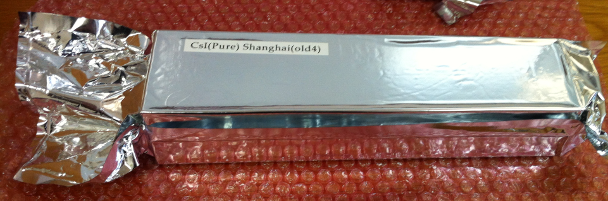
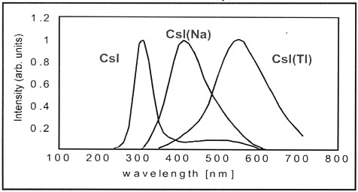
Light Yield measurement issues
CsI crystal adsorbes H₂O on surface:
surface becomes opaque, decrease light propagation and transmission to detector
Handling precautions are needed: dry atmosphere, no direct contact with hands
Crystals are shipped in “moisture barrier” bags
UV emission: detector for LY measurement must be UV-sensitive. Standard PMT are not (photocathode windows made of standard glass)
Large dimensions: crystals are 30 cm long, about 5x5 to 8x8 cm² section
large containers are needed to keep crystals in the dark during measurements and avoid air contact

Slide 7
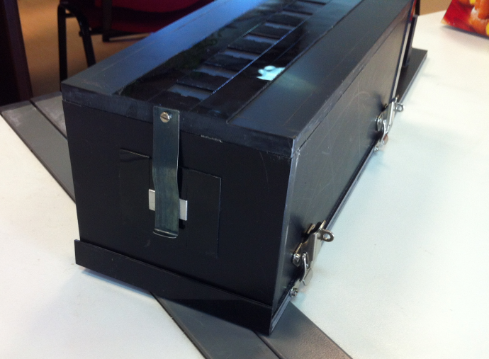
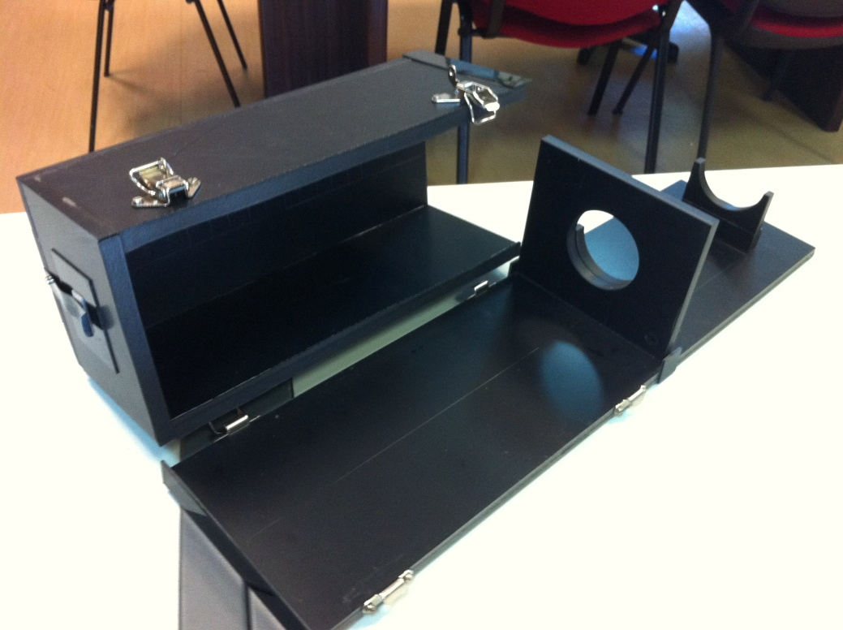
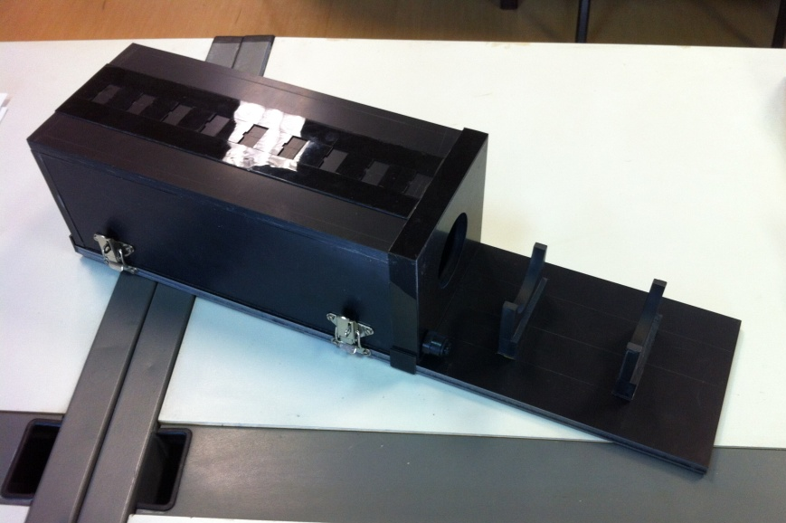
Light Yield measurement solutions: dry box
A black box hosting one crystal at a time has been constructed in Casaccia (A. Lucchi)
dry air (or nitrogen, argon) flushing around the crystal
optical coupling to PMT
ready for every Belle II crystal dimension
light tight
9+1 fixed positions for radioactive source for LY measurements

Slide 8
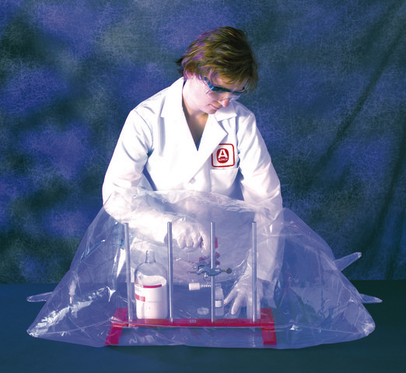
CsI handling solutions: inflatable glove box
A simple tool to handle CsI crystals in dry atmosphere:
inflatable glove box
polyethylene bag with feedthrough
gas inlet-outlet
different sizes
zip-closure
can even host instrumentation for measurements

Slide 9
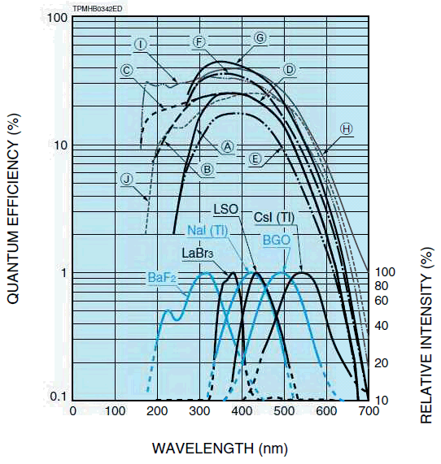
Light Yield measurement solutions: PMT and DAQ
UV sensitive PMT R2059 Hamamatsu
Gain: 1.0 x 10⁷
T. T. S. : 0.55ns
25 nA typical dark current
Absolute QE curve & Gain curve requested
To be delivered in February
DAQ Setup:
VME Crate (RM1 Pool)
VME-USB bridge to be delivered (personal loan until then)
V1720 Digitizer to be delivered (RM3, PG-RM1 loan until then)
HV PMT (RM1 Pool)
PC to be delivered
See curve C

Slide 10
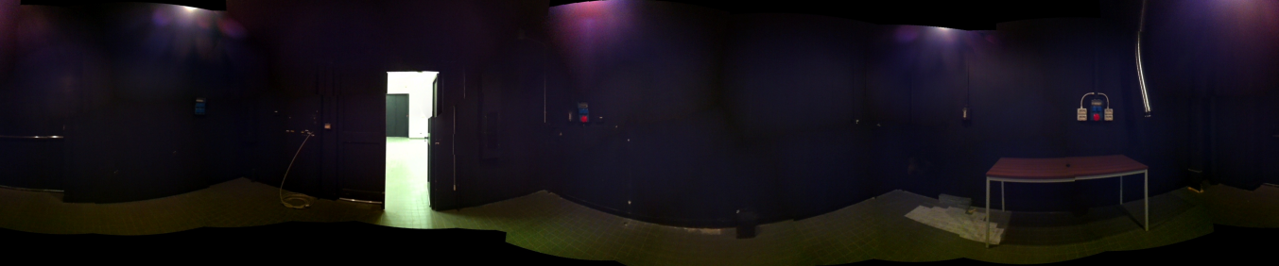
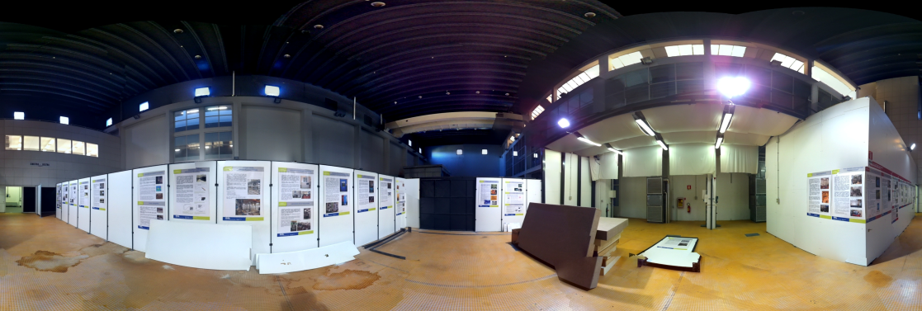
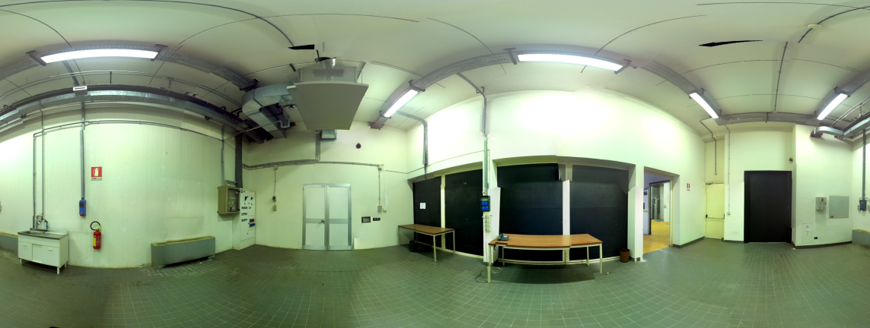
Light Yield measurement solutions: (really) dark room
A large dark room is available for our “dark” measurements:
Built for CMS ECAL R&D and construction
25 m² dark room with air conditioning, large doors, Ethernet, electronic cables feed-through
Annex rooms for different activities, plus a large storage
http://photosynth.net/view.aspx?cid=f6527272-04f7-464d-864b-c2fc12663d04
http://photosynth.net/view/86427cf7-d9b5-47b6-9305-03c779806458
http://photosynth.net/view/2e6facfc-cdeb-48b1-9e81-952e381e25dc
http://photosynth.net/view/4aa6e341-6029-4926-8dde-6951c83d0dc5

Slide 11
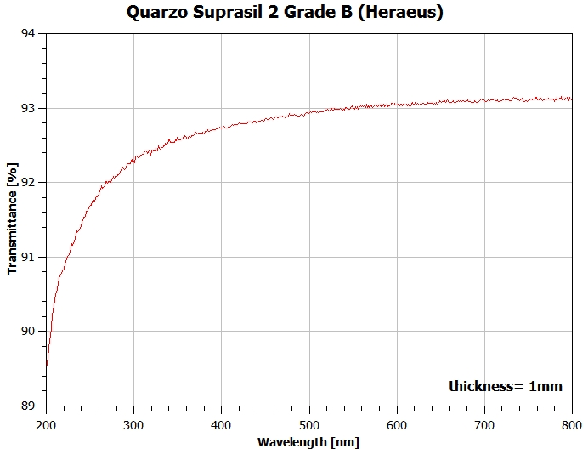
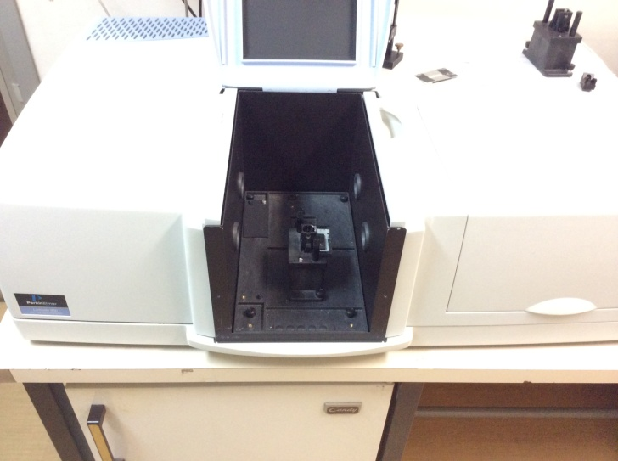
Light attenuation measurement issues
As for LY measurements:
Crystals have large dimensions
Must be kept in dry atmosphere
We will build a second dry-box with quartz windows
to allow optical measurements
This box will fit into the large optical bench for transmittance measurements
for small samples we can use Perkin-Elmer spectrophotometer with gas flushing capabilities
Optical bench
Perkin-Elmer

Slide 12
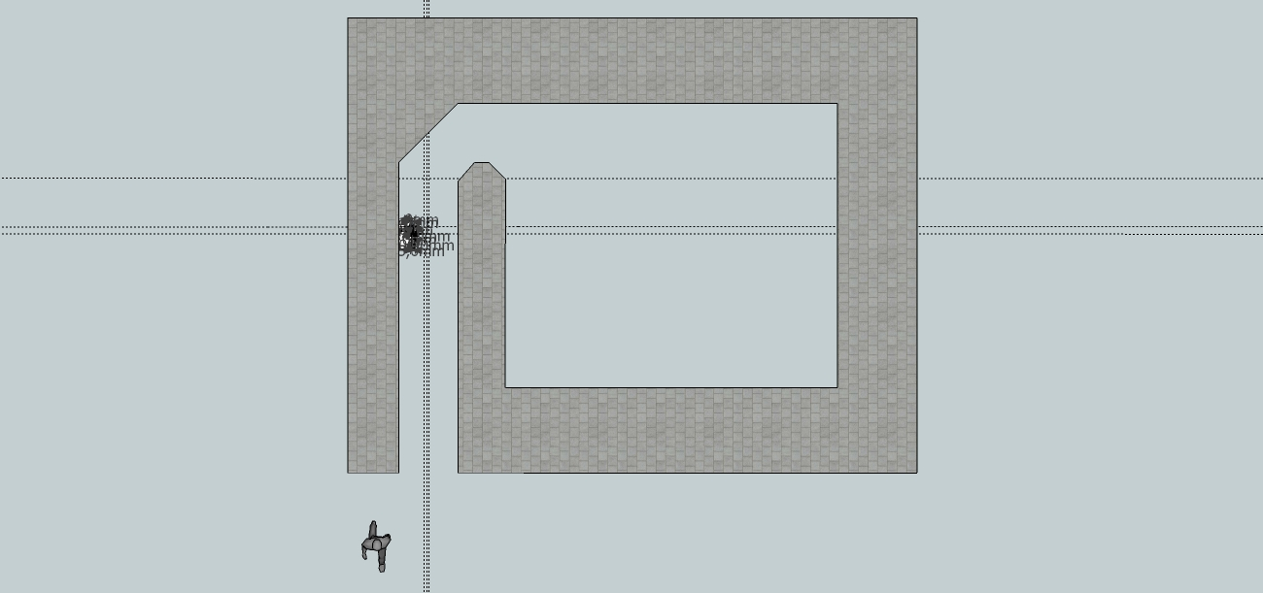
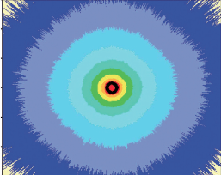
Crystals Irradiation
Low dose rates are needed for CsI
Crystals must be kept in the dark during irradiation
Reflective Wrapping is not desirable since it can be damaged by irradiation, introducing additional parameters in LY and Attenuation measurements
Air contact must be avoided as well
Low dose rates are available
Crystals can be wrapped in moisture-barrier bags before irradiation: dry + dark
Irradiation can also be performed with the dry-box
1 Gy/h
Top view of the irradiation cell
2 kGy/h
6 m
7 m
5 Gy/h

Slide 13
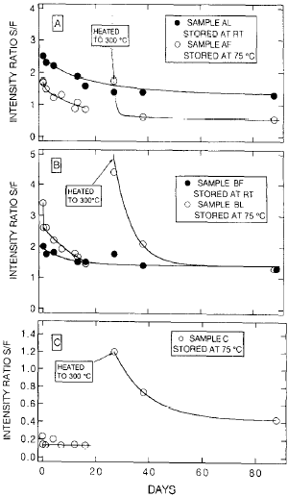
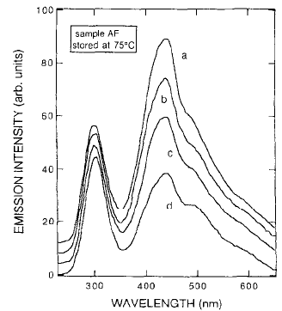
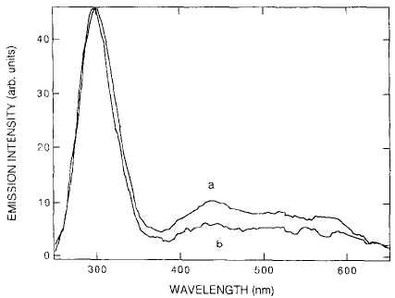
CsI thermal annealing for slow component reduction
CsI emission fast (UV) and slow (VIS) components ratio is sometimes controversial: in some cases a Slow/Fast S/F > 1 is reported
This could be the explanation:
0 days
new crystals
16 days
0 h
1 h
Decreasing slow component with 75°C annaling in brand new crystals
3 years old crystal: completely different S/F!
Small effect after 1h @ 75°C
3y old crystal
Hamada et al, NIMA 365(1995) 98-103

Slide 14
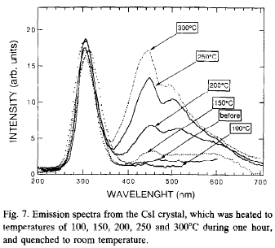
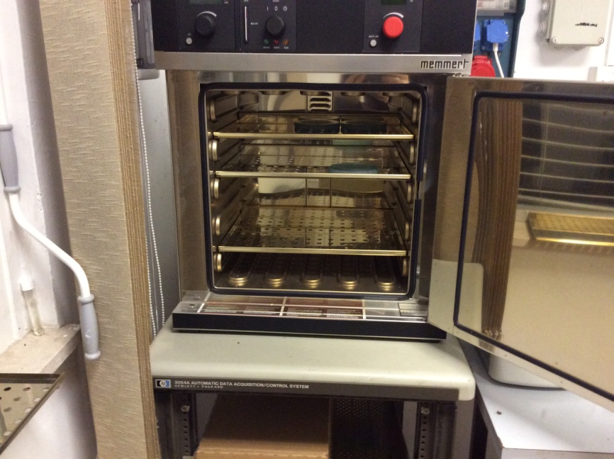
CsI thermal annealing for slow component reduction
Thermal treatment has a double effect:
accelerate quenching of intrinsic vacancies
generate new vacancies in lattice
Optimal temperature for CsI annealing is 100°C
A computer-controlled furnace is available for controlled T steps annealing
Hamada et al, NIMA 365(1995) 98-103

Slide 15
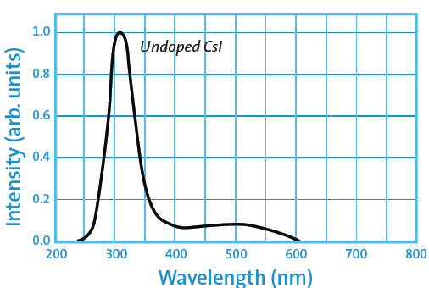
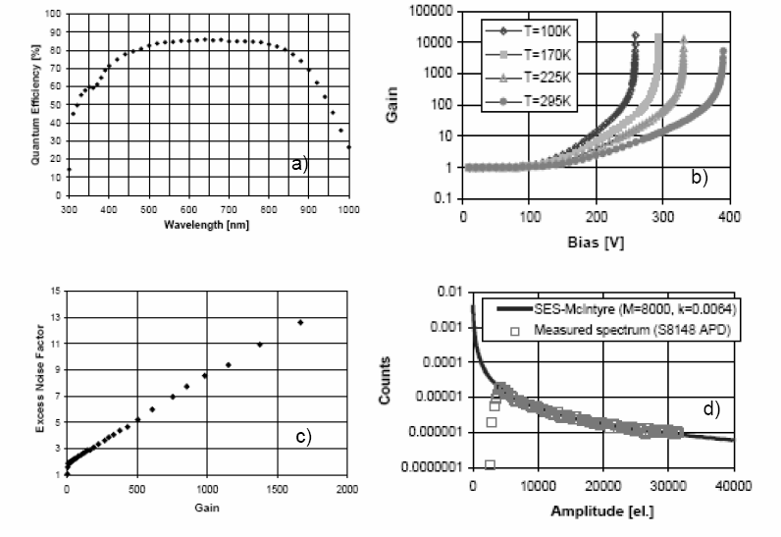
Wavelength shifters
Instead of using an UV-sensitive photodetector to read out CsI UV emission, we could shift the UV scintillation light to visible wavelength. After discussion with Boris Schwartz: BC-480 by Saint-Gobain doped-polyvinyltoluene
1.58 refractive index, 5 ns decay time, 5 ns FWHM
absorbs UV (min 260 nm), emits in blue (peak 425 nm)
rad-hardness qualification @ ENEA with gamma and neutrons
Alternatively, POPOP-doped polystirene
CMS APD
BC-480

Slide 16
Wavelength shifters
Instead of using an UV-sensitive photodetector to read out CsI UV emission, we could shift the UV scintillation light to visible wavelength. After discussion with Boris Schwartz: BC-480 by Saint-Gobain doped-polyvinyltoluene
1.58 refractive index, 5 ns decay time, 5 ns FWHM
absorbs UV (min 260 nm), emits in blue (peak 425 nm)
rad-hardness qualification @ ENEA with gamma and neutrons
Alternatively, POPOP-doped polystirene
CMS APD QE
BC-480
BC-480

Slide 17
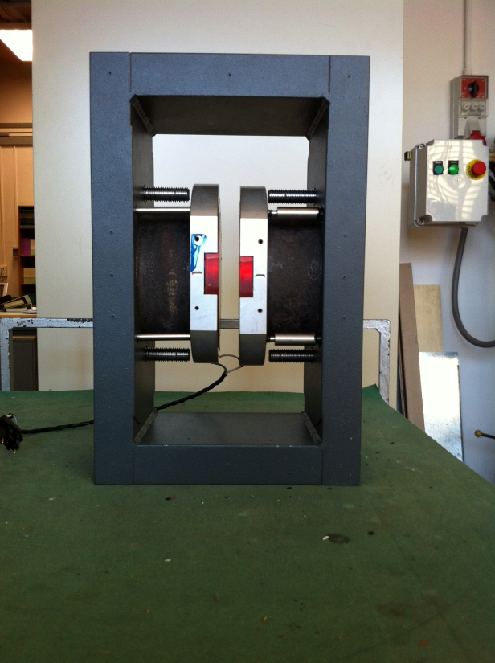
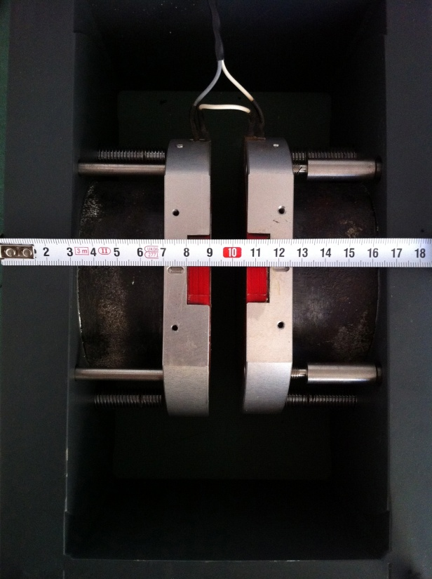
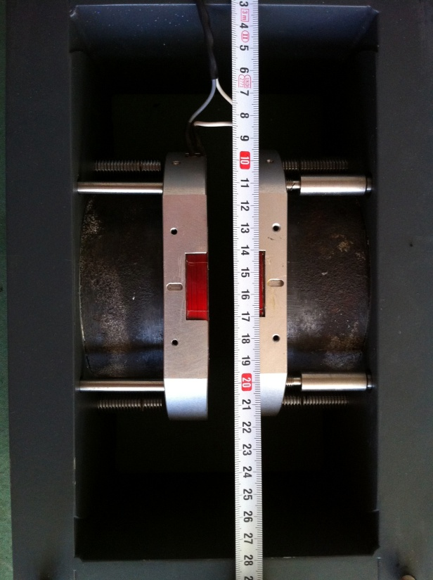
APD irradiation solutions
APD could be irradiated under bias @ Calliope with on-line monitoring, and B-field
CAEN V6521HP HV module to be delivered:
Current monitoring down to 100 pA, 6 kV max
A dipole magnet is available for combined tests γ + B field:
0.3 T max, 1 cm gap, dose rate 3 Gy/h or less (to be confirmed)

Slide 18
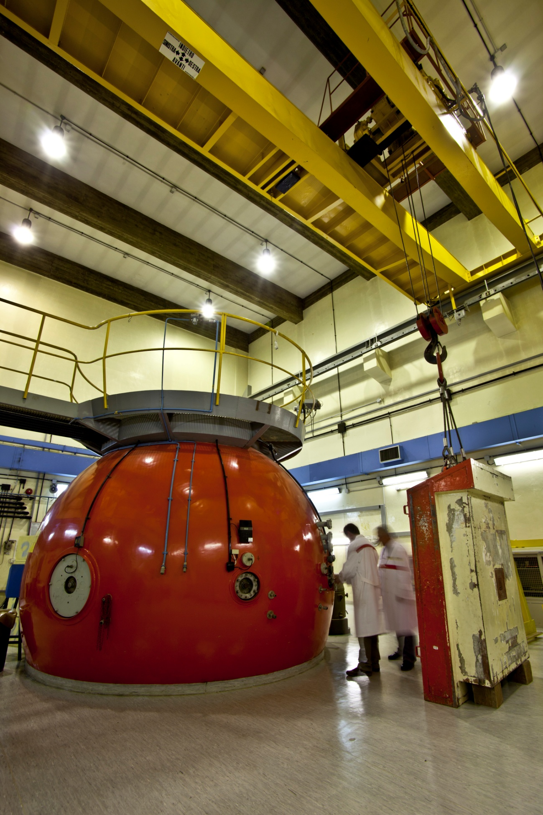
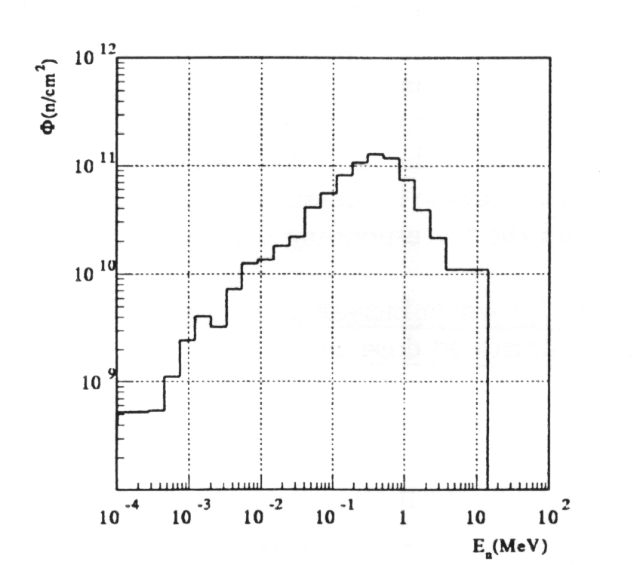
Tapiro reactor
Maximum nominal power:
5 kW thermal
Maximum neutron flux at the core centre:
2.2⋅10¹² n/cm²⋅s.
Biased electronic irradiation
certified flux delivery
© valentinogriscioli.com
Horizontal channel
spectrum
© valentinogriscioli.com

Slide 19
Materials for Optical Coupling
.
Dow Corning 3145 glue
CMS
High viscosity
BC630
Optical Grease
Silicon Grease

Slide 20
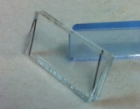
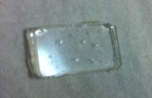
Optical characterization: UV-VIS range
Transmittance curves
Range: 210-800 nm
UV-VIS spectrometer Lambda 950 (Perkin-Elmer)
.
1) two-quartz supports:
quartz (thickness = 1 mm)
Separators
(different thickness)
BC 630
Glue or grease
planar layer
uniform thickness
Dow Corning 3145

Slide 21
Optical characterization: UV-VIS range, two-quartz supports
.
Transmittance curves normalized by the two-quartz supports spectrum
BC630
Thickness [μ] | Transmittance @ 320 nm [a.u.]
55 | 1.01
114 | 0.97
257 | 0.96
680 | 0.90
glue and grease: different spectra below 380 nm
glue: not homogeneous layer (bubbles) lower %T

Slide 22
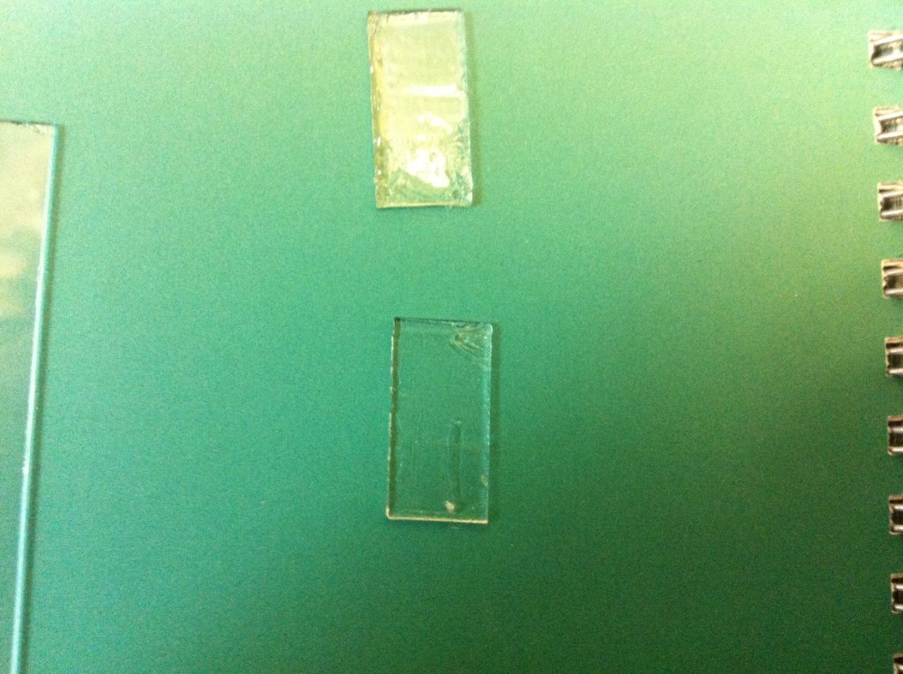
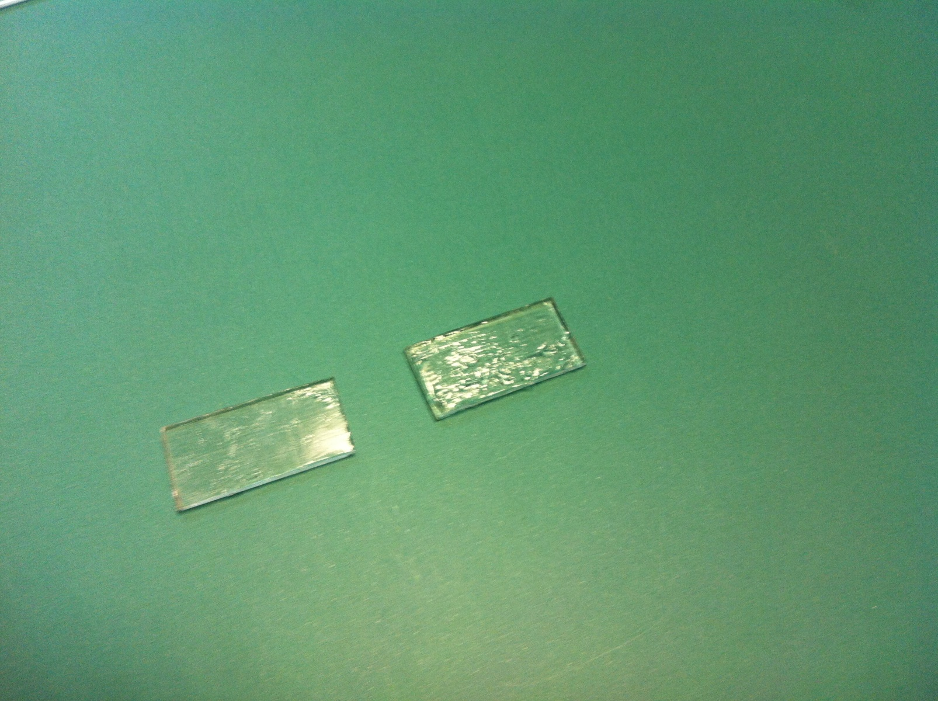
Optical characterization: UV-VIS range
.
2) single-quartz support:
glue or grease
quartz (thickness = 1 mm)
BC 630
not planar layer
not uniform thickness
Dow Corning 3145

Slide 23
Optical characterization: UV-VIS range, single-quartz support
.
Transmittance curves normalized by the single- quartz support spectrum
Thickness [μ] | Transmittance @ 320 nm [a.u.]
100 | 0.86
200 | 0.87
100 | 0.94
210 | 0.75
qualitative evaluation
glue and grease: different spectra below 380 nm
transmittance depends on the sample thickness
BC630
Dow Corning 3145

Slide 24
.

