Slide 1
Post-Trigger Data
Runs: 499-672 (2013-05-08 - 2013-05-30)
mysql pt_phase2 -e "select FileName from pt_files where Comments is null and FileSize>1900;" --user=Km3NeT -h fasserver.lns.infn.it --password=Km3NeTuser
Old PMT HV setup
Old trigger conditions
Total number of files: 60
Total live time: 187 hr
Standard analysis: higher rigger rate but lower reconstruction rate (of a factor ≈3) → different trigger conditions.
No Monte Carlo available (old simul normalized to data)
Trigger conditions?????

Slide 2
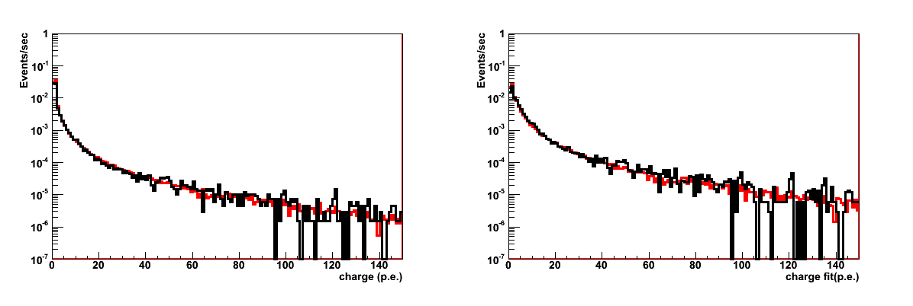
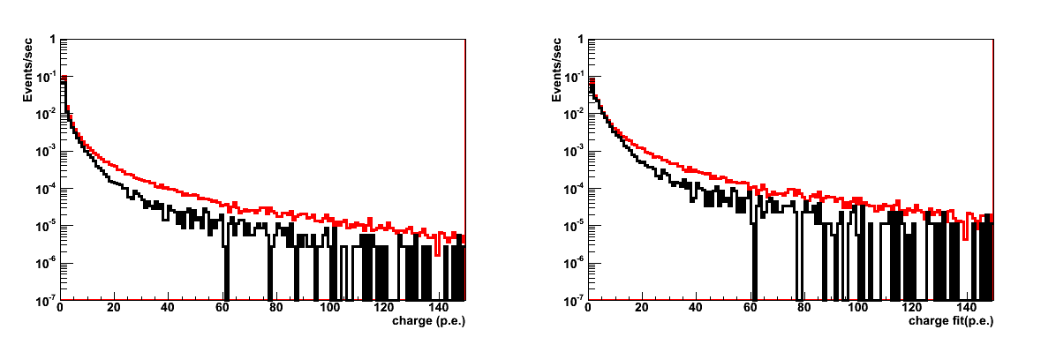
Runs: 499-672
DATA
MC/2.8
DATA
MC/2.8
Runs: 847-953
DATA
MC
DATA
MC

Slide 3
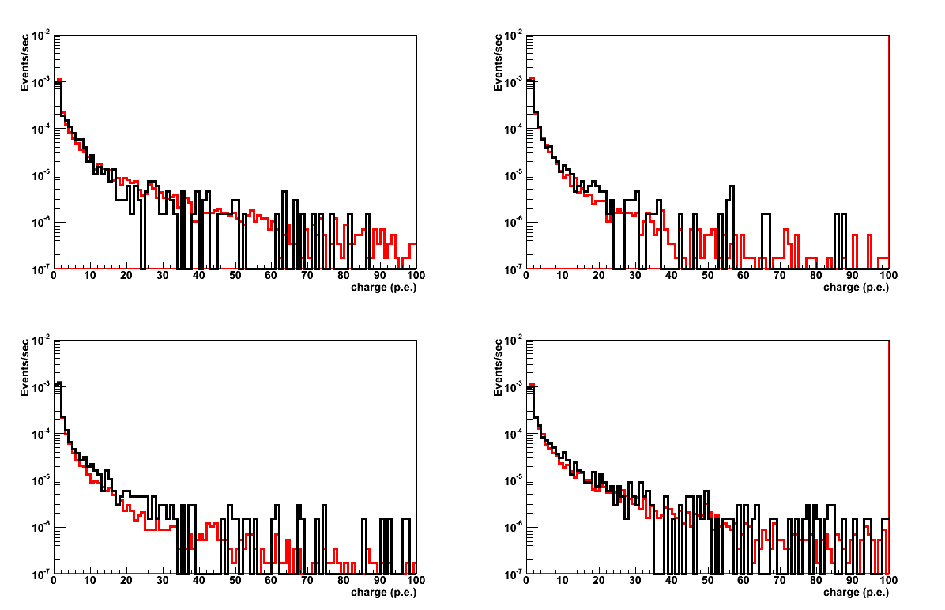
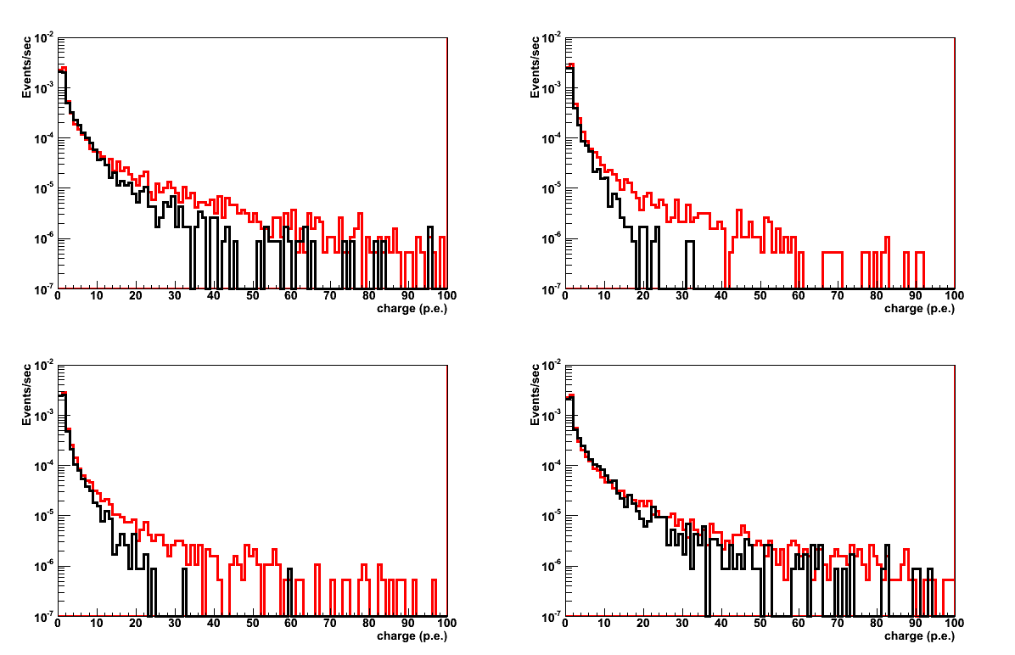
eFCM 5: Charge
Runs: 499-672
Runs: 847-953
DATA
MC/2.8
PMT0
DATA
MC/1.23
PMT0
PMT2
PMT2

Slide 4
eFCM 5: Charge
Runs: 499-672
Runs: 847-953
DATA
MC/2.8
PMT1
DATA
MC/1.23
PMT1
PMT3
PMT3

Slide 5
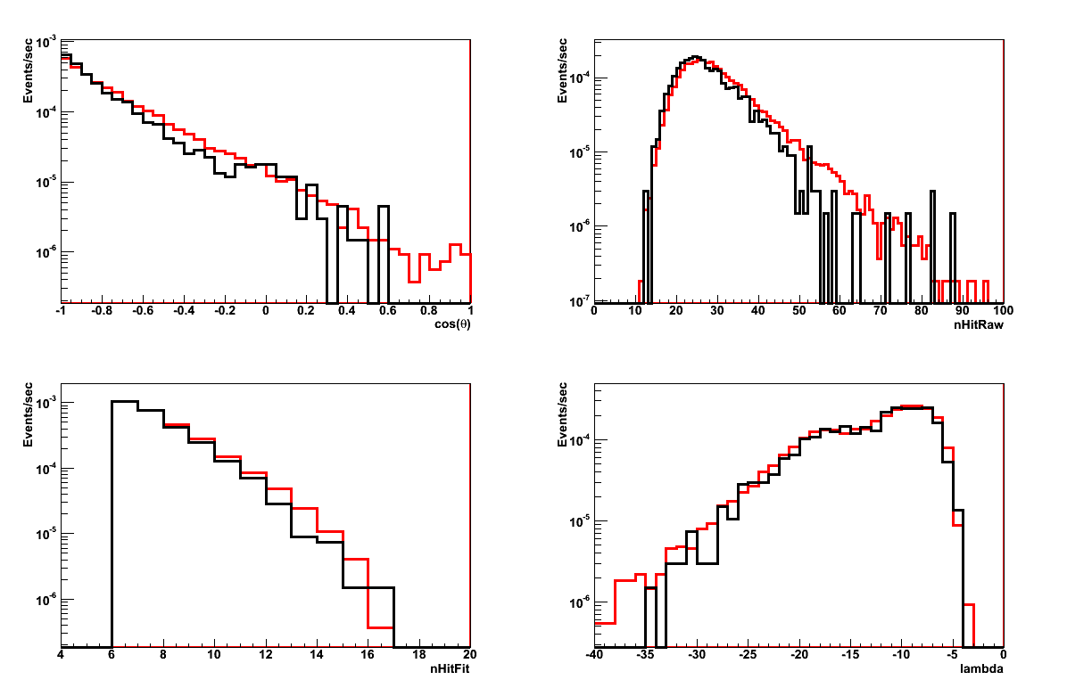
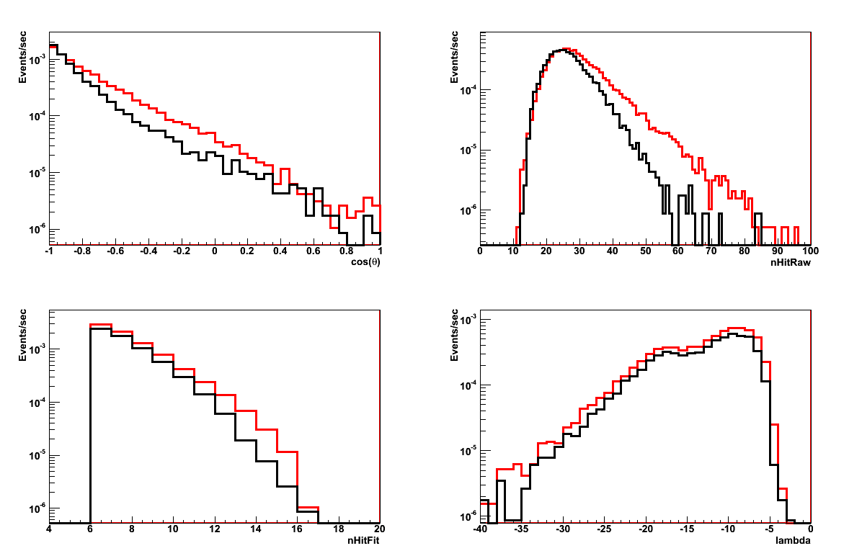
Runs: 499-672
Runs: 847-953
DATA
MC/2.8
DATA
MC

Slide 6
Runs: 499-672
Runs: 847-953
DATA
MC/2.8
DATA
MC

Slide 7
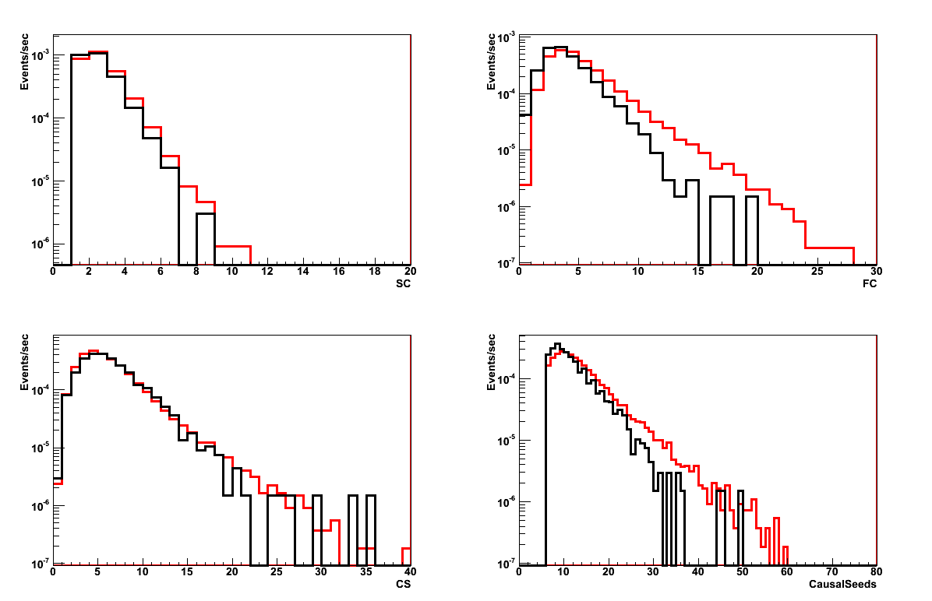
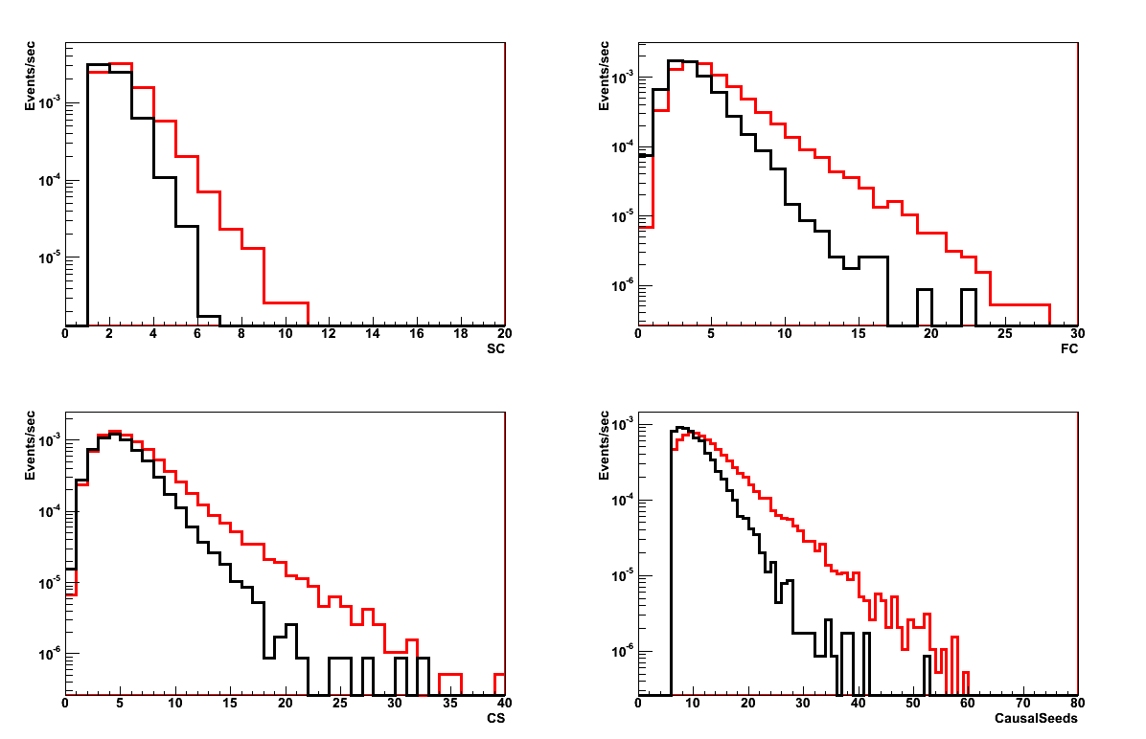
Runs: 499-672
Runs: 847-953
DATA
MC/2.8
DATA
MC

Slide 8
Runs: 499-672
Runs: 847-953
DATA
MC/2.8
DATA
MC

Slide 9
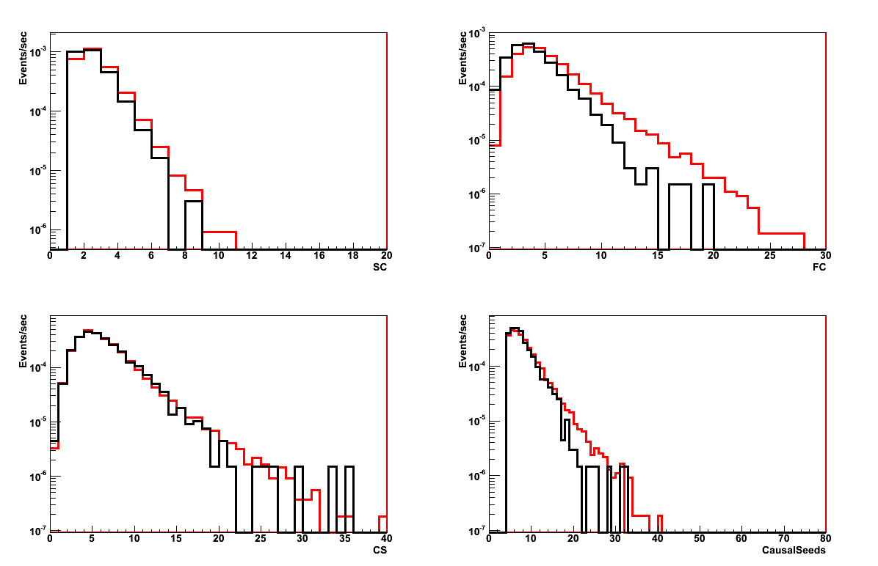
Runs: 499-672
DATA
MC/2.8
NO FC!!!

Slide 10
eFCM Pmt 499 847 874
1 0 10.05 8.94 8.53
1 1 9.62 8.66 8.44
1 2 9.27 8.58 8.58
1 3 9.54 8.67 8.40
2 0 12.65 9.13 8.53
2 1 9.24 8.49 8.49
2 2 10.38 7.34 7.36
2 3 10.97 7.86 7.81
3 0 10.89 8.96 8.61
3 1 10.72 8.91 8.49
3 2 9.75 8.84 8.77
3 3 9.46 8.62 8.35
4 0 9.30 8.56 8.30
4 1 7.95 8.09 8.08
4 2 9.59 9.67 8.92
4 3 9.59 8.55 8.41
5 0 11.62 8.85 8.47
5 1 10.21 8.70 8.27
5 2 10.51 9.19 8.52
5 3 7.13 7.32 7.68
6 0 10.03 9.08 8.48
6 1 8.69 8.68 8.35
6 2 9.52 8.43 8.44
6 3 9.69 8.45 8.41
7 0 9.94 8.91 8.45
7 1 8.77 7.88 7.86
7 2 -1 -1 -1
7 3 7.61 7.61 7.69
8 0 10.33 9.28 8.56
8 1 9.22 8.29 8.30
8 2 8.86 8.10 8.08
8 3 9.23 8.58 8.11
Runs | Period | N. Files
499-672 | 2013-05-08 - 2013-05-30 | 60
847-873 | 2013-06-22 - 2013-06-28 | 14
874-953 | 2013-06-28 - 2013-07-17 | 47
Discrepancy due to HV?
Floor Coincidences?
Trigger conditions?

