Slide 1
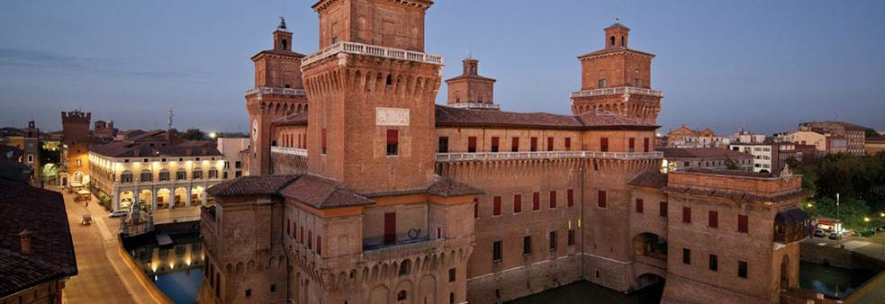
Introduction
Augusto Ceccucci / CERN
NA62 Collaboration Meeting
September 1 – 5, Ferrara, Italy

Slide 2
FERRARA: A CITY OF ARTS AND SCIENCES
Nicolaus Copernicus was a Renaissance mathematician and astronomer who formulated a model of the universe that placed the Sun rather than the Earth at its center.
In 1503, Copernicus attended the University of Ferrara, where he prepared to take the canon law exam. After passing the test on his first attempt, he hurried back home to Poland, where he resumed his position as canon and rejoined his uncle at a nearby Episcopal residence (source biography.com)

Slide 3
FERRARA: A CITY OF ARTS AND SCIENCES
Alfonso II d'Este
(22 November 1533 – 27 October 1597) was Duke of Ferrara from 1559 to 1597. He raised the glory of Ferrara to its highest point, and was the patron of Torquato Tasso, Giovanni Battista Guarini and Cesare Cremonini —favouring the arts and sciences, as the princes of his house had always done….(source Wikipedia)

Slide 4
NA62 Goal
We aim to measure precisely
exploiting a novel in-flight technique based on:
Calorimetry to veto extra particles
Very light trackers to reconstruct the K⁺ and the π⁺ momenta
Full particle identification
State of the art:
[1] J. Brod, M. Gorbahn, PRD78, arXiv:0805.4119
[2] AGS-E787/E949 PRL101, arXiv:0808.2459
[3] M. Gorbahn arXiv:0909.2221
[4] KEK-E391a, arXiv:0911.4789v1
[5] A.J. Buras et al., EPJ C72, arXiv:1208.0934
[6]MS PAS BPH-13-007; LHCb-CONF-2013-012

Slide 5
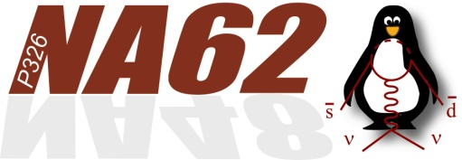
The NA62 Collaboration
Birmingham
Bristol
Glasgow
Liverpool
IHEP
INR
JINR
Mainz
Prague
UC Louvain
Bratislava
CERN
Bucharest
George Mason
SLAC
UC Merced
BU(*)
Ferrara
Florence
LNF
Naples
Perugia
Pisa
Rome I
Rome II
Turin
Sofia
San Luis Potosi
*CERN-BU KR2109
28 Institutes, 206 Collaborators

Slide 6
NA62 “No-lose” Theorem
Measure precisely SM parameters or discover New Physics
Standard Model
New Physics
Part of a Strong Flavour program worlwide which includes LHCb and BELLEII

Slide 7
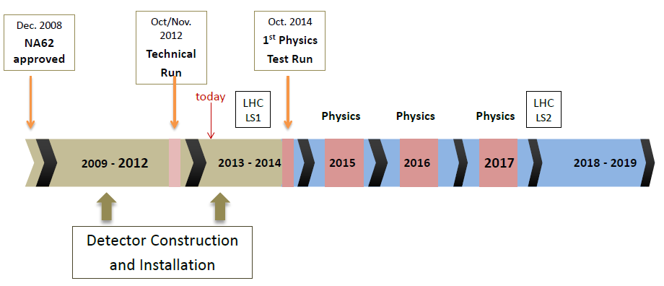
NA62 Layout
~10¹² / s protons from SPS (400 GeV/c) on Be target (~1 λ)
750 MHz secondary beam:
Positive
Kaon fraction ~6%
Δ p/p ~ 1%

Slide 8
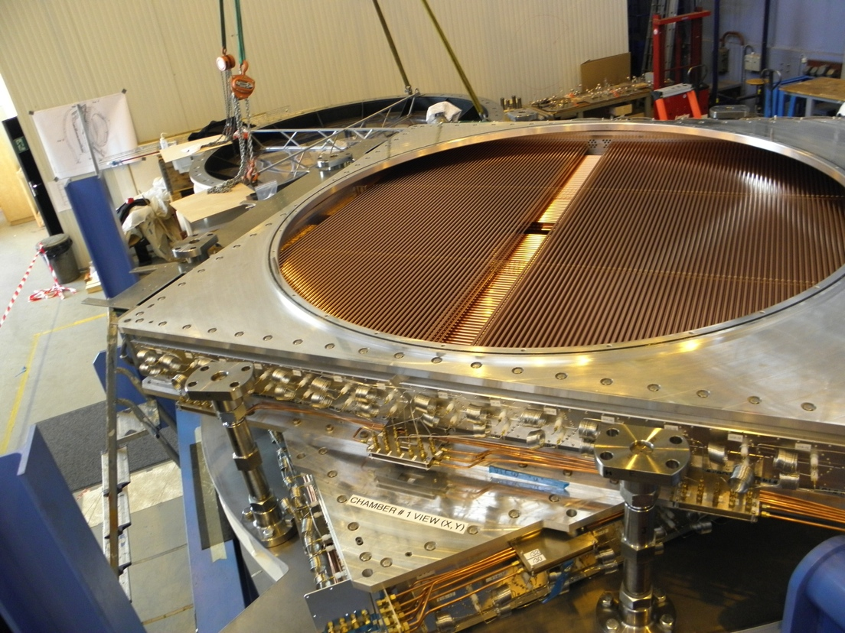
NA62 STRAW TRACKER

Slide 9
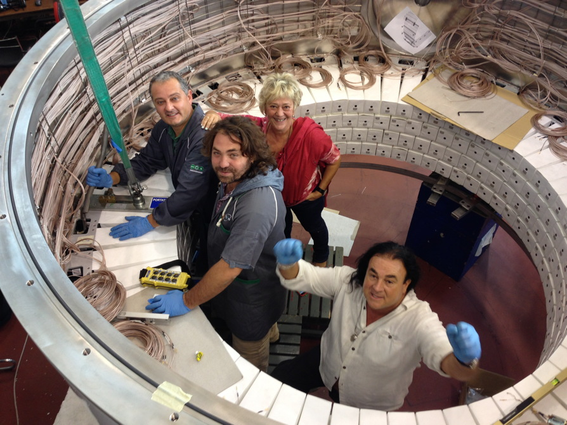
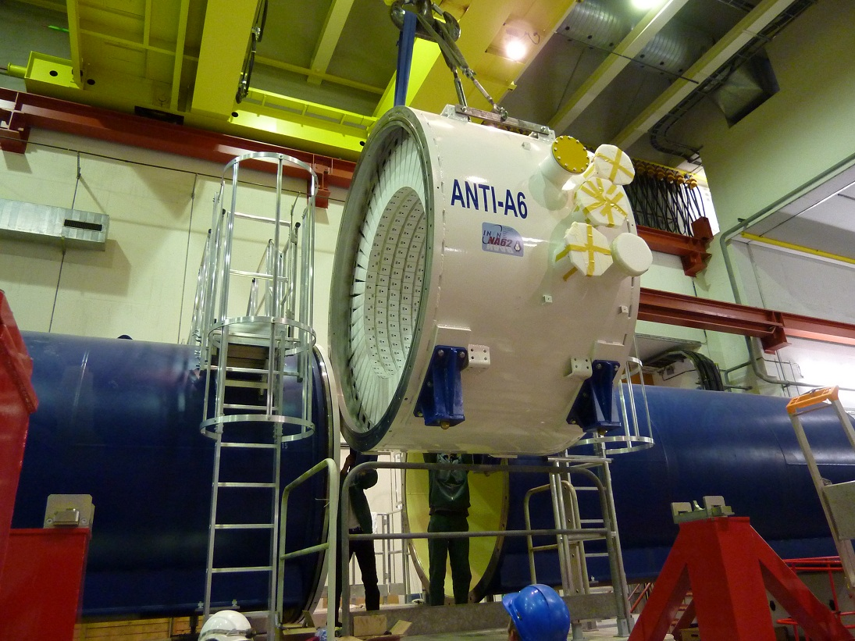
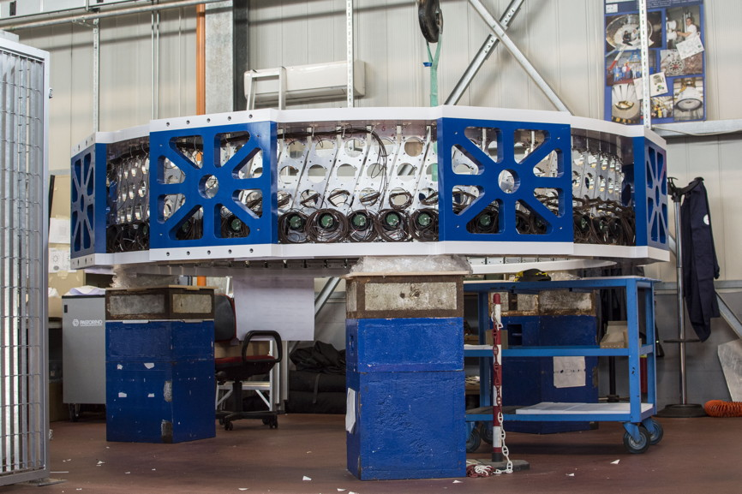
NA62 LAV

Slide 10
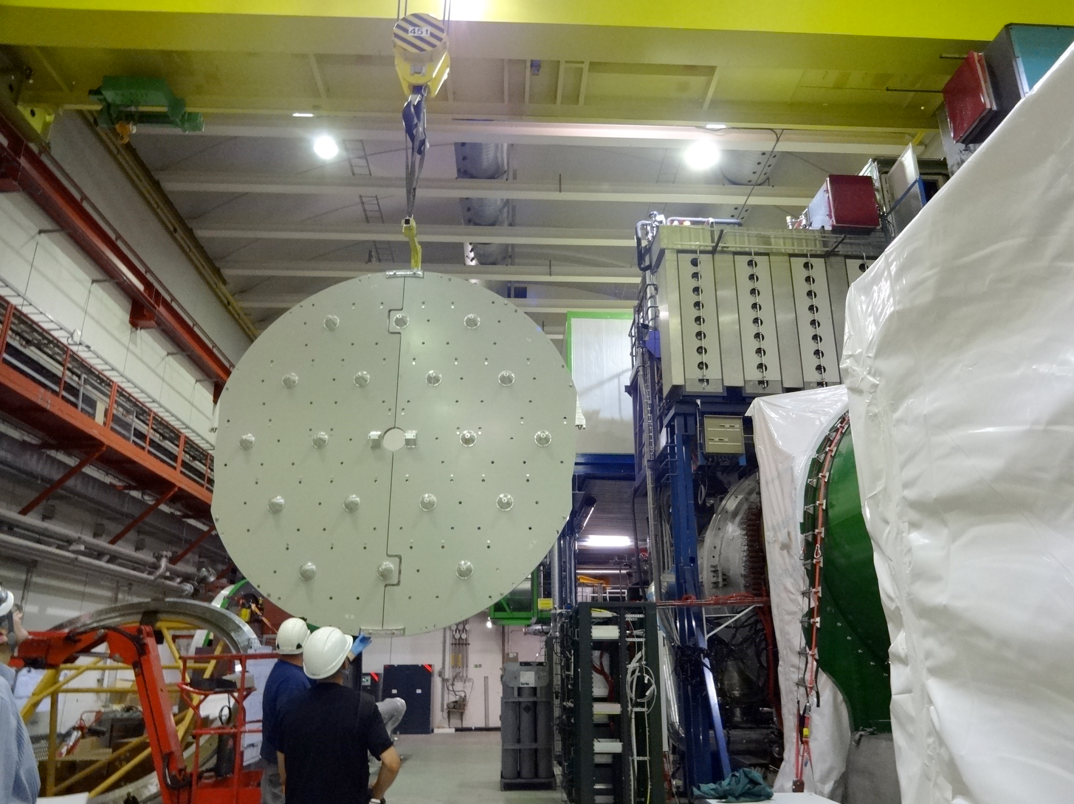
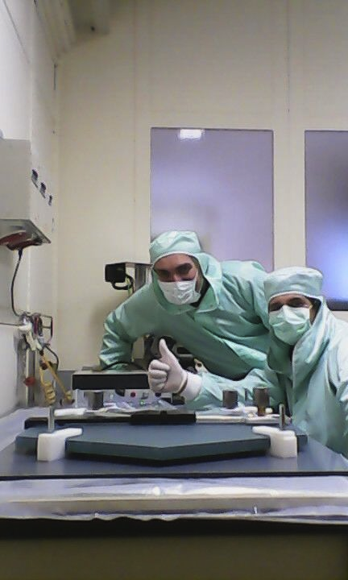
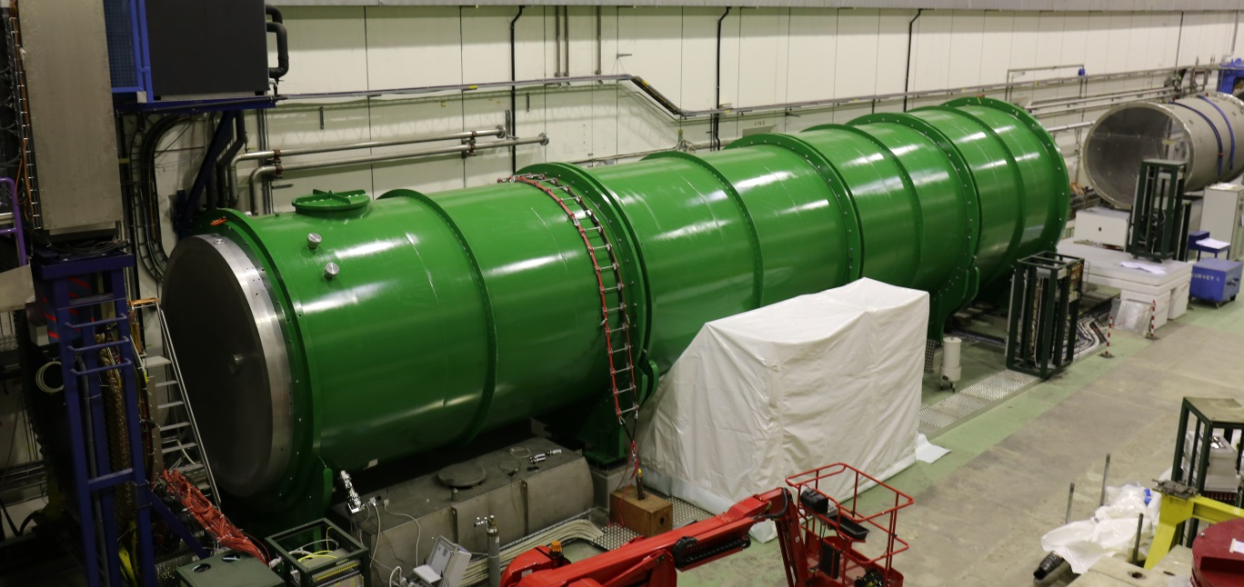
NA62 RICH

Slide 11
SM and CKM matrix
PDG 2014
The unique measure of CP-Violation in the SM is the
area of the Unitarity Triangle (Jarlskog invariant J)

Slide 12
Unitarity Triangle for Kaons
When the bd UT is used, the variables extracted from kaons are affected by an apparent parametric uncertainty due to V_{cb}
The six UTs are all born equal (they have the same measure of CP-violation, the Jarlskog invariant J_{CP})
Κ_{e3}, BR(Κ⁺→π⁺νν ) and BR(Κ⁰_{L}→π⁰νν ) (or ε, ε’/ε) completely determine the ds UT triangle w/o V_{cb} or V_{ub}
(S. Kettell et al., 2002)
A remarkable feature is that in the ds UT
J_{CP}= 5.6 * sqrt(BRK0) !!!
This is a determination which is basically free from theoretical error (down to 1-2%)
It is to be compared with the current J_{CP} determination from the bd UT fit where the error ranges from 3% to 7% depending on the treatment of the errors

Slide 13
UNITARITY TRIANGLES (UT)
From R.F. Lebed, PRD 55, 348, hep-ph/9607305

Slide 14
Why it is so special:
1. Apart from a small admixture (ε_{K}~2.229 10⁻³ ), K⁰_{L} is a CP eigenstate. Neglecting the CP-even state we can write:
2. In taking the difference, the charm part (which is
almost real) drops off and only the imaginary part of
the top contribution remains!
3. The main experimental background (K⁰_{L} →π⁰π⁰) is
heavily suppressed by CP conservation !
4. The very long life time of the K⁰_{L} makes the interesting
partial width “measurable” (Br~O(10⁻¹¹))

Slide 15
Formulas from A.J. Buras et al. RMP 80, 2008
Numerical example:

Slide 16
Formulas from A.J. Buras et al. RMP 80, 2008

Slide 17
(My Numerology)
The charm- top-quark interference
term is comparatively large
For this set of values the m_{c} parametric uncertainty is:
δBr/Br ~ 0.68 δP_{c}/P_{c}

Slide 18
Charm contribution parametric sensitivity
Thanks to the NNLO calculation (Buras, Gorbahn, Haisch, Nierste, 2006)
the charm scale error is now negligible.
The main charm uncertainty now comes from the charm mass
Effects of light quarks loops were computed by Mescia and Smith (2005)
Two loop EW corrections were computed by Brod, Gorbahn
and Stamou (2011)

Slide 19
NA62 Start up

Slide 20
NA62: Beam Time 2014

Slide 21
ArGON Ions in SPS: not for NA62
Dear Colleagues,
there will be a 6 week SPS run with Ar ions for the NA61 experiment early 2015. The exact dates will be finalised in october 2014.
The momenta which will be available during this run are 13A GeV/c, 19A GeV/c, 30A GeV/c, 40A GeV/c, 75A GeV/c, 150A GeV/c. Ar ions can be made available for test-beams in the H4 and/or H8 beam lines, according to interest of the user community.
Please let me know you beam time request for these 2 beam lines for the Ar run by filling the attached beam time request form and returning it to me by September 15th 2014.
Best regards,
Henric Wilkens

Slide 22
LHC Future running
Presented by M. Lamont at
Rencontres du Vietnam 2014:
Physics at LHC and beyond

Slide 23
Availability of the LHC injectors (R. Heuer, March 2014 Council)

Slide 24
For how long should we take data ?
Naive projection: S=S_SM; S_EQ = S/(1+B/S)
δBR/BR (%) = sqrt(S_EQ)/S_EQ
Running until | B/S | δBR/BR (%)
LS2 | 1/10 3/10 1/1 | 6.1 6.6 8.2
LS3 | 1/10 3/10 1/1 | 4.1 4.4 5.5
LS4 | 1/10 3/10 1/1 | 3.5 3.7 4.6
It depends crucially on the
level and knowledge of
the backgrounds
To match the ~5% theory
error requires to run until LS3
Implications for operation
and maintenance

Slide 25
DISCUSSION/SPARE MATERIAL

Slide 26
NA62 Sensitivity

Slide 27
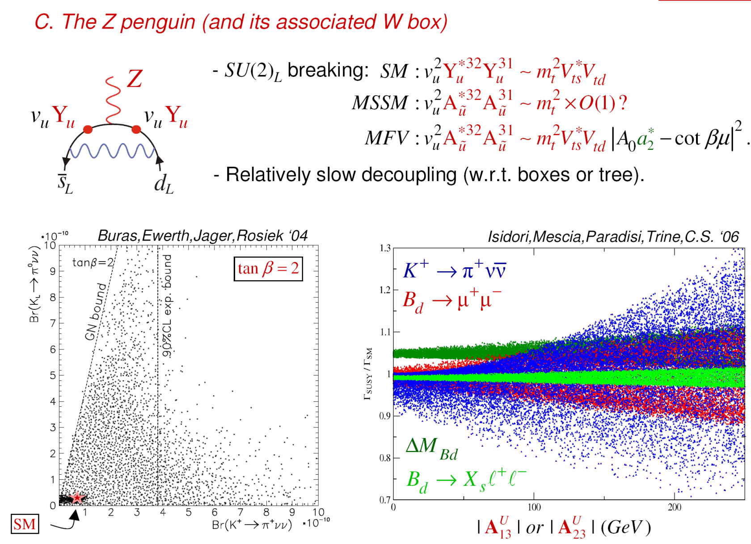
Kaon Rare Decays and BSM
(courtesy by Christopher Smith)

Slide 28
Example: Rare K decay sensitivity to flavor violating Z’
Buras, De Fazio, Girrbach arXiv:
Grossman-Nir limit
← →
Allowed by AGS
E949/E787
Left Handed Z’ large V_{ub}
Constrained MFV
Left Handed Z’ large V_{ub}
Sensitivity beyond direct searches

Slide 29
The Unitarity Quadrangles
From: Grossman, Nir and Rattazzi hep-ph/970123

Slide 30
A nice interplay betWEEn Kaons and BEES in the SM

Slide 31
Sensitivity BSM
Isidori and Teubert, arXiv:1402.2844

