Slide 1
Status of NA62 straw electronics and services
Peter LICHARD,
Johan Morant,
Vito PALLADINO

Slide 2
Services
3 chambers wired with HV, LV and data cables
Still need to arrange them for crates
HV connectors on MPOD side should be finished this week for 3 equipped chambers
Data cables for chamber 4 ordered
Expected in 2 weeks
Production 8 days, shipping ???
VME crates
3 installed in the pit
Will need to change place in the rack to compensate for cable length
Chamber 1; cables short, crate at the bottom
Chamber 2, cables too long, crate at the higher half of rack
VME SBC
5 Reinstalled with SLC6
Problems with library and driver versions
Power supplies for powering patch panels arrived
Will use provided software for control and monitoring for this year run
Integration to DCS next year

Slide 3
Services
MPOD
3 Bins with LV modules ready for some time
HV modules arrived rather late
Company moves to new factory with our PS
Proposed new shipping on the week of 8.9.
After intervention they promised to ship them sooner

Slide 4
Covers
3 chambers tested
1 cover had to be replaced
Johan measured temperature on the chamber with power on and plastic covering chamber, < 25 degrees
Need to rebuild our ‘test rack’ and ‘test bench’
VME crate from test rack is for chamber 4
Need to keep test bench alive for (re-) tesing covers
Take 6U VME crate from the POOL
Johan will provide injection control and circuitry
In 154 we will keep
Complete readout with straw prototype for development
Cover test bench
Spare covers, spare SRBs, patch panels (?)
Components and cables

Slide 5
SRB
Plans and reality
Test data format compliance with ALTERA demonstrator board – failed, reason unknown
Prototype May/June -> July
Test with TDAQ in August – only simple connectivity with PC-farm
sending/receiving Ethernet packets
Software on pc farm (Jonas) will be debugged/extended as soon as we will have enough SRB’s in the pit

Slide 6
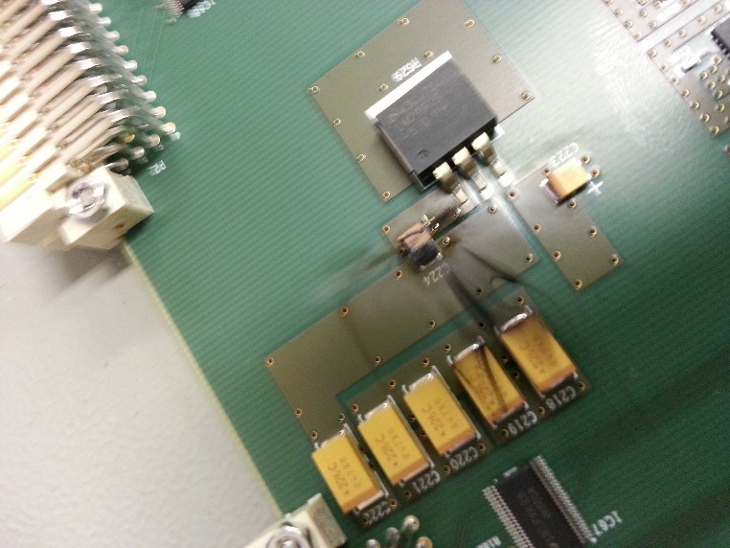
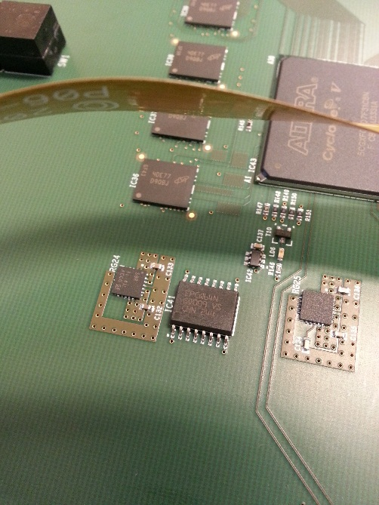
Prototypes arrived – Hooorraaaaaa but…
Tantalum capacitors inverted, causing explosion with real firework
EPROM mounted 180 degrees, shorting power supply

Slide 7
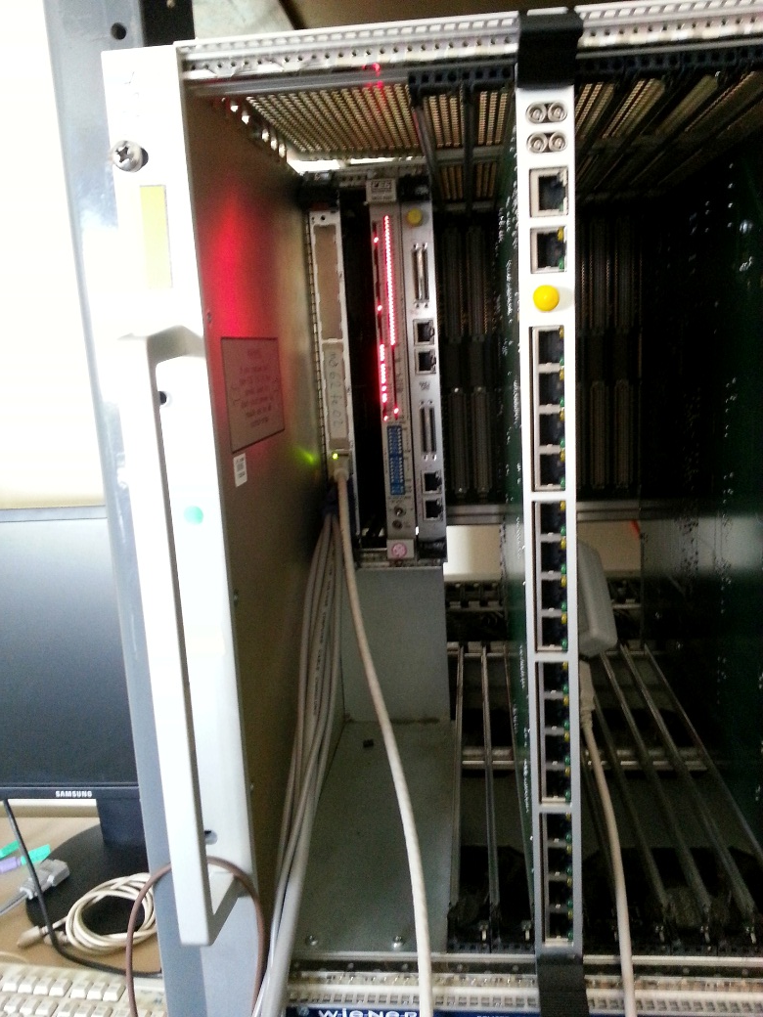
Full SRB (Straw Readout Board)

Slide 8
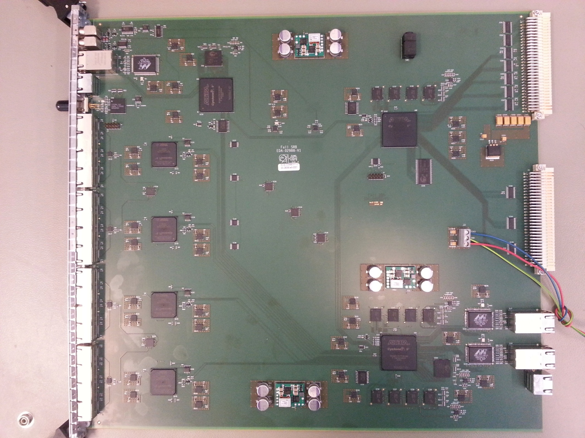
LOOKUP
TABLE
ETH
Trigger
Manager
DDR3
TTCrx
VME
manager
HISTOGRAM
SRAM
CLOCK
DELAY
Front-End
(To covers)
DDR3
Event
Manager
x2 Gb eth
DDR3
QDR

Slide 9
BASICs
VME slave – modified and tested
Bridges VME <-> master_slow_control <-> slave_slow_control <-> Avalon_vme_master
Designed to work with vme-style protocol and avalon
Delayed due to problem of different specs
Clock generation and distribution
Small problem with our version of TTCRx
TESTED AND FUNCTIONAL

Slide 10
On-board high speed links 2.5Gb/s
VME manager receives a complete copy of all data
Histograms
Dump of (all) data for on-line monitoring
Lab readout
Event Manager receives all data
Time sort
(trigger selection)
Storage
Ethernet out to PC farm
Copy sent to Trigger Manager
All links are bidirectional
Allows to send the test data to verify the functionality
LINKS TESTED AND FUNCTIONAL

Slide 11
Communication with covers
ALTERA dropped soft IP for medium speed links in CYCLONE V
They introduced hard macro (real SERDES built on the chip)
After lot of trials and problems with different versions of QUARTUS software it turned out that they provide very few(/unsufficient) clock resources to drive the SERDESes. We need to adjust every link timing as the cable length is different for every cover. We have lost a lot of time ….
Designed our own soft IP for medium speed links
Test with covers next week of 8.9.2014

Slide 12
Big volume DDR3 memory 2*2GB + 2GB
Used mainly for high volume, not speed!
20 MHz write/read should be sufficient
Tested with ALTERA memory tool
Remains test with real inputs/outputs

Slide 13
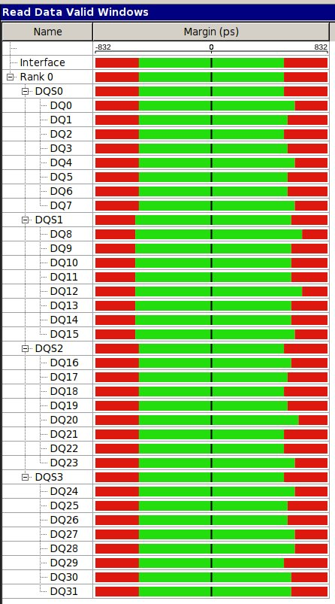
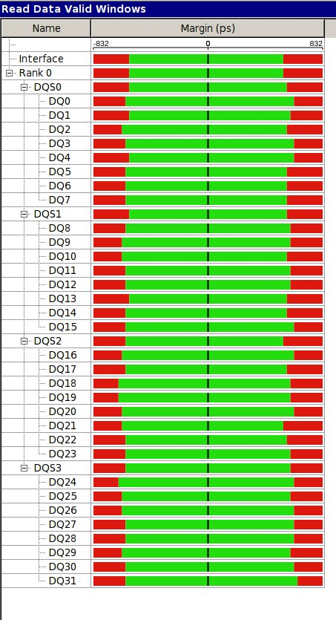
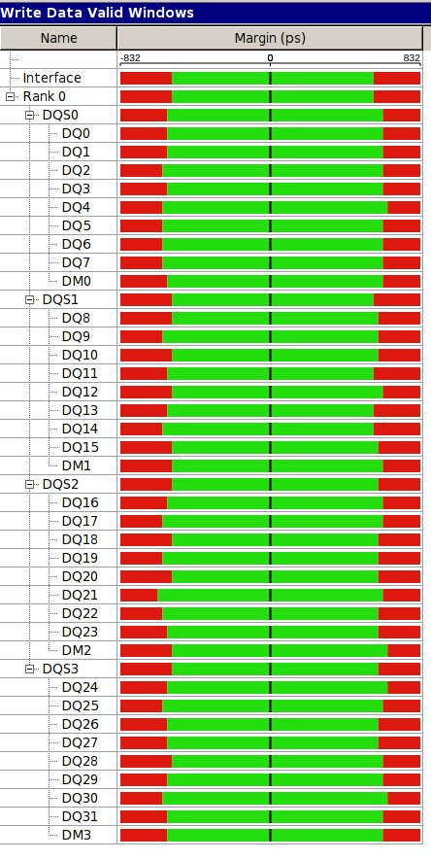
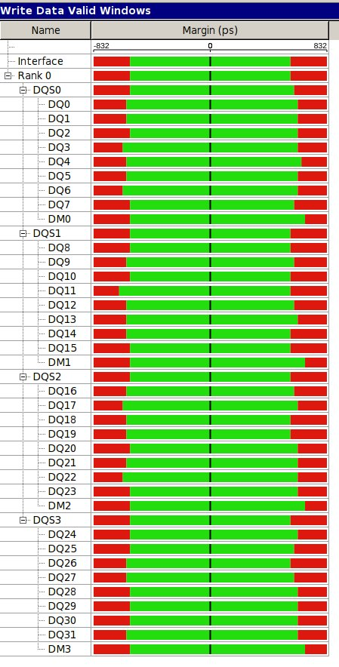
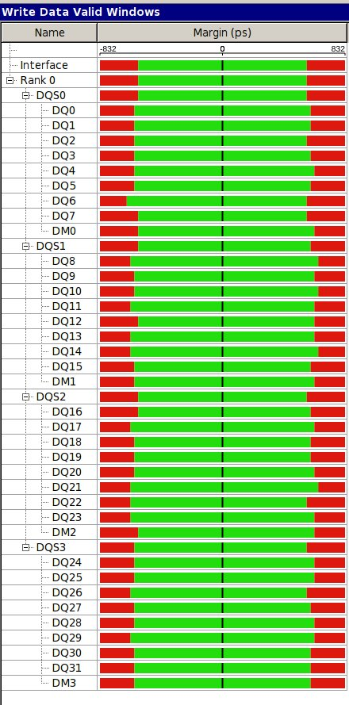
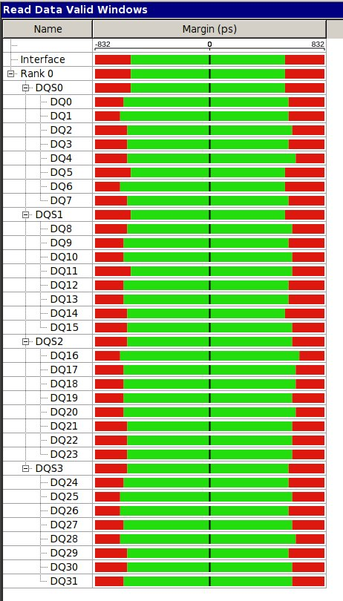

Slide 14
Asynchronous high speed (10ns) SRAM
Used for storing on-board generated monitoring histograms
80 MHz write/read allows 40MHz read-modify-write operation
Tested

Slide 15
Ethernet interfaces 2+1
1 + 1 spare for PC-farm data connection
1 for eventual trigger
Tested
Full test with data-formatted packets
More Vito’s talk

Slide 16
High speed synchronous SRAM - QDR
1 serves as time-remapping machine for data
1 for eventual trigger lookup table
ALTERA IP not suitable for our purposes
Need to write simple IP for QDR
Not tested

Slide 17
TTC optical interface
TTCRx tested with LTU and TTCex
Commands received
Our version (not radiation hard batch) shows strange behaviour without optical fibre
Starts and stops clock output randomly
Causes confusion in clock selection
Tested

Slide 18
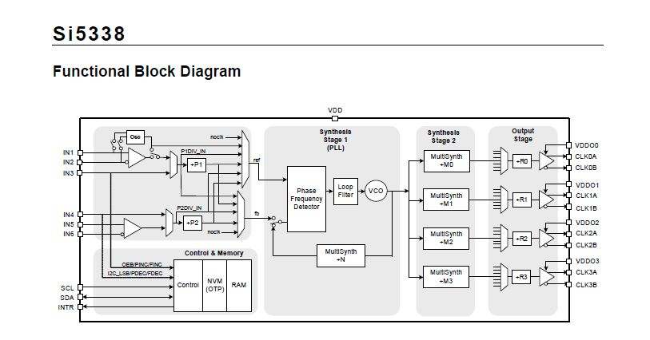
XTAL
25 MHz
Si5338
50 MHz
Si5338
4x
125 MHz
D
E
T
E
C
T
O
R
40.07658 MHz
BUFFER
With
AUTO
SWITCH
Si53302
Si5338
TTC
TTCRX
Si5338
Si5338
Si5338

Slide 19
I2C control of clock delays
T0 adjustment for all links
Not tested yet

Slide 20
Summary and plans
HV connectors assembly on 3 chambers is on-going
Data cables for 4-th chamber ordered
Possibly delivered end of the next week
Cable installation critical
Final installation of VME crates in racks and cable routing next week
3 MPODs should arrive next week
Installation and integration in DCS (Serguei S.)
Patch panel power supplies arrived
Johan preparing software for control and monitoring
Install them in a crate shelf
We have to re-do cover test bench and install it in 154
Small scale readout system in 154
SRB
Originally we expected all assembled boards at CERN now
50 PCBs produced in July
2 assembled at CERN
Problem with 1 type of FPGA and EPROM
We secured enough components for 24 boards
Should arrive to CERN assembled next week – assembly started
Enough for 3 chambers fully equipped
Equip 1 chamber first and do the noise scans and cosmics
The rest of FPGA should arrive to CERN after 11.9.2014 – received 2 deliveries this week
The rest of boards could be ready in 3 weeks – first/second week of October
Testing 1 week
Ready for installation ~15.10.2014
Firmware/software development continues (and probably will for a long time)
Cover readout next week
Data to pc-farm as soon as we have more boards

Slide 21
Summary and plans
in the next 2 weeks
A lot of material will arrive
Manpower from Dubna (Sergei M., Sergei Sch, Dmitri)
We should finish chamber 4 installation
Define procedure for T0 adjustment
Define online and offline monitoring
What MUST be done on SRB
What can or can’t be done on SRB
What must be done on PC
How often and how much raw data we should store through VME interface for monitoring
Data analysis
Feedback on detector performance
Scan thresholds
Scan HV
Write and debug Run Control and local DAQ

