Slide 1
Software and TDAQ
Peter Lichard, Vito Palladino
NA62 Collaboration Meeting,
Sept. 2014 Ferrara.

Slide 2
Straw DAQ
Straw will have 2 operational modes:
Triggerless
Standard L0 matching
Triggereless mode: we will record all the data coming from the detector (it might not be suitable for run with full intensity, 148Tb/d of data throughput), and the trigger time stamps, each PC in pc farm will record data coming from 2 SRBs
Standard mode: will send data within a tunable time window (from 0ns to 800ns with 25ns step).

Slide 3
Possible Solution for TL Mode
Straw 1
Straw 2
Straw 3
Straw 4
Opt Switch
SRB8
SRB8
SRB8
SRB8
2x1Gb/s
SRB7
SRB7
SRB7
SRB7
2x1Gb/s
SRB6
SRB6
SRB6
SRB6
2x1Gb/s
SRB5
SRB5
SRB5
SRB5
2x1Gb/s
10(+10)Gb/s
SRB4
SRB4
SRB4
SRB4
2x1Gb/s
SRB3
SRB3
SRB3
SRB3
2x1Gb/s
SRB2
SRB2
SRB2
SRB2
2x1Gb/s
SRB1
SRB1
SRB1
SRB1
2x1Gb/s
Opt Switch
Merger
10Gb/s
10Gb/s
Switch
10Gb/s
10Gb/s
10Gb/s
PC
10Gb/s
PC
10Gb/s
1Gb/s
PC
10Gb/s
1Gb/s
PC
10Gb/s
PC
10Gb/s
1Gb/s
PC
PC farm
1Gb/s
PC
1Gb/s
PC
1Gb/s
1Gb/s
1Gb/s

Slide 4
Data Handling (First Step)
SRBs are equipped with 2x1Gb/s Ethernet ports each to transmit data,
UDP packets are assembled in Event manager (data are read from the DDR3) and then forwarded to the physical link,
First (fake) data from SRB have been sent to PC farm (19/08/2014).

Slide 5
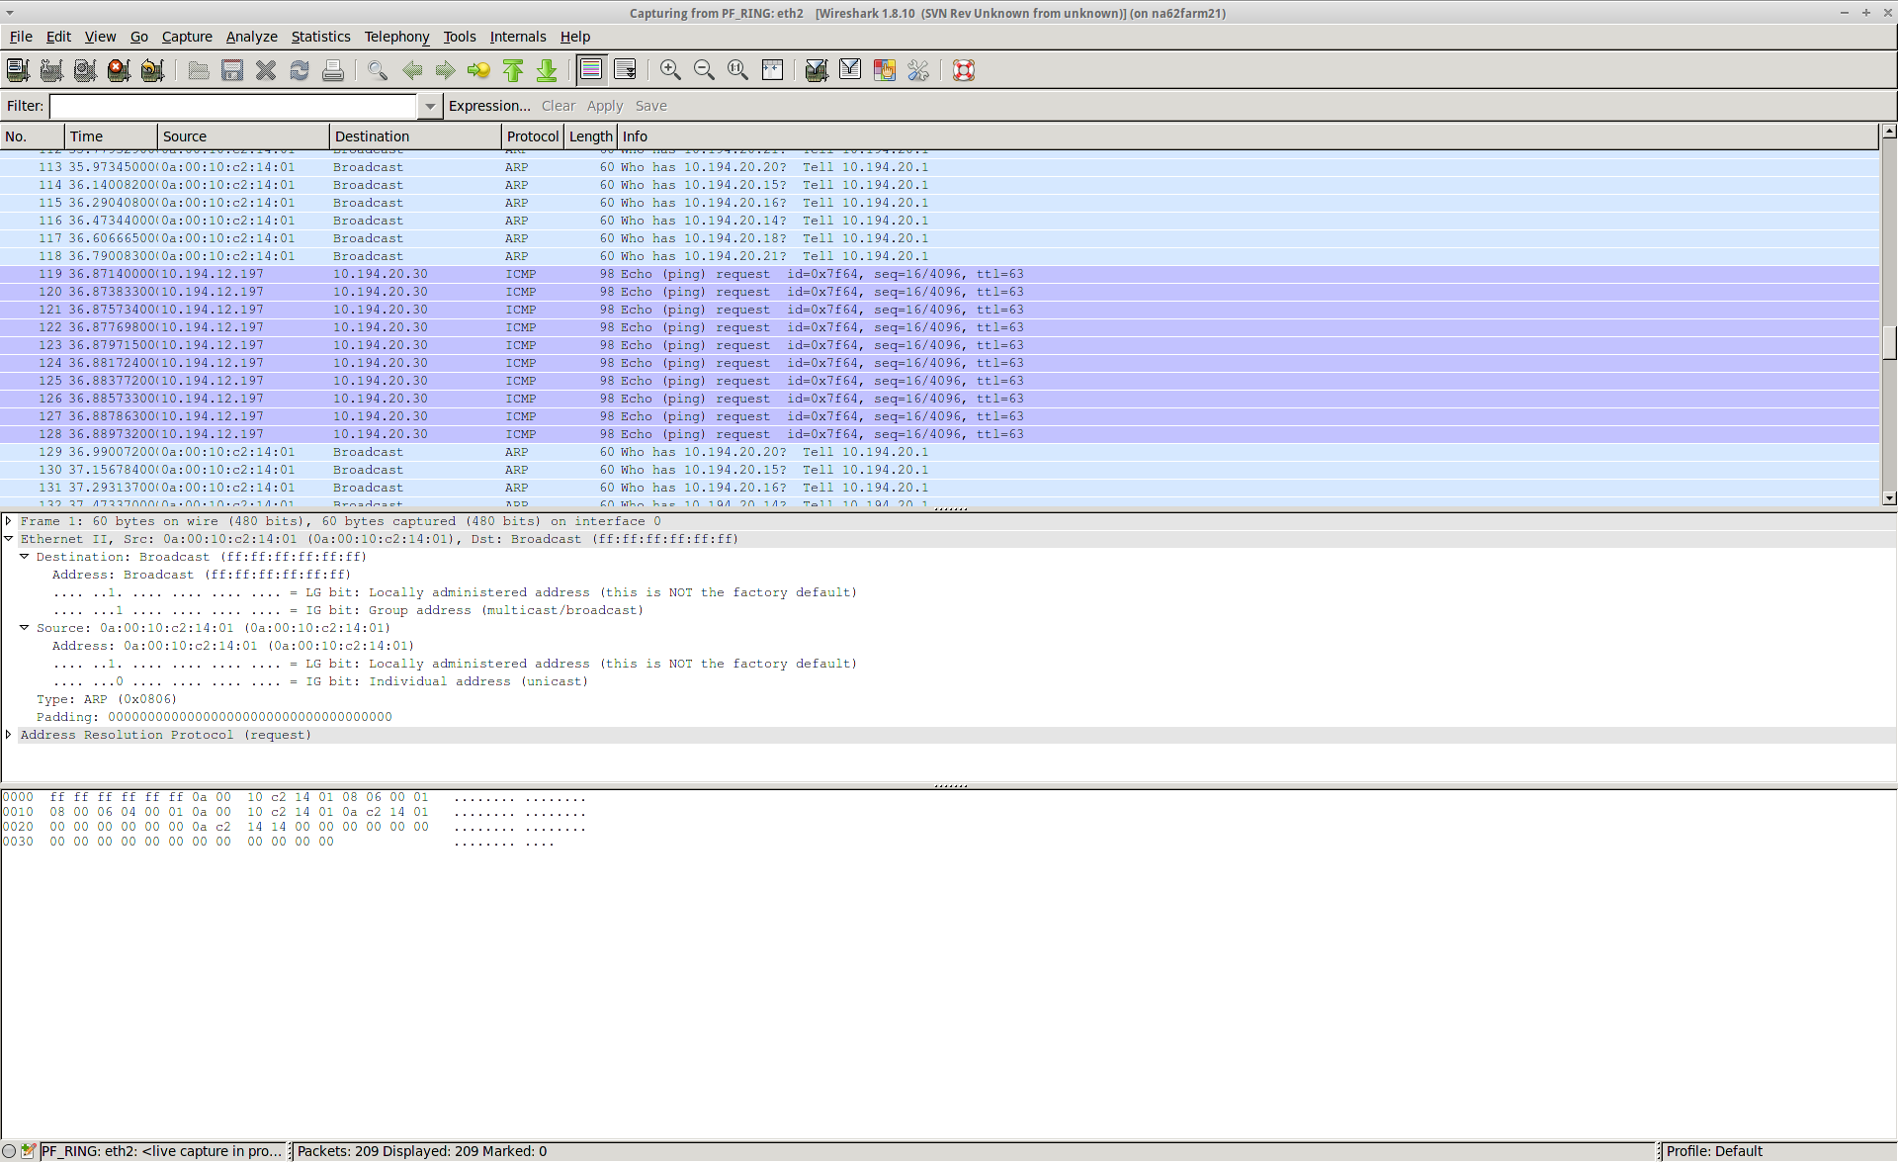
Data Handling (First Step)
SRBs are equipped with 2x1Gb/s Ethernet ports each to transmit data,
UDP packets are assembled in Event manager (data are read from the DDR3) and then forwarded to the physical link,
First (fake) data from SRB have been sent to PC farm (19/08/2014).

Slide 6
Data Handling (First Step)
SRBs are equipped with 2x1Gb/s Ethernet ports each to transmit data,
UDP packets are assembled in Event manager (data are read from the DDR3) and then forwarded to the physical link,
First (fake) data from SRB have been sent to PC farm (19/08/2014).

Slide 7
RUN Control
RUN control provides the management of the detector,
SBC will be the bridge between RUN control commands and hardware (SRB and COVER configuration),
The RUN control is not yet implemented:
Riccardo has already prepared an interface for the LKr that can fit our requirements,
Next week we plan to install the SBCs (the VME bridge) at least for straws 1, 2, and 3,
At the same time we can install and test the software form the RUN control side

Slide 8
Monitoring
VME Monitoring:
The SRBs will be able to use the full statistic (in and outside the burst) to generate histograms like the occupancy of each channel (VME online monitoring),
These histograms are stored in the VME manager and than forwarded (to PC farm? Dedicated PC?),
In case of in-spill monitoring we will send the data in accordance to the general rules of the experiment,
PC farm Monitoring:
Monitoring from the data stored in PC farm is also foreseen,
Inter-station correlations,
Tracking samples,
…

Slide 9
VME Monitoring (in-SPILL)
~
SOB
~
~
EOB
~
Monitoring data sent to SBCs
SPILL (integration time)
~
~
BURST (SRB signal)
Needed to wait “late” data from COVERs (few μs)

Slide 10
VME Monitoring (off-SPILL)
Gap between SPS cycle and command to perform off-spill operations
~
SOG (Start Of Gap)
~
~
~
~
EOG (End Of Gap)
~
~
~
~
EOB
~
~
~
~
BURST (SRB signal)
~
~
~
Tunable integration window (from few μs up to SPS cycle)

Slide 11
Software EOB data
Riccardo,
02/09/2014 TDAQ meeting
Need to add information coming from non-TEL62 based detectors
i.e. DCS data for the KTAG, LKr calibration settings, Straw eob data, etc.
Basic mechanism discussed, protoype implemented, to be reviewed
Based on DIM publishing
Add the data to the EOB event of the various detectors
Decoding left to detector reconstructions
Plan to add derived classes to SpecialTrigger class

Slide 12
Viewer
Example to follow:
KTAG on-line monitoring
(Technical Run)

Slide 13
Database
The final solution of parameters storage is a database,
Emanuele Leonardi (Rome) is working on it
The WG (me) needs to provide the structure of this DB that will store all the information we need to initialize the detector:
Thresholds
SRB configuration (timing, delays, eth configuration, hsl configuration, PLL, etc.)
We can start with a simple TXT (or XML) file

Slide 14
Software
Ethernet controller ✓
Thresholds setting and getting ✓
Noise scan ~ (to be tested)
SRB firmware upload ✗
COVER firmware upload ✓ (working on the old SRB to be tested on the new one)
Run control ✗ (sw from LKr)
Monitoring ✗
Concerning the SRBs, anything to add to the list that you think is needed for the Run…

Slide 15
Conclusions and Plans
The first (small) step toward SRB integration within the TDAQ system has been done,
Software will be completed within next 2/3 weeks (at least the main parts),
Run control must be tested text week
Monitoring is not in a good shape but we can have something
Next steps toward October the 6th:
Develop the firmware to send realistic (but still fake) data to PC farm,
Installation of the new SBCs is planned for the next week,
Next week is foreseen a first implementation of RUN control,
Real data in PC farm (~ mid Sept.),
Coarse time ordering (steps of 25ns) not immediately ready,
L0 matching will be next step,
On line monitoring.

Slide 16
Spares

Slide 17
Data Formats

Slide 18
Data Formats
The coarse time (16-MSB) can 1.64 ms time resolution

Slide 19
Data Throughput (DT)
 | Full luminosity | 20% FL | 1% FL
Average rate per Straw (kHz) | 60 | 12 | 0.6
DT per SRB (Gb/s) | 1.29 | 0.26 | 0.012
Data per SRB per Burst (MB) | 800 | 160 | 8
DT per station (Gb/s) | 10.3 | 2.1 | 0.1
Data whole detector (TB/d) | ~148 | ~30 | ~1.5

