Slide 1
Straws L1 Implementation
Laura Rogers and Thomas Hancock
(Thanks to Jonas Kunze)
02/09/2014 Laura Rogers

Slide 2
Outline
Aim to test algorithms running within the L1 Framework
☑ Emulate detector output using NA62Reco
☑ Access emulated data through Jonas’ framework
☑ Write a framework within Jonas’ L1 framework for the straw algorithm
□ Start testing algorithms (work in progress)
02/09/2014 Laura Rogers

Slide 3
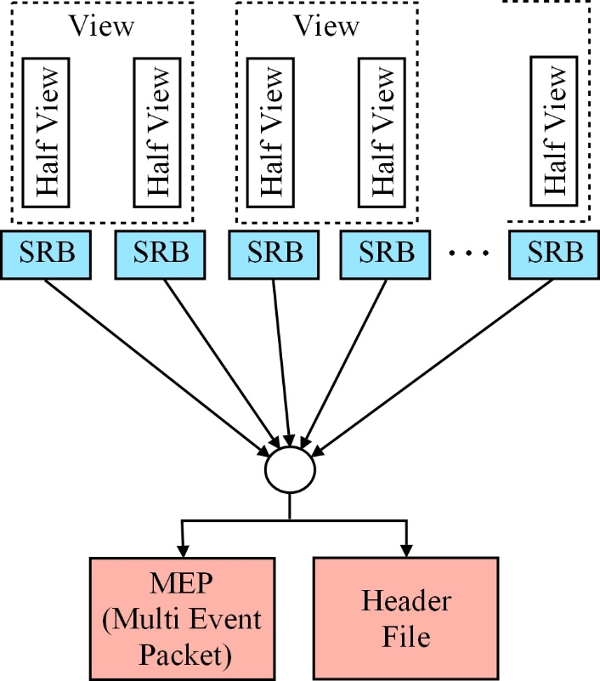
Straws
4 chambers, each with 4 views
Each chamber has 8 SRBs (Straw Readout Board)
SRBs all send data to the tel board
Combines signal into MEP and Header file
02/09/2014 Laura Rogers

Slide 4
Emulating the detector signal
Used the NA62 Reconstruction software
Outputs the data in the binary format defined below
16-bits data
word
Packet Length |  |  |  |  |  |  |  |  |  |  |  |  |  |  | L0 trigger type |  |  |  |  |  |  |  |  | Flags |  |  | SRB ID
Coarse time first slot
16-bits data word |  |  |  |  |  |  |  |  |  |  |  |  |  |  | 16-bits data word
16-bits data word |  |  |  |  |  |  |  |  |  |  |  |  |  |  | 16-bits data word
16-bits data word |  |  |  |  |  |  |  |  |  |  |  |  |  |  | 16-bits data word
Err |  | Straw ID |  |  |  |  |  |  | E* | Fine Time |  |  |  |  | 16-bits data word
… |  |  |  |  |  |  |  |  |  |  |  |  |  |  | …
N edges slot 3 |  |  |  |  |  |  |  | N edges slot 2 |  |  |  |  |  |  | N edges slot 1 |  |  |  |  |  |  |  |  | N edges slot 0
N edges slot 7 |  |  |  |  |  |  |  | N edges slot 6 |  |  |  |  |  |  | N edges slot 5 |  |  |  |  |  |  |  |  | N edges slot 4
N edges slot 11 |  |  |  |  |  |  |  | N edges slot 10 |  |  |  |  |  |  | N edges slot 9 |  |  |  |  |  |  |  |  | N edges slot 8
N edges slot 15 |  |  |  |  |  |  |  | N edges slot 14 |  |  |  |  |  |  | N edges slot 13 |  |  |  |  |  |  |  |  | N edges slot 12
31 | 30 | 29 | 28 | 27 | 26 | 25 | 24 | 23 | 22 | 21 | 20 | 19 | 18 | 17 | 16 | 15 | 14 | 13 | 12 | 11 | 10 | 9 | 8 | 7 | 6 | 5 | 4 | 3 | 2 | 1 | 0
* Edge Type (Leading/Trailing)
02/09/2014 Laura Rogers

Slide 5
Path Reconstruction
Currently performing very simple path reconstruction between two hits
This path is tracked back to the beam line to check that they intersect
02/09/2014 Laura Rogers

Slide 6
Path Reconstruction
Currently looking at ways to reduce the execution time of the code
02/09/2014 Laura Rogers

Slide 7
Multiple Tracks
To do: Need to add and test with multiple tracks
02/09/2014 Laura Rogers

