Slide 1
Flavio Marchetto
INFN - Torino
Introduction to GTK
NA62 Collaboration meeting – Ferrara – Sept. 1°, 2014

Slide 2
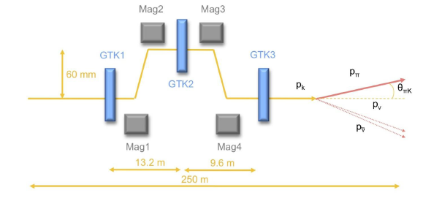
Introduction : detector generalities and specifications (1)
Detector layout
not to scale
Three same Si-pixel stations: each station (60x27)mm²
pixel dimensions: (300x300) μm² ; thickness: 200 μm
To measure the following quantities of the beam particles:
direction (σ_{RMS} ~16 μrad)
momentum (σ_{RMS} ~ 0.15 GeV/c, or σ_{RMS}/p ~ 0.2% )
track time (σ_{RMS}~ 200 ps/station -> ~ 150 ps/track)

Slide 3
Introduction : detector generalities and specifications (2)
Mounted inside the vacuum tube
Dimensions of the stations to match the beam shape
Sensor technology: p-in-n
18000 pixels/ station -> 54000 pixels grand total
Each sensor is read-out via 10 chips

Slide 4
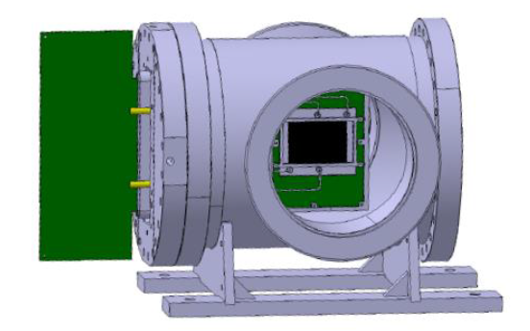
GTK-RO (A. Cotta)
Cooling plate (A. Mapelli)
GTK carrier (M. Morel)
Optical fibers
Cooling plant
(< 22 Sept.)
Bump-bonding (R. Arcidiacono)
ASIC test (A. Kluge)

