Slide 1
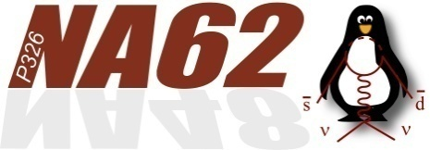
Assembling of Straw Modules at JINR has been FINISHED!
Yu. Potrebenikov
Straw WG meeting, September 03, 2014

Slide 2
Summary
Number (Ch/Mod/ Coordinates) | Start of assembling | End of assembling | End of testing | Delivered to CERN | Assembling and testing time (months)
CH2 M1 U-V | 09.2012 | 04.2013 | 10.2013 | 11.2013 | 11
CH2 M2 X-Y | 07.2013 | 01.2014 | 02.2014 | 04.2014 | 8
CH4 M1 U-V | 12.2013 | 02.2014 | 03.2014 | 04.2014 | 4
CH4 M2 X-Y | 02.2014 | 05.2014 | 06.2014 | 07.2014 | 4
2

Slide 3
Features
of the Dubna assembling line
3

Slide 4
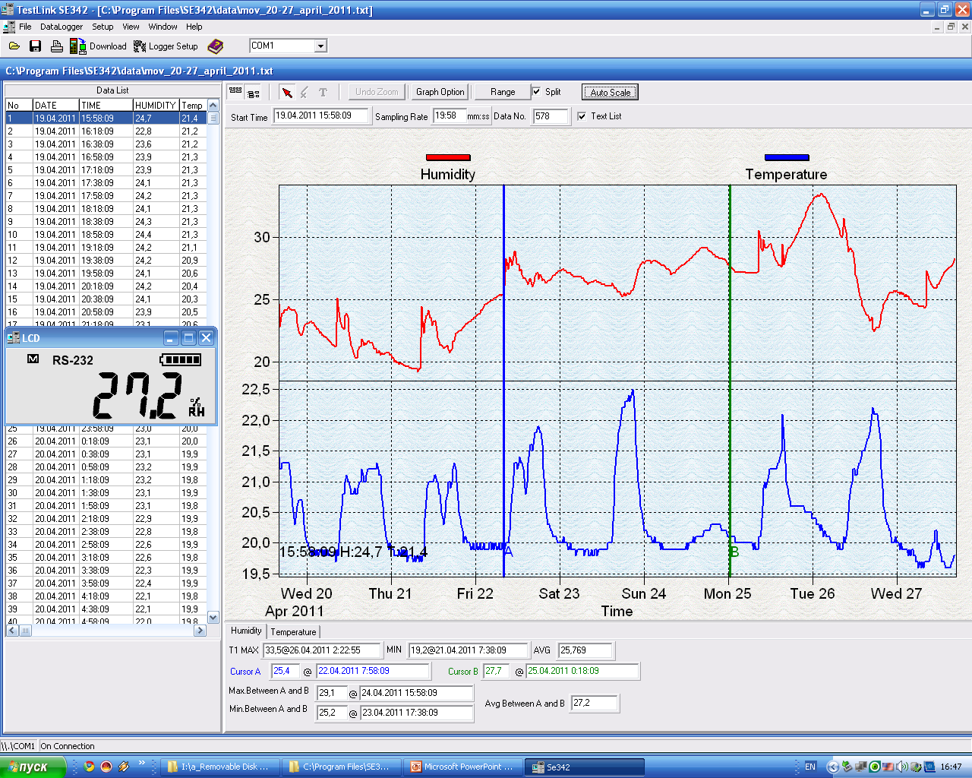
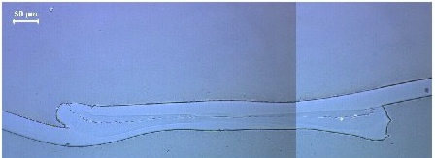
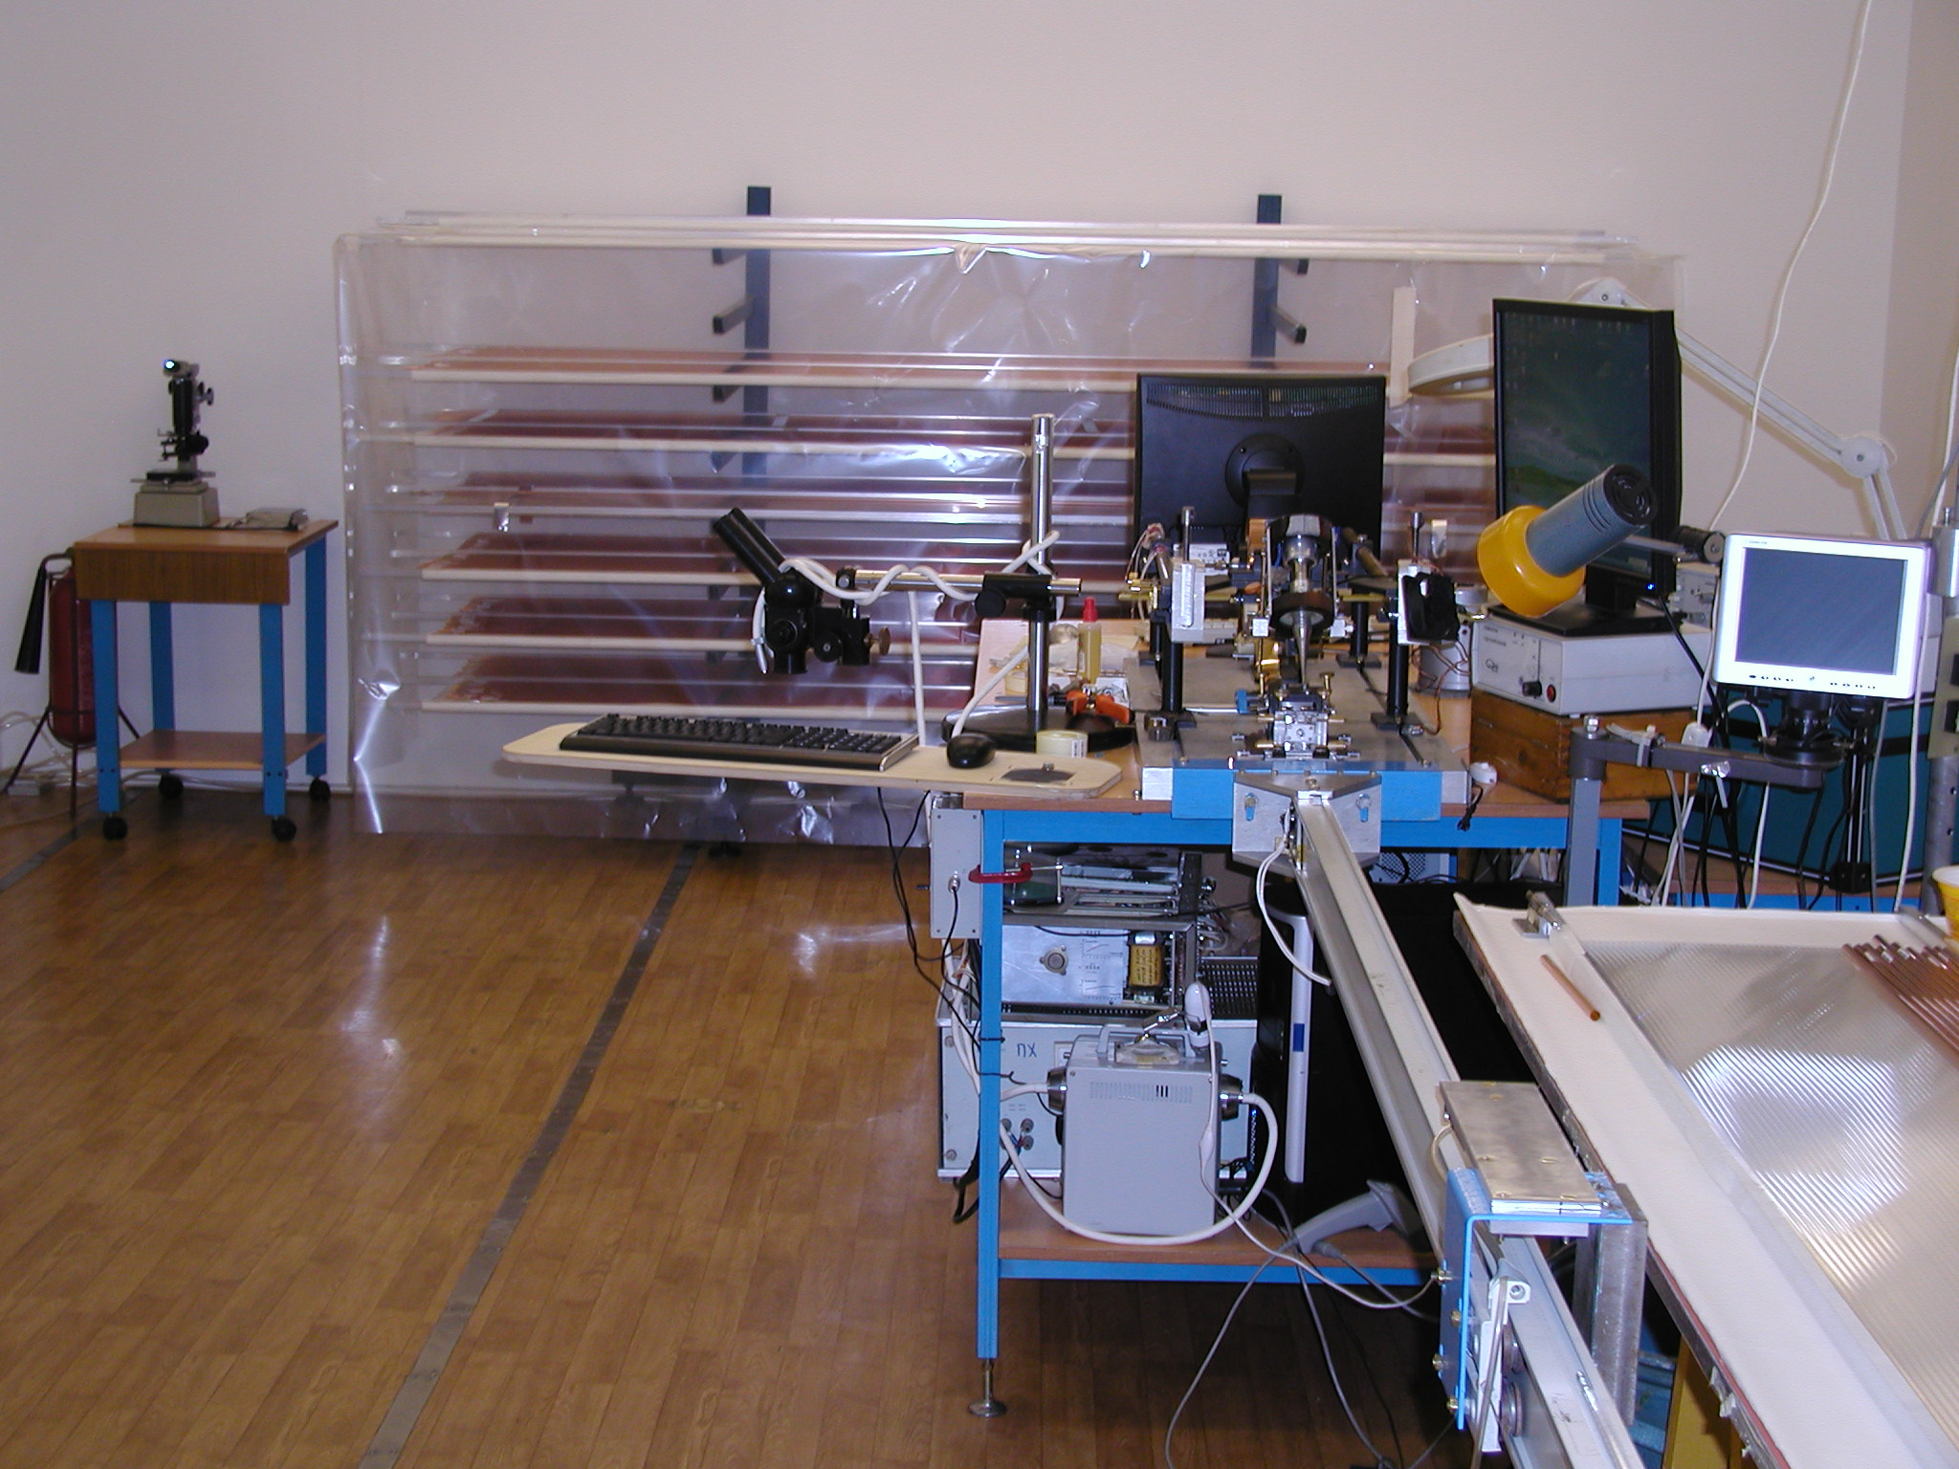
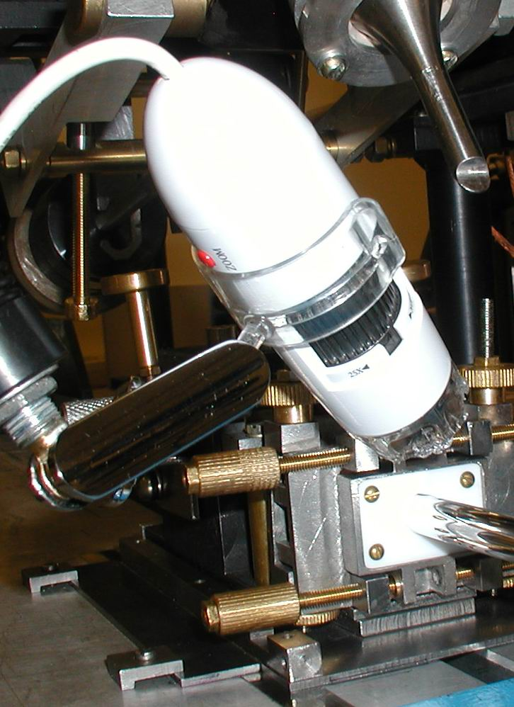
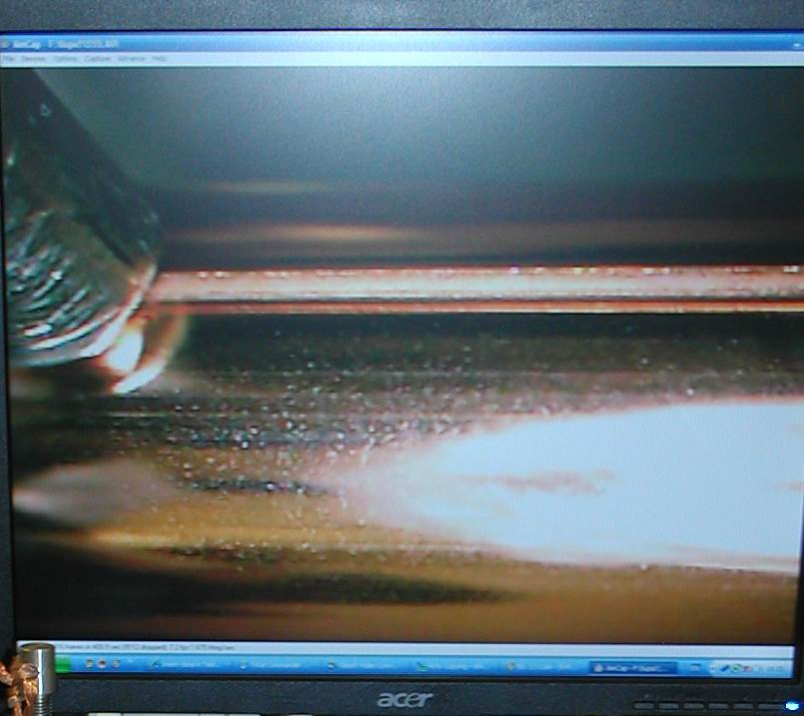
Straw production line
Microscope pictures of a straw cross- section for quality control of the weld
Humidity and temperature
control at clean room
Common view of
the Clean room
ISO clean room standard 6
600 μm
On-line control of a weld seam by the digital microscope (zoom x20 on a PC monitor)
Unique welding machine
4

Slide 5
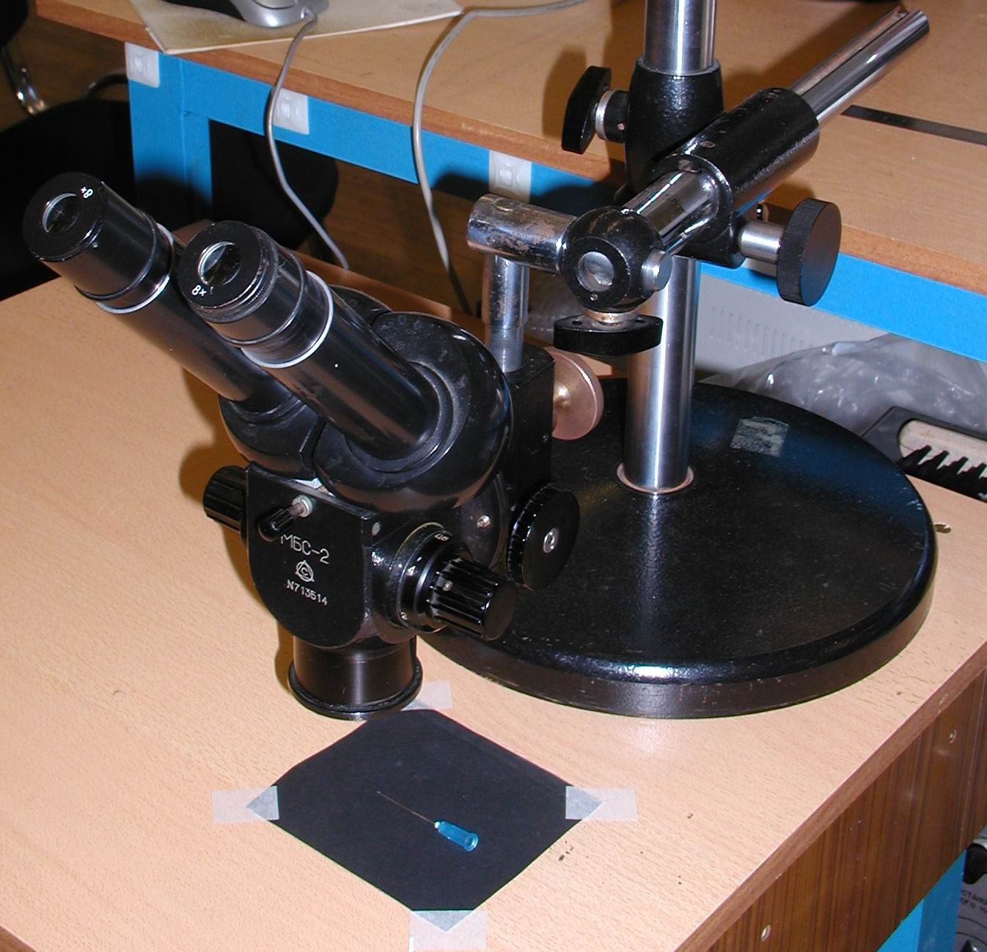
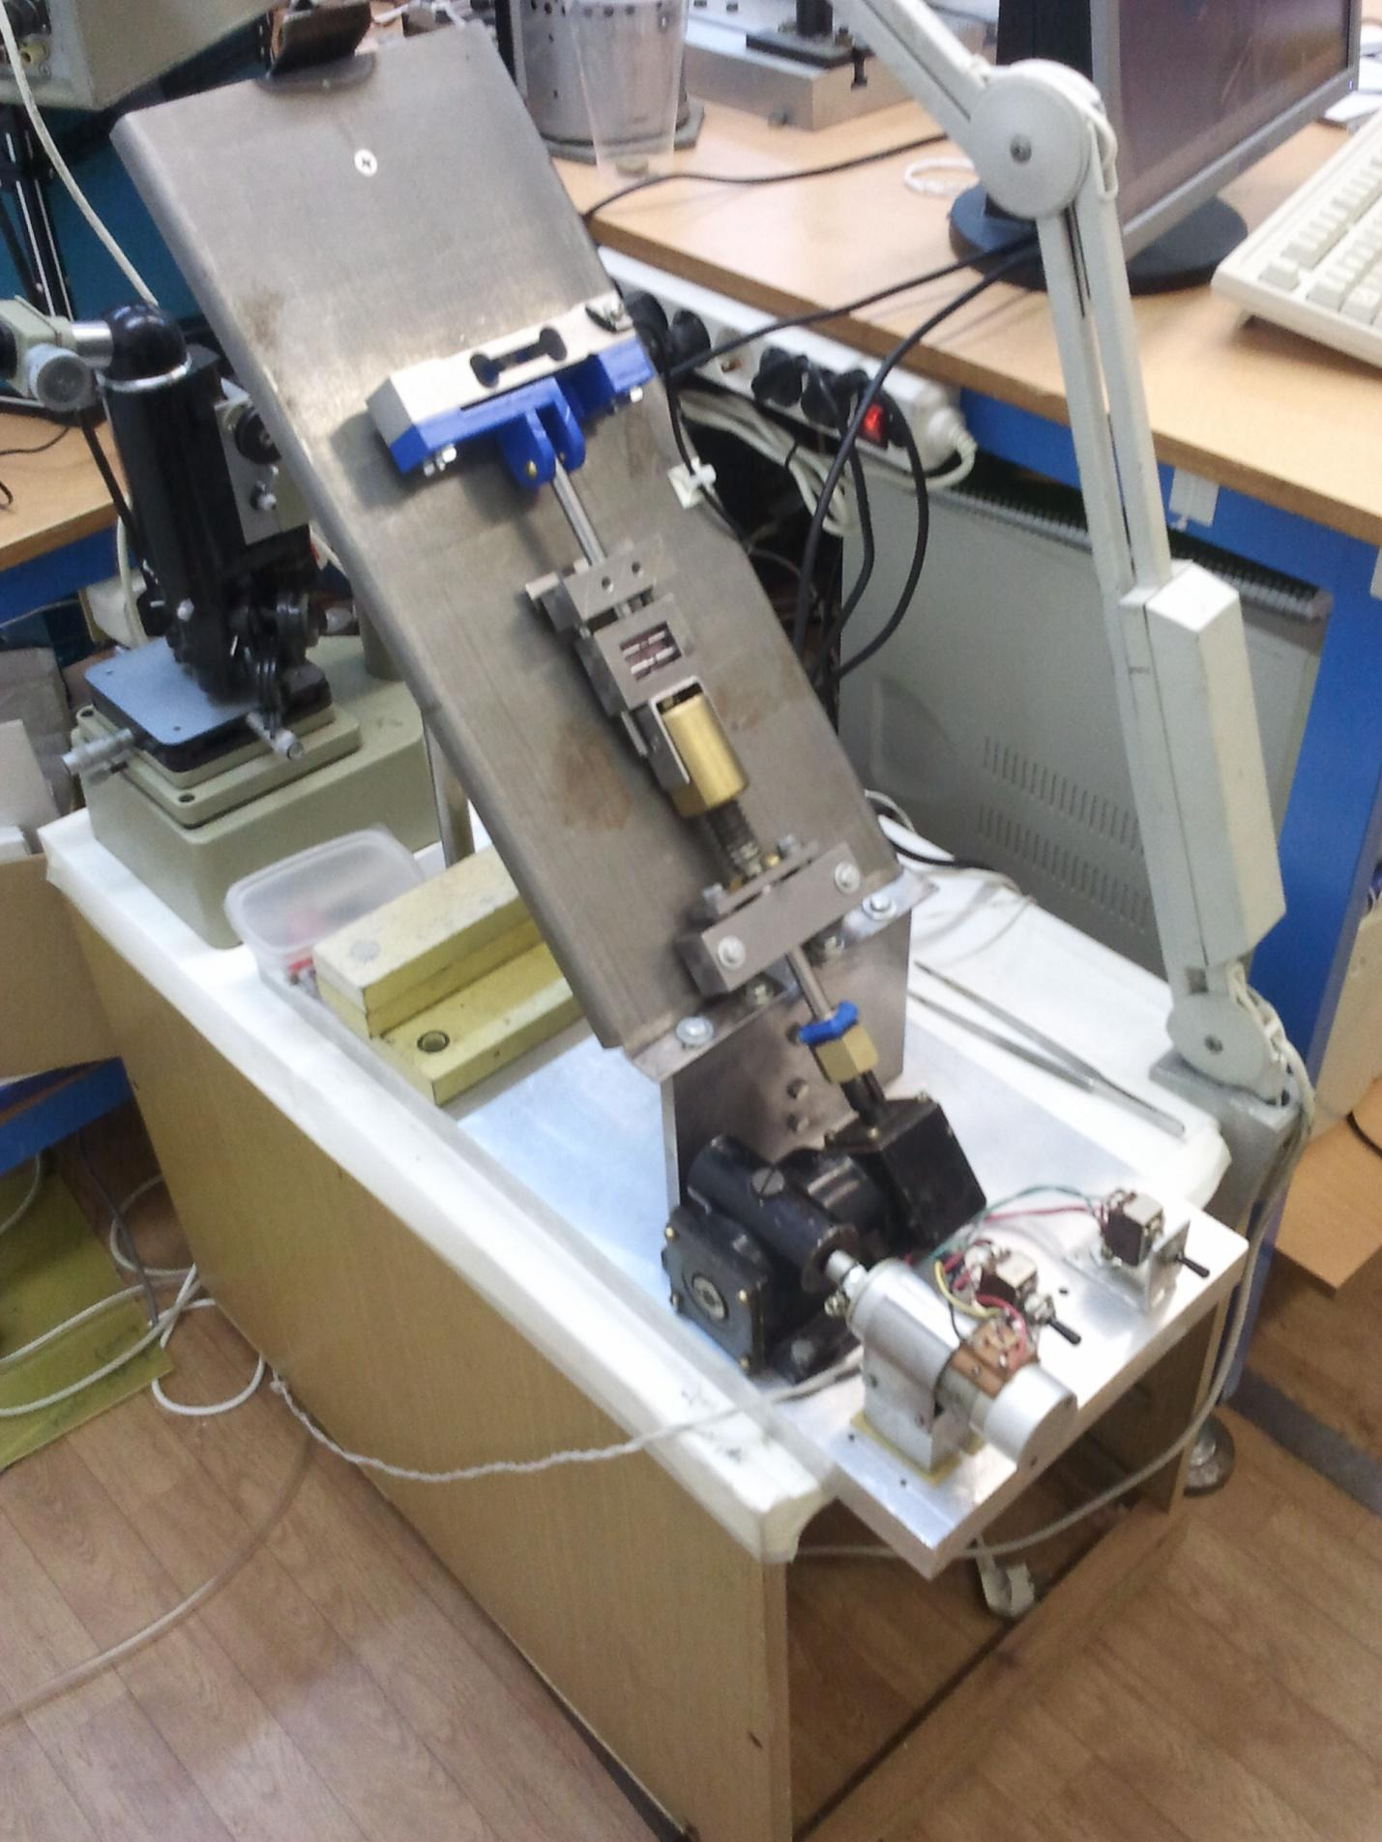
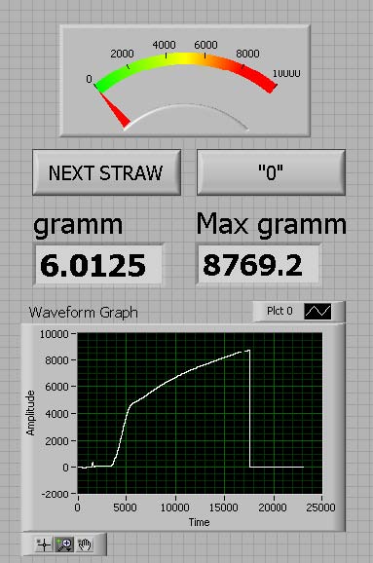
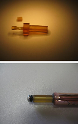
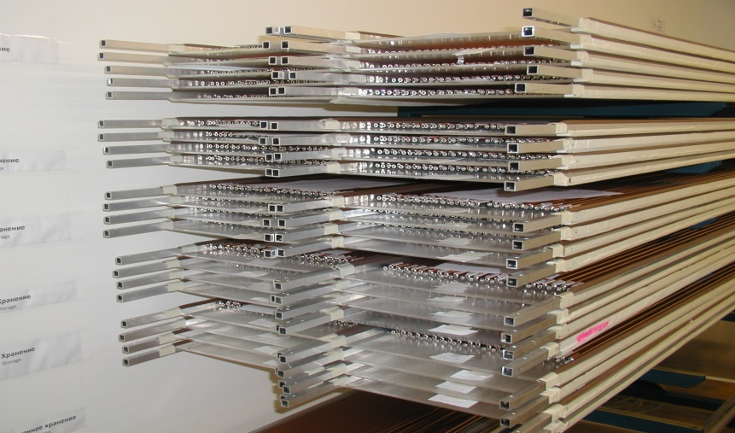
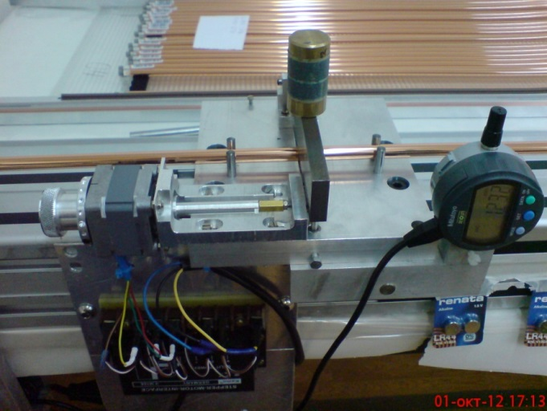
Straw mass production: off-line tests
Optical check of seam quality
Stand for tensile strength
measurement
Straw long term overpressure test (> 1 month as min)
Straw end-plugs
(top with nipple)
Straw storage after 3 bar overpressure test with 1,5 bar overpressure inside
Stand for straw gas leak measurement

Slide 6
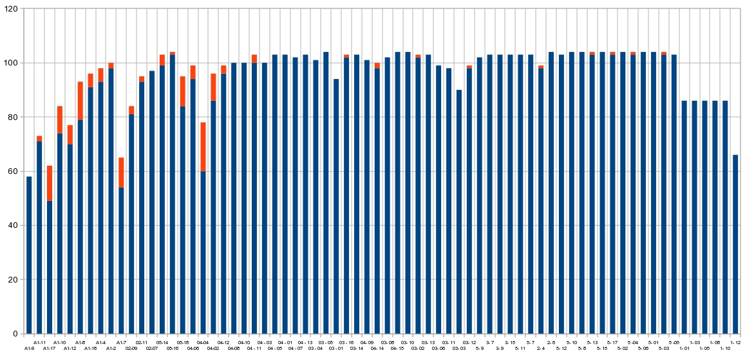
Summary of straw mass production
6740 2.7 m straws have been produced
Length of a roll: 300 m 250 m
Straw quality vs roll of Mylar tape
Parameter of the quality control Rejected straws

Slide 7
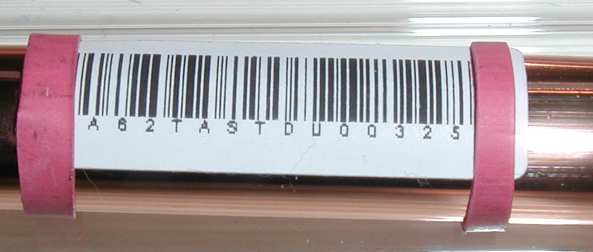
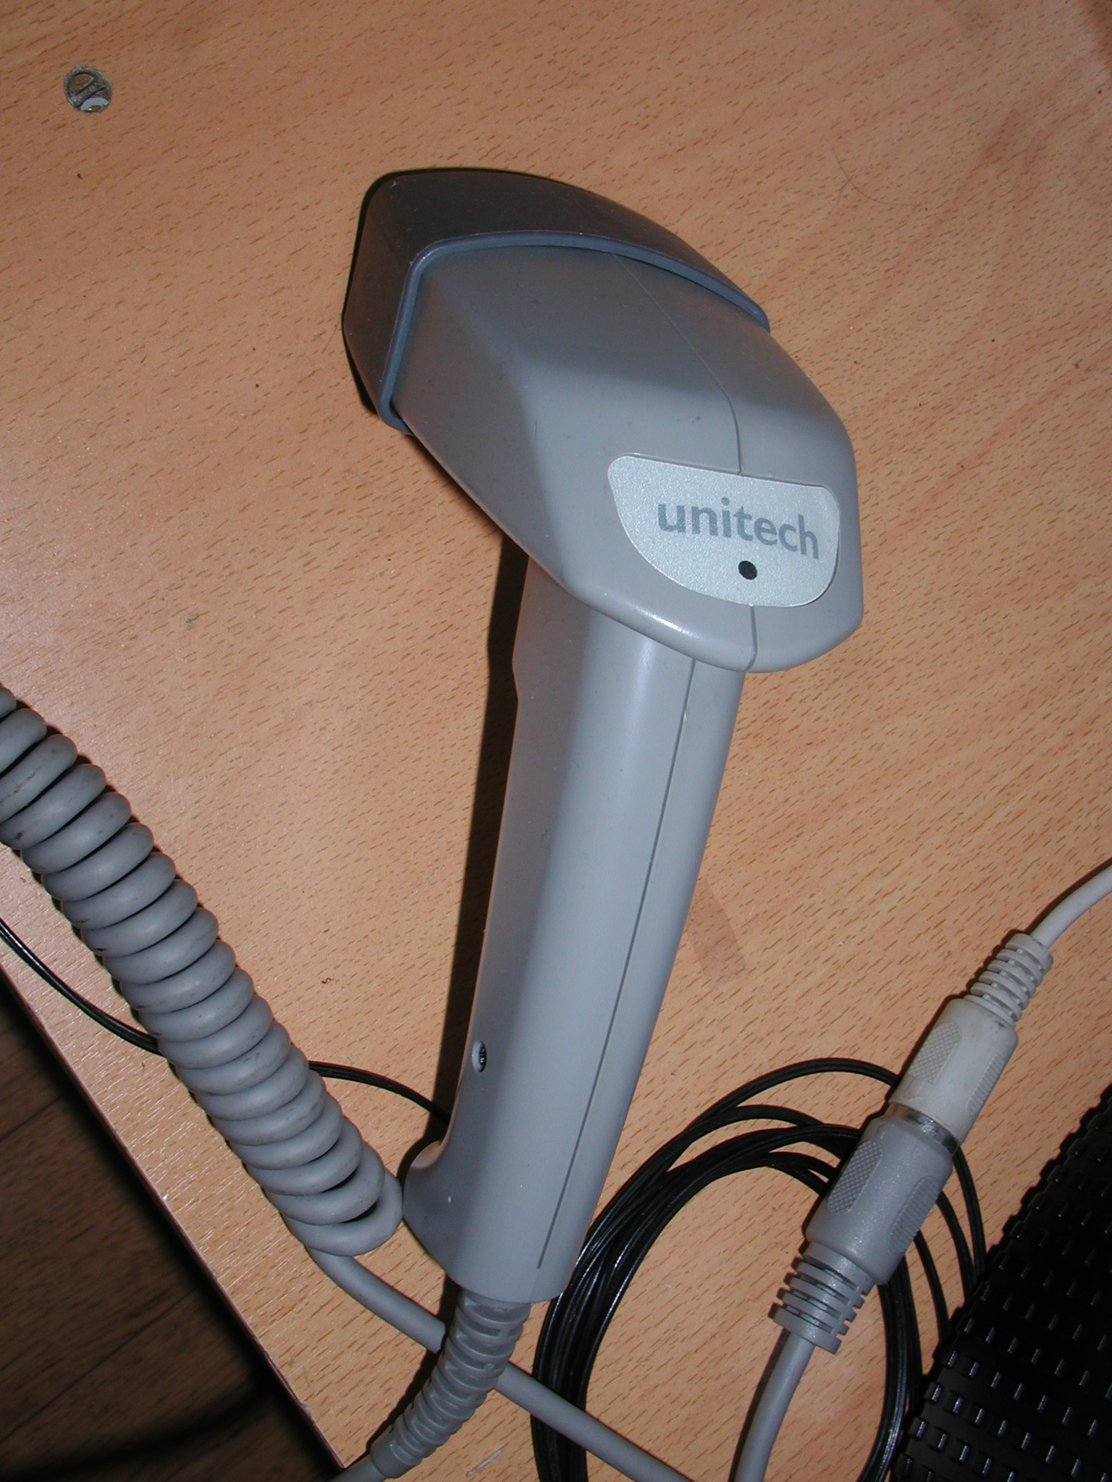
Straw data base and new design
Barcode and the NA62 Data Base
NA62 straw label: NA62TASTDU003525
NA62 – NA62 experiment
TA or TR – Tracker
ST - straw
DU–Dubna, JINR, Russia
CE – CERN (Sefar, Swiss)
003525 – straw serial # (000001-999999)

Slide 8
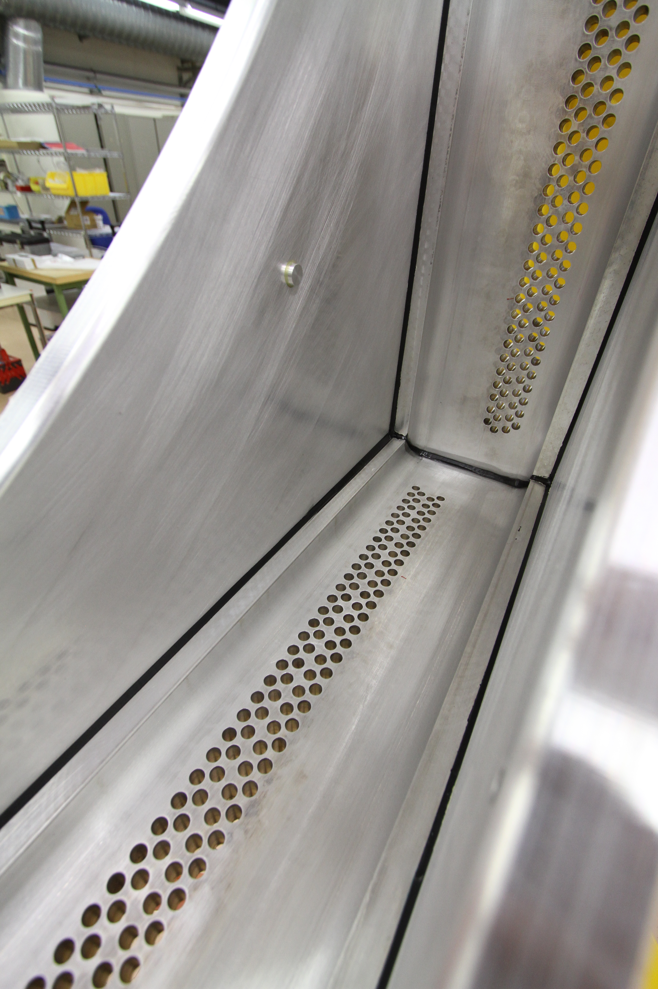
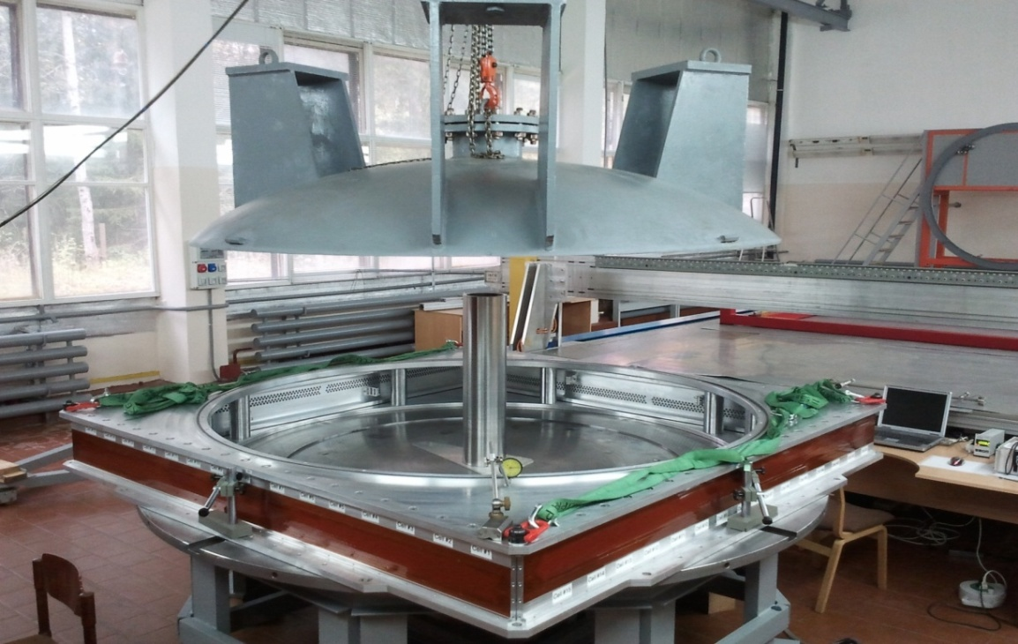
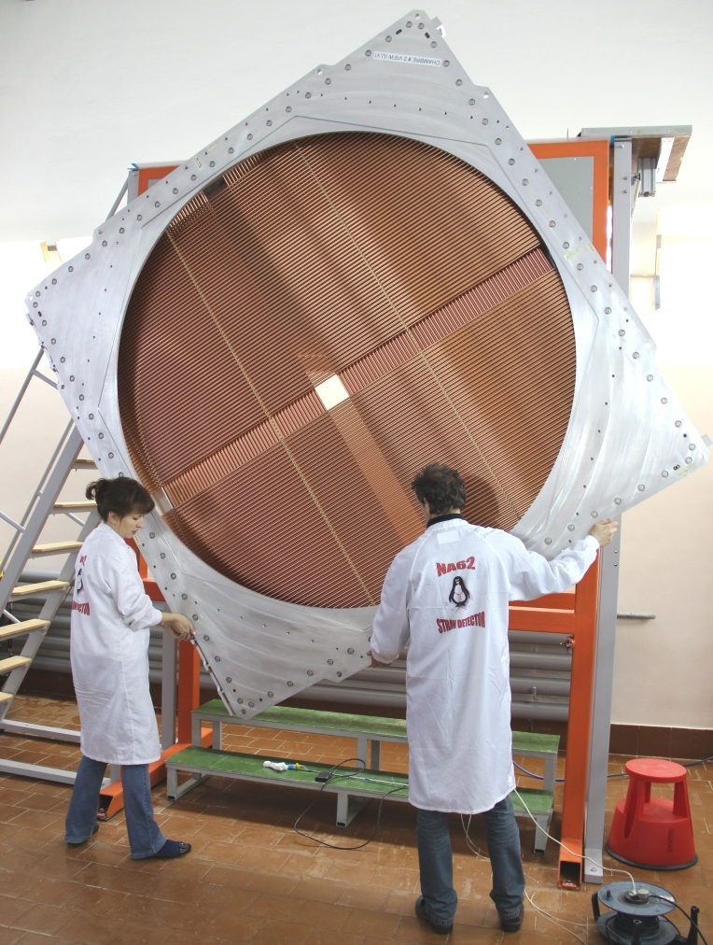
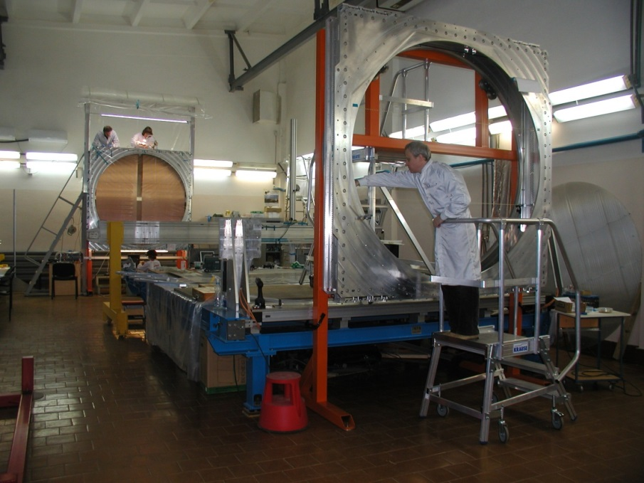
Detector production at JINR:
Modules 2,3,7,8
Sealing of the Module elements in a special “Dry room”
Vacuum test of the Module after sealing
A Module assembly rotation jig
The JINR assembling area
with 2 assembling jigs

Slide 9
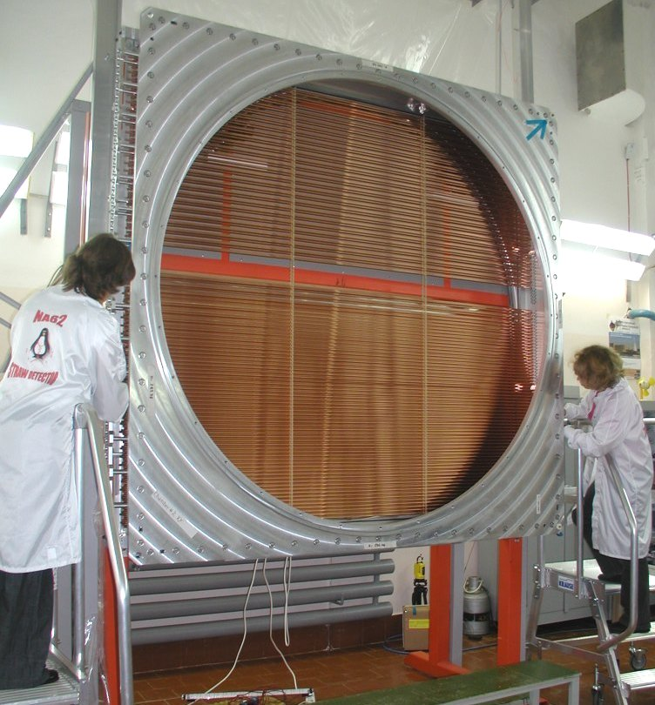
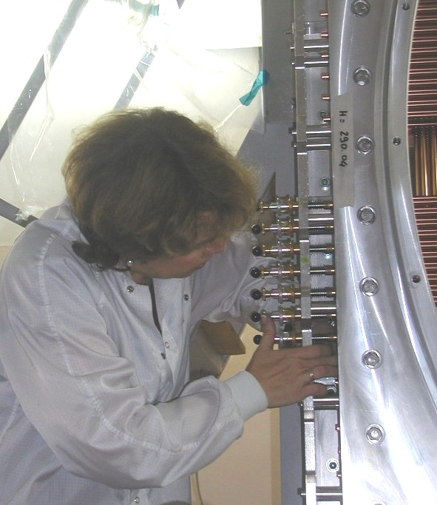
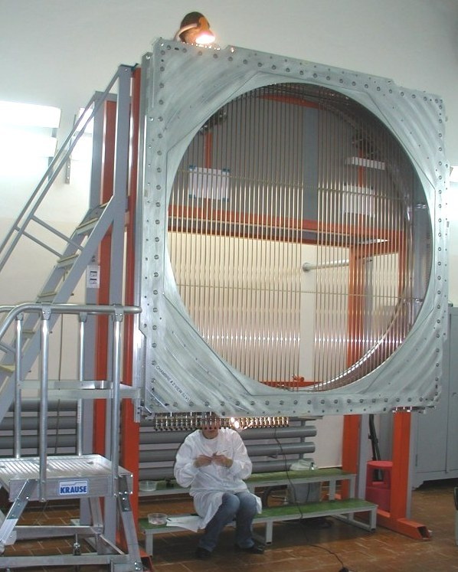
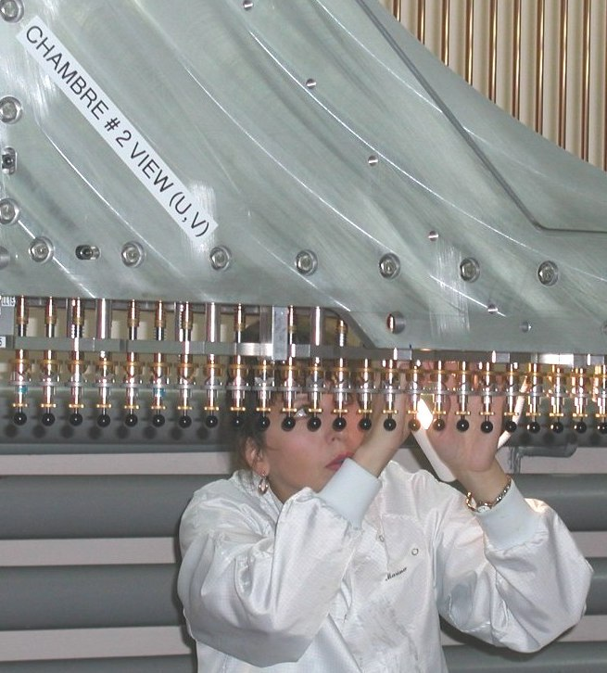
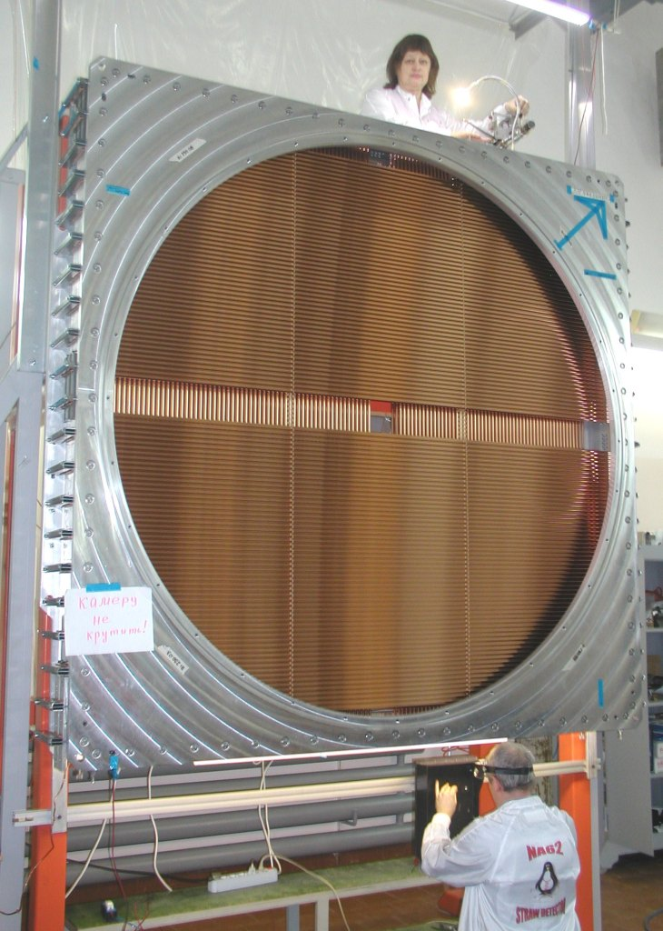
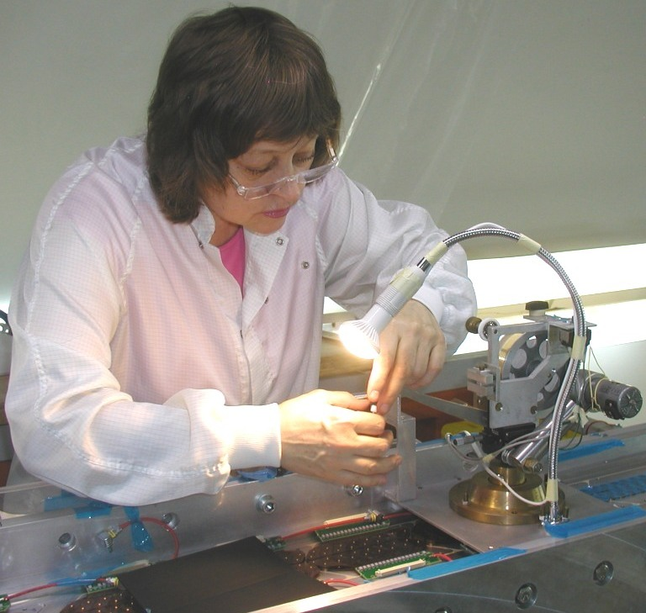
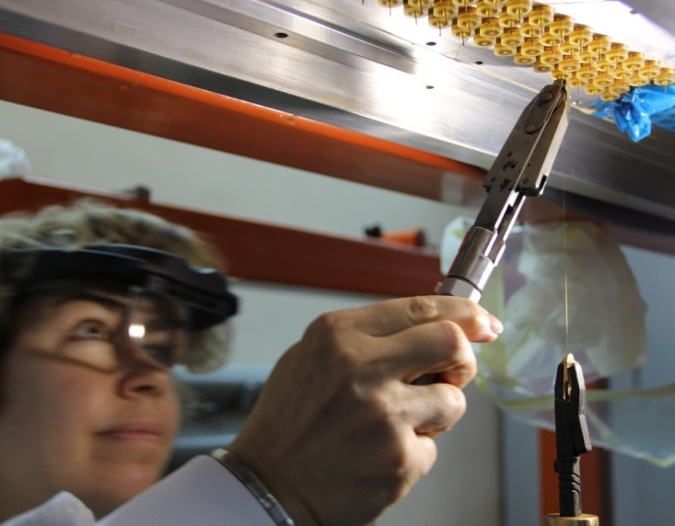
Detector production at JINR:
straw assembling and wiring
Straw insertion and fixing in a horizontal position of a module frame
Straw gluing from the top and bottom in a vertical position of a module frame
Top
This procedure need 15 days for wire insertion – more than 2 times faster than usually
Wiring in vertical position of a module frame
Bottom

Slide 10
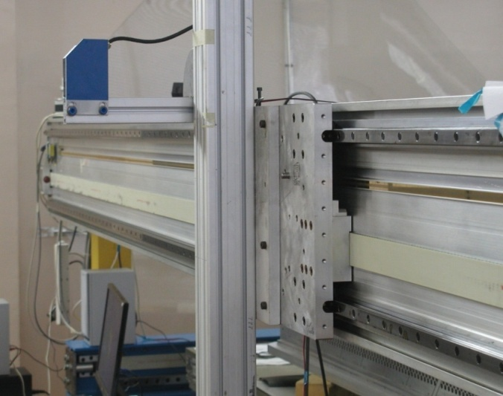
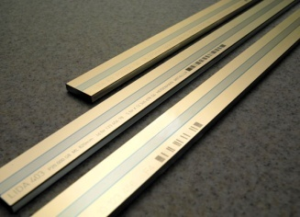
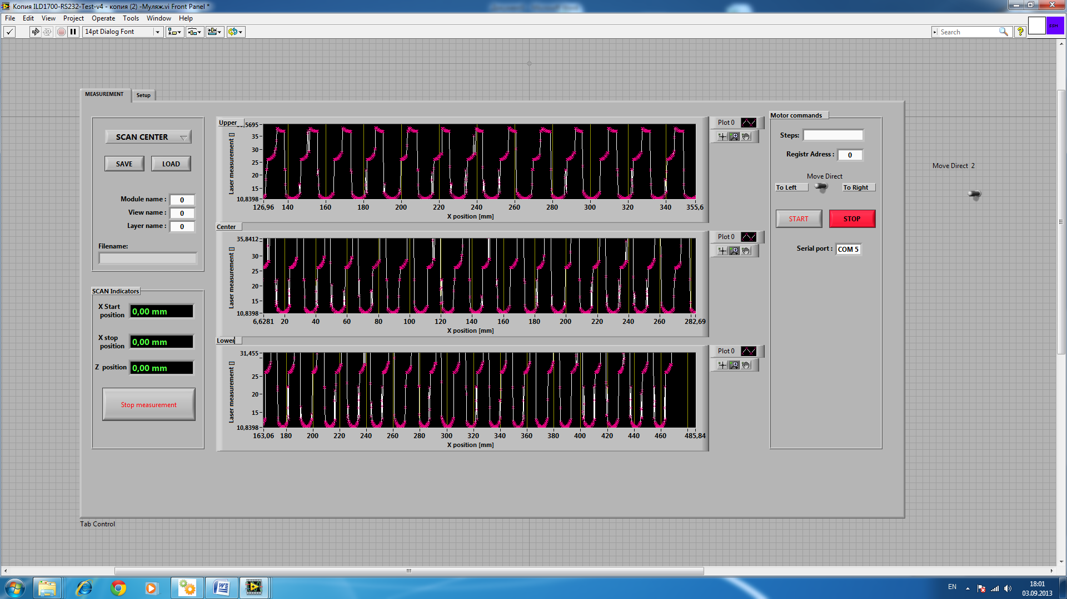
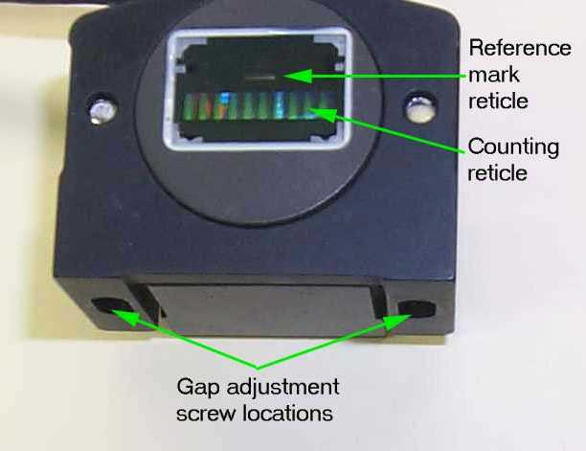
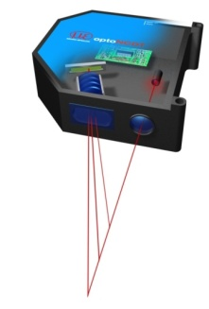
Detector production at JINR:
straw positioning test
INFN
User interface
saving data
Optical ruler
commands
Optical ruler:
Handenhain
measurement - up to L=4500 mm
accuracy - (1-2) mkm
Stepping motor with raster pattern:
1 step = 10,4 mkm
Optical sensor
Scan indicator
visualization
Example: measurement of a straw shape
Laser
“Micro Epsilon” Laser sensor:
measurement distance -
L=(30-50) mm
accuracy - 3 mkm
beam diameter – 0.3 mm
and distances between straws in a module view

Slide 11
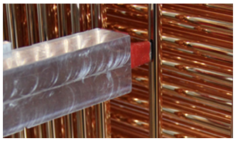
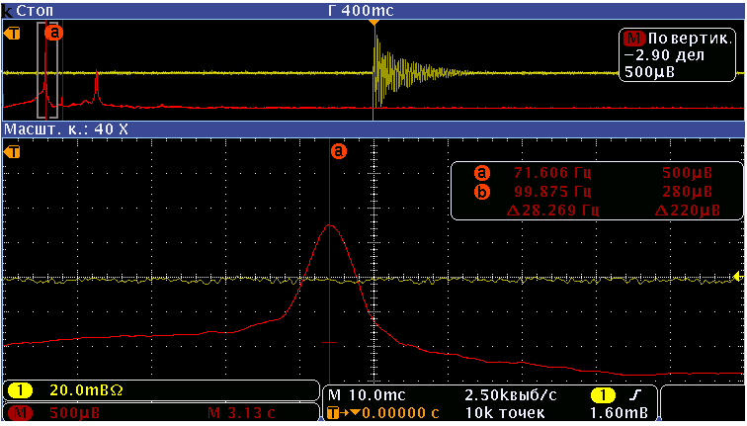
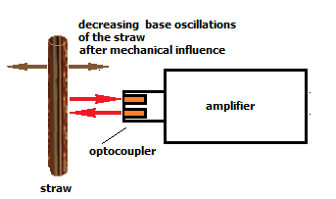
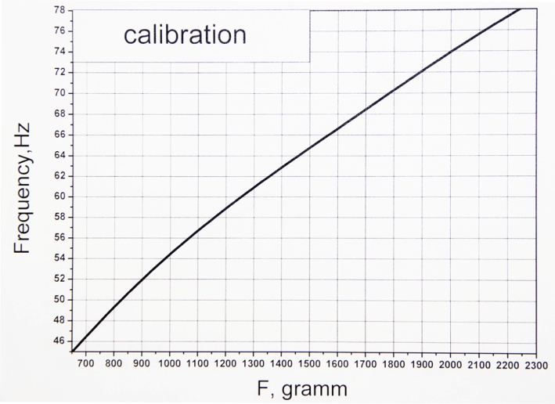
Detector production at JINR:
straw pretention test
Opto-coupler
Oscilloscope with the FFT function
Requirement: F > 1.5 KG → Fr >=65 Hz)
1500 G

Slide 12
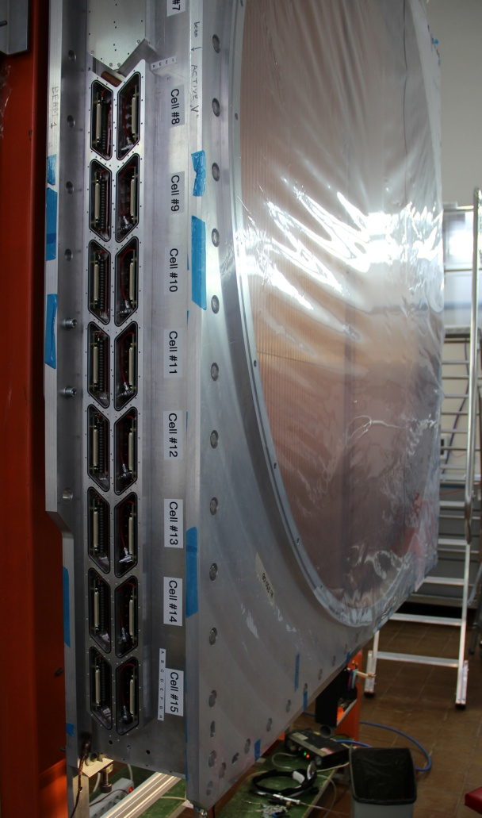
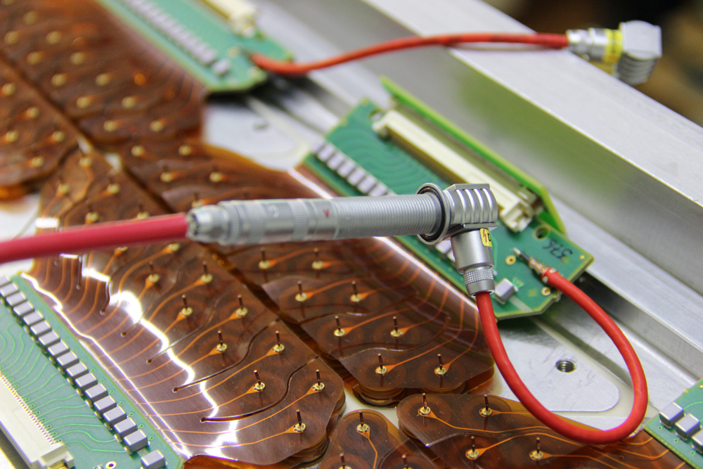
Detector production at JINR:
HV and gas leakage test
Requirement:
I < 4 nA at HV = +2200 V
Temp T=(23-25) degree
Humidity H=(35-40) %
Chamber CH2 M1 U-V - HV – OK, L = 0.5 cm³/min
Chamber CH2 M2 X-Y - HV – OK, L = 0.5 cm³/min
Chamber CH4 M1 U-V - HV – OK, L = 0.1 cm³/min
Chamber CH4 M1 U-V - HV – OK, L = 0.1 cm³/min
These tests have been done for last 2 modules simultaneously!

Slide 13
Wire position measurement
suggested by L.Glonti
performed by T.Enik and A.Kolesnikov

Slide 14
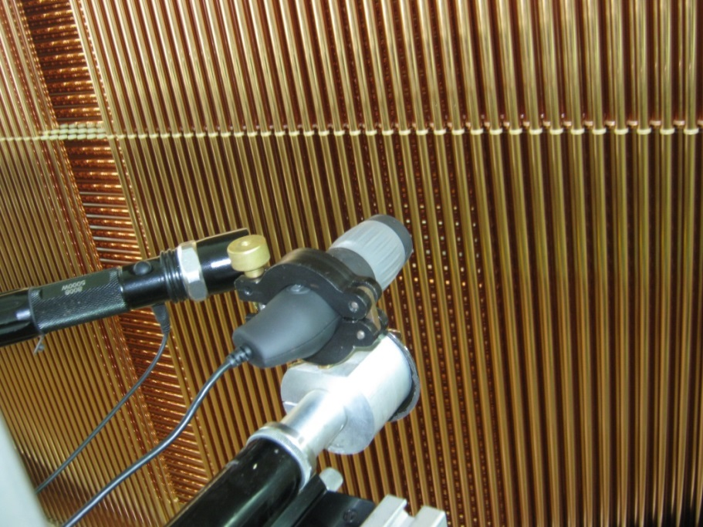
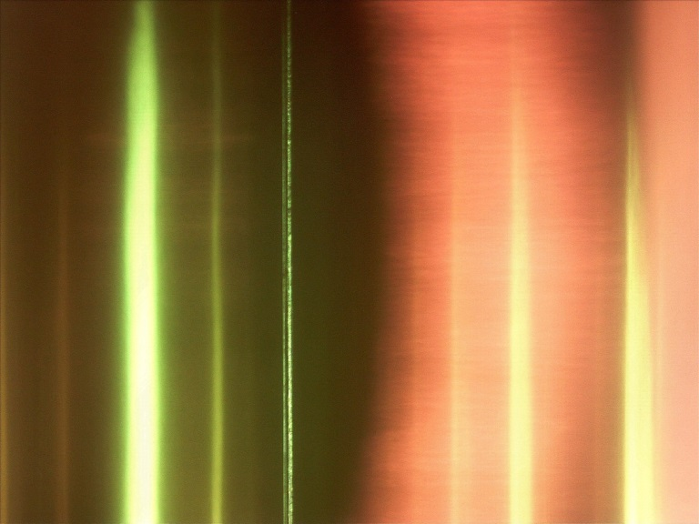
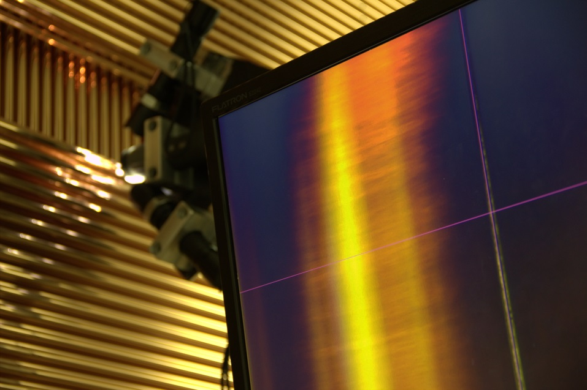
Tooling
High-intensity light source
Digital microscope
The same optical ruler
as was used for straw
position measurement
Wire image in a straw
in reflected lite
Two high-intensity
light sources

Slide 15
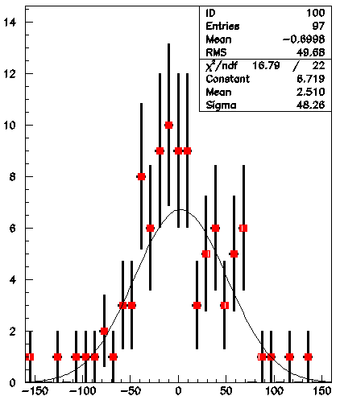
Module 8 (X-Y):
measurement of distances between wires inside straws
X-plane, layer 1:
49 wires
97 wires
33 wires
RMS for wire positions – 40 ÷ 50 μm

Slide 16
Module 8 (X-Y)
measurement at CERN
Y-plane, layer 4:
M = 0 μm
RMS = 40 μm
39 wires

Slide 17
Thank you for attention!

