Slide 1
RICH WG
M.Lenti

Slide 4
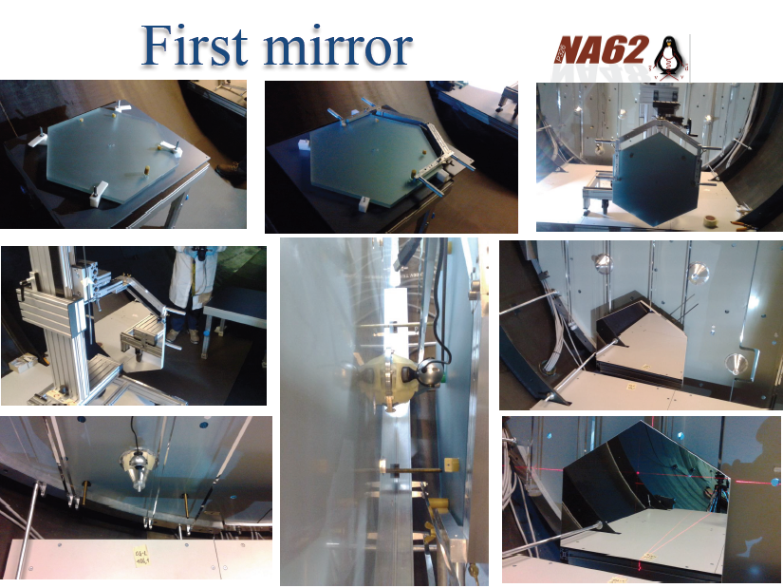

Slide 6
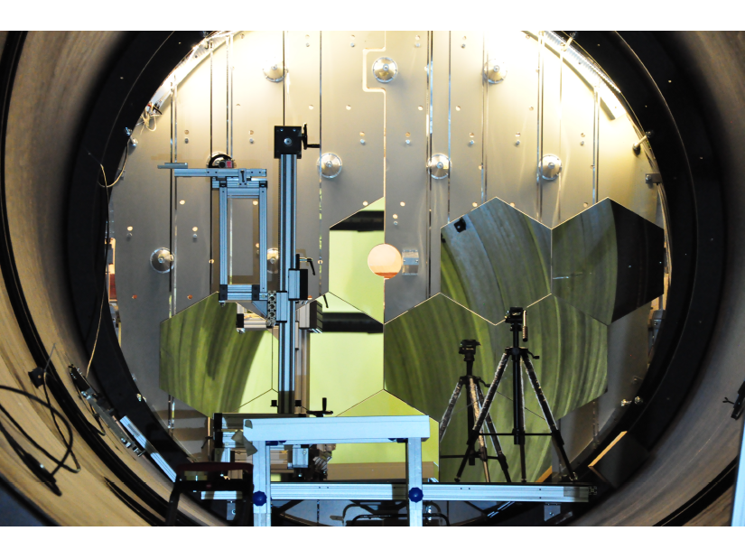
Two rows and half

Slide 7
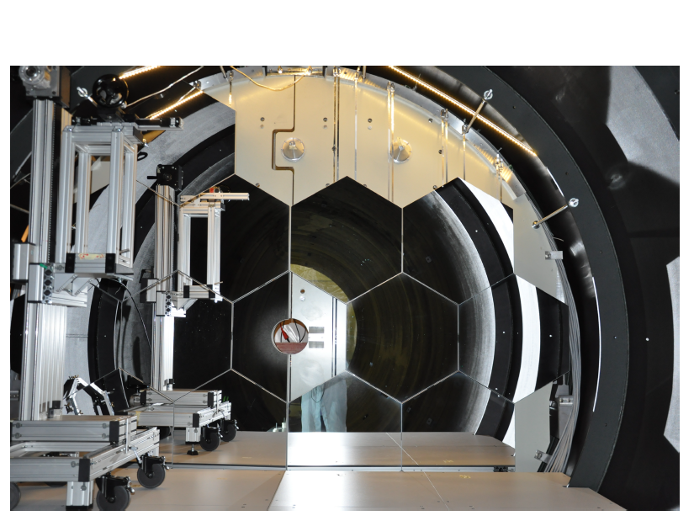
4 rows and 1 mirror

Slide 8
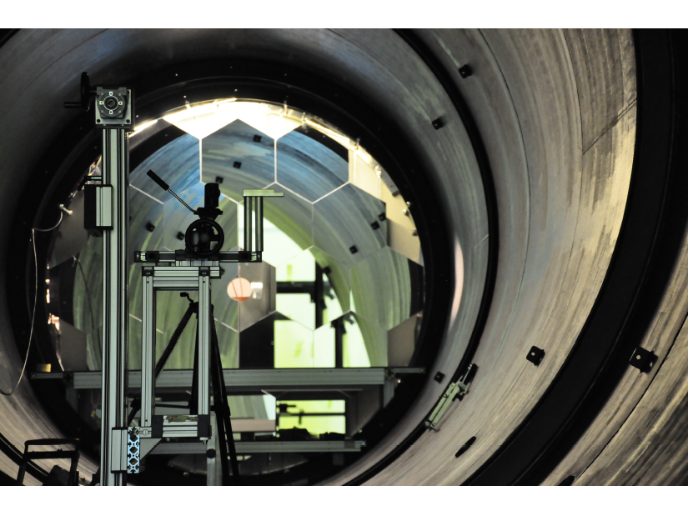
All but one semihex

Slide 9
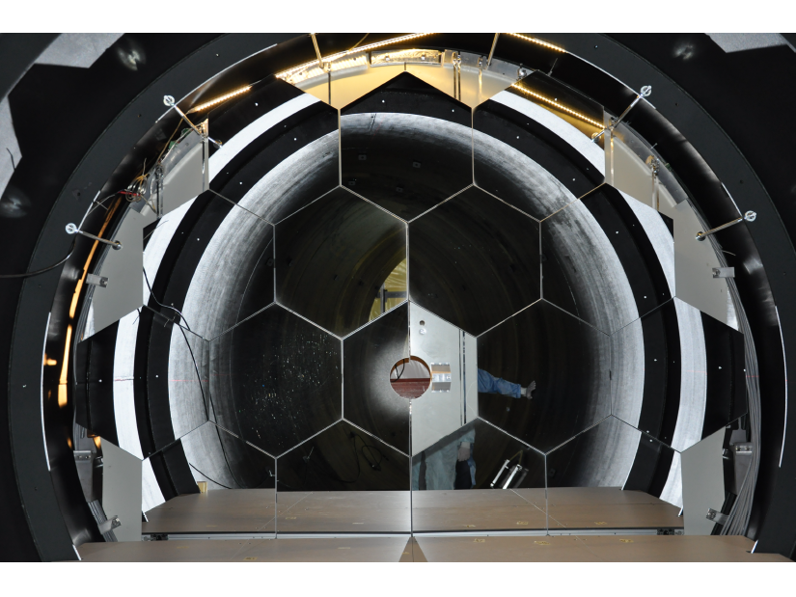
Zoom….

Slide 10
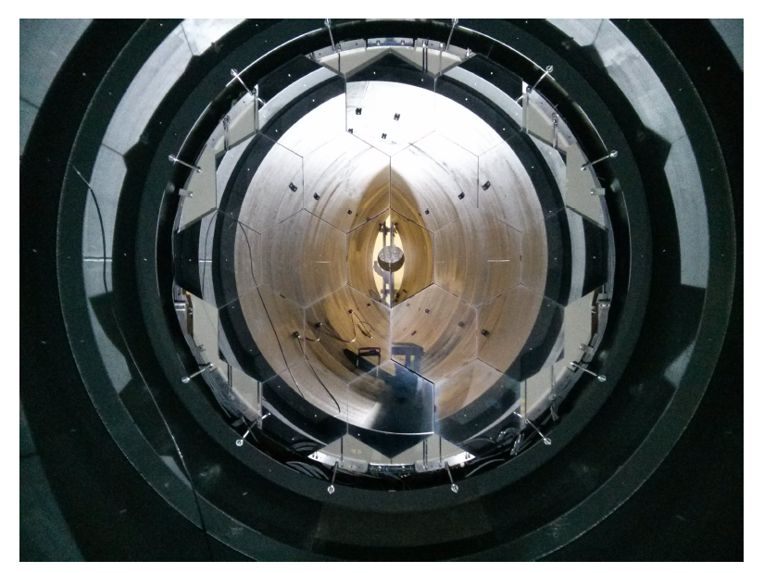
Complete!

Slide 11
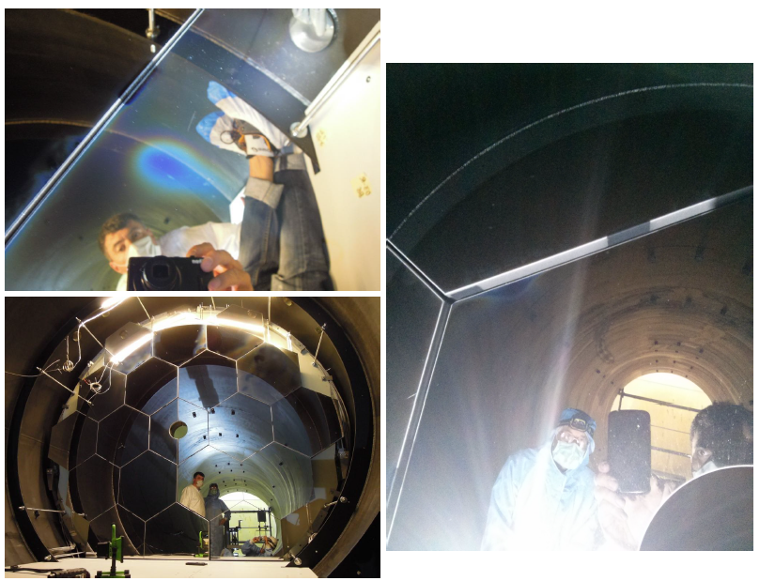
Some mirrors show “halos” when looked at
large angles. Under investigation.

Slide 13
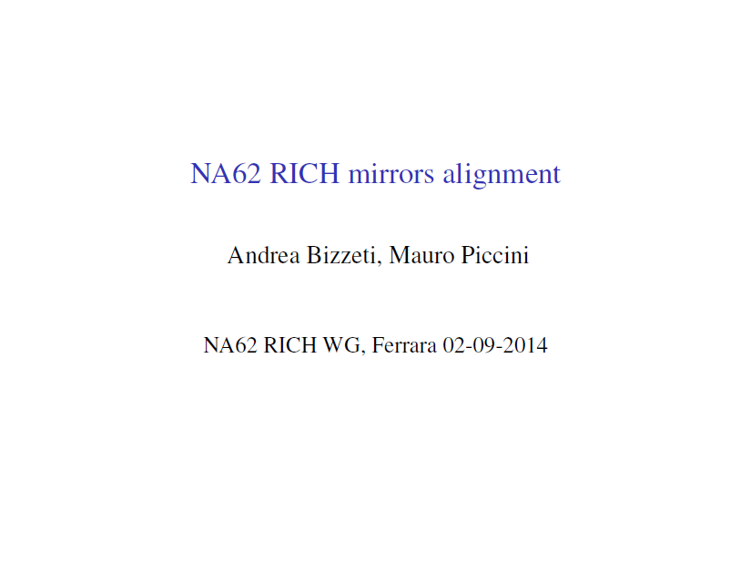

Slide 17
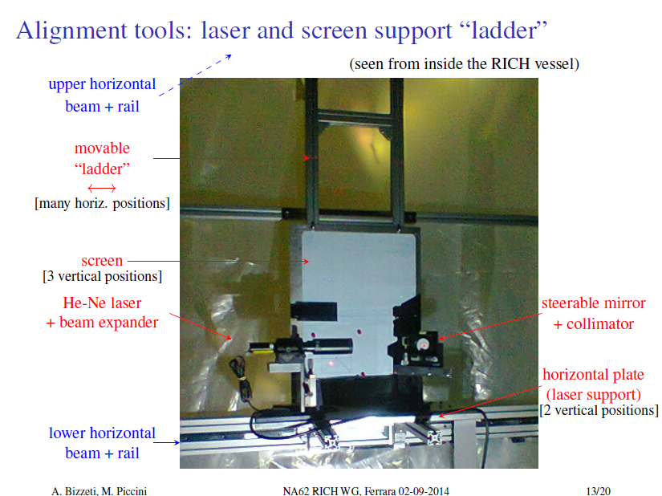

Slide 19
Now it is
OK

Slide 22
Status and INSTALLATION OF PMTs and FE
F. Bucci
INFN Florence
RICH Working Group, 02/09/2014

Slide 23
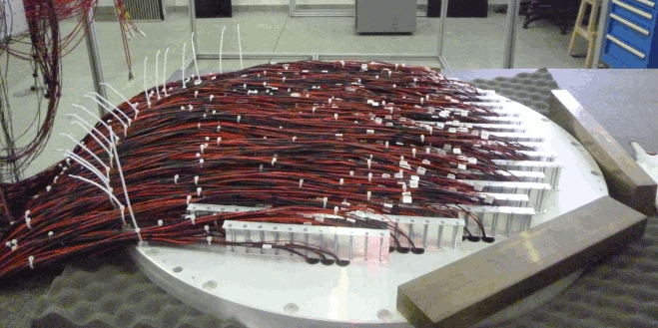
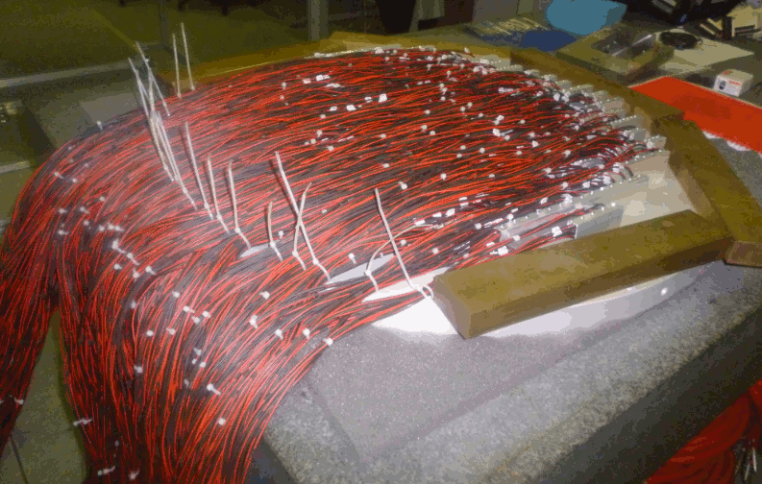
PMTS INSTALLATION
Installation of PMTs on the Jura and Saleve lodging disk completed
Looked at the signal shape and measured the rate of each PMT
Jura lodging disk
Saleve lodging disk

Slide 24
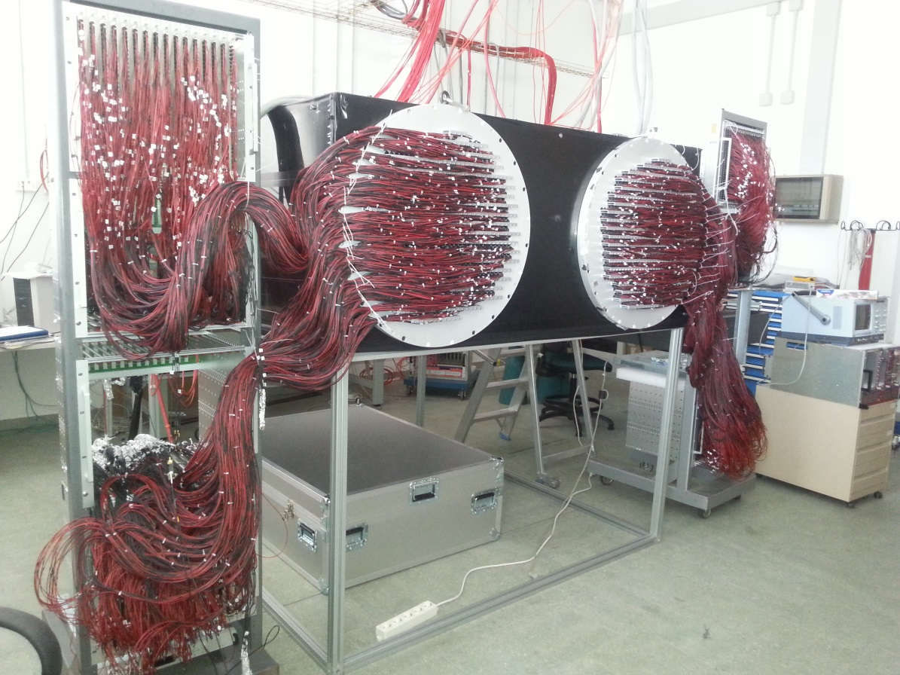
PMTS TEST
Installed the disks on a light tight box and illuminated with a laser
Plugged all the HV cables of the PMT dividers in the HV distribution boards located at the same distance as in the experimental area

Slide 25
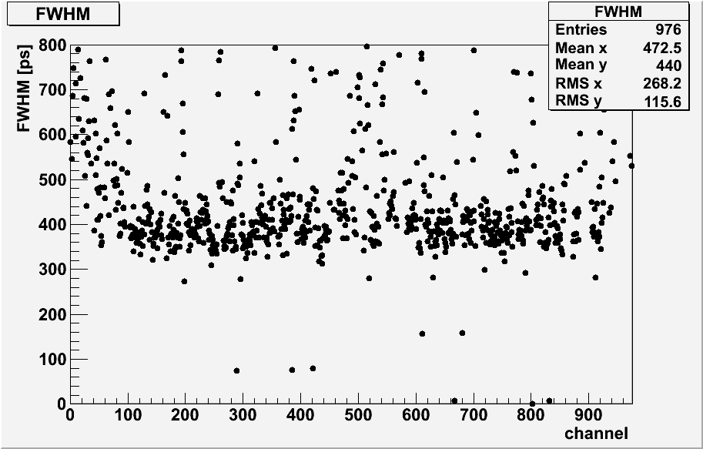
JURA PMT TEST
Data acquisition performed with 2 old FE boards (48 channels) and 1 CAEN TDC (128 channels)
before slewing correction
after slewing correction
3 dead channels

Slide 26
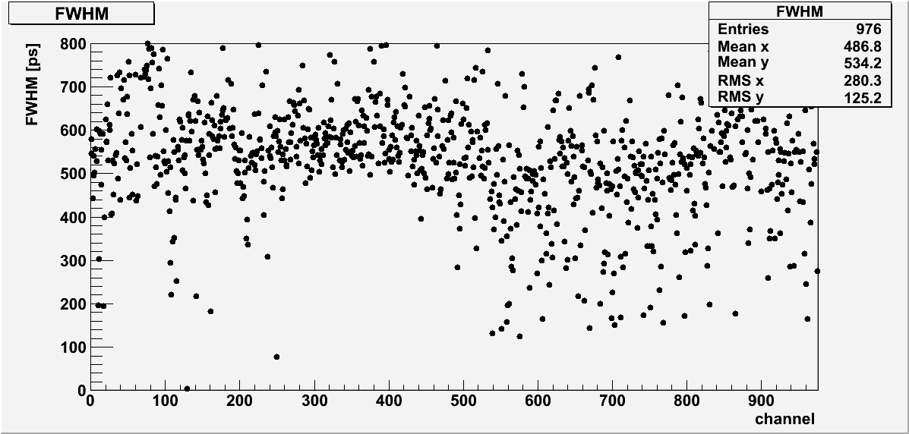
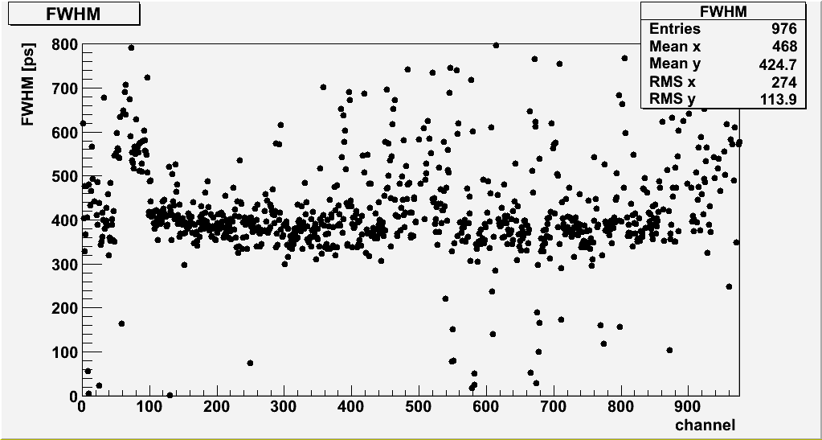
SALEVE PMT TEST
before slewing correction
after slewing correction
3 dead channels

Slide 27
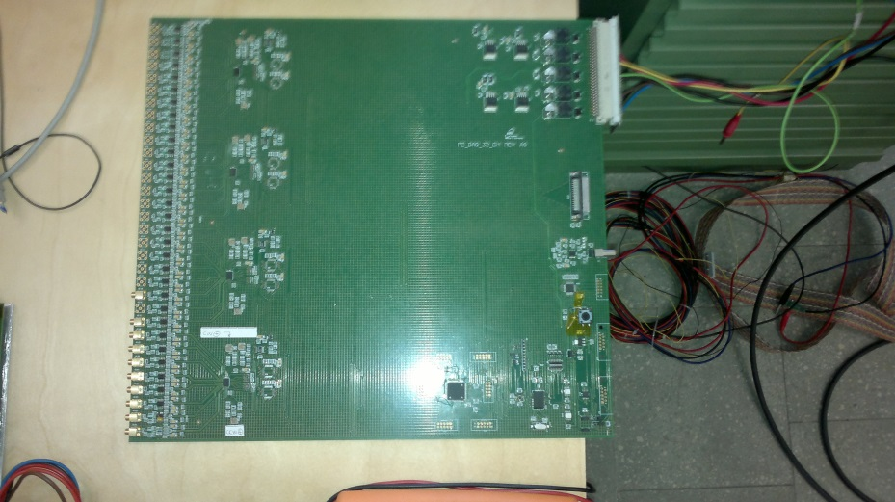
FE STATUS AND TEST
New FE board prototype is ready
Two different setup still under testing
Performances are OK
Order to be placed within the end of the week
Full production should be finished at the end of September
The arrival at CERN is foreseen at the beginning of October

Slide 28
CONCLUSIONS
The PMTs with their dividers have been installed and tested on the two lodging disks
FE boards still missing but prototype ready and under test
Full FE boards production foreseen by the end of September
All the electronics except the FE boards will be carried and installed at CERN starting from next Monday
FE boards schedule tight but still feasible

Slide 29
RICH Trigger Firmware Status
Two different firmware versions has been developed:
RICH version
GPURICH version
Most of the firmware is common between the two versions
PP FPGA
SL FPGA
CHANNELS INFO
HANDLING
CHANNELS INFO
HANDLING
RICH
HITS CLUSTERING
RICH
CLUSTERS MERGING
GPURICH
GPURICH

Slide 30
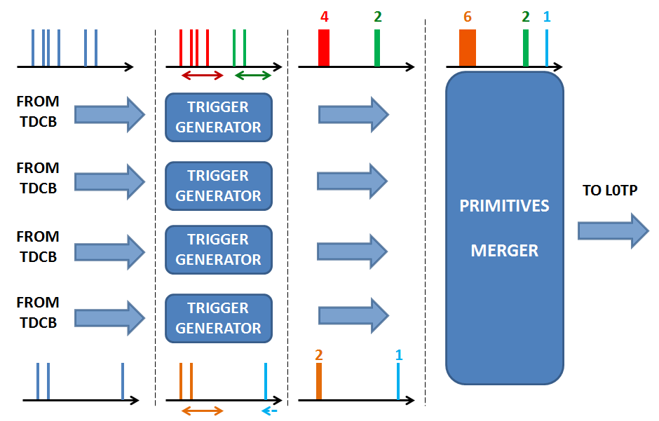
RICH Firmware
RICH version tested in June
Primitive production worked fine

Slide 31
RICH Firmware
From data to primitives:
(data from June test)
PP INPUT
PP OUTPUT / SL INPUT
SL OUTPUT
Average finetime
PRIMITIVE_DATA: 0x00000000
PRIMITIVE_DATA: 0x00010061
PRIMITIVE_DATA: 0x00000000
PRIMITIVE_DATA: 0x00000001
PRIMITIVE_DATA: 0x000200c2
PRIMITIVE_DATA: 0x00000000
PRIMITIVE_DATA: 0x00000002
PRIMITIVE_DATA: 0x00010024
PRIMITIVE_DATA: 0x00000001
PRIMITIVE_DATA: 0x00000003
PRIMITIVE_DATA: 0x00020085
PRIMITIVE_DATA: 0x00000001
PRIMITIVE_DATA: 0x00000004
PRIMITIVE_DATA: 0x0001000b
PRIMITIVE_DATA: 0x00000003
multiplicity
TDCB 0
0xA0000000
0x42d00061
0xB0000002
TRIG_IB0: 0x5c010061
TRIG_IB0: 0x00000000
timestamp – lsb 25 ns
0xA0000000
0x4368030b
0x40680185
0xB0000002
sorting
TRIG_IB1: 0x5c010085
TRIG_IB1: 0x00000001
TRIG_IB1: 0x5c01000b
TRIG_IB1: 0x00000003
TDCB 1
0xA0000000
0x42600124
0x430800c2
0x40780185
0x409800c2
0xB0000005
clustering
TRIG_IB2: 0x5c0200c2
TRIG_IB2: 0x00000000
TRIG_IB2: 0x5c010024
TRIG_IB2: 0x00000001
TRIG_IB2: 0x5c010085
TRIG_IB2: 0x00000001
cluster
merging
TDCB 2
TDCB 3
0xA0000000
0xB0000001
TRIG_IB3: - - - - - - - - - -

Slide 32
RICH Trigger Firmware Status
Firmware tested at CERN with emulated data
Primitive production is working fine (some issues to be addressed)
Some problems during the integration of the trigger firmware in the
“generic” one (talk by Roberto Piandani)
Found a working temporary solution
Final solution is under test
Rate and latency tests to be done

Slide 33
RICH Software Status
Simulation: updated to the final geometry and committed
Digitization: improved to include the SuperCell grouping (not committed yet)
Reconstruction: committed version includes multiring reconstruction and online monitoring.
Improved to include SuperCell grouping (not committed yet)

Slide 39
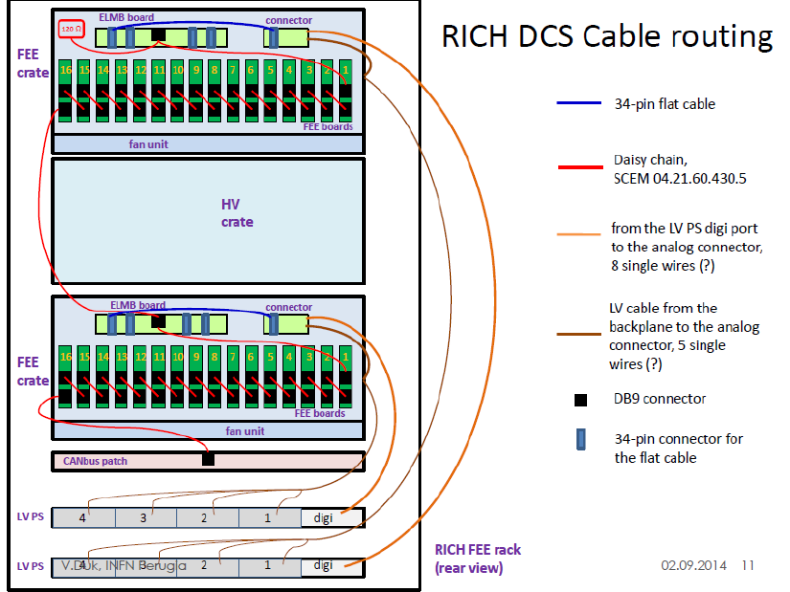

Slide 41
Conclusions of Conclusions
The RICH Mirrors have been installed and aligned
The PM will be installed starting next week with HV, LV, etc
FE electronics to be installed beginning of October
RICH software in good shape
RICH DCS quite progressing
Tough schedule but on track to be ready for the start of the run

