Slide 1
LKr status
R. Fantechi

Slide 2
Lkr components
Detector
Ok, sleeping for 2 years..
Cold since 1998
HV/LV
Readout
Preamplifiers, transceivers, CREAMs
Trigger
Calibration
Hardware, software

Slide 3
High voltage – Low voltage
HV ready to be switched on
Fix one channel of the current monitoring system which seems to be broken
Start with the standard 3000 V value
LV for preamplifier and transceiver almost ok
Need to change fuses to single transceivers and check one regulator card for transceivers
Likely no transceiver to be replaced
DCS for both subsystems ready

Slide 4
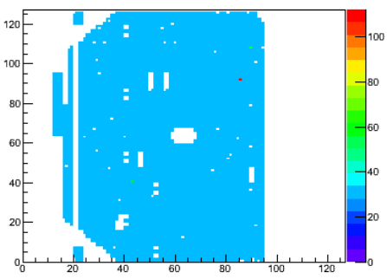
Preliminary data using only 75% of channels

Slide 5
CREAM installation

Slide 6
A fully cabled crate
Green Eth DCS cable
Black Eth data cables
Gray Eth sum cables
Red choke/error cable
Yellow TTC fiber

Slide 7
Current issues
18 CREAMs still to be delivered at CERN
Faulty modules repaired at CAEN
In some cases, need to redo the production
Additional 5 prototypes available if needed (FW not loadable via VME)
Enough modules to be able to lend some to Mainz for the MUV readout
Firmware refinements under way
Proper handling of choke/error conditions
Fix a problem with TSL handling

Slide 8
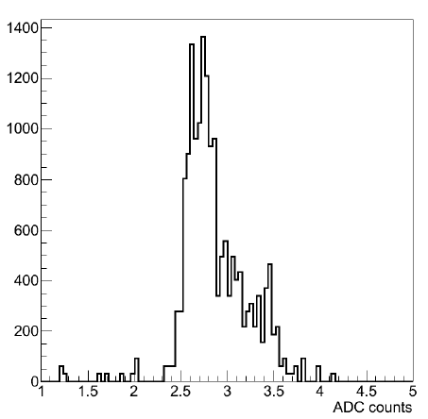
Baseline sigma distributions
Preamplifiers /transceiver off
Preamplifiers /transceiver on

Slide 9
LKr trigger infrastructure
Crates and power supplies arrived, PS to be installed
Cabling done for racks 6,7,8
Two weeks and half needed to complete the cabling
From 15/9

Slide 10
LKr trigger infrastructure

Slide 11
LKr trigger electronics
Teldes available at CERN now
To be ent back to PG for testing
Mezzanine receiver cards
2 preproduction cards assembled and tested
Mezzanine transmitter cards
2 prototype tested, 4 preproduction PCB being produced this week, 1 week needed and then to be assembled
Cables in preparation
Test bench available for TX/RX cards
Request for a LKr trigger test bench at CERN

Slide 12
Plans for the early days of the run

Slide 13
Calibration hardware
Calibration driver electronics unchanged wrt NA48
Only some cosmetics in connections
The in/out interface for the programming has been changed
From CAMAC/NIM to VME/TALK board
Patch panel for connections
VME software rewritten with C++ classes
Calibration sequence software integrated with the run control
Ready to go

Slide 14
Calibration software
Work going on by Alan and Michal
Migrate NA48 Fortran code to NA62 C++ one
Be ready for the 2014 run
Crosscheck the procedures with 2012 data
Fundamental not only to get calibration constants but also for a continuous check of the performances of the single channels
Eventually be able to prepare digital filter constants for the CREAMs

Slide 15
Strategy

Slide 16
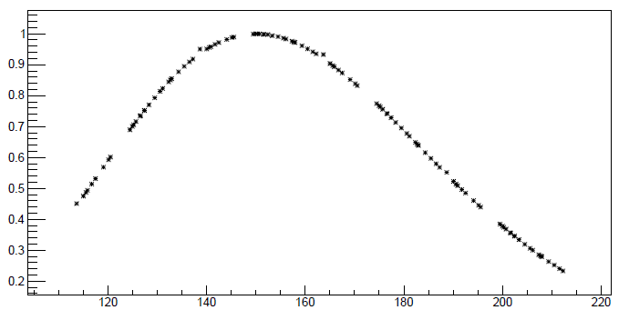
Time alignment of pulses
Double Fermi-Dirac fit

Slide 17
Current status

