Slide 1
Straw Working group
Ferrara 4/9/2014

Slide 2
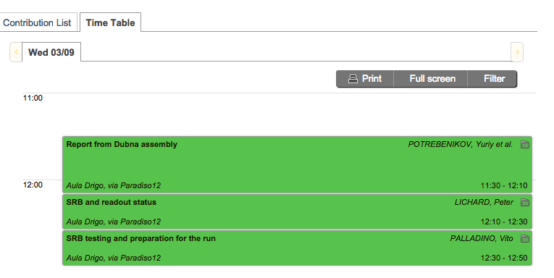
Outline
Status and Plans
Installation of Chambers 1-3
Chamber 4
Vacuum test
SRB
Readout, monitoring and software
Passports

Slide 3
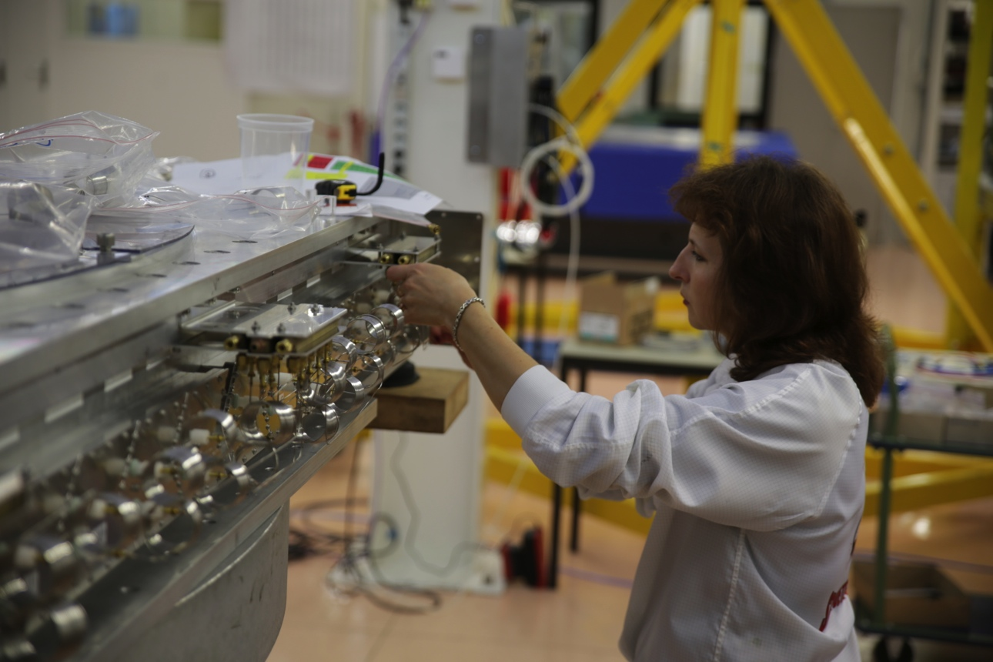
Last preparations on Chamber 4 in 154

Slide 4
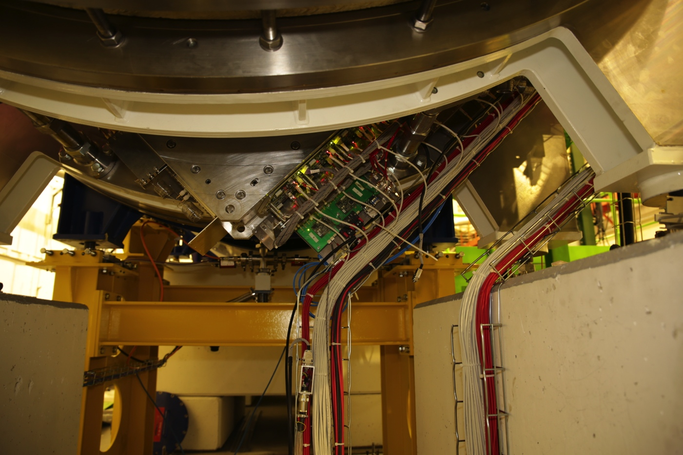
Powering up Chamber 1 in ECN3

Slide 5
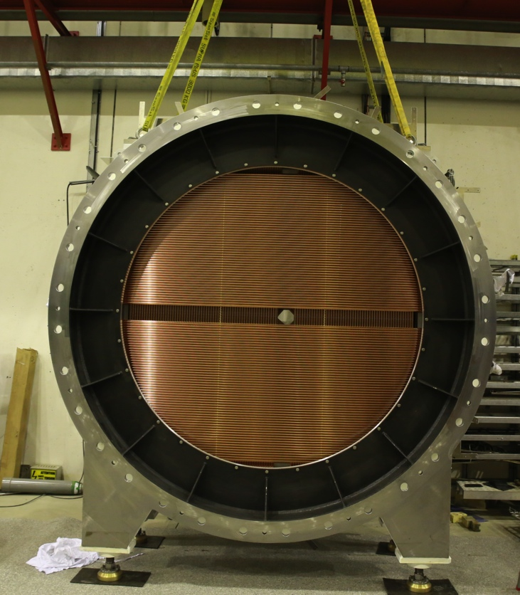
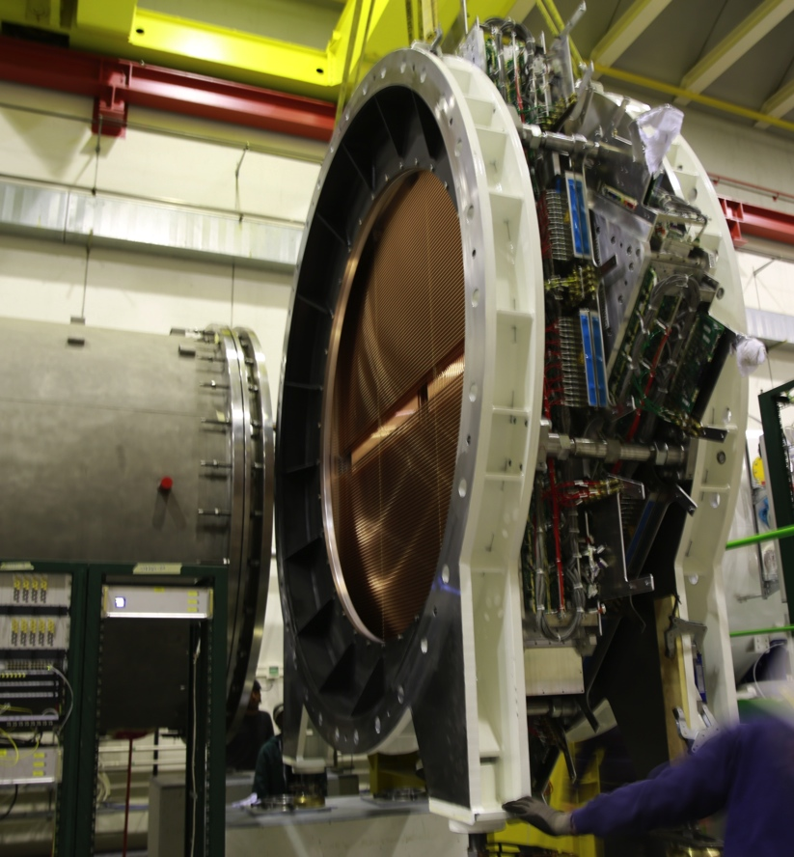
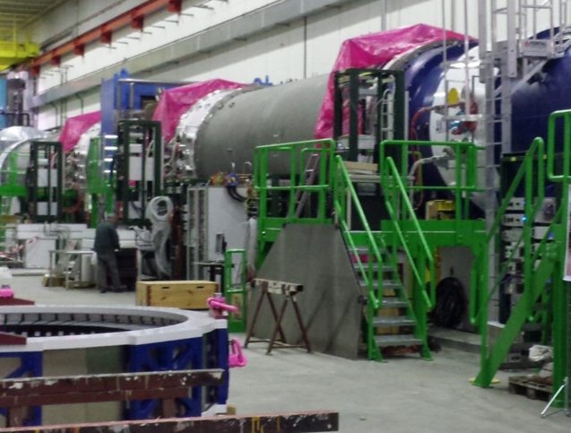
Installation of chamber 1-3

Slide 7
Summary
Number (Ch/Mod/ Coordinates) | Start of assembling | End of assembling | End of testing | Delivered to CERN | Assembling and testing time (months)
CH2 M1 U-V | 09.2012 | 04.2013 | 10.2013 | 11.2013 | 11
CH2 M2 X-Y | 07.2013 | 01.2014 | 02.2014 | 04.2014 | 8
CH4 M1 U-V | 12.2013 | 02.2014 | 03.2014 | 04.2014 | 4
CH4 M2 X-Y | 02.2014 | 05.2014 | 06.2014 | 07.2014 | 4
7

Slide 8
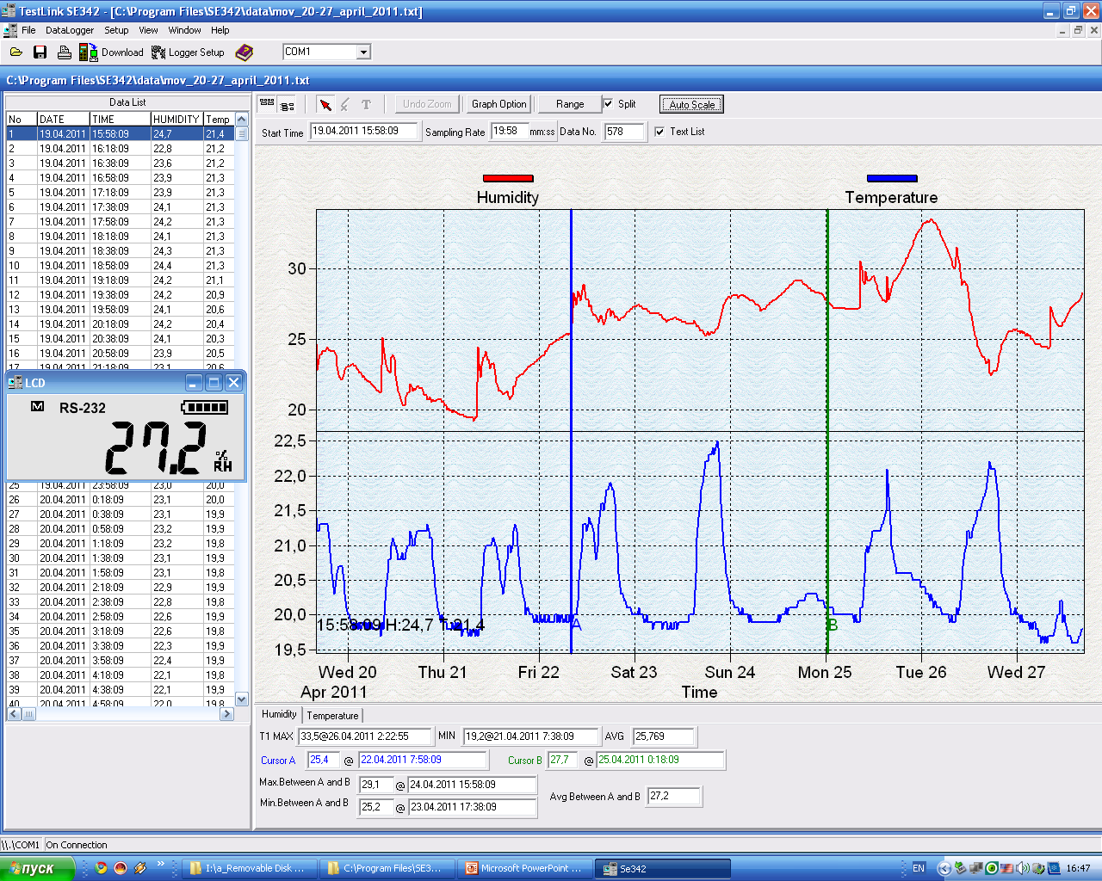
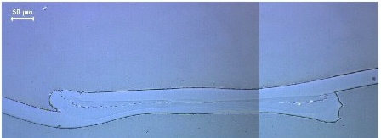
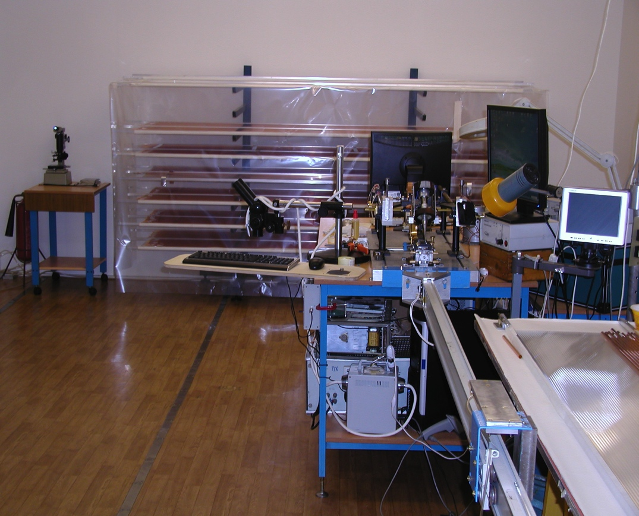
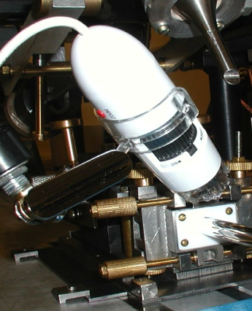
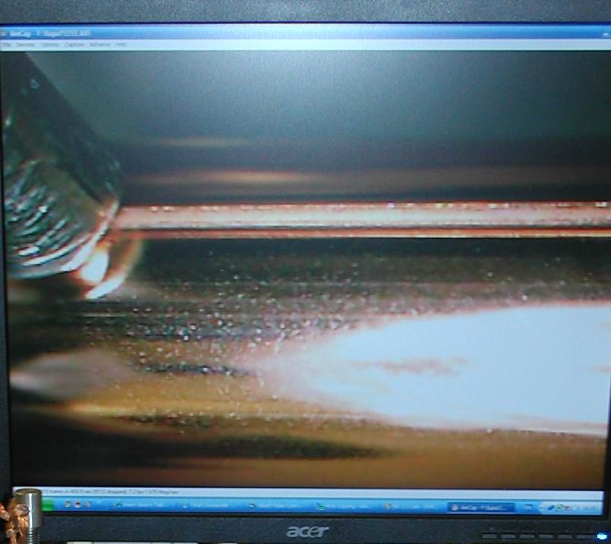
Straw production line
Microscope pictures of a straw cross- section for quality control of the weld
Humidity and temperature
control at clean room
Common view of
the Clean room
ISO clean room standard 6
600 μm
On-line control of a weld seam by the digital microscope (zoom x20 on a PC monitor)
Unique welding machine
8

Slide 9
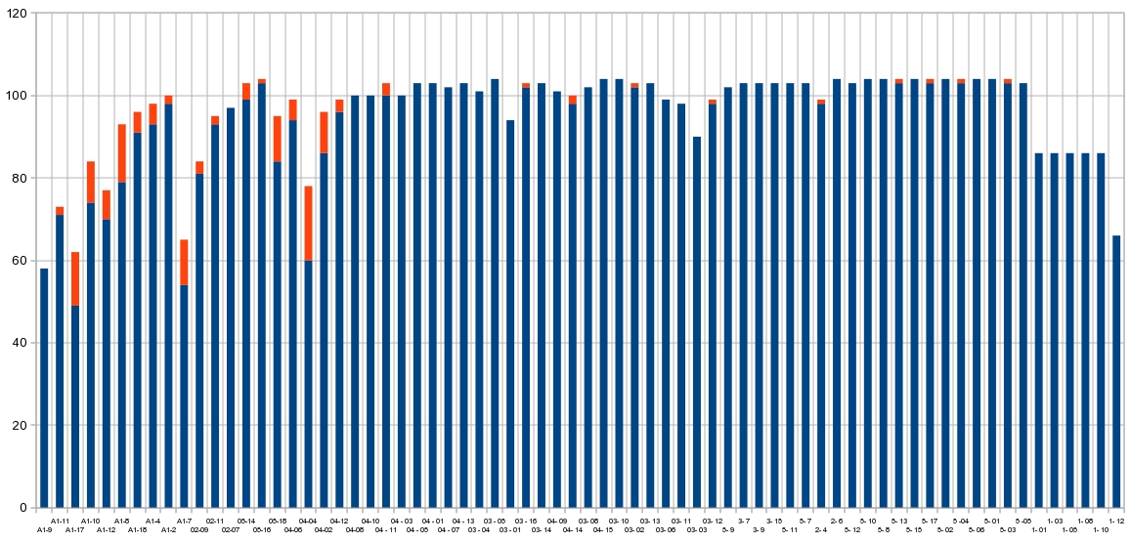
Summary of straw mass production
6740 2.7 m straws have been produced
Length of a roll: 300 m 250 m
Straw quality vs roll of Mylar tape
Parameter of the quality control Rejected straws

Slide 10
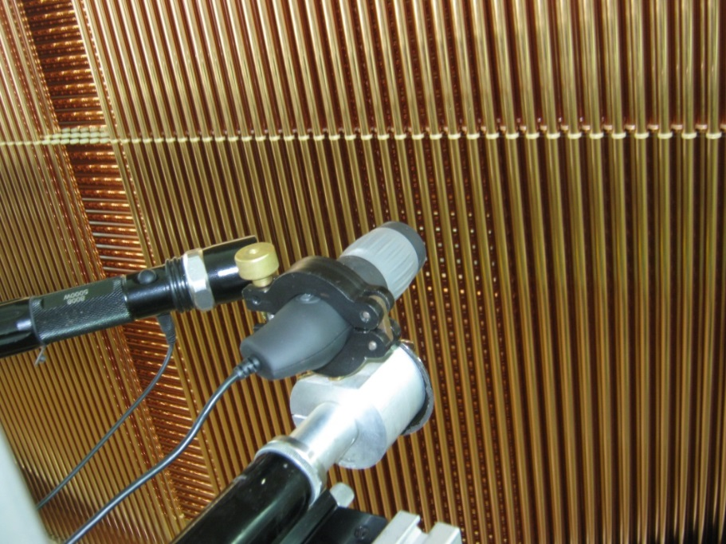
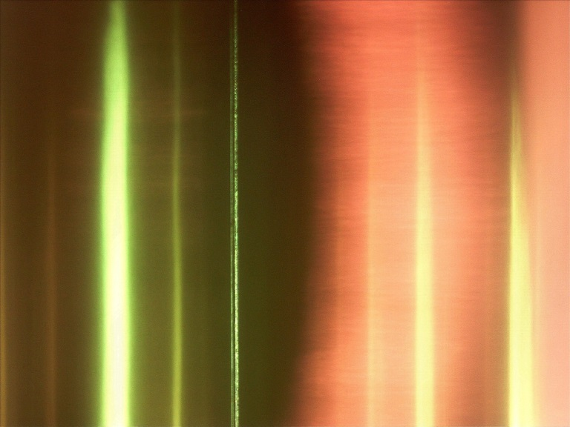
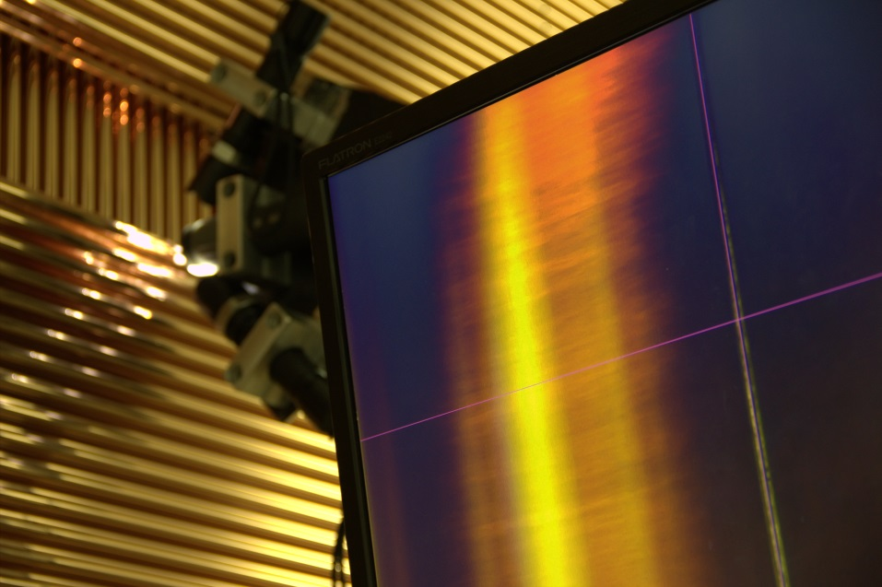
Tooling
High-intensity light source
Digital microscope
The same optical ruler
as was used for straw
position measurement
Wire image in a straw
in reflected lite
Two high-intensity
light sources

Slide 11
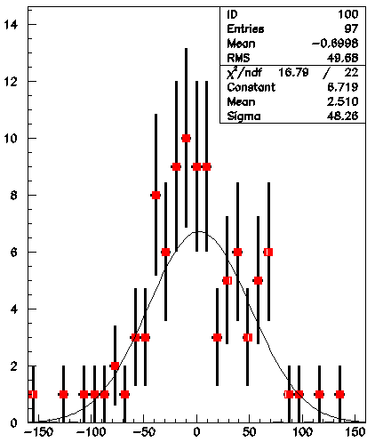
Module 8 (X-Y):
measurement of distances between wires inside straws
X-plane, layer 1:
49 wires
97 wires
33 wires
RMS for wire positions – 40 ÷ 50 μm

Slide 12
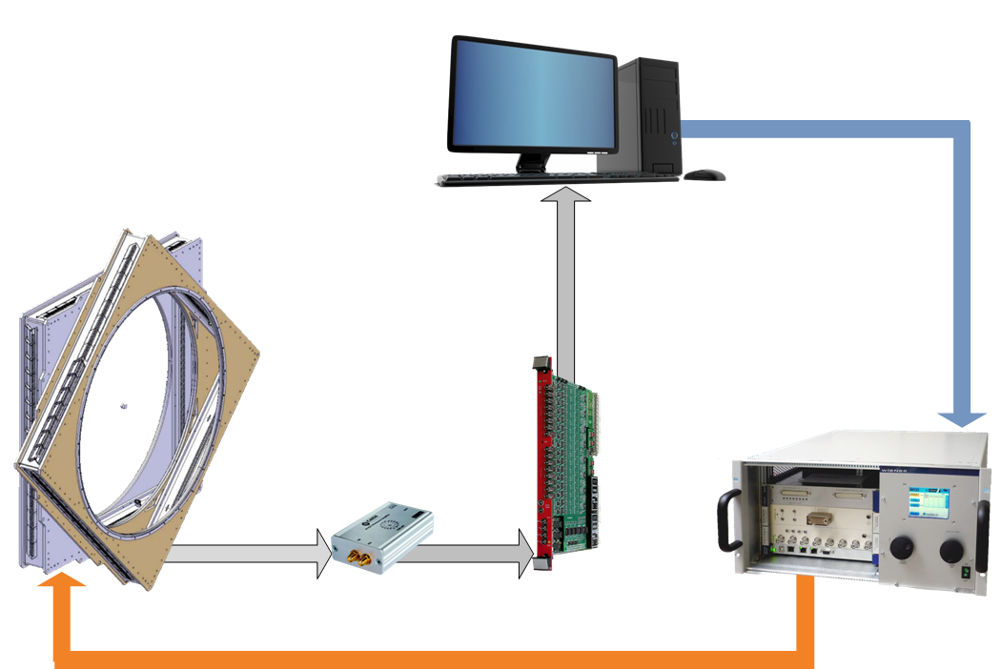
Straw gas gain monitor
PC monitoring gas gain (LabView, C++)
Straw tracker – Carioca 1-16 ch. output analog signal
feedback system
MPOD Universal Low and High Voltage Power Supply System
ADC
Amplifer
High Voltage Power Supply

Slide 13
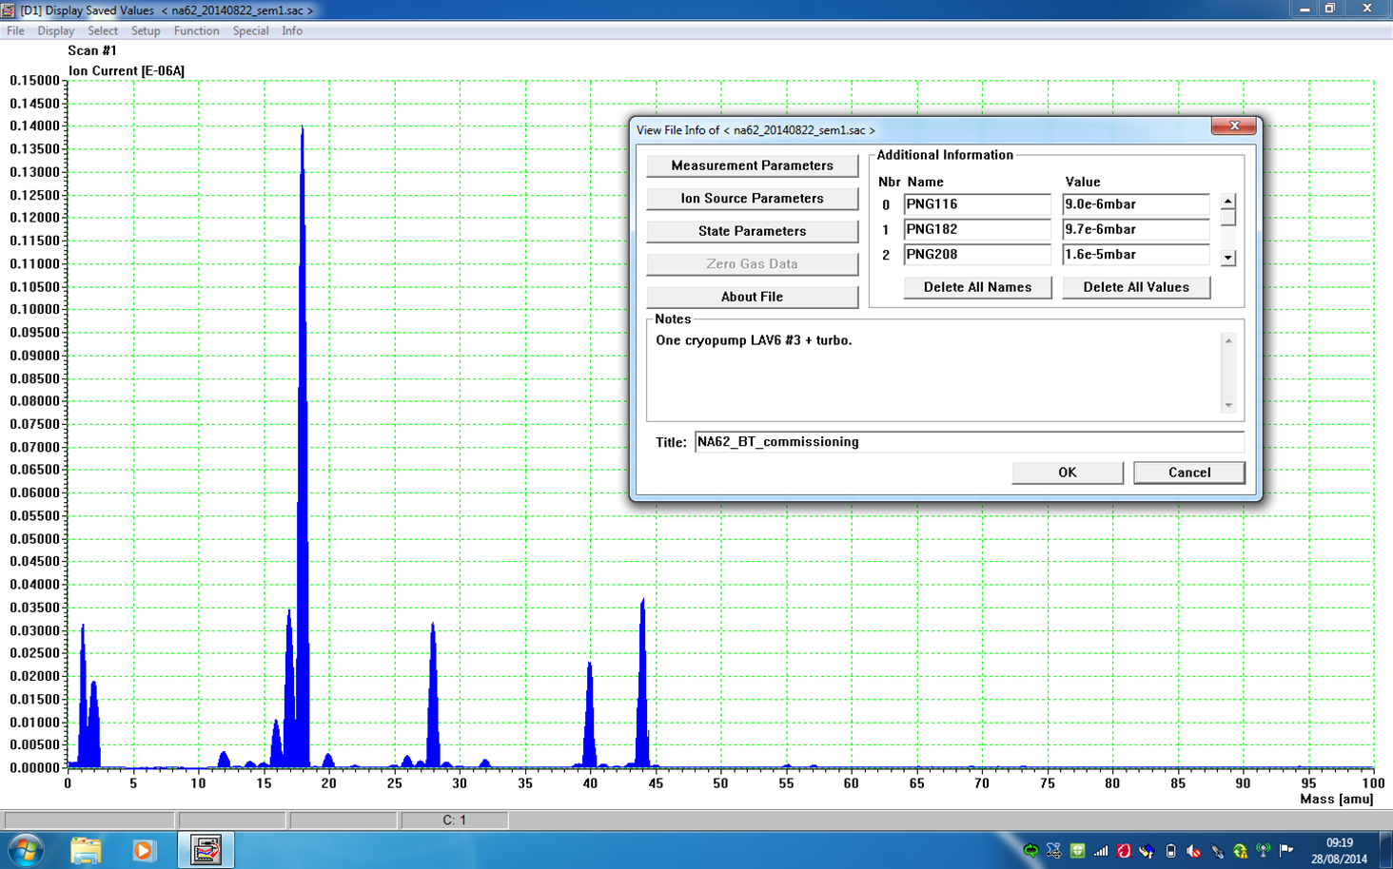
Status Vacuum System
Decay tube (Sector 5)
Berthold Jenninger
Vacuum instruments installation completed
Remote control of all instruments (apart cryopumps) ready
Pressure reached during Decay tube commissioning:
1.2E-6 mbar (decay area)
3.2 E-6 mbar (straw area)
Still water outgassing dominated.
No major leaks on system, neither on vacuum tank nore on Straw system.
5376 straws!

Slide 14
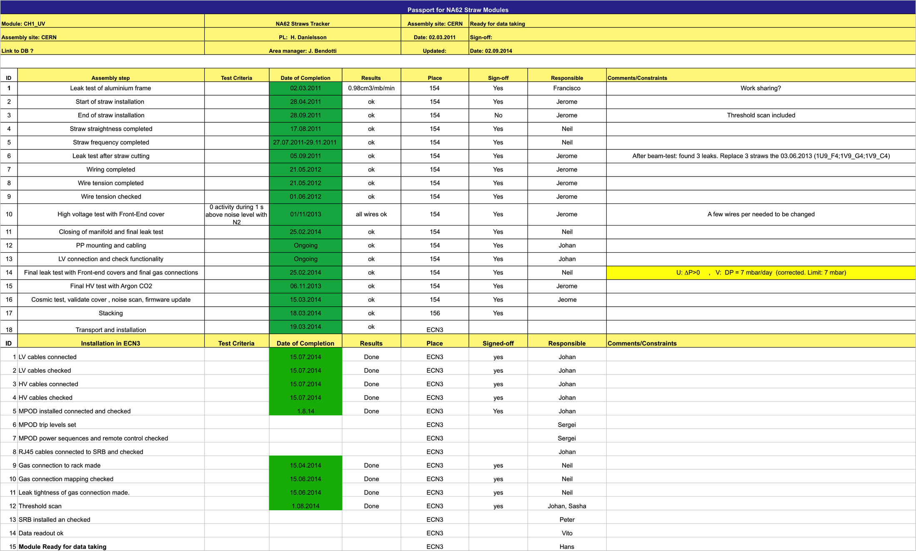
Passport (Ch1)

Slide 15
Summary and plans (Peter)
HV connectors assembly on 3 chambers is on-going
Data cables for 4-th chamber ordered
Possibly delivered end of the next week
Cable installation critical
Final installation of VME crates in racks and cable routing next week
3 MPODs should arrive next week
Installation and integration in DCS (Serguei S.)
Patch panel power supplies arrived
Johan preparing software for control and monitoring
Install them in a crate shelf
We have to re-do cover test bench and install it in 154
Small scale readout system in 154
SRB
Originally we expected all assembled boards at CERN now
50 PCBs produced in July
2 assembled at CERN
Problem with 1 type of FPGA and EPROM
We secured enough components for 24 boards
Should arrive to CERN assembled next week – assembly started
Enough for 3 chambers fully equipped
Equip 1 chamber first and do the noise scans and cosmics
The rest of FPGA should arrive to CERN after 11.9.2014 – received 2 deliveries this week
The rest of boards could be ready in 3 weeks – first/second week of October
Testing 1 week
Ready for installation ~15.10.2014
Firmware/software development continues (and probably will for a long time)
Cover readout next week
Data to pc-farm as soon as we have more boards

Slide 16
Conclusions and Plans (Vito)
The first (small) step toward SRB integration within the TDAQ system has been done,
Software will be completed within next 2/3 weeks (at least the main parts),
Run control must be tested text week
Monitoring is not in a good shape but we can have something
Next steps toward October the 6th:
Develop the firmware to send realistic (but still fake) data to PC farm,
Installation of the new SBCs is planned for the next week,
Next week is foreseen a first implementation of RUN control,
Real data in PC farm (~ mid Sept.),
Coarse time ordering (steps of 25ns) not immediately ready,
L0 matching will be next step,
On line monitoring.

Slide 17
Summary
The last chamber was completed on 1.08.2014 ! Chamber 1 , 2 and 3 are installed, but not fully cabled yet. Chamber 4 will be in installed in the coming weeks.
Chamber 1,2 & 3 (5376 straws) were part of the vacuum test with final pressure of ~ 3 x 10⁻⁶ mbar. All three chambers were connected to the gas system with final gas mixture circulating.
Between now and October 6, the work is concentrated on the SRB and the readout of the four chambers. Firmware , software run control monitoring. No major problem, but still a lot of work.

Slide 18
Spares

Slide 19
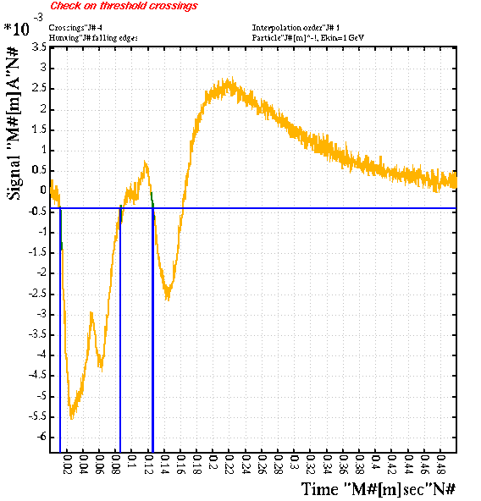
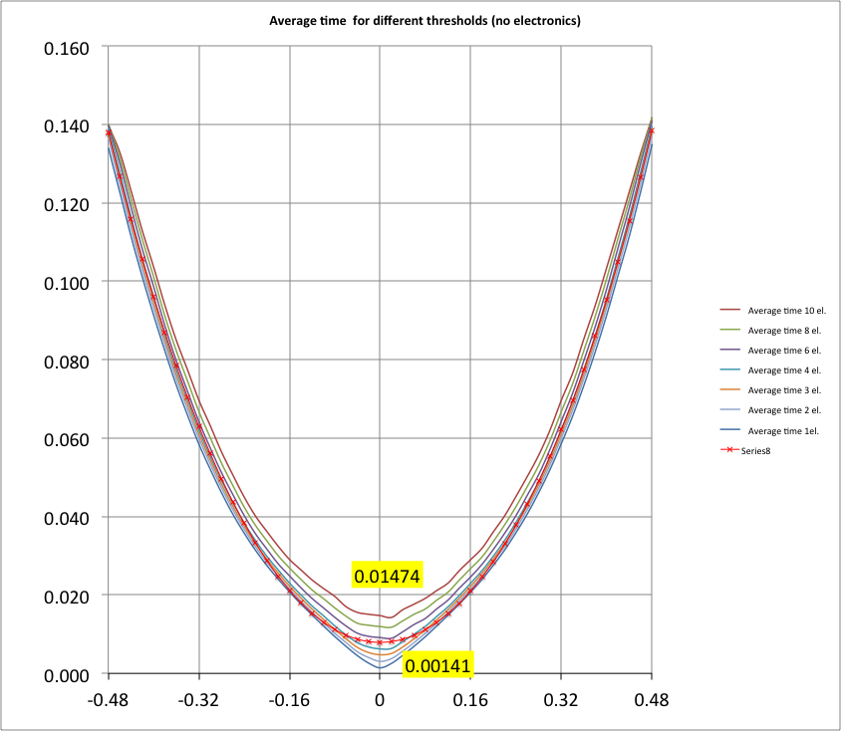
Garfield
R=-0.006cm

