Slide 1
L0 trigger simulation
Bruno Angelucci
INFN & University of Pisa
NA62 Physics WG – Ferrara 01/09/14

Slide 2
Outline
Muon halo and beam pions in accidentals generation
Why
How
Results
Study of the central event’s RICH primitive time
Final L0 trigger results

Slide 3
Halo in accidentals - why
Muon halo and beam pions missing in the former simulation presented in Physics WG on 04/06/14

Slide 4
Halo in accidentals - how
Software rev342 (NA62MC and NA62Reconstruction)
Downgrade to rev301 for the Spectrometer (with private patches) to avoid crashes (CERN Jira NARKD-21).
Private CHOD digi to compare results.
LKr cluster reco excluded to avoid crashes (not designed for too big pile up windows?)
10k πνν events + 10k of 6 K main decays + 10k of 4 muon halo components and beam pions
Accidentals superimposed to central event at generation level. Two samples with ±50 ns and ±150 ns (see J.Pinzino’s talk) windows.

Slide 5
Halo in accidentals - how
Halo files from the HALO program
99144 - muons_upstream_gtk3_pip.bin
11792 - muons_upstream_gtk3_kap.bin
21375 - muons_upstream_gtk3_pim.bin
3035 - muons_upstream_gtk3_kam.bin
526562 - pions_downstream_gtk3.bin
2 copies (same particles): central event, accidentals
sequential reading for central event
skip each time a random number for accidentals

Slide 6
Halo in accidentals - how
NEW

Slide 7
Halo accidentals - Results
Process | Rate (kHz) | L0 rate with acc (kHz)
 | 8452 | 152±11
 | 446 | 7.8±0.6
 | 674 | 35.0±1.5
 | 2748 | 165±7
 | 743 | 35.2±1.6
 | 234 | 2.8±0.3
 | 99144 | 280±50
 | 11792 | 22±5
 | 21375 | 21±7
 | 3035 | 4±2
 | 526562 | 580±170
TOTAL |  | 1300±180
Eff. signal |  | (78.0±1.1)%

Slide 8
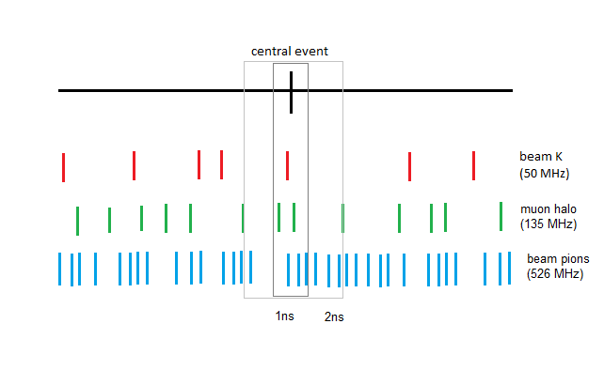
Central primitive time
How to decide if a central event passes L0?
At least one RICH primitive (and no veto) within 1ns from the central time (known from MC)
Probability that accidentals in that 1ns windows produce a L0 signal
Constant number of event to be subtracted to avoid multiple counting

Slide 9
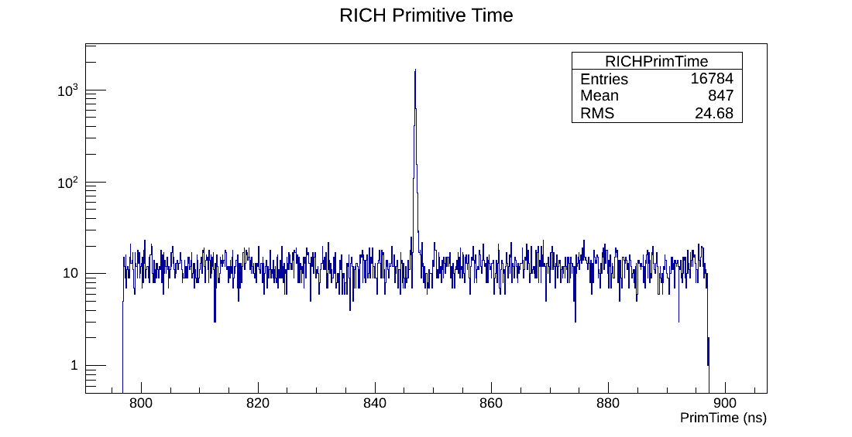
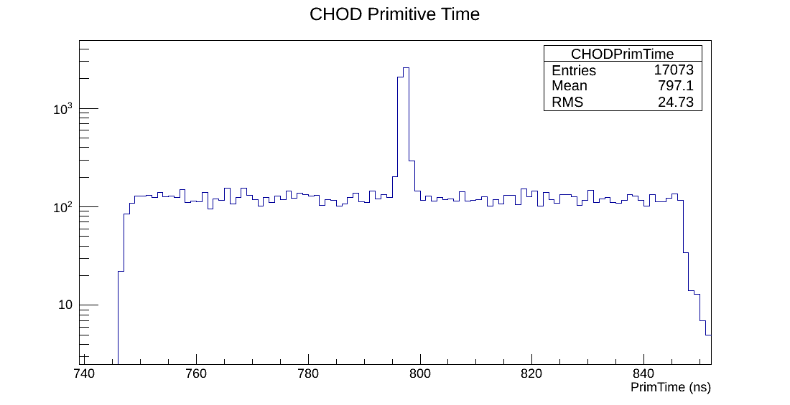
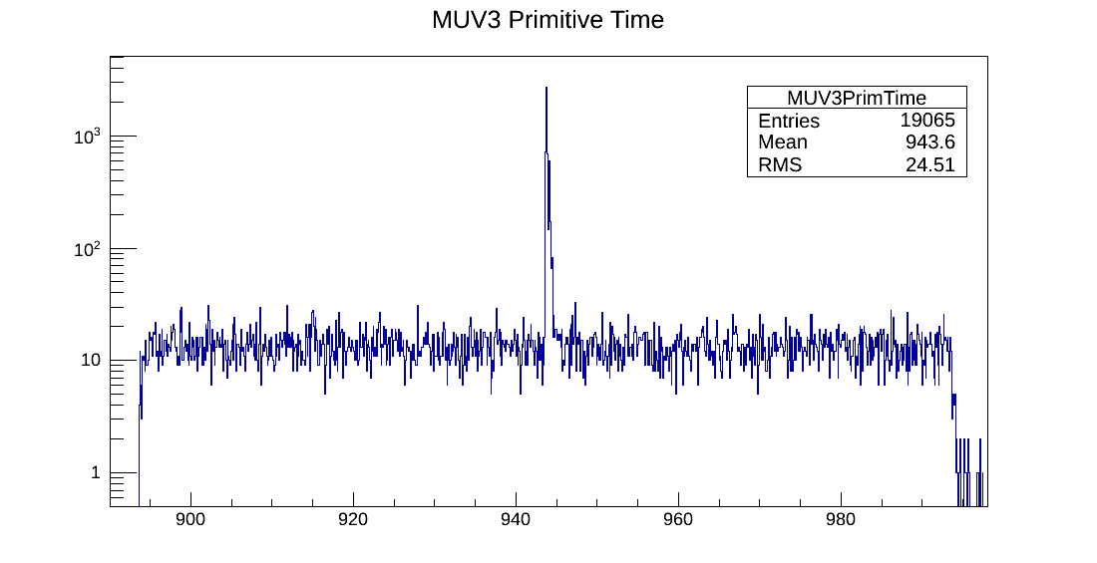
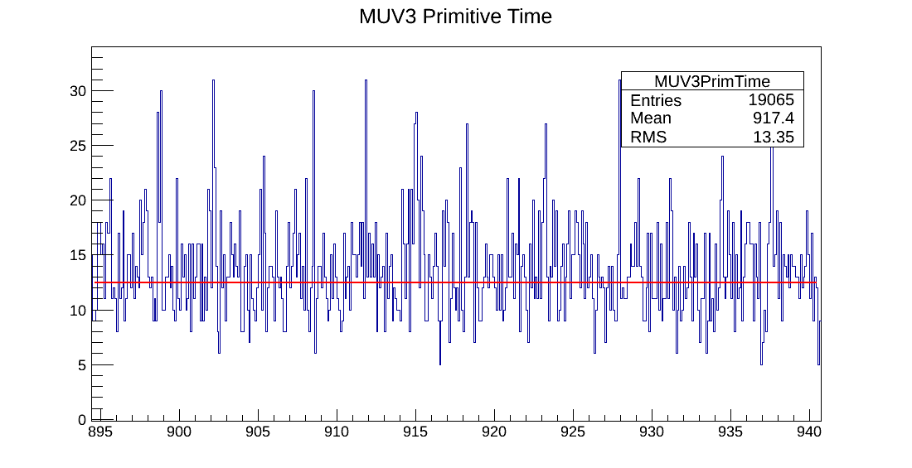
Primitive time and rates
Primitive rates
RICH 10.97±0.17
CHOD 12.25±0.17
MUV3 12.46±0.16
(MHz)

Slide 10
Varying time windows
Number of events passing L0 within the specified time window
Δt =1 ns | Δt =0.5 ns | Δt =2 ns
180 | 173 | 181
175 | 165 | 178
519 | 502 | 524
599 | 576 | 606
474 | 465 | 477
121 | 121 | 125
28 | 19 | 36
19 | 15 | 26
10 | 4 | 14
4 | 3 | 6
11 | 5 | 16
Evidence of this effect
Only 3k events

Slide 11
Only accidentals
Sample with no central event
Count non due to central event =
(7.1±0.8) evt/ns (over 10⁴ generated events)
same order of beam pions and muon halo
Primitive time win | # events passing L0 (/10⁴)
0.5 ns | 7
1 ns | 9
2 ns | 15
10 ns | 71

Slide 12
Correction
Number of events passing L0 within the specified time window after the correction for accidentals counting
Δt =1 ns | Δt =0.5 ns | Δt =2 ns
172.9 | 169.45 | 166.8
167.9 | 161.45 | 163.8
511.9 | 498.45 | 509.8
591.9 | 572.45 | 591.8
466.9 | 461.45 | 462.8
113.9 | 117.45 | 110.8
20.9 | 15.45 | 21.8
11.9 | 11.45 | 11.8
2.9 | 0.45 | 0
1.87 | 1.935 | 1.74
3.9 | 1.45 | 1.8
Only 3k events

Slide 13
Final rates
Process | Rate (kHz) | L0 rate (kHz) Δt =1 ns | L0 rate (kHz) Δt =0.5 ns | L0 rate (kHz) Δt =2 ns
 | 8452 | 146±11 | 143±11 | 141±11
 | 446 | 7.5±0.6 | 7.2±0.6 | 7.3±0.6
 | 674 | 34.5±1.5 | 33.6±1.5 | 34.3±1.5
 | 2748 | 163±7 | 157±7 | 163±7
 | 743 | 34.7±1.6 | 34.2±1.6 | 34.3±1.6
 | 234 | 2.7±0.3 | 2.7±0.3 | 2.6±0.3
 | 99144 | 210±50 | 150±40 | 220±60
 | 11792 | 4±2 | 14±5 | 14±6
 | 21375 | 6±6 | <5 | <8
 | 3035 | <2 | 2±2 | <2
 | 526562 | 200±180 | <200 | <300
TOTAL |  | 820±190 | 620±130 | 700±240
Eff. signal |  | (78.0±1.1)% | (76.3±1.1)% | (78.5±1.1)%

Slide 14
Conclusions
Muon halo and beam pions added in the simulation of accidentals at generation
Few statistic for halo highlighted the necessity to consider the time window to search for the primitive
Final rates expected for this L0 configuration
uncertainty on halo rate needs more events to be simulated
rate of ~700kHz compatible with the estimated count non due to central event (7.1)
A note will be published next week

