Slide 1
Update on Power Supplies and GTK carrier GTK_WGM_Ferrara M.Morel 02.09.2014

Slide 2
Power Supplies
Cables & fibers
GTK_carriers
Summary

Slide 3
Power Supplies
Cables & fibers
GTK_carrier
Summary

Slide 4
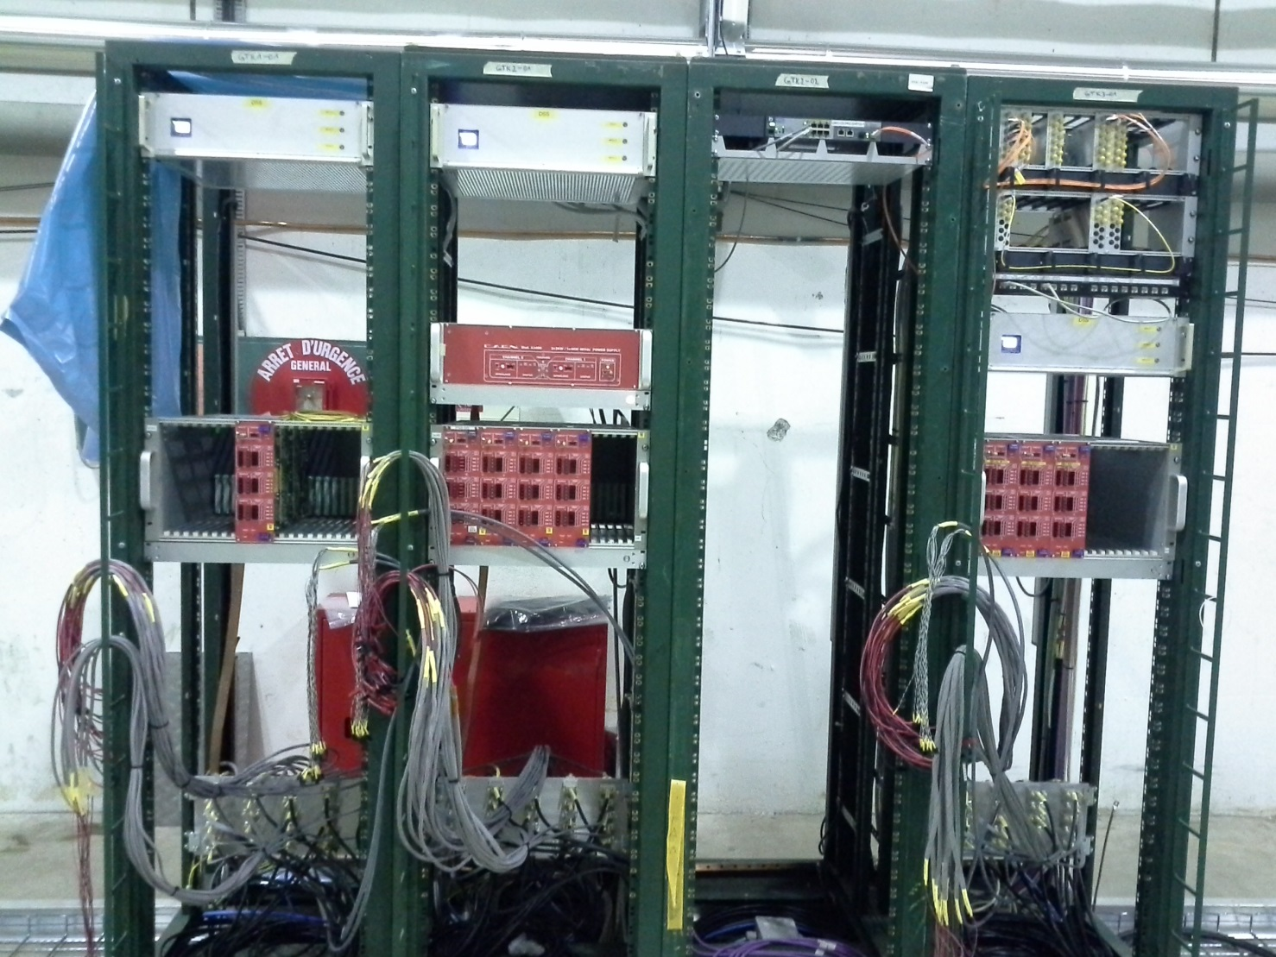
Racks GTK1-01, GTK2-01, GTK3-01 in TCC8

Slide 5
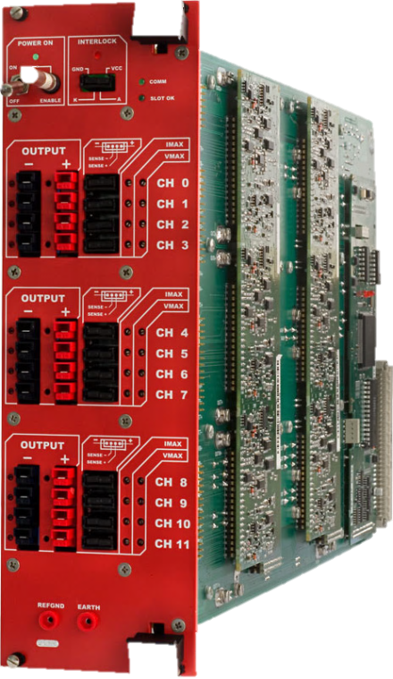
Low Voltage A3009 and A3009K modules
1 x 2V5 Dig
1 x 3V3 Dig
1 x 5V Dig
1V2 Dig
x 10 ch
1V2 A
X 10 ch
3 x 5V3 Dig
1 x A3009
2 x A3009K + 1 x A3009
Common to the 3 stations.
Sitting in rack GTK2-01
Supplies the Temp logic
(VDD_temp and 3V3_NI)
3 modules in each EASY crate
Interlocked with Temperature
(OR of cooling and TDCpix)

Slide 6
What is installed in TCC8 and Bat 918?
- 3 x EASY CRATES 3000
3 x 3009K 2 x Analog and 1 x Digital 1V2
3 x 3009 2V5, 3V3, 5V
1 x 3009 5V3 non interlocked*
1 A3486 48V power supply
4 Fan units (under each EASY crate and A3486)
1 mainframe SY2527
1 branch controller A1676A
1 HV module A1821P Pos HV
1 HV module A1821HN Neg HV
TCC8
Bat918
What is missing?
3 x 3009K 2 x Analog and 1 x Digital 1V2
2 new modules: delivery time expected for September
1 broken module ( gave OVC on 48V): sent to CAEN for reparation.

Slide 7
Power Supplies
Cables & Fibers
GTK_carriers
4 Summary

Slide 8
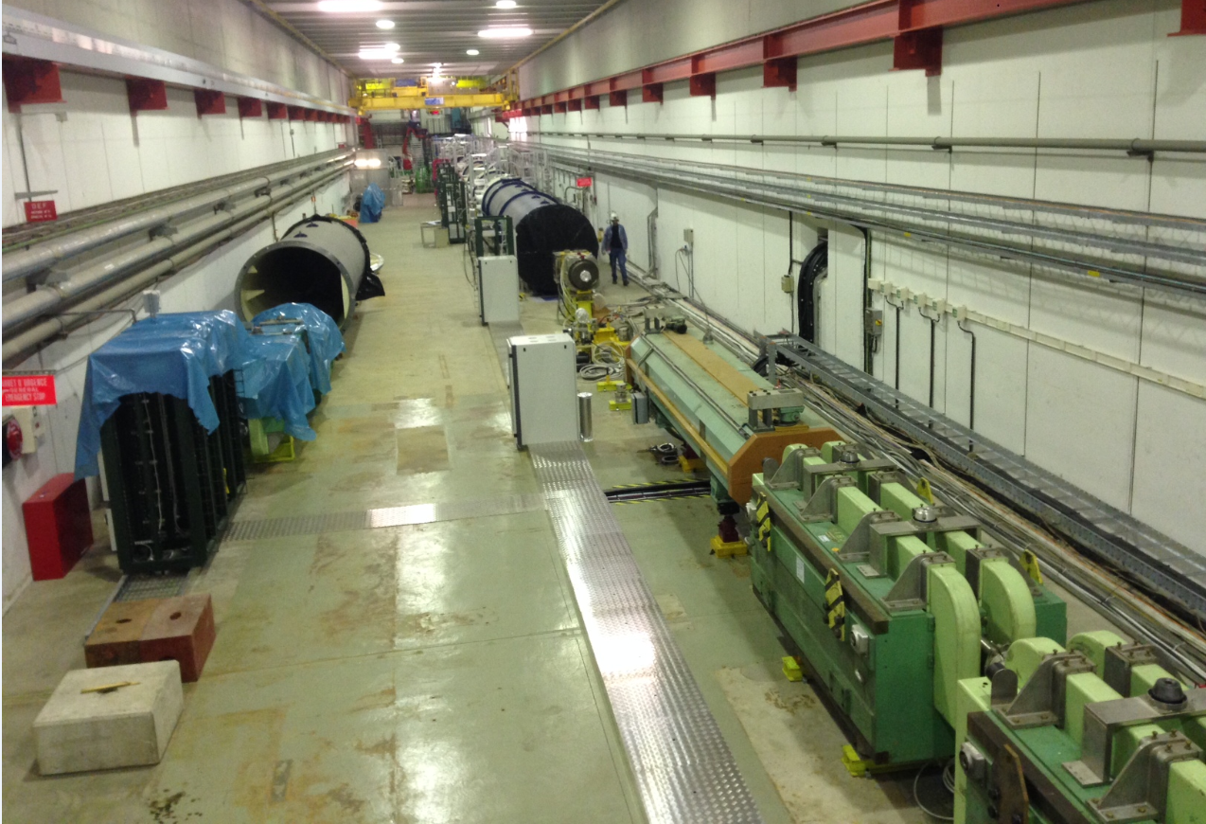
TCC8

Slide 9
Electrical cables routing scheme
Patch
Panel1
GTK
Station 1
4m
Electronic
Rack 1
Patch
Panel2
18m
Electronic
Rack 2
GTK
Station 2
9m
4m
20m
Each Patch Panel:
10 x 1.2V Digital
10 x 1.2V Analog
1 x 3.3V Dig
1 x 2.5V Dig
1 x 5V Dig
10 x Analog senses
16 x digital senses
1 x 5.3V dig (NON interlocked)
1 x Bias (~500 to 1000V)
1 x 10 temperature interlocks
Electronic
Rack 3
Patch
Panel3
GTK
Station 3
4m

Slide 10
What is done?
All the cables have been installed between the racks GTK1 to GTK3
and the mini racks PP_GTK1 to PP_GTK3.
Electrical patch panels (6 in total) are installed
The cables between the mini racks and the GTK_carriers are ready.
What is missing?
Tests of the connections between the racks with specific loads,
They will be performed on the second week of September
Cabling the optical fibers breakouts between the mini racks
and the GTK_carriers.
Will be done after Angelo Gonzales Puertas’s intervention in order to move
the optical patch panels inside the mini racks (3rd week of September)

Slide 11
Power Supplies
Cables & Fibers
GTK_carriers
Summary

Slide 12
ELTOS has delivered 2 cards of the second batch in beginning August
just before the summer closer.
The boards have not been completed (missing solder masks and silkscreens)
Board1 has several short circuits in the window area
+ one open line on the Top layer.
Board2 has the same short circuits + two opens in the inner layers.
Despite these errors we decided to add the solder mask (thanks to Rui’s Lab),
to mount the SMD components and to integrate the two assemblies equipped with TDCpix
with a thickness of 450um.
The two GTK_carriers have been powered without the assembly and some signals
have been successfully tested.
The totality of the board will be validate after the wire bonding of the TDCpix.
One of the board is actually in the DSF (gluing of the flange).
A third batch of 5 GTK_carriers is foreseen to be delivered in mid September.
We founded another company able to produce the GTK_carrier boards.
This company SOMACIS http://www.somacis.com/ is specialize in the fabrication
of complex PCBs. Beginning of August we asked them to launch a production of 5 boards
They need 25 working days to complete the production.

Slide 13
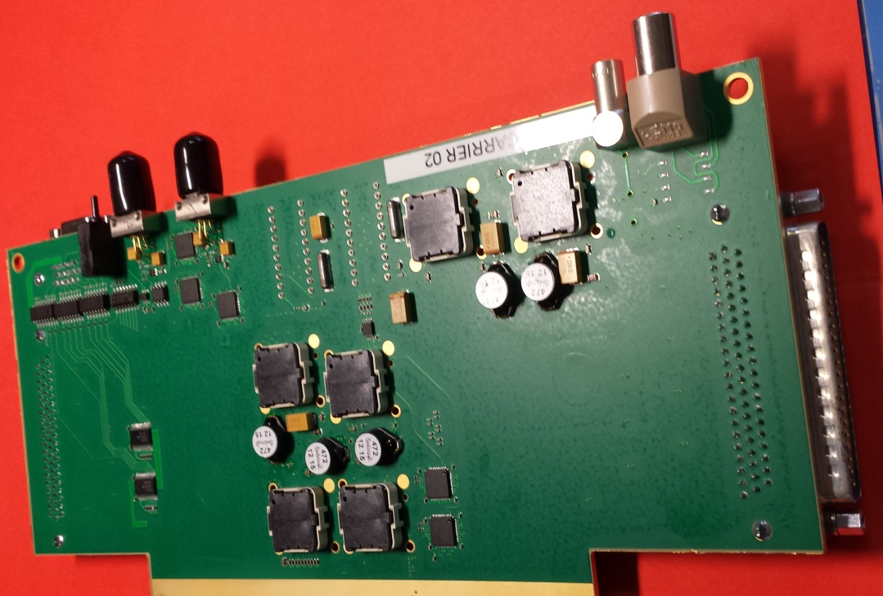
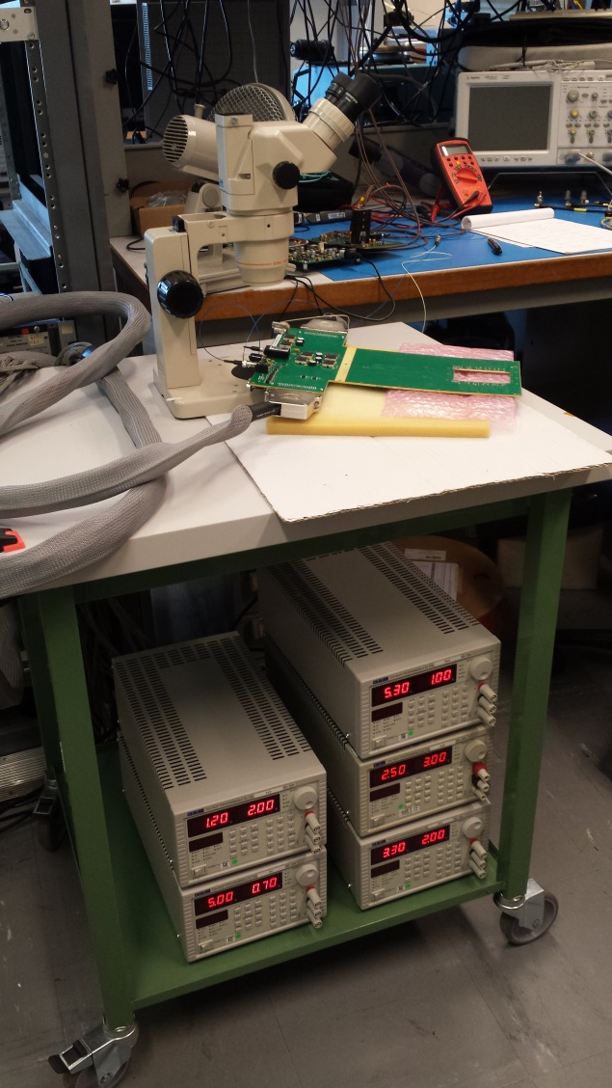
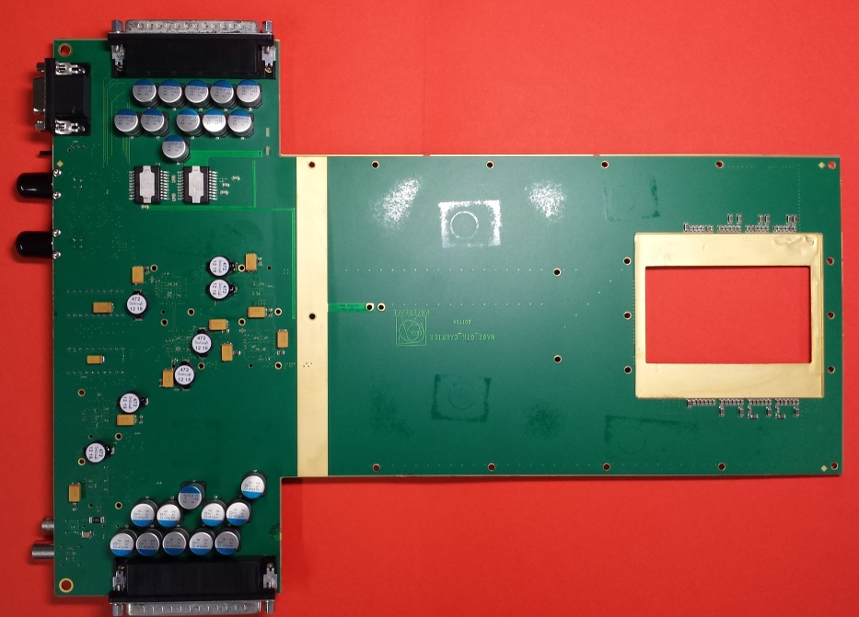
GTK_carrier Top side
GTK_carrier Test setup
GTK_carrier Bottom side

Slide 14
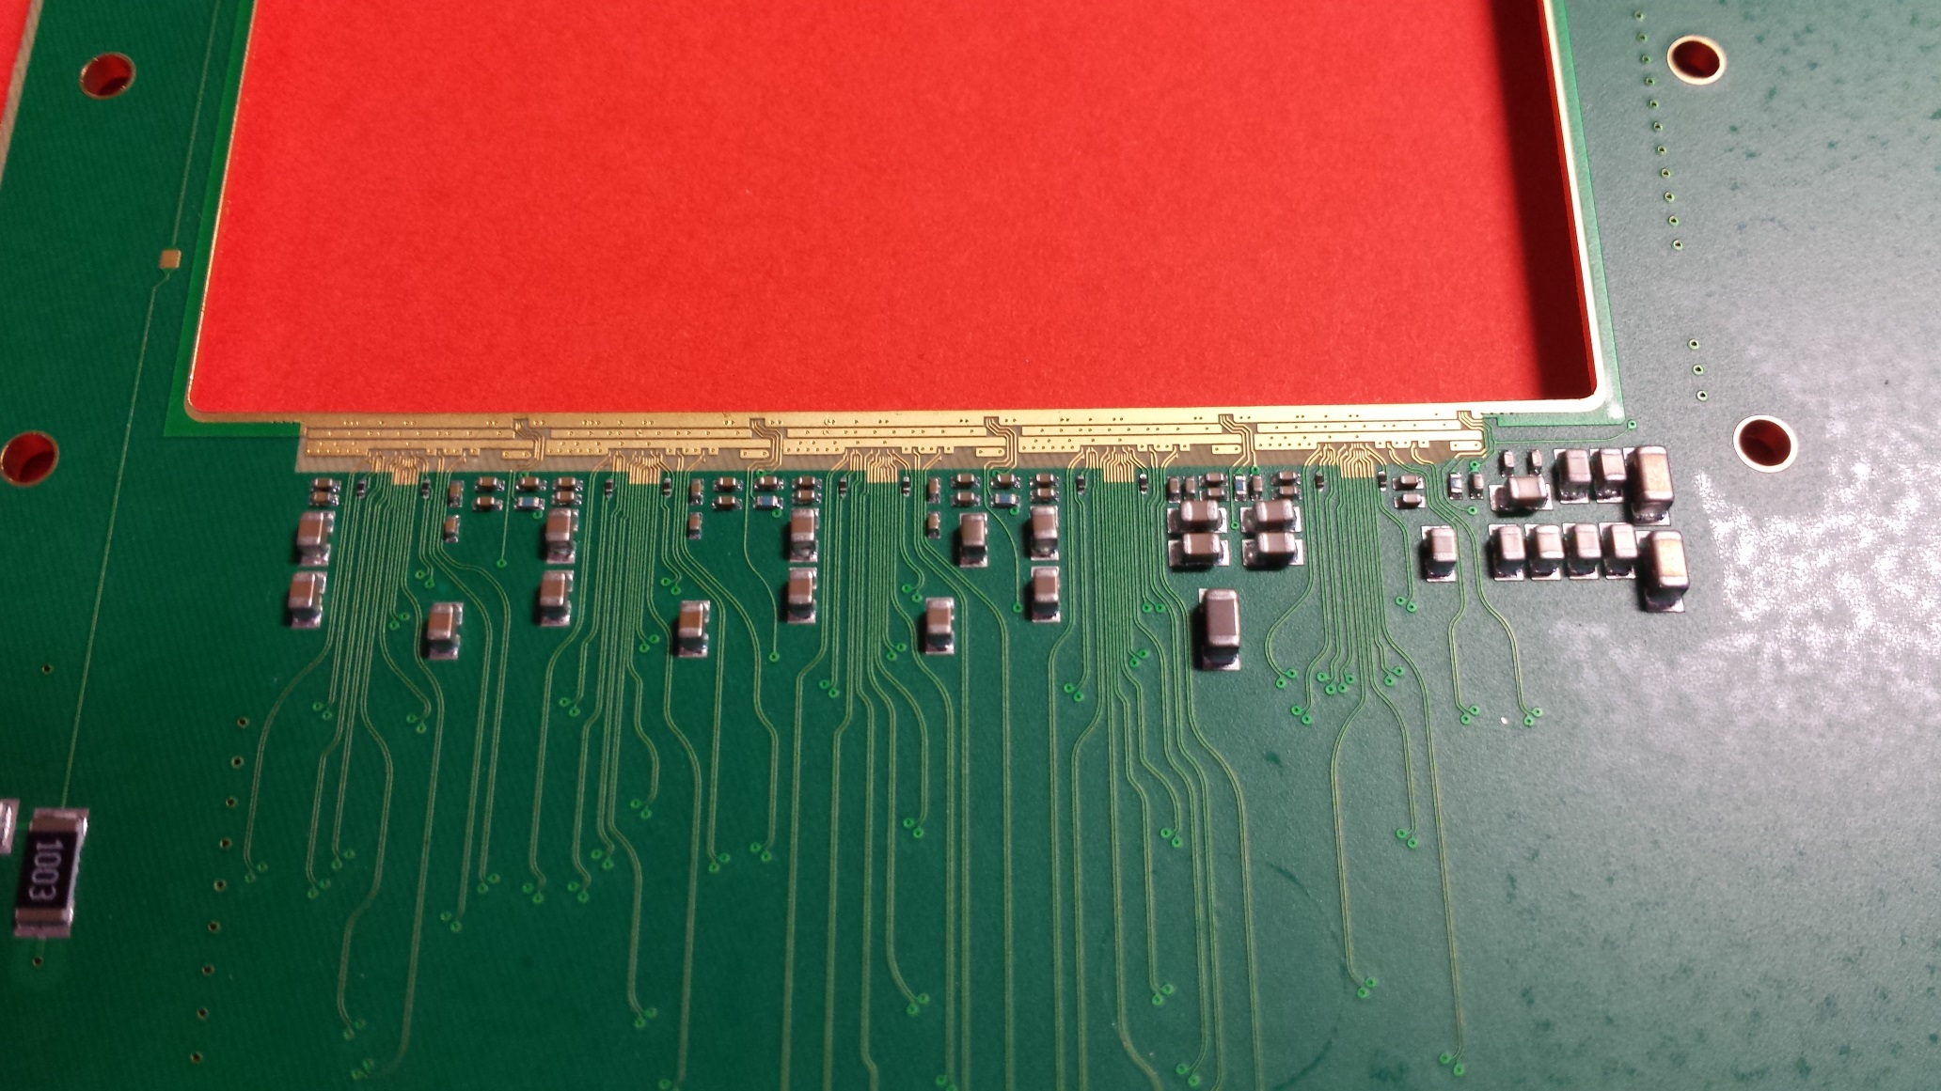

Slide 15
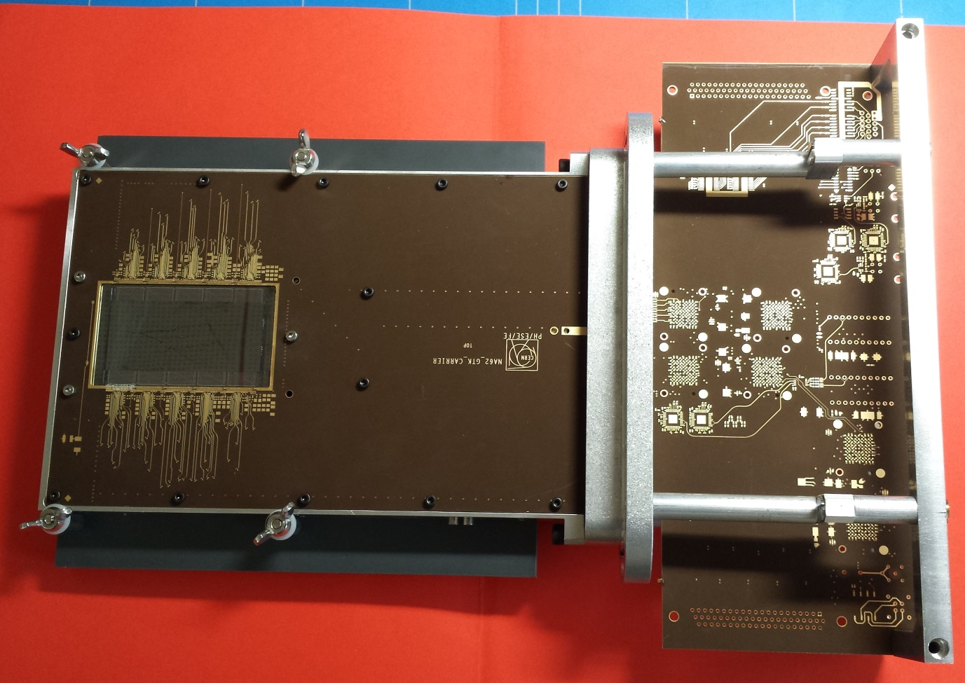
Dummy Assembly
We used a dummy assembly to validate the full integration in the GTK_carrier
One GTK_carrier from the first batch has been selected and sent to the bonding lab.
We discovered during the wire bonding that the dimension of the countersink was
not respected so the bonding pads are much lower than foreseen.

Slide 16
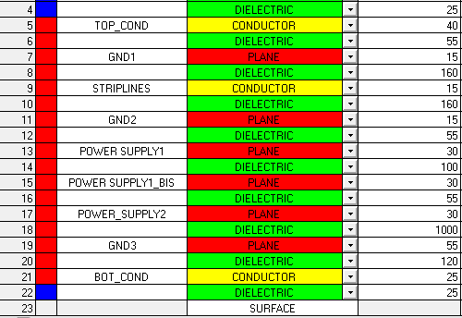
GTK_CARRIER cross section
PCB
785µm
2 mm
330µm
sensor
PCB
TDCpix
Micro-cooling plate
Frame

Slide 17
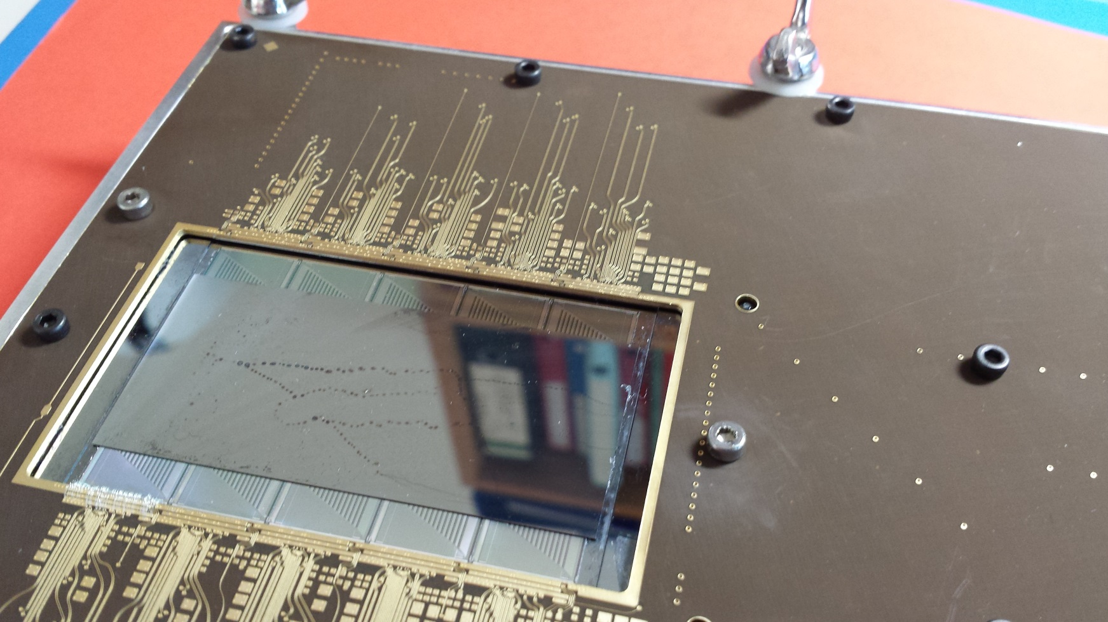
Dummy Assembly (daisy chain TDCpix)
One dummy TDCpix has been wire bonded

Slide 18
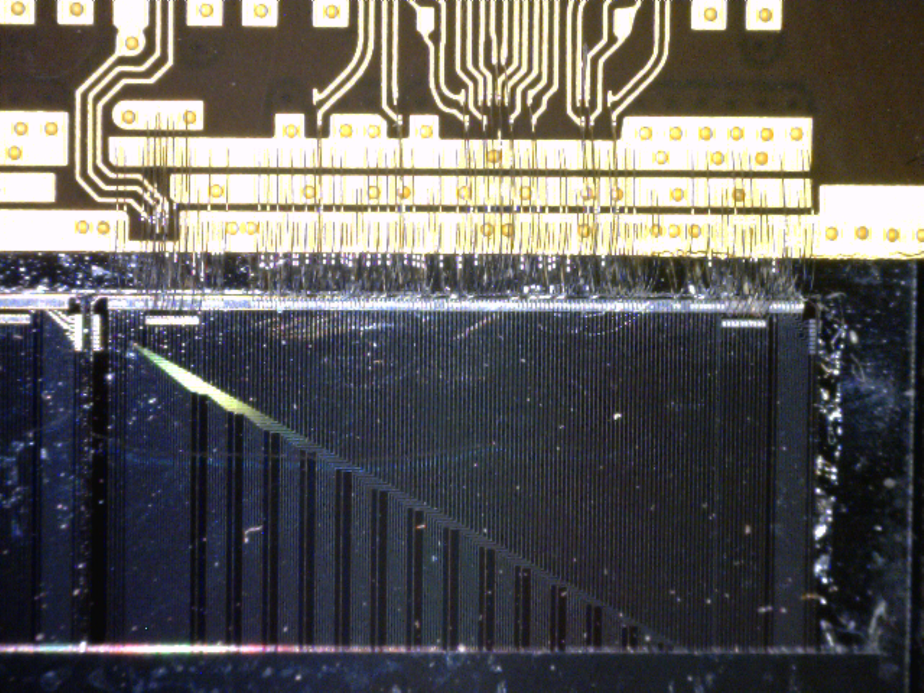
Dummy Daisy chain chip wire bonded to the GTK_carrier

Slide 19
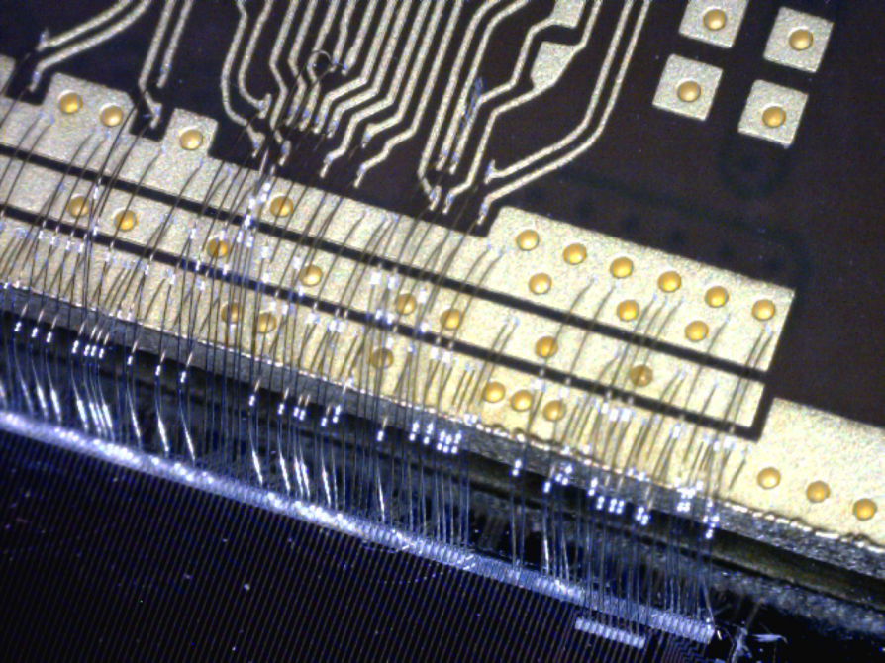
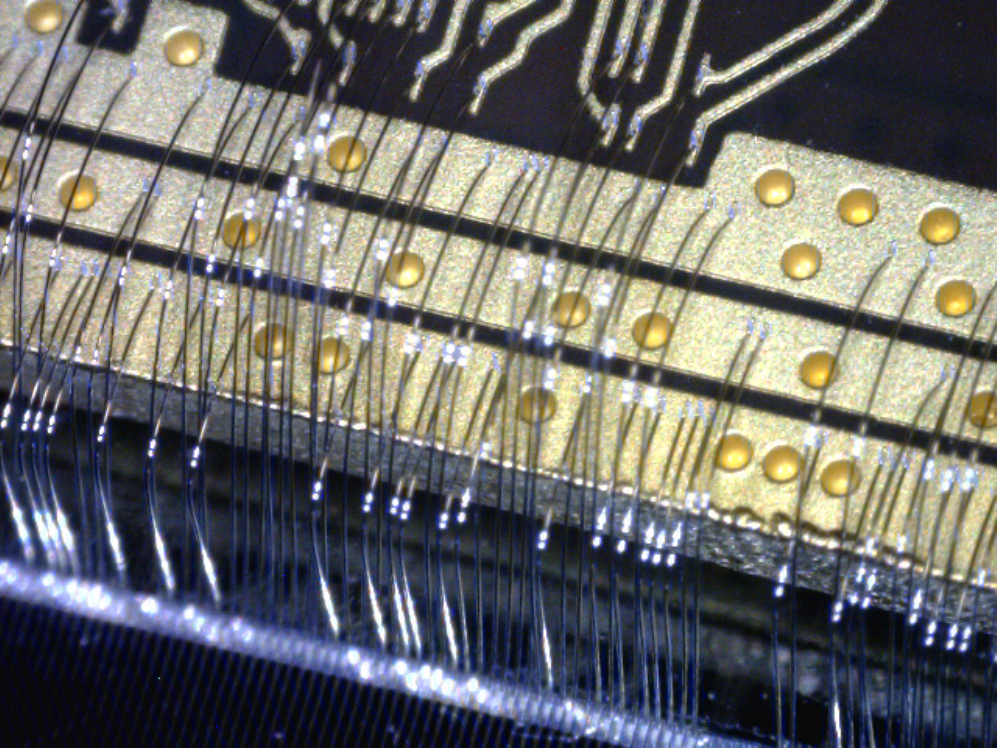
Dummy Daisy chain chip wire bonded to the GTK_carrier

Slide 20
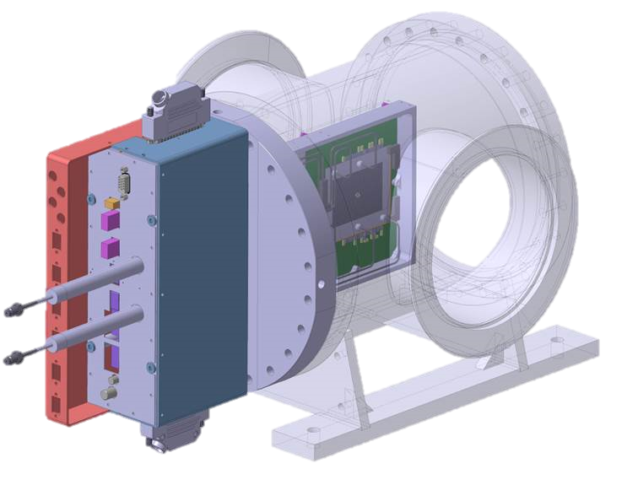
GTK_VESSEL #1-2

Slide 21
Power Supplies
Cables & Fibers
GTK_carriers
Summary

Slide 22
Summary
3 CAEN power supplies are missing but should be
delivery during September to complete the setup.
All the cables have been installed and will be tested soon
2 GTK_carriers from batch 2 will be equipped with
assemblies (TDCpix 450µm) for the October run.

