Slide 1
GTK Detector's Review
Flavio Marchetto
INFN - Torino
NA62 – Collaboration meeting – Ferrara – Sept. 4th 2014

Slide 2
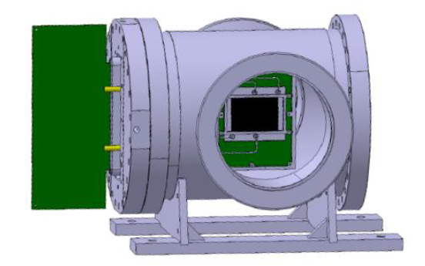
GTK-RO (A. Cotta)
Cooling plate (A. Mapelli)
GTK carrier (M. Morel)
Optical fibers
Cooling plant
(< 22 Sept.)
Bump-bonding (R. Arcidiacono)
ASIC test (A. Kluge)
Software: calibration, alignment, reconstruction (B. Velghe, C. Mandeiro)
ASIC wafer characterization (M. Perrin-Terrin)

Slide 3
ASIC test: very good -> very likely not necessary a further submission to foundry
Bump-bonding (IZM) : 6 sensors by Sept. 15 (3 thinned at 100 μm, 3 at 250 μm)
PCB carrier (Eltos): 5 boards by Sept. 15th
Micro-cooling plate (Cea-Leti): 3 wafers -> 6 plates by Sept. 3rd

Slide 4
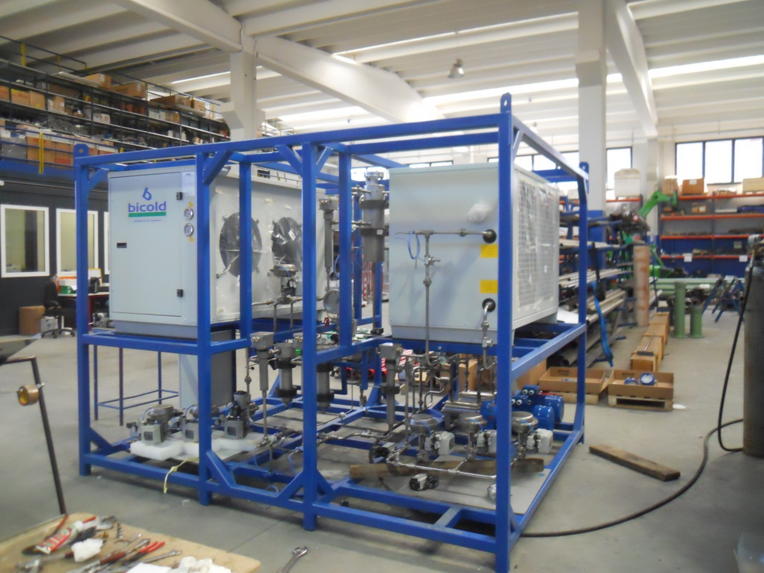
Cooling plant (Delta-ti Impianti): before Sept. 22nd (or 29th ?) ; piping at CERN starts today

Slide 5
Bump-bonding (IZM)
Already at CERN from July, 1st
2 full sensors
6 single-chip sensors
(thinned to 450 μm)
wire-bonded and tested: OK
To be delivered (Sept. 12th )
3 full sensors + 6 single chip sensors (thinned to 250 μm)
3 full sensors + 6 single chip sensors (thinned to 100 μm)
End of next week: 8 full sensors available

Slide 6
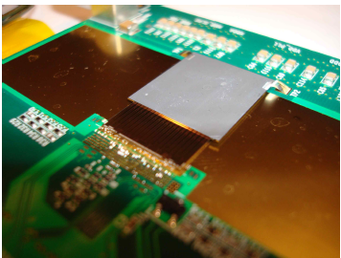
TDCpix
Test on single-chip sensor: results are very positive

Slide 7
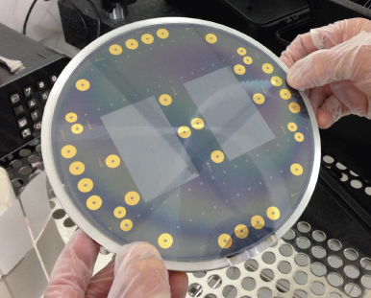
Micro-channel cooling plate
3 wafer -> 6 plates delivered in these days (CEA-Leti) (nominally Sept. 3rd )

Slide 9
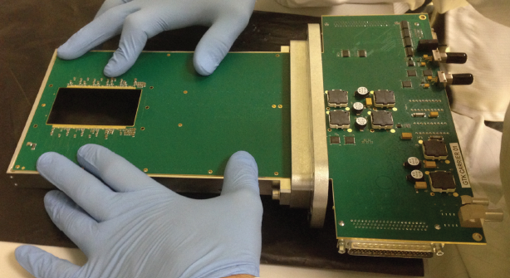
PCB carrier
Two carriers (with only half of the chips connected) were delivered end of July
Expected delivery (Eltos) of a batch of 5 carriers: Sept. 15th

Slide 10
Assembling of two (modest) stations is now possible
2 GTK-carriers (half-chip connection)
2 full-sensors 450 μm thick
2 micro-channel cooling plate (arriving today from CEA-Leti)
These two stations will be the first to be installed on the beam line and will serve as GTK1 and GTK2.
As soon as the thinned full-sensors and the GTK-carriers (new batch) will arrive the assembly of “towards-the-final” GTK stations can start.

Slide 11
GTK-RO (A. Cotta)
Cooling plate (A. Mapelli)
GTK carrier (M. Morel)
Optical fibers
Cooling plant
(< 22 Sept.)
Bump-bonding (R. Arcidiacono)
ASIC test (A. Kluge)

Slide 12
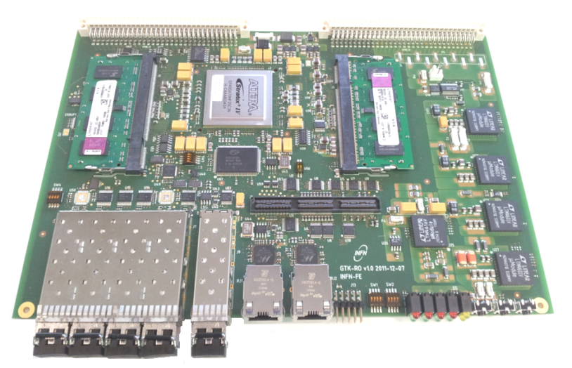
GTK-RO
30 mother-boards (one board per ASIC chip)
6 boards received on 12-06-2014
10 boards received on Sept. 3rd
18 boards by Sept. 22nd
Integration test (slow control signals and serial output signals) between the TDCpix ASIC I/O and GTK-RO through Optical Fibers is expected to be done next week

Slide 13
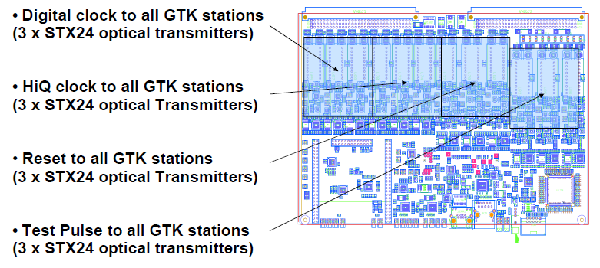
GTK-RO needs a daughter-board to interface the ASIC and the mother-board to the TTC

Slide 14
Status of the GTK-RO daughter boards
It is under investigation, as a backup solution, the possibility of using the FPGA, hosted in the GTK-RO mother-board, to generate the timing signals to the ASIC.

Slide 15
Characterization of the ASIC wafers: ongoing, almost finalized (Bob, Carlos, Mathieu)
Software (Bob, Carlos, Mathieu):
MC simulation: OK
Database: OK
Calibration and alignment: ongoing
Track reconstruction: ongoing

