Slide 1
Restart and modifications to CDR (september 2014)
P. Valente, E. Leonardi, F. Pantaleo

Slide 2
Objectives
Re-start CDR for data-taking as it was in 2012-2013
Reverse-engineer the scripts in order to
Fix problems
Control and maintain it as it is
Evolve according to new requirements
Multiple mergers
xrootd replacing rfio
EOS
…
Evolve towards a real book-keeping database + file catalog

Slide 3
Summary of CDR mechanism
Data transfer triggered by creation of “bookmark files” in pre-defined directories
Bookmark file created by merger software
/merger/bkm
“bookmark” files for steering the CDR
/merger/cdr
data files
CDR scripts on na62merger :
/home/na62cdr/cdr/
ccf (empty)
onl_cdr (perl code)
setup
toolkit
lockfiles
This directory was missing
Not preventing multiple instances but just stopping daemons

Slide 4
Scripts
mymaster_cron.pl:
watchdog script started by crontab to check the main 3 scripts to be running (as daemons):
submitStage0.pl
Performs the copy to CASTOR according to bookmark files trigger
complete_online.pl
Checks for transfer complete and updates bookmark files
cleanup_online.pl
Check free disk space on merger and when below threshold deletes files belonging to completed bursts (both bkm and cdr)
inspect_online.pl: produce periodically summary info

Slide 5
submitStage0.pl: submit transfers
Once a burst is completed…
Data file written to /merger/cdr
Bookmark file written to OnlineDataComplete
submitStage0.pl
Checks for the bookmarks in OnlineDataComplete and for each of them:
Copies it to OnlineTransferStart
Issues the transfer command (rfcp)
Creates a new bookmark in OnlineTransferStop
Contains size, timestamp, filepath
Checks that the target file is created (on CASTOR)
Copy the new bookmark in OnlineDataComplete

Slide 6
complete_online.pl: check transfers and store file locations
Inspects the data directory (/merger/cdr) checking, for each data file, the corresponding bookmarks in OnlineTransferStart/Stop/Complete:
Expects 1110 as starting state: transfer command successfully completed: file exists and size matches, checked by submitStage0.pl
Produces 1111 as final state, copying the bookmark file from OnlineTransferStop to OnlineDataComplete
Any other bookmark state is an anomalous condition:
1100: transfer started but never acknowledged completion:
Just remove bookmark and let submitStage0.pl retry the transfer…
10xx: something strange happened: no starting bookmark…
Issue: no check, e.g. no comparison with OnlineDataComplete, the place where the initial bookmark is created the first time, and no action taken

Slide 7
Bookmarks mechanism
 | DataStop | TransferStart | TransferStop | TransferComplete | DataLKr | DataComplete | DataClear
/merger/cdr/cdr00001029-0000.dat
size: 2910268
datetime: 14-10-13_14:26:44
/castor/cern.ch/na62/data/2013/raw/tmp/cdr00001029-0000.dat /merger/cdr/cdr00001029-0000.dat
/castor/cern.ch/na62/data/2013/raw/tmp/cdr00001029-0000.dat /merger/cdr/cdr00001029-0000.dat
complete-online
submitStage0
/merger/cdr/cdr00001029-0000.dat
size: 2910268
datetime: 14-10-13_14:26:44
Practically, a file-system database
But consistency not assured
merger

Slide 8
Files in /merger/bkm
 | DataStop | TransferStart | TransferStop | TransferComplete | DataLKr | DataComplete | DataClear
 | 0 | 0 | 0 | 0 | 0 | 1 | 0
0000010 (56012 entries)
...
cdr00004006-0001_27.dat mask: 0000010
...
Not in CASTOR
To be processed from the start
(as produced from the merger)

Slide 9
Files in /merger/bkm
 | DataStop | TransferStart | TransferStop | TransferComplete | DataLKr | DataComplete | DataClear
 | 0 | 0 | 0 | 0 | 0 | 1 | 0
 | 0 | 1 | 1 | 1 | 0 | 1 | 0
0111010 (22391 entries)
...
cdr00001029-0098.dat
cdr00001029-0099.dat
...
Found in CASTOR
Successfully completed
Check match between CASTOR and merger disk
Candidates to be put in the file database
Candidates to be deleted from merger disk when needed

Slide 10
Files in /merger/bkm
 | DataStop | TransferStart | TransferStop | TransferComplete | DataLKr | DataComplete | DataClear
 | 0 | 0 | 0 | 0 | 0 | 1 | 0
 | 0 | 1 | 1 | 1 | 0 | 1 | 0
 | 0 | 1 | 1 | 0 | 0 | 1 | 0
0110010 (70 entries)
...
cdr00001029-0000.dat mask: 0110010
cdr00001029-0001.dat mask: 0110010
...
Found in CASTOR
Transfer to CASTOR done (by submitStage0.pl) but final bookmark not created (complete-online.pl failed)
Check match between CASTOR and disk
Recover TransferComplete bookmarks

Slide 11
Files in /merger/bkm
 | DataStop | TransferStart | TransferStop | TransferComplete | DataLKr | DataComplete | DataClear
 | 0 | 1 | 1 | 1 | 0 | 1 | 0
 | 0 | 0 | 0 | 0 | 0 | 1 | 0
 | 0 | 1 | 1 | 0 | 0 | 1 | 0
 | 1 | 0 | 0 | 0 | 0 | 0 | 0
1000000 (5 entries)
-rw-r--r--. 1 na62cdr vl 77 11 mar 17:33 cdr00002006-0000.dat
-rw-r--r--. 1 na62cdr vl 76 17 mar 17:33 cdr00002008-0000.dat
-rw-r--r--. 1 na62cdr vl 76 17 mar 17:33 cdr00002008-0001.dat
-rw-r--r--. 1 na62cdr vl 76 17 mar 17:33 cdr00002008-0002.dat
-rw-r--r--. 1 na62cdr vl 73 16 apr 10:03 cdr00002400-3221.dat
Not in CASTOR
Different bookmark format!
Probably produced by different CDR version…

Slide 12
/merger/bkm/DataLKr
 | DataStop | TransferStart | TransferStop | TransferComplete | DataLKr | DataComplete | DataClear
 | 0 | 1 | 1 | 1 | 0 | 1 | 0
 | 0 | 0 | 0 | 0 | 0 | 1 | 0
 | 0 | 1 | 1 | 0 | 0 | 1 | 0
 | 1 | 0 | 0 | 0 | 0 | 0 | 0
(19509 entries)
…
-rw-r--r--. 1 root root 0 22 mar 2013 lkr_merged-1363956931
-rw-r--r--. 1 root root 0 22 mar 2013 lkr_merged-1363956948
-rw-r--r--. 1 root root 0 22 mar 2013 lkr_merged-1363956964
-rw-r--r--. 1 root root 0 22 mar 2013 lkr_merged-1363956981
Are they in CASTOR?
Do we want them in CASTOR?
Different files, not in OnlineDataComplete

Slide 13
Files on CASTOR…
nsls /castor/cern.ch/na62/
data
mc
Offline
share
nsls /castor/cern.ch/na62/data/
2012
2013
prova
testbeams
nsls /castor/cern.ch/na62/data/2013
core_watch.pl
dracut.conf
lkr_cdr00000392-0038.dat
raw/tmp
nsls /castor/cern.ch/na62/data/2013/raw/tmp | wc -l
5130
nsls /castor/cern.ch/na62/data/2012
dummytests
gid
prova
raw
ttt
ttt1
ttt2
ttt777
ttt8
yyy2
nsls /castor/cern.ch/na62/data/2012/raw
Lkr
tmp
nsls /castor/cern.ch/na62/data/2012/raw/tmp | wc -l
22054

Slide 14
After many checks…
71737 files in /merger/cdr but not all of them valid data files:
62743 .dat
62677 with bookmarks
66 files in /merger/cdr with no bookmarks in /merger/bkm:
8609 .eob (from Nov. 2012 to Nov. 2013)
95 .root
…
77484 files in /merger/bkm/OnlineDataComplete
276 files with even different naming: cdr00001030-dat.1, .2, …
5 “old” bookmarks: 1000000
77203 valid bookmarks
54602 to be processed: 0000010
22401 completed: 0111010
200 completed, missing TransferComplete: 0110010, complete_online.pl to be performed
49 → 0 started but not completed : 0010010, TransferStart file removed by earlier version of submitStage0.pl…
Fixed by hand
77203 valid bookmarks
14526 bookmarks with no file in /merger/cdr (but they are on CASTOR)
62677 with data file in /merger/cdr

Slide 15
Modifications/1
submitStage0.pl: Copy to CASTOR presently not working due to problem with Kerberos authentication in the daemon (submitStage0.pl)
First of all, fix it
Wrapped submit_Stage0.pl in a bash script using k5start to launch daemon: submit_Stage0.sh
Kerberos authentication using keytab file (created with ktutil)
Automatic ticket renewal
Ticket correctly acquired, transfers to CASTOR successful
Check renewal mechanism on long time scale
complete_online:
The same problem of submitStage0 regarding Kerberos authentication
File statistics bug, script dies because unable to get info for files older than 1 year.
Fix it

Slide 16
Modifications/2
Allow running from different mergers
Original Compass software sending from different event builders
In principle no interference if different mergers will have separate data areas
Check/modify scripts for >1 merger
General cleanup of configuration files to remove host-dependent stuff
Configure all parameters/directories/options via setup file
For a given year of data-taking, work only on files belonging to it
Test writing with different protocols: xrdcp in place of rfcp
xrdcp cdr00xxxxxx.dat xroot://castorpublic.cern.ch//castor/cern.ch/na62/data/<year>/raw/tmp/

Slide 17
Details on configuration
~/.ccfrc
Defines the base directory for all scripts and configuration files: CCF_ROOT
Check in every script correct parsing of ~/.ccfrc
$CCF_ROOT/setup/setup.dat
Master configuration file
In principle, can be the same for all mergers (KEY HOST VALUE sintax) and sym-linked to an afs or nfs common area
$CCF_ROOT/setup/users.dat
Define authorized user(s) on merger machine(s)
~/$USER.keytable
Keytable file for Kerberos authentication

Slide 18
Modifications/3
Configure and test for writing to EOS:
After having copied files to CASTOR
In parallel
Probably copying before sending to tape does not make sense
Work started
A lot of places in the scripts relying on CASTOR-specific stuff
In any case necessary, in order to replace rfcp with xrdcp for copying to CASTOR

Slide 19
Modifications/4
Subscribe (all) files to book-keeping database/1
Prepare the database(s)
Prepare the schema
Transfer schema to DB on demand
Prepare mysql server in the farm
Transfer schema to farm
Virtualize

Slide 20
Modifications/5
Subscribe (all) files to book-keeping database/2
Insert data into the DB
Fill DB with BKM information
Start with already existing information
Fix/check “TransfereComplete” bookmark that keeps track of target location in CASTOR (complete-online.pl)
Insert source as soon as merger(s) write the first bookmark
Keep track of what is going on with the migration
Replace the bookmark files with database tags (?)
Use DB queries in place of checking bookmark files (?)
Make it an option
Modify scripts accordingly

Slide 21
Naming conventions
Follow present convention
cdrXXYYYYYY-ZZZZ.dat
XX is the merger-ID (01,02, …); 00 means FARMDEBUG
YYYYYY is the run number; make it auto-increment in the Run Control
ZZZZ is the burst number (9999 burst is >1 day with ~15 s cycle)
Allow more than 1 file per burst:
cdrXXYYYYYY-ZZZZ_n.dat
Whatever in between cdr and .dat will define the file key
Run
Burst
File Copy
Burst
File Copy
Burst
File Copy
Burst
File Copy
File
…
Burst
File

Slide 22
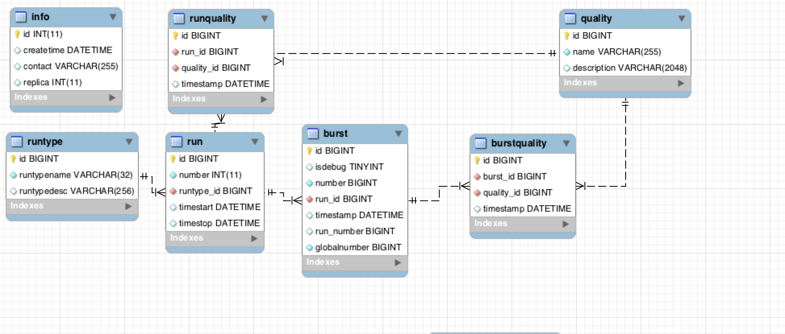
na62_bk schema
Run/burst/quality information (the real book-keeping)

Slide 23
na62_bk schema
File/file replicas and CDR information

Slide 24
na62_bk schema: link files to burst

Slide 25
Start testing
Start inserting files and bursts present on na62merger on /merger/cdr and /merger/bkm
62743 data files produced 62743 records in file and filecopy
50133 bursts
429 run numbers

Slide 26
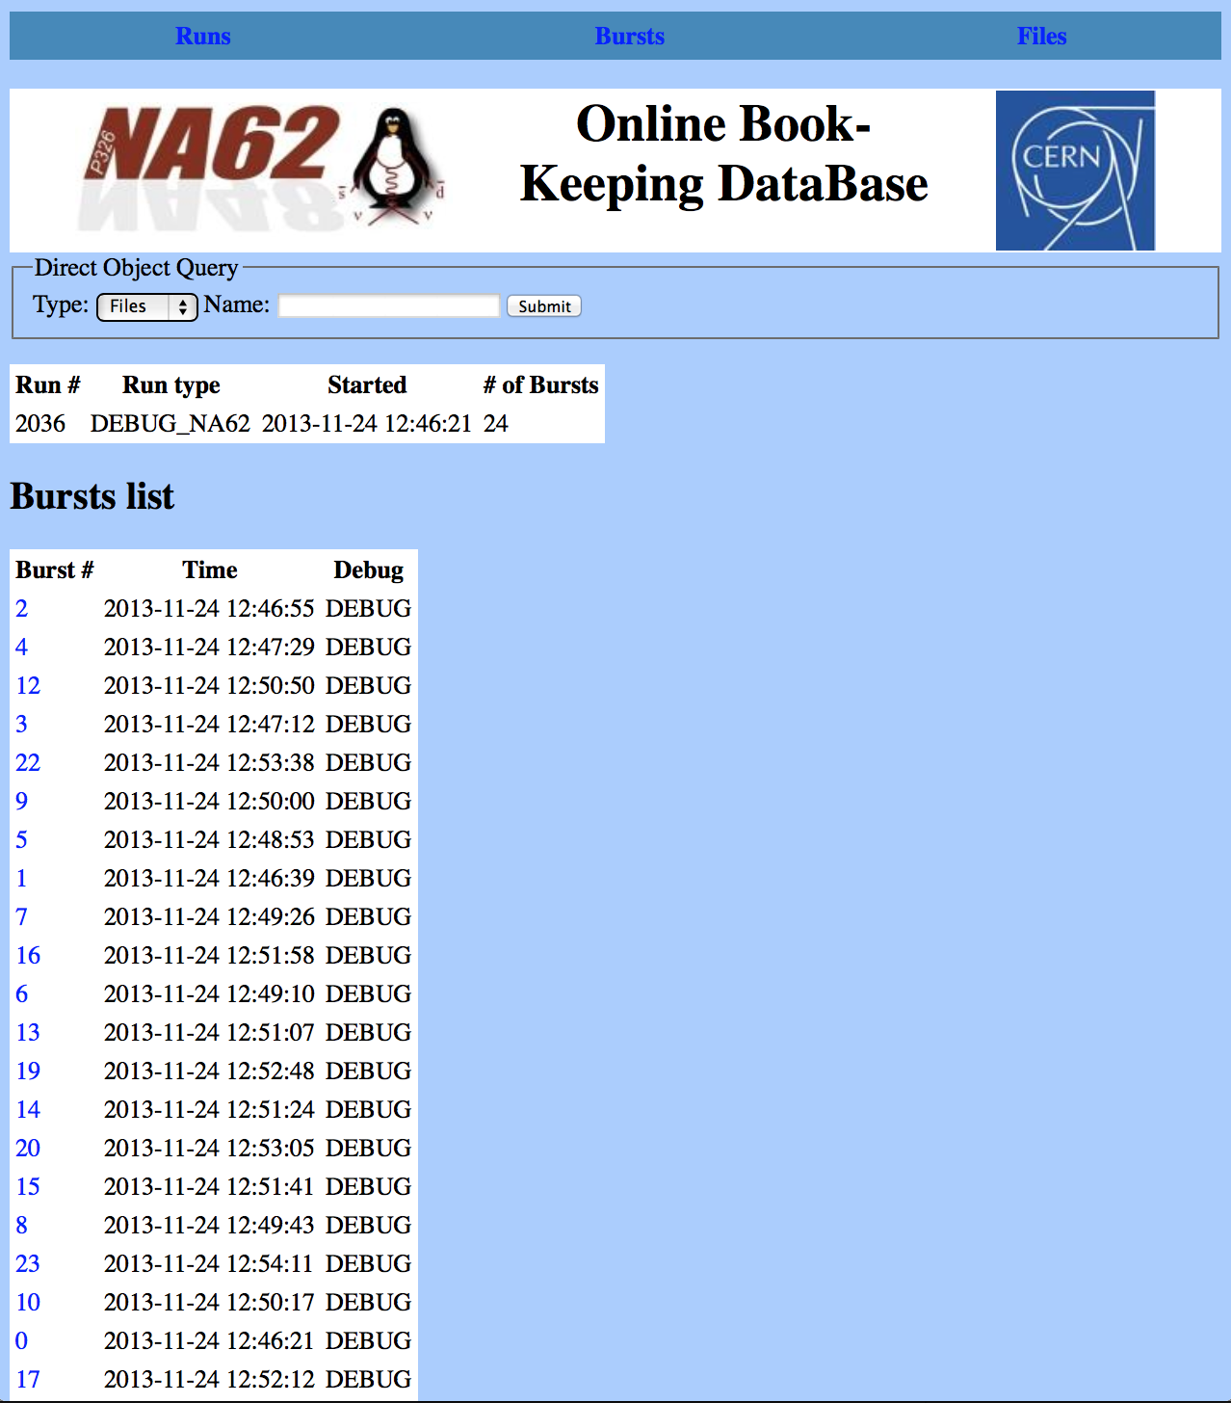
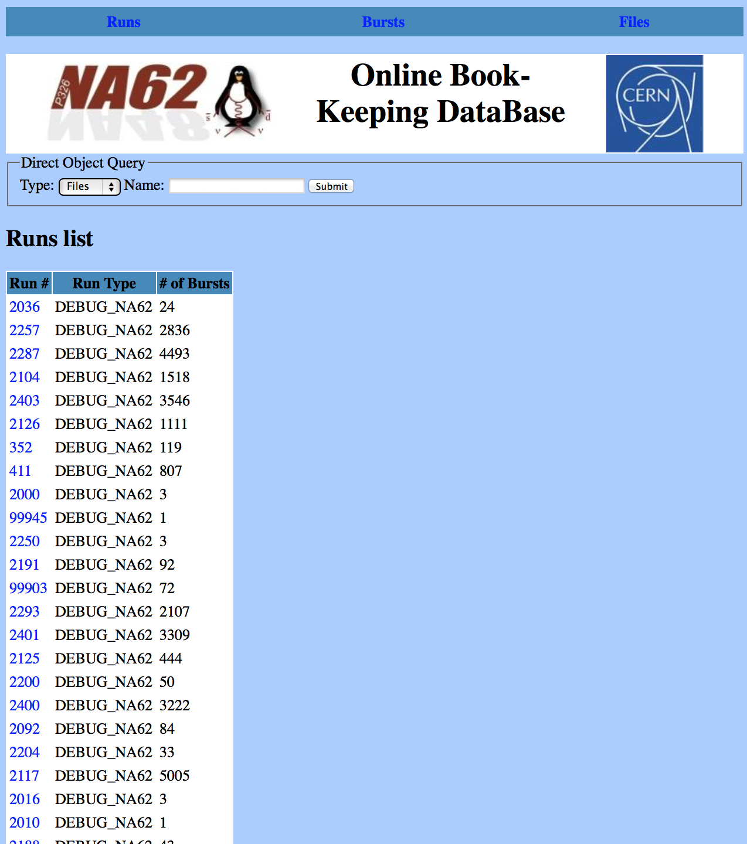
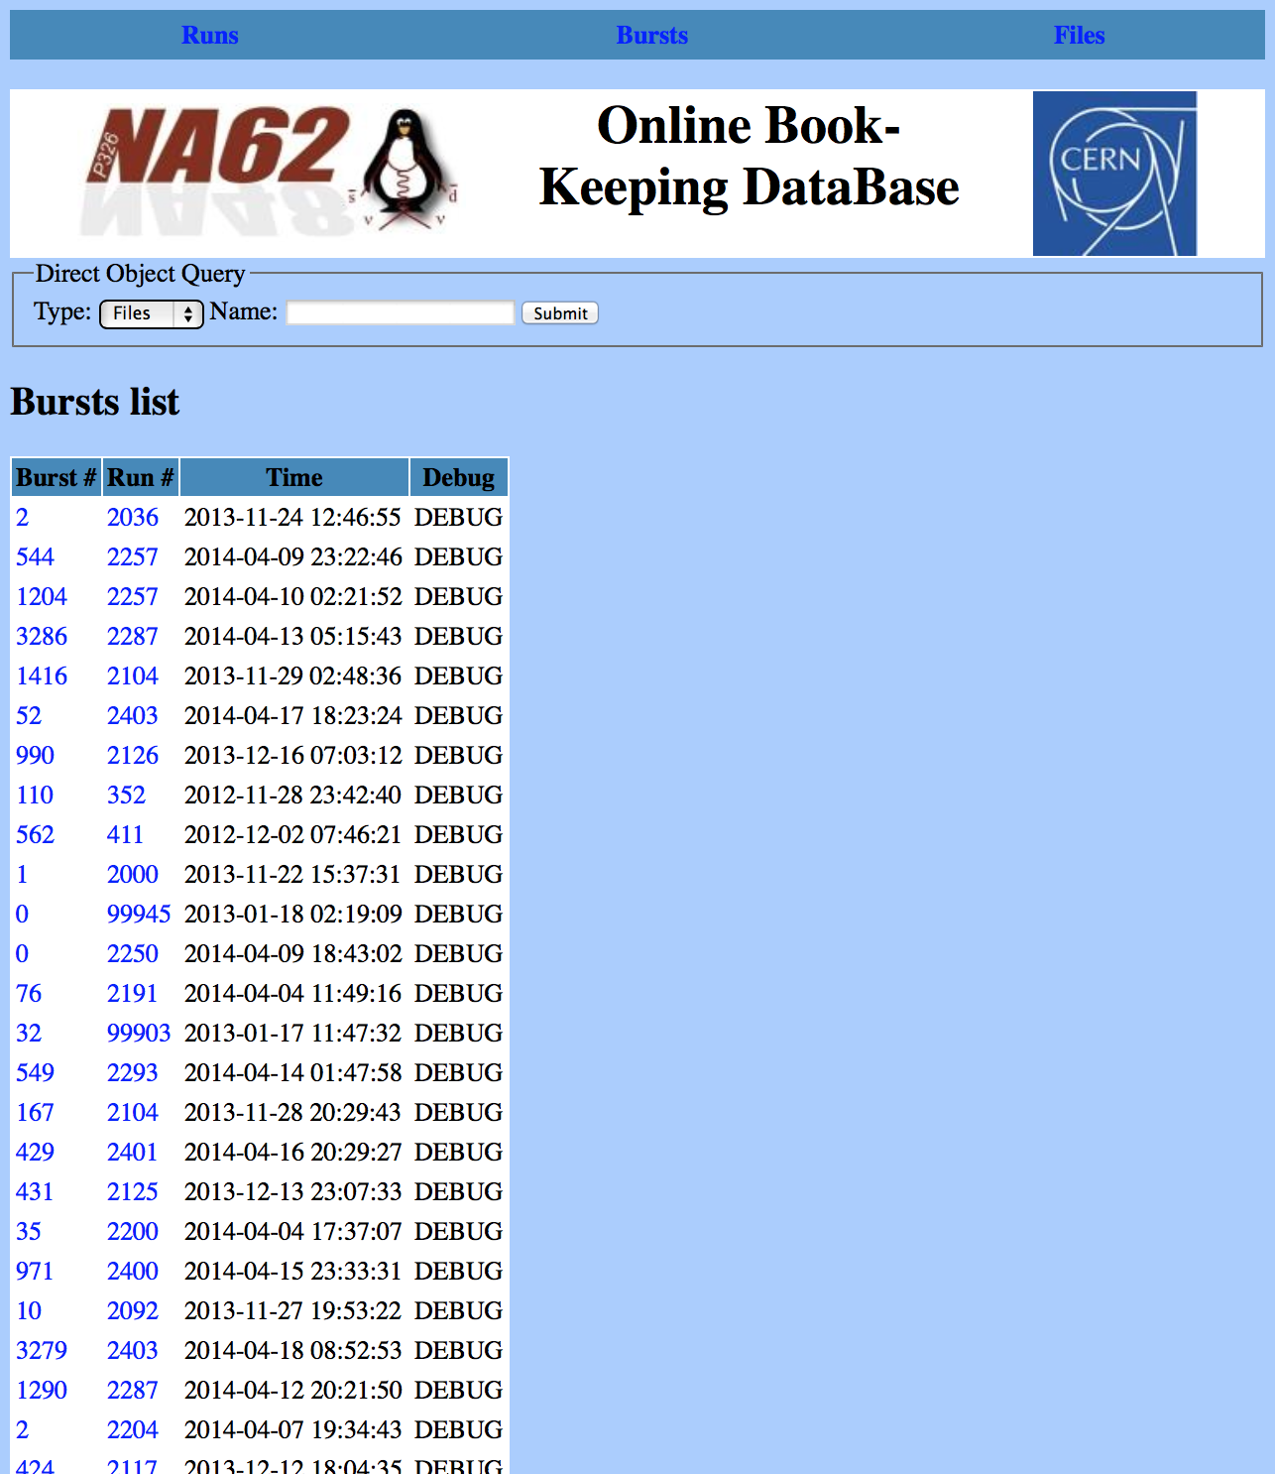
na62_bk web interface

Slide 27
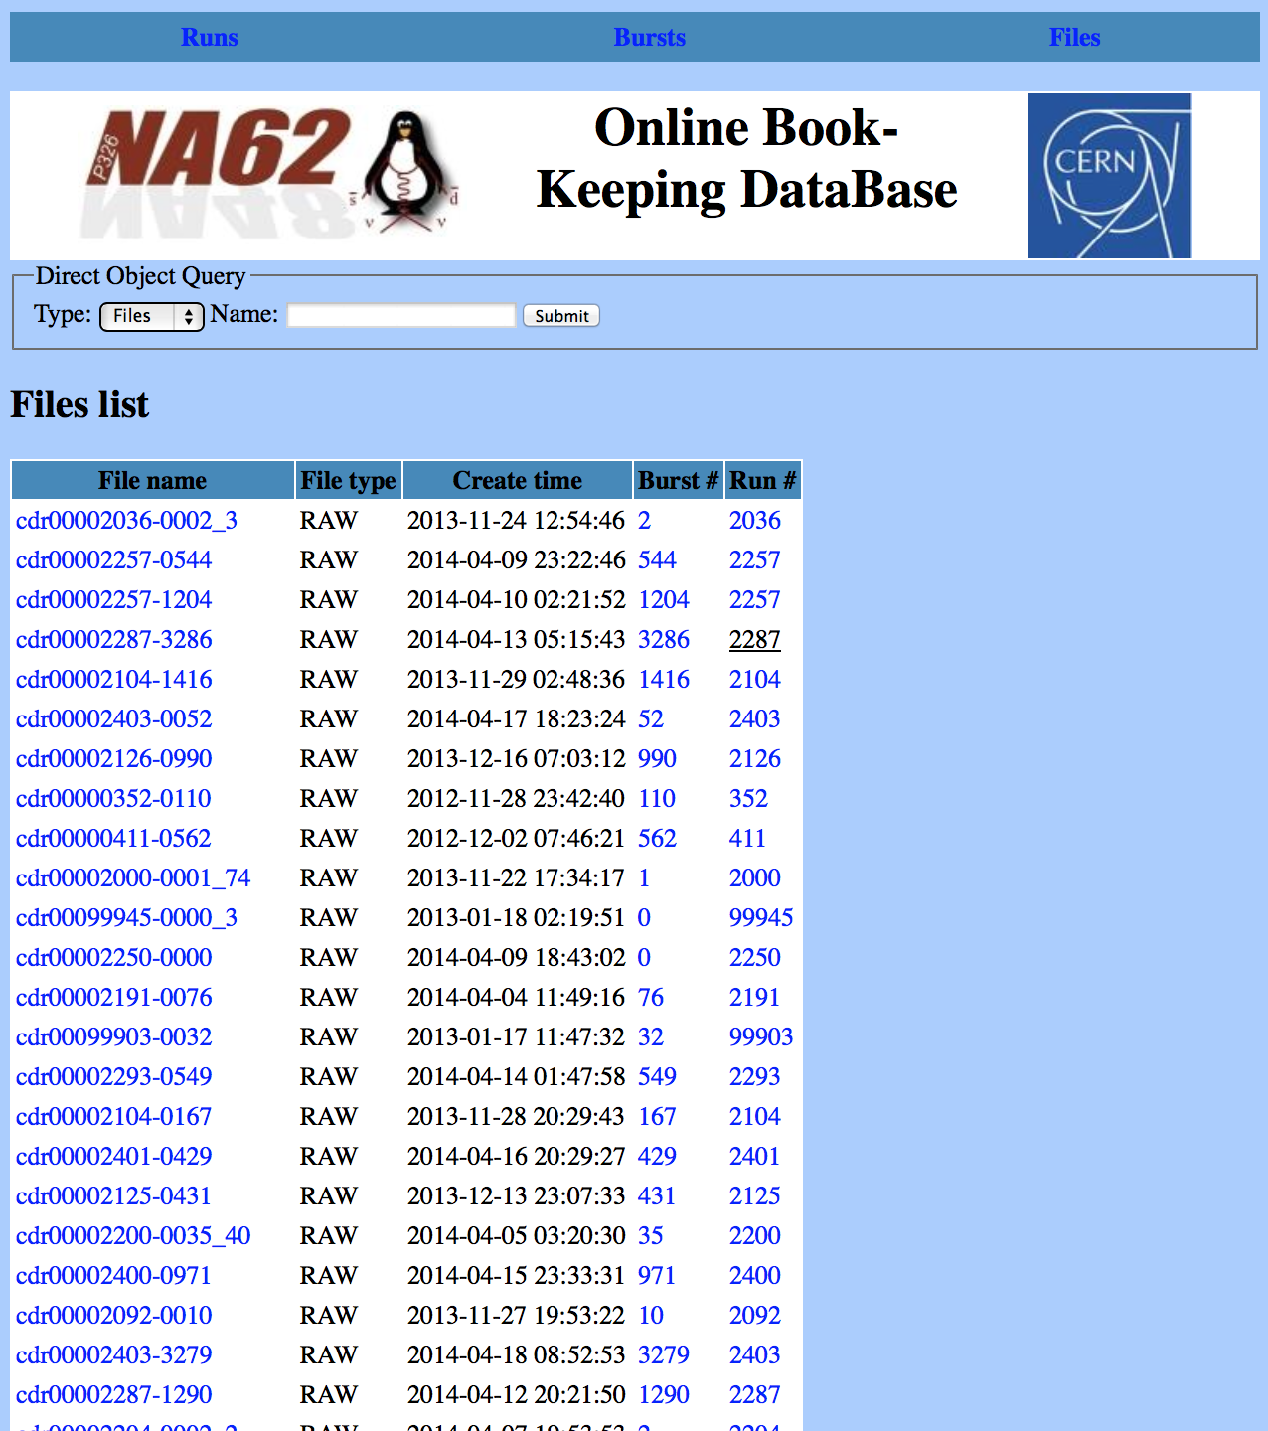
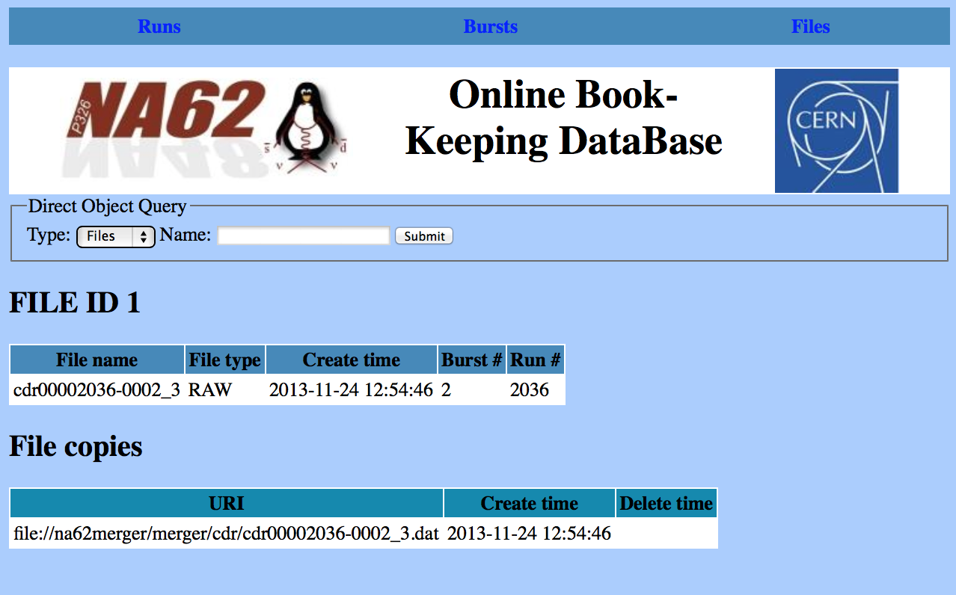
na62_bk web interface

Slide 28
Modifications/5
Move home directory to… ?
Local home directories for users moved to afs on new merger machines:
/afs/cern.ch/user/n/na62cdr/cdr/
Versioning in GIT
Repo: https://github.com/valentep/na62cdr

Slide 29
Further evolutions…
Where to put the run database?
At B918, on a mysql server running on a VM in the farm
Replicate all tables to DB on Demand at CERN-IT
Connected with more general question of online/offline databases… interactions with Phil on that
Fail-safe
Keep track of file replicas?

Slide 30
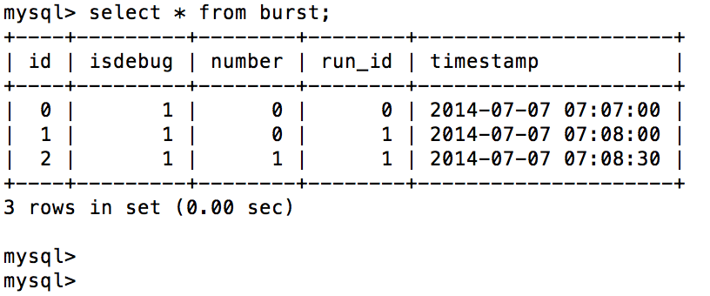
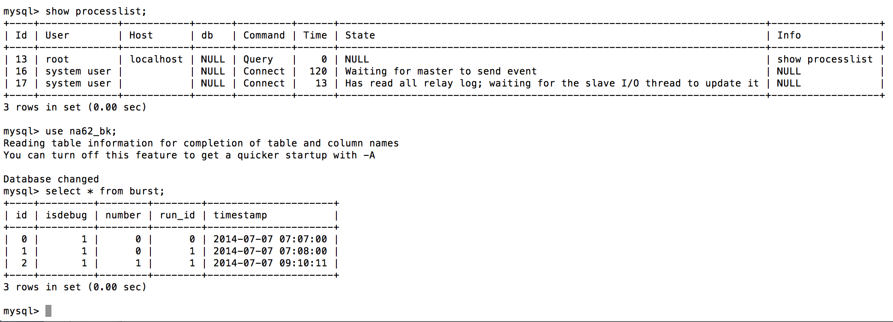
Test replication
Slave: na62merger3
Master: na62merger

Slide 31
Online and offline replicas
Master
na62merger
Slave
dbod-na62cdr
Run Control
Run
Run
php/web
CDR
Run
Slave
na62merger3
NA62 network
GPN

Slide 32
Fail-safe
new Slave
na62merger2
Slave
dbod-na62cdr
Run Control
Run
Run
php/web
CDR
Run
Slave → Master
na62merger3
NA62 network
GPN

Slide 33
Mergers disk space
na62merger
/merger 11TB used 4,9TB=45%
na62merger2
/merger 16TB used 284 GB=2%
na62farm2:/performance
na62farm2:/workspace
na62merger3
/merger 16TB used 226 MB=1%
na62farm2:/performance
na62farm2:/workspace
Presently 43 TB total disk space, >3 days of nominal data taking

Slide 34
To do before restarting CDR
Define na62cdr home page for na62mergerXX machines
/afs/cern.ch/user/n/na62cdr or
/home/na62cdr
Rename na62merger → na62merger1
Also a kick-start script for installing on a new merger cleanly is necessary

