Slide 1
PC-based L0TP
Status Report
“on behalf of the Ferrara L0TP Group”
Ilaria Neri
University of Ferrara and INFN - Italy
Ferrara, September 02, 2014

Slide 2
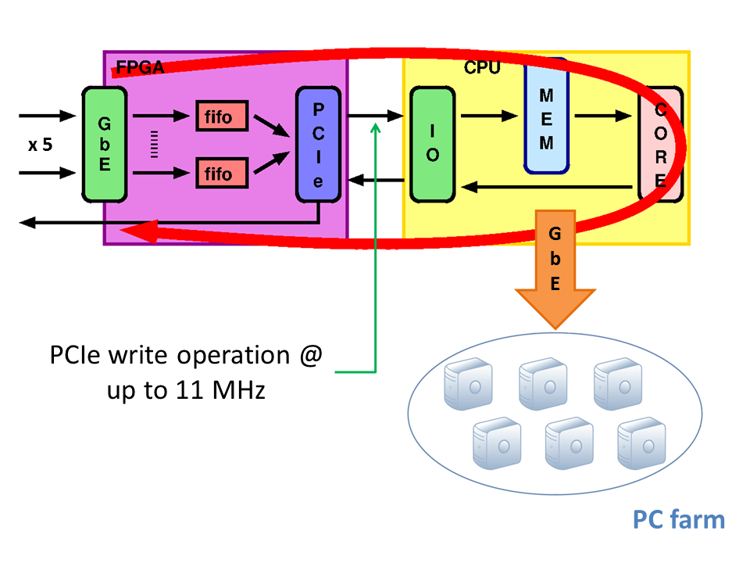
PC-based L0TP

Slide 3
Status on April 02, 2014
FPGA firmware side:
DE4’s remote control ✓
TTC signals management
Fixed latency trigger
Choke/Error management ✗
Work in progress
Work in progress
Testbench side:
PC-based MTP Transmitter ✓
TTC signal generator ✗
PC software side:
MEP transmission to PC farm ✓
Debug: optimize synch. method ✗

Slide 4
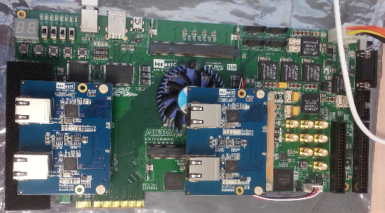
FPGA firmware
Altera Stratix-IV GX230 FPGA on a Terasic DE4
TTC daugther board
GbE
NIOS II
PCIe
Fixed latency trigger
RS232
JTAG

Slide 5
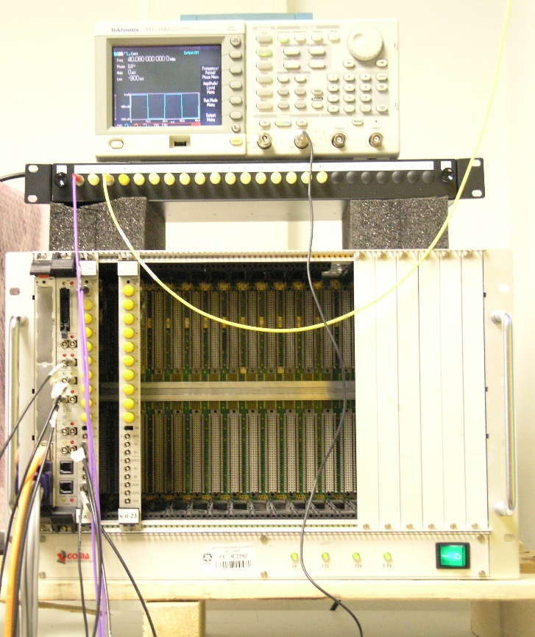
TTC signals management
Integration with TTC interface daughter board developed by Torino group.
Synchronisation of DE4 with the TTC system through the daughter board has been tested by using a Local Trigger Unit (LTU) available at Physics Department in Ferrara.
40.08 MHz clock generator
40.08 MHz clock
+ SOB + EOB
signals
DE4 fpga connected to the TTC board
LTU, TTCex and clock generator

Slide 6
LTU setup
set LTU to “standalone” (or local) mode
configure the TTCrx to work in trigger mode “11” (by sending a special B channel short message)
configure the LTU with a trigger list and generate triggers during the simulated burst period (different rates were tested)

Slide 7
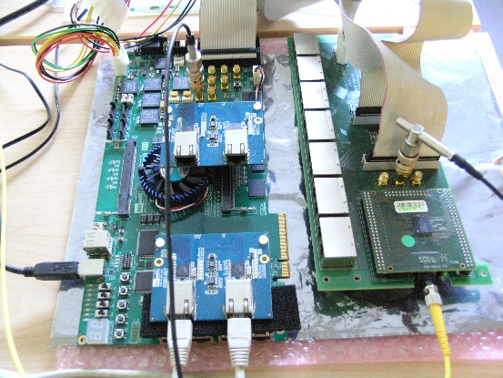
First results
The Start of Burst (SOB) condition is determined by the BCntRes and EvCntRes signals going high for one clock period.
The End of Burst (EOB) condition is marked by only the EvCntRes signal going high for one clock period.

Slide 8
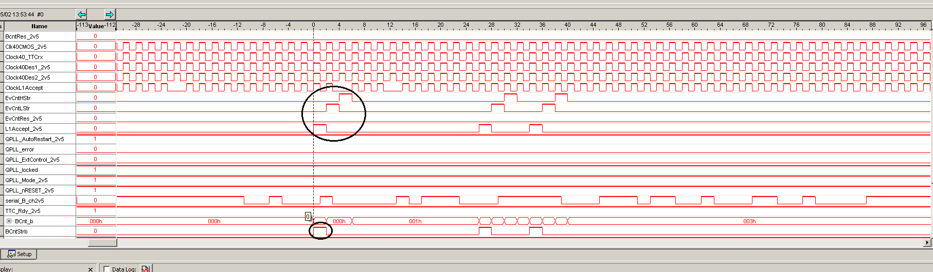
Triggers by LTU
In trigger mode “11”, each L1Accept trigger is followed by the EvCntLStr and EvCntHStr signals as depicted in TTCrx reference manual.
The whole system TTCrq_DE4 proved to correctly receive all the signals necessary to synchronise the detectors.

Slide 9
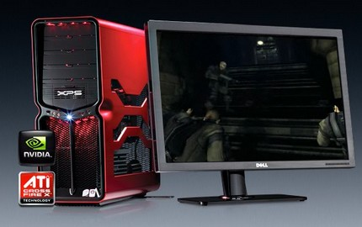
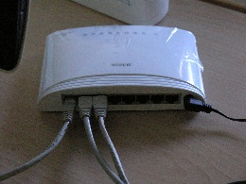
Fixed latency trigger
DE4 and TTC daughter board are remotely controlled by an external computer connected via a Gigabit ethernet switch.
Standard network
connection
Gb ethernet switch
Optical fiber
DE4 and TTC board
LTU, TTCex and clock generator

Slide 10
Fixed latency trigger
Latency programmable up to 1.6 ms.
LTU in global mode.
Triggers are generated inside the FPGA via the external computer. After passing through the Fixed latency Unit, they are sent to the LTU (6 bit - trigger code) which transmits them to the DE4 through the TTC board.
011111
DE4:
Fixed
latency Unit
Tc = 011111
TTC
board
DE4
check
TTC
board
LTU

Slide 11
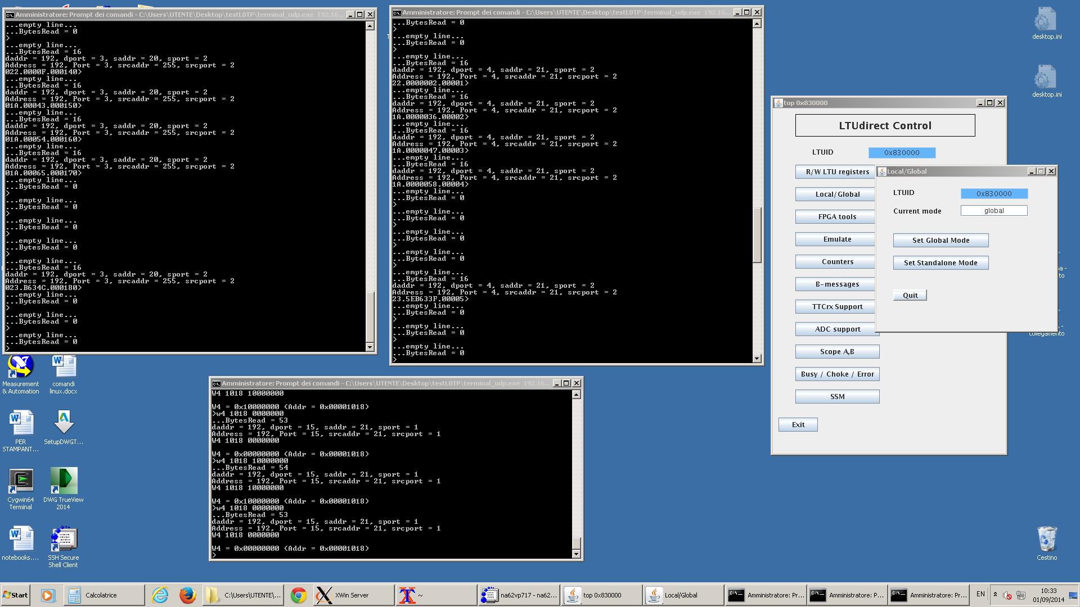
Results
Latency set to 800 ns (32 clock cycles)
17 clock cycles between triggers
Triggers received on the DE4 from the LTU
Triggers sent to the LTU
…Setting the registers of the FPGA and TTCrq

Slide 12
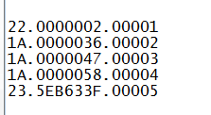
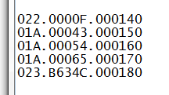
Results: fixed latency triggers
Data are in the form: triggercode.timestamp.triggercounter
Triggers are correctly received on the TTC board, 13 clock cycles after the fixed latency unit.
Triggercode.timestamp.triggercounter

Slide 13
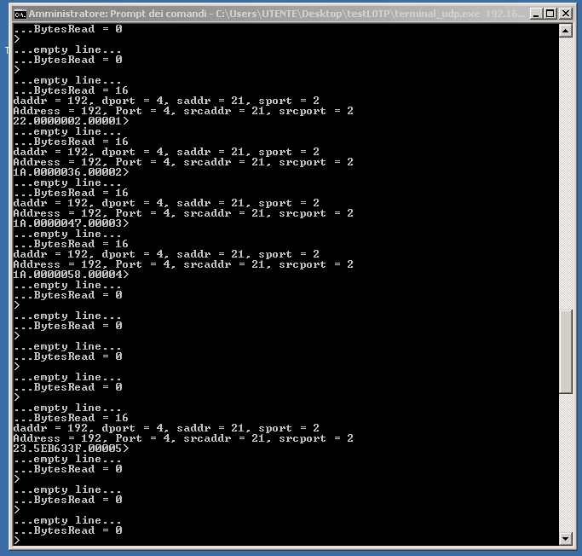
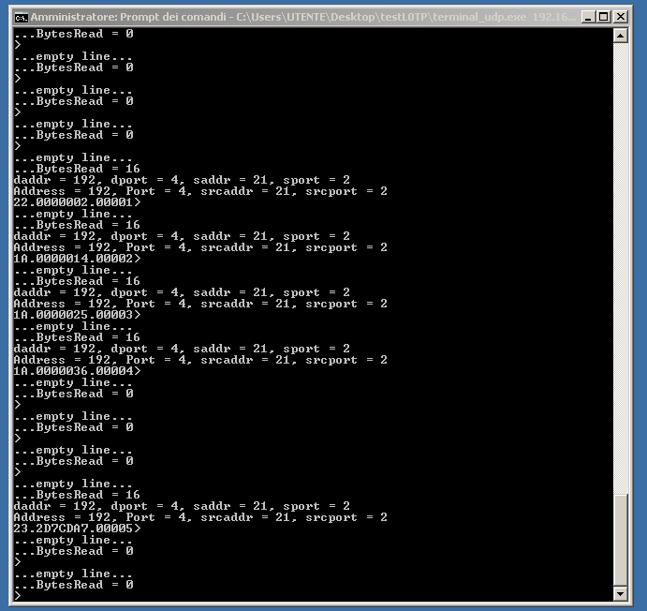
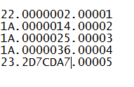
Results
The fixed latency trigger logic has been verified.
Due to reading operation of memory buffer, the constant latency module adds 2 clock cycles to the timestamp of outputs.
Thus, the difference between timestamp is equal to the programmable fixed latency, i.e., 0x20 (32 clock cycles):
fixed latency trigger timestamp
No latency trigger timestamp
vs
(0x36) - (0x2) - (0x14) = (0x20)

Slide 14
FPGA firmware side:
DE4’s remote control ✓
TTC signals management
Fixed latency trigger
✓
✓

Slide 15
Test with external PC-based MTP transmitter
On april 2014:
1. Loss of primitives under particular conditions
SOLVED increasing ethernet fifo buffers
2. Non optimized PCIe transfer
TO BE TESTED change of transfer control conditions
✗

Slide 16
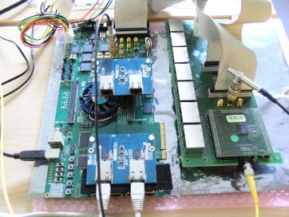
Future plans
In order to make a complete latency measurement, there must be synchronization between the MTP source and the DE4_TTC_board.
We plan to use a second DE4 as a synchronous MTP emitter.
LTU
and clock generator
L0TP
DE4
+
TTC
board

Slide 17
Conclusions
FPGA firmware side:
DE4’s remote control ✓
TTC signals management ✓
Fixed latency trigger ✓
Choke/Error management logic under test
Testbench side:
PC-based MTP Transmitter ✓
TTC signal generator ✓
DE4-based MTP Transmitter ✗
PC software side:
MEP transmission to PC farm ✓
Debug: optimize synch. method solution under test

