Slide 1
LTU+TTCex system status
T. Blažek, V. Černý, M. Kovaľ, R. Lietava
Comenius University Bratislava
M. Krivda
University of Birmingham

Slide 2
Clock distribution and trigger flow
Sync.
card
Triggers
Trigger inputs
L0TP
40 MHz clock source
CHOKE/
ERROR
TTC
Clock +
Triggers
TTC partition
. . . . . . . . . . . . . . . . . . .
LTU 1
+
TTCex
LTU 2
+
TTCex
LTU 3
+
TTCex
LTU 11
+
TTCex
. . . . . . . . . . . . . . . . . . . . . . .
TTCrx
TTCrx
TTCrx
TTCrx
. . . . . . . . . . . . . . . . . . . . . . .
QPLL
QPLL
QPLL
QPLL
FEE
FEE
FEE
FEE

Slide 3
11 TTC partitions – final setup
1st VME crate:
1 x VME processor
11 x LTU
2 x TTCit
Cabling:
LTU ↔ TTCex
Clock → TTCex
TALK → LTU
SoB/EoB → LTU
Optical fibres
Choke/Error
2nd VME crate:
11 x TTCex
1 x Clock FO
Photo: 2014-06-03

Slide 4
Installation notes
Hardware: 11 LTU+TTCex partitions working correctly
Tested using TTCit board, no problems reported from users
One minor issue: TTCex (CHOD - SN21) 1st laser not working (red cap)
To-do: CANBUS connection (2nd VME crate) → DCS
Choke/Error
To-do: connect cables (ready in el. barrack)
Enable Ch/Err in LTU (can be done at the start of run – Run Control)
SoB/EoB incoming signal (periodic, from TALK) issue:
Observed on all LTUs: more SoB than EoB received (double SoB)
Frequency < 1 of 1000 bursts (sometimes OK for long periods)
Possible explanation: too long pulse
No problem observed during technical run (SPS signal)

Slide 5
LTU firmware & software
https://twiki.cern.ch/twiki/bin/view/NA62/LTUrelatedSoftware
Last LTU FW update: May 2014, v. 21
LTU DIM servers upgraded (next slide)
Please, use the latest version of firmware and software, report any problems
VME : SLC5 → SLC6 upgrade performed: tested, OK
Plan: monitor counters run by run

Slide 6
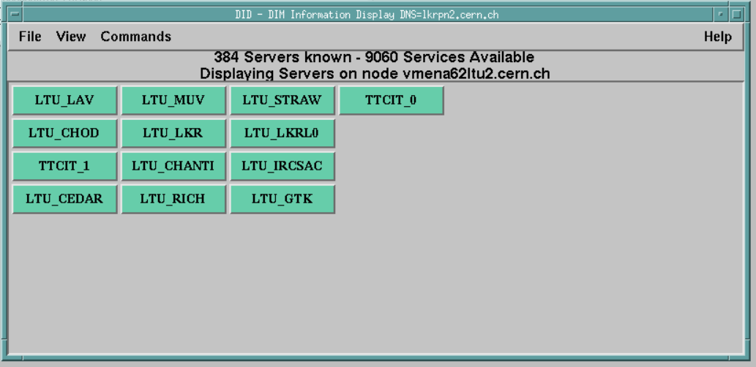
DIM servers
11 LTU and 2 TTCit DIM servers running on the VME processor
Upgraded to support new Run Control protocol: tested, OK
XML configuration files support implemented
Stable running, up-time more than a month

Slide 7
Clock synchronization
L0TP – LTU time delays setting:
L0TP provides 20MHz signal (toggle)
Firmware/software support in each LTU to measure delay
Correct time delays can be set in each LTU even remotely in few minutes
LTU – TTCex time delays setting:
Based on oscilloscope measurement in LAB: delay table ready
TTCrx delay parameters:
We do not send any TTCrx chip time delay parameters via optical link (long B-messages), responsibility of each sub-system

Slide 8
Conclusions
LTU+TTCex (11 TTC partitions)
Prepared for the run
Remaining issues:
Choke/Error cables + test
1 TTCex laser replacement
Investigate SoB/EoB counting
Ultimate test: Dry run with all 11 sub-detectors:
Compare counters: N. of bursts, triggers …
Stability checks (timestamp difference should be constant)

Slide 9
Spare: LTU & TTCex inventory
https://twiki.cern.ch/twiki/bin/view/NA62/TdaqLogistics
LTU and TTCex orders
https://twiki.cern.ch/twiki/bin/view/NA62/TdaqHWDistribution
Current status:
 | CEDAR | GTK | CHANTI | LAV | STRAW | RICH | CHOD | IRC/SAC | MUV | LKR/L0 | LKR
LTU s.n. | 14 | 3 | 15 | 17 | 12 | 13 | 18 | 11 | 16 | 7 | 19 (*)
TTCex s.n. | 26 | 25 (**) | 21 (***) | 29 | 15 | 7 | 30 (****) | 4 | 11 | 6 | 22
# of lasers | 2 | 4 | 10 | 10 | 4 | 10 | 2 | 10 | 10 | 6 | 2
VME address | 1 | 2 | 3 | 4 | 5 | 6 | 7 | 8 | 9 | A | B
(**) TDAQ TTCex temporarily assigned for GTK
(*) Terminating resistor on L0 input
(***) Laser indicating LED not working, lasers are OK
(****) 1st laser not working

