Slide 1
L0 performance simulation
F. Marchetto
INFN - Torino

Slide 2
L0TP features
Input: up to seven primitives from detectors
Primitives: aligned according to Timeslot given by an address formed by:
Timestamp + 3 MSB of the FineTime (bit 7-6-5)
Fine Time bit from 0 through 4 are ignored to form the address but can be used for logical operation
Each Timeslot width is: 25 ns/8 = 3.125 ns
How to expand a given Timeslot to account for the inevitable measurement errors?
2 Ts -> +/-1 based on the 4th Finetime bit: 0->-1; 1->+1
Reference detector
3 Ts
-1
-1
3.125
alignment
+1
+1
t

Slide 3
4th bit = 0
4th bit = 1
3.125 ns
t
If 4th bit of the primitive is equal 0, then the event occurred in the first part of the timeslot
If 4th bit of the primitive is equal 1, then the event occurred in the last part of the timeslot

Slide 4
L0 efficiency, background reduction and random veto depend on:
1) Primitives time resolution
2) Primitives time alignment
3) Timeslot width expansion (2 ,3)

Slide 5
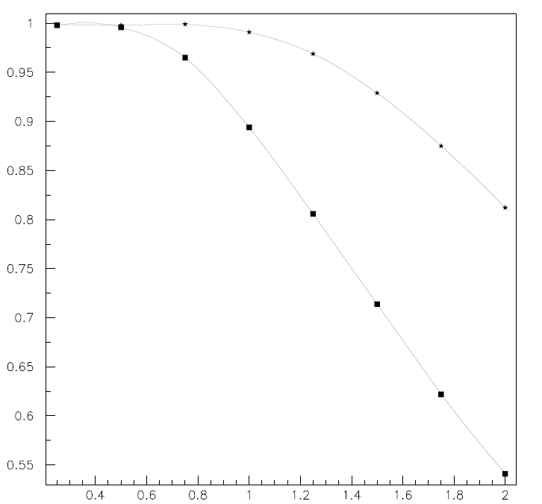
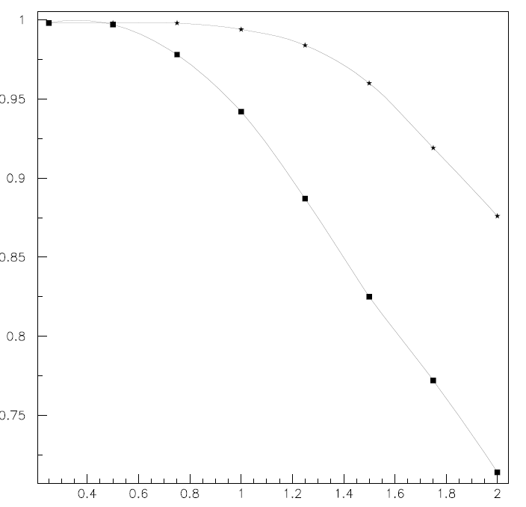
Trigger efficiency as a function of the primitives resolution
two detectors are required in the trigger
A*B
three detectors are required in the trigger
A*B*C
three timeslots window
three timeslots window
two timeslots window
two timeslots window
primitive resolution in nsec

Slide 6
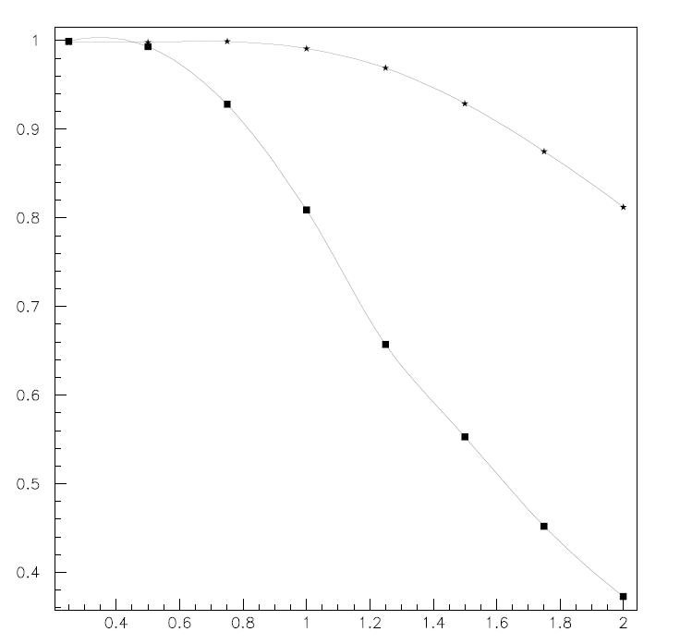
Trigger efficiency as a function of the primitive resolution
three detectors are required A*B*C
three timeslots
3-bit from the Finetime (3.125 ns)
20%
4-bit from the Finetime
(1.5625 ns)
primitive resolution in nsec
For primitives time resolution of 1 nsec, using 4 bits from the FineTime and opening 3 timeslots window, one loses roughly 20% of efficiency

Slide 7
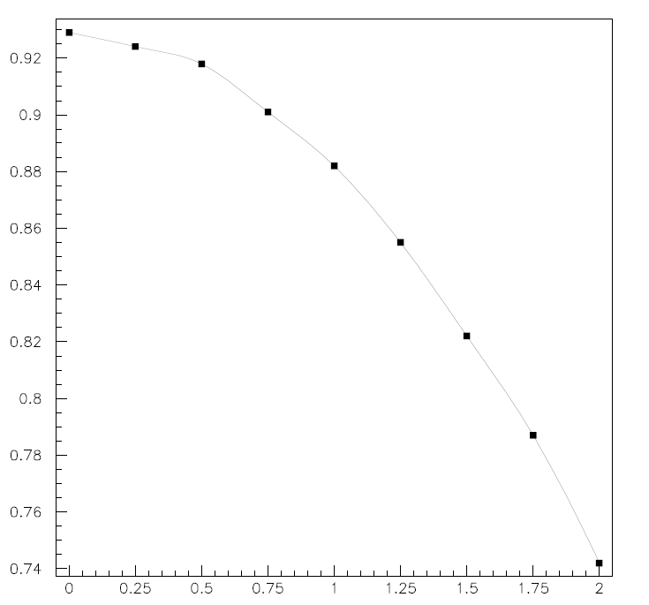
How is affected the resolution if the detector primitives are not timewise aligned
three detectors
timeslot of 3.125 nsec
time resolution of each primitive is 1.5 nsec
trigger window of three timeslots
Plot of the efficiency as a function of the time shift of two detectors, one positive and one negative.
efficiency
time shift (ns)

Slide 8
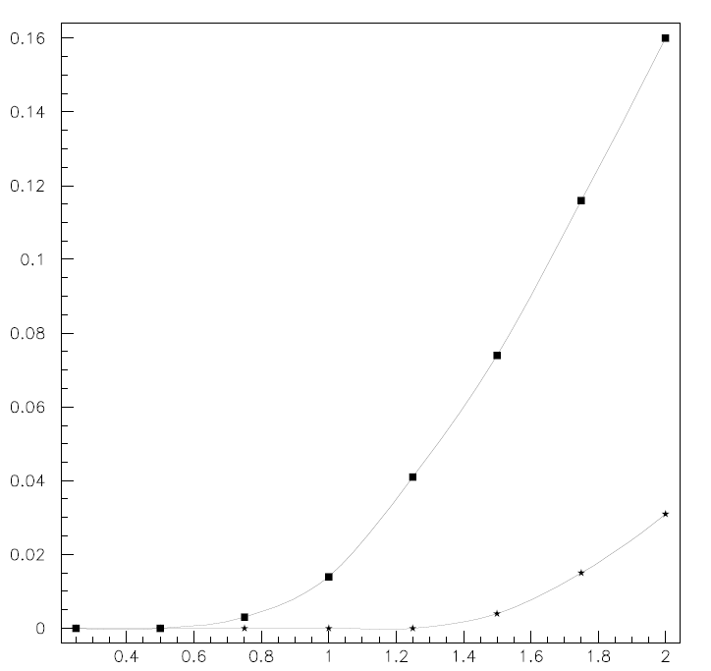
Background reduction as a function of the primitives resolution
The veto window can be extended to two timeslots or three timeslots, using the same algorithm as explained
1 detectors in VETO
two timeslots
three timeslots

Slide 9
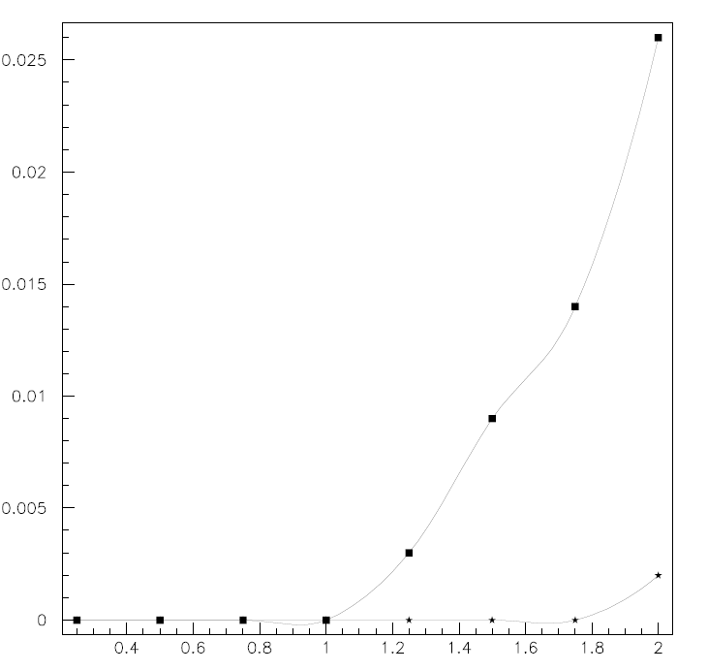
Background reduction as a function of the primitives resolution
2 detectors in VETO
two timeslots
three timeslots

Slide 10
Tentative conclusions
Efficiency
timeslot of 1.56 ns requires that the time resolution of the primitives should be better than 0.5 ns otherwise the trigger efficiency would be jeopardized;
trigger window of three timeslots are necessary;
beside time resolution, also the alignment (for which the full Fine Time is necessary) has a relevant impact;
Background rejection
in case of a single detector in veto, three timeslot window has an impact in the reduction
for two or more primitives in veto, the impact is limited and the two timeslot window is already quite effective.

