Slide 1
RICH TDAQ STATUS
F. Bucci, R. Ciaranfi, M. Lenti, M. Piccini, C. Santoni
TDAQ WG, 02/09/2014

Slide 2
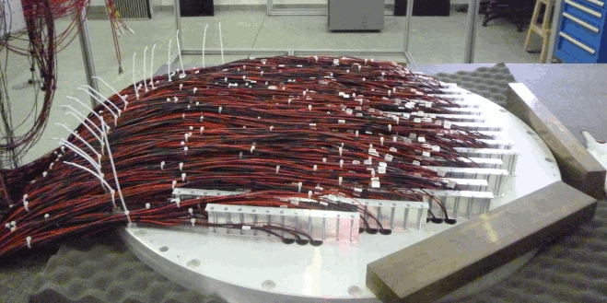
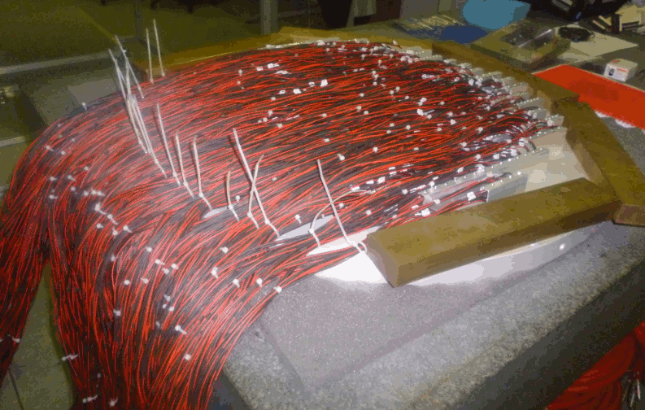
PMTS INSTALLATION
Installation of PMTs on the Jura and Saleve lodging disks completed
Looked at the signal shape and measured the rate of each PMT
Jura lodging disk
Saleve lodging disk

Slide 3
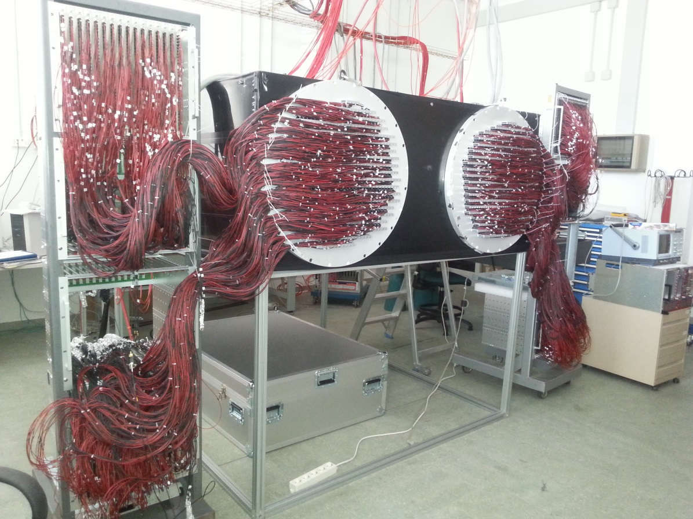
PMTS TEST
The disks were installed on a light tight box and enlighted with a laser
to look for dead channels
The HV cables of the PMT dividers were plugged in the HV distribution boards located at the same distance as in the experimental area

Slide 4
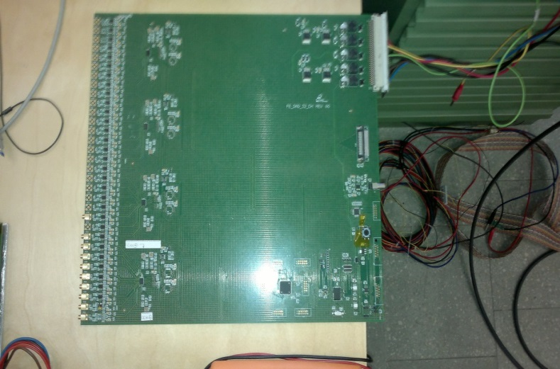
FE STATUS AND TEST
New FE board prototype is ready
Two different setup still under testing
Performances look promising
Order to be placed within the end of the week
Full production should be finished at the end of September
The arrival at CERN is foreseen at the beginning of October
FE boards schedule tight but still feasible

Slide 5
SCHEDULE OF INSTALLATION AND TEST OF PMTS AND FE
All the electronics but the FE boards will be carried to CERN next Monday.
In the following two weeks the PMT lodging disks will be installed in ECN3 and the HV cables will be plugged.
The last week of September the full chain of electronics will be tested by using a FE board prototype and enlighting the PMTs disk with a laser.

Slide 6
RICH Trigger Firmware Status
Two different firmware versions has been developed:
RICH version
GPURICH version
Most of the firmware is common between the two versions
PP FPGA
SL FPGA
CHANNELS INFO
HANDLING
CHANNELS INFO
HANDLING
RICH
HITS CLUSTERING
RICH
CLUSTERS MERGING
GPURICH
GPURICH

Slide 7
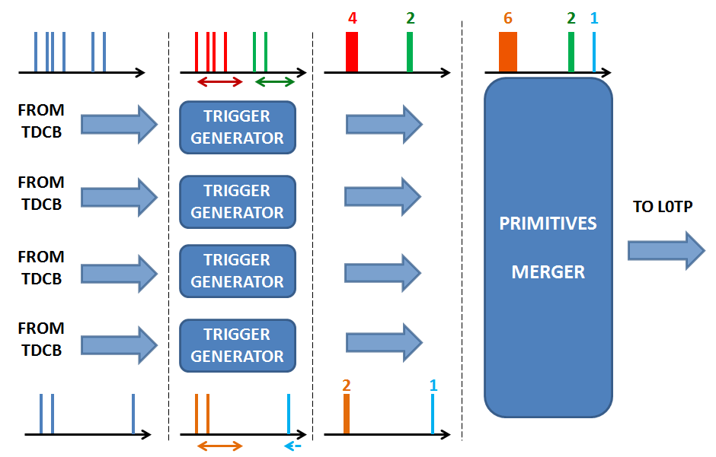
RICH Firmware
RICH version tested in June
Primitive production worked fine

Slide 8
RICH Firmware
From data to primitives:
(data from June test)
PP INPUT
PP OUTPUT / SL INPUT
SL OUTPUT
Average finetime
PRIMITIVE_DATA: 0x00000000
PRIMITIVE_DATA: 0x00010061
PRIMITIVE_DATA: 0x00000000
PRIMITIVE_DATA: 0x00000001
PRIMITIVE_DATA: 0x000200c2
PRIMITIVE_DATA: 0x00000000
PRIMITIVE_DATA: 0x00000002
PRIMITIVE_DATA: 0x00010024
PRIMITIVE_DATA: 0x00000001
PRIMITIVE_DATA: 0x00000003
PRIMITIVE_DATA: 0x00020085
PRIMITIVE_DATA: 0x00000001
PRIMITIVE_DATA: 0x00000004
PRIMITIVE_DATA: 0x0001000b
PRIMITIVE_DATA: 0x00000003
multiplicity
TDCB 0
0xA0000000
0x42d00061
0xB0000002
TRIG_IB0: 0x5c010061
TRIG_IB0: 0x00000000
timestamp – lsb 25 ns
0xA0000000
0x4368030b
0x40680185
0xB0000002
sorting
TRIG_IB1: 0x5c010085
TRIG_IB1: 0x00000001
TRIG_IB1: 0x5c01000b
TRIG_IB1: 0x00000003
TDCB 1
0xA0000000
0x42600124
0x430800c2
0x40780185
0x409800c2
0xB0000005
clustering
TRIG_IB2: 0x5c0200c2
TRIG_IB2: 0x00000000
TRIG_IB2: 0x5c010024
TRIG_IB2: 0x00000001
TRIG_IB2: 0x5c010085
TRIG_IB2: 0x00000001
cluster
merging
TDCB 2
TDCB 3
0xA0000000
0xB0000001
TRIG_IB3: - - - - - - - - - -

Slide 9
GPURICH Firmware
GPURICH version tested in August
Primitive production worked fine
SL OUTPUT
(TDSPY)
TIMESTAMP 25 ns
MULTIPLICITY
FINETIME
---
CH ID
CH ID
CH ID
FIRST
UDP
PACKET
SECOND
UDP
PACKET

Slide 10
RICH Trigger Firmware Status
Firmware tested at CERN with emulated data
Primitive production is working fine (some issues to be addressed)
Some problems during the integration of the trigger firmware in the
“generic” one (talk by Roberto Piandani)
Found a working temporary solution
Final solution is under test
Rate and latency tests to be done

