Slide 1

“Perspectives for a GPU trigger”
TDAQ, Ferrara, 2.9.2014
Gianluca Lamanna (INFN)
On behalf of GAP collaboration

Slide 2

GPU system for pilot run
Parassitic
2 TEL62 used for GPU → one RICH spot
No interference with standard trigger primitives production
NANET data acquisition
Single GPU NVIDIA K20
2024 TDC channels, 4 TEL62
TEL62
GPU
Ingredients:
  TEL62 Firmware
  Data collection for GPU
    NANET and PFRING
  Processing on GPU
    KNANET and KPFRING
Trigger TEL62
Standard primitives
Notes:
Gpu in october run

Slide 3
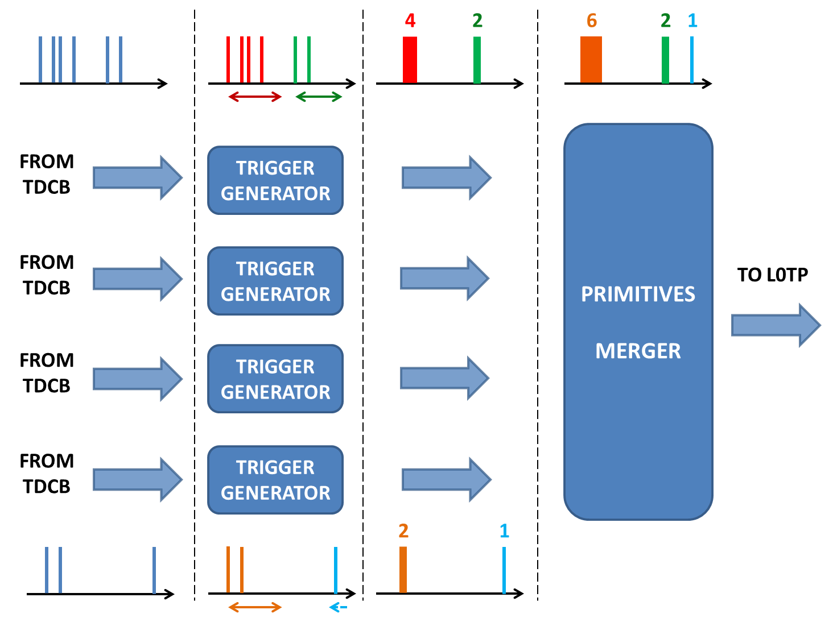
GPURICH special firmware
GPURICH Firmware: small modification with respect to the standard RICH trigger firmware (Cristiano).
Same philosophy: matching window in PP + merging in SL
Dedicated data format to fully exploit data transmission bandwidth.
Notes:
Fw tel62+ formato dati

Slide 4
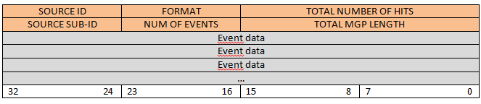
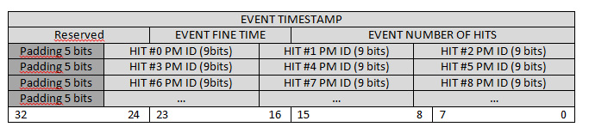
MPG Data format

Slide 5
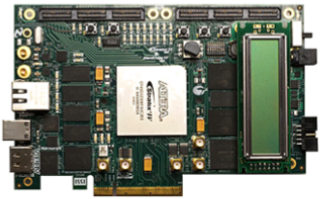
NANET-1
Base solution: data acquisition based on NANET-1 (Apenet group)
PFRING solution: still possible
Data decompressor: preprocessing on NANET FPGA before copy in GPU
Notes:
Nanet+decompressore e formato dati

Slide 6
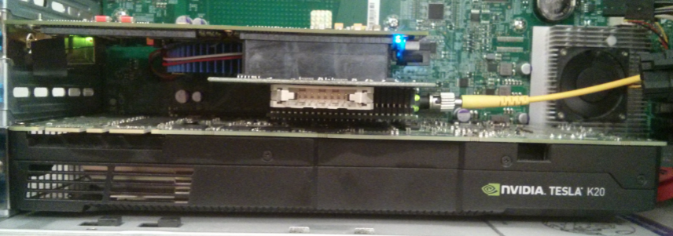
TTC board
SOB and EOB latched on NANET using a dedicated Mezzanine board on HSMC connector (Ferrara)
The board is ready for “L0TP-GPU” (i.e. it can communicate with LTU)
Precise time profiling using 25 ns counter running on NANET (resetted by SOB)
Notes:
Scheda ttc

Slide 7
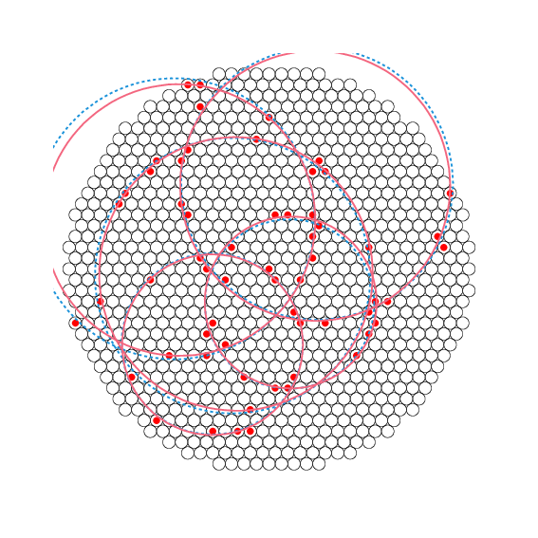
GPU Kernel
Multi-ring GPU Kernel (Almagest) triggered by data transfer.
2 sources data merging will be implemented in the kernel
MGP0 – source 0
“software”
MGP1 – source 0
MGP0 – source 1
….
GPU
NANET
“hardware”
MGP0 – source 0+1
MGP1 – source 0+1
….
GPU
NANET
Notes:
kernl

Slide 8
Test in August (1 week)
Test in august:
  Installation in ECN3
  LAV8: TEL62 LAV6-LAV7
Simulated data:
  Fake primitives from SL → completed after the CERN test
  Fake hits from TDC memory → opportunity to investigate the “DDRINIT” general problem (Cristiano is still working heavily)
Problem with NANET environment
  OS reinstallation (from Fedora to CentOs 6.5)
Small problem with TTC card
  Mechanical fragility of the HSMC connector → fixed.
Notes:
Test fatti

Slide 9
October run
Still 2 TEL62
  One spot, GPURICH trigger
Kernel
  Two sources “software” merging. Almagest. Short cut for single ring based on multiplicity (to be studied)
NANET
  1 Gb/s version: switch to merge links.
Intrinsic rate limitation:
  MGP=1 →800 Mb/s X TEL62 → about 5 MHz from the beam
  Limitation due to computing throughput of new kernel will be measured before the test
  Downscaling already implemented in TEL62
Notes:
Obiettivo run ottobre e test prelimianri (misura latenza)

Slide 10
October run goals
Measure the latency on completed system:
  Latching of “hardware” time (arrival in nanet, start of DMA end of computing, etc.) using PCI-express registry
Measure computing time and throughput
Understand bottleneck
Main goals:
  The system should not interfere with normal trigger
  The system should prove to be reliable
  End of R&D (still update possible before spring run → for instance: “NANET-10”, optimized kernel, small change in the “internal” communication data format, …)
Notes:
pfring

