Slide 1
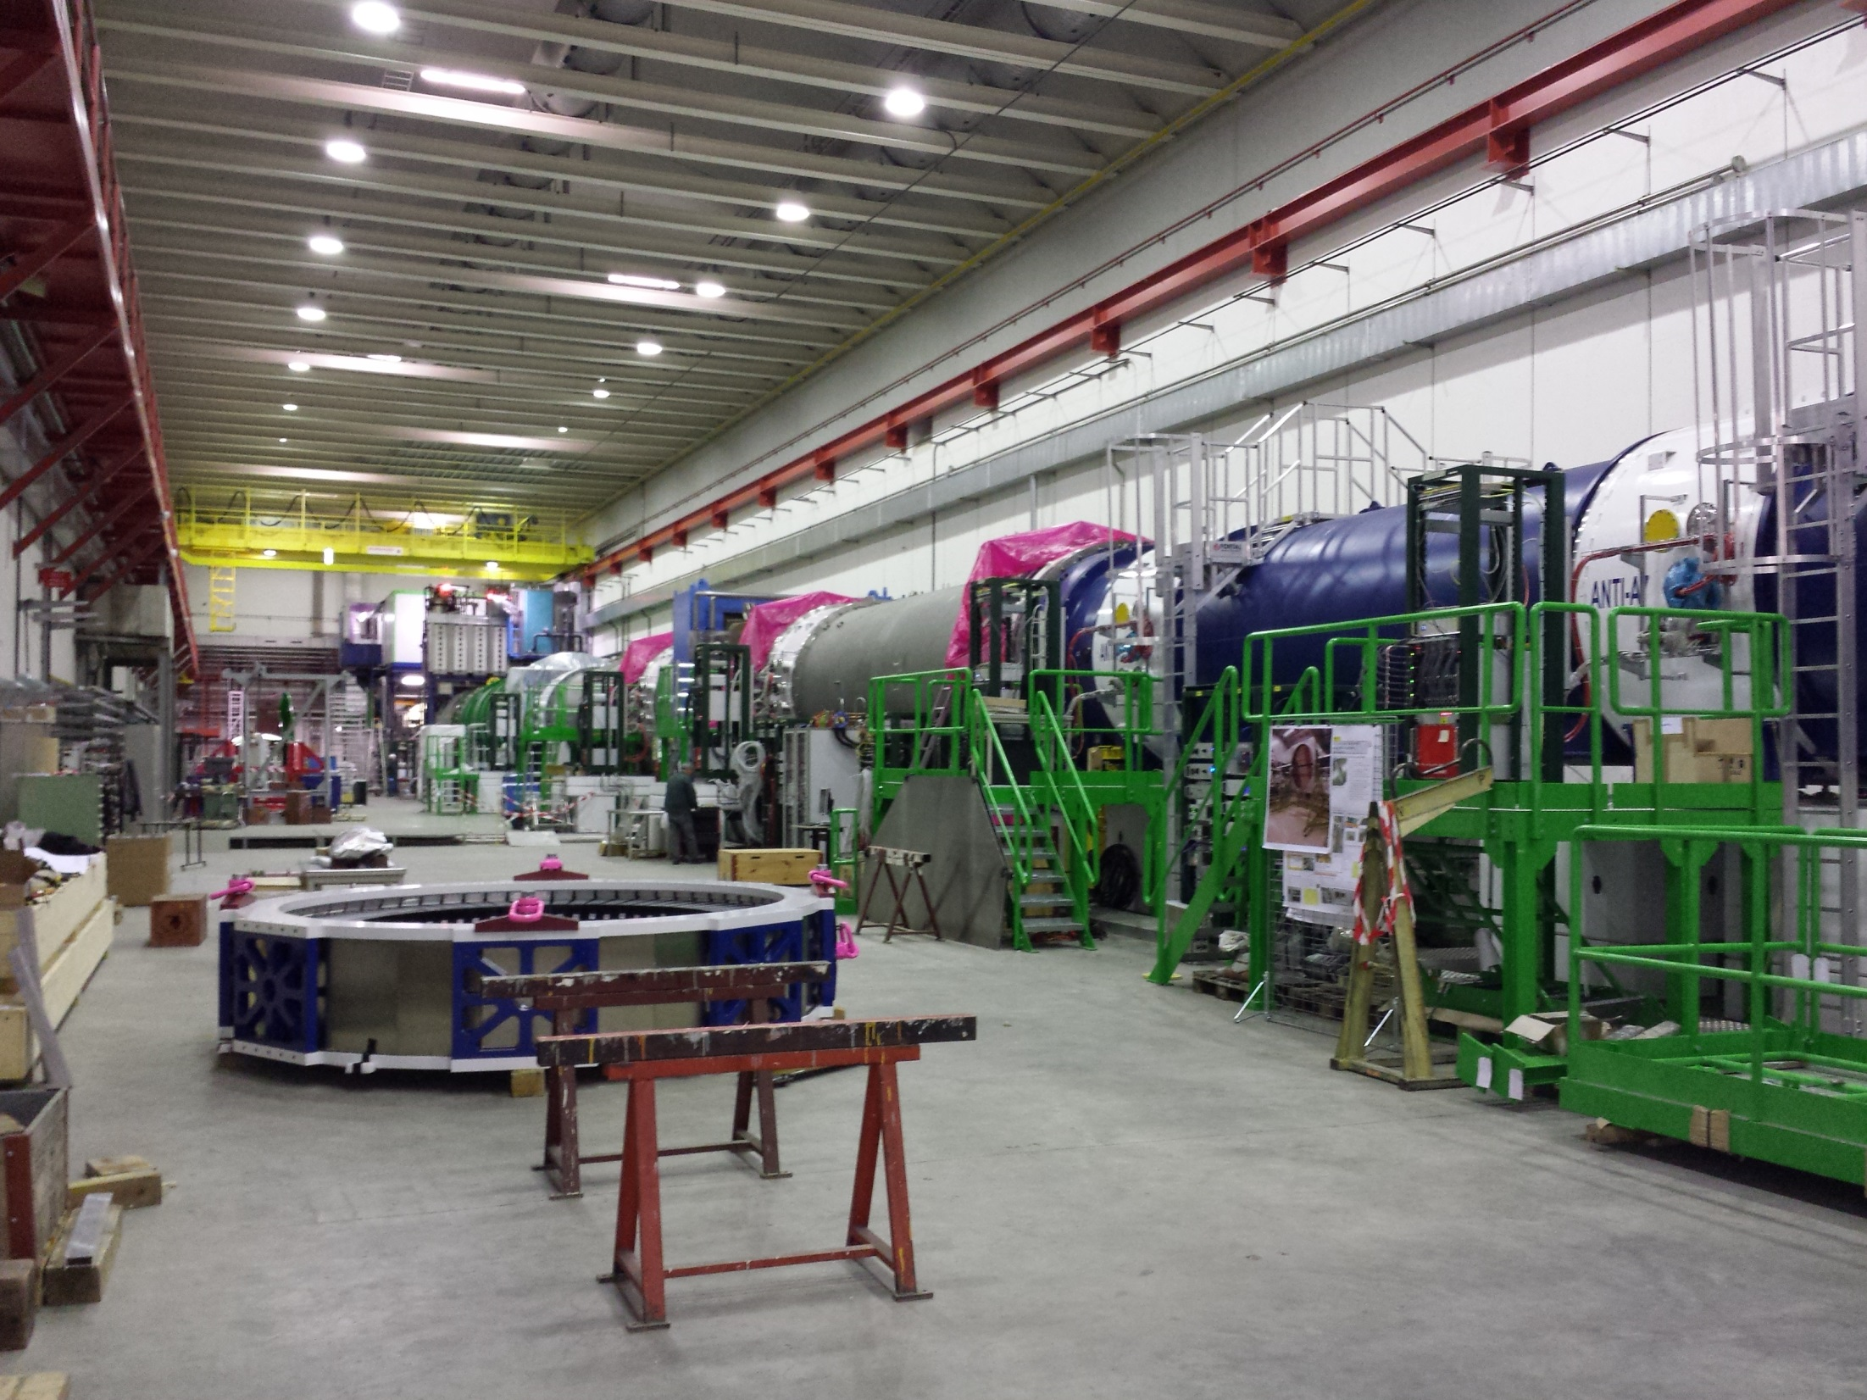
Status of the Installation
Ferdinand Hahn

Slide 2
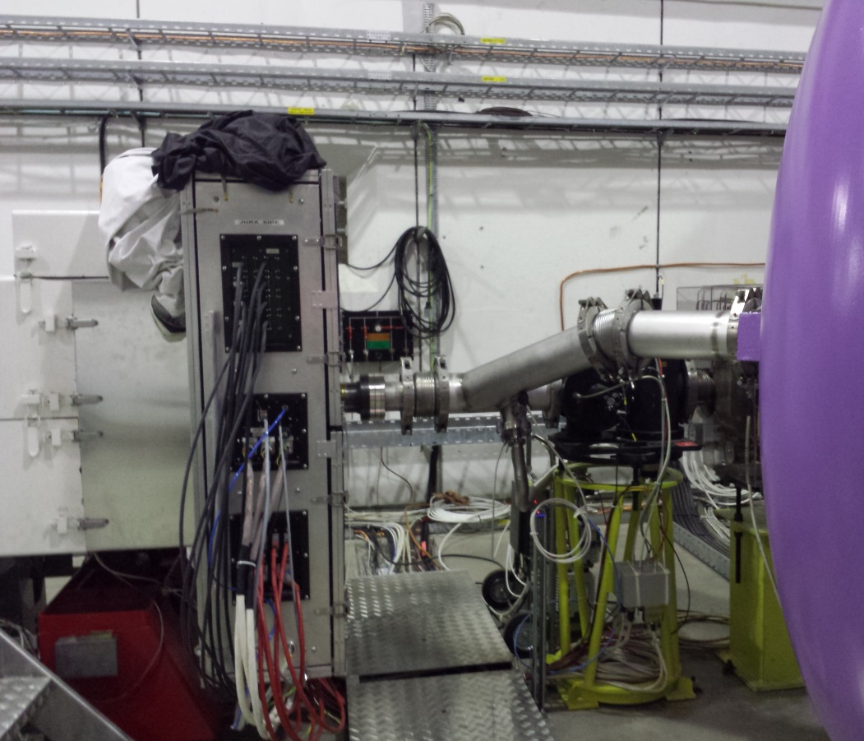
KTAG
5/8 sectors equipped
DCS system in pogress
DAQ commissioning in progress
Test pressure scan this week (t.b.c)

Slide 3
GTK
In the Pit:
Finish beam sector 3+4 by end of this week.
Vessels (1,2+3) are in place (alignment this week)
Cooling system installation started (expected operational > 22/09).
Detector Assembly:
Test assembly with dummy detector successfully done
Bottlenecks: carrier board, assembly work, testing,…
Tight schedule!
Target: Install 2 detectors…. for the start of the Run
3 stations equipped as of November

Slide 4
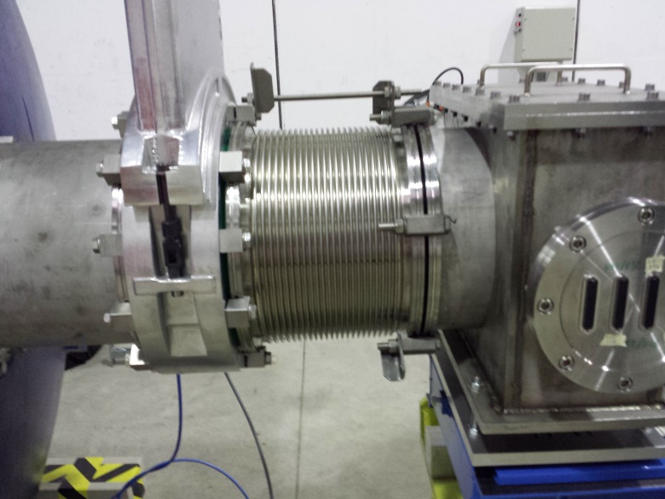
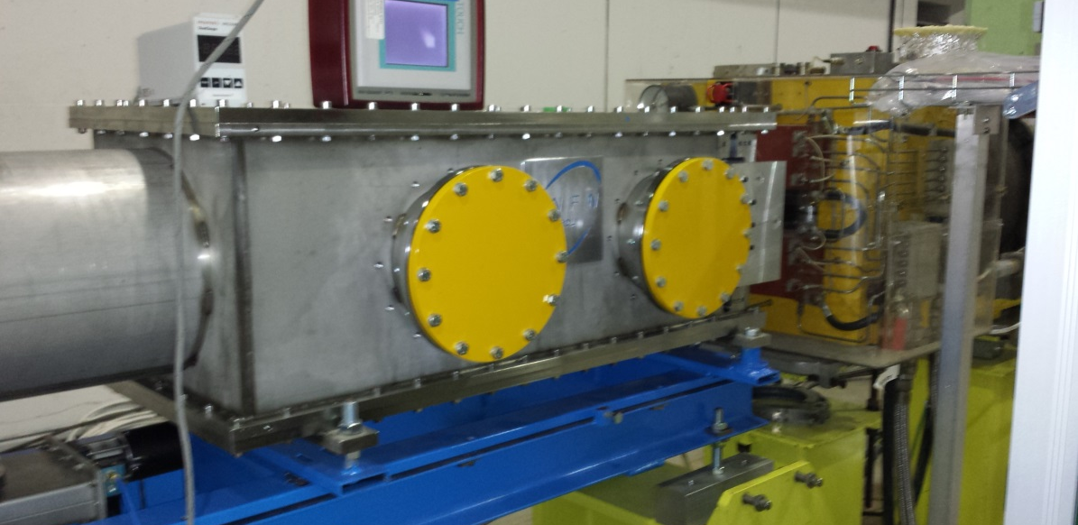
CHANTI
Detector installed
RO connection (feed-through Flanges missing) and test in September
Beam sector under vacuum
Commissioning in September

Slide 5
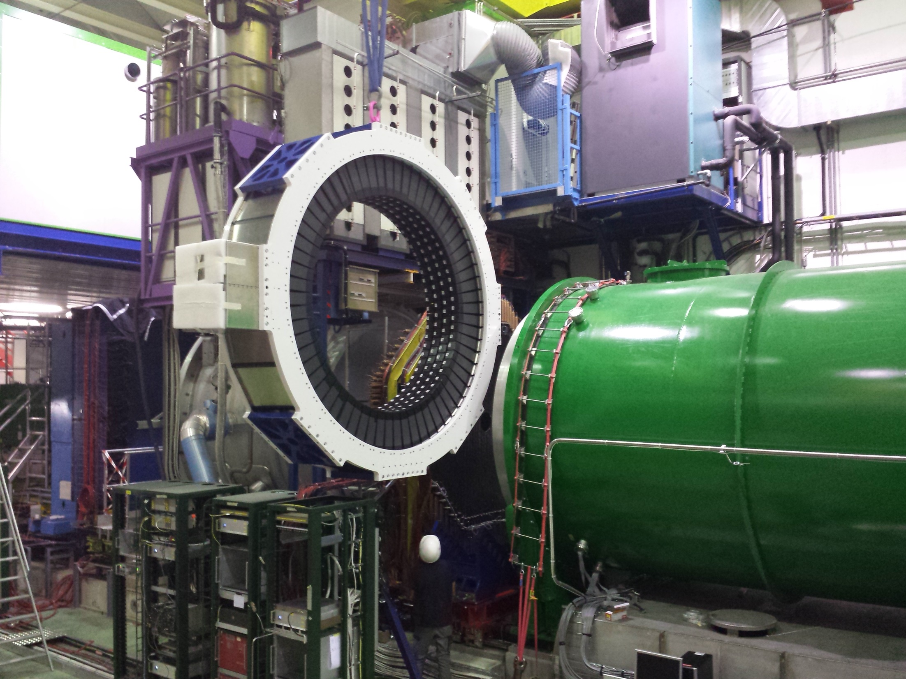
LAV 12 Installation on 28.08.2014

Slide 6
LAV
All 12 LAV’s are installed!
Modifiactions of roller width (done by Frascati Team)
RO boards + TEL’s are being installed
Commissioning well advanced
DCS okay.
Congratulations to the Frascati/Pisa Team for the excellent work!

Slide 7
Straw Tracker
Detector Installation
STRAW 1-3 installed
Straw 4 installation next week
Cabling done except for Straw 4
RO being tested (using 1 SRB)
24/32 SRB’s available for the start of the Run
May be delayed again
Target:
Trigger-less RO at the beginning
Possibly: all SRB’s and triggered RO in November.

Slide 8
RICH + Al Beam Pipe
Mirrors installed and aligned
Rear window closed
Suspension bar for beam pipe (installation ongoing)
Front window closure -> this week
Al- beam pipe installation in weeks 36+37.
Al Beam pipe Leak test (??)
RICH Cabling in in weeks 37+38
FE boards will be installed end September
RICH filling, perhaps, in first week of October
Schedule: tight, but do-able
Risk: RO commissioning time very short

Slide 9
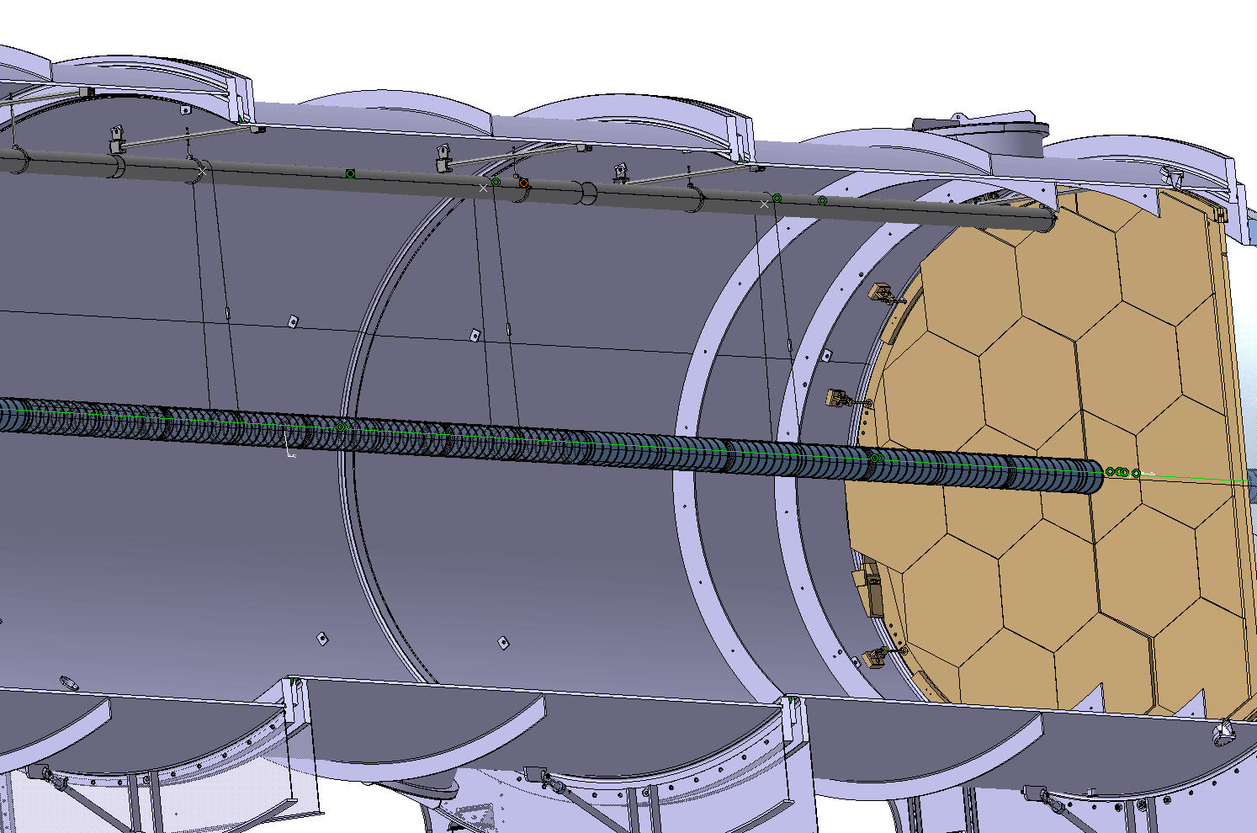
Beam Pipe Suspension

Slide 10
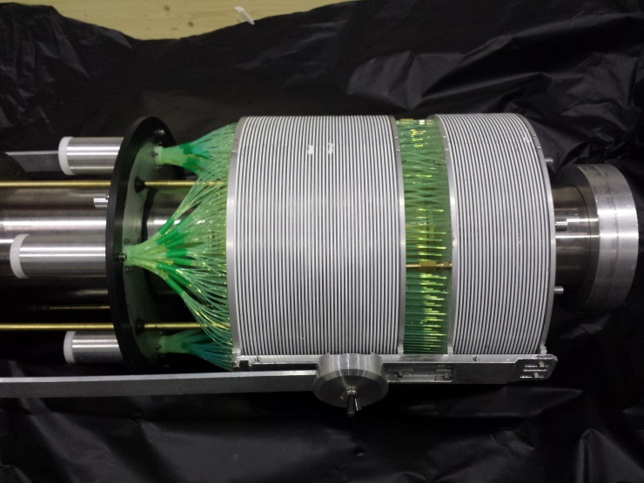
SAV
SAC:
Installed and aligned
RO / Gandolf being prepared
IRC:
Detector delivered
Installation possibly in week 37

Slide 11
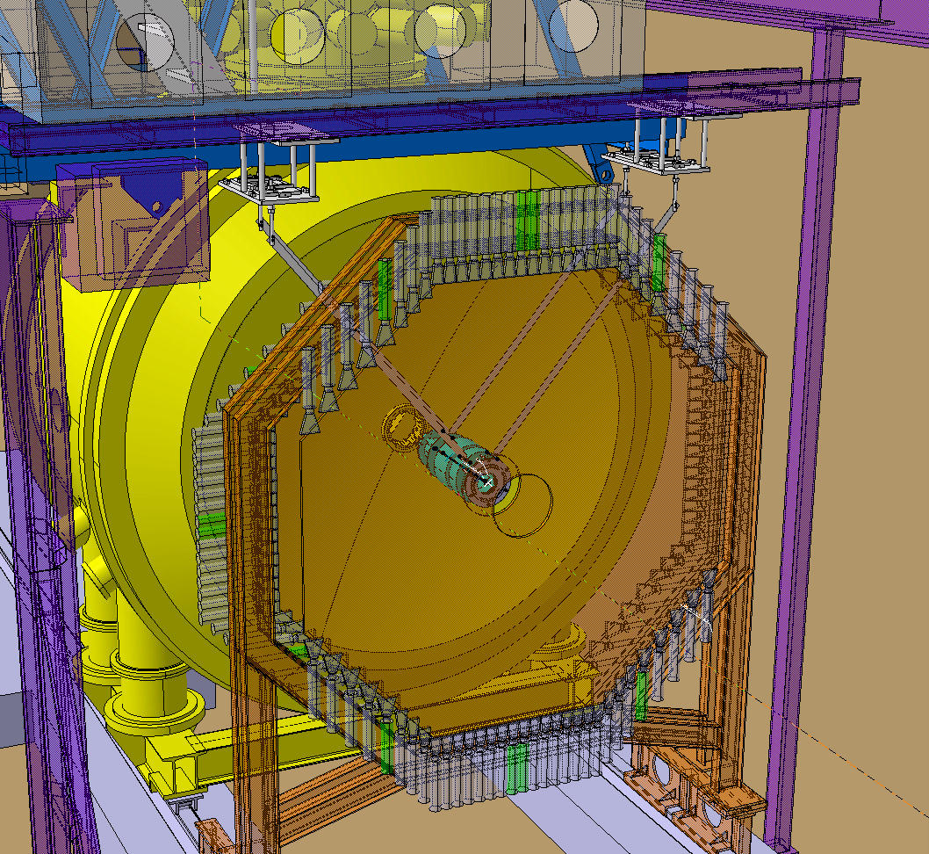

Slide 12
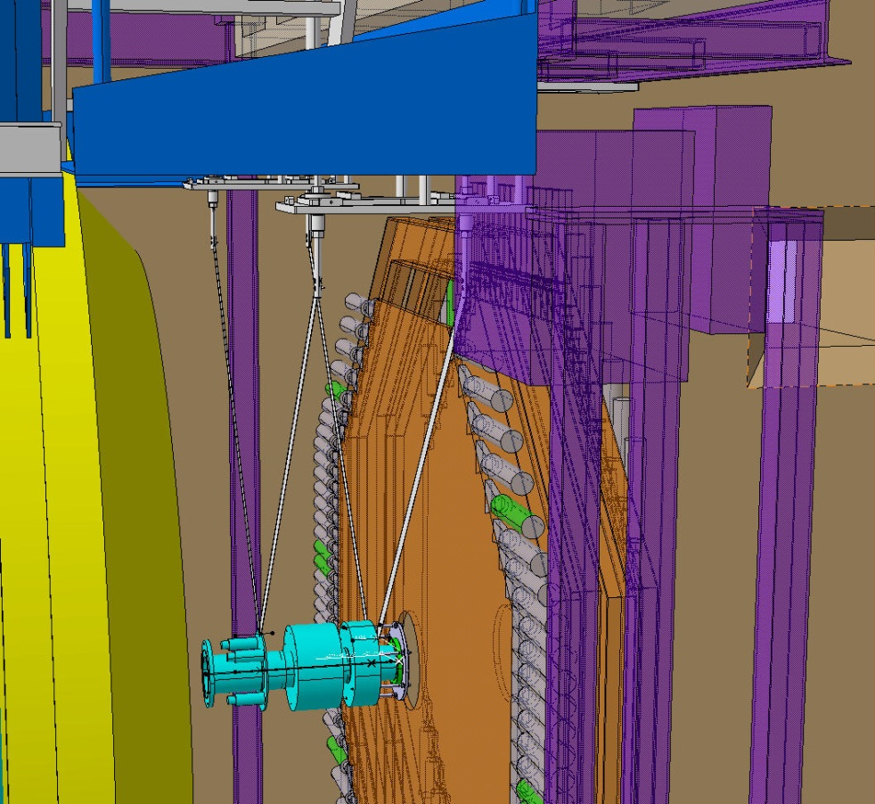
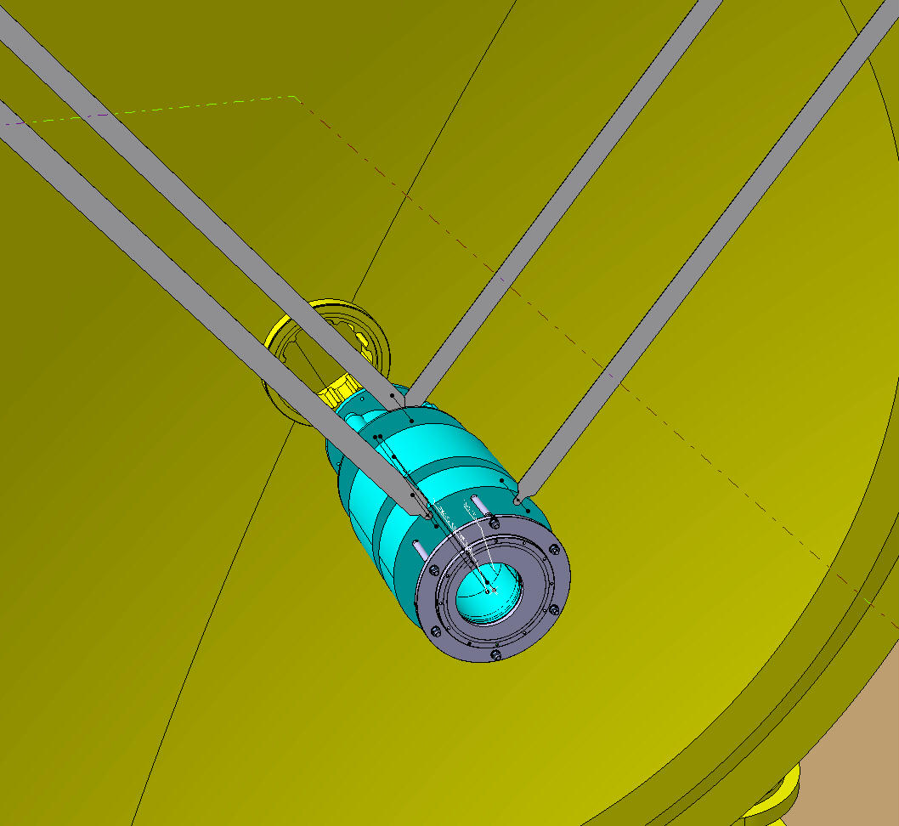

Slide 13
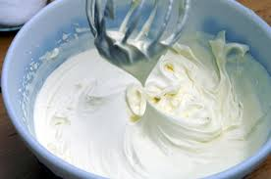
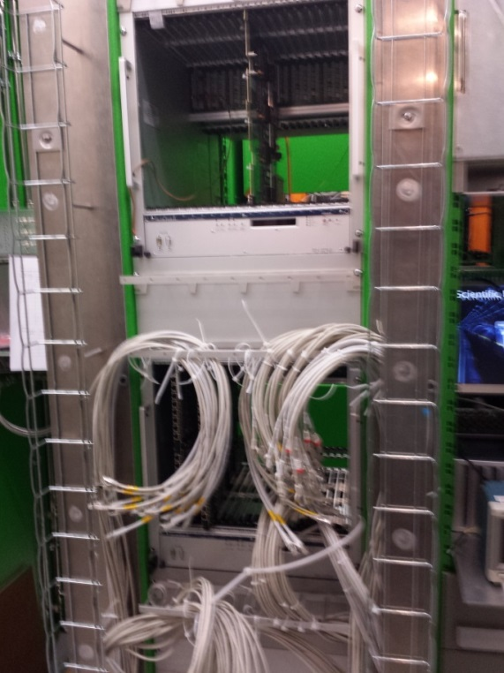
LKR + LKR L0
LKR hardware okay
CREAM RO installed and operational.
LKR L0 trigger
Hardware installation continous.

Slide 14
MUV
MUV3
Installation okay
RO still problematic:
New CFD board prototype could not be tested (problem with threshold DAC, intermittent contacts on the board,…)
Decision was made to go back to old CFD‘s (like in 2012), requires a lot of tuning work, which needs to be done in September.
MUV2:
Installation okay
CREAM RO (on loan from LKR) been prepared / details to be worked out…
MUV1:
Detector still in Mainz, status update in MUV WG
We have to evaluate this week, what is realistically possible

Slide 15
Status Vacuum System
Berthold Jenninger
Decay tube (Sector 5)
Vacuum instruments installation completed
Remote control of all instruments (apart cryopumps) ready
Pressure reached during Decay tube commissioning:
1.2E-6 mbar (decay area)
3.2 E-6 mbar (straw area)
Still water outgassing dominated.
No major leaks on system, neither on vacuum tank nore on Straw system.
Other sectors
Remote control of other sectors not yet ready (2 weeks necessary).
Sector 1: being pumped
Sector 2: start pumping early next week
Sector 3: being being closed, pumping expected end of next week (week 36)
Sector 4: pumped and leak tested
Sector 6 (LKr): switch to new pumping and control by week 37
Interlocks will be available by week 38

Slide 16
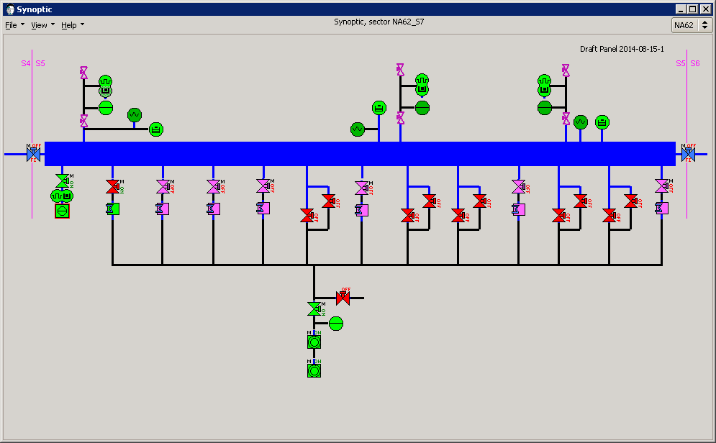
Berthold Jenninger
Synoptics of Decay tube vacuum control
Vacuum gauges
Decay Tank
Turbo group
(DN250)
7x Cryopumps and DN620 gate valves
5x Roughing valves
(DN25 and DN40)
Roughing line
Roughing pumping group
Color code indicates present status (on, off, open, close, communication , under- or overrange ...)

Slide 17
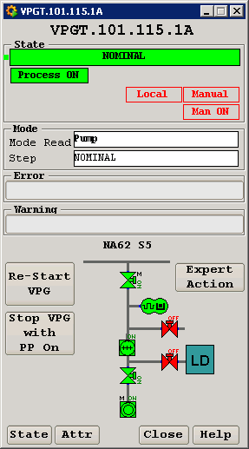
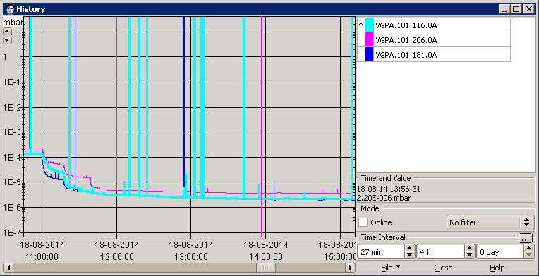
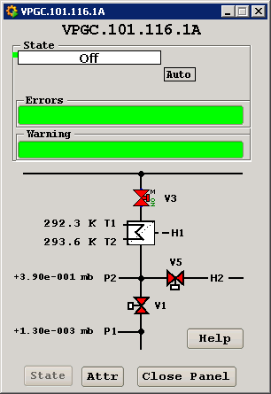
Details and history
Berthold Jenninger
Examples
Details on Turbo pumping group
History penning gauges when starting cryopumps
Instabilities in profibus network understood and resolved
Turbo pumping only
(one month)
Details on Cryo pumping group
Start cryopumping

Slide 18
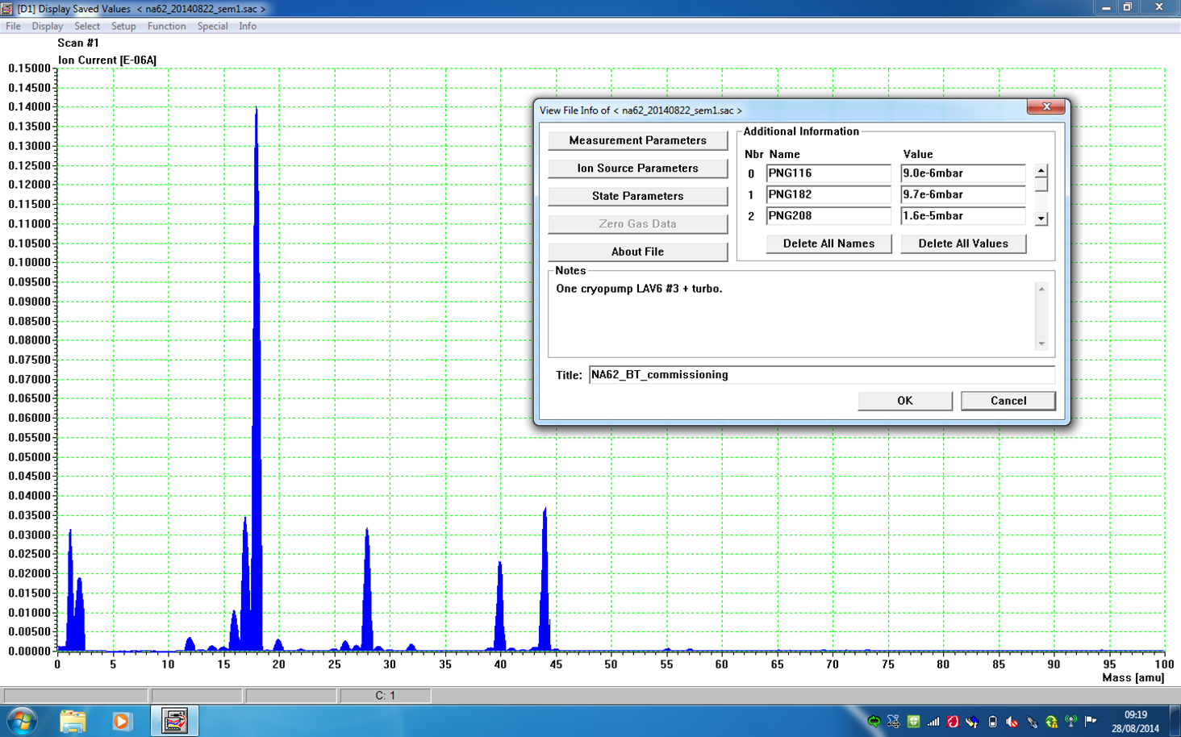
Berthold Jenninger
Residual gas spectrum shortly before venting
Only one cryopump connected
18
H₂O
28
N₂
CO
C₂H₄
44
CO₂
Expected ratio Ar/CO2: 0.15
(supposing same pumping speed for Ar and CO2,
i.e. only pumping on second stage of cryopump)
2
H₂
40
Ar
Measured Ar/CO2: 0.6
(probably first cryopump stage at 90 K contributes to CO2 pumping)

Slide 19
Conclusions
Detector installation is getting to the end.
Remaining attention areas:
Al beam pipe + IRC
RICH-Straw Link + Straw 4
RICH RO
GTK completion
LKR L0 installation
MUV3 CFD board tuning
MUV1 installation
DAQ commissioning work
Hardware deliveries drive the schedule

