Slide 1
Status and INSTALLATION OF PMTs and FE
F. Bucci
INFN Florence
RICH Working Group, 02/09/2014

Slide 2
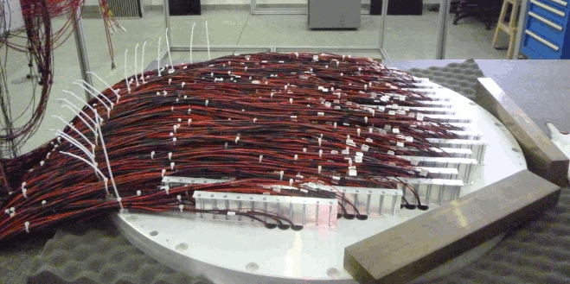
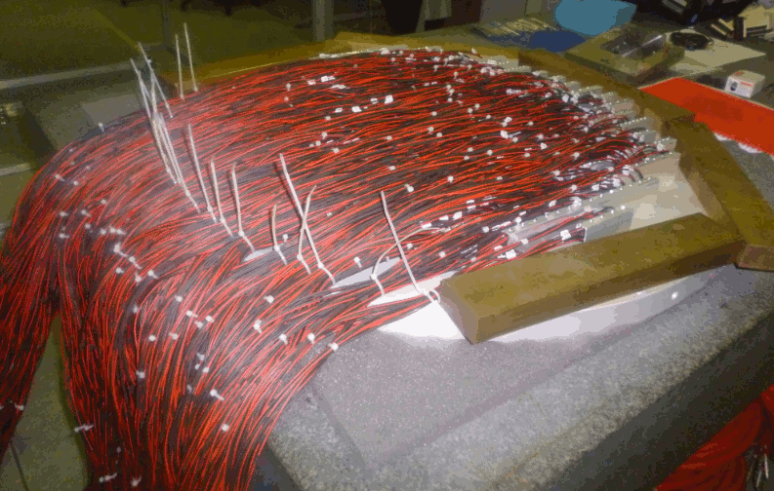
PMTS INSTALLATION
Installation of PMTs on the Jura and Saleve lodging disk completed
Looked at the signal shape and measured the rate of each PMT
Jura lodging disk
Saleve lodging disk

Slide 3
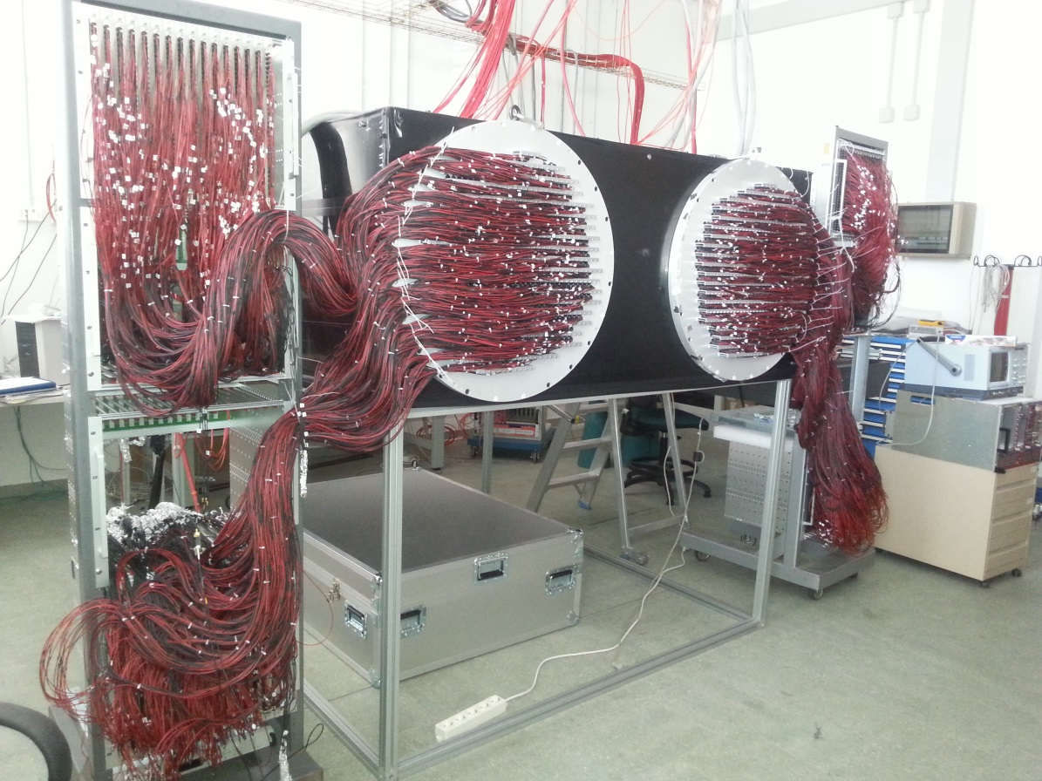
PMTS TEST
Installed the disks on a light tight box and illuminated with a laser
Plugged all the HV cables of the PMT dividers in the HV distribution boards located at the same distance as in the experimental area

Slide 4
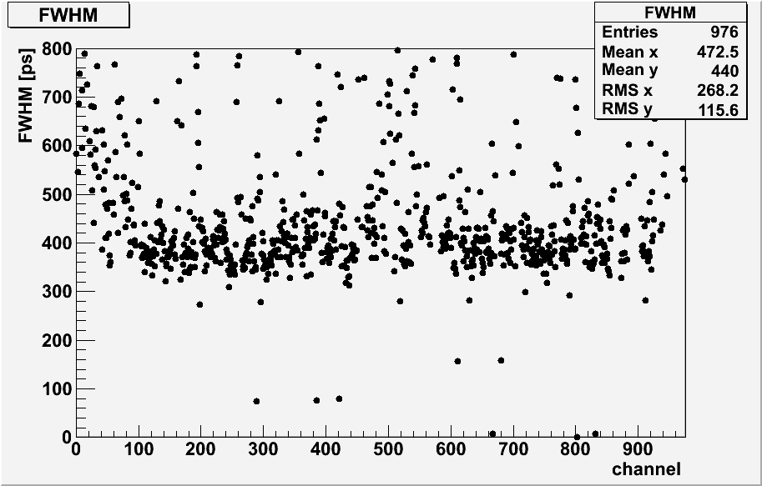
JURA PMT TEST
Data acquisition performed with 2 old FE boards (48 channels) and 1 CAEN TDC (128 channels)
before slewing correction
after slewing correction
3 dead channels

Slide 5
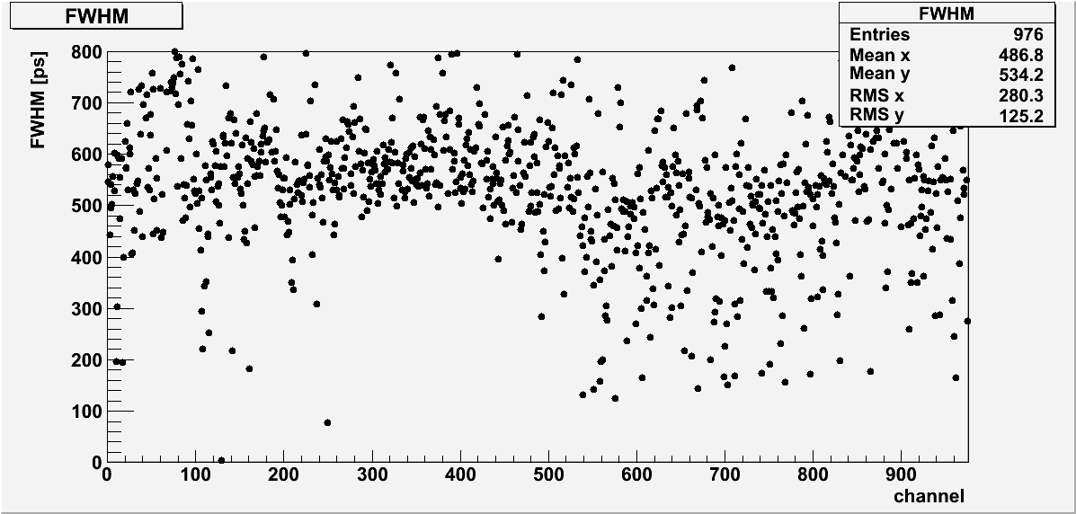
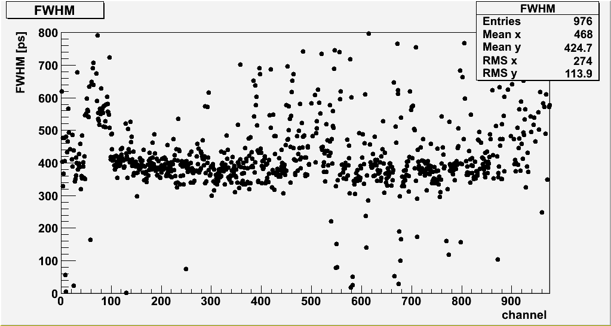
SALEVE PMT TEST
before slewing correction
after slewing correction
3 dead channels

Slide 6
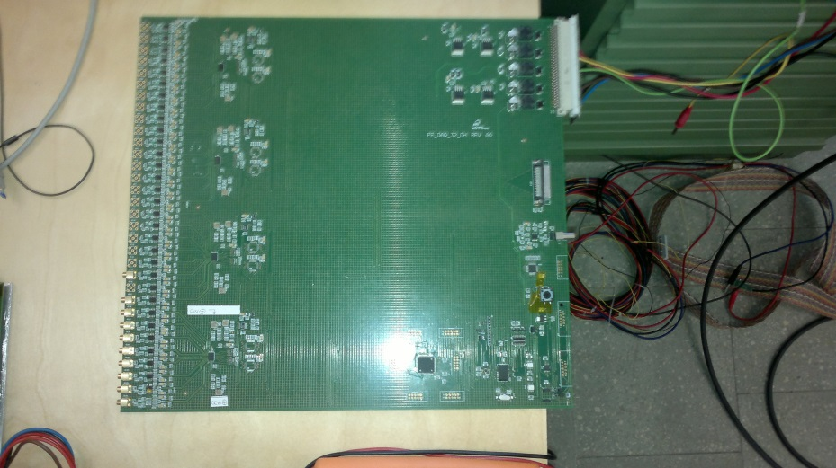
FE STATUS AND TEST
New FE board prototype is ready
Two different setup still under testing
Performances look promising
Order to be placed within the end of the week
Full production should be finished at the end of September
The arrival at CERN is foreseen at the beginning of October

Slide 7
PMTS AND FE INSTALLATION SCHEDULE
On Monday, the 8th of September, we will bring at CERN all the electronics except the FE boards
08/09-12/09: Intallation of quartz window disks, hats and PMT lodging disks (Fernando, Massimo, Mauro, me)
15/09-19/09: Hats and PMT lodging installation and cabling (Fernando, me)
22/09-27/09: Test of the full electronic chain by using a FE board prototype (Mauro and me)
29/09-03/10: Installation of the FE boards and cabling

Slide 8
CONCLUSIONS
The PMTs with their dividers have been installated and tested on the two lodging disks
FE boards still missing but prototype ready and under test
Full FE boards production foreseen by the end of September
All the electronics except the FE boards will be carried and installed at CERN starting from next Monday
FE boards schedule tight but still feasible

