Slide 1
Shaper study
Collected runs
Numerical Shaping algorithm
results

Slide 2
Runs collected
run energy run cond HV
100 100 shaper 750
101 100 = 850
102 100 = 1000
10 3 100 No shaper 750
104 100 = 850
105 100 = 1000
106 100 = 800
107 100 = 900
Preparato sw run analizzato 104

Slide 3
Shaping algorithm used
Time A.U.
Time A.U.
Algo details:
We have been sampling the waveform@10GHz
L,G =Number of samples in
In this study Δ t_{L} = Δ t_{G}= 30 ns

Slide 4
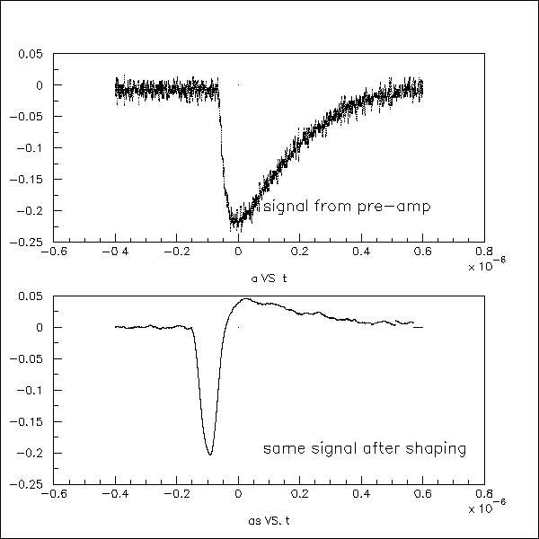
Shaped signal example
Noise?

Slide 5
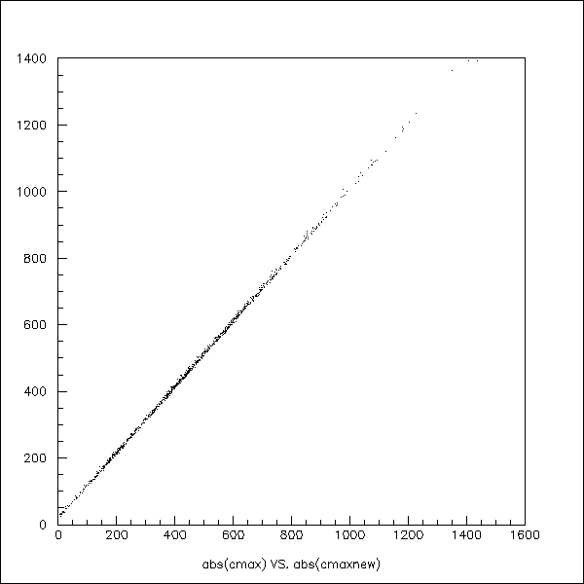
Correlation plot among shaped and not shaped peak value
Shaping does not
change peak value (energy)

Slide 6
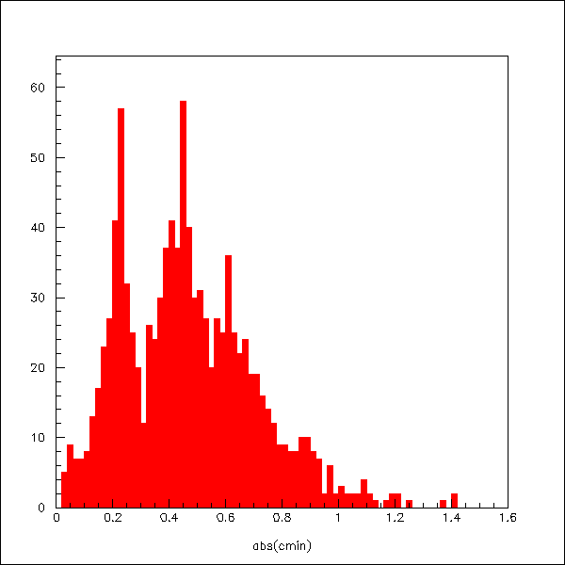
Unfortunately……
Large peaks in energy spectra:
Not all energy is conteined
beam spread.

Slide 7
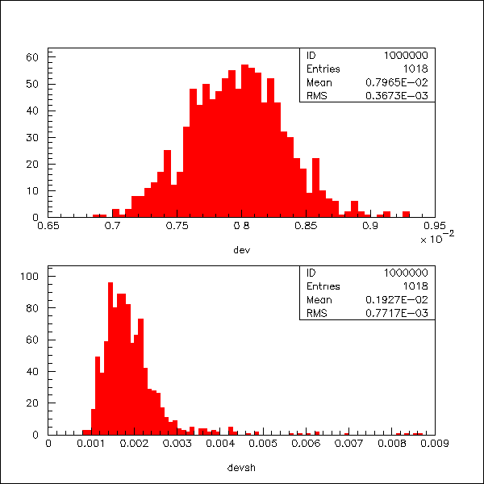
But….Noise results on run 104
Sigma=8mV no shaping
Sigma<2mV after shaping

