Slide 1


Sezione di Roma
Università degli studi di Cassino e del Lazio meridionale¹
ENEA centro ricerche «Casaccia»²
Sezione di Padova
Università degli studi di Padova³
Irraggiamenti su dispositivi GaN
C. Abbate¹, S. Baccaro², G. Busatto¹, S. Fiore², S. Gerardin³, F. Iannuzzo¹,
A. Sanseverino¹, G. Spiazzi³, F. Velardi¹
Gruppo V
APOLLO
Alimentatori di POtenza per aLti Livelli di radiaziOne
Roma, 9 Dicembre 2013
Workshop conclusivo esperimento APOLLO
Dipartimento di Fisica, Università degli studi “La Sapienza”
ROMA

Slide 2
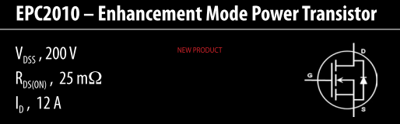
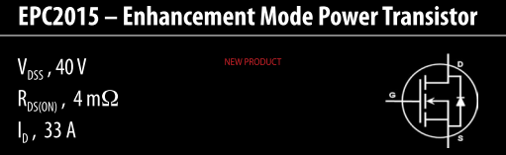


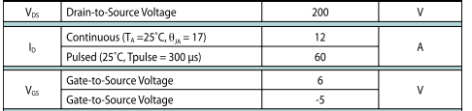
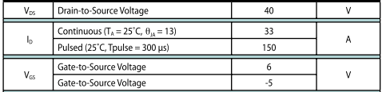
GaN HEMTs: Devices
GaN High Electron Mobility Transistors
  Enhancement-mode GaN transistors
  Manufactured by Efficient Power Conversion (EPC)
  Blocking voltage 40/200 V
  Maximum I_{DS} is 12/33 A continuous, 60/150 A pulsed
From EPC website

Slide 3
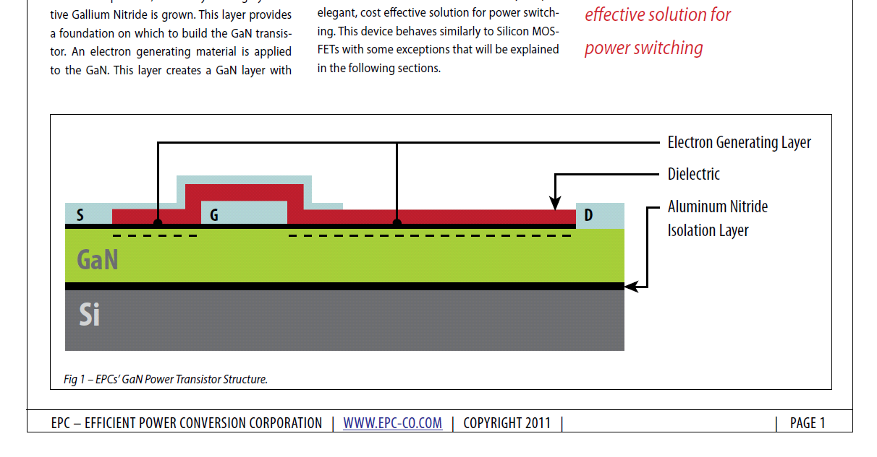
GaN HEMTs: Potential for Radiation Hardness
Material
  GaN is quite hard to displacement effects. Minimum energy to displace GaN atoms is larger than in Si and GaAs, close to SiC
Heterostructure
  Channel is formed through band engineering
  In principle, no dielectric layers are used underneath the gate, so tolerance to total dose is expected to be excellent
From EPC website

Slide 4
GaN HEMTs: Potential for Radiation Hardness (2)
Questions marks
  No information are provided as to how enhancement-mode has been achieved
  Some additional layers have been probably introduced to engineer the positive threshold voltage
  What’s the impact on radiation hardness?
From EPC website

Slide 5
Irradiation campaigns on GaN
Gamma rays¹
Heavy ions²
Combined Gamma/Heavy ions^{1,2}
Protons³
Facilities:
ENEA Calliope
Tandem LNL
CN LNL

Slide 6
Combined Gamma/Heavy ions
Irradiation campaigns on GaN

Slide 7
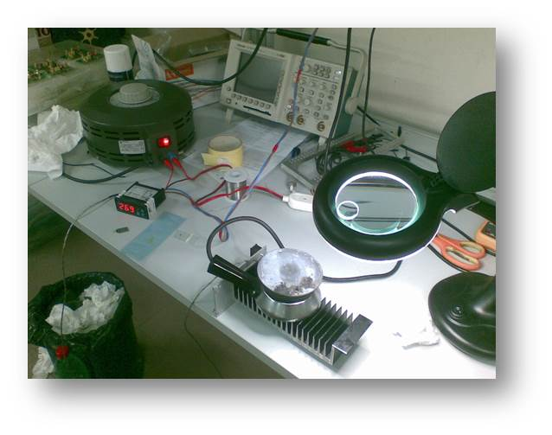
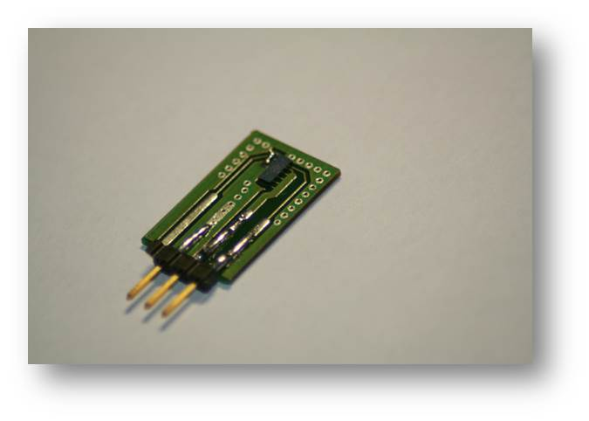
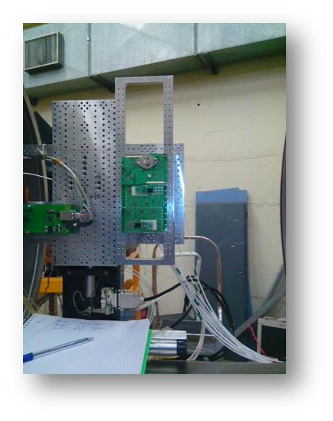
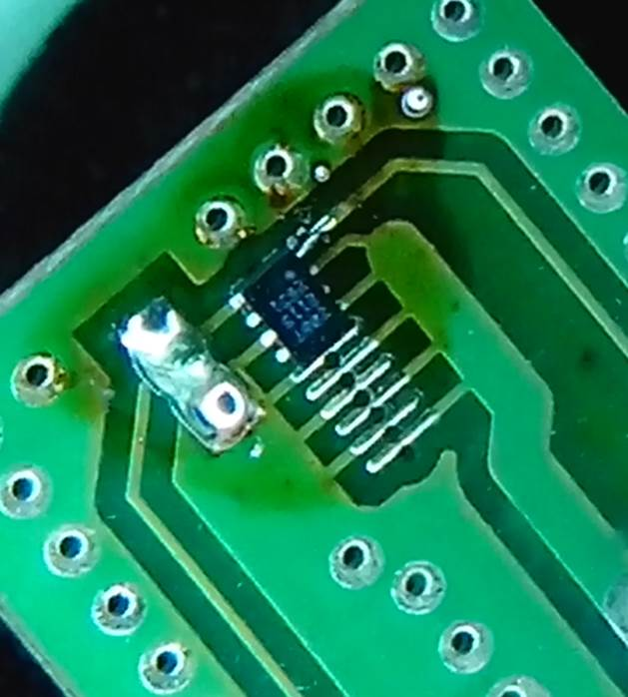
Sample preparation
Device: EPC 2015
ratings: 40V 33A
Detail of the used PCB (device is not EPC2015)

Slide 8
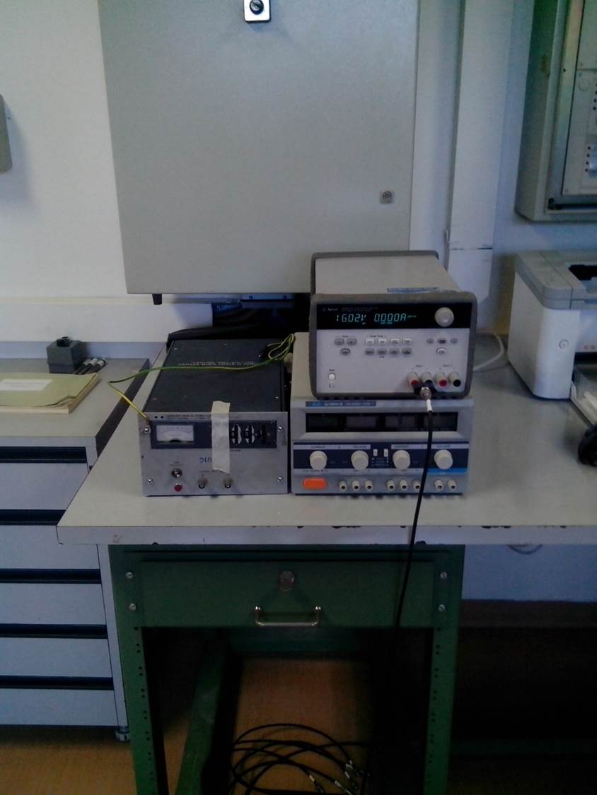
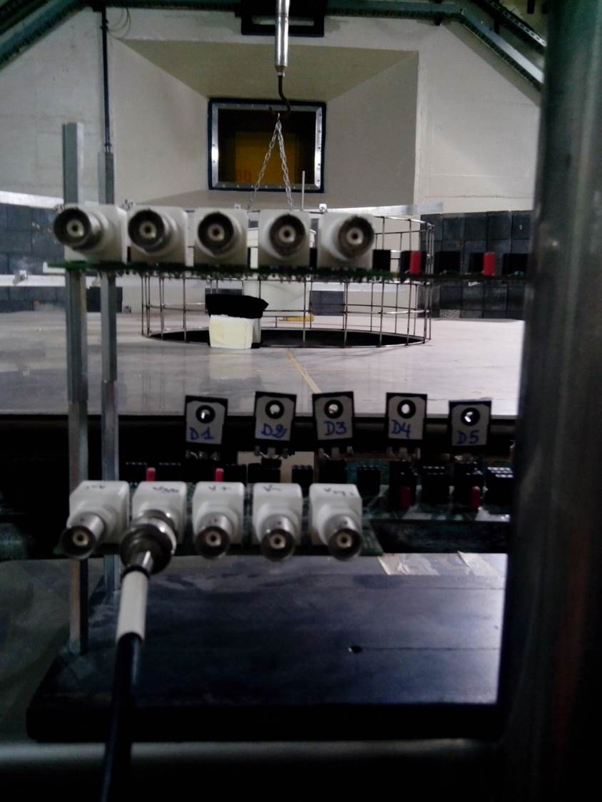
Gamma irradiations
Dose steps:
  0 Gy (Fresh)
  570 Gy
  1.1 kGy
  1.7 kGy
  5.2 kGy
  10.8 kGy
Bias conditions:
  Vgs=+4V
  Vds=0

Slide 9
Heavy ion irradiation
Species
  ¹²⁷I at 276MeV
Irradiated samples:
  Fresh
  annealed Fresh
  annealed 1.1kGy
  annealed 1.7kGy
  annealed 5.2kGy
  annealed 10.8kGy

Slide 10
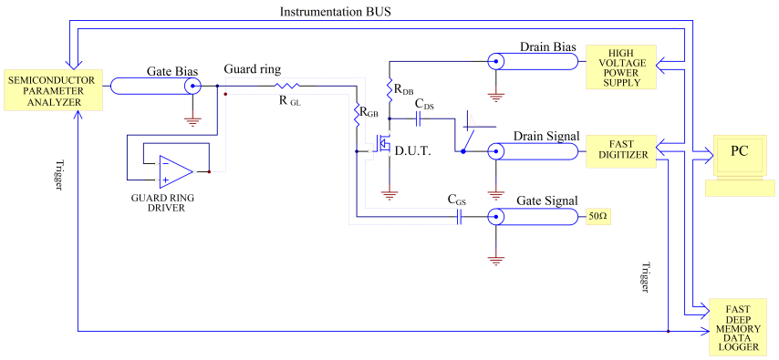
Experimental setup for heavy ion irradiations
R_{DS} is very critical for GaNs:
  high values (≈1MΩ) slow down pulses (plenty of double pulses that frustrate statistics) and degrades S/N ratio
  low values (≈50Ω) filters out the pulse signals

Slide 11
Measurement procedure
Collected waveform population at Vds=30V
Scatter plot
Average charge

Slide 12
Results (1)
Annealed fresh
  sample-to-sample variability!
D1A
D4A
D2A

Slide 13
Results (2)
Increasing gamma doses
570Gy
1.72kGy
5.15kGy
10.9kGy
Difficult interpretation, but no rupture

Slide 14
Gamma irradiation: conclusions
New experimental setup allowed acquiring large quantity of samples for the sake of statistics
Sample-to-sample variability is to be faced
Hardly interpretable dependence of the generated charge on the applied voltage
Further analyses with higher surface energy loss (less range?) should be performed in the future
Tested device appear to be very hard to combined irradiation

Slide 15
PROTON IRRADIATIONS
Irradiation campaigns on GaN

Slide 16
Proton irradiations
Low-energy proton irradiation at Laboratori Nazionali di Legnaro
  3-MeV protons
  Fluence up to 4∙10¹⁴ p/cm²
  Energy is too low, to give rise to secondary particles ⇒ no indirect SEE
  Ionization and displacement damage

Slide 17
Proton irradiations (2)
DC parameters have been measured before and after 1.8 MeV proton irradiation
Observed effects include:
  Increase in gate current
  Threshold voltage reduction
  Transconductance drop
We investigated damage dependence on
  proton fluence
  blocking voltage

Slide 18
Post-rad Gate Current – EPC2010
Device exposed to 10¹⁴ p/cm² in unbiased conditions
Increase in gate current at all voltages, up to one order of magnitude
More pronounced for negative voltage
Some room temperature annealing

Slide 19
Post-rad Drain Current
Device exposed to 10¹⁴ p/cm² in unbiased conditions
Unexpected decrease in threshold voltage (1V)
Degraded substreshold slope
Modest room-temperature annealing

Slide 20
Post-rad Transconductance
Device exposed to 10¹⁴ p/cm² in unbiased conditions
Peak transconductance drop, more than 30%
Drain current almost unchanged: threshold voltage reduction offset transconductance degradation

Slide 21
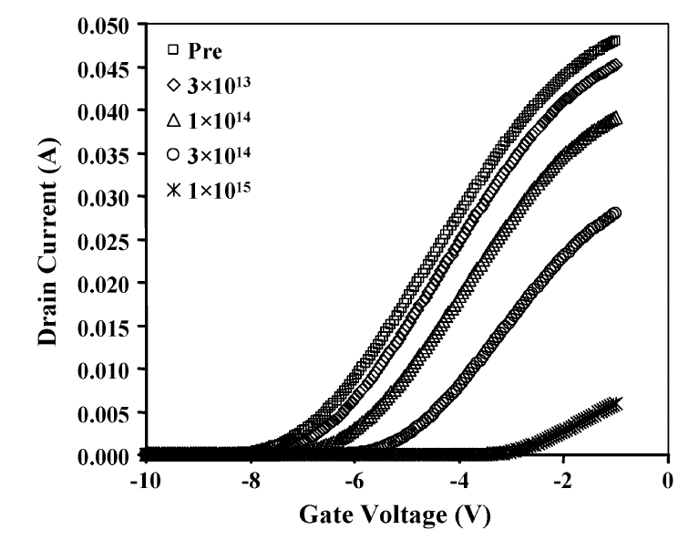
Literature Data (1)
From Karmakar et al., IEEE-TNS 2004
Drain current decrease is typically reported on depletion-mode devices in the literature, in contrast with the behavior of EPC samples
Difference due to unknown process steps or introduction of dielectric layers?

Slide 22
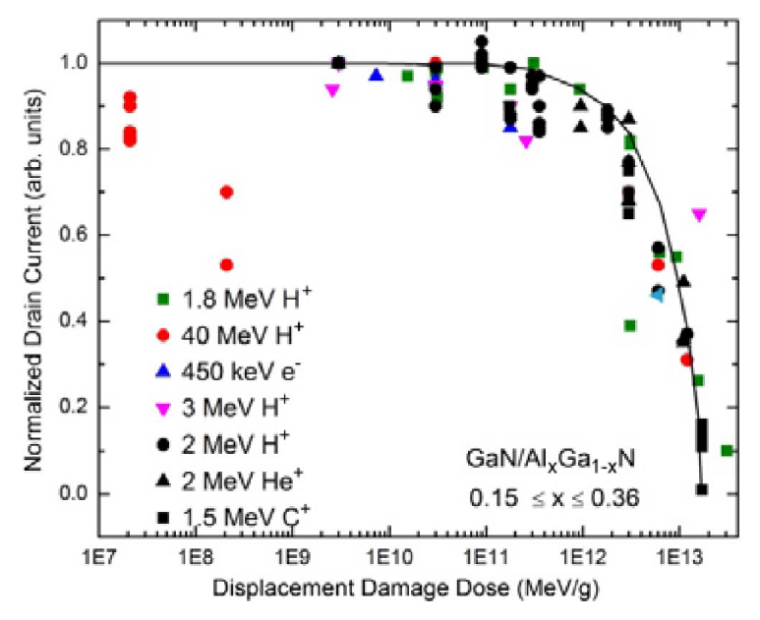
Literature Data (2)
From Weaver et al., IEEE-TNS 2012
Compilation of several test data over the course of ten years for GaN HEMTs
All devices show decreases in drain current

Slide 23
Proton irradiation: conclusions
Small dependence of degradation on blocking voltage: 40V vs 200V
Small dependence of degradation on proton fluence
Sample-to-sample variability
Possible superimposition of displacement effects and ionization effects
Unbiased conditions may not be the worst-case, if ionization effects are present
Degradation only at very high fluence of low-energy protons (worst-case condition for ionization and displacement)

