Slide 1
Company Profile

Slide 2
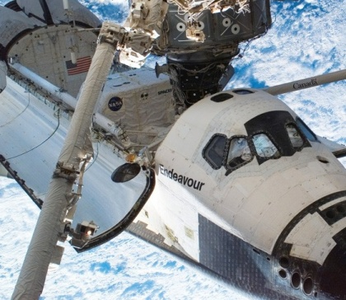

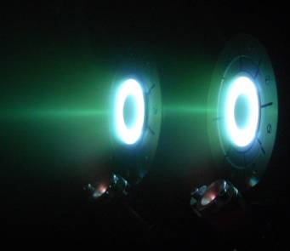



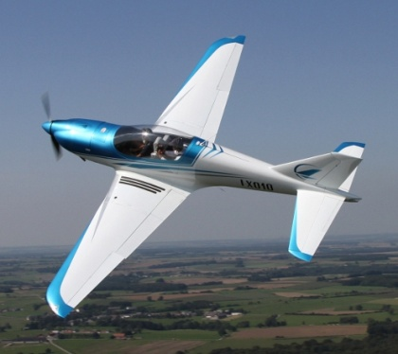

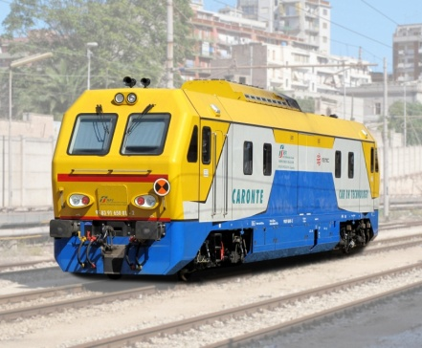

A worldwide leading Transportation and Aerospace Group
SYNERGIC HIGH-TECH COMPANIES WITH 750+ HIGHLY SKILLED EMPLOYEES
AEROSPACE
AEROSPACE
AVIATION
RAILWAY

Slide 3
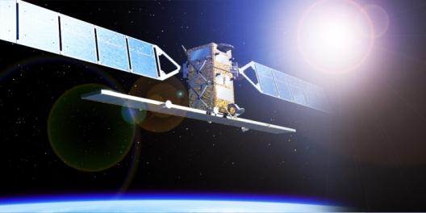

Company Overview
SITAEL S.p.A. is an Italian Medium Enterprise able to cover all the processes needed for the Design, Development, Production and Qualification of Instruments, Electronics and Microelectronics Systems compliant with high reliability standards.
Furthermore, with the support of selected partners, SITAEL is able to provide turn-key Microsatellites Based Solutions for Earth Observation Applications and Services.
Counting on more than 150 high qualified employees and state-of-the-art facilities, SITAEL is strongly involved into Aerospace and Industrial Markets.

Slide 4
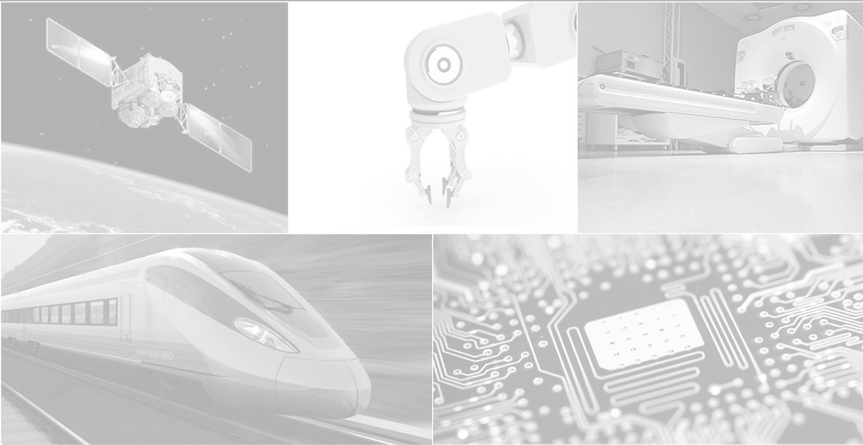

History
April 2010
October 2010
December 2011
Acquisition by Angelo Investments
CAEN AURELIA SPACE became SITAEL Aerospace
Merger between SITAEL Aerospace and MEL SYSTEM into SITAEL SpA
Space activities merger between Aurelia Microelettronica and CAEN Aerospace into CAEN AURELIA SPACE
June 1994
December 2009
CAEN Aerospace and Aurelia Microelettronica established as CAEN spin-off

Slide 5
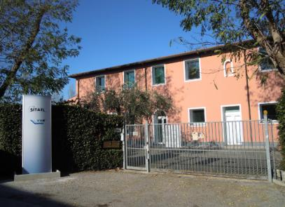
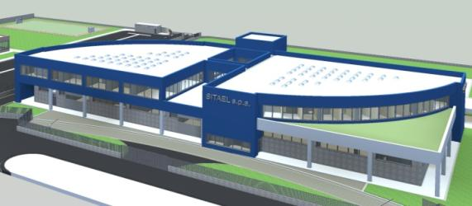
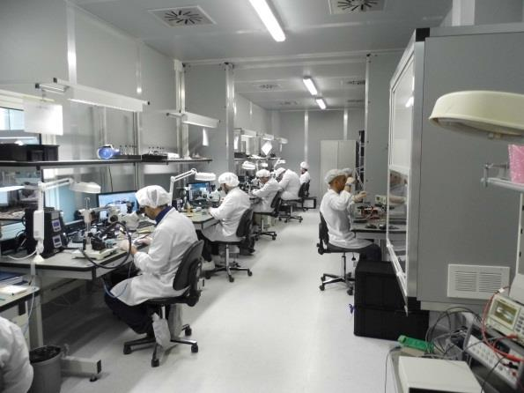
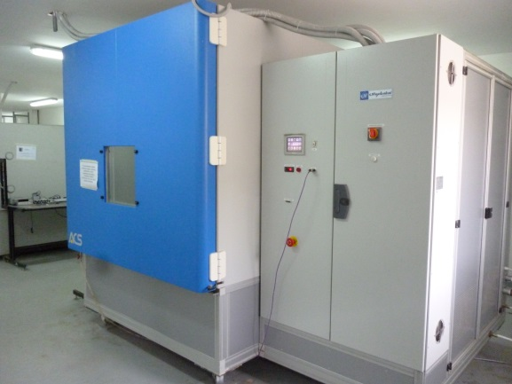
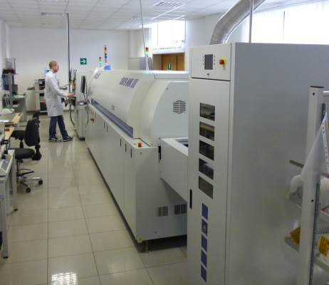
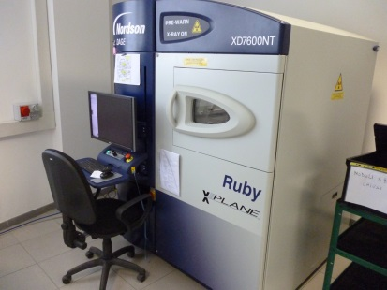
Plants and Facilities
Headquarters in Modugno (BA) – Design, Engineering and Production
Premises in Pisa – Design and low volume production
10000 m² new Headquarters under construction in Bari
  Qualified production line for space activities
  Large area class ISO 8 Clean Rooms
  Automatic Assembly Line
  Anechoic Chamber
  Mechanical Test Facilities
  Thermal Chamber
  X-Ray Machine

Slide 6
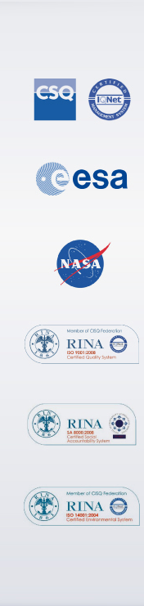
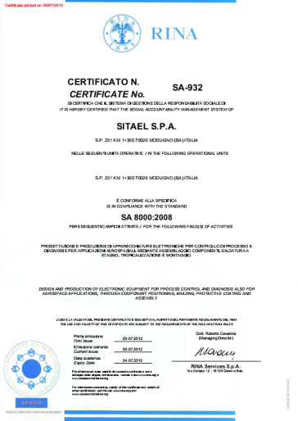
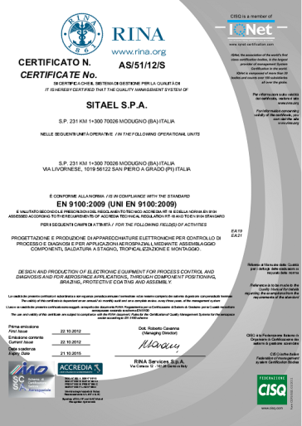
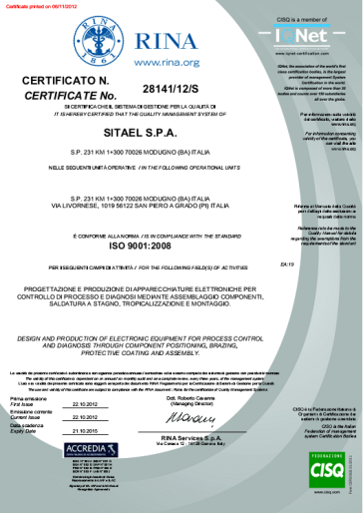
Quality Assurance Certifications
Aerospace certification ISO/EN 9100
ISO 14001:2004
SA8000

Slide 7
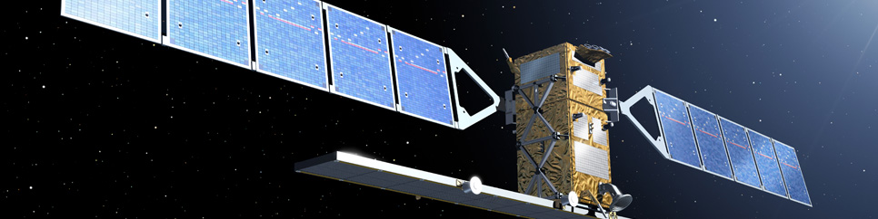
Aerospace
Notes:
7

Slide 8
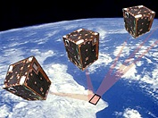
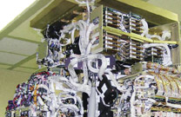
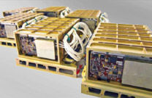
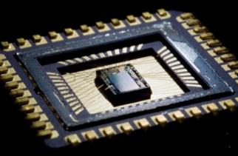
Aerospace Competences
Systems
Microsatellites
Sub-Systems
Small instruments
Sensors and Detectors
Electric Propulsion
AOCS
Equipments
Spacecraft Electrical Power
  Control Electronics for Complex Systems
  Spacecraft Data and Communications
  Electrical Ground Support Equipments
Microelectronic Devices
Rad tolerant Analog, Digital and Mixed-Signal ASICs
Digital IP Cores for Complex FPGAs
Notes:
8

Slide 9

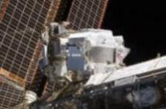
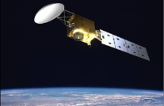
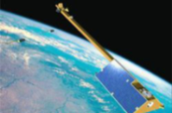
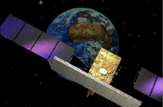
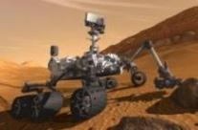






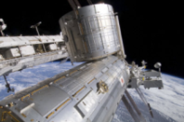
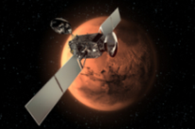
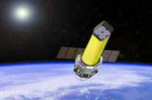
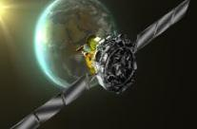



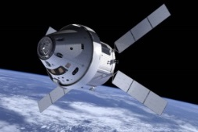
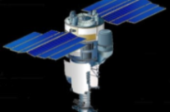
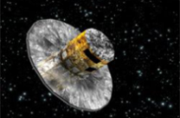
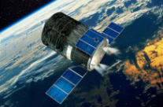



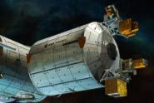
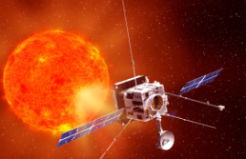
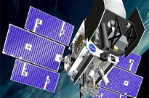
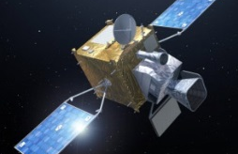



Main Space Programs and Customers
SITAEL has an extensive heritage in a wide range of solutions that have been delivered to the most important Space Players in Europe and all around the world
MUSIS CSO
SENTINEL 1
SENTINEL 3
AMS01/AMS02
EarthCARE
SWARM
COSMO 2nd Gen
Curiosity
CALET
ExoMars
ASTRO-H
INTEGRAL
Orion MPCV
PAMELA
GAIA
ATV
ASIM
Solar Orbiter
ICESat-2
MTG

Slide 10
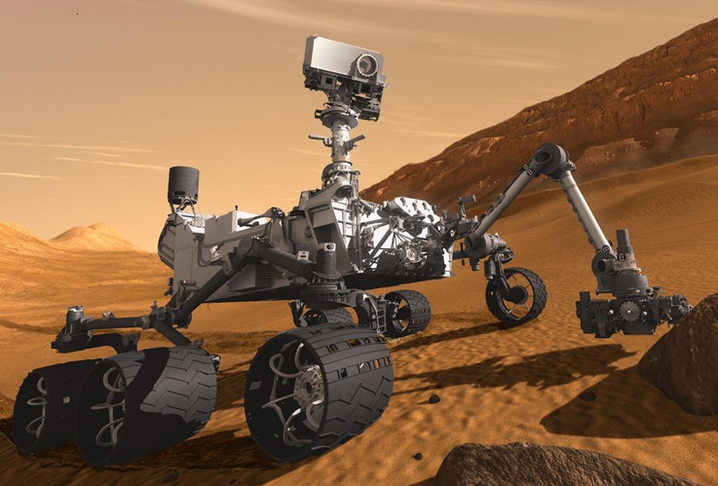
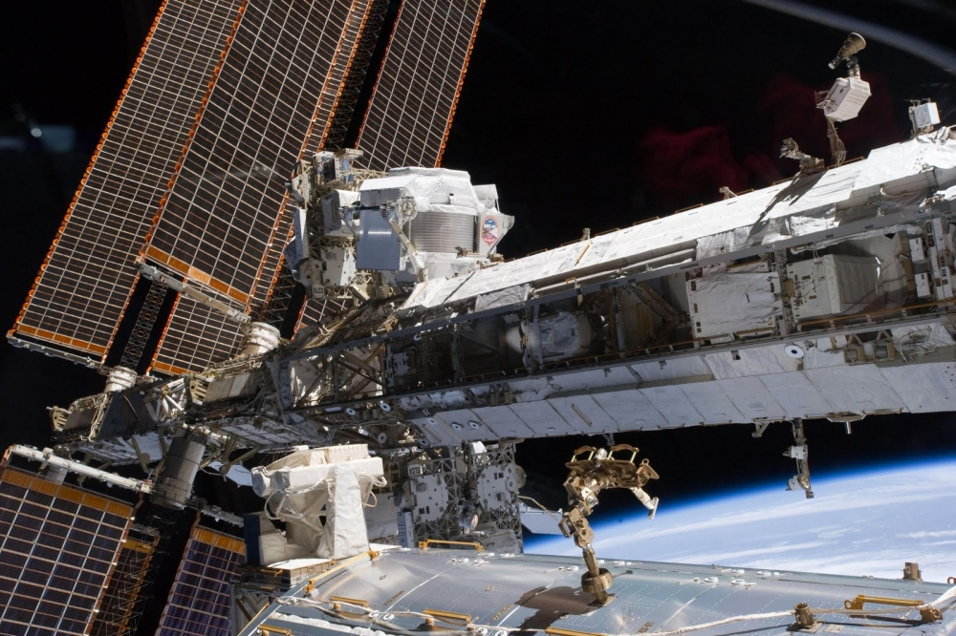


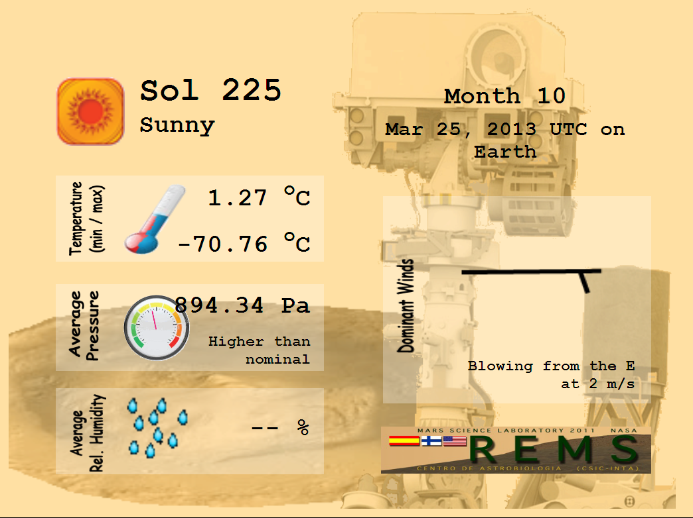

Recent success stories: Curiosity and AMS-02
With Curiosity on Mars
On 5 August 2012 10:31 p.m. PDT, NASA’s Mars Science Laboratory (“Curiosity” Rover) landed on Mars surface. SITAEL developed a key component in the mission, the REMS ASIC, a miniaturized device able to withstand Mars’ extreme radiations and temperatures. Installed inside the weather monitoring station of the rover, the integrated circuit is currently taking measurements for five minutes every hour, on Mars’ environmental parameters (Wind, Humidity, Temperature), giving an invaluable contribution to the mission.
With AMS-02 on the International Space Station
On May 19th 2011, the AMS-02 has been safely installed on the ISS and then successfully activated. For 10 years the experiment will use the unique environment of Space to study the Universe and its origin by searching for antimatter, dark matter while performing precision measurements of cosmic rays composition and flux. SITAEL provided about 80% of electronic devices for all the AMS-02 sub-detectors, working perfectly since payload switch on, thus allowing AMS-02 data collection.
Check Daily Mars Weather!
http://cab.inta-csic.es/rems/marsweather.html
First Results of the AMS-02 Experiment
http://www.ams02.org/2013/04/first-results-from-the-alpha-magnetic-spectrometer-ams-experiment/

Slide 11
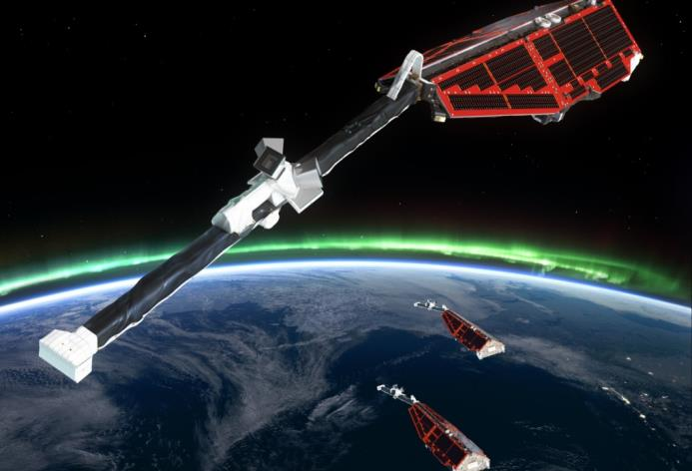
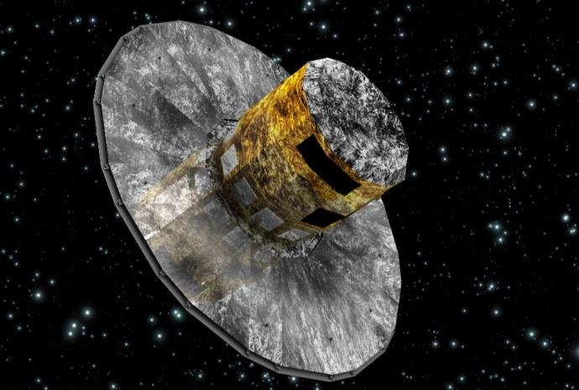


Ready for launch: Swarm and GAIA
Swarm Mission
Swarm is the fifth ESA Earth Explorer Mission. The Swarm concept involves placing a constellation of three satellites in three different near-polar orbits to provide high-precision and high-resolution measurements of strength and direction of Earth’s magnetic field.
As subcontractor of the Canadian company COM DEV, SITAEL took care of the development of the Low Voltage Power Supply (LVPS) and High Voltage Power Supply (HVPS) Units for the Canadian Electric Field Instrument (CEFI). The goal of the CEFI instrument is to characterize the electric field about the Earth by measuring the plasma density, drift, and acceleration at high resolution.
GAIA Mission
The GAIA mission will rely on the proven principles of ESA’s Hipparcos mission to solve one of the most difficult yet deeply fundamental challenges in modern astronomy: to create an extraordinarily precise three-dimensional map of about one billion stars throughout our Galaxy and beyond. SITAEL, as subcontractor of SYDERAL, developed the Power Supply Boards (PSB) for the Payload Data Handling Unit (PDHU) of the GAIA Satellite. The PDHU is a computer control mass memory unit that is the interface between the scientific data arriving from the optical payload and the main spacecraft computer that passes the packetised data to the ground.
Launched on November 22nd
Launch scheduled for December 19th

Slide 12
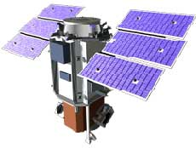
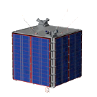
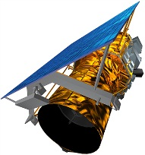
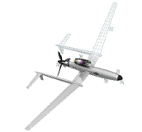


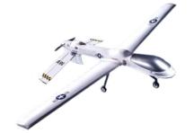
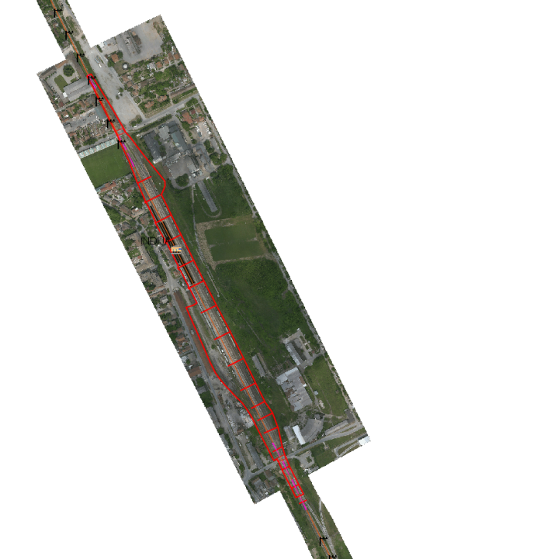
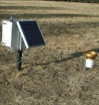




EO Solutions based on Microsatellites – Services & Applications
Satellites
Microsatellites
AIRBORNE DATA
SPACE DATA
IN-SITU DATA
DATA FUSION CENTRE
LAND MONITORING
Volcanos
Fires
Earthquakes
Coal mines
Agriculture (water stress, evapotranspiration, growth trend)
Wastes
Archeology
HEALTH AND HAZARDS
Urban Heat Island
Industrial risks
Oil spill
Coastal inundations
Diseases
Asbestos-cement detection
Energy efficiency
CO2 monitoring
Albedo
SECURITY AND SURVEILLANCE
Border security
Object Detection and Recognition
Minefields and landmines detection
Industrial and power plant monitoring
Homeland Security
Long range surveillance

Slide 13

Thank you for your attention!
phone: +39 080 53 21 796
Fax: +39 080 53 55 048
e-mail: info.space@sitael.com
SITAEL S.p.A.
S. P. 231, KM. 1+300 - 70026 Modugno (BA)
Via Livornese 1019 - 56122 Pisa (PI)
ITALY
www.sitael.com

Slide 14


EO Solutions based on Microsatellites - Platform and Payload
Complete Microsatellite (1-200 kg, 3-500 W) lifecycle in house
Cost effective Microsatellites based on open, modular and scalable avionics.
COTS-based or Space Qualified HW to support different mission needs
Fast integration based on modular and flexible architectures able to support a wide variety of different missions from remote sensing to communications.
Telecommunication
TM/TC link: S-Band
P/L Data link: X-Band
Payload
Multiple configurations for different payloads arrangement:
Optical (Panchromatic, Hyperspectral, TIR)
Store and Forward Communication (UHF-VHF)
Micro spacecraft dispensers
Custom payload accommodation
AOCS
Magnetometers
Magnetic coils
Reaction and Momentum wheels
Sun/Earth sensor
GPS
Satellite Management
On Board Computer
Data Processing and Communication
Mass Memory
Power Management and Conditioning
Rad tolerant electronics
Propulsion
Hall thrustes
FEEP thrusters
Resistojet thrusters
Mono/Bi-propellant
Electric and fluidic lines
Power generation
Solar arrays (with cover glass)
Battery pack

Slide 15




Small Instruments and Advanced Sensors
In the past SITAEL has been involved by its customers, not only in the production of sub-equipment, but also in the payload integration process. Two important cases of success are represented by PAMELA Experiment where SITAEL developed the entire power supply system and several data acquisition boards, taking care also of the whole payload integration and the AMS-01/AMS-02 Experiment, where SITAEL developed 80% of the electronics for all the AMS-02 sub-detectors (TOF, TRD, Tracker, ECAL, RICH)
SHIRA - ELISIR
Earth Observation Payload composed by Panchromatic Chamber and Hyperspectral Optical Instruments in the frequency range from infrared up to thermal infrared
SSOA - Advanced Optical Sensors
New generation advanced Silicon Photomultipliers (SiPM) modules for innovative spectroscopic analysis
SSCAM – Attitude Control Systems for Microsatellites
Study and Development of Sensors and Actuators for Attitude Control of Microsatellites

Slide 16


Electric Propulsion
Since several years, SITAEL is involved into the development of component technologies for Electric Propulsion Systems (Hall and FEEP), in particular, a strong heritage is represented by the Power and Processing Unit (PPU) on these devices, that has to be very compact and efficient, in order to have a final system very small to be hosted on microsatellite platforms for attitude and orbit control.
Hall Effect Thrusters (HET)
SITAEL is currently involved in the development of 50-5000W Electric Propulsion Systems for Small Satellites, based on low and middle power HETs. In particular SITAEL is responsible for the PPU design and production.
Field-Emission Electric Propulsion (FEEP)
SITAEL developed the Qualification Model of a Power Processing and Control Unit (PPCU) HV power supply system for μNewton FEEP Thrusters.

Slide 17





Spacecraft Electrical Power
HV series
Up to 12 kV high efficiency high voltage DC/DC converters and linear regulators family
LMV series
From 2.6 up to 120 V space-born high efficiency single and multi-outputs DC/DC Converters
Specific Power Supplies
With over 18 years experienced engineering staff, SITAEL is able to produce space-qualified power supply systems to meet any requirements coming from different satellite payloads and platform sub-systems
  Optical Payloads (Detectors, Imagers, Spectrometers, APD, PMT, CCD)
    Spectrometer Telescope for Imaging X-rays (Solar Orbiter)
    Soft Gamma-ray Detector, Hard X-ray Imager and Soft X-ray Spectrometer (ASTRO-H)
    Avalanche Photo Diodes and Photo Multiplier Tubes (CALET)
    Modular X- and Gamma-Ray Sensor (ASIM)
    Canadian Electrical Field Instrument (SWARM)
    JEM-X (INTEGRAL)
  RF Payloads (SAR, SRAL)
    SAR TGU (Sentinel1)
    SRAL-C Ku (Sentinel3)
  Data Systems (PDHU, MMU)
    MMFU (EarthCARE)
    PDHU (GAIA)

Slide 18



Control Electronics for Complex Systems
Specific control solutions for the most complex aerospace systems in order to improve system performances and reduce component mass and size. Main applications are:
  Propulsion
  Mechanisms
  Power supplies
  Cryogenics
Cooler Drive Electronics for Cryocoolers
Control, drive and power electronics system for Cryocoolers.
Mechanical vibration Reduction Capability (reduction of any mechanical vibrations during normal operation)
Active Damping feature (reduction of pistons movements during Launch Phase)
CMGA Control Unit for COSMO SkyMed 2nd Generation
Design and production, in collaboration with Selex ES, of the Control Unit of the Control Moment Gyro Assembly (CMGA), an inertial platform used on satellite for attitude control.
S9063 - PS Control Board
Initially developed and flight proven successfully on PAMELA Experiment (in orbit since since 2006), the S9063 control module based on ACTEL 54SX FPGA, has been adopted by SITAEL with slight customization, also for the AMS Experiment and for CALET Experiment.

Slide 19




Spacecraft Data and Communication
Involved into the Enabling and Critical Technologies harmonization process in collaboration with ESA and Prime Industries, SITAEL developed on-board computers, TM/TC and Mass Memory modules in order to be at the forefront of the most urgent needs of the space data systems and Communication scenario.
Integrated Payload Processing Module (IPPM)
Single module based on a RISC CPU equipped with a large amount of memory and wide internetworking capability
Space Payload Data Processor (SpacePDP)
Open and modular Payload Data Processing system for satellite and space exploration platforms
SDR Space Transponder (STAR)
TM&TC equipment based on SDR (Software Defined Radio) technics to be used in small satellites
Radiation Improved COTS-based Mass Memory Module
COTS based Mass Memory Module relying on a SITAEL improved memory module IP Core to mitigate the radiation effects, making use of digital techniques.

Slide 20




Electrical Ground Support Equipments (EGSE)
CDE EGSE
EGSE for the MUSIS CSO CryoCooler Power Drive and Control Electronics
CMGA EGSE
EGSE for the COSMO Skymed Second Generation Control Moment Gyro Assembly
SpW-RTC Development Suite
Development Suite for SpaceWire Remote Terminal Controller
A1493 PCI-SpW/CAN board
Flexible FPGA based device that can house up to 2 CAN links, 2 MIL-STD-1553B connections and 4 SpaceWire ports. PCI or external USB.

Slide 21




Space Microelectronics
SITAEL provides analog, digital and mixed-signal ASICs resistant to significant values of TID and SEE, and complex digital IP Cores for rad-hard FPGAs, available under specific license agreements, including screening and qualification service according to ESA and NASA standards.
  Front-end and ADC for sensors and actuators
    Sensor Front-End ASIC for Curiosity
    Sensor Signal Processor (SSP) for CCD/CMOS
  Serial buses controllers and transceivers
    EUR1553 monolithic Transceiver fully compliant to MIL-STD-1553B. (ECI Phase I)
    Stand Alone CANbus Controller for Space Applications fully compliant with Bosch CAN 2.0B Standard with 8 bit programmable MCU interface (Atmel p/n: AT7908E)
    CANopen Controller capable to handle both low level communication aspects and the higher level Object dictionary memory management aspects
  Discrete commands management
    16 channels High Power Command ASIC for platform and payload control of Data Handling equipments
  MCU/DSP
    SPARC V8 Microcontroller for low-end space applications based on SPARC V8 architecture
    DSP for Space Applications, high performance, scalable, multi-purpose, up to 1 GFLOPS
  Encoding/Decoding
    Receiver Low Power Analog Decoder

Slide 22






Technology for Defence and Security
TRM ASIC (Prime Italian Defence Industry)
Mixed-signal ASIC that provides GaAs digital control signals for GaAs components and generates gate biases of the different RF amplifiers.
LVPS (Prime Italian Defence Industry)
Low Voltage Power Supply for Avionic Applications.
GRAY128 (Large Canadian Industry)
Readout ASIC for CZT gamma-ray detector.
12bit ADC (ASI / Prime Italian Defence Industry)
12-bit 5MSPS self calibrating ADC for Space and Defence Application.
CRYPTONITE
FPGA-based co-processor PCI Board able to execute cryptography calculations in parallel with the system CPU.
Wrist Monitor Device (Israeli Defence Industry)
Advanced Care and Alert Portable Telemedical Monitor

Slide 23

SITAEL EO Programmes

Slide 24


Main Achievements on EO Programmes - in progress
  MUSIS CSO (Air Liquide, CNES)
  Control, Drive and Power Electronics for CryoCoolers
  SENTINEL 1 (EADS Astrium, ESA)
  DC/DC Converters for the SAR Transmit Gain Unit
  SHIRA Satellite at High Resolution TIR (Apulia Region)
  Phase A/B1 study for Earth Observation hyperspectral optical Instruments
  COSMO SkyMed 2nd Generation (SELEX ES, TAS)
  Control Momentum Gyro Assembly Control Unit (CMGA CU)
EarthCARE (Syderal, EADS Astrium, ESA)
Mass Memory and Formatting Unit Power Supply Boards
MTG (SELEX ES, TAS, ESA)
Lightning Imager Pixel Processor ASIC

Slide 25
Main Achievements on EO Programmes - completed
  SENTINEL 1 (Thales Alenia Space)
  16 channels High Power Command ASIC
SENTINEL 3 (Thales Alenia Space)
Power Supply Units for the SRAL-C Ku RFU
  SWARM (COMDEV, ESA)
  LV and HV Power Supply Units of SWARM CEFI

Slide 26

SITAEL Scientific Programmes

Slide 27


Main Involvements on Scientific Programmes - in progress
  ASTRO-H (JAXA, ESA)
  HV Power Supply systems for APD, CdTe and PM sensors
  CALET (JAXA, NASA, ASI)
HV Power Supply System for APD and PM sensors of CALET Experiment to be installed on ISS Japanise Module
  ASIM (TERMA, ESA)
HV Power Supply System for Atmosphere-Space Interactions Monitor (ASIM) to be installed on ISS Columbus Module
  EXOMARS (Thales Alenia Space, ESA)
  CANopen Controller IP Core
  Orion MPCV (Selex ES, Astrium DE, NASA)
  120V/28V DC/DC Converter Module of the Service Module PCDU of NASA Multi Purpose Crew Vehicle
  Solar Orbiter STIX (ESA)
  High Voltage DC/DC Converter for Spectrometer/Telescope for Imaging X-rays
  Solar Orbiter METIS (OHB, ASI, ESA)
  Power and Processing Unit for the METIS Coronagraph.

Slide 28
Main Involvements on Scientific Programmes - completed
  INTEGRAL (IAS, ESA)
  HV Power supply systems for Microstrip Gas Chambers
MSL/CURIOSITY (NASA, EADS Astrium)
Rover Environmental Monitoring System ASIC
  PAMELA (ASI, INFN, CNR)
  Sensors and Electronics Integration for all Instruments
AMS-01/AMS-02 (NASA, ASI, MIT, INFN)
Sensors and Electronics Integration for all Instruments
  GAIA (Syderal, ESA)
  Power Supply Boards for Payload Data Handling Unit (PDHU)
  ATV (RSC-Energia)
  CASA-2 CANbus 2.0 Controller ASIC

Slide 29
Main Aerospace Customers

Slide 30

Railways and Industrial
30
Notes:
30

Slide 31


Market Served
Railways
Main sub-contractor for safety solutions for some of the leading railways and rolling stock manufacturers.
Enhanced safety features and innovative solutions in Diagnostic Applications and Signaling Systems.
Involved into the development of the most advanced train control and railway diagnostic systems, such as Automatic Train Protection systems and Opto-Electronic sensors.
Green Technology
Improving energy efficiency of reusable, rechargeable batteries with BMS and innovative software solutions.
“eSocialBike” application that integrates e-bikes and batteries with mobile and web technologies, making data available on smartphone.
Catalog and customized solution for multi-cell applications, product development includes protection, gas gauge, cell balancing and other functions.

Slide 32



Industrial Services
Design
Feasibility study/product specification
HW/SW/FW design
PCB layout according to DFM/DFT best practices
Mechanical design
V&V life cycle management according to CENELEC
Functional, Environmental and EMC tests
Rapid prototyping
Production
Surface Mount (SMT) and through-hole (THT) technologies
Conformal coating and special treatments
Automatic Optical Inspection (AOI) and X-Ray (XCT) soldering joint control
In Circuit (ICT) and Functional (FCT) test
Cabinet manufacturing and System assembly
Custom tailored test design and execution
After Sales
Full after sales support for maintenance
Frame logistic contract for the management of final user support
Delivery of replacement parts / low volume production

Slide 33




Business strategic area
Signalling
Equipment for AUTOMATIC TRAIN PROTECTION AND CONTROL SYSTEMS

Slide 34
Signalling applications
Key facts & figures
2.230 km of Italian line equipped with ATP signalling technology
SSC: 1.432 km
    2.372 LEU
SCMT (ETCS Level 1 like)/ ETCS: 798 km
    486 centralized LEU
    493 signal LEU
Control System
Automatic Train Protection and Control (ERTMS, SCMT, SSC)
Onboard Equipment
European Vital Computer (EVC),
Balise Transmission Module (BTM - RSDD)
Lineside Equipment
Lineside Equipment Unit (LEU)
Hot Box & Hot Wheel Detectors (HBD)
Wheel Sensor
Ss INFILL

Slide 35





Main Railways Projects
SCMT Project (Running train control system)
Technology “ATP - Automatic Train Protection”, finalized to the automatic protection of the running train, by mean of data communication between on board and ground equipments that together constitute the whole system.
EDS Project (Signal encoder system)
Aim of the EDS is to assign to every configuration of a rail light signal acquired by means of dedicated interfaces) the information to send to the balise and from them to the train.
SSC Project (Support system for driving)
Protection in relation of fixed signal; Diagnostic of the Tags installed; Control of the speed by means of on board odometer system and GPS; Diagnostic systems via GSM-R.
SSB (On Board SubSystem)
Highly configurable system able to perform the functionalities of both of SSC and SCMT systems. It’s made up of three subsystems: RSDD Antenna, BTM, ALA Cabinet.
ROGER
Integrated system with opto-electronic technology for the railway diagnostics.
The special vehicle set for the ROGER diagnostics are: ROGER 400, ROGER 600, ROGER 1000
Notes:
35

Slide 36





Control Systems
onboard sub-systems
KERNEL
TIU
ODO
RSC
BTM
BALISE ANTENNA
ETCS L2
ETCS L1
SCMT
SSC
BL3
ETCS L2
ETCS L1
SCMT
SSC
BL3
ETCS L2
ETCS L1
SCMT
SSC
BL3
ETCS L2
ETCS L1
SCMT
SSC
BL3
ETCS L2
ETCS L1
SCMT
SSC
BL3
ETCS L2
ETCS L1
SCMT
SSC
BL3

Slide 37


Control Systems
wayside sub-system
SIGNAL LEU
MLEU
ETCS L2
ETCS L1
SCMT
SSC
BL3
ETCS L2
ETCS L1
SCMT
SSC
BL3

Slide 38






















Main references
343 vehicles equipped with ICAB series I onboard sub-systems
ICAB wayside installations*
2157 km in operation
2717 Signal LEU
599 Station LEU
6072 Eurobalises
2372 Transponders installed
662 Transponder Tags installed
* all signalling schemes
CARONTE
PV7
D345
D445
D146
D145
Pilota
MD VC TD
ALn 668
Other customers
40 ATR-220 diesel multiple trains equipped with ATP onboard sub-systems.

Slide 39




Business strategic area
Diagnostics
SYSTEMS

Slide 40









Equipment for Track measurement and inspection Systems
Track measurement systems
Opto-electronics
ROGER 800
TURKEY
Track Geometry
Rail Profile
Rail Corrugation
ROGER 800
AUSTRALIA
DIAMANTE
ITALY
Rail Profile System
Rail Corrugation System

Slide 41

Equipment for SIL4 Train Inspection Portal
Simultaneous acquisition of 3D profile and thermographic scan of the train at speeds up to 330 km/h
System architecture 2-out-of-3 guarantees an high availability
System compliant with SIL4 specifications and directly interfaced with signalling systems
The system is able to check 2 trains simultaneously.

