Slide 1



FBK SiPM Performances
FBK 1X1 VS FBK 3X3
Massimo Capasso
CTA Meeting 28 novembre 2013

Slide 2
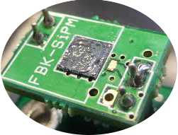
Amplitude Distribution
Waveform Plot
Timing

Slide 3
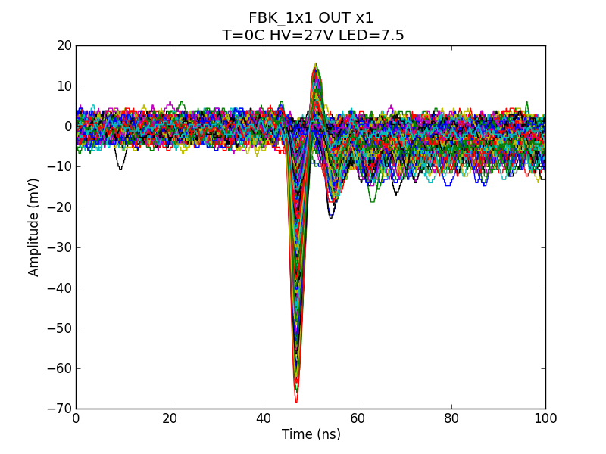
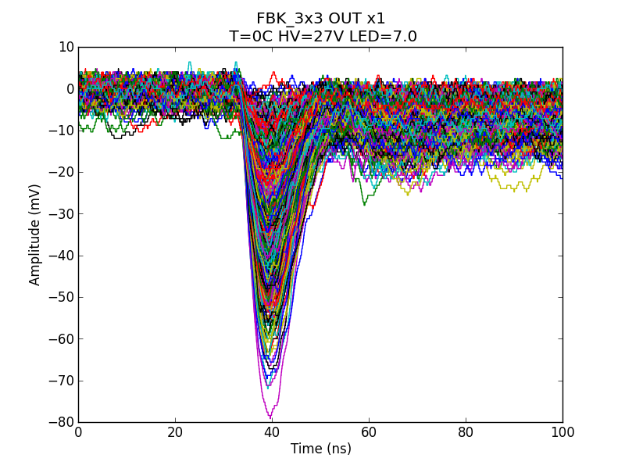
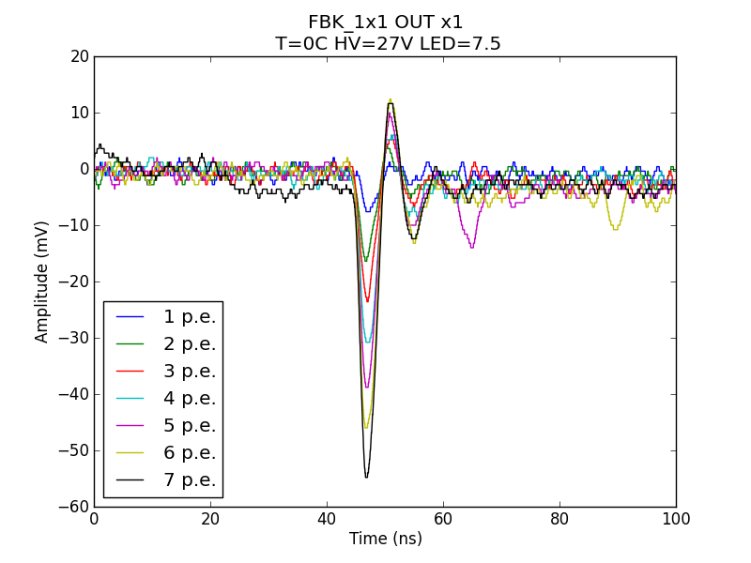
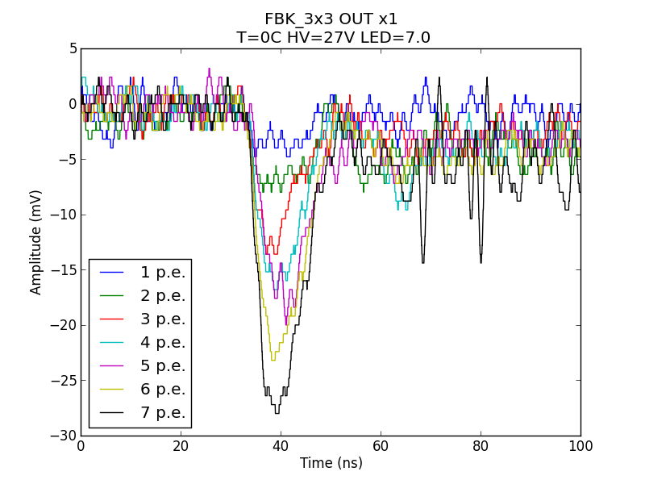

Slide 4
Amplitude Distribution
Waveform Plot
Timing

Slide 5
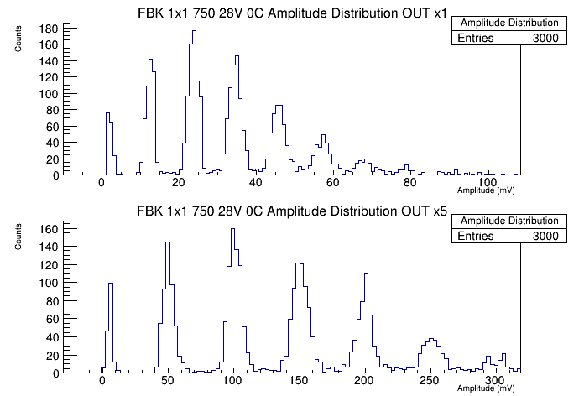
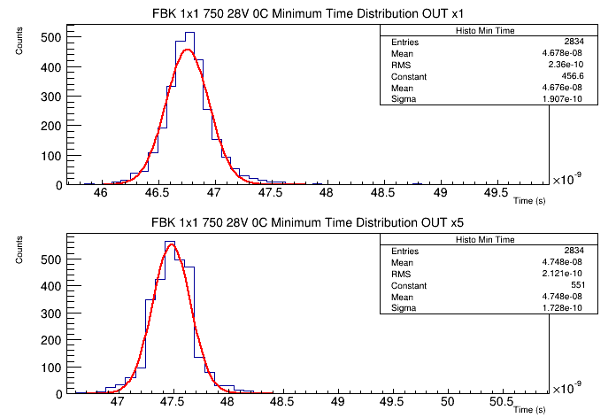
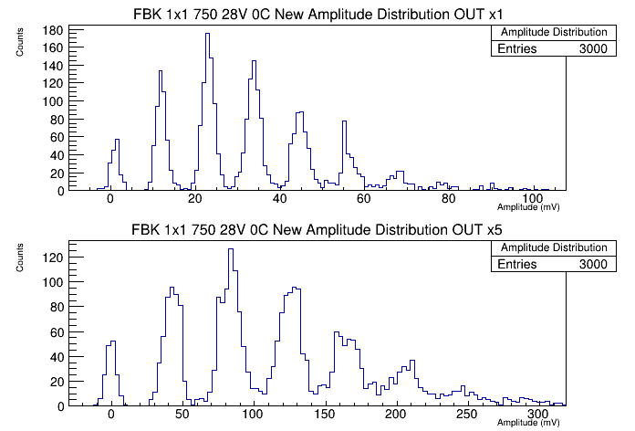

Slide 6
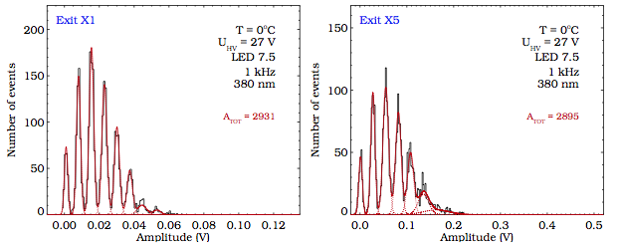
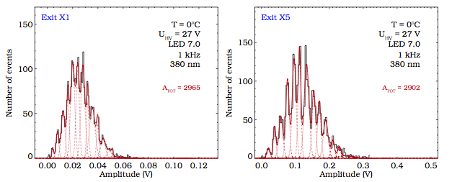
FBK 1x1 VS FBK 3x3 @ 0°C
FBK 1x1
FBK 3x3

Slide 7
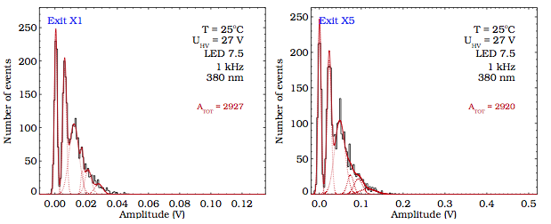
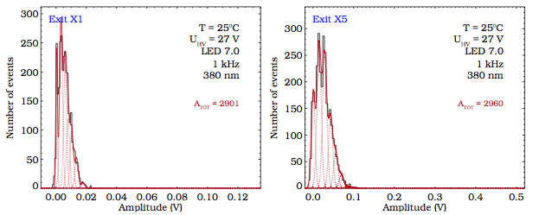
FBK 1x1 VS FBK 3x3 @ 25°C
FBK 1x1
FBK 3x3

Slide 8
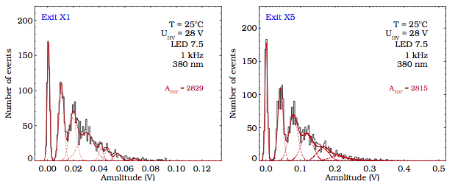
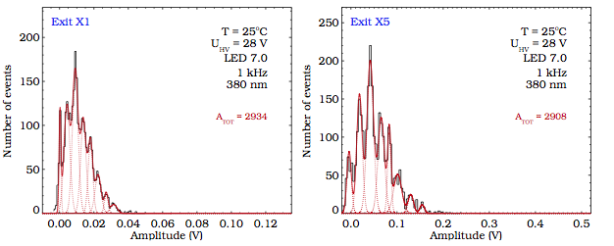
FBK 1x1
FBK 3x3

Slide 9
Gain @ T=0°C
FBK 1x1
FBK 3x3

Slide 10
Gain @ T=25°C
FBK 1x1
FBK 3x3

Slide 11
Amplitude Distribution
Waveform Plot
Timing

Slide 12
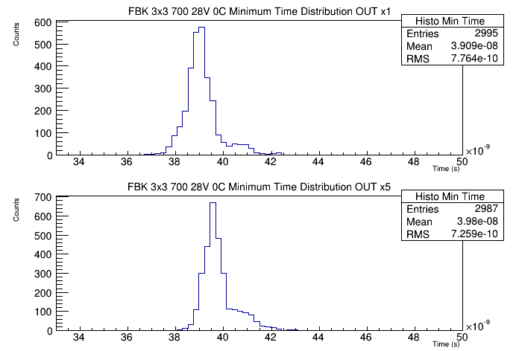
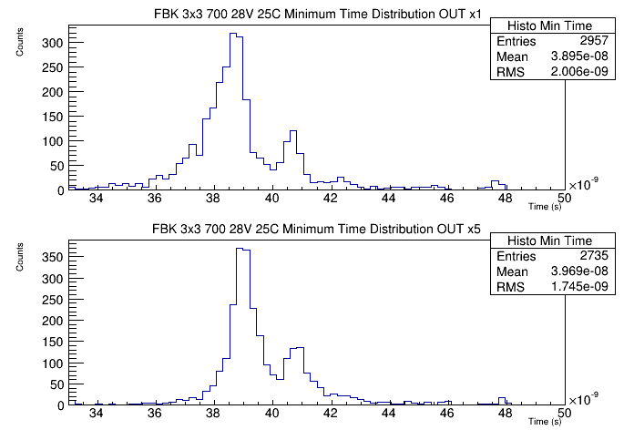
Min Time Distribution FBK 3x3

Slide 13
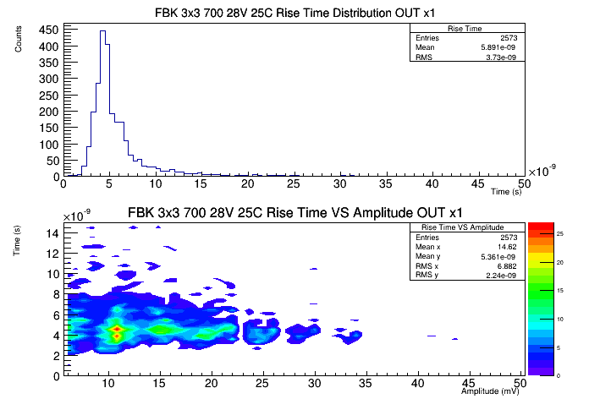

Slide 14
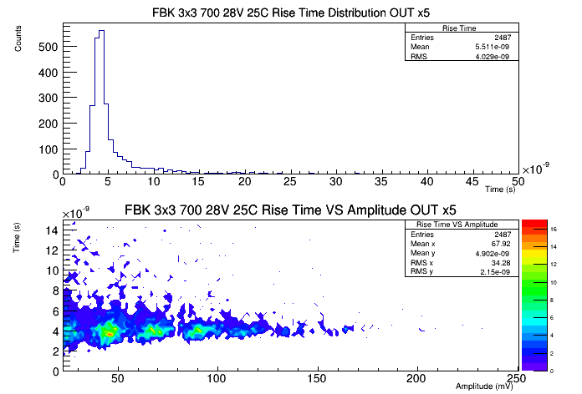

Slide 15
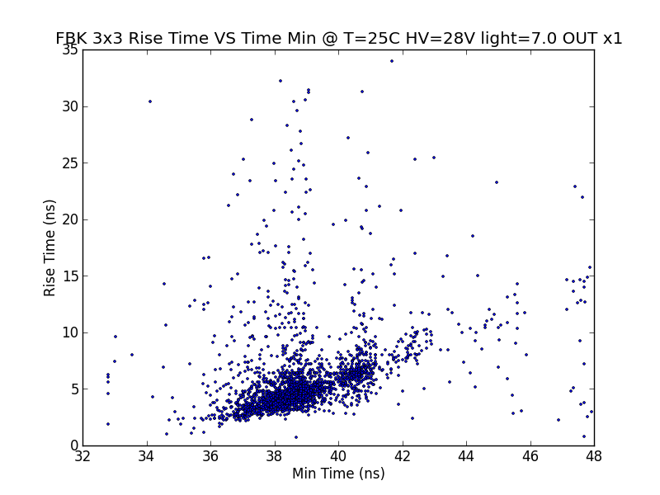
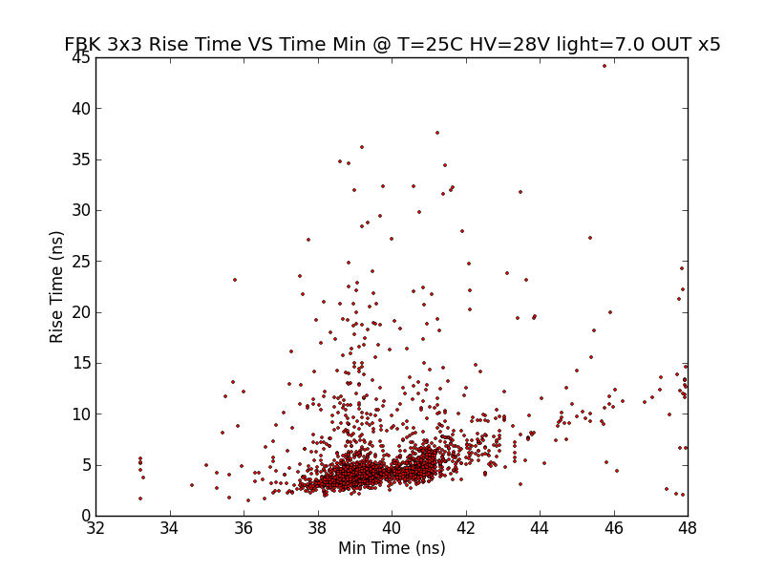

Slide 16
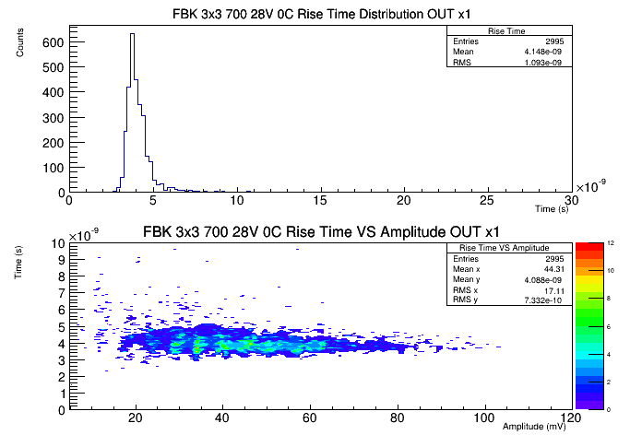

Slide 17
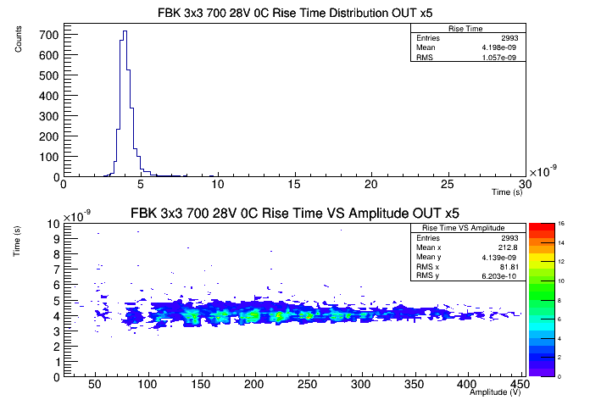

Slide 18
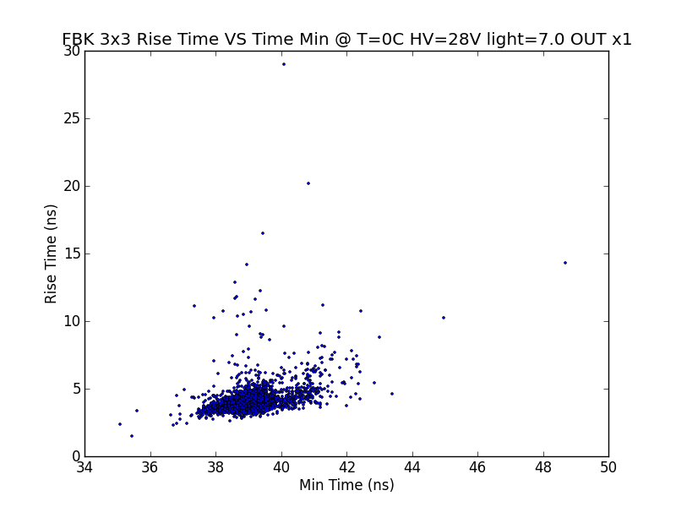
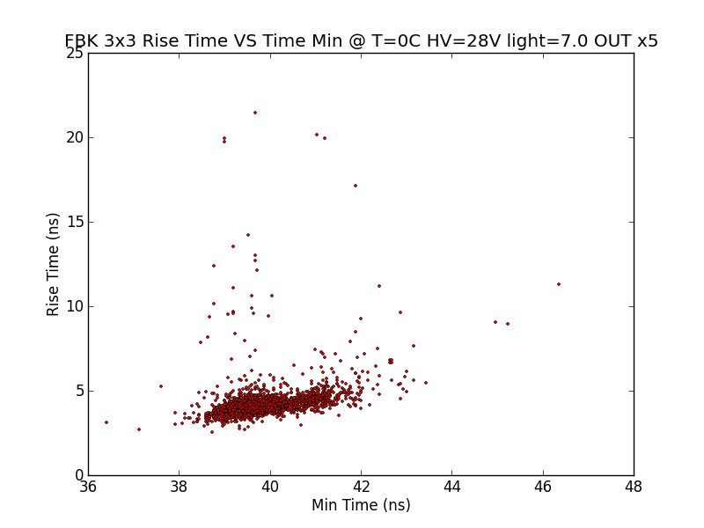

Slide 19
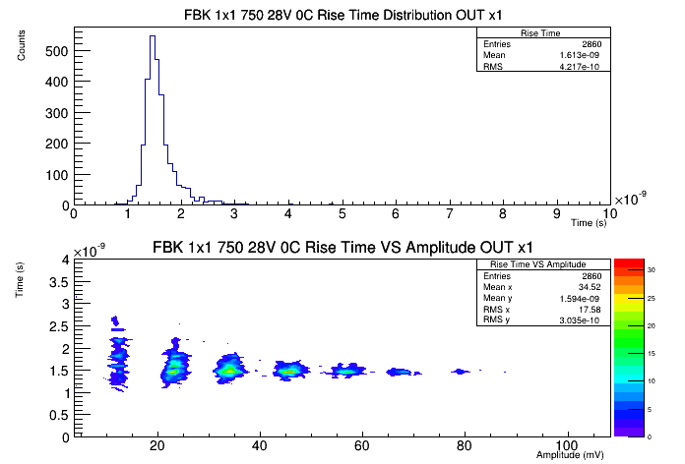

Slide 20
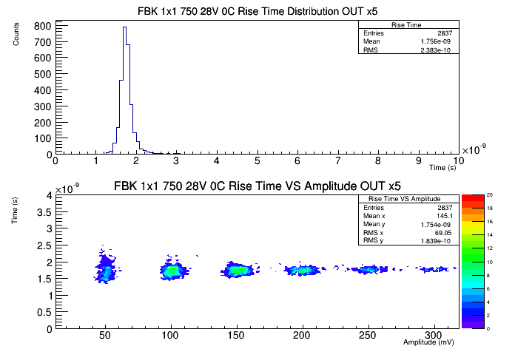

Slide 21
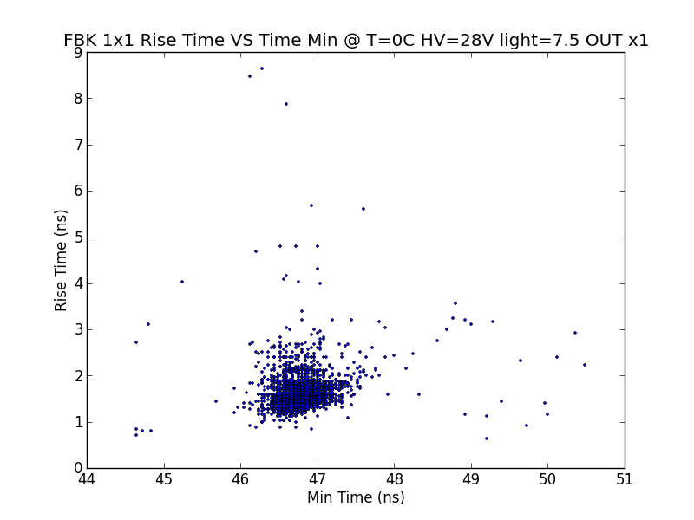
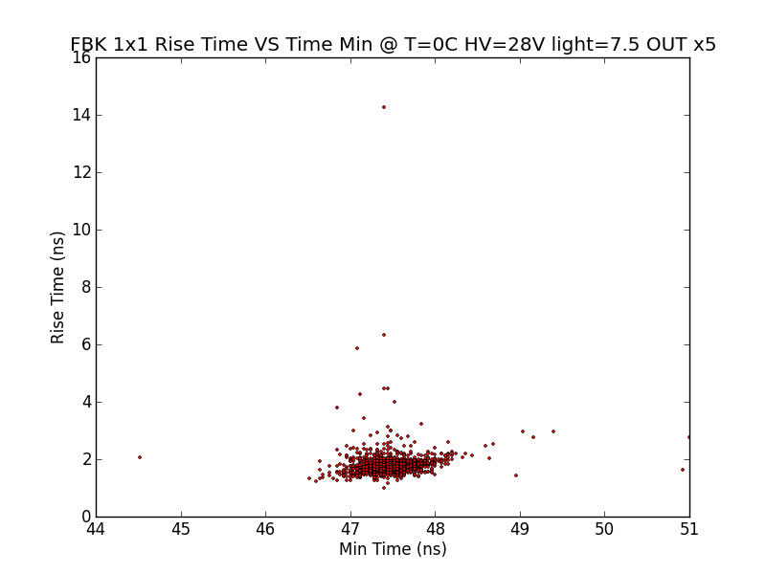

Slide 22
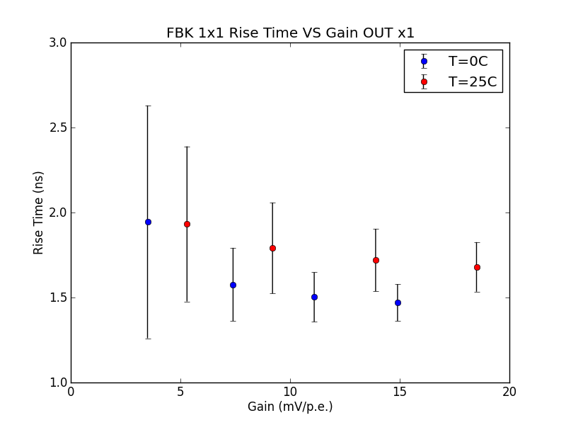
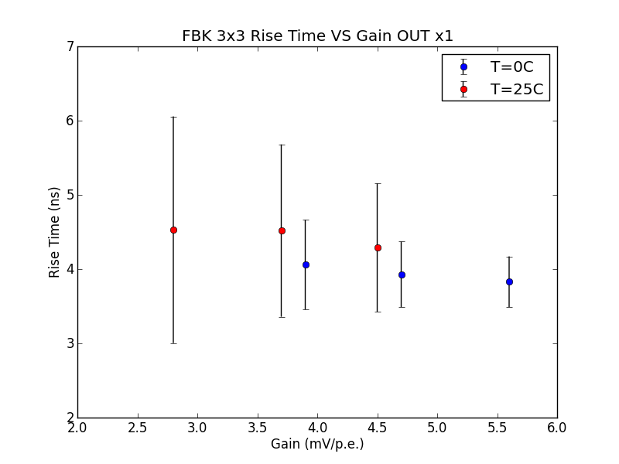
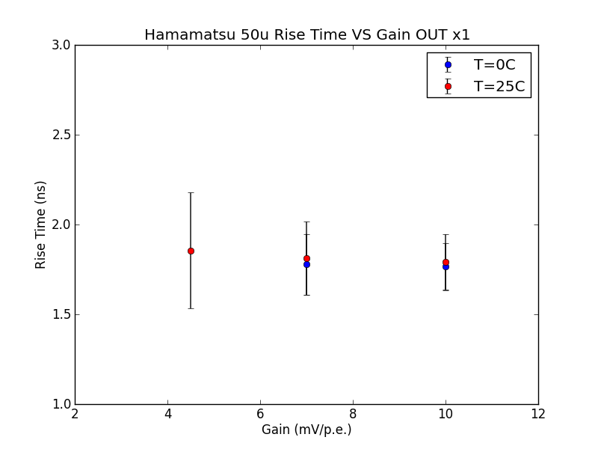
Rise Time VS Gain OUT x1

Slide 23
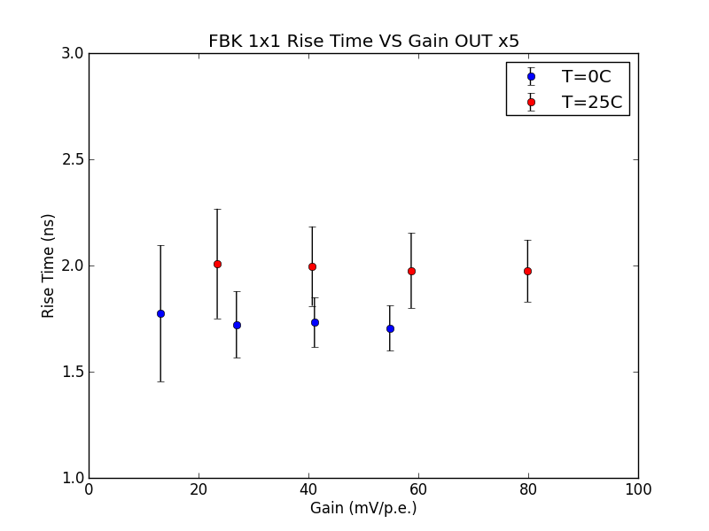
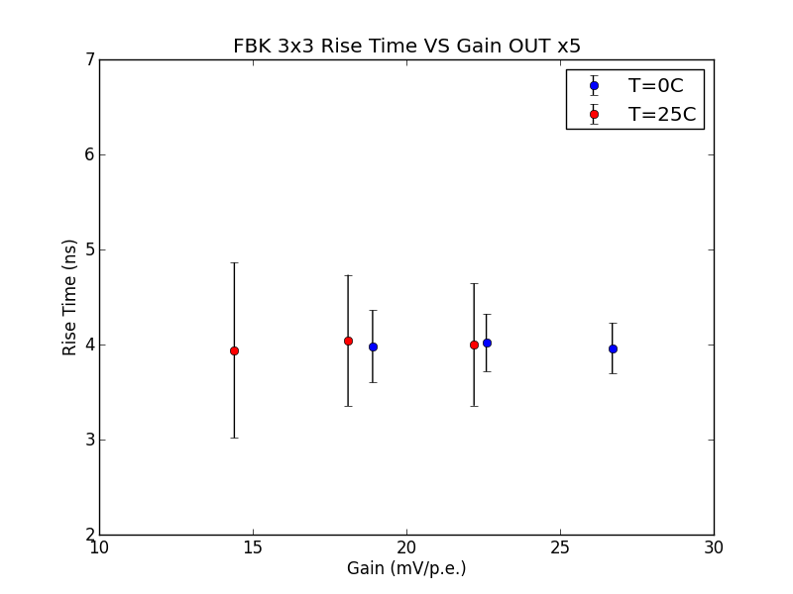
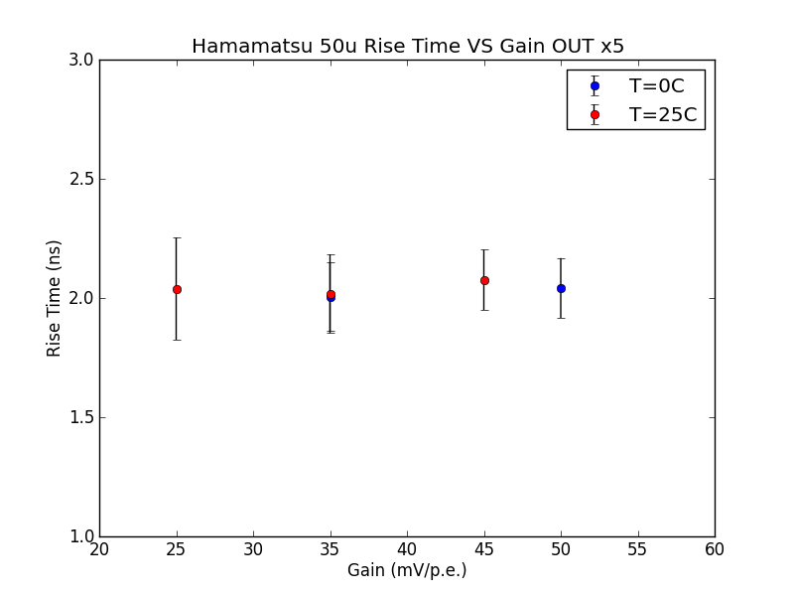
Rise Time VS Gain OUT x5

Slide 24
SUMMING UP…
FBK 1x1 gain ( 40mV/p.e. @ OV = 3V, T = 25°C)
FBK 3x3 gain (25mV/p.e. @ OV = 3V, T = 25°C)
FBK 3x3 Rise Time > FBK 1x1 Rise Time
Jitter

Slide 26
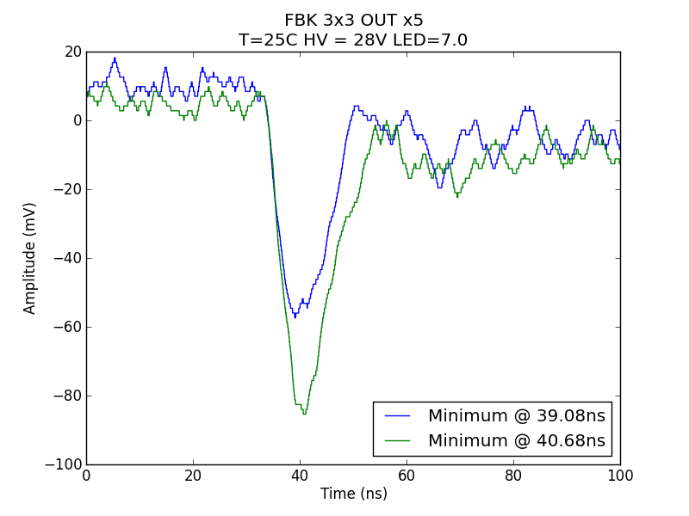
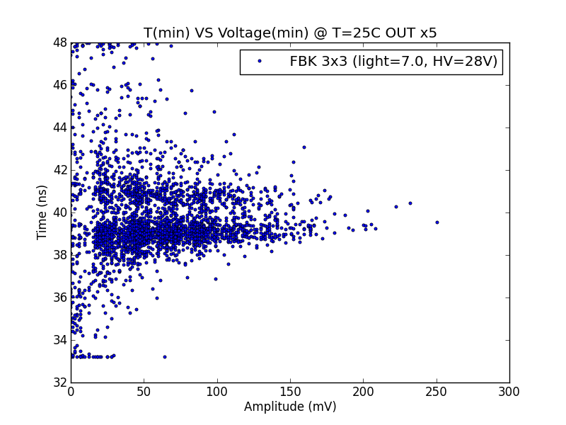

Slide 27
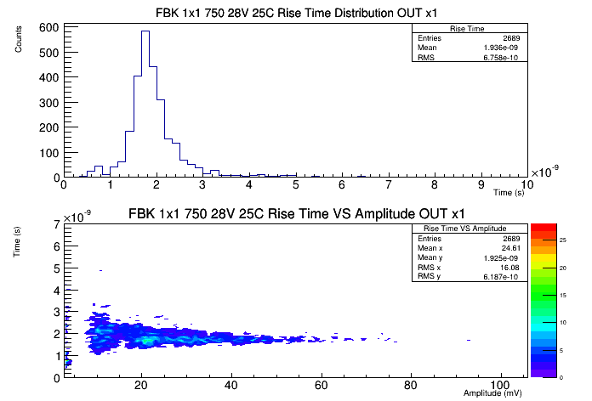
BACKUP: RiseTime

Slide 28
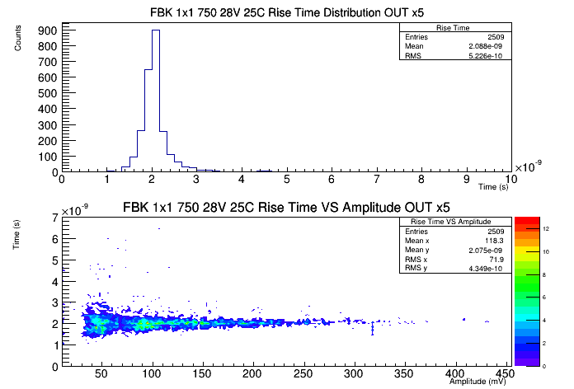

Slide 29
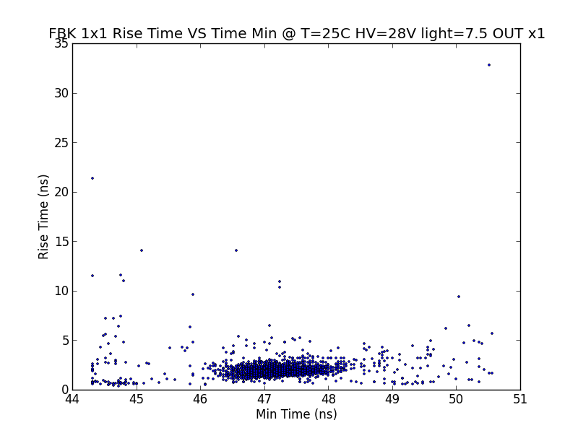
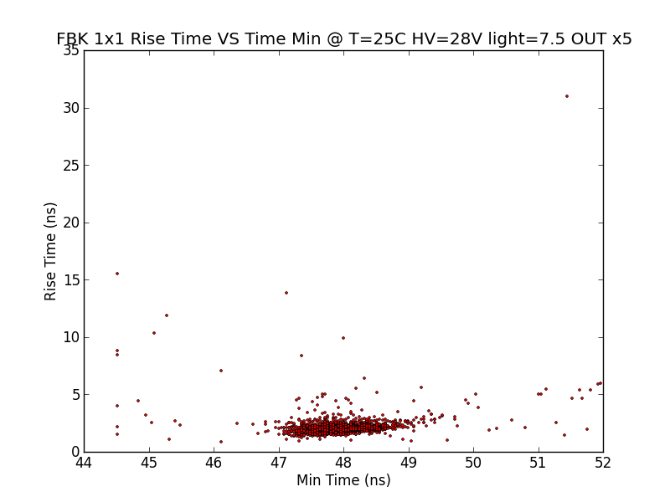

Slide 30
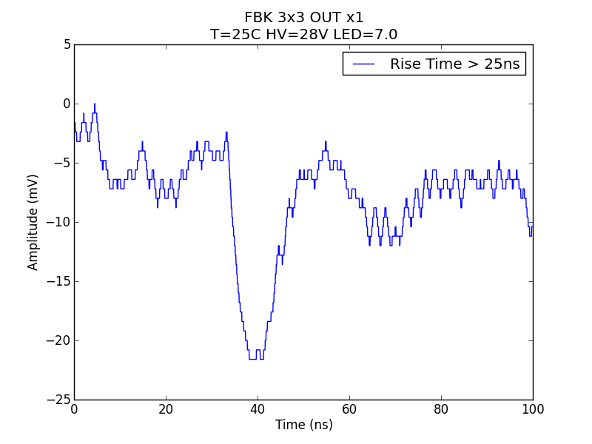
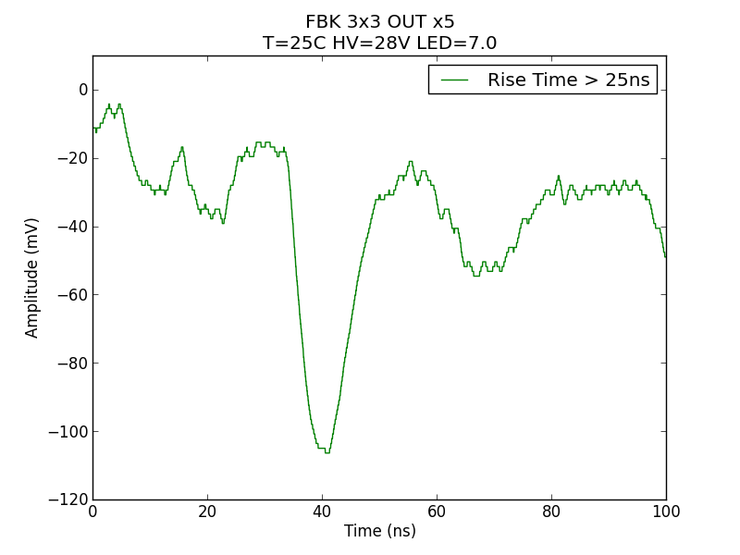
BACKUP: High Rise Time
(x,y) = (33.1ns,-2.6mV)
(x,y) = (33.5ns,-17.5mV)
(x,y) = (38.3ns,-21.9mV)
(x,y) = (41.1ns,-107.2mV)

Slide 31
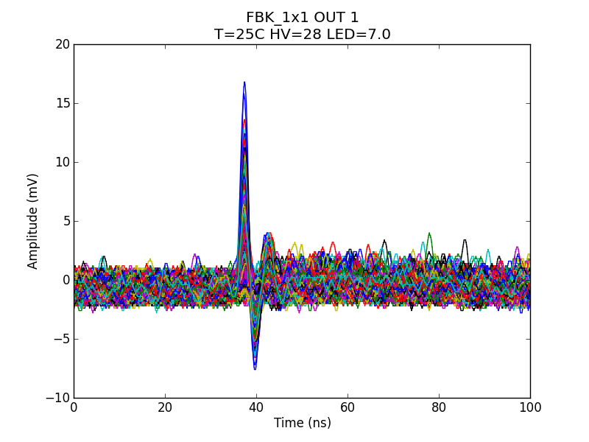
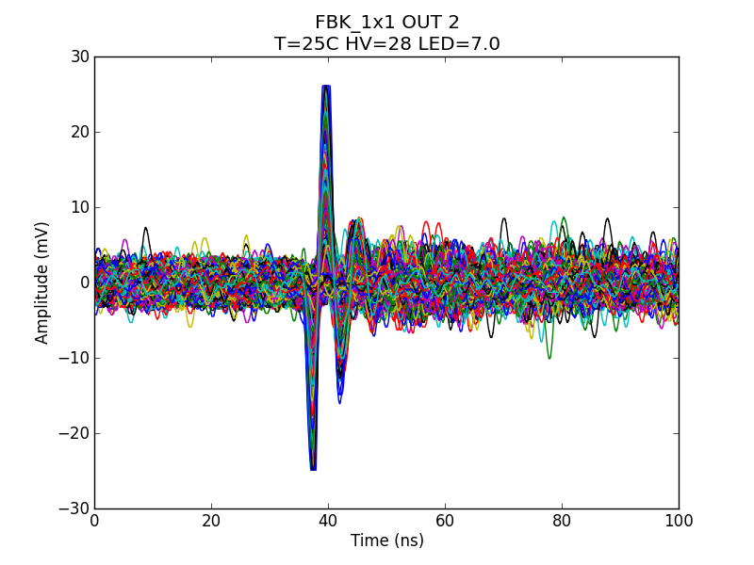
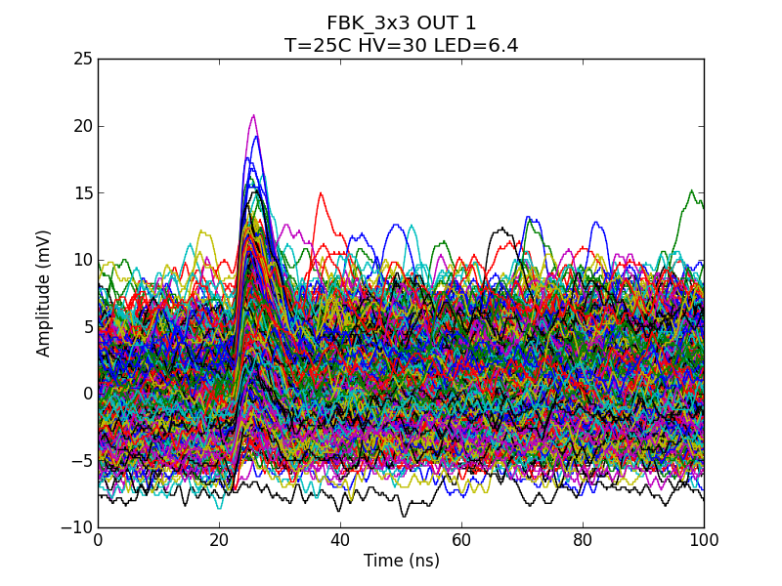
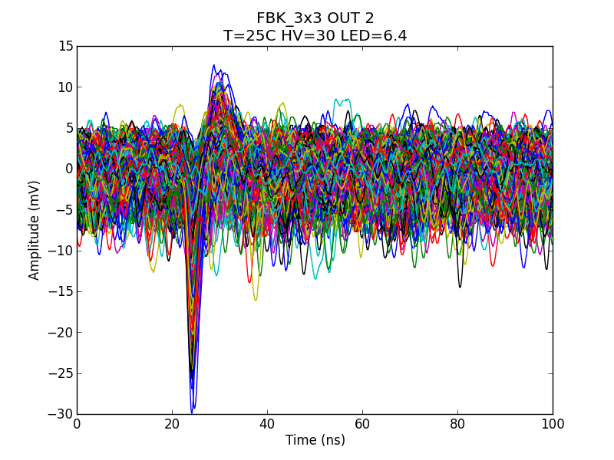
“Polo Zero” @ T=25°C

Slide 32
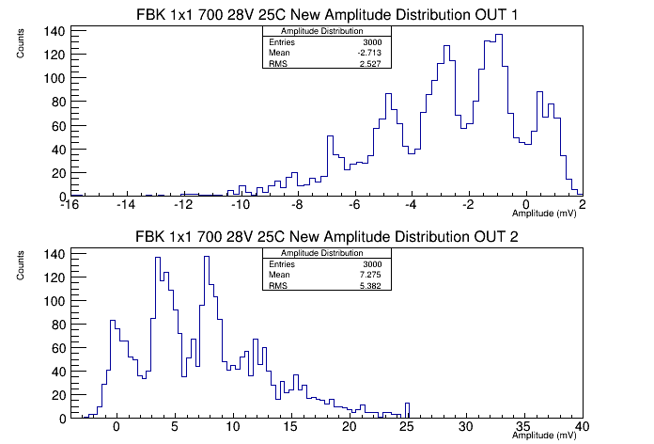

Slide 33
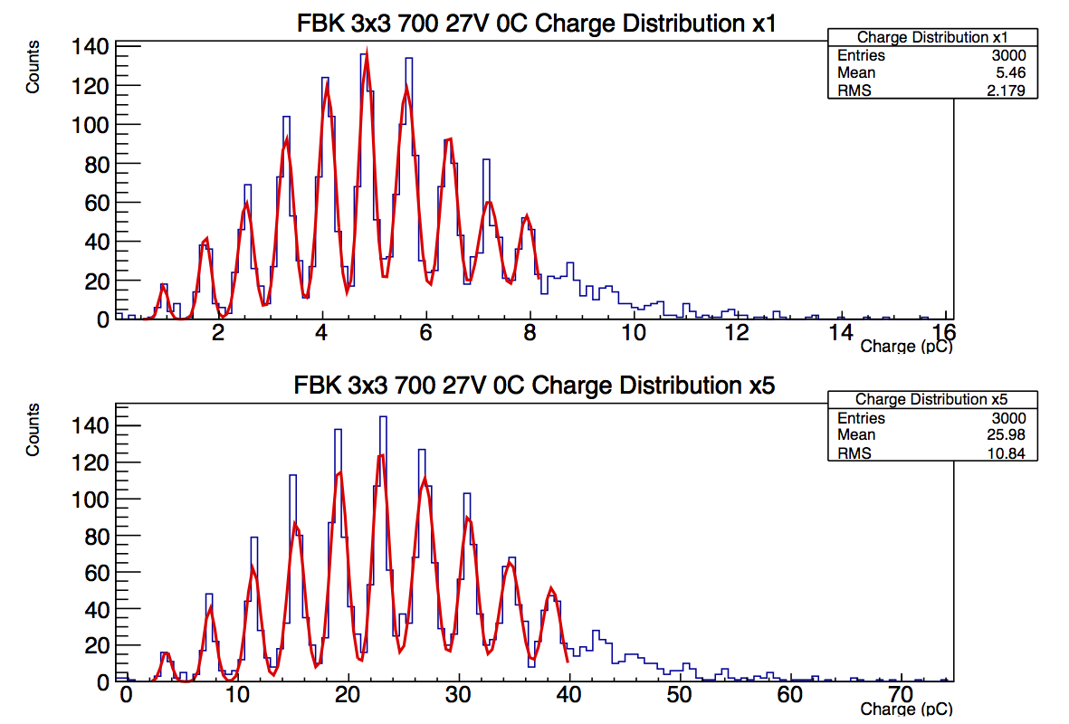
BACKUP: Charge Distribution
0.75pC/p.e.
4pC/p.e.

Slide 34
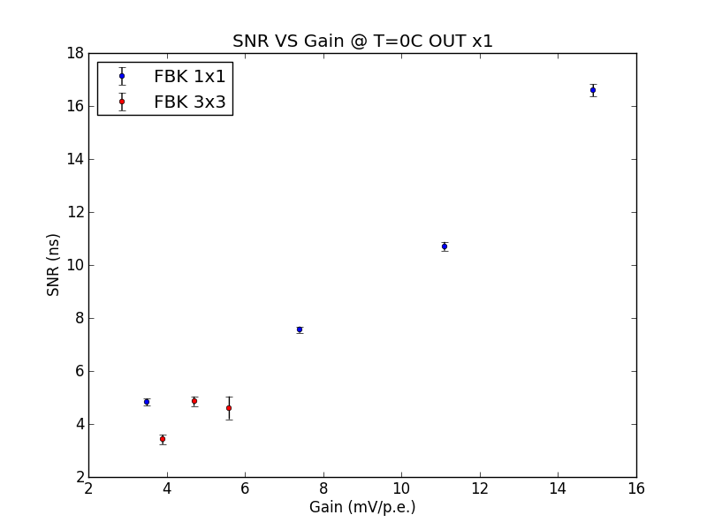
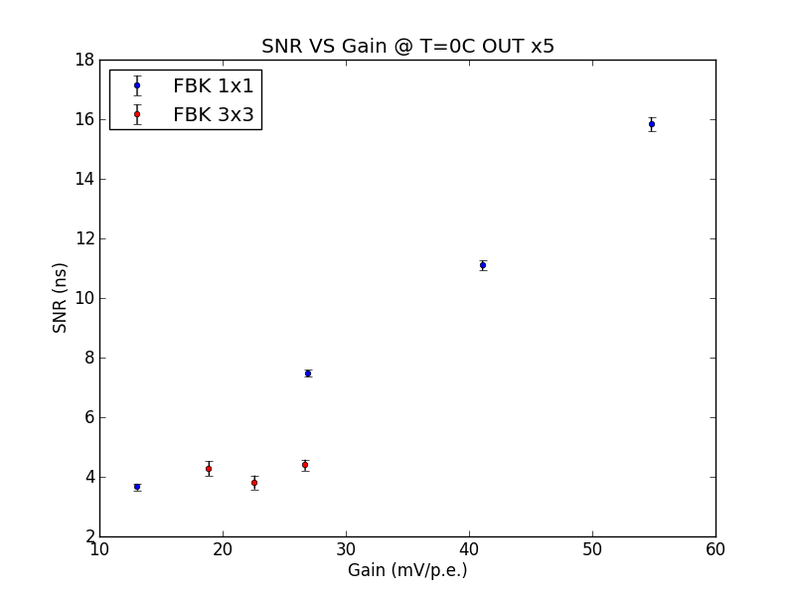
BACKUP: SNR @ T=0°C

Slide 35


SNR @ T=25°C

