Slide 1
The absolute neutrino mass scale and the KATRIN experiment
Nancy Wandkowsky
LNGS Seminar, November 21, 2013
Karlsruhe Institute of Technology (KIT) – Institute for Experimental nuclear Physics (IEKP)
The absolute neutrino mass scale
direct & indirect methods
The KATRIN experiment
Radon-induced background
Summary

Slide 2
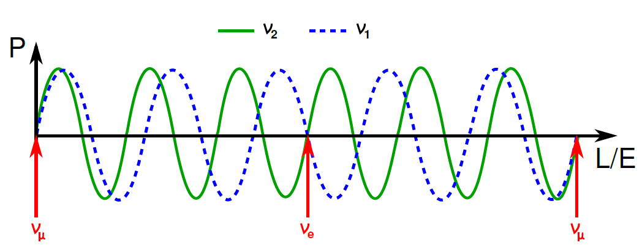
The absolute neutrino mass scale
Neutrino oscillations
$$|\left.ν_{α}\right\rangle =\sum_{i}{U_{αi}|\left.ν_{i}\right\rangle }$$
$U_{αi}$: PMNS
mixing matrix
Observation of neutrino oscillations requires
the existence of massive neutrinos!

Slide 3
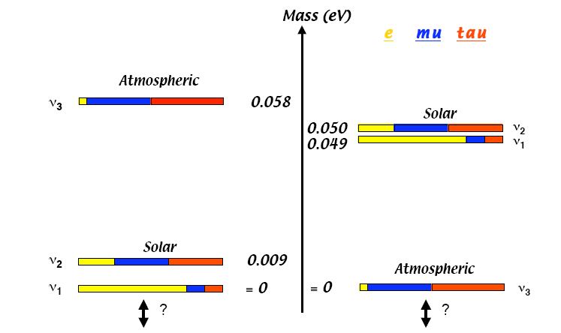
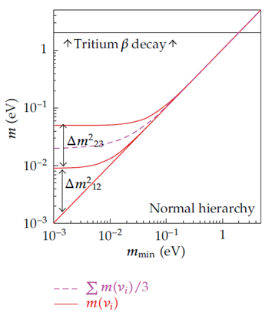
The absolute neutrino mass scale
Neutrino oscillations
ν−mass (eV)
atmospheric
ν₃
ν₂
ν₁
solar
solar
atmospheric
? ?
ν−mass offset?
absolute scale m₁?

Slide 4
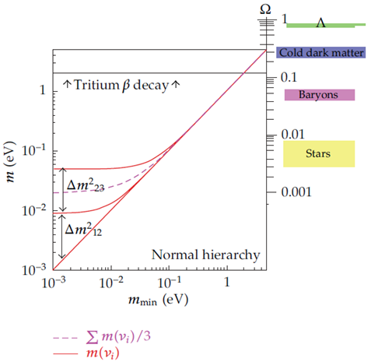
The absolute neutrino mass scale
Neutrino oscillations
ν−mass (eV)
atmospheric
ν₃
ν₂
ν₁
solar
solar
atmospheric
? ?
ν−mass offset?
absolute scale m₁?

Slide 5
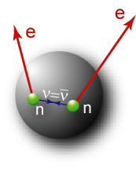
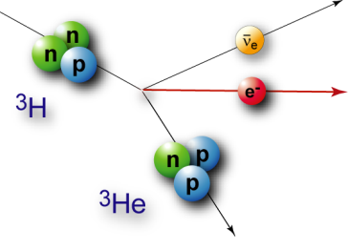
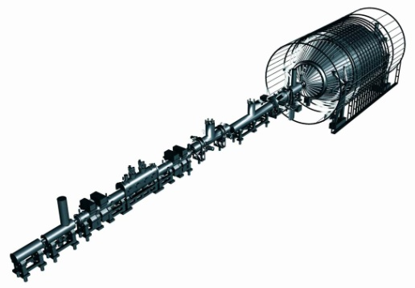
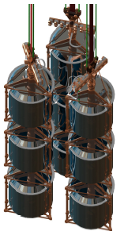
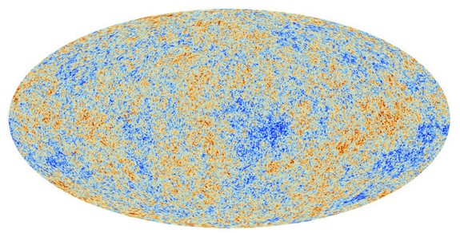
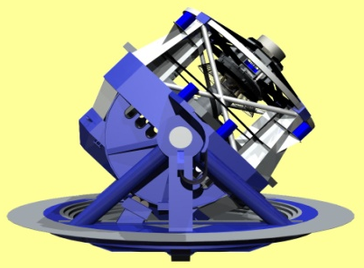
The absolute neutrino mass scale
Overview of methods
kinematics of ß-decay
absolute ν_{e}-mass: m_{ν}
search for 0νßß
eff. Majorana mass m_{ee}
model-independent
status: m_{ν} < 2.3 eV
KATRIN, MARE, ECHO
model-dep. (CP-phases)
status: m_{ee} (Ge) < 0.2-0.4 eV
GERDA, EXO, CUORE
neutrino masses:
experimental techniques
cosmology
sum Σm_{i}, HDM Ω_{ν}
model-dependent (multi-parameter fits)
status: Σm_{i} < 0.3 eV
Planck, LSST, weak lensing

Slide 6
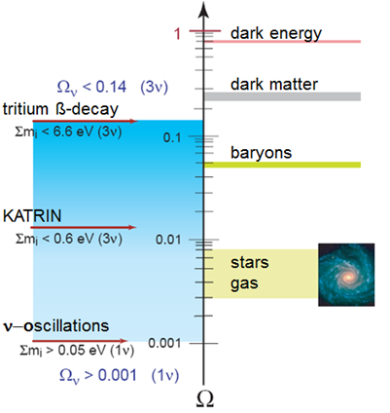
The absolute neutrino mass scale
Indirect methods: cosmology
$Ω_{tot}=$1 → $ρ_{c}=5.1 GeV/m^{3}$
$$N_{ν_{i}}=112/{cm}^{3}$$
$$\sum{m_{i}}<45 eV$$
(Gerstein-Zeldovich-limit)

Slide 7
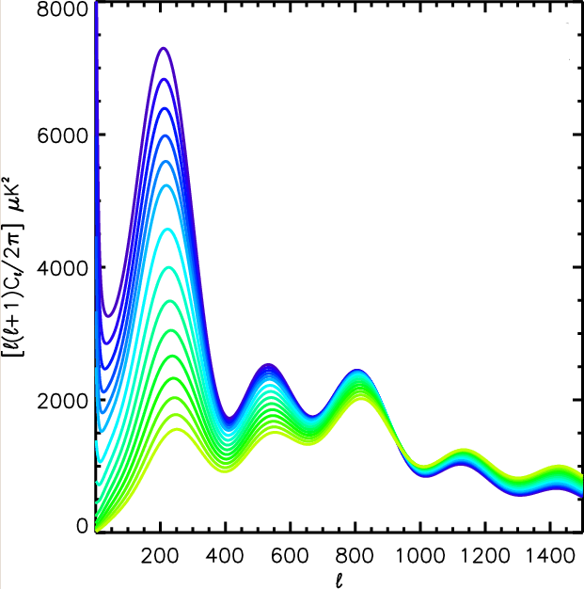
The absolute neutrino mass scale
Indirect methods: cosmology
large structures
small structures
CMB power spectrum:
relativistic at decoupling: HDM
suppress small structures
support large structures
“large” m_{i}
$$Ω_{m}=Ω_{B}+Ω_{CDM}+Ω_{ν}$$
Degeneracy of parameters!
$$\sum{m_{i}}<0.23 eV$$
(Planck+WP+highL+BAO)
arXiv:1305.0147
“small” m_{i}

Slide 8
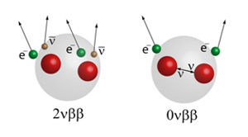
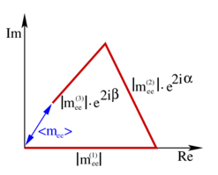
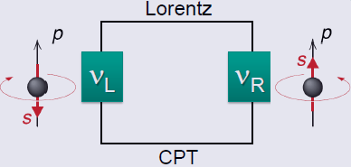
The absolute neutrino mass scale
Indirect methods: 0νββ
Majorana neutrino ($ν=\overline{ν}$)
spinflip for massive neutrinos
lepton number violation
Effective Majorana mass:
$$\left|m_{ee}\right|=\left|\sum_{i}{U_{ei}^{2}m_{i}}\right|$$
$$=\left|c_{12}^{2}c_{13}^{2}m_{1}+s_{12}^{2}c_{13}^{2}m_{2}e^{2iα}+s_{13}^{2}m_{3}e^{2iβ}\right|$$

Slide 9
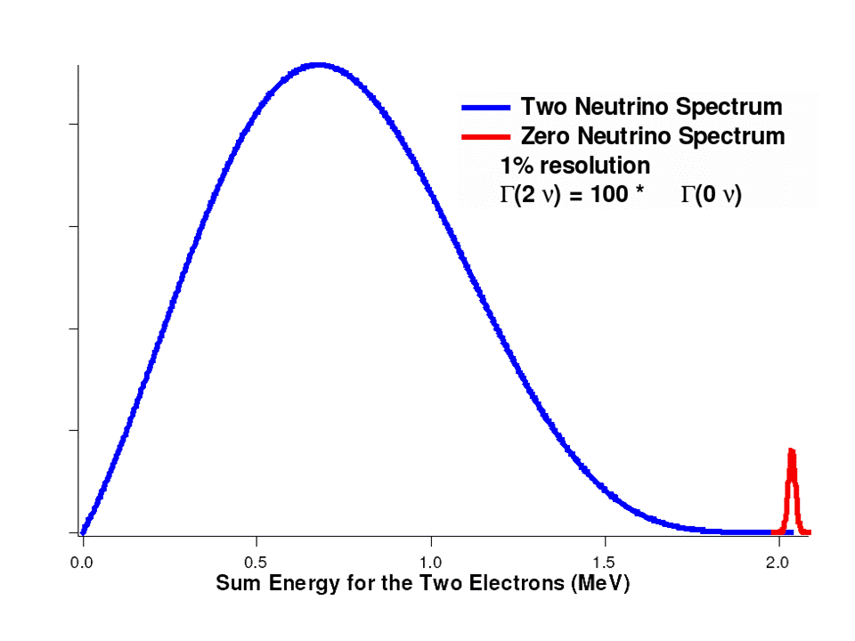
The absolute neutrino mass scale
Indirect methods: 0νββ
Experimental observable: half-life $T_{1/2}^{0νββ}$
Various isotopes: ${}_{}^{76}{Ge},{}_{}^{136}{Xe},{}_{}^{130}{Te},{}_{}^{100}{Mo},{}_{}^{150}{Nd}…$
$$T_{1/2}^{0νββ}\left({}_{}^{76}{Ge}\right)>3∙{10}^{25} y$$
$$T_{1/2}^{0νββ}\left({}_{}^{136}{Xe}\right)>1.6∙{10}^{25} y$$
GERDA: arXiv:1307.4720
EXO: arXiv:1205.5608

Slide 10
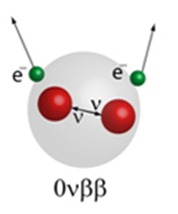
The absolute neutrino mass scale
Indirect methods: 0νββ
Experimental observable : half-life $T_{1/2}^{0νββ}$
assume Majorana neutrino exchange
nuclear matrix element
Pro: Lepton number violation, Majorana nature
Contra: model dependence, matrix elements
$${\left|m_{ee}\right|}^{2}={\left(T_{1/2}^{0νββ}∙G^{0νββ}(E_{0},Z)∙{\left|M^{0νββ}\right|}^{2}\right)}^{−1}$$
phase space factor
$m_{ee}\left({}_{}^{76}{Ge}\right)<\left(0.2−0.4\right)eV$
$$m_{ee}\left({}_{}^{136}{Xe}\right)<\left(0.14−0.38\right) eV$$
GERDA: arXiv:1307.4720
EXO: arXiv:1205.5608

Slide 11
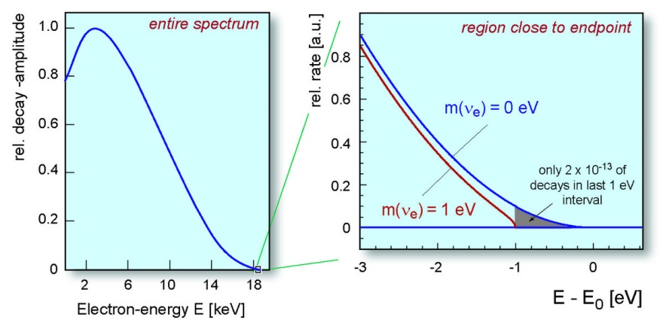
The absolute neutrino mass scale
Direct determination of m(ν_{e})
β-decay: (A,Z) → (A,Z+1) + e⁻ + ${\overline{ν}}_{e}$

Slide 12
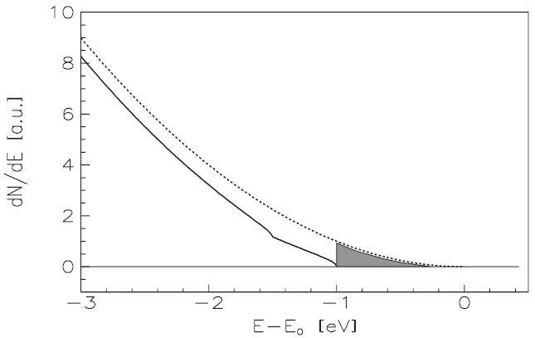
The absolute neutrino mass scale
Direct determination of m(ν_{e})
β-decay: (A,Z) → (A,Z+1) + e⁻ + ${\overline{ν}}_{e}$
electron energy spectrum:
$$\frac{dN}{dE}=K∙F\left(E,Z\right)∙p∙E_{tot}∙(E_{0}−E_{e})∙\sqrt{{\left(E_{0}−E_{e}\right)}^{2}−{"m(ν_{e})"}^{2}}$$
(modified by electronic final states, recoil corrections, radiative corrections)
effective neutrino mass:
${"m(ν_{e})"}^{2}=m^{2}(ν_{e})=\sum_{i}{|U_{ei}|^{2}}m_{i}^{2}$

Slide 13
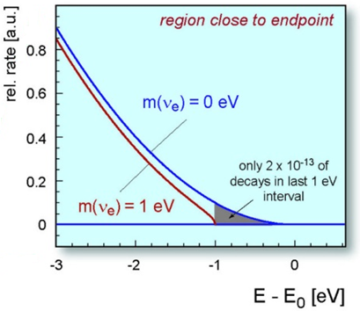
The absolute neutrino mass scale
Direct determination of m(ν_{e})
β-decay: (A,Z) → (A,Z+1) + e⁻ + ${\overline{ν}}_{e}$
ß-source requirements
short half life t_{½}  high luminosity
low endpoint energy E₀
simple atomic/molecular structure
³H: super-allowed
E₀ | 18. 6 keV
t_{1/2} | 12.3 y
¹⁸⁷Re: unique 1st
E₀ | 2.47 keV
t_{1/2} | 43.2 Gy

Slide 14
The absolute neutrino mass scale
Direct determination of m(ν_{e})
β-decay: (A,Z) → (A,Z+1) + e⁻ + ${\overline{ν}}_{e}$
ß-detection requirements
large acceptance angle (~2π)
low background rate
high energy resolution (~eV)
short dead time, no pile up
calorimeter
source = detector
source: ¹⁸⁷Re
spectrometer
external ß-source
source: ³H
KATRIN

Slide 15
The KATRIN experiment
KArlsruhe TRItium Neutrino experiment (KATRIN)
determination of m(ν_{e}) with a sensitivity of 200 meV
predecessor experiments (Mainz, Troitsk): m(ν_{e}) < 2.1 eV
$$\frac{dN}{dE}=K∙F\left(E,Z\right)∙p∙E_{tot}∙(E_{0}−E_{e})∙\sqrt{{\left(E_{0}−E_{e}\right)}^{2}−m^{2}(ν_{e})}$$
requirement: improve m²( ν_{e}) by 2 orders of magnitude!
70 m
source
transport
spectrometer
detector

Slide 16
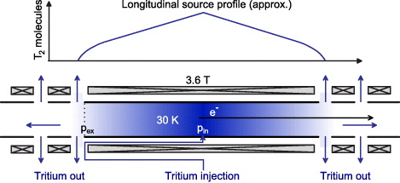
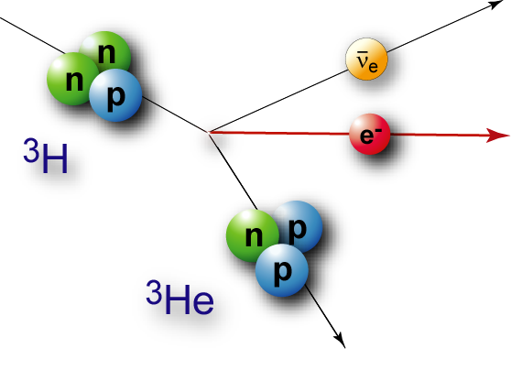
The KATRIN experiment
windowless gaseous
tritium source

Slide 17
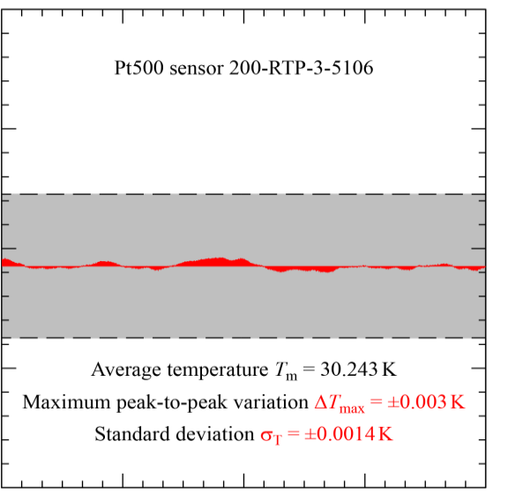
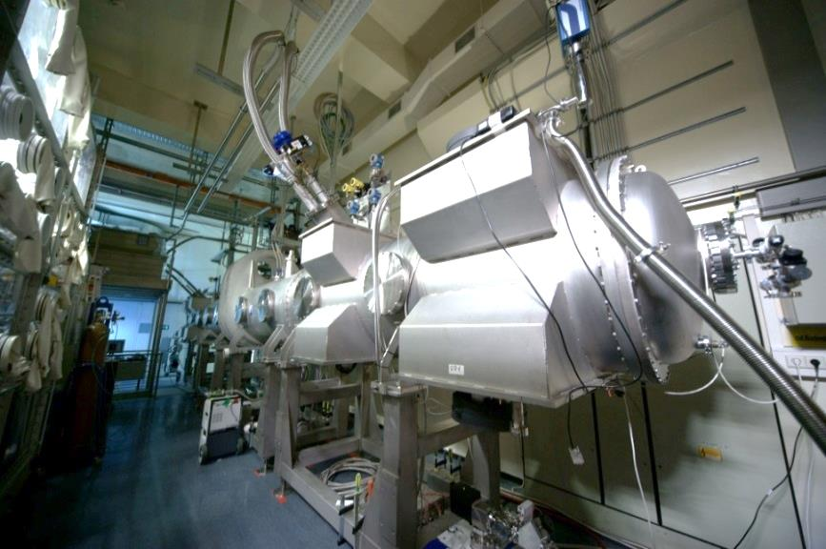
The KATRIN experiment
windowless gaseous
tritium source
30.35
4h measurement
30.30
KATRIN specification
Temperature T_{BT} [K]
30.25
30.20
06:00 07:00 08:00 09:00 10:00
WGTS Demonstrator

Slide 18
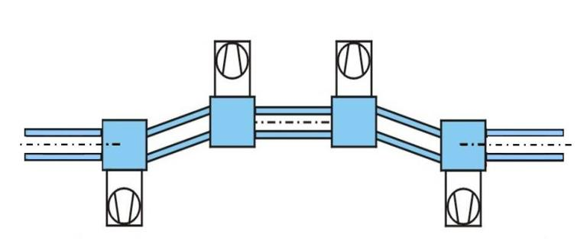
The KATRIN experiment
tritium free
transport
section
DPS
differential pumping section (DPS):
active T₂ pumping with 4 TMP´s
magnetic guiding of signal-β
e

Slide 19
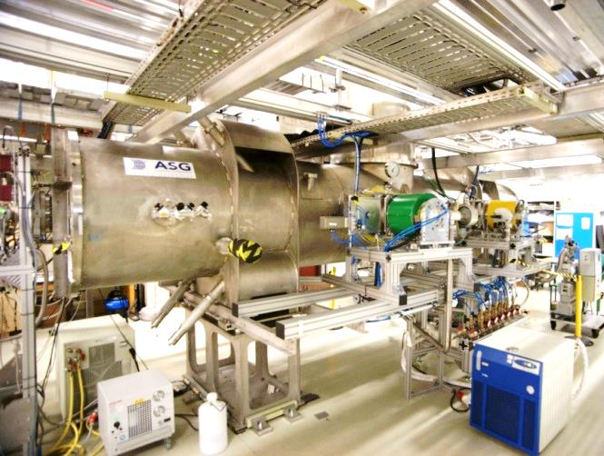
The KATRIN experiment
transport
section
DPS
differential pumping section (DPS):
DPS pumping concept successfully
tested in 2011
gas flow reduction by 2.5·10⁴ achieved
failure of protection diode
→ new concept worked out
delivery and commissioning in 2014

Slide 20
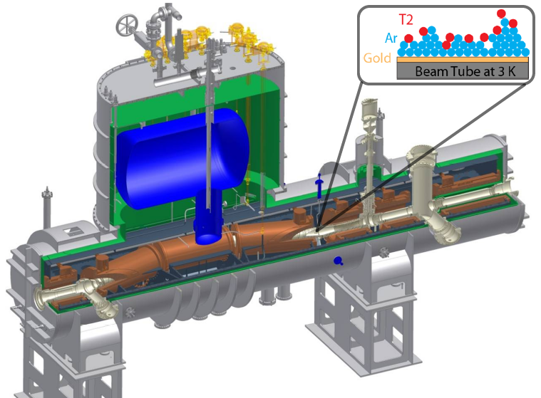
The KATRIN experiment
transport
section
CPS
cryogenic pumping section (CPS):
argon frost pump: cryosorption
magnetic guiding of signal-β

Slide 21
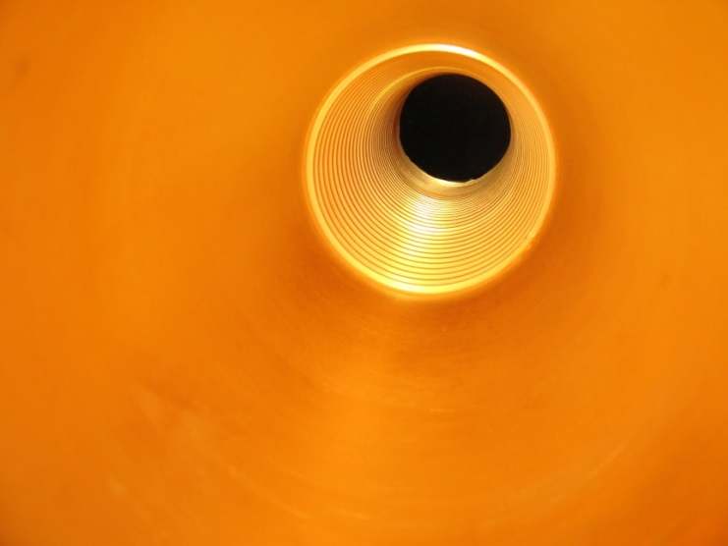
The KATRIN experiment
transport
section
CPS
cryogenic pumping section (CPS):
CPS pumping concept demonstrated
beam tube gold coating, cold tests of
magnets successfully passed
reworking of protection diodes
delivery and commissioning in 2014

Slide 22
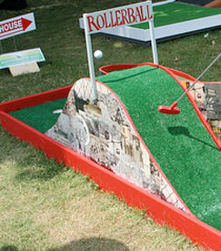
The KATRIN experiment
spectrometer section
electrostatic filter
10⁻² e⁻/s
10³ e⁻/s
-20
10¹⁰ e⁻/s
potential (kV)
-10
0
-40
-30
-20
-10
0
10
distance to analyzing plane (m)

Slide 23
The KATRIN experiment
spectrometer section
isotropic electron emission
-20
potential (kV)
-10
0
-40
-30
-20
-10
0
10
distance to analyzing plane (m)

Slide 24
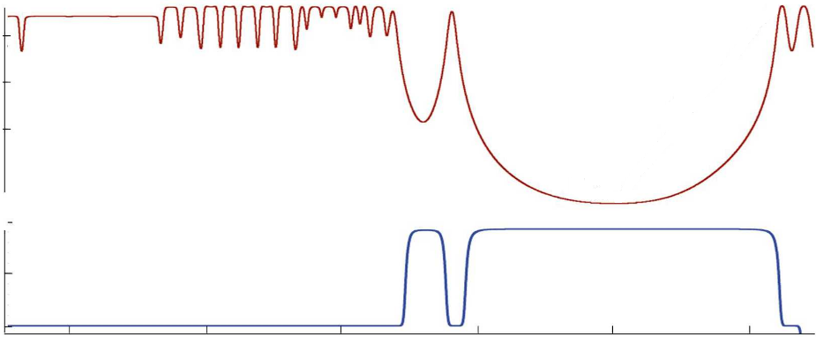
The KATRIN experiment
spectrometer section
magnetic adiabatic collimation
electrostatic filter
MAC-E filter principle
1
10⁻¹
B_{max}
B-field (T)
1:20000
10⁻²
B_{min}
-20
-10
potential (kV)
0
-40
-30
-20
-10
0
10
distance to analyzing plane (m)

Slide 25
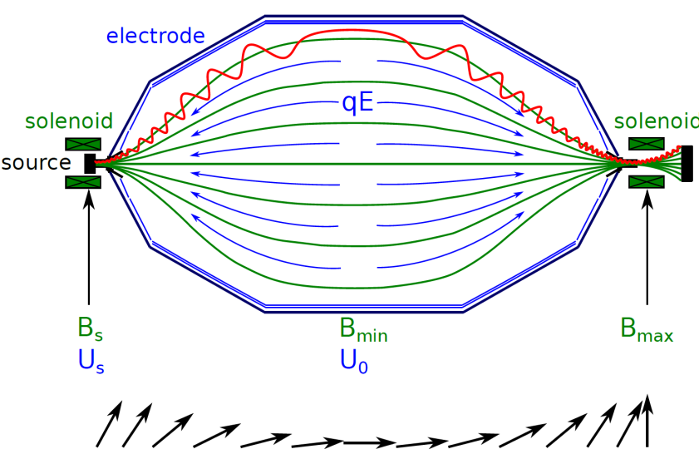
The KATRIN experiment
spectrometer section
magnetic adiabatic collimation
electrostatic filter
MAC-E filter principle
orbital magnetic
moment conserved:
$$E_{kin}$$
$$E_{⊥}$$
$$μ=\frac{E_{⊥}}{B}$$
$$θ$$
$$E_{||}$$
energy resolution: 0.93 eV

Slide 26
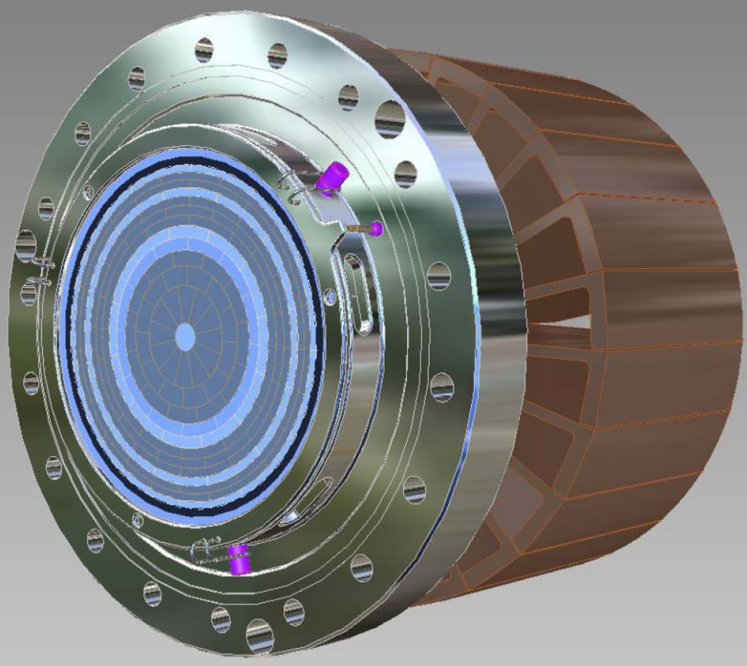
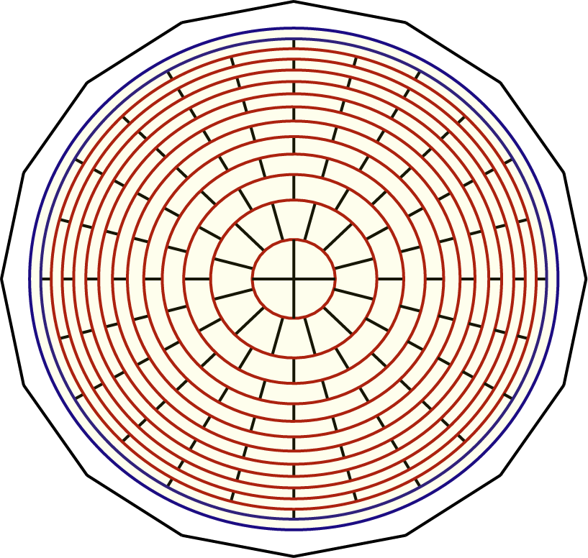
The KATRIN experiment
detector section
counting of signal electrons
guided flux
Φ = 191 T cm²
148 pixel Si PiN diode
1 keV energy resolution

Slide 27
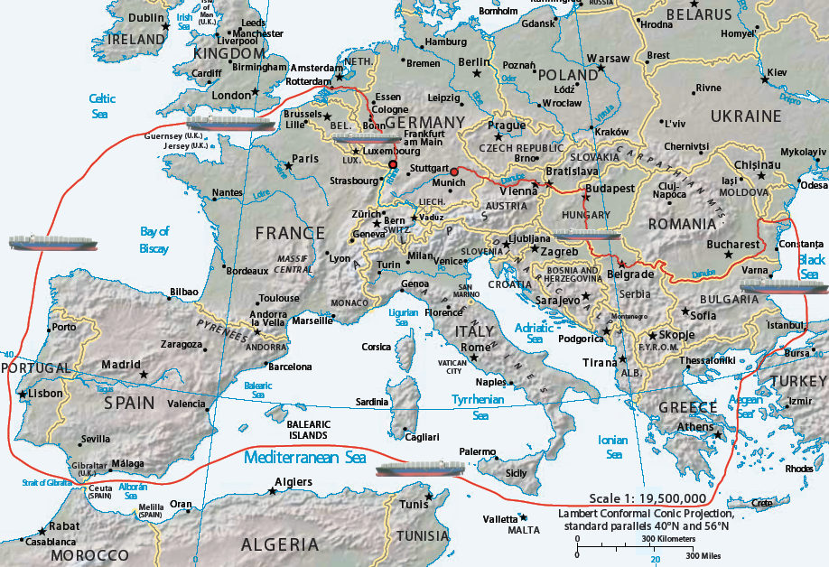
The KATRIN experiment
KATRIN
@ KIT
spectrometer manufacture
9000 km!
Donau
250 km

Slide 28
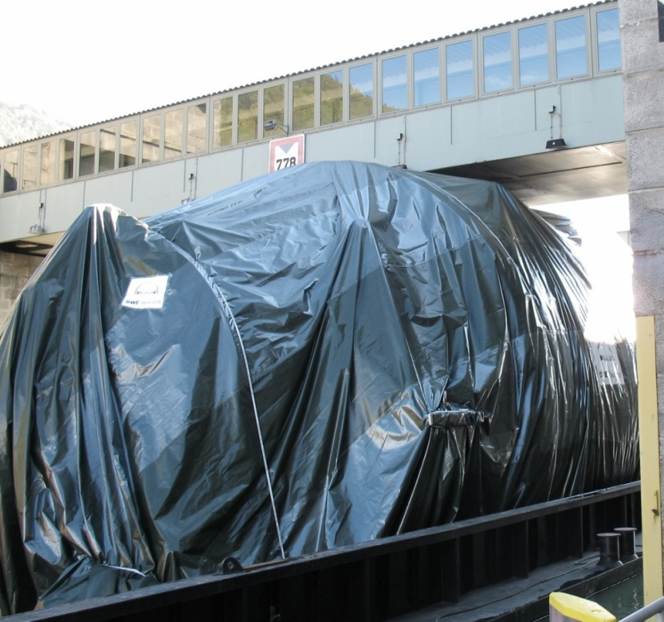
The KATRIN experiment
Jochenstein lock

Slide 29
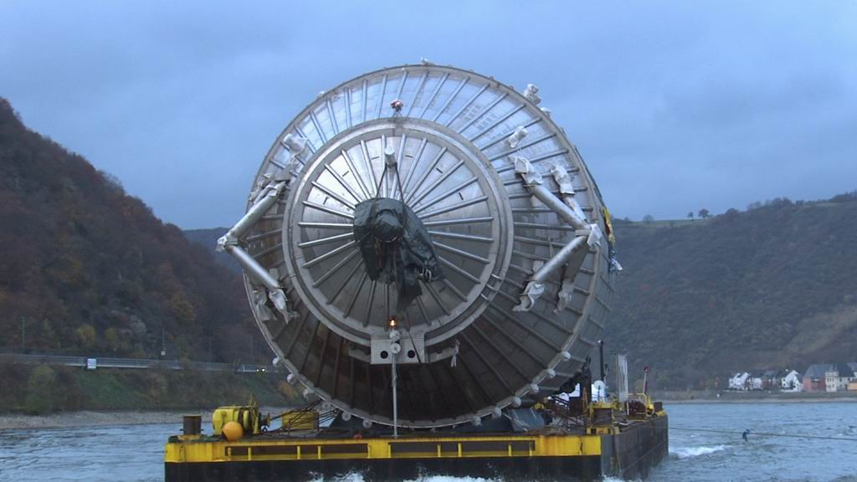
The KATRIN experiment
Donau

Slide 30
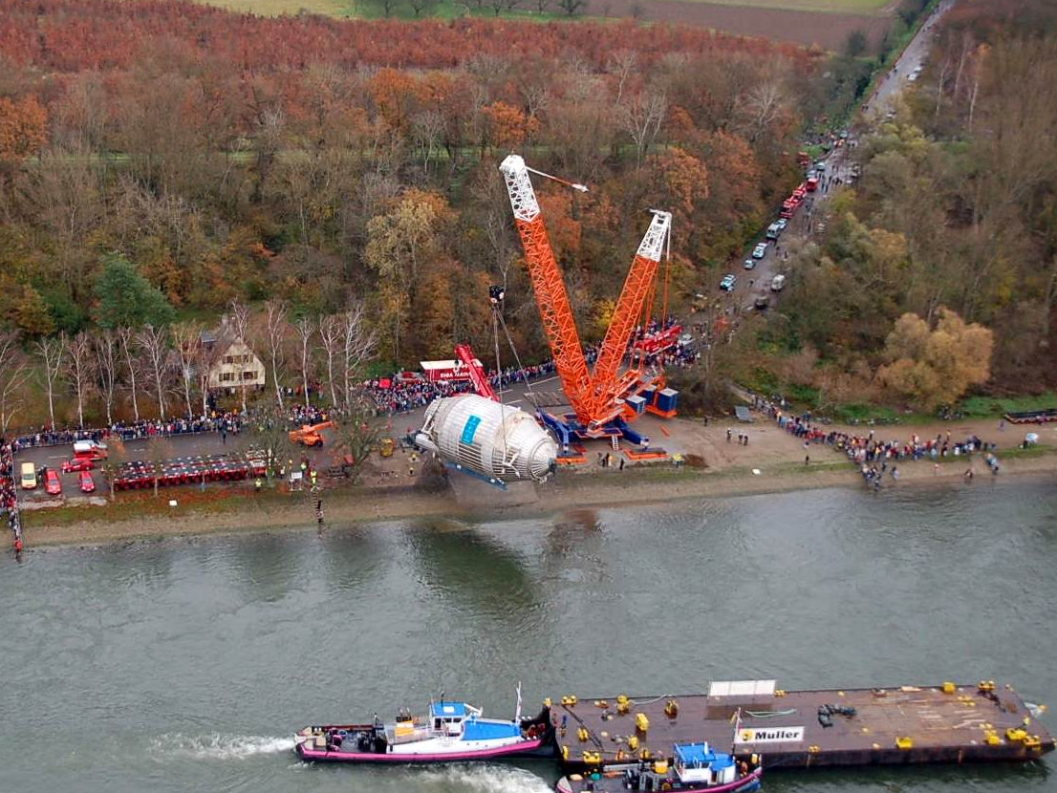
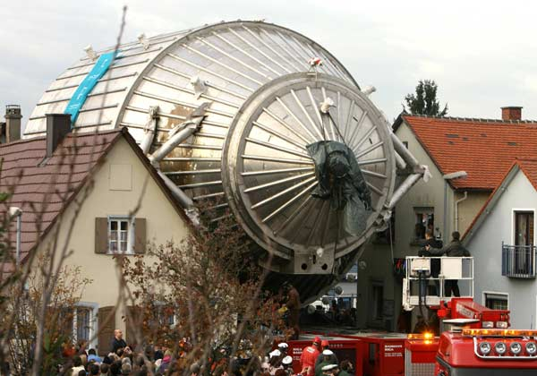
The KATRIN experiment
The last 7 km!
In pictures: photos of the year 2006
The main spectrometer of the Karlsruhe Tritium Neutrino Experiment (KATRIN) is manoeuvred through Leopoldshafen in southern Germany.
KATRIN
7 km
SPMT
river
Rhine

Slide 31
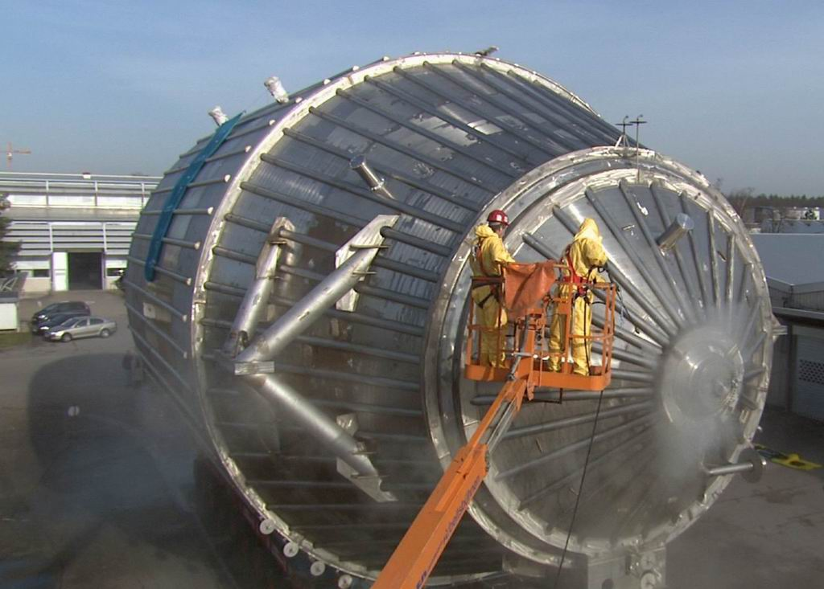
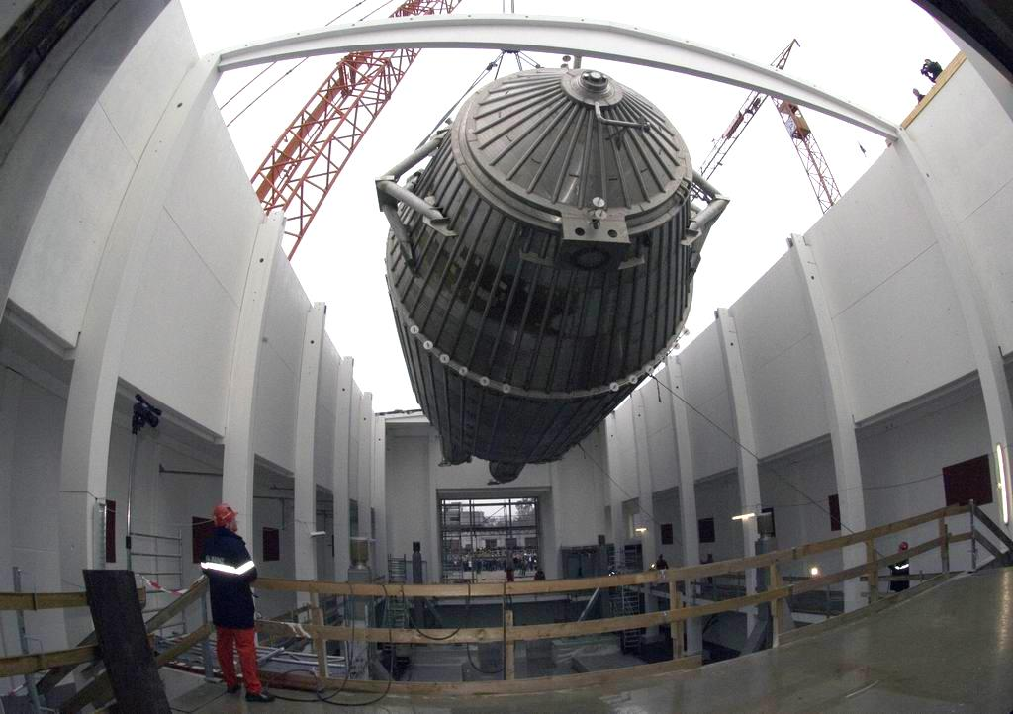
The KATRIN experiment
The last 7 m!
steam blasting
November 29, 2006

Slide 32
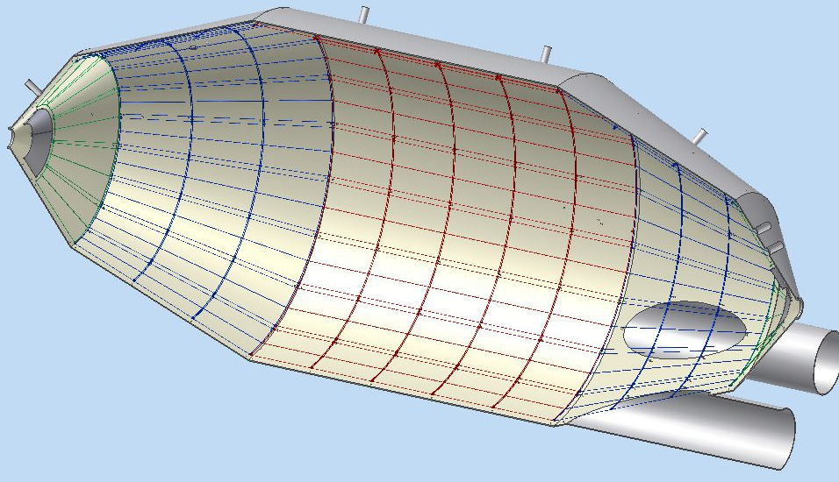
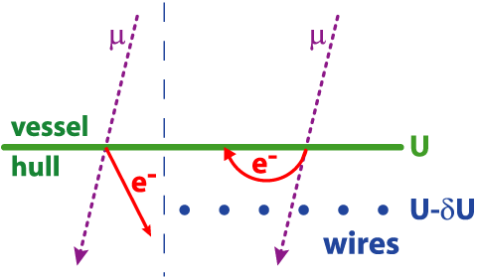
The KATRIN experiment
Wire electrode
248 modules: 23120 wires
…
U₂
U₁
U₀
electron energy analysis
background suppression
smooth electric potential
maximal potential in center
single layer: factor ~10
double layer: factor 100

Slide 33
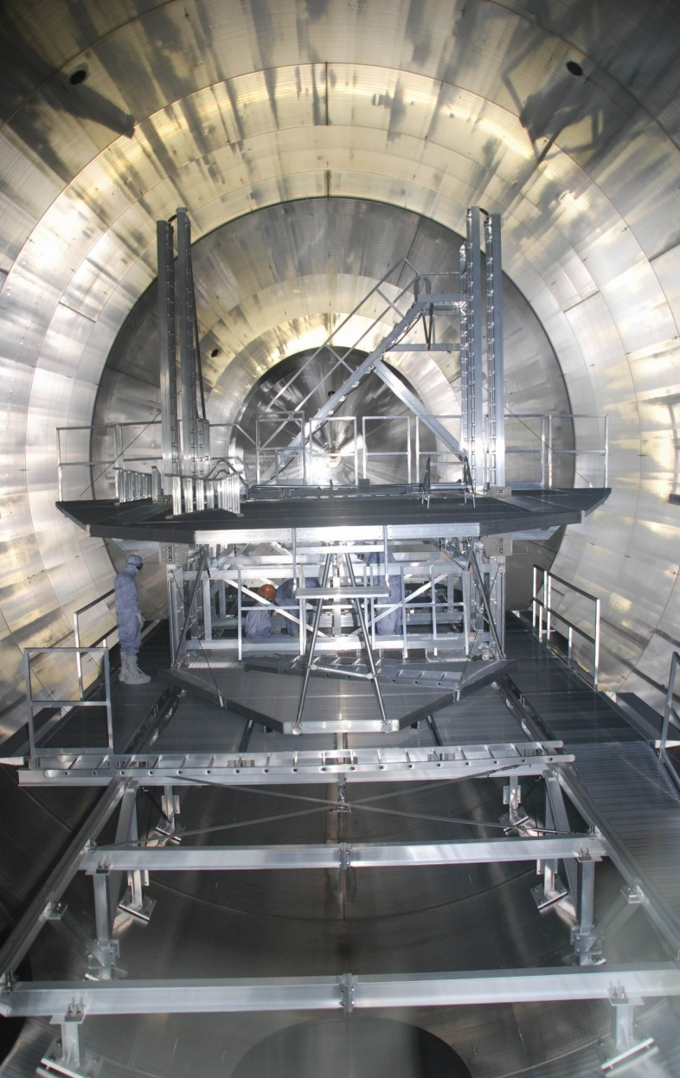
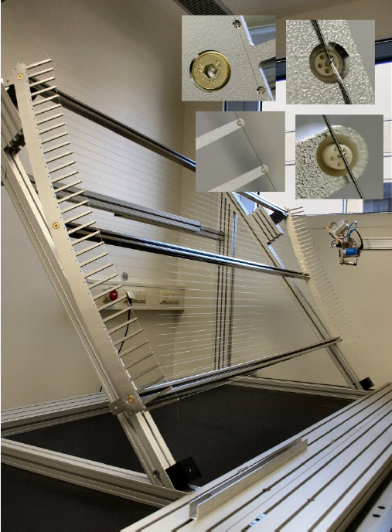
The KATRIN experiment
Wire electrode installation

Slide 34
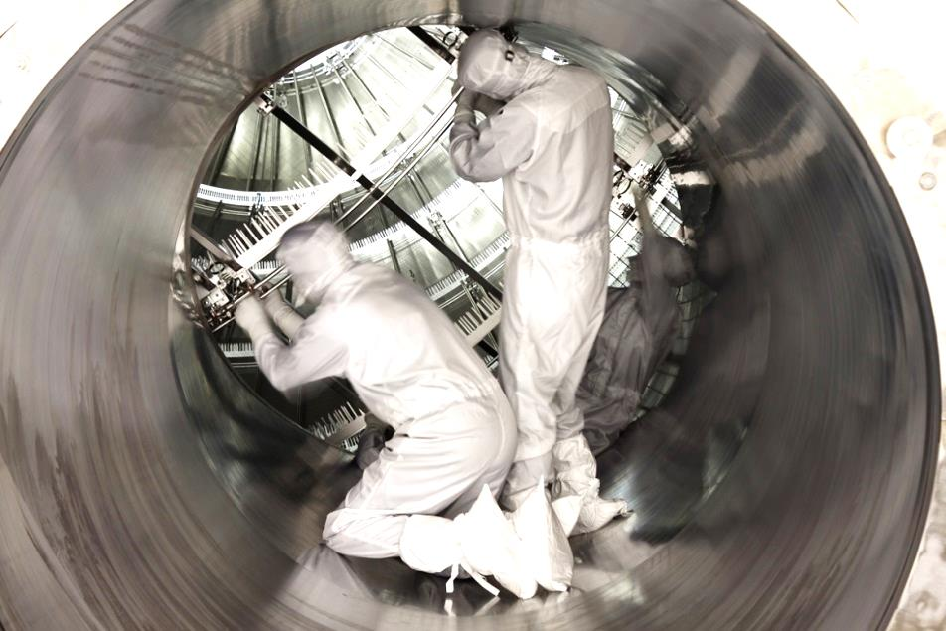
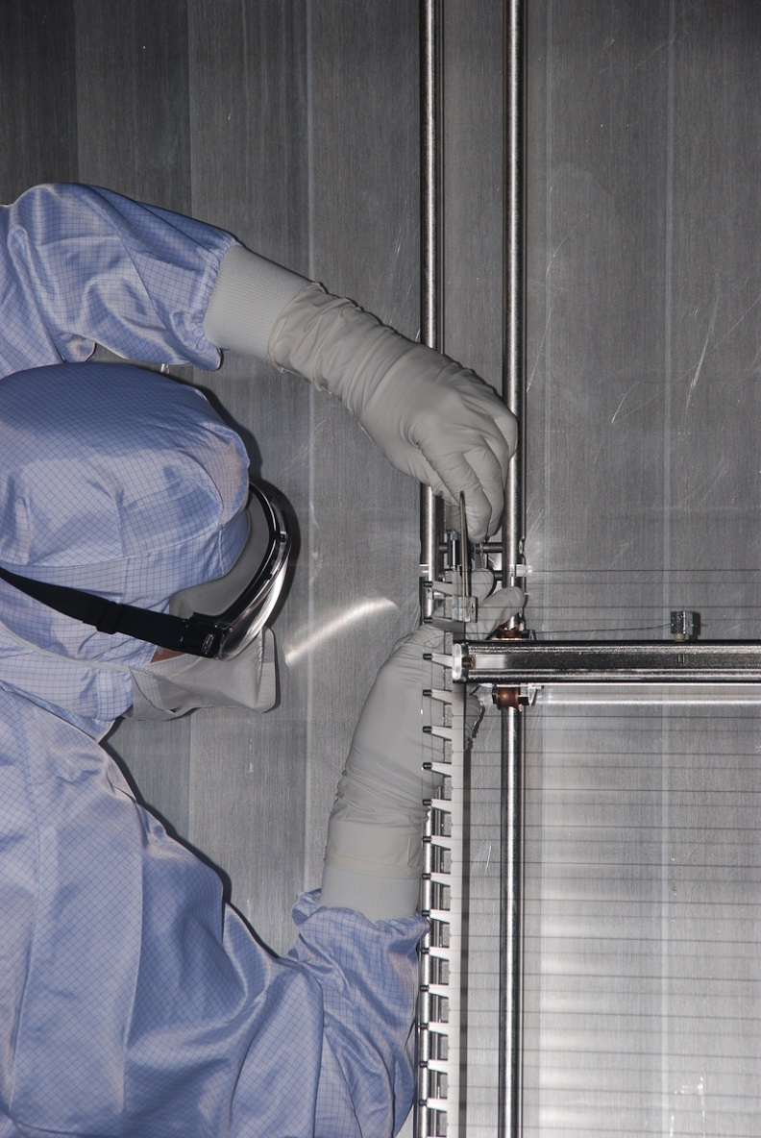
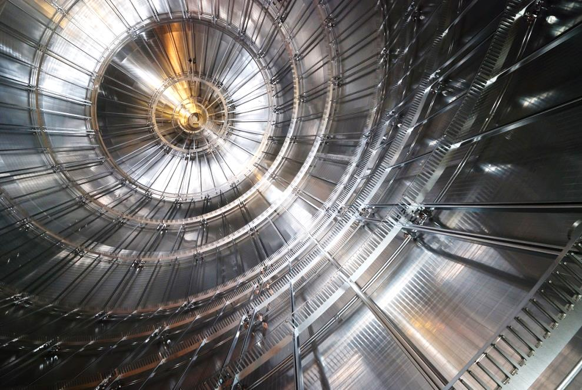
The KATRIN experiment

Slide 35
The KATRIN experiment

Slide 36
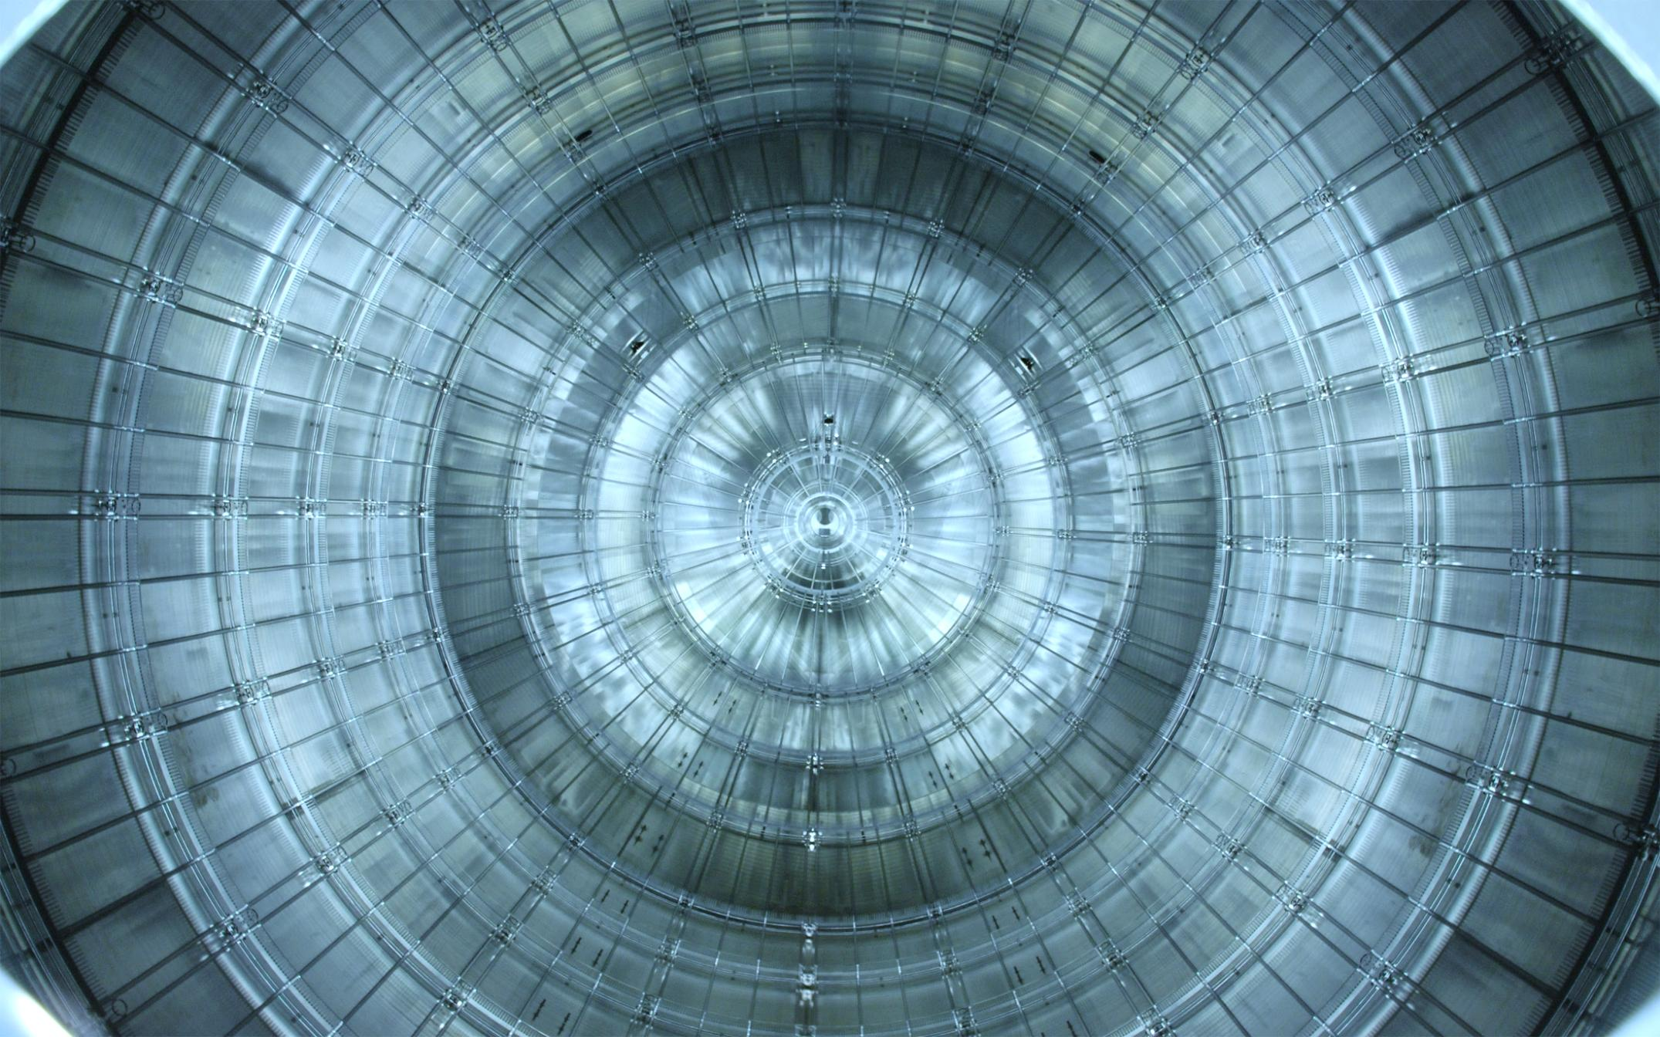
The KATRIN experiment
January , 2012:
Electrode installation finished

Slide 37
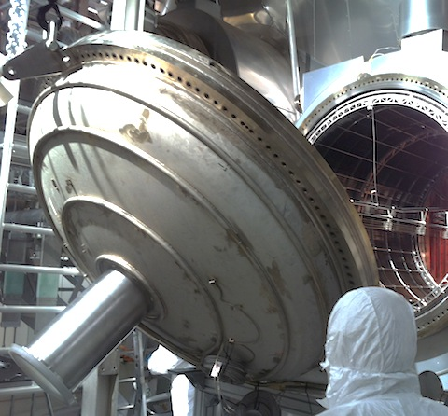
The KATRIN experiment
May 8, 2012
Spectrometer closed

Slide 38
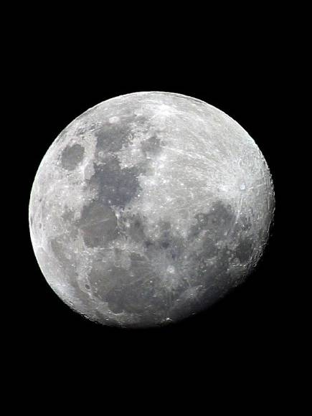
The KATRIN experiment
Bake-out
p = 10⁻¹¹ mbar
back at vacuum in July 2012: 10⁻⁸ mbar (water-dominated)
required pressure: 10⁻¹¹ mbar to minimize scattering on residual gas
challenge: large volume of 1240 m³

Slide 39
The KATRIN experiment
Bake-out
required temperature for water removal: 200°C
slow heating so inner electrode can follow expansion of vessel

Slide 40
The KATRIN experiment
Bake-out
activation of getter material (NEG St 707) at 300°C
main hydrogen pump

Slide 41
The KATRIN experiment
Bake-out
slow heating/cooling (~1°C/h): expansion of vessel and electrode
temperature breakpoints: 200°C – water removal from vessel
300°C – activation of getter material
leak developed &
fixed immediately
back to
10⁻¹¹ mbar level
During measurements:
4·10⁻¹¹ mbar

Slide 42
The KATRIN experiment
expansion
fix point
(video mirrored)
J. Wolf

Slide 43
The KATRIN experiment
Integration of detector and spectrometer
May 16, 2013: SDS connection established
May 28, 2013: opening gate valve

Slide 44
The KATRIN experiment
First light
May 31, 2013
asym. magnetic field
map electrode onto detector
confirmed by simulations
Det

Slide 45
The KATRIN experiment
Main spectrometer and detector commissioning
May 31 – Sep 23, 2013
study electron transport and background behavior
KATRIN control room

Slide 46
Radon-induced background
background investigations at the KATRIN pre-spectrometer
periods of elevated rate
characteristic ring structure at the detector
Event A
Event B

Slide 47
Radon-induced background
radial confinement: cyclotron motion (gyration around magnetic field line)
axial confinement: magnetic bottle effect
magnetron motion: $\vec{v}=−\frac{cE}{eB^{3}}∙\vec{B}⨯∇_{⊥}\vec{B}+\frac{c}{B^{2}}$ $∙\vec{E}⨯\vec{B}$
pre-spectrometer
B_{max}
B_{min}
B_{max}
electron momentum

Slide 48
Radon-induced background
p = 10⁻¹¹ mbar
magnetically stored electrons scatter off residual gas → ionization
→ secondary electrons (30 eV primary energy loss per ionization)
high primary energies → hundreds of secondary electrons
UHV → storage time up to several hours
pre-spectrometer
F. Fränkle et al, Astropart. Phys. 35, 128 (2011)
S. Mertens et al, Astropart. Phys. 41, 52 (2013)
N. W. et al, J. Phys. G 40 (2013)
N. W. et al, New J. Phys. 15 (2013)

Slide 49
Radon-induced background
radon as electron source
getter material (St 707, PS: 90m, MS: 3km): ²¹⁹Rn (t_{1/2}=3.96 s)
vessel surface (PS: 25m², MS: 690m²): ²²⁰Rn (t_{1/2}=55.6 s)

Slide 50
Radon-induced background
radon emanation from getter/wall into the spectrometer
radon decay in the sensitive spectrometer volume
alpha-emission: not relevant for KATRIN
accompanying electrons: source of background
Getter pump

Slide 51
Radon-induced background
electron multiplicity
up to 20 electrons emitted per decay
in reasonable agreement with
measurement (from literature)
electron energy spectrum
up to 500 keV

Slide 52
Radon-induced background
comparison of pre-spectrometer measurements with KASSIOPEIA
pressure: 2·10⁻⁹ mbar

Slide 53
Radon-induced background
Expectations for the main spectrometer
modeling of physics processes: KASSIOPEIA
extrapolations to main spectrometer
expectation: background on the order of 1 count per second
1
1
10⁻¹
Background rate (cps)
10⁻²
10⁻³
10⁻⁴
scenario 1
scenario 2
scenario 3
scenario 4
S. Mertens et al, Astropart. Phys. 41, 52 (2013)

Slide 54
Radon-induced background
First look at background with full HV
no surprises: previous MAC-E filters: >10⁵ cps initial rate
about 300 mcps due to radon-induced background
required rate: 10⁻² cps
counter measures needed
2.5
PRELIMINARY
2
10⁻²
1.5
Background rate (cps)
1
0.5
2·10⁻³
0
100
200
300
400
500
600
time (s)

Slide 55
Radon-induced background
Passive background reduction: principle
spectrometer
vessel
NEG-Pump
LN₂ cooled
baffle
²¹⁹Rn

Slide 56
Radon-induced background
Passive background reduction: measurement results
reduction by 300 mHz, remaining background mainly µ-induced
PRELIMINARY
WARM BAFFLES
mean rate: 0.78 ± 0.20 cps
Background rate/unit volume (cps/m³)
COLD BAFFLES
mean rate: 0.47 ± 0.09 cps
detector rings

Slide 57
Summary & Conclusion
Neutrino oscillations manifest existence of neutrino masses
Cosmology: $\sum{m_{i}}<0.23 eV$, parameter degeneracy
0νββ: $m_{ee}<0.2−0.4 eV$, CP-phases, matrix elements
β-decay: $m_{ν}<2 eV$, model-independent
KATRIN: direct $m(ν_{e})$ determination with 200 meV sensitivity
Successful spectrometer commissioning summer 2013
Radon-induced background understood and under control
Remaining components to be delivered in 2014
Start of tritium operation in 2015

Slide 58
Thank you for your attention!

