Slide 1
FTK integration in tau trigger
Takashi Kubota
The University of Melbourne
ATLAS Pisa meeting
12/11/2013

Slide 2
Contents
Overview of my study (why I’m here?)
Scope of the study
Necessary steps & status
Summary

Slide 3
Overview of my study (why I’m here?)
FTK integration in tau trigger
Associative Memory Module test, R&D
Upgrade ATLAS trigger for 3rd generation fermions
→ (in 3 years) transfer AM technology to human vision study
The project has just been granted by ARC with a lot of travel fee ;)
Physics analysis (VH→WW)
Finalising Run1 analysis
Move to Higgs to fermion study?
Or something which exploit 3rd generation fermions

Slide 4
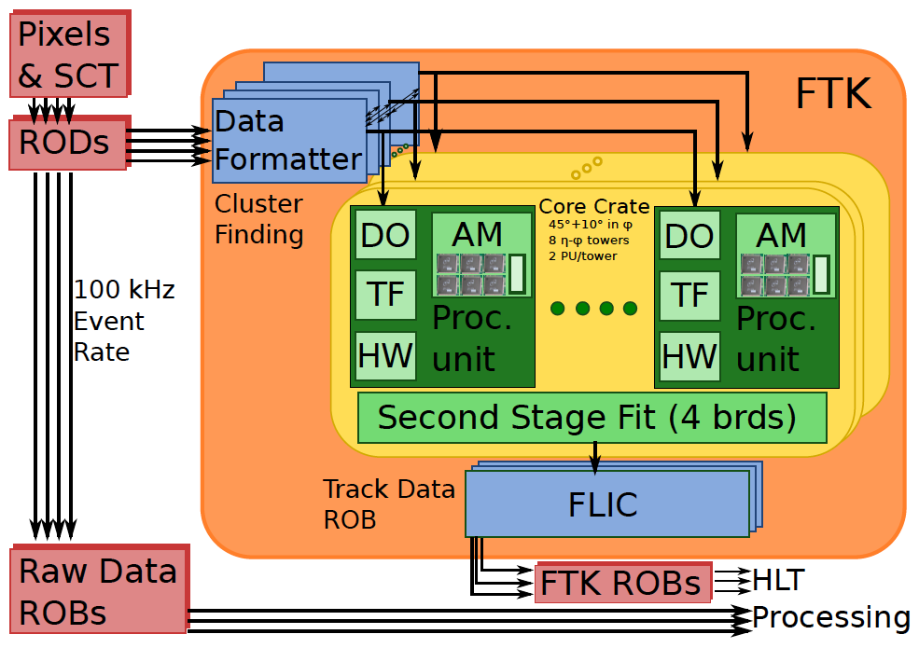
Scope
FTK emulation has been developed by other experts
Guido et al.
Performance studies done with offline samples
Chiara, Lilly, Nicolo…
My work is to integrate FTK information in tau trigger with Viviana
I’m working here!

Slide 5
Steps (currently working at L2)
Fetch FTK info.
Fill tau track EDM with FTK info.
Menu building
Revert the order between the track and calo Fex&Hypo
Currently calo first, to be track first
Implement FTK specific track cuts
Based on peoples effort
Integrate FTK PV finder

Slide 6
Fetch FTK info
ID track information are filled by TrigL2SiTrackFinder
TrigL2SiTrackFinder is configured depending on the trigger chain
FTK configuration is called ‘strategy F’
Dump of ‘Run Time Test’ for L2_tau20_medium:
--- snip ---
T2IDTau_Tau_1GeV_dZ02_dR0103\
DEBUG Found track pT = -949.399 eta = -1.93313 phi0 = 2.37533 AlgId = 8
--- snip ---
is ‘Strategy F’
algorithm for ID track fetch in tau trigger
Fetching FTK info. Has been done properly

Slide 7
Fill tau track EDM with FTK info.
Common tau track EDM is shared by strategies
TrigTauTracksInfo
Also filling algorithm is shared
TrigT2IDTau
Dump of ‘Run Time Test’ for L2_tau20_medium:
--- snip ---
T2IDTau_Tau_1GeV_dZ02_dR0103\
DEBUG Found track pT = -949.399 eta = -1.93313 phi0 = 2.37533 AlgId = 8
--- snip ---
FTK track info
FTK track info is correctly filled in the tau track EDM

Slide 8
Menu building (on going!!)
Revert the order between the track and calo Fex&Hypo
Looks easy (two algorithms share more or less symmetric structure)
Waiting for further information from Viviana
Implement FTK specific track cuts
Will be done in the common filler (TrigT2IDTau)
Integrate FTK PV finder
Package already available and testing under way
Will contact experts

Slide 9
Summary
I have been working in FTK integration in tau trigger with Viviana
Tested that FTK info is fetched
Tested that FTK info is filled in tau trigger EDM
Will be working on the menu building
Sounds many of ingredients are there
Will contact with experts (actually collecting information is the most time consuming in the ATLAS...) and unify them

