Slide 1
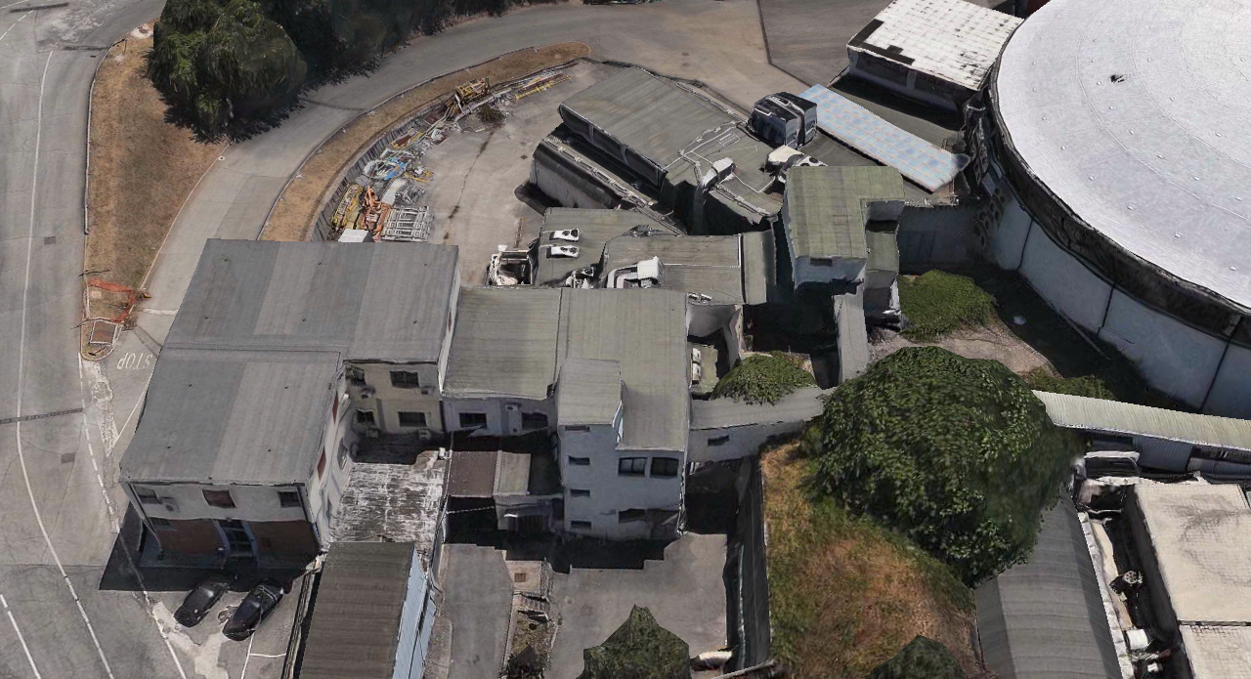
DAFNE beam-test facility
47th LNF Scientific Committee
Frascati, 14th November 2013

Slide 2
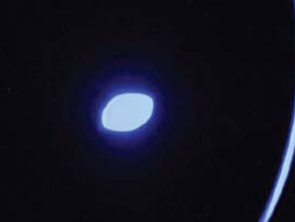
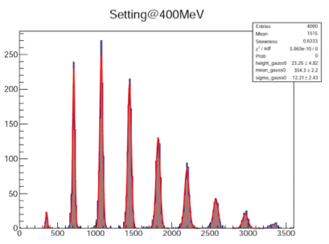
BTF concept
From 10⁷-10⁹ positrons or electrons at 510 MeV from the linac…
…To a finely tuned “single-particle” beam:
  50-500 MeV electrons or positrons
    Independent from linac primaries
  Poisson statistics at low intensity
  Few % intensity fluctuations at intermediate intensity (thousands of particles)
    Limited by Linac energy uncertainty
  <1% momentum spread
    Limited by selection/collimation configuration
  Few mm beam spot
    Limited by emittance and optics
[Mambo BGO]

Slide 3
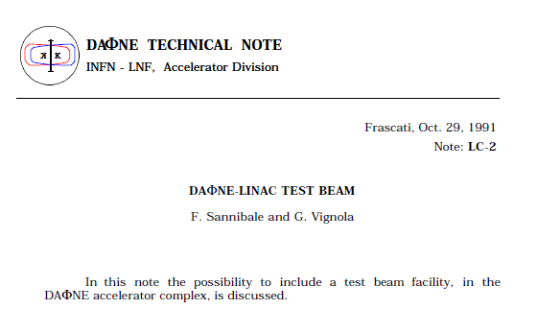
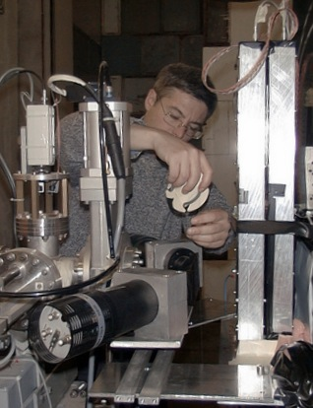
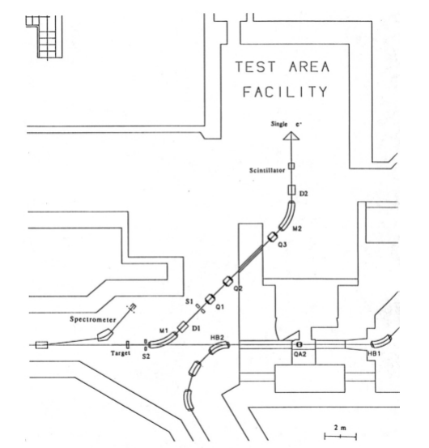
BTF history/1
Originally designed in the DAFNE accelerator complex by F. Sannibale and G. Vignola, 1991
Commissioning started, Feb. 2002, by G. Mazzitelli and P. Valente
Users access since Nov. 2002

Slide 4
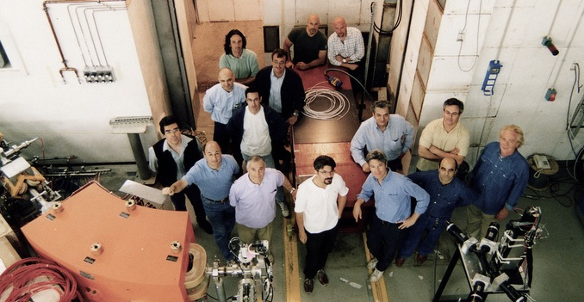
BTF history/2
Separation of BTF line from DAFNE injection, 2004, B. Buonomo joins
Photon tagging, 2005, AGILE team collaboration
Pulsed magnet + fast dipole, 2006, L. Quintieri joins

Slide 5
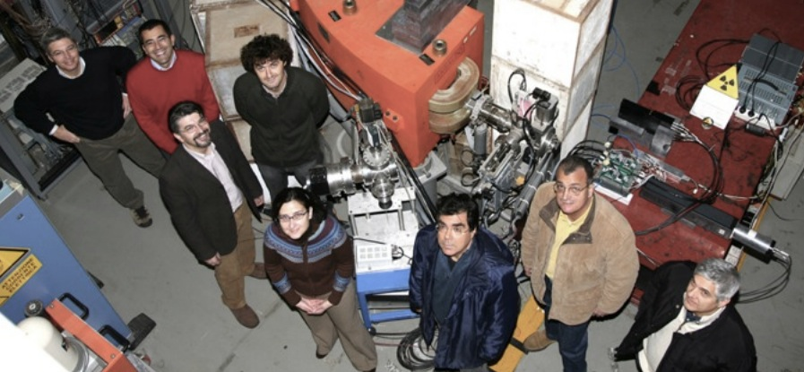
BTF history/3
Target shielding 2008
Neutron source studies start 2009
2010, L. Foggetta joins

Slide 6
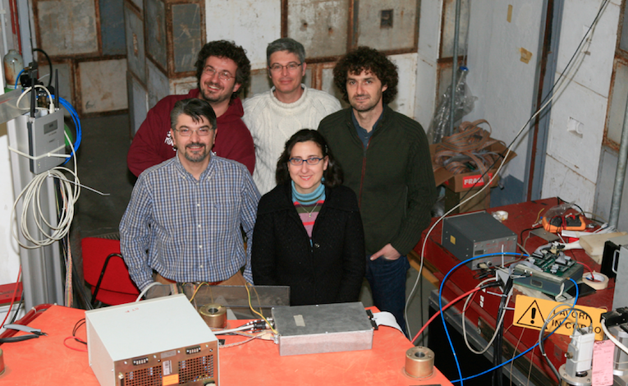
BTF people
Staff
Paolo Valente, scientific responsible
Bruno Buonomo, technical responsible
  Linac technical staff
Luca Foggetta, operations and run coordinator,
diagnostics, acquisition and controls, services, …
  DAFNE operations team
Maria Rita Ferrazza, administration support
  Luca Ceccarelli, undergrad. student, user support
  Oscar Frasciello, Ph.D. student, simulations
Related projects
AIDA, FP7, beam-test facilities, diagnostics, G. Mazzitelli, F. Murtas, G. Claps
n@BTF, NESCOFI neutron studies, R. Bedogni, A. Esposito
IRIDE-neutrons, A. Pietropaolo, L. Quintieri, S. Bartalucci, ...
!CHAOS, innovative control systems

Slide 7
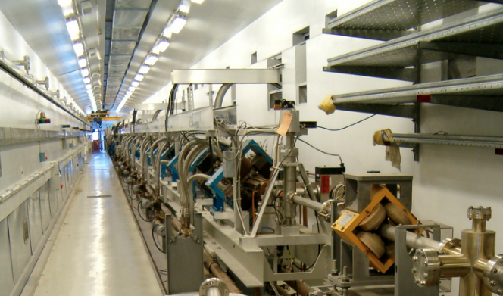
DAFNE Linac
 | Design | Operational
Electron beam final energy | 800 MeV | 510 MeV
Positron beam final energy | 550 MeV | 510 MeV
RF frequency | 2856 MHz
Positron conversion energy | 250 MeV | 220 MeV
Beam pulse rep. rate | 1 to 50 Hz | 1 to 50 Hz
Beam macropulse length | 10 nsec | 1 to 10 nsec
Gun current | 8 A | 8 A
Beam spot on positron converter | 1 mm | 1 mm
norm. Emittance (mm. mrad) | 1 (electron) 10 (positron) | < 1.5
rms Energy spread | 0.5% (electron) 1.0% (positron) | 0.5% (electron) 1.0% (positron)
electron current on positron converter | 5 A | 5.2 A
Max output electron current | >150 mA | 350 mA
Max output positron current | 36 mA | 100 mA max
Trasport efficiency from capture section to linac end | 90% | 90%
Accelerating structure | SLAC-type, CG, 2π/3
RF source | 4 x 45 MWp sledded klystrons TH2128C

Slide 8
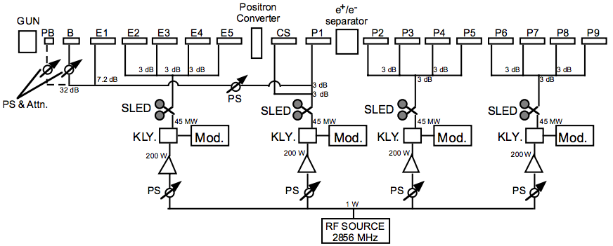
DAFNE Linac
A
B
C
D

Slide 9
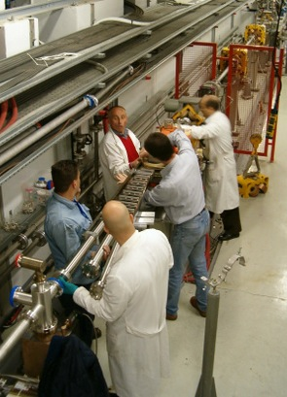
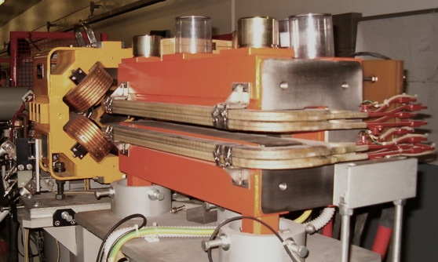
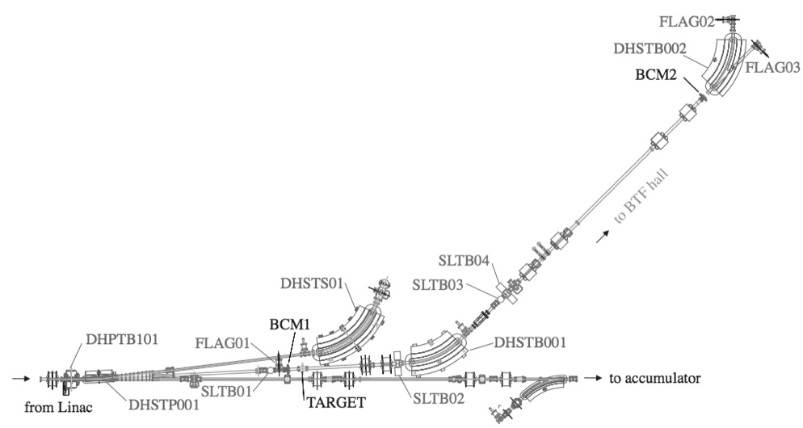
Bunch selection and timing
Three-way selection installed in Spring 2004
Fast-dipole 3° + Pulsed dipole 3° can drive bunches at
  0° to damping ring
  3° to BTF line
  6° to Linac spectrometer
  Linac
  spectrometer
  BTF line
  to/from DR

Slide 10
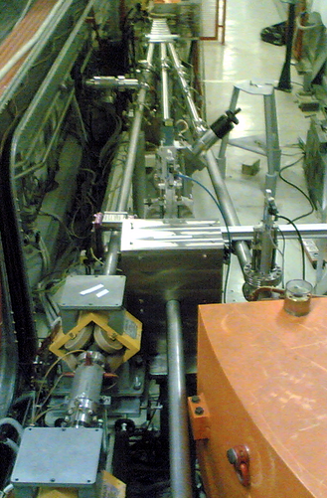
Beam attenuation
Copper target
  Optimized shielding to reduce e.m. background

Slide 11
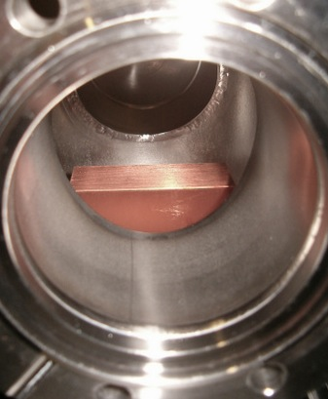
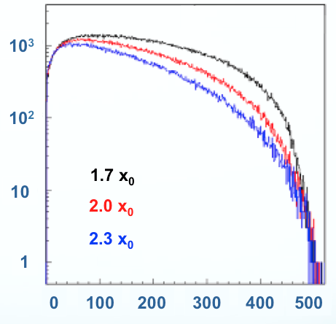
Beam attenuation
Copper target
  Variable depth: 1.7, 2.0, 2.3 x₀

Slide 12
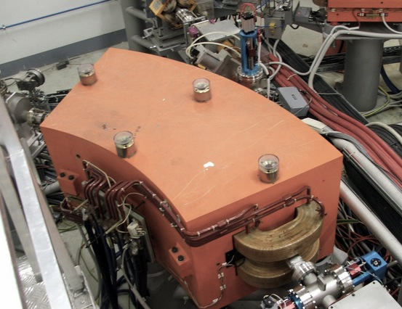
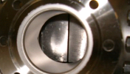
Energy selection
42° momentum selection dipole
Tungsten collimators
Linac
spectrometer

Slide 13
Intensity fine tuning
A fine adjustment of the number of particles can be achieved:
  Without changing the momentum resolution:
    Modulating the Linac current [not possible in ‘parasitic mode’, very rough]
      Act on transport optics or modulators power/phase
    Choosing another target depth [step change but reproducible]
    Closing/Opening the down-stream vertical collimators [fine but small range]
    Closing/Opening the up-stream vertical collimators
  Also changing the momentum resolution:
    Closing/Opening the horizontal collimators

Slide 14
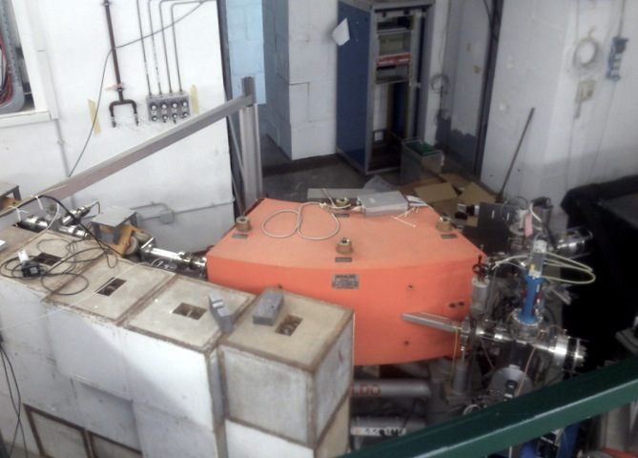
BTF line
45° line
Equipped with detector testing gadgets:
  Remote-control table
  Beam spot and intensity diagnostics for medium and low intensity beam
Straight line
More background
Used mainly for high-intensity;
  neutron photoproduction
  equipped with fluorescence flag

Slide 15
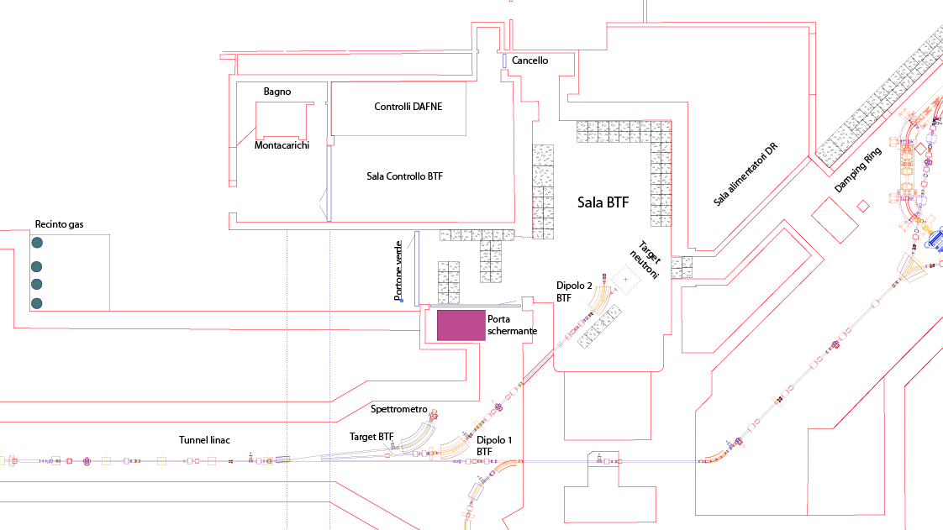
BTF complex

Slide 16
KLOE
DR hall
DR pumping
DR
power
BTF
hall
DAFNE hall
Nuclear Physics
building
BTF
control room
Linac tunnel
Modulators
hall

Slide 17
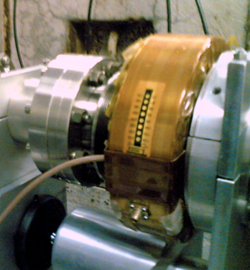
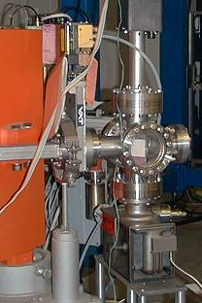
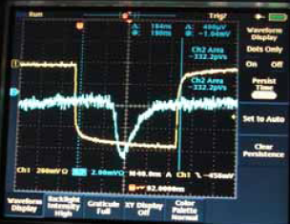
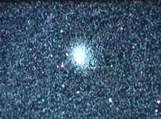
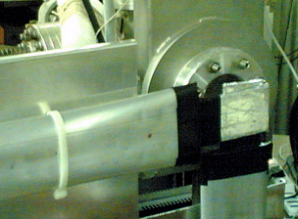
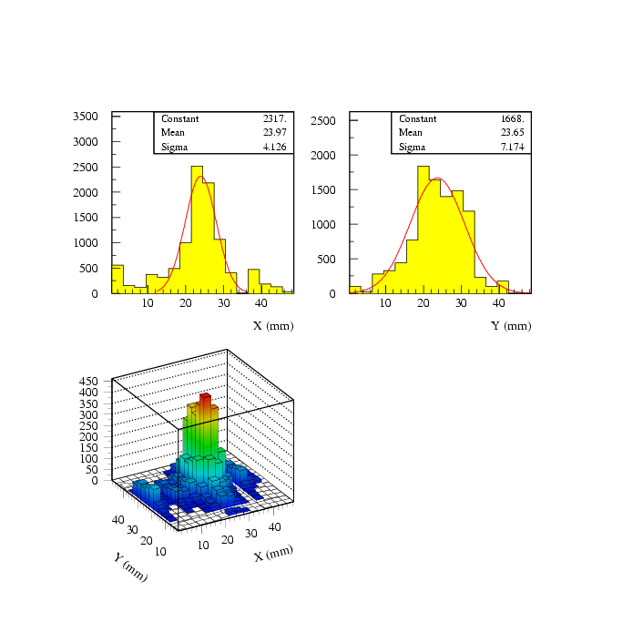
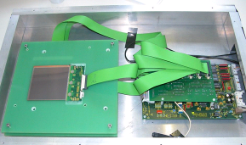
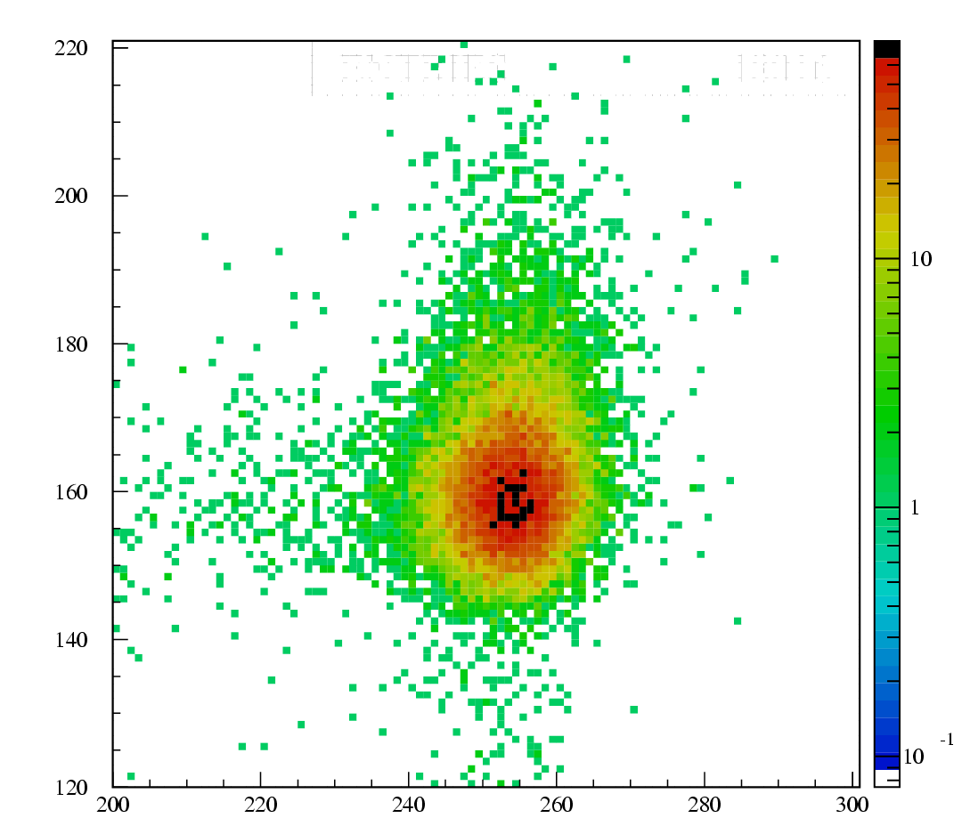
Diagnostics
High intensity
Integrating current toroid
Fluorescence flag
Medium-low intensity
Scintillating fibers hodoscope
Silicon micro-strip detectors (currently under maintenance]
GEM Time-projection chambers

Slide 18
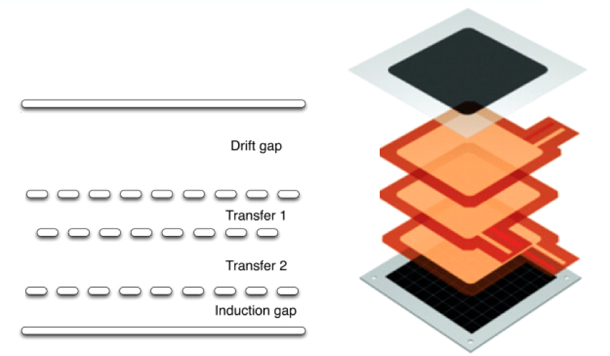
Triple GEM scheme

Slide 19
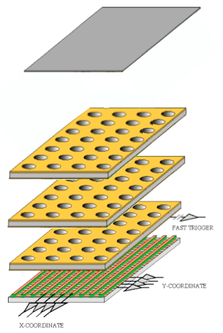
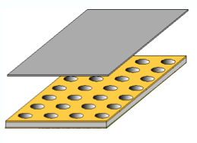
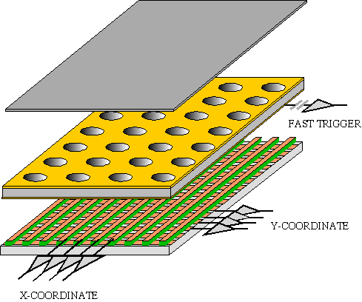
GEM TPC
Particle
conversion
Particle
conversion
t_{drift}
Gain
Gain
Readout
Readout
Standard Triple-GEM detector
Triple-GEM as time-projection chamber

Slide 20
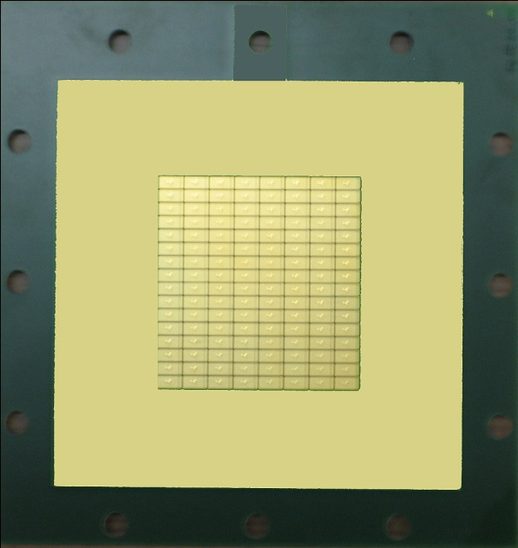
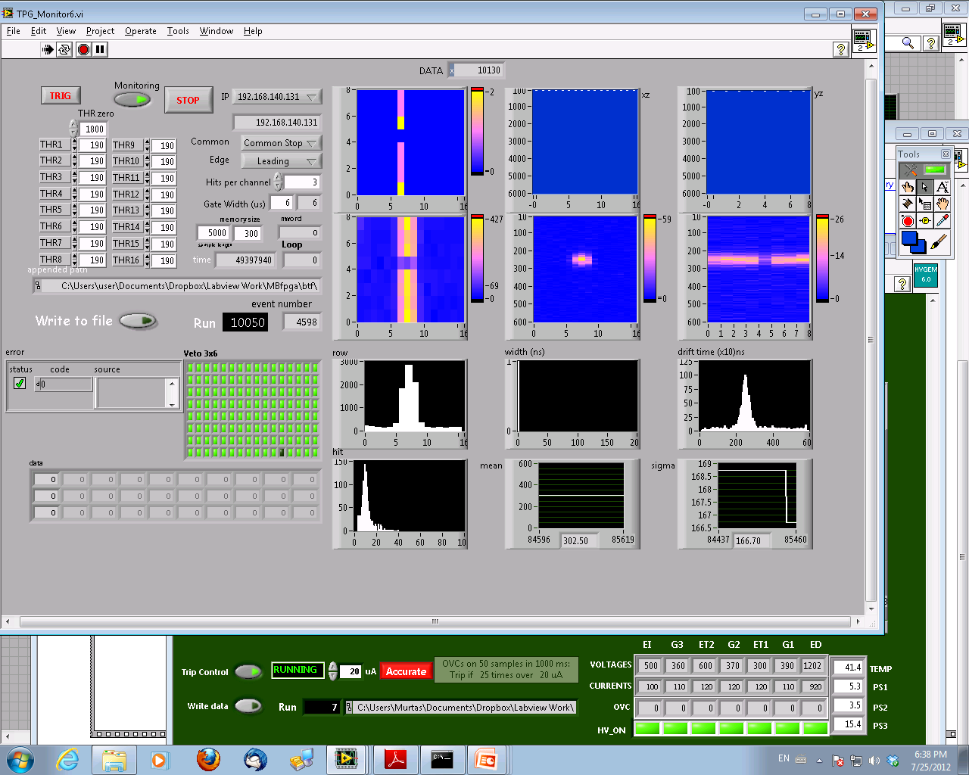
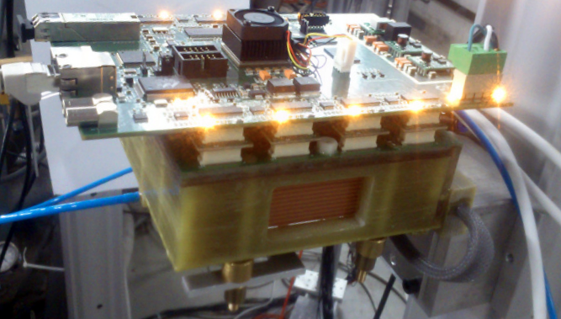
GEM TPC
5 cm
Top
Front
Side
Vertical
4 cm
4 cm
5 cm
Horizontal

Slide 21
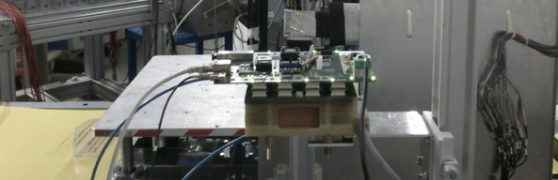
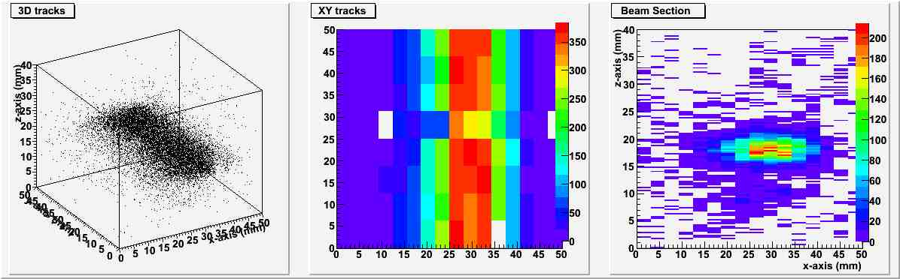
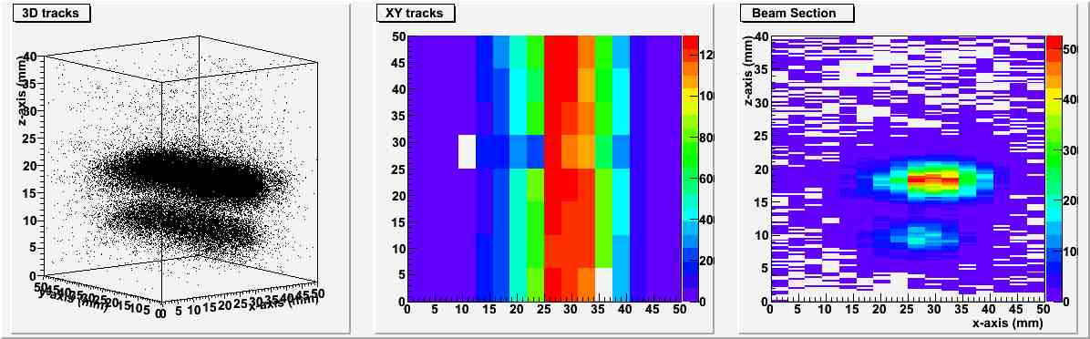
GEM TPC example: channeling
Positron beam, 477 MeV
- No channeling
- Channeling

Slide 22
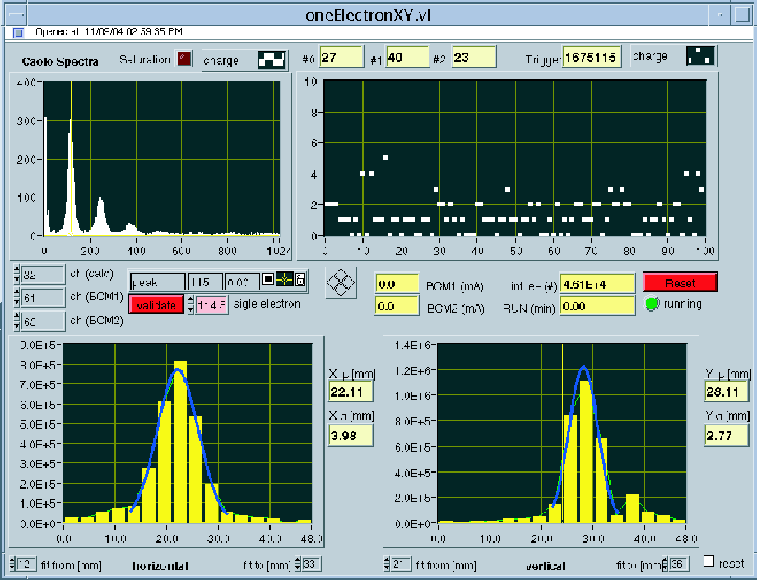
Control system
‘old’ online monitor of BTF diagnostics integrated in the DAFNE general control system
calorimeter
Many additional bits and pieces added during the last years and have to be integrated:
  New remotely controlled motorized table
  GEM TPC acquisition system
  Slits/collimators/target motors and encoders
  WCM’s oscilloscope readout
XY beam
profile
detector
Significant work already done and still under way on controls, in close collaboration [or by] the !CHAOS project
The BTF line (magnets, controls, diagnostics, tools) will be the first real application of !CHAOS
First commissioning going on this week
No nice picture to show, but we expect a brand new [working] system soon

Slide 23
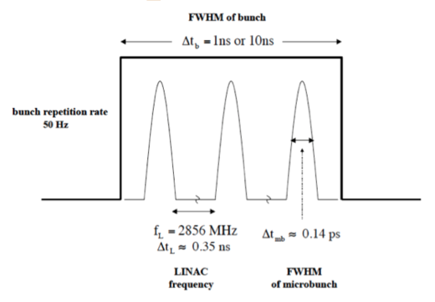
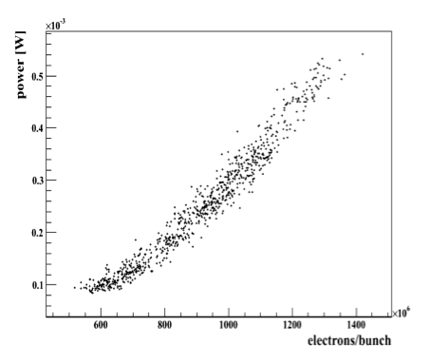
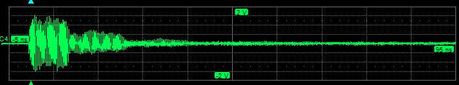
Beam parameters
Parameter | Value
Maximum rep. rate | 1-24 Hz [49 Hz]
Pulse duration | 1 / 10 ns
Linac frequency | 2,856 GHz
Parameter | Value
Maximum allowed intensity | 3×10¹⁰ e⁻/s
Maximum energy | 510 MeV [650 /550 MeV e⁻/e⁺]
[AMY microwave antenna]
[AMY microwave antenna]
10 ns

Slide 24
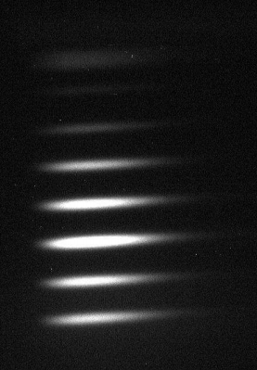
Beam parameters
Measured emittance:
  √<x²>=4 mm
  √<x’²>=1.7 mrad
  √(<x>²<x’>²−<xx’>²)=4 mm⋅mrad
[508 MeV, Pepper pot]

Slide 25
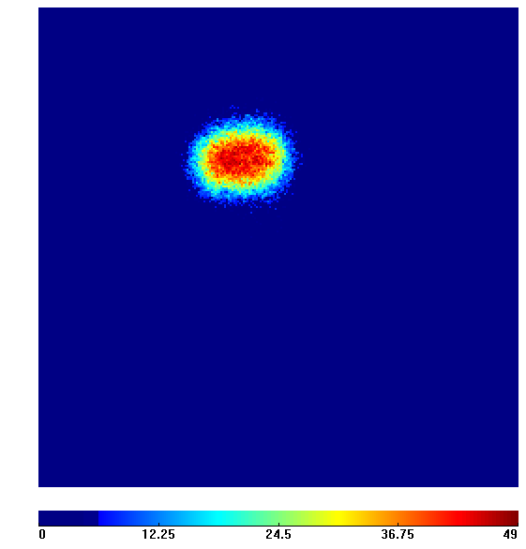
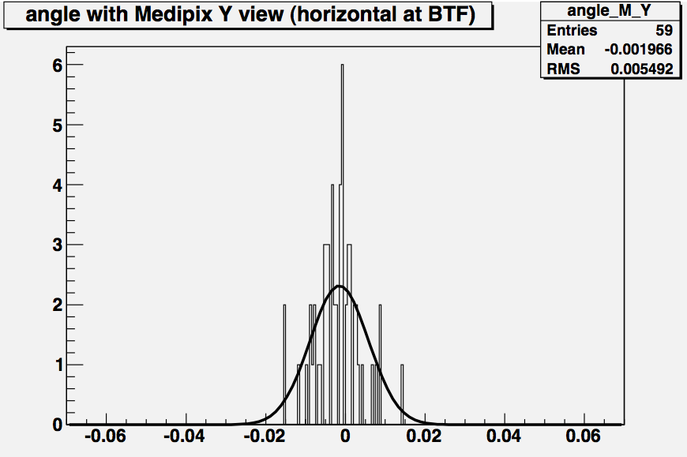
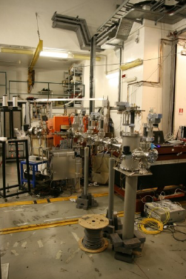
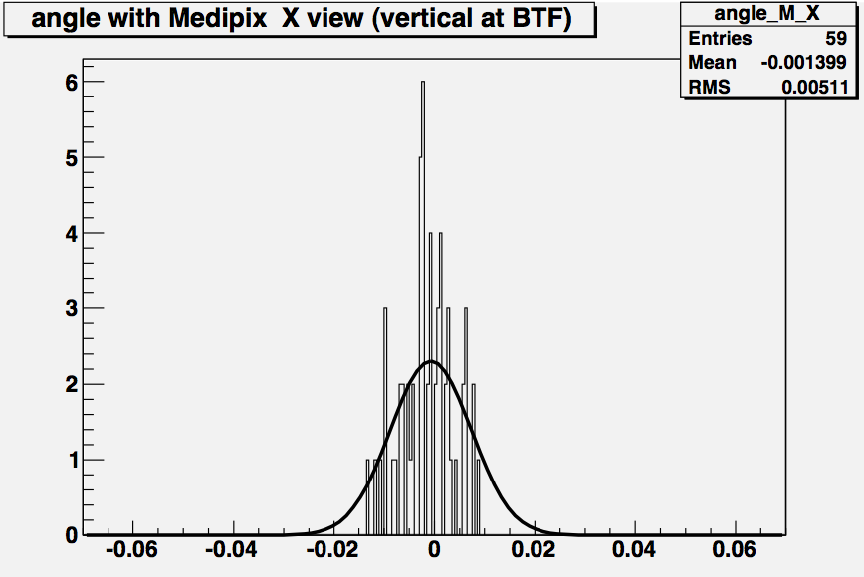
Beam parameters
FWHM 2.4 × 1.8 mm
2 mrad RMS
1.4 mrad RMS
[UA9 Medipix detector]

Slide 26
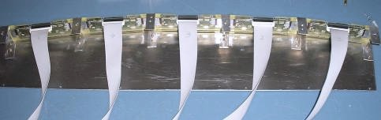
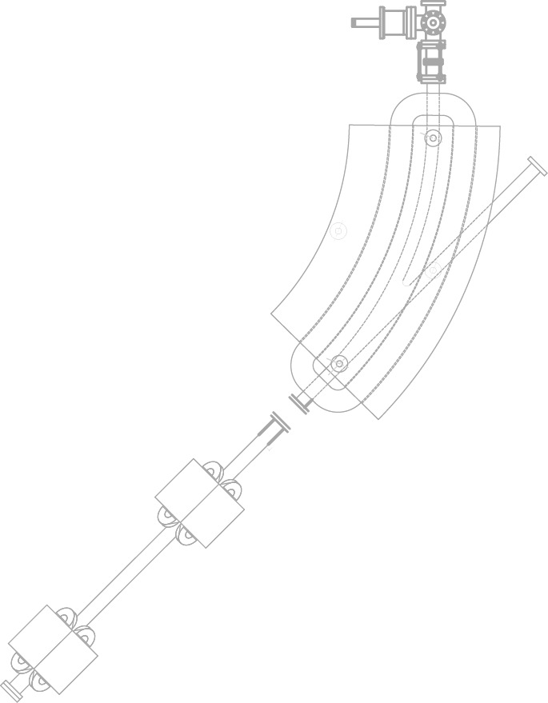


Photon tagging/1
Bremsstrahlung
photon
silicon detectors
silicon tagging
target
dipole magnet
Incoming electron
Be window
Designed and built in close collaboration with the AGILE collaboration with the main purpose ot the AGILE scientific payload calibration:
  Silicon trackers + calorimeter

Slide 27




Photon tagging/2
10
20
50
100
200
500 MeV
400× Crab Nebula

Slide 28
Photon tagging/3
Some issues of this system
In order to have useful tagged photons, need to select clean single electron tracks:
  Offline reconstruction mandatory
  Low beam intensity, below 2-3 electrons/bunch
  Low useful rate, <0.5 Hz after selection (few % efficiency)
    At low energy:
      Low efficiency due to not linear “binning” in energy
      Cut-off due to acceptance of tagging modules (detectors outside the vacuum pipe)
    At high-energy
      Low efficiency due to 1/E spectrum
      More sensitive to spurious events due to off-momentum or off-angle electrons
Due to the peculiar geometry, uneven distribution of photon energies, in particular issue with:
  Geometric overlap of electrons radiating an intermediate energy photon and off-central electrons

Slide 29

Neutron source/1
Why photo-production? Because it’s more convenient up to 10¹⁶ n/s (at the target)
Number of neutrons proportional to the electron beam power:
  P = rate×energy =[N×f]×E
    N = number of particles per bunch (let’s consider 1×10¹⁰)
    f = frequency (up to 49 Hz)
    E = beam energy (usually 510, up to 800)
  Maximum power: 40 W at 510 MeV
  500 MeV
  Very simple estimate of neutron yield from Swanson’s empirical formula
    10¹¹ n/s for Tungsten
    -20% on Lead, +50% on Uranium

Slide 30



Neutron source/2
n@BTF project
Simulated and designed an optimized target (W cylinder d=70 mm, l=60 mm) and shielding system (lead and polyethylene)
Preliminary measurements of the neutron field and photon background
Isolethargic fluence
10 eV
1 keV
1 MeV
100 MeV

Slide 31



Neutron source/3
At 90° better n/γ ratio

Slide 32


Neutron source/4
Bonner Sphere Spectrometer equipped with Dysprosium activation foils (Dy-BSS)
Response matrix previously tested in reference neutron fields, ±2% overall uncertainty

Slide 33

Neutron source/5
Good data/simulations agreement

Slide 34

Neutron source summary
At 1.5 m distance:
Total neutron flux: 8×10⁻⁷ n/cm²/pr ±3%
Flux = 4.5×10⁵ n/cm²/s
Equivalente dose = 45 mSv/h
d (m) | ×10⁻⁷ n/cm²/pr
0.5 | 58
1 | 15
1.5 | 8
Total photon flux = 5×10⁻⁵ γ/cm²/pr
d (m) | ×10⁻⁵ n/cm²/pr
0.5 | 63
1 | 5.7
1.5 | 1

Slide 35
BTF users/1
Mainly, two kinds of users:
  Test of detectors or beam diagnostics
    Any kind of detector: calorimeter,s scintillators, fibers, drift chambers, micro-pattern gas detectors (GEM, MSGC), RPC, diamond, silicon pixels, silicon micro-strips, fluorescence detectors, Cerenkov, RICH, …
  Real experiments using the electron or positron beam
    Thermo-acoustic expansion of materials due to ionizing particles (RAP)
    Absolute air and Nitrogen fluorescence yield (AIRFLY)
    Microwave emission from e.m. showers (AMY)
    Electron and positron channeling, parametric radiation

Slide 36
BTF users/2
Year | Beam-days
2002 | 30
2003 | 150
2004 | 282
2005 | 364
2006 | 244
2007 | 224
2008 | 193
2009 | 256
2010 | 230
2011 | 105
2012 | 316
2013 | 160
At least 20 teams/year
Average of 10 days/team
Average of 200 beam-days/year
Typically, two calls/year (November and May)
TARI funding in FP7 (HadronPhysics)
40% of rejection in 2013

Slide 37
















BTF users/3
C

Slide 38
















BTF users/4
C

Slide 39

BTF impact
A simple search on google scholar
Not easy to track all publications: many users do not cite or acknowledge the facility in the correct way
References to BTF
Year

Slide 40


BTF costs

Slide 41

More info…
LNF committee, since Oct. 1st 2012:
  G. Bencivenni, P. Branchini, Prof. A. Di Ciaccio (chair), E. Cisbani, G. Mazzitelli
  P. Valente, B. Buonomo – ex officio
Database and schedule:
http://www.lnf.infn.it/acceleratori/btf/php/schedule.php?year=2013&acc=1

Slide 42

Where do we go from here?

Slide 43



First “upgrade”: constant improvement
2012-2013
Remotely controlled motorized table (AIDA) operational
Improved beam position diagnostics under commissioning (GEM TPC, AIDA)
Improved shielding for high intensity
Neutron beam monitors (servizio FISA) for high intensity
Gas system refurbished
Network, DAQ and controls revised and fully operational
Vacuum system improved (2×10⁻⁹ mbar)
New remote YAG flag
New end-flange with WCM and protection
Beam transport and timing optimized: 1.4, 3 and 10 ns shots now avalialable

Slide 44


Constant improvement: an example
Beam exit flange:
At the beginning:
  Standard flanges with thinned ‘window’, 1.5 mm Aluminum
    Necessary because BTF vacuum in direct connection with Linac main vacuum (with a ‘fast’ safety valve)
  BTF vacuum sectioned, for a long period we used Kapton exit window
    Low pressure (not real vacuum): 10⁻³, 10⁻⁴
Now:
  Independent BTF vacuum system and pump
  New flange with Berillium thin window, 0.5 mm thick
  Integrated ceramics and WCM for beam charge measurement

Slide 45
Lessons from 10+ years of BTF
The idea was there since from the beginning (Vignola, Sannibale), the commissioning required two youngsters enthusiasm and ingenuity (and relatively few resources)
A process of constant improvement with many small modifications/add-ons
A few larger upgrades, requiring more significant resources:
  Decoupling from DAFNE injection: large effort from the entire Accelerator Division
  High efficiency and long-term running: not transparent to the DAFNE operations, impacts on resources of the AD
  Tagged photon beam: difficult to handle, maintain, not really competitive with continuous sources
  Neutron beam:
    More interesting, more difficult wrt diagnostics, beam control
    But offers wider opportunities
Enlargement of user community/beam usage:
  Interested remains in single particle for detector testing but…
  … increasing interest in low energy with low background
  … increasing interest in high intensity electron and positron beams

Slide 46
Possible perspectives
Large room for improvement in the field of innovative detectors:
  Extend energy range:
    Towards lower energy for detector testing
    Towards high energy for
      Higher neutron yield and more fast neutrons
      Lower multiple scattering, better spot
  Improve diagnostics quality (good upgrades thanks to AIDA, but more can be done)
  Exploit time structure of beam (and even improve it?)
  Exploit the possibility of high intensity and more particles, especially neutrons
  Exploit the flexibility and ease of use (and improve it)
  And…

Slide 47
… improve access possibilities
Since duty-cycle is already quite high:
  Increase the number of beam lines
  Enlarge the experimental area
  Improve beam quality
    Background: more/better shielding
    Beam divergence: more/better collimation
    Beam size: better/more flexible optics

Slide 48
Future plans/1
Three main lines:
  1. Low-energy electron/positron beams
    Improve low-energy diagnostics (LYSO calorimenter, AIDA)
    Improve background
  2. Electron/gamma beam for detector-testing
    Improve high-resolution tracking:
      Silicon micro-strip maintenance
      GEM TPC routinely in operations (AIDA)
    Improve photon tagging resolution
      Change tagging scheme
  3. Neutron source
    Increase linac energy
    Install ‘standard’ neutron diagnostics
    Routine operations of neutron source

Slide 49




New BTF lines
  Keep using 0° line for ‘standard’ testing
  Use 45° line to drive beam to a new “target area”
    This allows to have a target station dedicated to neutron production and
    A space for neutron experiments
  Add 90° to build a “low energy” line
    This allows to use the Linac groundwork and tunnel as additional shielding

Slide 50

A simpler alternative
  Essentially:
  Keep the neutron target inside the original BTF hall
    No time of flight
    No beam-dump experiments
  Do not modify walls and control room
  Expand experimental hall a bit only along access road

Slide 51


Future plans/2
More can be imagined…
  4. Micro-divergence beam for channeling experiments
    Change collimation scheme, e.g. like CERN SPS ‘TAX’ dump-collimators

Slide 52


Future plans/3
More can be imagined…
  5. Exploit the full Linac beam for beam-dump experiments
    Need to improve biological shielding to drive the full intensity beam [>10¹⁰ e⁻] for a significant time
N^{e−}/10⁹

Slide 53
Future plans/4
Present BTF hall
Low energy expansion
Neutron facility

Slide 54

Thank you

Slide 55

Shieldings

Slide 56





Roof
Hot spot
Shielding
height

Slide 57


Slide 58


Slide 59

More ambitious plans are possible…

