Slide 1
The KM3NeT Phase-1 Memorandum of Understanding

Slide 2
Un po’ di storia
Preparazione di un MoU decisa alla fine del 2011
Bozza di MoU presentata all’ASC ed alla collaborazione nella riunione conclusiva del Preparatory Phase a Catania in febbraio 2012
Avviate anche le procedure di elezione del management con la nomina di un search commitee (Coyle, Taiuti, de Wolf)
Ad aprile brusco stop
Ripresa delle discussioni con una riunione ad Erlangen il 22-23 giugno 2012
Al search committee affidato il management “ad interim” della collaborazione con obiettivo primario il completamento del MoU
Sulla base del’agreement, preparata una nuova versione del MoU
Draft presentato alla collaborazione nel meeting di Bologna del 5 ottobre
Nuova versione presentata all’ASC a Catania il 4 dicembre 2012

Slide 3
KM3NeT Phase-1 MoU
Current version is 11.0
Memorandum of Understanding for collaboration in the implementation of the first phase of the KM3NeT Research Infrastructure
Core MoU
Annexes
List of Funding Authoritorities and names of their representatives in the Resource Review Board
List of Institutes in the KM3NeT-phase1 Collaboration and names of their representatives to Parties
Present Parties in the KM3NeT-phase 1 Collaboration by Country and Institute
Oversight, governance and management breakdown structure of the KM3NeT-phase1 project
Facilities of the KM3NeT-phase1 RI
Subsystems of the KM3NeT-phase1 Research Infrastructure
List of members of the Scientific and Technical Advisory Committee
Technical Participation of the Parties and Institutes in the KM3NeT-phase1 project
Implementation schedule and milestones
Definition of cost categories and Common Fund
Values of Deliverables and Commitments of the Parties
Publication Strategy and Conference Policy
User Access Policy
List of Acronyms

Slide 4
Status
Dopo innumerevoli iterazioni, il MoU è stato discusso e approvato dall’IB nel meeting di Wuerzburg (12/10/2013)
Inviato al KFA (KM3NeT Funding Agencies) board il 2/11/2013
Sarà discusso nella riunione del KFA il 19/11/2013
Pronto per la firma

Slide 5
Parties
Funding Agencies o Funding Authorities che firmeranno il MoU
CNRS (Francia)
University of Erlangen (Germania)
FOM (Olanda)
INFN (Italia)
Ministry of National Education (Romania)
… altri potrebbero aggungersi in futuro …
La situazione di Grecia e Spagna è da chiarire
Previsto anche lo stato di “osservatore”
Partecipa ai meeting dell’IB ma senza diritto di voto
Non firma articoli (tranne nel caso sia l’autore principale o per i PhD)

Slide 6
Preamble (… i punti principali …)
…
(f) The Parties concerned have established the baseline technology for the KM3NeT Detection Unit, which is described in the KM3NeT Technical Design Report as the flexible string option.
(g) The Parties concerned have demonstrated that the optimal configuration for detection of neutrinos from Galactic sources consists of several instrumented volumes.
(h) The Parties concerned have initiated joint actions to validate by means of field tests of Pre-Production Models the basic KM3NeT Detection Unit of the neutrino telescope.
(l) The need to establish an international framework to coherently employ the available funds for implementation of the first phase of the KM3NeT Research Infrastructure.
(p) The interest of institutes involved in the KM3NeT Design Study and the KM3NeT Preparatory Phase to form an international collaboration in order to build, install and operate the first phase of the KM3NeT Research Infrastructure in the Mediterranean Sea which houses a neutrino telescope and instrumentation for Earth and Marine science research as an essential step toward a second phase of extension of the neutrino telescope volume to several cubic kilometers.
(r) The intention of the Funding Agencies involved in the KM3NeT Preparatory Phase to establish a European Research Infrastructure Consortium (ERIC) as the legal framework for KM3NeT.

Slide 7
1. Purpose
1.1 This Memorandum of Understanding (MoU) defines the first phase of the KM3NeT Research Infrastructure. Its purpose is to define the programme of work to be carried out for this phase and the distribution of charges and responsibilities among the Parties and Institutes for the execution of this work. It sets out organizational, managerial and financial guidelines to be followed by the Collaboration and the external scientific and technical review processes.
1.2 The first phase includes the preparation for the next phase of the KM3NeT neutrino detector with an instrumented volume of several cubic kilometres
1.3 The first phase comprises the final prototyping and preproduction, engineering, construction, calibration, transportation, assembly, installation and commissioning of the elements which form the basis of the KM3NeT neutrino detector and the seafloor and shore station infrastructures and the operation of the installed neutrino detectors.
1.4 The first phase includes the installation of a node for connection of instrumentation for Earth and Sea Sciences (ESS) at the KM3NeT installation sites, which will be included in the intended EMSO network of cabled observatories.
…
1.7 This MoU is the first step toward the intended establishment of a KM3NeT-ERIC (European Research Infrastructure Consortium), of which this MoU will form the basis for its statutes.

Slide 8
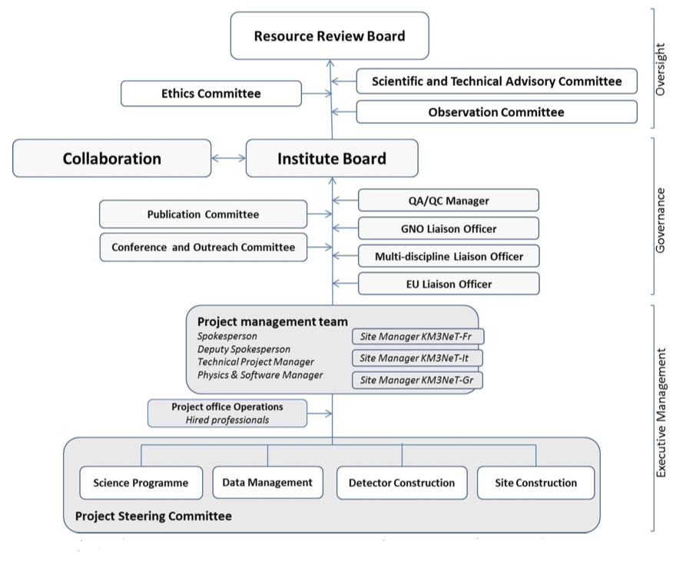
Governance (dettagliata nell’annex 4)

Slide 9
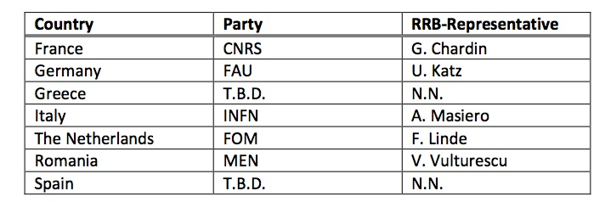
Il Resource Review Board
A Resource Review Board (RRB) shall be set up by the Parties to supervise the work for KM3NeT- phase1. Parties appoint their representatives. A representative of the consortium for Earth and Sea Science that may share facilities of the KM3NeT-phase1 infrastructure is invited as an observing member of the RRB to form the liaison with the highest governing board of the ESS Consortium. The RRB elects a chairperson, who becomes supra parte and leaves its delegation. The Party affected by this departure appoints another representative in the RRB. The role of the RRB includes:
Monitoring the general financial and human resource support;
Endorsement of the annual budget;
Liaise with the highest governing board of the Earth and Sea Science Consortium that share the infrastructure with KM3NeT-phase1;
Endorsement of observational campaigns and experiments of scientists which are not a member of the Collaboration;
Oversight of ethical issues and endorsement of corresponding measures in due consideration of the recommendations of the Ethics Board

Slide 10
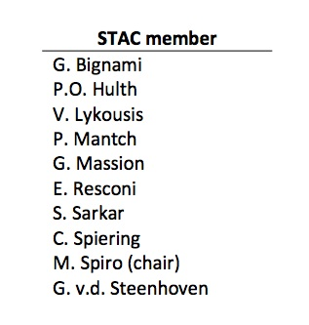
Lo Scientific and Technical Advisory Committee
A Scientific and Technical Advisory Committee (STAC) wis setup by the RRB. The STAC monitors and evaluates the progress in definition of scientific objectives, priorities and output, and technical decisions related to these issues. The STAC installs an Observation Committee for evaluation of observational campaigns and experiments of scientists which are not a member of the Collaboration. The STAC reports to the RRB and makes recommendations to the Collaboration.
Primo meeting - Amsterdam, 18 novembre 2013
Secondo meeting - Roma, 16 gennaio 2014

Slide 11
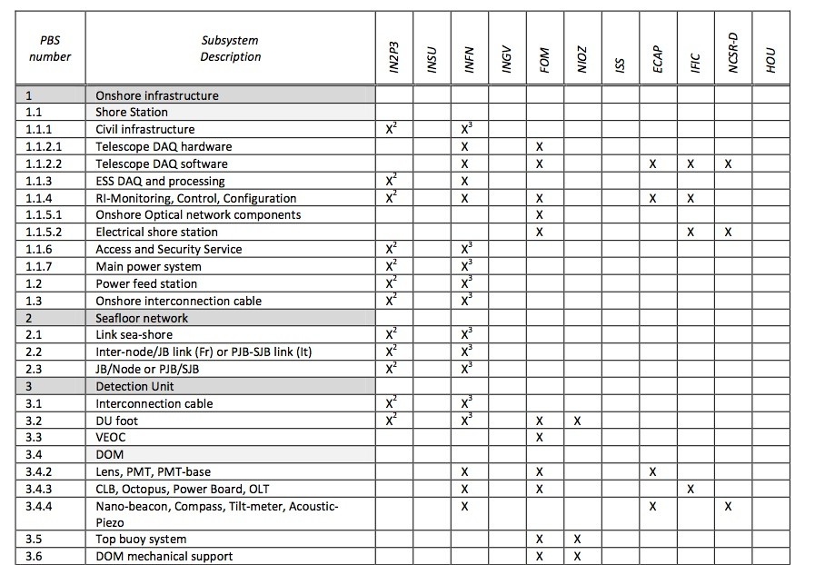
Technical participation (1)

Slide 12
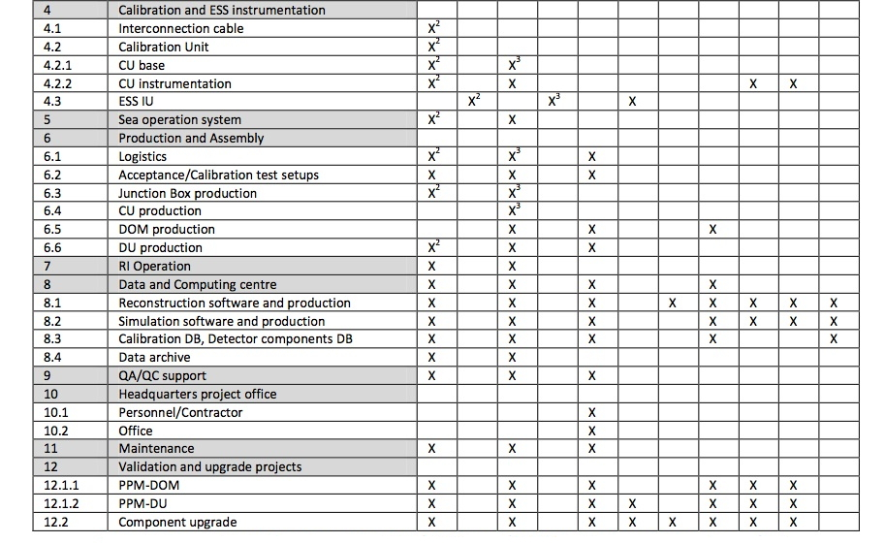
Technical participation (2)

Slide 13
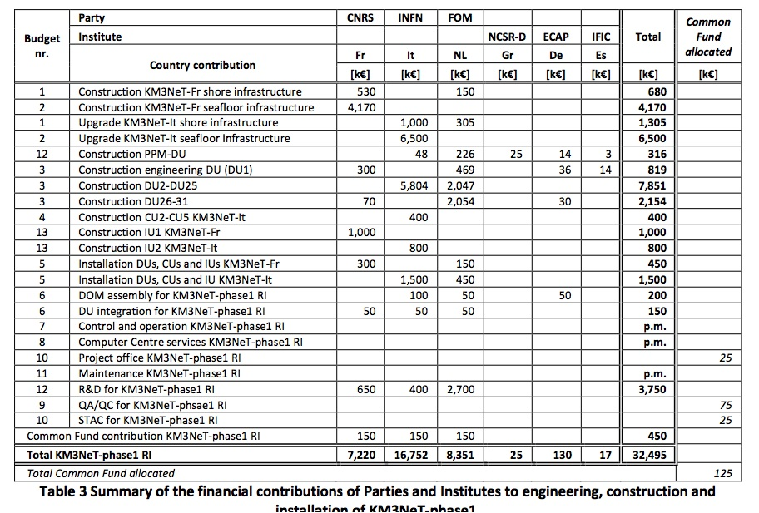
Values of deliverables and committments

Slide 14
PPM-DU (con tre DOM) installata a Capo Passero (marzo 2014)
Prima DU a Tolone (autunno 2014)
24 DU a Capo Passero
Committment italiano per l’acquisizione di (quasi tutto il) materiale per i DOM per 24 DU
Alcune gare già lanciate (15000 PMT da 3”) o pronte (sfere, coling system)
Nel committment INFN è inclusa anche la rete di fondo relativa alle 24 DU
Meccanica a carico di NL

Slide 15
L’EC ha istituito un High Level Assessment Expert Group (AEG) per rivedere i progressi delle infrastrutture nella roadmap ESFRI
Alcune critiche “severe” sono state sollevate per KM3NeT
E’ stato preparato un documento di risposta che dovrà essere approvato dal RRB e dallo STAC nei prossimi giorni
Prevista un’audizione da parte della EC ad inizio dicembre

Slide 16
Horizon 2020
A breve partirà il nuovo programma quadro dell’EC per il periodo 2014-2020: Horizon2020
4-5 novembre c’è stato a Zeuthen un workshop di brainstorming organizzato da APPEC (https://indico.desy.de/conferenceDisplay.py?confId=7970) per individuare le opportunità nell’ambito di H2020 per la comunità astroparticellare
Prime call in uscita a dicembre (deadline in aprile 2014)

Slide 18
Spares

Slide 19
The “Erlangen agreement”
The string design is considered as the baseline KM3NeT detection unit subject to its validation;
Italian groups will contribute to the validation of the string detection unit;
The Italian PON budget will be used for a seafloor network at the Capo Passero site, and several detection units (towers and strings); the seafloor network will be designed to be compliant with both strings and towers;
The seafloor network at the Capo Passero site will accommodate an additional number of strings produced by the KM3NeT Collaboration, at least equal to the number of strings realized with the PON budget;
The tower construction will be planned in a staged way in order to switch to the string design at any time and as soon as it has been validated;
The French budget for a neutrino telescope in the scope of the KM3NeT-MEUST project will be used to realize a shore station, a seafloor network in the Toulon area and several string detection units;
The seafloor network at the Toulon site will be designed to accommodate string detection units;
The Netherlands and Romania budgets will be used for the construction of string detection units.

