Slide 1


Dark Matter implied by Higgs Boson
A come back of the higgsino Kid
Leszek Roszkowski*
National Centre for Nuclear Research (NCNR/NCBJ)
Warsaw, Poland
*On leave of absence from
University of Sheffield

Slide 2
Outline
Brief Introduction
Implications of mh~126 GeV and direct limits on SUSY:
Prospects for detection
Issue of fine tuning
Summary
DM: ~1 TeV higgsino
Based on:
arXiv:1302.5956, Two ultimate tests of constrained supersymmetry,
K. Kowalska, L. Roszkowski, E. M. Sessolo JHEP 1306 (2013) 078
arXiv:1402.1328, Low fine tuning in the MSSM with higgsino dark matter and unification constraints, K. Kowalska, L. Roszkowski, E. M. Sessolo, S. Trojanowski JHEP 1404 (2014) 166
arXiv:1405.4289, What next for the CMSSM and the NUHM: Improved prospects for superpartner and dark matter detection, L. Roszkowski, E. M. Sessolo, A. J. Williams
and some earlier papers

Slide 3
Well-motivated candidates for dark matter
1307.3330
SUS
Y

Slide 4

Where is the WIMP?
Mass range: at least 20 orders of magnitude
Interaction range: some 32 orders of magnitude

Slide 5
Direct Detection AD 2011 - Before LHC
preLHC!
Confusion region
motivated by theory (SUSY)
MasterCode, BayesFITS

Slide 6
Direct Detection Nov. 2013
PDG update 2013
(1204.2373)
LHC:
theory region has moved down and right
in a very specific way
Smoking gun
of SUSY?
preLHC!
motivated by theory (SUSY)
Confusion region gone
MasterCode, BayesFITS

Slide 7
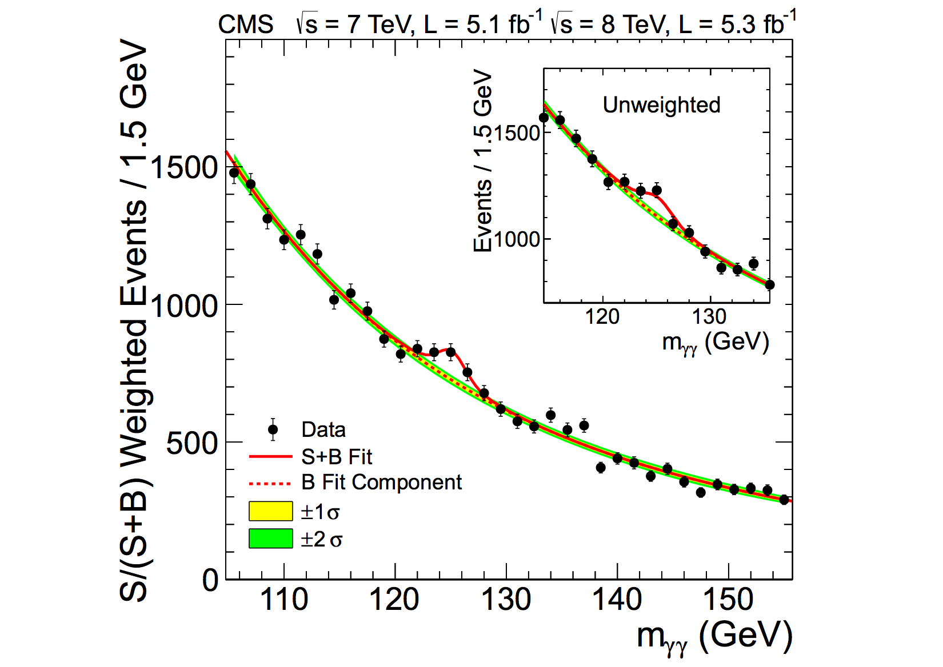
Main news from the LHC so far…
SM-like Higgs particle at ~126 GeV
No (convincing) deviations
from the SM
Stringent lower limits
on superpartner masses
SUSY masses pushed to 1 TeV+ scale…
ATLAS-CONF-2013-047

Slide 8
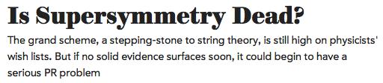

…and from the media…
April 2012

Slide 9
The 126 GeV SM-Like Higgs Boson
A blessing or a curse for SUSY?

Slide 10
The 126 GeV Higgs Boson and SUSY
A blessing…
Fundamental scalar --> SUSY
Light and SM-like --> SUSY
Excl. by LEP
Low energy SUSY prediction:
Higgs mass up to ~135 GeV
Constrained SUSY prediction:
SM-like Higgs with mass
up to ~130 GeV
Pomarol

Slide 11
The 126 GeV Higgs Boson and SUSY
A curse…
Only m_h~126 GeV and CMS lower bounds on SUSY applied here.
126 GeV Higgs->
Multi-TeV SUSY

Slide 12
~126 GeV Higgs in the CMSSM
Include only m_h~126 GeV
and lower limits from direct
SUSY searches
1302.5956
We use DR-bar approach (SoftSusy).
It gives larger m_h.
A curse…
~126 GeV Higgs mass implies
multi-TeV scale for SUSY
A weak upper bound on M_SUSY
Consistent with:
SUSY direct search lower limits at LHC
constraints from flavor
…except at very small tanb->1 where it goes away
126 GeV - worst possible value (G. Giudice)

Slide 13
…significant tension with LHC bounds

Slide 14
The 126 GeV SM-Like Higgs Boson
A blessing or a curse for DM?

Slide 15
CMSSM: numerical scans
Perform random scan over 4 CMSSM +4 SM (nuisance) parameters simultaneously
Use Nested Sampling
algorithm to evaluate
posterior
Use 4 000 live points
Very wide ranges:
1302.5956
Use Bayesian approach (posterior)

Slide 16
Hide and seek with SUSY
?
10 dof

Slide 17
CMSSM
Global scan, Bayesian
total posterior probability regions
Kowalska, LR, Sessolo,
arXiv:1302.5956
~1 TeV
higgsino DM
bino DM
CMSSM: these are the only
DM-favored regions
~1 TeV higgsino-like WIMP:
implied by ~126 GeV Higgs

Slide 18
CMSSM and DM searches
~1 TeV
higgsino LSP
FP/HB
A-funnel
Stau coan’n
Focus point region ruled out by LUX (tension with X100)
~1TeV higgsino DM: exiting prospects for LUX, X100 and 1t detectors

Slide 19
~1 TeV higgsino DM
Robust, present in many SUSY models
(both GUT-based and not)
Implied by ~126 GeV Higgs mass
and relic density
Most natural
Smoking gun of SUSY!?
Condition: heavy enough gauginos
No need to employ special mechanisms (A-funnel or coannihilation) to obtain correct relic density

Slide 20
… generic
e.g., Next-to-MSSM (extra singlet Higgs)
Kaminska, Ross, Schmidt-Hoberg, 1308.4168

Slide 21
Fall and rise of higgsino DM
LR, PLB 262 (1991) 59: in MSSM:
too little DM until mass >> 1 TeV
(in conflict with naturalness)
bino favored
1991: put to grave
2004: first signs of being
still (again?) alive
2009: favored in unified
SUSY at m_1/2>~2 TeV
2012: favored by ~126 GeV Higgs mass
MSSM (Profumo & Yaguna,
hep-ph/040703)
NUHM in
0903.1279
Strege et al., 1212.2636
Kowalska, et al., 1302.5956
~1 TeV higgsino DM:
NUHM: even at low m_0, CMSSM: m_0 of few TeV

Slide 22
Update 2014
Effect of 3 loop corr’s to m_h: increase by ~2 GeV
LUX limit: FP region practically excluded
Theory sigma_p down by ~1 order of mag
Recent (micrOmegas3.1):
1405.4289
Main effects:
m_0: slight shift down
~1 TeV higgsino still dominant
some increase of A-funnel region
FP region excluded

Slide 23
Bayesian vs chi-square analysis
(updated to include 3loop Higgs mass corrs)
Buchmueller et al
1312.5250
chi2
Reasonably good agreement in overlapping region
~1 TeV higgsino-like WIMP: implied by ~126 GeV Higgs -> large m1/2 and m0

Slide 24
Unified vs pheno SUSY
Unified SUSY (Constrained MSSM)
General SUSY (p9MSSM)
arXiv:1306.1567
MSSM:
much bigger ranges allowed
~1 TeV higgsino DM: prospects for detection similar to unified SUSY
new LUX limit: started to exclude mixed (bino-higgsino) neutralino

Slide 25
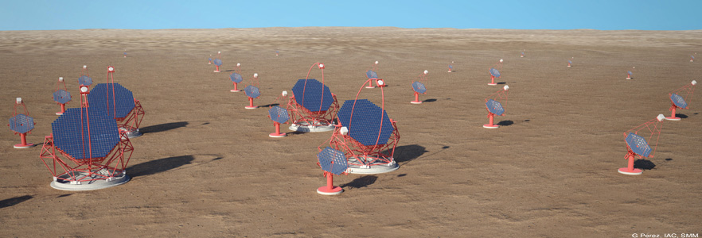
CTA – New guy in DM hunt race
http://www.cta-observatory.org/
ground-based gamma-ray telescope
Arrays in southern and northern hemisphere for full-sky coverage
Energy range: tens of GeV to >100 TeV
Sensitivity: more than an order of mag improvement in 100 GeV – 10 TeV
Cherenkov Telescope Array
Galactic Center DM Halo
diffuse gamma radiation from WIMP pair annihilation

Slide 26
CTA and Unified SUSY DM
1405.4289
CTA to probe large WIMP masses
~1 TeV higgsino DM: to be almost fully covered CTA

Slide 27
But what about fine-tuning!?
Unified SUSY: ~1 TeV higgsino DM favored:
~126 GeV Higgs mass
Lower bounds on MSUSY
Most natural solution
No need to employ special mechanisms (A-funnel or coannihilation) to obtain correct relic density

Slide 28
Fine tuning in the CMSSM
Barbieri-Giudice
K. Kowalska et al.,
arXiv:1402.1328,
JHEP 1404 (2014) 166
In ~1 TeV higgsino region:
Simplest boudary conditions at GUT: enormous FT

Slide 29
RGE focussing
Focus Point mechanism:
Chan, Chattopadhay, Nath '98
Feng, Matchev, Moroi '99
Dependence on inputs at GUT scale:
Integrate 2-loop RGEs:
Some contributions
can correlate.

Slide 30
Reduce FT in higgsino region
Higgs non-unification
Gaugino non-unification
1402.1328
Relate mu to scalars
e.g, Giudice-Masiero

Slide 31
Reduce FT in higgsino region
altogether:
FT can be reduced
as far down as ~20
all constraints satisfied
~1 TeV higgsino DM
1402.1328

Slide 32
Great thanks go
to
Giulia and all the organizers!!!
…don’t forget to do it again!

Slide 33
Are we done with the LHC?
Typical mass spectra:
1405.4289
LHC14 reach:
Gluino: ~2.7 GeV
Squarks: ~3 TeV
LHC – only stau coannihilation will be +/- covered
Need a lot of luck!

Slide 34
To take home:
DM: jury is still out, discovery claims come and go,
…but
Higgs of 126 GeV → ~1TeV (higgsino) DM – robust prediction of unified (and pheno) SUSY:
  To be probed by 1-tonne DM detectors
  Big bite by LUX already in 2014
  Independent probe by CTA
  Far beyond direct LHC reach
Fine-tuning can be reduced down to 1 in 20
Smoking gun of SUSY!?
SUSY may be too heavy for the LHC
DM searches may hopefully come to the rescue

